Slide 1

FileBucket
Share Yourselves

Slide 2
Presented By
SE/2013/011 – Sandun Susantha
SE/2013/012 – Renuka Piyumal
SE/2013/018 – Kavuri Karthikeyan
SE/2013/020 – Senira Keshan
SE/2013/025 – Lasitha Gayan

Slide 3
Content
What is peer to peer network?
What is TCP protocol?
Send file
Receive file
Project Architecture
Protocol – Send file
Protocol – Receive file
User Interface & Features
Demonstration
Notes:
Peer to peer and tcp protocol will be described by “kauvuri.”
Coding part will be explained by “renuka”
User interface of file bucket will explained by “lasitha”
At last “kumara” will demonstrate our product.

Slide 4
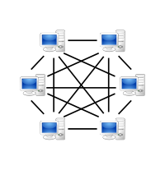
What is peer to peer network?
Peer-to-peer (P2P) is a decentralized communications model in which each party has the same capabilities and either party can initiate a communication session. Unlike the client/server model, in which the client makes a service request and the server fulfil the request, the P2P network model allows each node to function as both a client and server.

Slide 5

What is TCP protocol?
TCP (Transmission Control Protocol) is a standard that defines how to establish and maintain a network conversation via which application programs can exchange data. TCP works with the Internet Protocol (IP), which defines how computers send packets of data to each other. Together, TCP and IP are the basic rules defining the Internet. TCP is defined by the Internet Engineering Task Force (IETF) in the Request for Comment (RFC) standards document number 793

Slide 6
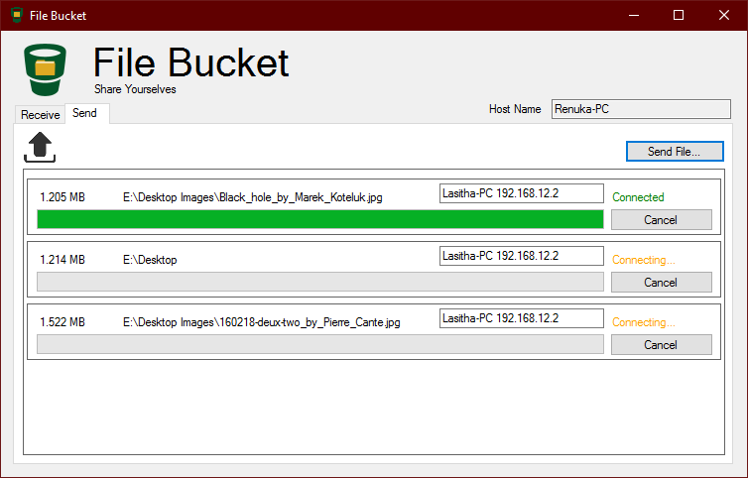
Shall we look at some features
Users’ PC Name
Progress bar

Slide 7
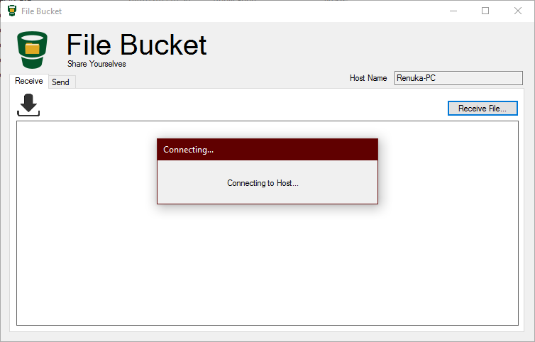
Shall we look at some features (cont.)
Notes:
It is waiting time for the receiving

Slide 8
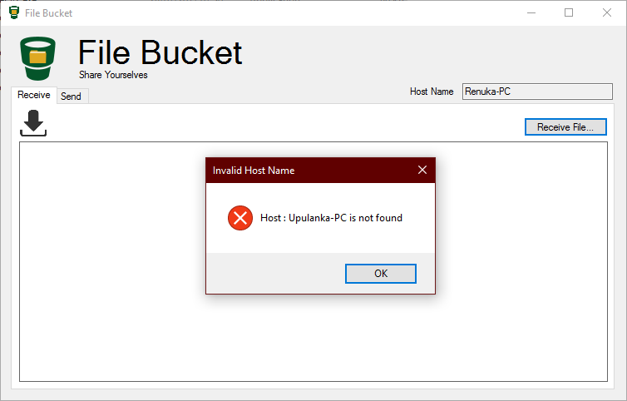
Shall we look at some features (cont.)

Slide 9
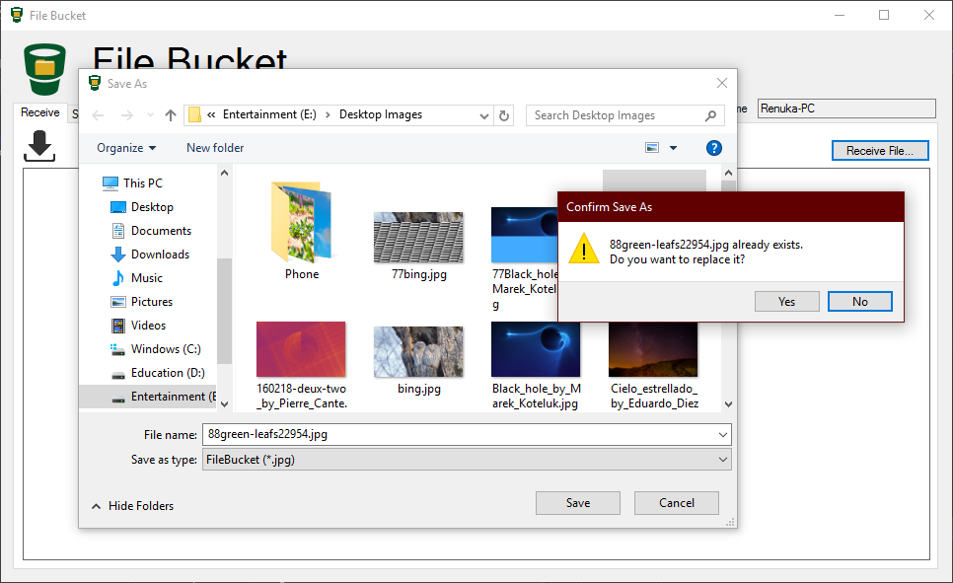
Shall we look at some features (cont.)

Slide 10

It’s Time to demonstrate

Slide 11
Send File
using (Stream stream = client.GetStream()) {
//Send file size
long fileSize = new FileInfo(FilePath).Length;
byte[] fileSizeBytes = BitConverter.GetBytes(fileSize);
stream.Write(fileSizeBytes, 0, 8);
using (FileStream fileStream = new FileStream(FilePath, FileMode.Open)) {
int count = (int)(fileSize / bufferSize);
int rest = (int)(fileSize % bufferSize);
byte[] fileBytes = new byte[bufferSize];
if (FileSendProgress == null) {
for (int i = 0; i < count; i++) {
fileStream.Read(fileBytes, 0, bufferSize);
stream.Write(fileBytes, 0, bufferSize);
}
} else {

Slide 12
Send File(Cont.)
else {
for (int i = 0; i < count;) {
fileStream.Read(fileBytes, 0, bufferSize);
stream.Write(fileBytes, 0, bufferSize);
i++;
FileSendProgress(i / (double)count);
}
}
//Rest Bytes
fileBytes = new byte[rest];
fileStream.Read(fileBytes, 0, rest);
stream.Write(fileBytes, 0, rest);
}
}

Slide 13
Receive File
using (Stream stream = client.GetStream()) {
//Receive file size
byte[] fileSizeBytes = new byte[8];
stream.Read(fileSizeBytes, 0, 8);
long fileSize = BitConverter.ToInt64(fileSizeBytes, 0);
FileSize = fileSize;
if (Connect != null) Connect(Connection.Successful);
int count = (int)(fileSize / bufferSize);
int rest = (int)(fileSize % bufferSize);
byte[] fileBytes = new byte[bufferSize];
//TODO hard code replace this
FilePath = "D:\\downloaded_image.jpg";
using (FileStream fileStream = new FileStream(FilePath, FileMode.Create)) {
if (FileReceiveProgress == null) {

Slide 14
Receive File(Cont.)
if (FileReceiveProgress == null) {
for (int i = 0; i < count; i++) {
stream.Read(fileBytes, 0, bufferSize);
fileStream.Write(fileBytes, 0, bufferSize);
}
} else {
for (int i = 0; i < count;) {
stream.Read(fileBytes, 0, bufferSize);
fileStream.Write(fileBytes, 0, bufferSize);
i++;
FileReceiveProgress(i / (double)count);
}
}

Slide 15
Receive File(Cont.)
//Rest Bytes
fileBytes = new byte[rest];
stream.Read(fileBytes, 0, rest);
fileStream.Write(fileBytes, 0, rest);
if (FileReceiveProgress != null) FileReceiveProgress(1);
}
}

Slide 16
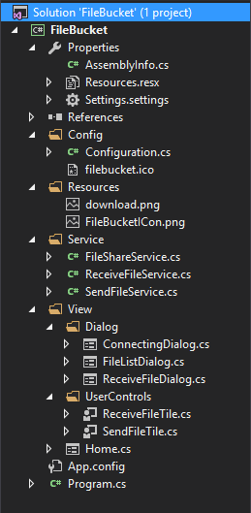
Project Architecture
Config
Resource
Services
View
UserControls

Slide 17
Protocol – Receive File
//Receive file size
byte[] fileSizeBytes = new byte[4];
stream.Read(fileSizeBytes, 0, 4);
int fileSize = BitConverter.ToInt32(fileSizeBytes, 0);
FileSize = fileSize;
//Receive File name
stream.Read(fileSizeBytes, 0, 4);
int fileNameLen = BitConverter.ToInt32(fileSizeBytes, 0);
byte[] fileNamebytes = new byte[fileNameLen];
stream.Read(fileNamebytes, 0, fileNameLen);
string fileName = Encoding.ASCII.GetString(fileNamebytes);
FilePath = fileName;

Slide 18

Protocol – Send File
//Send file size
FileInfo fileInfo = new FileInfo(FilePath);
int fileSize = (int) fileInfo.Length;
byte[] fileSizeBytes = BitConverter.GetBytes(fileSize);
stream.Write(fileSizeBytes, 0, 4);
//Send file name
byte[] fileNamebytes = Encoding.ASCII.GetBytes(fileInfo.Name);
fileSizeBytes = BitConverter.GetBytes(fileNamebytes.Length);
stream.Write(fileSizeBytes, 0, 4);
stream.Write(fileNamebytes, 0, fileNamebytes.Length);

Slide 19

Further Works
Add a search functionality to find what are the file with a given name.
Add a centralize sever, then peers cant identify what are the available peers and files.
Private file sharing( Encrypted file sharing ).

Slide 20

Questions

Slide 21

Thank You

