Slide 1
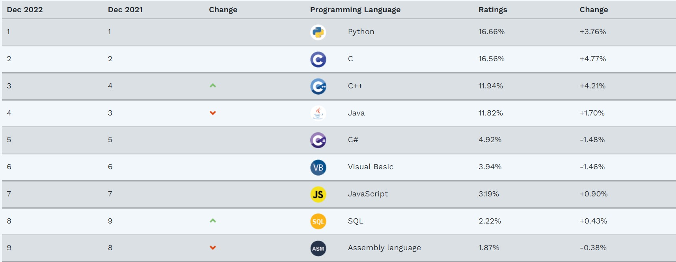
Programming Language
Rank of the language (Website:Tiobe)
Usage of the language in IT (Website: stack overflow)
Most of the learners which language will learn (Website: pypl).
Tiobe:

Slide 2
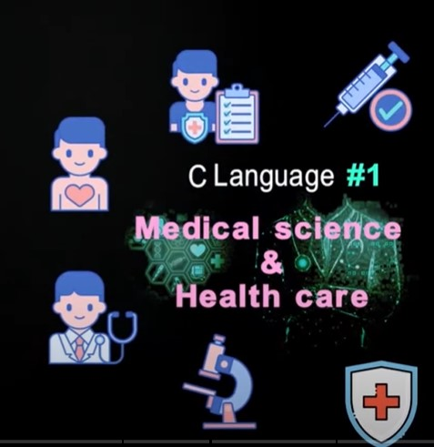
C language is #1 When Covid-19 came.

Slide 3
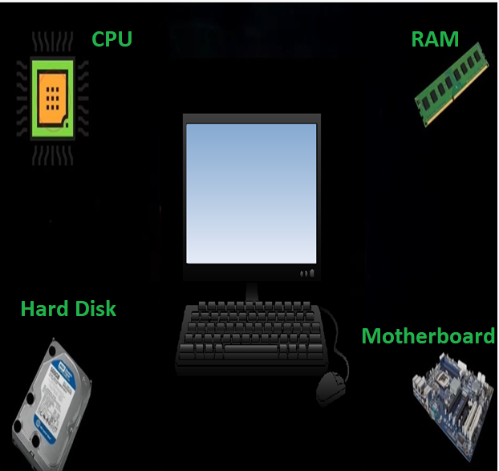
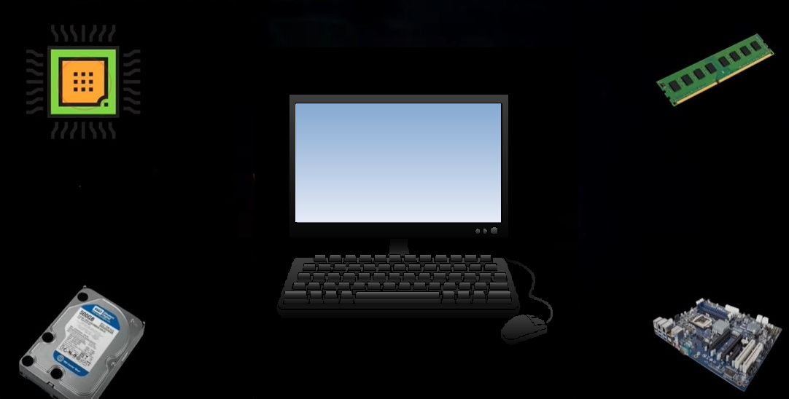
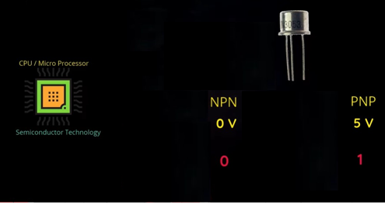

Slide 4
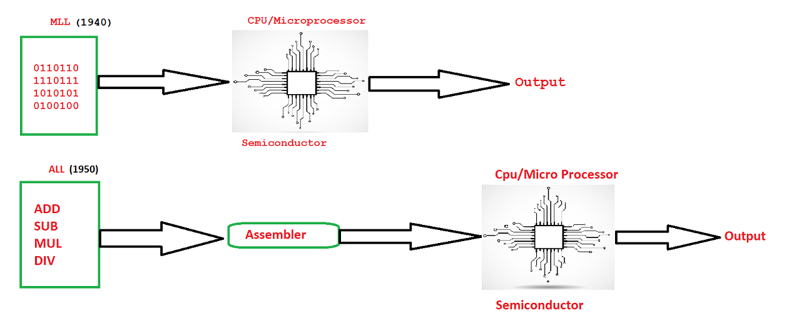
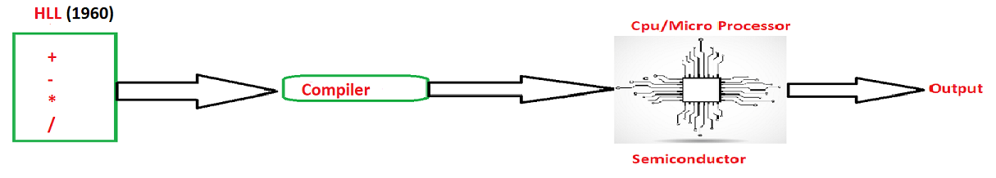

Slide 5
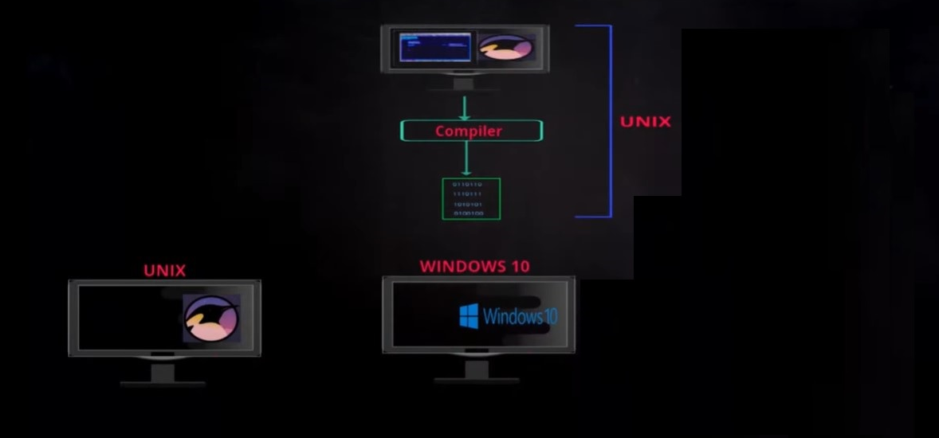
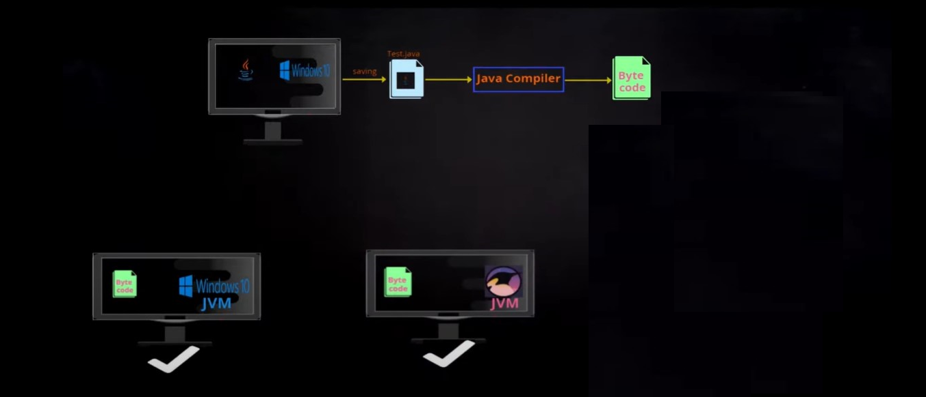
Platform
Dependent
Platform Independent

Slide 6
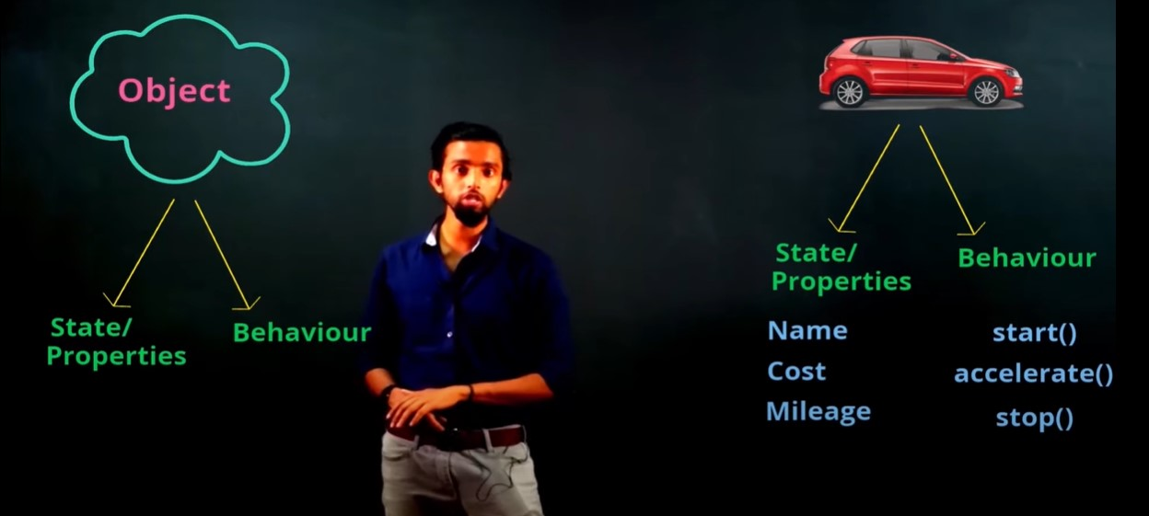

Slide 7
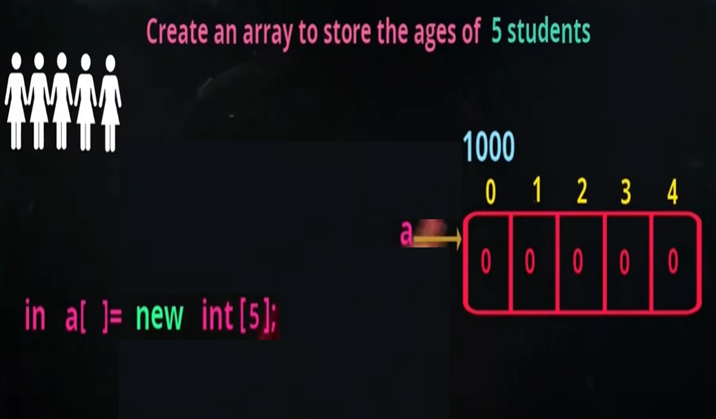

Slide 8
class Simple{
public static void main(String[] args){
System.out.println("Hello Java");
}
}
Note:
Save:class_name.java
Compilation:Javac class_name.java
Execution:Javac class_name

Slide 9
Display Car Objects
public class Car {
private String name;
private int mileage;
private int cost;
public Car() {}
public Car(String name, int mileage, int cost) {
super();
this.name = name;
this.mileage = mileage;
this.cost = cost;
}
public String getName() {
return name;
}
public void setName(String name) {
this.name = name;}
public int getMileage() {
return mileage;
}
public void setMileage(int mileage) {
this.mileage = mileage;
}
public int getCost() {
return cost;
}
public void setCost(int cost) {
this.cost = cost;
}
@Override
public String toString() {
return "Car [name=" + name + ", mileage=" + mileage + ", cost=" + cost + "]";
}
}

Slide 10
public class CarDemo {
public static void main(String[] args) {
Car car=new Car();
car.setName("bmw");
car.setMileage(100);
car.setCost(1000000);
System.out.println(car.getName());
System.out.println(car.getMileage());
System.out.println(car.getCost());
}
}

