Slide 1
Dominion Energy Virginia reliability: what public data shows, and where I'd look first
Independent analysis of public data
Saketh Bollina
3 November 2026
Data: EIA-861 · PUDL · NOAA Storm Events · EIA-930
Notes:
Thank you for having me. I'm Saketh Bollina. To prepare, I tried to understand Dominion Energy Virginia's reliability the way an analyst on your team would, so I rebuilt the reported reliability numbers from public data: EIA's annual reliability filings, NOAA's storm records and EIA's hourly demand data. Everything here is public. I had no Dominion internal data, and I'll point out where public data stops. In the next ten minutes: first the answer, what happened to outage minutes and where the change came from; then how Dominion compares with twelve peer utilities; then weather; then how demand is changing shape. Last, what I would do with Dominion's own data in the first 90 days, and how I built this. I've kept the numbers few, and each one has its source on the slide. Please stop me at any point.

Slide 2
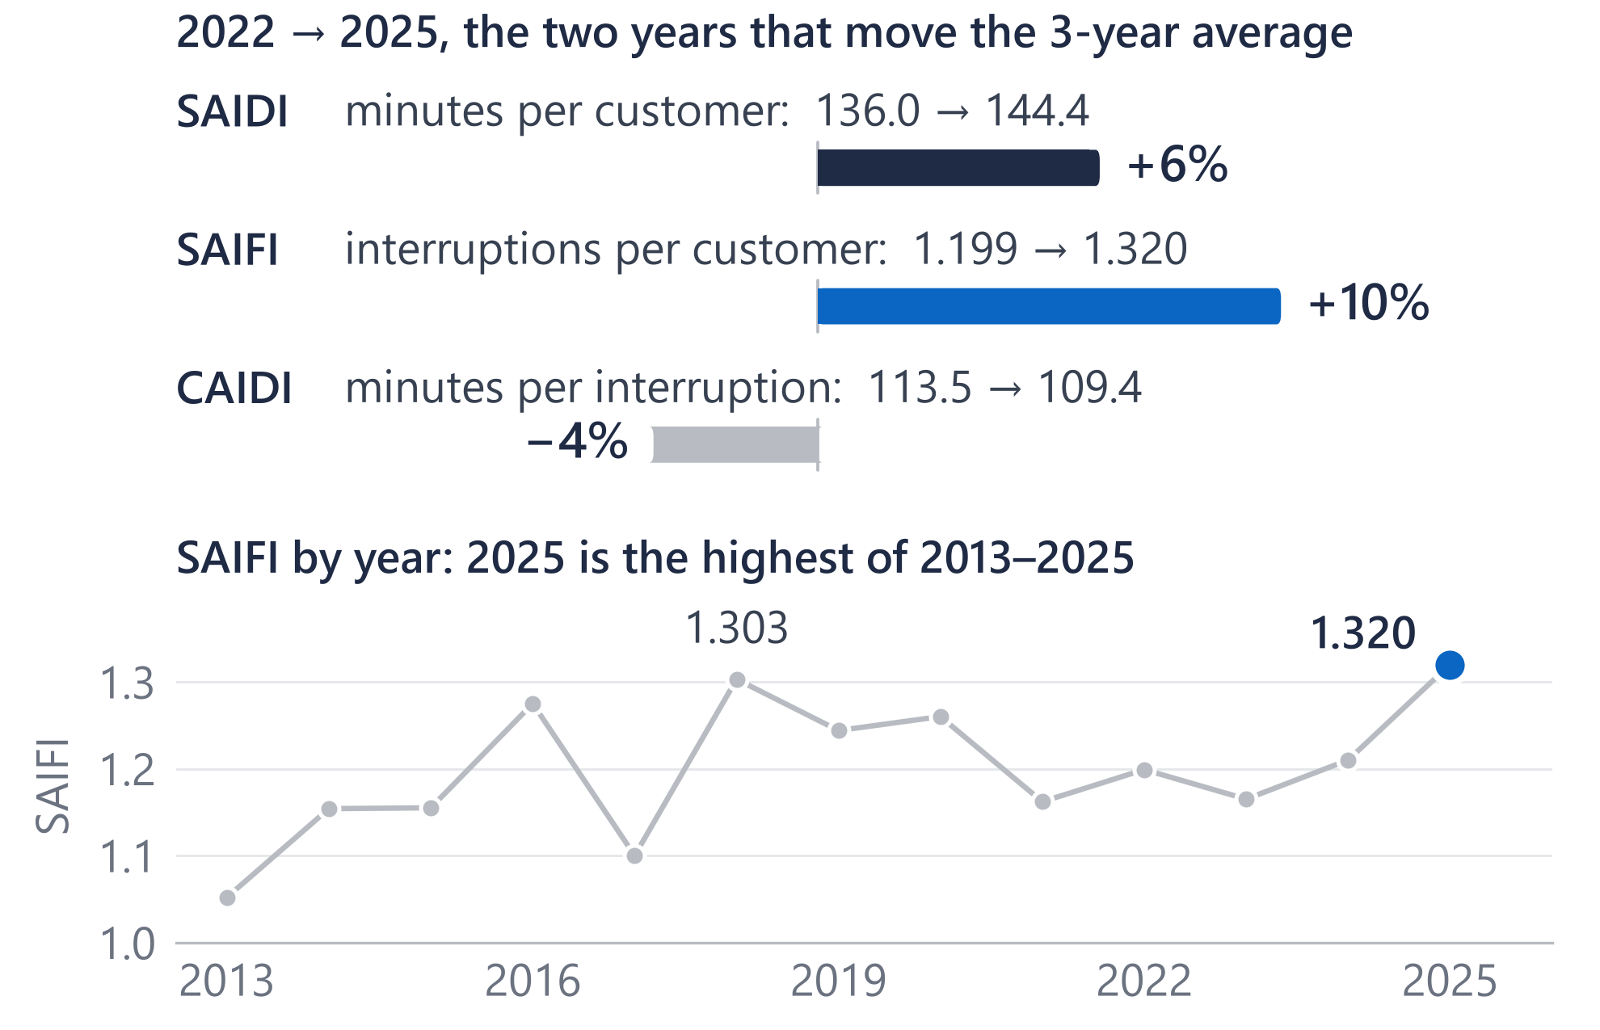
Outage minutes rose from 130 to 133 because interruptions became more frequent, not longer
130 → 133
Reported 3-year average outage minutes per customer, ex-major events (2022–24 → 2023–25)
130.2 → 133.0
The same figures rebuilt from public EIA-861 data: they reconcile
136.0 → 144.4
The average moved because 2025 replaced 2022 in the 3-year window
For Dominion: the first question is what is making interruptions more frequent, before how to restore faster.
Source: EIA-861 2025 final and PUDL (EIA-861) 2013–2024, Dominion Energy Virginia, excluding major event days; 3-year means of annual values. Reported figures: Dominion Energy 2025 Annual Report, p. 10.
2
Notes:
Dominion's 2025 annual report gives SAIDI, excluding major events, of 133 minutes for the three years ending 2025, up from 130, and attributes the increase primarily to storm activity. SAIDI is average outage minutes per customer. I rebuilt it from EIA's public filings and got 130.2 and 133.0, so the public data reconciles. A three-year average only moves when a year leaves the window: here 2025, at 144.4 minutes, replaced 2022, at 136.0. Between those two years SAIFI, how often customers lose power, rose 10 percent, and CAIDI, how long each interruption lasts, fell 4 percent. So the rise is more frequent interruptions, not longer ones. And 2025's SAIFI, 1.32, is the highest in EIA's 2013 to 2025 record. Two cautions I'd volunteer: 2025's SAIDI is still below 2018 and 2019, and over eleven years none of these trends is statistically significant, so one year is not a trend. Measured from 2023 instead, about four-fifths of the change is still frequency.

Slide 3
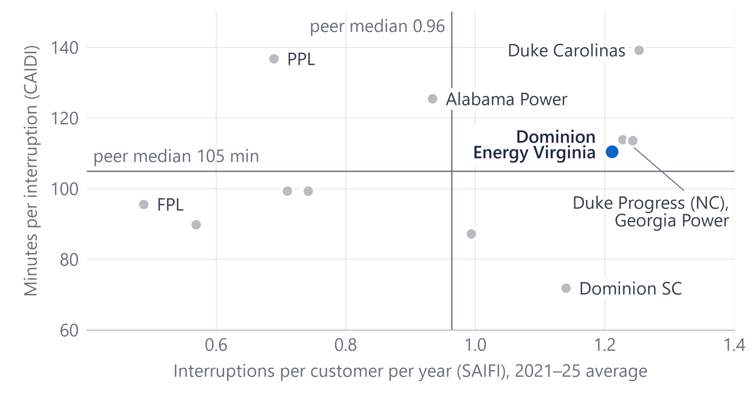
Among 12 peer utilities, Dominion restores at a mid-pack pace; frequency is the gap
1.21
interruptions per customer a year: 4th highest of 12 (peer median 0.96)
110 min
per interruption: 6th of 12 (peer median 105)
Methods differ: Dominion uses its own major-event rule, most peers IEEE 1366, so ranks are indicative.
For Dominion: preventing interruptions is where the gap to peers is; restoration speed is already near the middle.
Source: EIA-861 / PUDL 2021–2025, excluding major event days, means of annual values; 12 large investor-owned utilities in PJM and the Southeast, chosen by EIA ID before results.
3
Notes:
To see whether that's unusual, I compared Dominion with twelve large investor-owned utilities in PJM and the Southeast, picked by EIA ID before I looked at any results. Across is interruptions per customer per year; up is minutes per interruption; both are 2021 to 2025 averages. Dominion is the blue dot. On restoration time it's mid-pack: 110 minutes against a peer median of 105, sixth of twelve. On frequency it's 1.21 interruptions a year, fourth highest of twelve, against a median of 0.96. Its nearest neighbours are Duke Energy Progress and Georgia Power. One caveat I'd raise myself: utilities set aside major event days in different ways. Most of these peers use the IEEE 1366 method and Dominion reports under its own rule, so I'd treat the ranking as indicative, not exact. The pattern matches the previous slide: the gap to peers is how often customers lose power, not how fast it comes back.

Slide 4
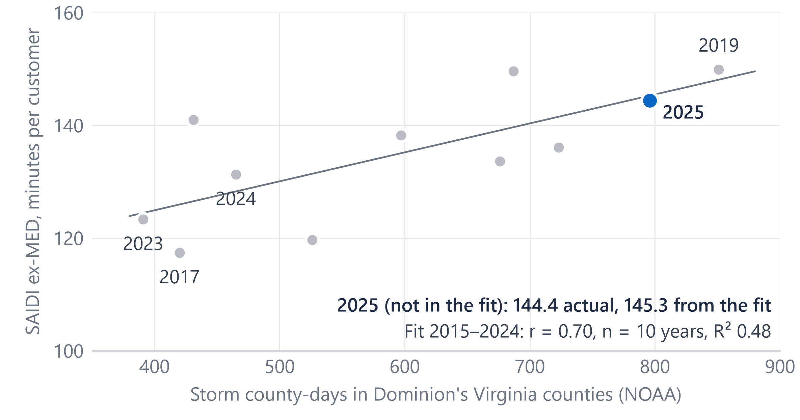
Years with more storm days had more outage minutes (r = 0.70 over ten years)
465 → 796
storm county-days in Dominion's Virginia counties, 2024 → 2025
r = 0.70
over 2015–2024 (n = 10): an association, not a cause
Dominion attributes the rise primarily to increased storm activity (2025 Annual Report, p. 10).
For Dominion: report reliability next to weather exposure, so that a stormy year is not mistaken for a trend.
Source: NOAA Storm Events 2015–2025, wind, winter and tropical event types, by county in Dominion's Virginia service territory (EIA-861); EIA-861 SAIDI excluding major event days; least-squares fit on 2015–2024.
4
Notes:
Weather is the obvious question. I counted storm county-days: each day a line-damaging storm, such as thunderstorm wind, an ice storm or a tropical storm, was recorded in a Virginia county Dominion serves, from NOAA's Storm Events data. 2025 had 796, up from 465 in 2024. Over 2015 to 2024, years with more storm days had more outage minutes: the correlation is 0.70. That's ten points, so I treat it as a check, not a model. The fit, made without 2025, puts 2025 at 145 minutes; the actual was 144. So 2025 looks like a stormy year more than a break in the trend, which is consistent with the annual report: Dominion attributes the rise primarily to increased storm activity. Adjusted for storm days, there's no clear trend since 2015. What this can't do is say which circuits, which causes, or whether hardened lines held up; that needs outage records. For reporting, I'd show reliability next to weather exposure.

Slide 5
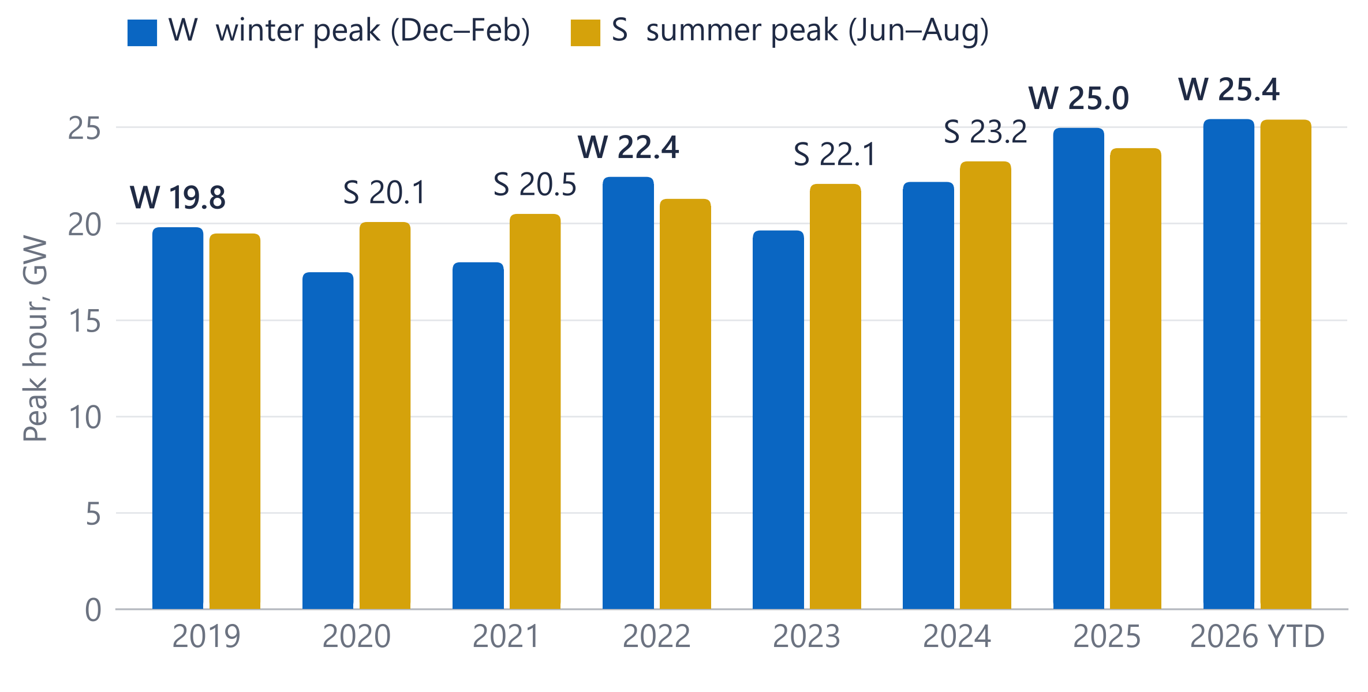
Overnight demand grew faster than afternoon demand, and winter rivals summer for the yearly peak
+39–41%
average load in the hours ending 1–5 a.m., 2019 → 2025
about +27%
in the hours ending 1–5 p.m., same years
Lowest hour of the year +52%, highest +26%. 2026 so far: 25,413 MW winter vs 25,384 MW summer.
For Dominion: less overnight slack and winter peaks: plans and reports built around summer afternoons need updating.
Source: EIA-930 hourly demand, PJM Dominion (DOM) zone, which is wider than Dominion's retail territory; July 2018–October 2026 (2026 year to date). Winter = Dec–Feb, summer = Jun–Aug.
5
Notes:
Reliability is one side; load is the other. This is EIA's hourly demand for the PJM Dominion zone, which is wider than Dominion's retail territory. Two changes stand out. First, the yearly peak: winter set the year's highest hour in 2019, 2022 and 2025, and 2026 is a near-tie so far, 25,413 against 25,384 megawatts. Second, the daily shape: from 2019 to 2025, average load in the hours ending 1 to 5 a.m. rose 39 to 41 percent, against about 27 percent in the hours ending 1 to 5 p.m. The lowest hour of the year rose 52 percent, the highest 26. Growth around the clock is consistent with large constant loads, but this data can't identify customers, so I don't attribute it to data centers. For planning and reporting, it means less overnight slack, and winter readiness matters as much as summer.

Slide 6
With Dominion's outage, meter and circuit data, I would start where public data stops
Days 1–30
Days 31–60
Days 61–90
Reconcile
Diagnose
Prioritise and track
Learn how outages, meter events and circuits are recorded and reported.
Interruptions by circuit and cause code, vegetation included; repeat interruptions (CEMI).
Rank feeders by customer-minutes; track Grid Resiliency work such as mainfeeder hardening against similar untreated feeders and weather.
Rebuild one year's SAIDI, SAIFI and CAIDI and reconcile them to the filed figures.
Restoration timed from meter “last gasp” (99.8% of meters are smart).
Deliverable: a Power BI programme-tracking report, refreshed on a schedule
Deliverable: a reconciled baseline with written definitions
Deliverable: tested views and a data dictionary
For Dominion: each step turns a system-level trend into a circuit-level view the programme team can act on.
Source: A plan: Dominion data is named by type only, and none was used here. Smart meters: EIA-861 2025 (AMI share of meters). Grid Resiliency: Dominion Energy website, read 1 November 2026.
6
Notes:
Public data narrows the question; Dominion's own data answers it. Here is how I'd spend the first 90 days, practically. First month, reconcile: learn how outages, meter events and circuits are recorded and how reliability is reported, then rebuild one year's SAIDI, SAIFI and CAIDI from source records and reconcile them to the filed numbers, the way I reconciled the public data to 133. Second month, diagnose: interruptions by circuit and cause code, vegetation included, and customers interrupted repeatedly. EIA's 2025 data shows 99.8 percent of Dominion's meters are smart meters, so restoration can be timed from last-gasp and restore signals. Third month, prioritise and track. Mainfeeder hardening already selects feeders on five years of outage history, and Dominion reports a 32 percent cut in outage minutes on feeders hardened for at least a year, as of November 2023. I'd build the Power BI report that tracks treated feeders against similar untreated feeders and weather, refreshed on a schedule.

Slide 7
Built like governed production reporting: tested, documented, and reconciled to the reported numbers
Public sources
Snowflake
Power BI
EIA-861 reliability
Import model and report
24,358 + 977 rows
RAW
STG
MART
NOAA Storm Events
as published, all text
typed and cleaned
facts, dimensions, views
831,288 rows
EIA-930 hourly demand
6,077,232 rows
12 tests pass
Data dictionary
Decisions log
Reconciled
keys, SAIDI = SAIFI × CAIDI, EIA's published 2025 values
a business definition for every column and measure
14 decisions, such as storm types and peers, made before results
rebuilt 130.2 and 133.0 vs 130 and 133 reported
For Dominion: reconcile first, test every load, document every decision: the same discipline for Dominion's reporting.
Source: Project build: SQL scripts, tests T1–T12, data dictionary and decisions log D1–D14; row counts as loaded.
7
Notes:
Briefly, how it's built, because it's the same discipline I'd bring. Three public sources: EIA's reliability filings, through PUDL plus the 2025 final file; NOAA Storm Events, about 831,000 storm records; and EIA-930 hourly demand, about six million rows. They land in Snowflake as raw text exactly as published, a staging layer types and cleans them, and a mart of facts, dimensions and views feeds Power BI in Import mode. Twelve tests run after each load: no duplicate keys, SAIDI equals SAIFI times CAIDI, the 2025 values match what EIA published, every county maps, full years, no duplicate hours. All pass. A data dictionary gives each measure a business definition, and a decisions log records fourteen choices, such as which storm types count and which peers to use, made before seeing results. The first check was reconciliation: 130.2 and 133.0 against the reported 130 and 133. Every chart comes from a script and a saved data snapshot.

Slide 8
Three takeaways: frequency first, reliability net of weather, plan for a new load shape
1
Look at frequency first
2
Net out the weather
3
Plan for a new load shape
Interruptions per customer +10% (2022→2025), the 2013–2025 high; 4th of 12 peers
Storm days track outage minutes (r = 0.70, ten years): an association, not a cause
Hours ending 1–5 a.m. +39–41% (2019→2025); winter set the peak in 2019, 2022 and 2025
I build governed Snowflake → Power BI reporting, and I've already started learning your reliability data.
How my experience maps Mercury Insurance, Data Analyst
Snowflake pipeline, 20M+ rows
Root-cause analysis on joined data
Validation and reconciliation
Metadata and business definitions
Requirements with operations and IT
→ this mart
→ SAIFI by cause
→ reconciled 133.0
→ data dictionary
→ programme teams
For Dominion: I would like to do this with your data.
Source: Numbers from slides 2–5. Experience: Mercury Insurance, Data Analyst, 2026 to present.
8
Notes:
Three takeaways. One: look at frequency first. Interruptions per customer rose 10 percent from 2022 to 2025 to the highest level in EIA's 2013 to 2025 record, and Dominion is fourth highest of twelve peers, while restoration time is mid-pack. Two: read reliability net of weather. Storm days line up with outage minutes, r of 0.70, but that's an association over ten years, not a cause. Three: plan for a new load shape. The small hours grew 39 to 41 percent, and winter set the yearly peak in 2019, 2022 and 2025. On fit: at Mercury Insurance I built a Snowflake pipeline across policy, claims and billing data, over 20 million rows, led a root-cause analysis, and owned validation and reconciliation for a pilot. This project applies the same habits to your data. I build governed Snowflake to Power BI reporting, and I've already started learning your reliability data. I would like to do this with your data. Thank you; I'm happy to take questions.

Slide 9
Definitions: SAIDI = SAIFI × CAIDI, and major event days are set aside by rule
SAIDI
SAIFI
CAIDI
=
×
outage minutes per customer per year
interruptions per customer per year: how often
minutes per interruption: how long
Dominion 2025: 1.320 × 109.4 = 144.4 minutes (excluding major event days)
Major event days (MED) are set aside so that one extreme storm does not swamp the trend. IEEE 1366 marks a day as a major event day when its SAIDI exceeds a threshold set from the previous five years of daily SAIDI (the “2.5 beta” method).
Dominion reports to EIA under its own major-event rule; most peers in this deck use IEEE 1366. Headline figures here exclude major event days; all-event figures are on A3.
Log split: ln(SAIDI ratio) = ln(SAIFI ratio) + ln(CAIDI ratio). Share from frequency = ln(SAIFI ratio) ÷ ln(SAIDI ratio): 2023→2025, 0.125 ÷ 0.158 = 79%.
Source: IEEE Std 1366 (reliability indices); EIA-861 reliability, Dominion Energy Virginia 2023 and 2025.
A1
Notes:
Definitions for reference. SAIDI equals SAIFI times CAIDI, which is why the change in SAIDI can be split exactly into a frequency part and a duration part using logs.

Slide 10
The weather fit is a check on one year, not a forecast
Year | Storm county-days | SAIDI ex‑MED | From the fit | Difference
2015 | 526 | 119.6 | 131.4 | −11.8
2016 | 597 | 138.2 | 135.1 | +3.2
2017 | 420 | 117.4 | 126.0 | −8.5
2018 | 687 | 149.6 | 139.7 | +9.9
2019 | 851 | 149.9 | 148.1 | +1.8
2020 | 431 | 141.0 | 126.5 | +14.5
2021 | 676 | 133.6 | 139.1 | −5.5
2022 | 723 | 136.0 | 141.5 | −5.5
2023 | 391 | 123.3 | 124.5 | −1.1
2024 | 465 | 131.3 | 128.3 | +3.0
2025 (not in fit) | 796 | 144.4 | 145.3 | −0.9
Fit on 2015–2024 (n = 10): SAIDI = 104.4 + 0.0514 × storm county-days; r = 0.70, R² 0.48.
2025 was left out: the fit gives 145.3, the actual was 144.4.
Adjusted for storm days, no clear trend since 2015: about +0.3 minutes a year (95% range −1.4 to +2.1).
Source: NOAA Storm Events and EIA-861, 2015–2025; ordinary least squares on ten annual points (exploratory).
A2
Notes:
Ten annual points, so the fit is a check, not a forecast. The 2025 value was left out of the fit and lands within a minute of it. After the storm-day adjustment, the trend since 2015 is about plus 0.3 minutes a year, with a range that includes zero.

Slide 11
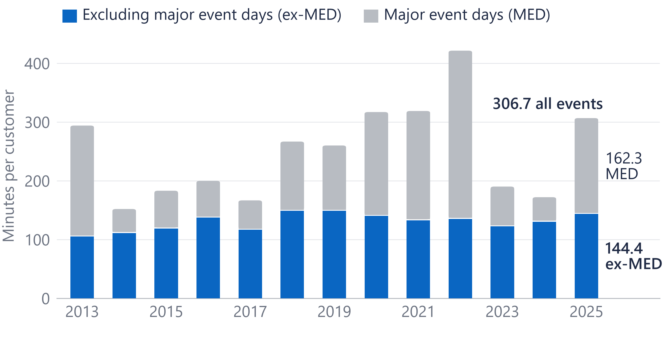
Major event days were about half of all-event outage minutes in 2025
53%
of 2025's all-event outage minutes fell on major event days (162.3 of 306.7)
Major-event minutes swing most: 285 in 2022, 41 in 2024.
Major-event minutes are EIA's all-events SAIDI minus ex-MED SAIDI, not a storm attribution.
Source: EIA-861 / PUDL 2013–2025, Dominion Energy Virginia: SAIDI with and without major event days.
A3
Notes:
All-event SAIDI in 2025 was 306.7 minutes; 144.4 of them were on ordinary days. The headline numbers in this deck use the ordinary-day series, which is the one Dominion reports.

Slide 12
Every number traces to a public source and a tested query
Source | Publisher | Years | Grain | Rows
EIA-861 Reliability, 2025 final | EIA | 2025 | utility × state × year | 977
PUDL EIA-861 reliability | Catalyst Cooperative | 2013–2024 | utility × state × year | 24,358
EIA-861 Service Territory | EIA | 2025 | utility × county | 11,803
NOAA Storm Events | NOAA NCEI | 2013–2025 | storm event | 831,288
EIA-930 hourly demand | EIA | Jul 2018–Oct 2026 | region × hour | 6,077,232
Dominion Energy 2025 Annual Report | Dominion Energy | 2025 | document (130, 133) | reference
Tests after each load (T1–T12, all pass): no duplicate keys; SAIDI = SAIFI × CAIDI within 2%; Dominion 2025 equals EIA's published 306.7, 144.4 and 2,675,735 customers; every county mapped; full years; no duplicate hours.
Source: Project documentation: sources register (publisher, vintage, licence) and data-quality tests; all public data.
A4
Notes:
Every source is public and every load is tested. The rows are as loaded; the licence and vintage of each file are in the project's sources register.

Slide 13
What public data cannot show, and what would answer it
Public data limit | What would answer it (Dominion data, by type)
One number per utility per year (EIA-861) | Outage records by event, circuit and cause
Storms counted by county, not by line | Outage records with cause codes and circuit location
Methods differ between utilities | Dominion's daily SAIDI and its filing method
The DOM zone is wider than the retail territory | Meter interval data by circuit
No customer identities: growth can't be attributed | Customer class and large-load records
Source: Project scope limits (decision D14) and the sources above.
A5
Notes:
These are the limits I'd name before anyone else does. Each one is answered by a kind of internal data, named by type only.

Slide 14
The twelve-peer comparison, with each utility's reporting method
Utility | Major-event method | SAIFI 2021–25 | CAIDI 2021–25 | SAIDI 2023–25
Duke Carolinas (NC) | IEEE 1366 | 1.25 | 139 | 179
Georgia Power | Mixed | 1.24 | 114 | 141
Duke Progress (NC) | IEEE 1366 | 1.23 | 114 | 144
Dominion Energy Virginia | Own method | 1.21 | 110 | 133
Dominion Energy SC | IEEE 1366 | 1.14 | 72 | 84
Duke Energy Florida | Mixed | 0.99 | 87 | 83
Alabama Power | Own method | 0.93 | 125 | 110
PECO | IEEE 1366 | 0.74 | 99 | 66
BGE | IEEE 1366 | 0.71 | 99 | 64
PPL Electric | IEEE 1366 | 0.69 | 137 | 99
Pepco (MD) | IEEE 1366 | 0.57 | 90 | 48
FPL | IEEE 1366 | 0.49 | 96 | 47
Source: EIA-861 / PUDL, excluding major event days; means of annual values; peers chosen by EIA ID before results. Sorted by SAIFI.
A6
Notes:
The full peer table. Sorted by frequency: Dominion is fourth. Methods differ, so treat the ranks as indicative.

