Slide 1
Dominion Energy Virginia reliability: what public data shows, and where I'd look first
Independent analysis of public data
Saketh Bollina
3 November 2026
Data: EIA-861 · PUDL · NOAA Storm Events · EAGLE-I · EIA-930
Notes:
Thank you for having me. I'm Saketh Bollina. To prepare, I tried to understand Dominion Energy Virginia's reliability the way an analyst on your team would, so I rebuilt the reported reliability numbers from public data: EIA's annual reliability filings, NOAA's storm records, the Department of Energy's county outage records and EIA's hourly demand data. Everything here is public. I had no Dominion internal data, and I'll point out where public data stops. In the next ten minutes: first the answer, what happened to outage minutes and where the change came from; then how Dominion compares with twelve peer utilities; then weather; then how demand is changing shape. Last, what I would do with Dominion's own data in the first 90 days, and how I built this. I've kept the numbers few, and each one has its source on the slide. Please stop me at any point.

Slide 2
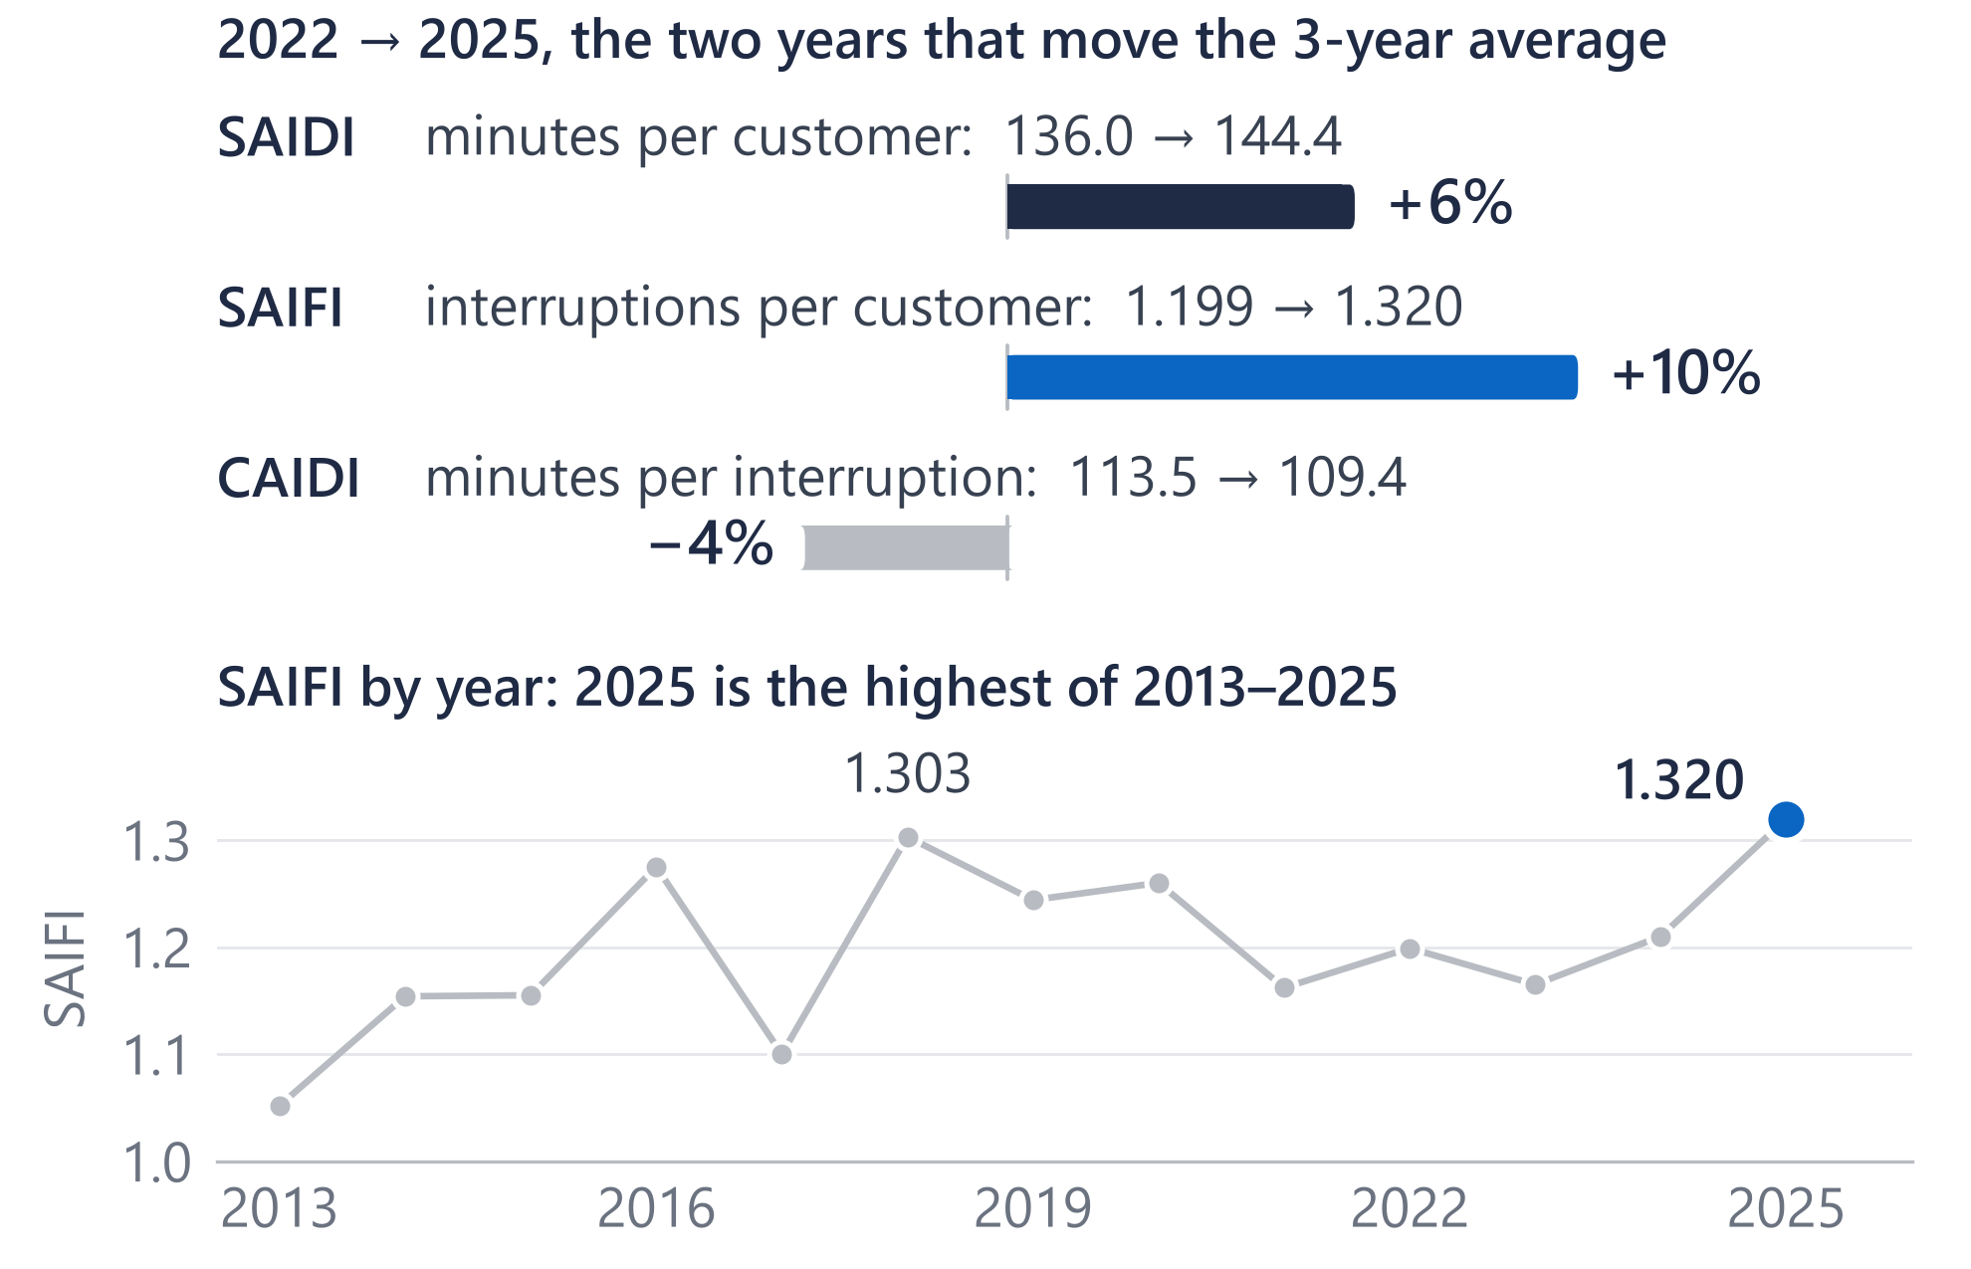
Outage minutes rose from 130 to 133 because interruptions became more frequent, not longer
130 → 133
Reported 3-year average outage minutes per customer, ex-major events (2022–24 → 2023–25)
130.2 → 133.0
The same figures rebuilt from public EIA-861 data: they reconcile
136.0 → 144.4
The average moved because 2025 replaced 2022 in the 3-year window
For Dominion: the first question is what is making interruptions more frequent, before how to restore faster.
Source: EIA-861 2025 final and PUDL (EIA-861) 2013–2024, Dominion Energy Virginia, excluding major event days; 3-year means of annual values. Reported figures: Dominion Energy 2025 Annual Report, p. 10.
2
Notes:
Dominion's 2025 annual report gives SAIDI, excluding major events, of 133 minutes for the three years ending 2025, up from 130, and says: "This increase is primarily due to increased storm activity." SAIDI is average outage minutes per customer. I rebuilt it from EIA's filings. The public Virginia data reproduces both reported figures to the minute: 130.2 and 133.0. A three-year average only moves when a year leaves the window: here 2025, at 144.4 minutes, replaced 2022, at 136.0. Between those two years SAIFI, how often customers lose power, rose 10 percent, and CAIDI, how long each interruption lasts, fell 4 percent. So the rise is more frequent interruptions, not longer ones, which is consistent with Dominion's explanation: storm county-days were higher in 2025 than in 2022, 791 against 718. And 2025's SAIFI, 1.32, is the highest in EIA's 2013 to 2025 record. Two cautions I'd volunteer: 2025's SAIDI is still below 2018 and 2019, and over eleven years no trend is statistically clear, so one year is not a trend. Measured from 2023, about four-fifths of the change is still frequency.

Slide 3
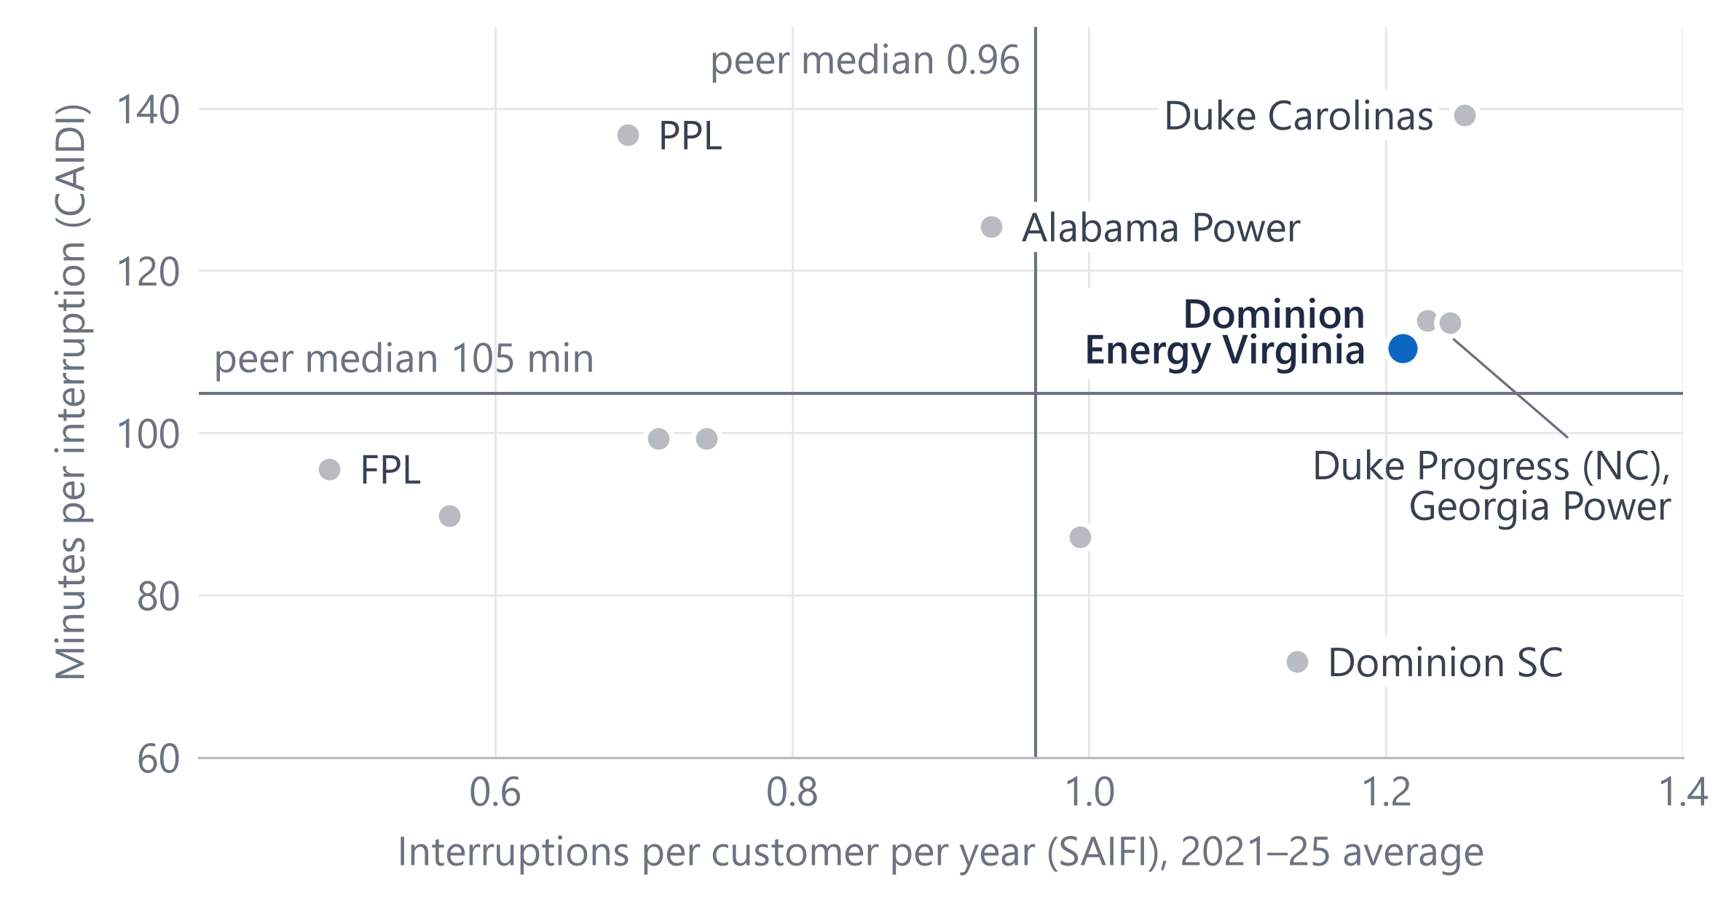
Among 12 peer utilities, Dominion restores at a mid-pack pace; frequency is the gap
1.21
interruptions per customer a year: 4th highest of 12 (peer median 0.96)
110 min
per interruption: 6th of 12 (peer median 105)
Methods differ: Dominion uses its own major-event rule, most peers IEEE 1366, so ranks are indicative.
For Dominion: preventing interruptions is where the gap to peers is; restoration speed is already near the middle.
Source: EIA-861 / PUDL 2021–2025, excluding major event days, means of annual values; twelve large investor-owned utilities in PJM and the Southeast, selected by EIA ID before results were computed.
3
Notes:
To see whether that's unusual, I compared Dominion with twelve large investor-owned utilities in PJM and the Southeast, picked by EIA ID before I looked at any results. Across is interruptions per customer per year; up is minutes per interruption; both are 2021 to 2025 averages. Dominion is the blue dot. On restoration time it's mid-pack: 110 minutes against a peer median of 105, sixth of twelve. On frequency it's 1.21 interruptions a year, fourth highest of twelve, against a median of 0.96. Its nearest neighbours are Duke Energy Progress and Georgia Power. One caveat I'd raise myself: utilities set aside major event days in different ways. Most of these peers use the IEEE 1366 method and Dominion reports under its own rule, so I'd treat the ranking as indicative, not exact. The pattern matches the previous slide: the gap to peers is how often customers lose power, not how fast it comes back.

Slide 4
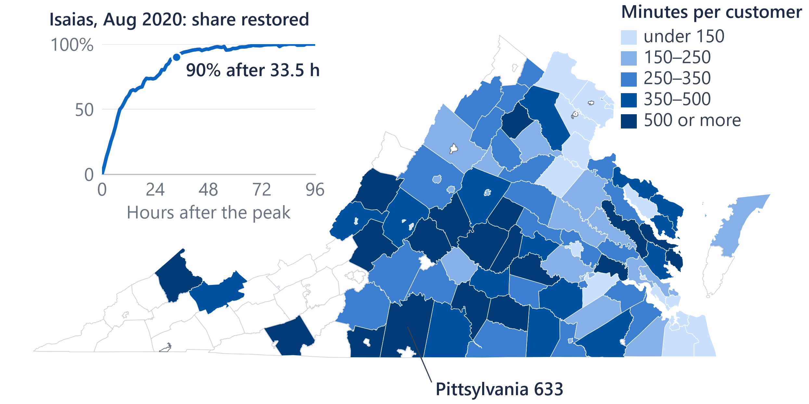
County-days with a storm report had about 12 times the outage customer-hours of calm days
11.9×
outage customer-hours per 1,000 customers vs calm county-days (95% CI 7.9–16.9)
Holds on non-major days (9.9×), in Dominion-only counties (19.9×) and in every year
EAGLE-I counts every utility in a county. 6,108 storm county-days, 2015–2025.
For Dominion: read each year against its storms, and start with the counties that lose the most minutes on ordinary days.
Source: EAGLE-I (ORNL) county outages, all utilities, 99 of Dominion's 103 EIA-861 service-territory counties (4 cities left off: unusable data); NOAA Storm Events. Map: non-major-day outage minutes per customer, 2015–24 average.
4
Notes:
Weather is the obvious question, so I went below the annual numbers to county-days. EAGLE-I, the Department of Energy's county outage record built from utilities' outage maps, gives the customers out every fifteen minutes in each county. On county-days with a NOAA storm report, outage customer-hours per thousand customers were about twelve times those of calm days: 11.9, with a 95 percent range of 7.9 to 16.9, over 6,108 storm county-days from 2015 to 2025. It holds on non-major days, in counties Dominion serves alone, and in every year. It's an association: storm reports are partly triggered by damage. The map shows where ordinary-day outage minutes are highest: rural and exurban counties. Among counties with 20,000 or more customers they run from 55 minutes a year in Prince William to 633 in Pittsylvania. EAGLE-I counts every utility in a county, so I use it for where and when, never to restate Dominion's SAIDI. The inset is Isaias in 2020: 351,738 customers out at the peak, all utilities in Dominion's counties, and 90 percent restored 33.5 hours after the peak. Across 47 large events there's no evidence restoration got faster. At the annual level, storm county-days and SAIDI correlate at 0.70 over ten years, in the appendix.

Slide 5

Overnight demand grew faster than afternoon demand, and winter rivals summer for the yearly peak
+39–41%
average load, hours ending 1–5 a.m., 2019 → 2025 (1–5 p.m.: about +27%)
Winter
set the yearly peak in 2019, 2022 and 2025; 2026 to 29 Oct: 25,413 vs 25,384 MW
Peak hour +26%, lowest hour +52%.
For Dominion: less overnight slack and winter peaks: plans and reports built around summer afternoons need updating.
Source: EIA-930 hourly demand, PJM Dominion (DOM) zone, which is wider than Dominion's retail territory; 2019 and 2025 full years; 2026 to the hour ending midnight, 29 Oct. Winter = Dec–Feb, summer = Jun–Aug.
5
Notes:
Reliability is one side; load is the other. This is EIA's hourly demand for the PJM Dominion zone, which is wider than Dominion's retail territory. Each column is one hour of the day: how much average load grew from 2019 to 2025. The hours ending 1 to 5 a.m. grew 39 to 41 percent; the hours ending 1 to 5 p.m. about 27 percent, the least of any hours. So the small hours grew fastest. Weather doesn't explain it: holding Virginia's heating and cooling degree days and the weekday fixed, average load rose about 33 percent, against 32 percent unadjusted. The peak changed too: winter set the year's highest hour in 2019, 2022 and 2025, and 2026, to 29 October, is a tie, 25,413 against 25,384 megawatts. The year's peak hour rose 26 percent and its lowest hour 52. Growth around the clock is consistent with large constant loads, but this data can't identify customers, so I don't attribute it to data centers. For planning and reporting: less overnight slack, and winter readiness matters as much as summer.

Slide 6
With Dominion's outage, meter and circuit data, I would start where public data stops
Days 1–30
Days 31–60
Days 61–90
Reconcile
Diagnose
Prioritise and track
Learn how outages, meter events and circuits are recorded and reported.
Interruptions by circuit and cause code, vegetation included; repeat interruptions (CEMI).
Rank feeders by customer-minutes; track Grid Resiliency work such as mainfeeder hardening against similar untreated feeders and weather.
Rebuild one year's SAIDI, SAIFI and CAIDI and reconcile them to the filed figures.
Restoration timed from meter “last gasp” (99.8% of meters are smart).
Deliverable: a Power BI programme-tracking report, refreshed on a schedule
Deliverable: a reconciled baseline with written definitions
Deliverable: tested views and a data dictionary
For Dominion: each step turns a system-level trend into a circuit-level view the programme team can act on.
Source: A plan: Dominion data is named by type only, and none was used here. Smart meters: EIA-861 2025 (AMI share of meters). Grid Resiliency: Dominion Energy website, read 1 November 2026.
6
Notes:
Public data narrows the question; Dominion's own data answers it. Here is how I'd spend the first 90 days, practically. First month, reconcile: learn how outages, meter events and circuits are recorded and how reliability is reported, then rebuild one year's SAIDI, SAIFI and CAIDI from source records and reconcile them to the filed numbers, the way I reconciled the public data to 133. Second month, diagnose: interruptions by circuit and cause code, vegetation included, and customers interrupted repeatedly. EIA's 2025 data shows 99.8 percent of Dominion's meters are smart meters, so restoration can be timed from last-gasp and restore signals. Third month, prioritise and track. Mainfeeder hardening already selects feeders on five years of outage history, and Dominion reports a 32 percent cut in outage minutes on feeders hardened for at least a year, as of November 2023. I'd build the Power BI report that tracks treated feeders against similar untreated feeders and weather, refreshed on a schedule.

Slide 7
Built like governed production reporting: tested, documented, and reconciled to the reported numbers
Public sources
Snowflake
Power BI
EIA-861 reliability
Import model and report
24,358 + 977 rows
RAW
STG
MART
NOAA Storm Events
as published, all text
typed and cleaned
facts, dimensions, views
831,288 rows
EIA-930 hourly demand
6,077,232 rows
12 tests pass
Data dictionary
Decisions log
Reconciled
keys, SAIDI = SAIFI × CAIDI, EIA's published 2025 values
a business definition for every column and measure
22 decisions, such as storm types and peers; peers fixed before any results
12 of 12 rebuilt values match the published figures, such as 133.0 vs 133
For Dominion: reconcile first, test every load, document every decision: the same discipline for Dominion's reporting.
Source: Project build: SQL scripts, tests T1–T12, data dictionary and decisions log D1–D22; row counts as loaded.
7
Notes:
Briefly, how it's built, because it's the same discipline I'd bring. Three public sources: EIA's reliability filings, through PUDL plus the 2025 final file; NOAA Storm Events, about 831,000 storm records; and EIA-930 hourly demand, about six million rows. They land in Snowflake as raw text exactly as published, a staging layer types and cleans them, and a mart of facts, dimensions and views feeds Power BI in Import mode. Twelve tests run after each load: no duplicate keys, SAIDI equals SAIFI times CAIDI, the 2025 values match what EIA published, every county maps, full years, no duplicate hours. All pass. A data dictionary gives each measure a business definition, and a decisions log records twenty-two choices, such as which storm types count and which peers to use; the peers were fixed before any results were computed. The first check was reconciliation: 130.2 and 133.0 against the reported 130 and 133, and in all twelve of twelve rebuilt values match their published figures. Every chart comes from a script and a saved data snapshot.

Slide 8
Three takeaways: frequency first, reliability net of weather, plan for a new load shape
1
Look at frequency first
2
Net out the weather
3
Plan for a new load shape
Interruptions per customer +10% (2022→2025), the 2013–2025 high; 4th of 12 peers
12× the outage customer-hours on storm county-days as on calm ones: an association
Hours ending 1–5 a.m. +39–41% (2019→2025); winter set the peak in 2019, 2022 and 2025
I build governed Snowflake → Power BI reporting, and I've already started learning your reliability data.
How my experience maps Mercury Insurance, Data Analyst
Snowflake pipeline, 20M+ rows
Root-cause analysis on joined data
Validation and reconciliation
Metadata and business definitions
Requirements with operations and IT
→ this mart
→ SAIFI by cause
→ reconciled 133.0
→ data dictionary
→ programme teams
For Dominion: I would like to do this with your data.
Source: Numbers from slides 2–5. Experience: Mercury Insurance, Data Analyst, 2026 to present.
8
Notes:
Three takeaways. One: look at frequency first. Interruptions per customer rose 10 percent from 2022 to 2025 to the highest level in EIA's 2013 to 2025 record, and Dominion is fourth highest of twelve peers, while restoration time is mid-pack. Two: read reliability net of weather. On county-days with a storm report, outages cost about twelve times the customer-hours of calm days. That's an association, not a cause, but it means a stormy year shouldn't be read as a trend. Three: plan for a new load shape. The small hours grew 39 to 41 percent, and winter set the yearly peak in 2019, 2022 and 2025. On fit: at Mercury Insurance I built a Snowflake pipeline across policy, claims and billing data, over 20 million rows, led a root-cause analysis, and owned validation and reconciliation for a pilot. This project applies the same habits to your data. I build governed Snowflake to Power BI reporting, and I've already started learning your reliability data. I would like to do this with your data. Thank you; I'm happy to take questions.

Slide 9
Definitions: SAIDI = SAIFI × CAIDI, and major event days are set aside by rule
SAIDI
SAIFI
CAIDI
=
×
outage minutes per customer per year
interruptions per customer per year: how often
minutes per interruption: how long
Dominion 2025: 1.320 × 109.4 = 144.4 minutes (excluding major event days)
Major event days (MED) are set aside so that one extreme storm does not swamp the trend. IEEE 1366 marks a day as a major event day when its SAIDI exceeds a threshold set from the previous five years of daily SAIDI (the “2.5 beta” method).
Dominion reports to EIA under its own major-event rule; most peers in this deck use IEEE 1366. Headline figures here exclude major event days; all-event figures are on A3.
Log split: ln(SAIDI ratio) = ln(SAIFI ratio) + ln(CAIDI ratio). Share from frequency = ln(SAIFI ratio) ÷ ln(SAIDI ratio): 2023→2025, 0.125 ÷ 0.158 = 79%.
Source: IEEE Std 1366 (reliability indices); EIA-861 reliability, Dominion Energy Virginia 2023 and 2025.
A1
Notes:
Definitions for reference. SAIDI equals SAIFI times CAIDI, which is why the change in SAIDI can be split exactly into a frequency part and a duration part using logs.

Slide 10
The weather fit is a check on one year, not a forecast
Year | Storm county-days | SAIDI ex‑MED | From the fit | Difference
2015 | 521 | 119.6 | 131.3 | −11.6
2016 | 594 | 138.2 | 135.0 | +3.2
2017 | 419 | 117.4 | 126.0 | −8.6
2018 | 683 | 149.6 | 139.7 | +9.9
2019 | 848 | 149.9 | 148.2 | +1.7
2020 | 429 | 141.0 | 126.5 | +14.5
2021 | 673 | 133.6 | 139.1 | −5.5
2022 | 718 | 136.0 | 141.5 | −5.4
2023 | 390 | 123.3 | 124.5 | −1.1
2024 | 464 | 131.3 | 128.3 | +3.0
2025 (not in fit) | 791 | 144.4 | 145.3 | −0.9
Fit on 2015–2024 (n = 10): SAIDI = 104.3 + 0.0518 × storm county-days; r = 0.70 (t = 2.75, p = 0.025; 95% CI 0.12 to 0.92), R² 0.49.
2025 was left out: the fit gives 145.3, the actual was 144.4.
Adjusted for storm days, no clear trend since 2015: about +0.3 minutes a year (95% range −1.4 to +2.1).
Source: NOAA Storm Events and EIA-861, 2015–2025; ordinary least squares on ten annual points (exploratory).
A2
Notes:
Ten annual points, so the fit is a check, not a forecast. r is 0.70, but with ten points its 95 percent interval runs from about 0.12 to 0.92, weak to very strong, so on its own this is thin evidence. The county-day comparison on slide 4 rests on 6,108 storm county-days. The 2025 value was left out of the fit and lands within a minute of it. After the storm-day adjustment, the trend since 2015 is about plus 0.3 minutes a year, with a range that includes zero.

Slide 11
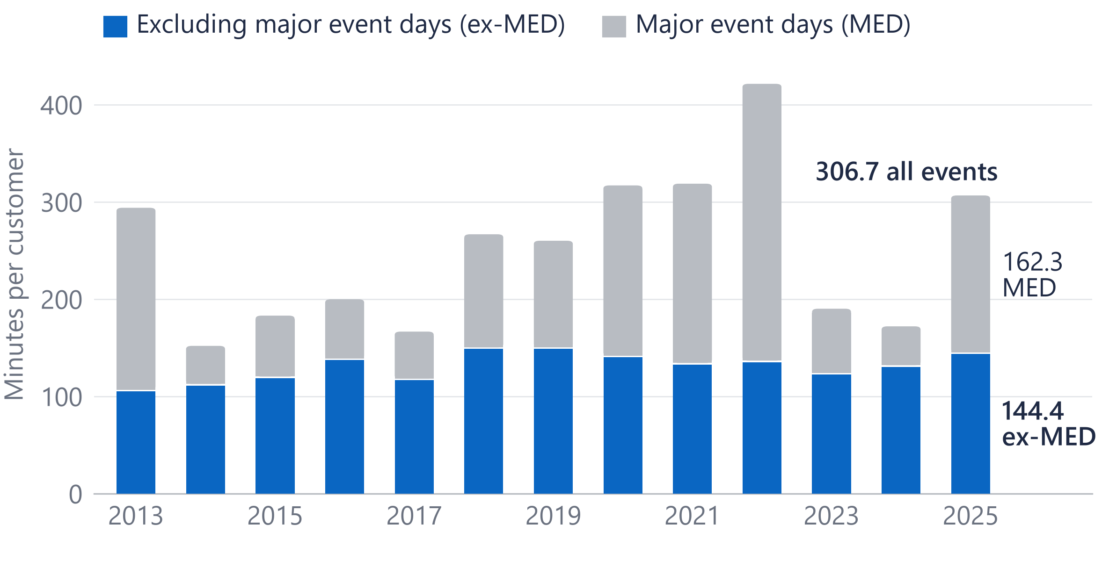
Major event days were about half of all-event outage minutes in 2025
53%
of 2025's all-event outage minutes fell on major event days (162.3 of 306.7)
Major-event minutes swing most: 285 in 2022, 41 in 2024.
Major-event minutes are EIA's all-events SAIDI minus ex-MED SAIDI, not a storm attribution.
Source: EIA-861 / PUDL 2013–2025, Dominion Energy Virginia: SAIDI with and without major event days.
A3
Notes:
All-event SAIDI in 2025 was 306.7 minutes; 144.4 of them were on ordinary days. The headline numbers in this deck use the ordinary-day series, which is the one Dominion reports.

Slide 12
Every number traces to a public source and a tested query
Source | Publisher | Years | Grain | Rows
EIA-861 Reliability, 2025 final | EIA | 2025 | utility × state × year | 977
PUDL EIA-861 reliability | Catalyst Cooperative | 2013–2024 | utility × state × year | 24,358
EIA-861 Service Territory | EIA | 2025 | utility × county | 11,803
NOAA Storm Events | NOAA NCEI | 2013–2025 | storm event | 831,288
EAGLE-I county outages | ORNL for DOE | Nov 2014–2025 | county × 15 minutes | 11,608,442
EIA-930 hourly demand | EIA | Jul 2018–Oct 2026 | region × hour | 6,077,232
Dominion Energy 2025 Annual Report | Dominion Energy | 2025 | document (130, 133) | reference
Tests after each load (T1–T12, all pass): no duplicate keys; SAIDI = SAIFI × CAIDI within 2%; Dominion 2025 equals EIA's published 306.7, 144.4 and 2,675,735 customers; every county mapped; full years; no duplicate hours. T13–T31 check the county outage, storm and load tables (all pass).
Source: Project documentation: sources register (publisher, vintage, licence) and data-quality tests; all public data.
A4
Notes:
Every source is public and every load is tested. The rows are as loaded; the licence and vintage of each file are in the project's sources register.

Slide 13
What public data cannot show, and what would answer it
Public data limit | What would answer it (Dominion data, by type)
One number per utility per year (EIA-861) | Outage records by event, circuit and cause
Storms counted by county, not by line | Outage records with cause codes and circuit location
Methods differ between utilities | Dominion's daily SAIDI and its filing method
The DOM zone is wider than the retail territory | Meter interval data by circuit
No customer identities: growth can't be attributed | Customer class and large-load records
Source: Project scope limits (decision D14) and the sources above.
A5
Notes:
These are the limits I'd name before anyone else does. Each one is answered by a kind of internal data, named by type only.

Slide 14
The ten largest outage events since 2014: three tropical, two winter, five wind
# | Peak day | Storm type | Customers out at the peak | Hours to 50% restored | Hours to 90% restored | Customer- hours (m)
1 | 12 Oct 2018 | Tropical (Michael) | 558,729 | 15.8 | 60.5 | 17.8
2 | 2 Mar 2018 | Wind | 419,136 | 18.8 | 55.0 | 13.2
3 | 4 Aug 2020 | Tropical (Isaias) | 351,738 | 8.3 | 33.5 | 6.2
4 | 3 Jan 2022 | Winter | 314,644 | 21.3 | 102.8 | 13.7
5 | 13 Feb 2021 | Winter | 281,707 | 40.5 | 101.5 | 16.5
6 | 9 Oct 2016 | Tropical (Matthew) | 269,298 | 11.3 | 52.8 | 8.0
7 | 16 Jun 2016 | Wind | 234,951 | 19.5 | 65.8 | 7.0
8 | 19 Jun 2025 | Wind | 225,609 | 4.5 | 22.0 | 2.1
9 | 16 Feb 2025 | Wind | 187,074 | 3.0 | 20.3 | 8.2
10 | 14 May 2018 | Wind | 159,532 | 4.5 | 20.0 | 1.4
Source: EAGLE-I (ORNL), all utilities' customers in Dominion's 103 counties, Nov 2014–2025; storm type from NOAA Storm Events and HURDAT2. Hours from the peak. The Feb 2025 event merges two storms.
A6
Notes:
These are EAGLE-I events: every utility's customers in the counties Dominion serves, so not Dominion's own event records. Michael in 2018 is the largest, 558,729 customers out at the peak. Winter storms took longest to restore, about 100 hours to 90 percent. Across 47 events with at least 50,000 customers out, after allowing for size, there's no evidence restoration got faster: hours to 90 percent moved plus 4.6 percent a year, p = 0.07, not significant. Isaias, highlighted, is the inset on slide 4 and the largest event with a matching federal report: DOE-417 lists 508,000 customers affected in Virginia.

