Slide 1
Dominion Energy Virginia reliability: what public data shows, and where I’d look first
Independent analysis of public data
Print test · design system v0
Notes:
Test notes: talk track goes here.

Slide 2
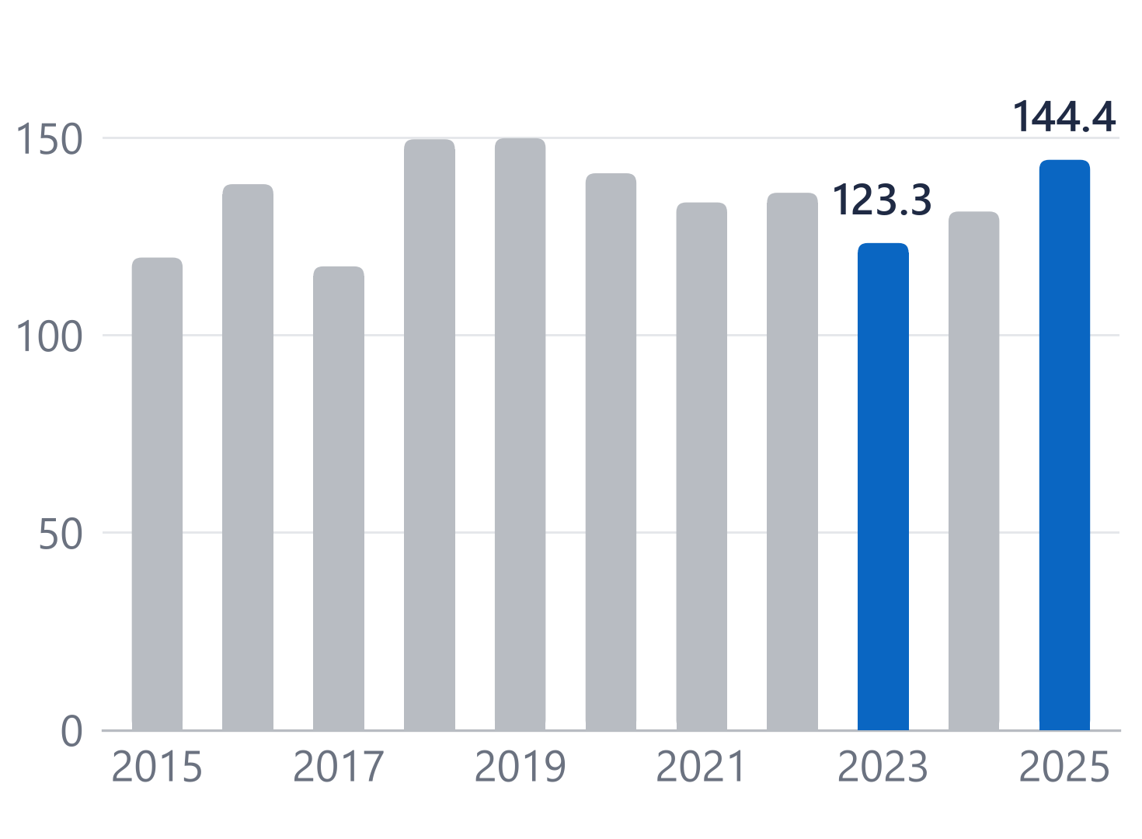
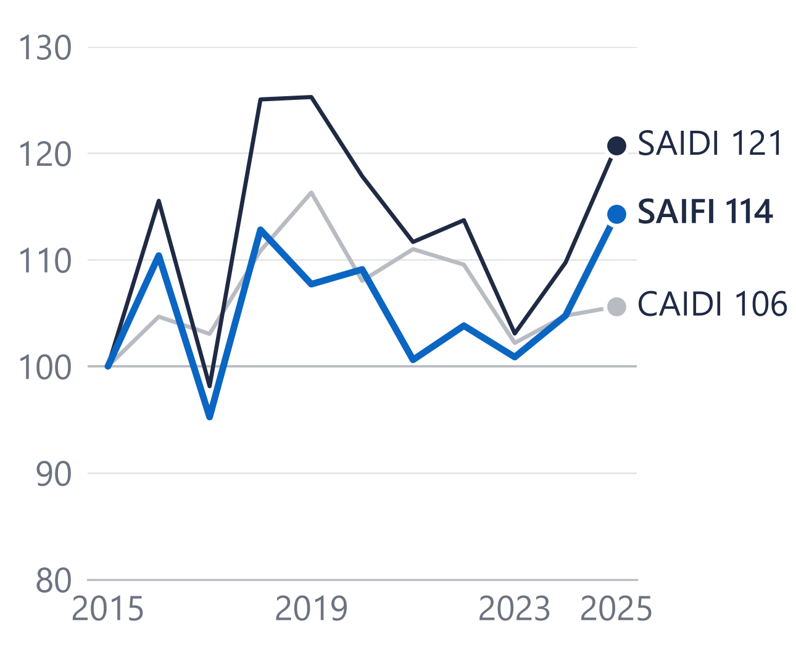
Outage minutes rose 17% from 2023 to 2025, and most of the rise came from more frequent interruptions
144.4
SAIDI ex-MED 2025, minutes
1.32
SAIFI ex-MED 2025, interruptions
109.4
CAIDI ex-MED 2025, minutes
For Dominion: the first place to look is what drives interruption frequency on the worst circuits.
Source: EIA-861 (2025 final) and PUDL 2015–2024, Dominion Energy Virginia, ex-MED. Table data/output/storm_vs_saidi.csv. Body 16 pt, labels 13.5 pt (12 and 10.1 pt printed).
2
Notes:
Test notes for slide 2.

