Slide 1
Dominion Energy Virginia reliability: what public data shows, and where I'd look first
Independent analysis of public data
Saketh Bollina
November 3, 2026
Data: EIA-861 · PUDL · NOAA Storm Events · EAGLE-I · EIA-930
Notes:
Thank you for having me. To prepare, I rebuilt Dominion Energy Virginia's reported reliability numbers from EIA's public filings, then added NOAA storm records, the Department of Energy's county outage records and EIA's hourly demand for context. Everything here is public, and I'll say where public data stops. Three findings, then the report, how it's built, and the first 90 days.

Slide 2

Outage minutes rose from 130 to 133; 2025 had more storms and more interruptions
130 → 133
Reported 3-year average outage minutes per customer, excluding major events
Rebuilt from EIA-861: 130.2 → 133.0
2025 (144.4) replaced 2022 (136.0) in the window.
Dominion attributes the rise primarily to increased storm activity (2025 Annual Report, p. 10). 2025 sits on the storm line, with no clear trend once storms are counted (A2).
Why it matters: a stormy year can move a 3-year average. With outage records, I'd ask whether non-storm interruptions are rising underneath.
Source: EIA-861 2025 final and PUDL (EIA-861) 2013–2024, Dominion Energy Virginia, excluding major event days; 3-year means of annual values. NOAA Storm Events (A2). Reported figures: Dominion Energy 2025 Annual Report, p. 10.
2
Notes:
Dominion's 2025 annual report gives SAIDI, excluding major events, of 133 minutes for the three years ending 2025, up from 130, and says: "This increase is primarily due to increased storm activity." SAIDI is average outage minutes per customer. Excluding major event days sets aside a few extreme days by a fixed rule, so the figure shows everyday performance. I rebuilt both figures from EIA's filings: 130.2 and 133.0. A three-year average moves when a year leaves the window: 2025, at 144.4 minutes, replaced 2022, at 136.0. A storm county-day is a day with a NOAA wind, winter or tropical storm report in one of the 103 Virginia counties Dominion serves. From 2022 to 2025 those rose 10 percent, 718 to 791; interruptions per customer, SAIFI, rose 10 percent; minutes per interruption, CAIDI, fell 4. Once storms are counted there's no clear trend, and 2025's SAIFI of 1.320 only edges 2018's 1.303. One year is not a trend.

Slide 3
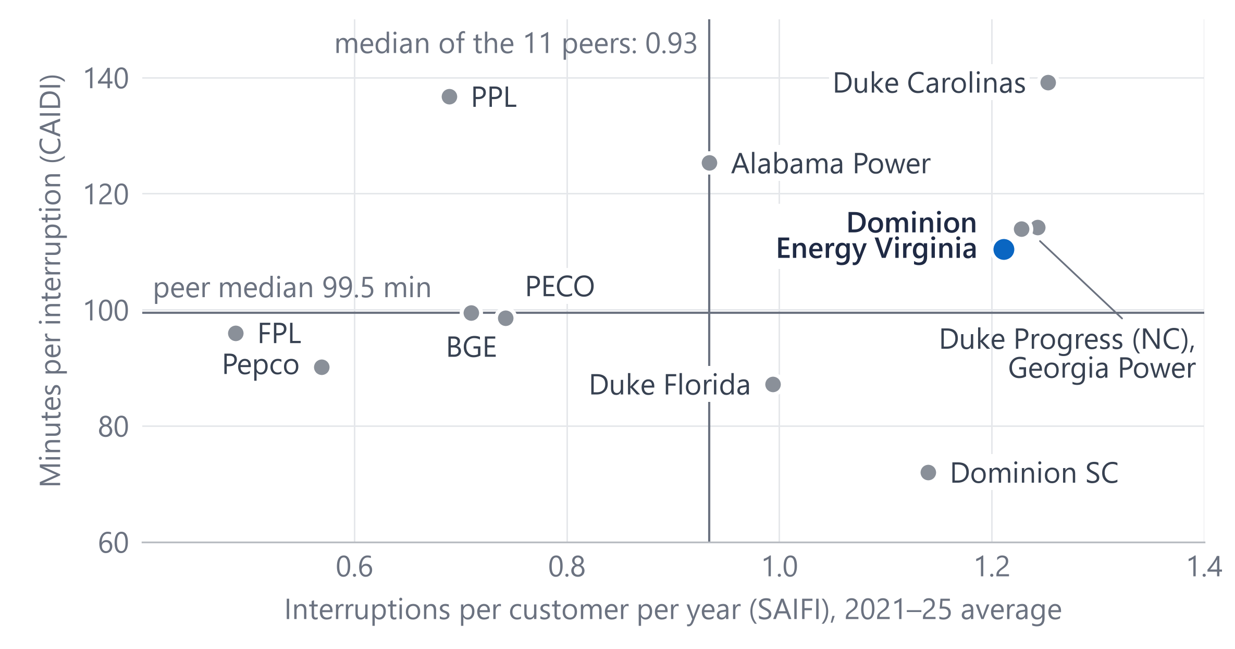
Among 12 large utilities, Dominion's interruption length is mid-pack; frequency is the gap
1.21
interruptions per customer a year: 4th highest of the 12 (peer median 0.93)
110 min
per interruption: mid-pack, 6th of the 12 (peer median 99.5)
Methods differ: Dominion uses its own (non-IEEE) major-event rule, most peers IEEE 1366, so ranks are indicative.
Why it matters: if frequency is where Dominion differs, the next question is which causes drive interruptions, and that needs outage records.
Source: EIA-861 / PUDL 2021–2025, excluding major event days, means of annual values. Dominion and 11 peers: twelve large investor-owned utilities in PJM and the Southeast, selected by EIA ID before results were computed; medians exclude Dominion.
3
Notes:
Is that unusual? These are twelve large investor-owned utilities in PJM and the Southeast, Dominion and eleven peers, picked by EIA ID before I looked at any results. Across is interruptions per customer per year; up is minutes per interruption; both are 2021 to 2025 averages. Dominion's minutes per interruption, 110, are sixth of twelve: mid-pack. Its frequency, 1.21 a year, is fourth highest, against a median of 0.93 for the eleven peers. Most of these peers use the IEEE 1366 method and Dominion reports under its own rule, so the ranking is indicative. The gap to peers is how often customers lose power.

Slide 4
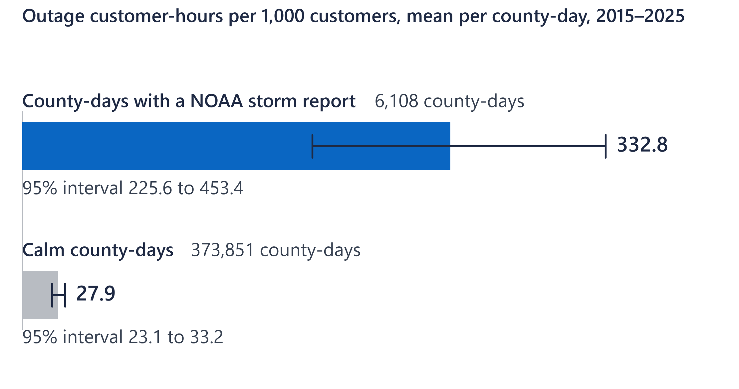
County-days with storms had about 12 times the outage hours of calm days
11.9×
storm vs calm county-days (95% CI 7.9–16.9)
Holds on non-major days (9.9×), in Dominion-only counties (19.9×) and in every year 2015–2025.
EAGLE-I counts every utility's customers in a county. An association: storm reports partly follow damage.
Why it matters: reporting reliability next to storm exposure would keep a stormy year from being read as a trend.
Source: EAGLE-I (ORNL) and NOAA Storm Events, 2015–2025: 6,108 storm county-days with complete outage readings in 99 counties (EAGLE-I); complete days only (2025: 74% of county-days). 95% intervals: 2,000 resamples of whole days.
4
Notes:
Weather is the obvious question, and county-days answer it more finely than annual totals. EAGLE-I, the Department of Energy's county outage record, counts the customers out every fifteen minutes. On 6,108 storm county-days with complete readings, in 99 counties, outage customer-hours per thousand customers averaged about 333, against about 28 on calm days: 11.9 times, with a 95 percent interval of 7.9 to 16.9. The interval resamples whole days, because one storm hits many counties at once. It holds on non-major days, 9.9 times; those leave out proxy major event days, the IEEE rule applied to daily outage customer-hours in the 103 counties: stand-ins, not Dominion's own. It holds in the counties Dominion serves alone, 19.9, and in every year. Two cautions: EAGLE-I counts every utility's customers, so this isn't Dominion's SAIDI; and storm reports partly follow damage, so it's an association, not a cause.

Slide 5
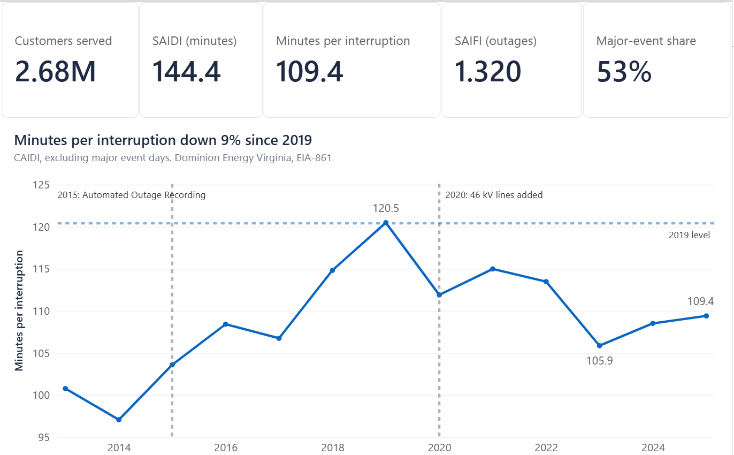
The Power BI report: one page per question, on customer-weighted measures
FCT_RELIABILITY
DIM_UTILITY
utility × state × year
many:1
peer group
A small star at the core; the other tables are pre-built summaries for particular pages, so most stand alone. 18 tables, one DataFolder parameter.
Customer-weighted measures; the cards follow the year slicer:
Selected SAIDI =
VAR SelectedYear =
SELECTEDVALUE('Dashboard Year'[Year], 2025)
RETURN
CALCULATE([SAIDI ex MED],
A detail of the Summary page: the 2025 cards and the CAIDI trend
FCT_RELIABILITY[YEAR] = SelectedYear)
Why it matters: Power BI reporting leads the role's duties, and the same model and measures could carry a program-tracking report.
Source: Power BI Desktop, the project's report: a detail of the Summary page, year 2025. Tables are CSV exports (16 from the local DuckDB mirror, 2 from the workbook) imported through a folder parameter; measures as in the project's measures.dax.
5
Notes:
The role's first listed duty is Power BI, so here is the report. This is a detail of its Summary page: the 2025 cards and the minutes-per-interruption trend. The core is a small star: one fact table at utility × state × year, many-to-one to a utility dimension, with customer-weighted measures. The other tables are pre-built summaries for particular pages, so most stand alone; only the ten largest outage events join their restoration curves. A year table drives the slicer. In production I'd conform them to shared date and county dimensions. The report's titles compare with 2019: frequency up 6 percent, minutes per interruption down 9. Slide 2 compares with 2022: up 10 and down 4. The 2020 mark is a counting change: lines up to 46 kilovolts are included from that year, and the data are not adjusted for it.

Slide 6
Built with production habits: tested, documented, and reconciled to the reported numbers
Original build, Oct 27–31, 2026
Added Nov 1, 2026
Sources
Downloads
SQL layers
Tests
CSV exports
Power BI Import
EIA-861 / PUDL, NOAA Storm Events, EIA-930
download scripts
sql/01–08: RAW → STG → MART
T1–T12
EAGLE-I, DOE-417, HURDAT2, degree days, Census, EIA-861M
scripts for the new sources, each with a manifest
sql/09–11; all of it run in a local DuckDB mirror (22 s)
T13–T31: all 31 pass
18 files with a manifest of row counts and checksums
template: 18 tables via one DataFolder setting; opens offline
Snowflake: holds the October build, sql/01–08 and T1–T12, where the report was developed in DirectQuery (D13). The same SQL loads the new tables there in one optional step (README step 7).
Reconciled: 12 of 12 match the published figures.
Documented: data dictionary; decisions D1–D22; peers fixed by EIA ID before results.
Why it matters: the same habits would serve the team's reports: reconcile first, test every load, write each definition down.
Source: Project repository: sql/01–11, tests T1–T31 (T1–T12 the October build), data dictionary, decisions log D1–D22. Build time of the local DuckDB mirror measured November 1, 2026.
6
Notes:
Briefly, how it's built. One set of SQL, written for Snowflake, takes the public files from raw text exactly as published, through a typed and cleaned staging layer, to a mart of facts, dimensions and views. The October build runs in Snowflake. The same SQL also runs in DuckDB, a local mirror that builds everything, the November tables included, and runs all 31 tests in about 22 seconds. The report imports CSV exports from that mirror, so it opens offline; the new tables reach Snowflake in one optional step. Decisions are logged, D1–D22, and twelve of twelve rebuilt values match the published figures: a check of definitions. The October build is mine: the pipeline, the first 12 tests and the report. On November 1 it was extended with help, using an AI coding assistant: the county outage analysis, 19 more tests and this template. I reviewed those changes and reran the checks myself. [you: say the last sentence only if you did both on Monday]

Slide 7
With Dominion's outage, meter and circuit data: the questions I'd bring and what I'd build
Days 1–30
Days 31–60
Days 61–90
Learn and reconcile
Ask about frequency
Build the tracking report
Learn how outages, meter events and circuits are recorded and reported.
By circuit and cause code, storm days apart from calm days; repeat interruptions (CEMIn).
Track mainfeeder hardening against matched untreated feeders (same pre-period performance), weather-normalized, in support of the program's selection rule.
Rebuild one year's SAIDI, SAIFI and CAIDI and reconcile them to the filed figures.
Outage times from meter last-gasp and restore messages (99.8% of meters are smart), checked against OMS.
Deliverable: a Power BI program-tracking report, refreshed on a schedule
Deliverable: a reconciled baseline with written definitions
Deliverable: tested views and a data dictionary
Why it matters: these are questions to check first with the people who own each definition, not conclusions.
Source: A plan: Dominion data is named by type only, and none was used here. Smart meters: EIA-861 2025 (advanced meters as a share of all meters). Grid Resiliency: Dominion Energy website, read November 1, 2026.
7
Notes:
Public data narrows the question; Dominion's own data answers it. The role supports four Grid Resiliency programs: mainfeeder hardening rebuilds targeted main lines to stronger standards; voltage island mitigation adds a second transformer where a substation has only one; voltage optimization uses smart-meter voltage readings to save energy; and intelligent grid devices locate and isolate faults and restore service. First month: learn how outages, meter events and circuits are recorded, and reconcile one year's SAIDI, SAIFI and CAIDI to the filed numbers. Second: interruptions by circuit and cause code, storm days apart from calm, and CEMIn, customers experiencing multiple interruptions. Meter last-gasp and restore messages time each outage, checked against the outage management system, OMS. Third: a Power BI report that tracks mainfeeder hardening against matched untreated feeders, weather-normalized.

Slide 8
Three takeaways: a stormier year, a frequency gap, and storms by county
1
A stormier year
2
Frequency is the peer gap
3
Storms by county
More storms and more interruptions in 2025; no clear trend once storms are counted
So causes are the question, and answering it needs outage records by cause code
Storm county-days carry far more outage hours, so report reliability beside storm exposure
I've built a tested Snowflake → Power BI pipeline on public reliability data.
How my experience maps Mercury Insurance, Data Analyst
Snowflake pipeline, 20M+ rows
Root-cause analysis on joined data
Metadata and business definitions
→ this project's mart
→ what I'd do with cause codes in the first 90 days
→ the data dictionary
Thank you. I'd like to do this work with your team.
Source: Takeaways: slides 2–4. Experience: Mercury Insurance, Data Analyst, 2026 to present.
8
Notes:
Three takeaways. One: 2025 was a stormier year, with more storms and more interruptions, and once storms are counted there's no clear underlying trend. Two: frequency is where Dominion differs from its peers, so the useful question is what causes the interruptions, and that needs outage records by cause. Three: storm county-days carry far more outage hours than calm ones, so I'd report reliability beside storm exposure by county. On fit: at Mercury Insurance I built a Snowflake pipeline across policy, claims and billing data, over 20 million rows, and led a root-cause analysis on joined data. I've built a tested Snowflake to Power BI pipeline on public reliability data, and I'd like to do this work with your team. Thank you; I'm happy to take questions.

Slide 9
Definitions: SAIDI = SAIFI × CAIDI, and major event days are set aside by rule
SAIDI
=
SAIFI
×
CAIDI
outage minutes per customer per year
interruptions per customer per year: how often
minutes per interruption: how long
Dominion 2025: 1.320 × 109.4 = 144.4 minutes (excluding major event days)
Major event days (MED): IEEE 1366's 2.5 beta method takes five years of daily SAIDI, drops zero days, and sets α and β as the mean and standard deviation of ln(daily SAIDI); a day above exp(α + 2.5β) is an MED.
Dominion reports to EIA under a non-IEEE rule (“Other” in EIA-861); most peers in this deck use IEEE 1366.
With major event days, 2025 SAIDI was 306.7 minutes, against 144.4 without them: MEDs held 53%.
Log split: ln(SAIDI ratio) = ln(SAIFI ratio) + ln(CAIDI ratio). From 2022, duration fell, so frequency accounts for more than all of the rise; from 2023, 79%.
Source: IEEE Std 1366; EIA-861 reliability, Dominion Energy Virginia, 2022, 2023 and 2025.
A1
Notes:
Definitions for reference. SAIDI equals SAIFI times CAIDI, which is why a change in SAIDI splits exactly into a frequency part and a duration part using logs. The split depends on the base year: from 2022, minutes per interruption fell, so frequency explains more than the whole rise.

Slide 10
The weather fit is a check on one year, not a forecast
Year | Storm county-days | SAIDI ex‑MED | From the fit | Difference
2015 | 521 | 119.6 | 131.3 | −11.6
2016 | 594 | 138.2 | 135.0 | +3.2
2017 | 419 | 117.4 | 126.0 | −8.6
2018 | 683 | 149.6 | 139.7 | +9.9
2019 | 848 | 149.9 | 148.2 | +1.7
2020 | 429 | 141.0 | 126.5 | +14.5
2021 | 673 | 133.6 | 139.1 | −5.5
2022 | 718 | 136.0 | 141.5 | −5.4
2023 | 390 | 123.3 | 124.5 | −1.1
2024 | 464 | 131.3 | 128.3 | +3.0
2025 (not in fit) | 791 | 144.4 | 145.3 | −0.9
Fit on 2015–2024 (n = 10): SAIDI = 104.3 + 0.0518 × storm county-days; r = 0.70 (t = 2.75, p = 0.025; 95% CI 0.12 to 0.92), R² 0.49.
Why 2015: the change to automated outage recording that year shifts the level (decision D6).
2025, left out of the fit: 145.3 from the fit (95% prediction interval 122.3–168.2), 144.4 actual.
Adjusted for storm days, the trend since 2015 is not distinguishable from zero: about +0.3 minutes a year (95% range −1.4 to +2.1).
Source: NOAA Storm Events and EIA-861, 2015–2025; ordinary least squares on ten annual points (exploratory). Storm county-days count Bedford city once (decision D22).
A2
Notes:
Ten annual points, so the fit is a check, not a forecast. r is 0.70, but with ten points its 95 percent interval runs from about 0.12 to 0.92, weak to very strong, so on its own this is thin evidence; the county-day comparison on slide 4 rests on 6,108 storm county-days with complete outage readings. The table's storm county-days count all 103 Virginia counties Dominion serves. The fit starts in 2015 because the change to automated outage recording that year shifts the level. 2025 was left out of the fit and lands within a minute of it; the 95 percent prediction interval for a single new year was about 122 to 168 minutes. After the storm-day adjustment, the trend since 2015 is about plus 0.3 minutes a year, with a range that includes zero.

Slide 11

Overnight demand grew faster than afternoon demand; winter rivals summer for the peak
+39–41%
average load, hours ending 1–5 a.m., 2019 → 2025 (1–5 p.m.: about +27%)
Winter
set the yearly peak in 2019, 2022 and 2025; 2026 so far: winter 25,413 vs summer 25,384 MW, a tie
Highest hour of the year +26%, lowest hour +52%.
I'd add winter and overnight views to load and outage reports.
Source: EIA-930 hourly demand, PJM Dominion (DOM) zone, which is wider than Dominion's retail territory; 2019 and 2025 full years; 2026 to the hour ending midnight, Oct 29. Winter = Dec–Feb, summer = Jun–Aug.
A3
Notes:
EIA's hourly demand for the PJM Dominion zone, which is wider than Dominion's retail territory. From 2019 to 2025 the hours ending 1 to 5 a.m. grew 39 to 41 percent, the hours ending 1 to 5 p.m. about 27. Holding Virginia's heating and cooling degree days and the weekday fixed, average load still rose about 33 percent, against 32 unadjusted. Winter set the yearly peak in 2019, 2022 and 2025, and 2026 so far is a tie. The two winter events in A6 took about 100 hours to clear 90 percent of the outage, against 20 to 66 for the other eight: two events, so a pointer, not a finding. This data can't identify customers, so I don't attribute the growth to data centers.

Slide 12
Every number traces to a public source; the tables behind them are tested after each load
Source | Publisher | Years | Grain | Rows
EIA-861 Reliability, 2025 final | EIA | 2025 | utility × state × year | 977
PUDL EIA-861 reliability | Catalyst Cooperative | 2013–2024 | utility × state × year | 24,358
EIA-861 Service Territory | EIA | 2025 | utility × county | 11,803
NOAA Storm Events | NOAA NCEI | 2013–2025 | storm event | 831,288
EAGLE-I county outages | ORNL for DOE | Nov 2014–2025 | county × 15 minutes | 11,608,442
EIA-930 hourly demand | EIA | Jul 2018–Oct 2026 | region × hour | 6,094,320
HURDAT2 storm tracks | NOAA NHC | 1851–2025 | storm × 6-hour fix | 55,524
DOE-417 disturbance reports | DOE | 2014–2025 | reported event | 3,702
CPC degree days | NOAA CPC | 2018–Oct 2026 | state × day | 309,504
Dominion Energy 2025 Annual Report | Dominion Energy | 2025 | document (130, 133) | reference
Tests T1–T31, all pass: T1–T6 on the reliability mart (no duplicate keys; SAIDI = SAIFI × CAIDI within 2%; Dominion 2025 equals EIA's published 306.7, 144.4 and 2,675,735 customers); T7–T9 on NOAA storms; T10–T12 on EIA-930 demand; T13–T31 on the new tables. Reconciled 12 of 12 against the annual report and the EIA-861 files.
Source: Project documentation: sources register (publisher, vintage, license) and data-quality tests; all public data.
A4
Notes:
Every source is public and every load is tested; the rows are as loaded. The twelve reconciled values: the two three-year SAIDI figures from the annual report, and from the EIA-861 files 2025 SAIDI, SAIFI, CAIDI and all-event SAIDI, 2025 customers, the same four measures for 2024, and 2025 commercial sales. It confirms definitions and filters; it is not an independent measurement.

Slide 13
What public data cannot show, and what would answer it
Public data limit | What would answer it (Dominion data, by type)
One number per utility per year (EIA-861) | Outage records by event, circuit and cause
Storms counted by county, not by line | Outage records with cause codes and circuit location
Methods differ between utilities | Dominion's daily SAIDI and its filing method
The DOM zone is wider than the retail territory | Meter interval data by circuit
No customer identities: growth can't be attributed | Customer class and large-load records
Source: Project scope limits (decision D14) and the sources above.
A5
Notes:
These are the limits I'd name before anyone else does. Each one is answered by a kind of internal data, named by type only.

Slide 14
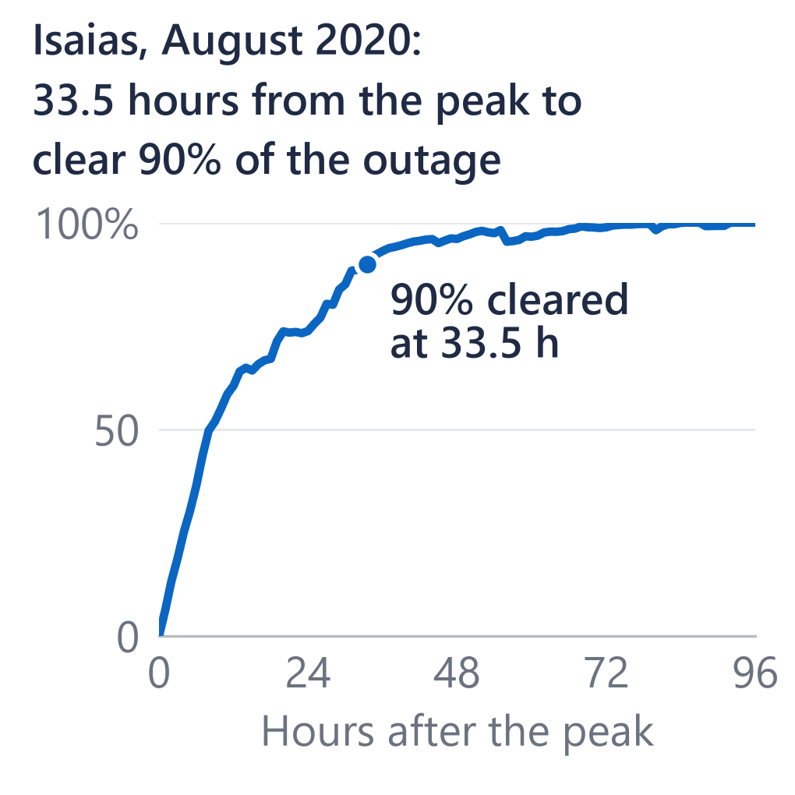
The ten largest outage events since 2014: three tropical, two winter, five wind
# | Peak day | Storm type | Peak customers out | Held 1 h | Hours to clear 90%
1 | Oct 12, 2018 | Tropical (Michael) | 558,729 | 545,548 | 60.5
2 | Mar 2, 2018 | Wind | 419,136 | 401,776 | 55.0
3 | Aug 4, 2020 | Tropical (Isaias) | 351,738 | 343,492 | 33.5
4 | Jan 3, 2022 | Winter | 314,644 | 308,015 | 102.8
5 | Feb 13, 2021 | Winter | 281,707 | 271,359 | 101.5
6 | Oct 9, 2016 | Tropical (Matthew) | 269,298 | 265,401 | 52.8
7 | Jun 16, 2016 | Wind | 234,951 | 233,003 | 65.8
8 | Jun 19, 2025 | Wind | 225,609 | 209,475 | 22.0
9 | Feb 16, 2025 | Wind | 187,074 | 172,538 | 20.3
10 | May 14, 2018 | Wind | 159,532 | 151,385 | 20.0
Source: EAGLE-I (ORNL), all utilities in Dominion's 103 counties, Nov 2014–2025; storm type from NOAA and HURDAT2. Cleared = (peak − customers out) ÷ (peak − pre-event level): a net count, not a utility's “% of affected customers restored”.
A6
Notes:
These are EAGLE-I events: every utility's customers in the counties Dominion serves, so not Dominion's own event records. Events are ranked by the highest count held for an hour; the peak is the highest fifteen-minute count. Hours to clear 90 percent run from the peak until 90 percent of the outage above the pre-event level has cleared. It's a net count, so it is not a utility's share of affected customers restored, which counts everyone affected and looks slower. Michael in 2018 is the largest, 558,729 customers out at the peak. The two winter storms took about 100 hours to clear 90 percent. Across 47 events with at least 50,000 customers out, after allowing for size, there's no evidence that clearing got faster: hours to clear 90 percent moved plus 4.6 percent a year, p = 0.07, not significant. Isaias, highlighted, is the largest event with a matching federal report: DOE-417 lists 508,000 customers affected in Virginia. The February 2025 event merges two storms.

