Slide 1
Dominion Energy Virginia reliability: what public data shows, and where I'd look first
Independent analysis of public data
Saketh Bollina
November 3, 2026
Data: EIA-861 · PUDL · NOAA Storm Events · EIA-930
Notes:
Thank you for having me. I'm Saketh Bollina. To prepare, I rebuilt Dominion Energy Virginia's reported reliability numbers from EIA's public filings, then added NOAA storm records and EIA's hourly demand for context. Everything here is public; I had no Dominion internal data, and I'll say where public data stops. Three findings, then the Power BI report, how it's built, and what I'd do in the first 90 days.

Slide 2

Outage minutes rose from 130 to 133; 2025 had more storms and more interruptions
130 → 133
Reported 3-year average outage minutes per customer, excluding major events
Rebuilt from EIA-861: 130.2 → 133.0
2025 (144.4) replaced 2022 (136.0) in the window.
Dominion attributes the rise primarily to increased storm activity (2025 Annual Report, p. 10). 2025 sits on the storm line, with no clear trend once storms are counted (A2).
Why it matters: a stormy year can move a 3-year average. With outage records, I'd ask whether non-storm interruptions are rising underneath.
Source: EIA-861 2025 final and PUDL (EIA-861) 2013–2024, Dominion Energy Virginia, excluding major event days; 3-year means of annual values. NOAA Storm Events (A2). Reported figures: Dominion Energy 2025 Annual Report, p. 10.
2
Notes:
Dominion's 2025 annual report gives SAIDI, excluding major events, of 133 minutes for the three years ending 2025, up from 130, and says: "This increase is primarily due to increased storm activity." SAIDI is average outage minutes per customer. I rebuilt it from EIA's filings. The public Virginia data reproduces both reported figures to the minute: 130.2 and 133.0, a rise of 2.8 minutes. A three-year average moves when a year leaves the window: 2025, at 144.4 minutes, replaced 2022, at 136.0. Between those two years storm county-days rose 10 percent, 796 against 723, and interruptions per customer, SAIFI, rose 10 percent; minutes per interruption, CAIDI, fell 4 percent. The weather fit in A2 puts 2025 on the storm line, and once storms are counted there's no clear trend. Two cautions: 2025's SAIFI of 1.320 only edges 2018's 1.303, and 2025's SAIDI is still below 2018 and 2019. One year is not a trend.

Slide 3
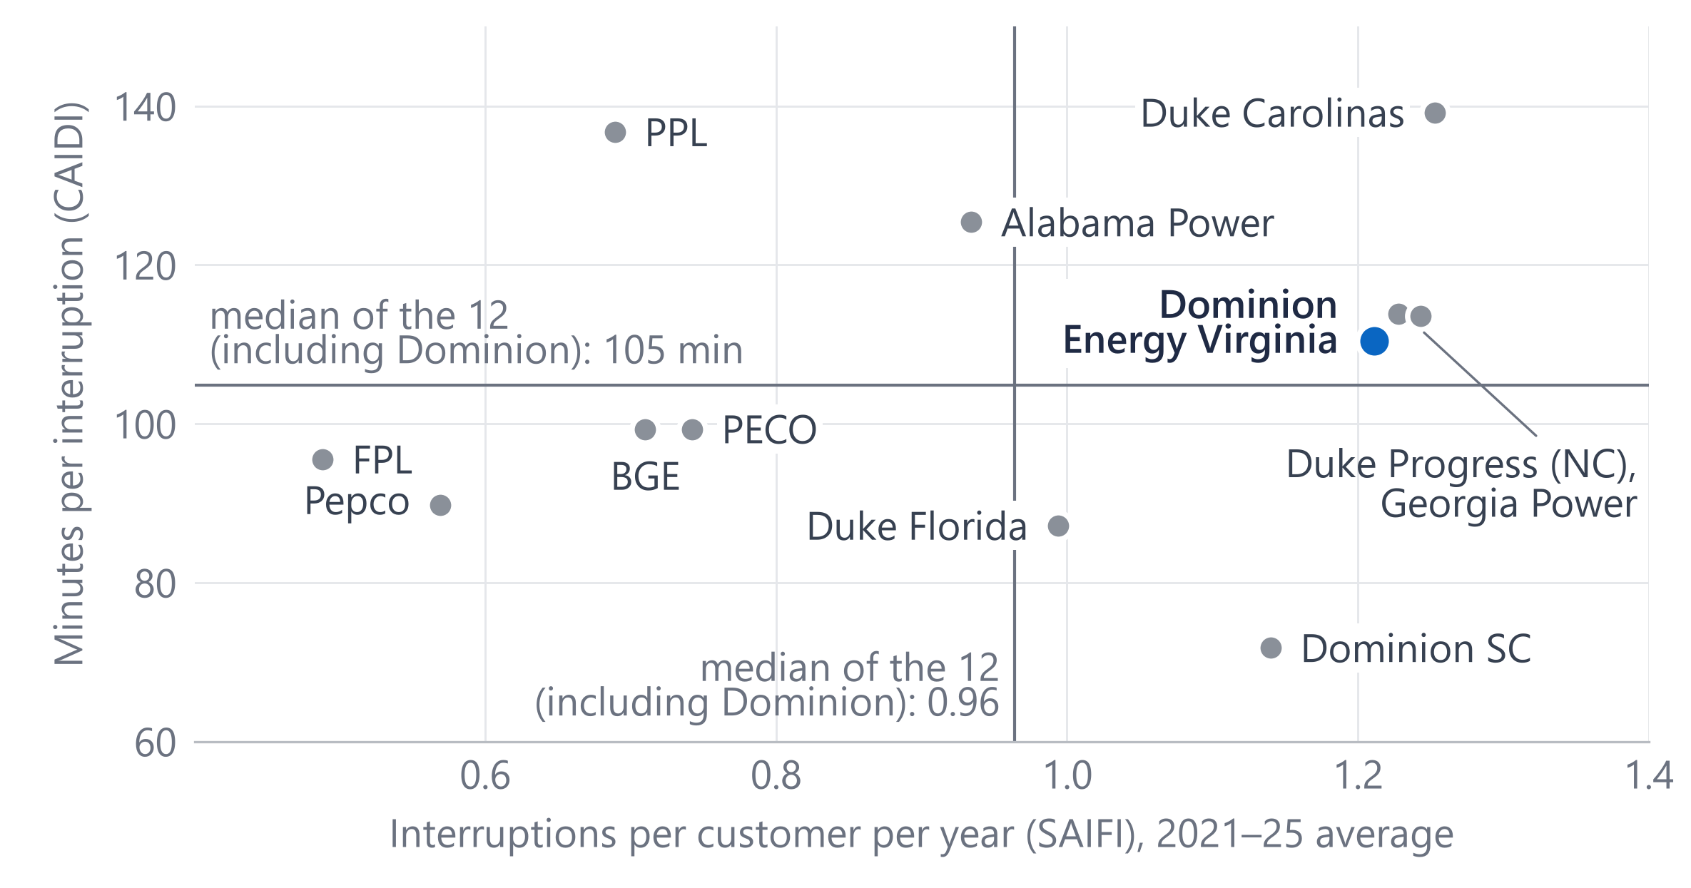
Among 12 large utilities, Dominion's interruption length is mid-pack; frequency is the gap
1.21
interruptions per customer a year: 4th highest of the 12 (median 0.96)
110 min
per interruption: mid-pack, 6th of the 12 (median 105)
Methods differ: Dominion reports under its own major-event rule; ranks are indicative.
Why it matters: if frequency is where Dominion differs, the next question is which causes drive interruptions, and that needs outage records.
Source: EIA-861 / PUDL 2021–2025, excluding major event days, means of annual values. Dominion and 11 peers: twelve large investor-owned utilities in PJM and the Southeast, selected by EIA ID before results were computed; medians include Dominion.
3
Notes:
Is that unusual? These are twelve large investor-owned utilities in PJM and the Southeast, Dominion and eleven peers, picked by EIA ID before I looked at any results. Across is interruptions per customer per year; up is minutes per interruption; both are 2021 to 2025 averages. Dominion is the blue dot. Its minutes per interruption, 110, are sixth of twelve: mid-pack. Its frequency, 1.21 interruptions a year, is fourth highest, against a median of 0.96 for all twelve, Dominion included. One caveat I'd raise myself: utilities set aside major event days in different ways. Dominion reports under its own major-event rule, so the ranking is indicative. The gap to peers is how often customers lose power.

Slide 4
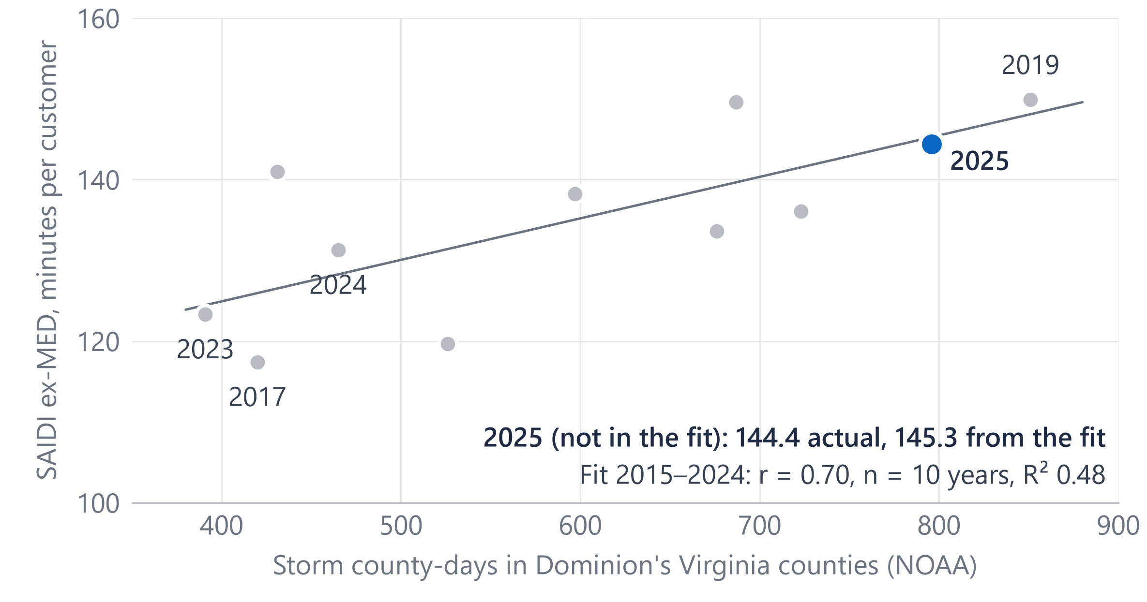
Years with more storm days had more outage minutes (r = 0.70 over ten years)
465 → 796
storm county-days in Dominion's Virginia counties, 2024 → 2025
r = 0.70
over 2015–2024 (n = 10): an association, not a cause. The fit, made without 2025, gives 145.3; the actual was 144.4.
Why it matters: reporting reliability next to storm exposure would keep a stormy year from being read as a trend.
Source: NOAA Storm Events 2015–2025, wind, winter and tropical event types, by county in Dominion's Virginia service territory (EIA-861); EIA-861 SAIDI excluding major event days; least-squares fit on 2015–2024.
4
Notes:
Weather is the obvious question. I counted storm county-days: each day a line-damaging storm, such as thunderstorm wind, an ice storm or a tropical storm, was recorded in a Virginia county Dominion serves, from NOAA's Storm Events data. 2025 had 796, up from 465 in 2024. Over 2015 to 2024, years with more storm days had more outage minutes: the correlation is 0.70. That's ten points, so I treat it as a check, not a model. The fit, made without 2025, puts 2025 at 145.3 minutes; the actual was 144.4. So 2025 looks like a stormy year more than a break in the trend, which is consistent with the annual report. What this can't say is which circuits or causes; that needs outage records.

Slide 5
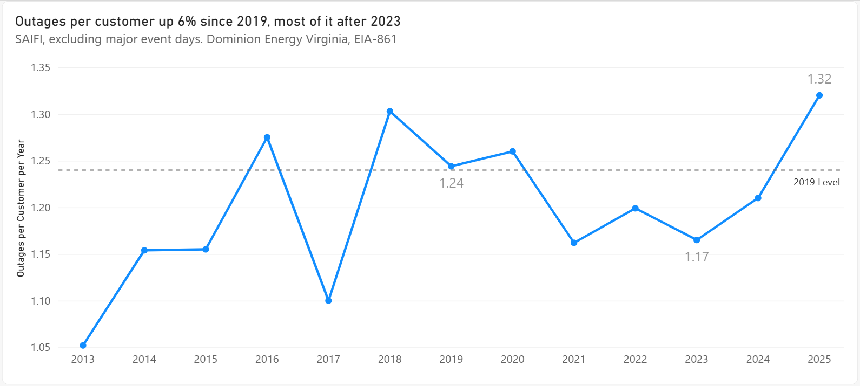
The Power BI report: one page per question, on customer-weighted measures
My current report: the What moved page, frequency chart (EIA-861, Import mode)
FCT_RELIABILITY
DIM_UTILITY
utility × state × year
many:1
peer group
Import for presentation, DirectQuery during development (D13).
Customer-weighted measures; the 3-year figure averages the annual values:
SAIDI 3yr ending 2025 =
CALCULATE(
AVERAGEX(VALUES(FCT_RELIABILITY[YEAR]),
[SAIDI ex MED]),
FCT_RELIABILITY[YEAR] IN {2023, 2024, 2025})
Why it matters: Power BI reporting leads the role's duties, and the same model and measures could carry a program-tracking report.
Source: Power BI Desktop, the project's report (.pbix; not on GitHub, by design): What moved page, Import mode. Measures as in the project's powerbi/measures.dax.
5
Notes:
The role's first listed duty is Power BI, so here is my current report. This is the frequency chart from its What moved page: how often the average customer loses power each year, against the 2019 level. Each page answers one question: scorecards, what moved, weather, the peer comparison, growth, seasonal demand, and two executive summaries. The model is a star: one fact table at utility, state and year, many-to-one to a utility dimension for names and peer groups. Measures are customer-weighted: SAIDI is total customer-minutes over total customers, and the three-year figure averages the three annual values, as Dominion reports it. I built it in DirectQuery against Snowflake during development; decision D13 is Import for presentation, and this chart runs on imported data.

Slide 6
Built with production habits: tested, documented, and reconciled to the reported numbers
Public sources
Snowflake
Power BI
EIA-861 reliability
Import for presentation; DirectQuery in development (D13)
24,358 + 977 rows
RAW
STG
MART
NOAA Storm Events
as published, all text
typed and cleaned
facts, dimensions, views
831,288 rows
EIA-930 hourly demand
6,077,232 rows
12 tests pass
Data dictionary
Decisions log
Reconciled
keys, SAIDI = SAIFI × CAIDI, EIA's published 2025 values
every table and column; measures defined in docs/05
decisions logged (D1–D14); the peer set was chosen by EIA ID before results
130.2 and 133.0 rebuilt against 130 and 133; 2025 matches EIA (test T4)
Why it matters: the same habits would serve the team's reports: reconcile first, test every load, write each definition down.
Source: Project build: SQL scripts, tests T1–T12, data dictionary and decisions log D1–D14; row counts as loaded.
6
Notes:
Briefly, how it's built. Three public sources: EIA's reliability filings, NOAA Storm Events, and EIA-930 hourly demand. They land in Snowflake as raw text exactly as published, a staging layer types and cleans them, and a mart of facts, dimensions and views feeds Power BI. I built the report in DirectQuery and switch it to Import for presentation, decision D13. Twelve tests run after each load: no duplicate keys, SAIDI equals SAIFI times CAIDI, the 2025 values match what EIA published. All pass. A data dictionary covers every table and column, and the measures are defined in the metrics guide. Decisions are logged, D1–D14; the peer set was chosen by EIA ID before any results. The first check was reconciliation: 130.2 and 133.0 rebuilt against the reported 130 and 133, and test T4 matches Dominion's 2025 values to EIA's published 306.7, 144.4 and 2,675,735 customers. A local script, scripts/run_local_duckdb.py, rebuilds the core mart and runs its checks.

Slide 7
With Dominion's outage, meter and circuit data: the questions I'd bring and what I'd build
Days 1–30
Days 31–60
Days 61–90
Learn and reconcile
Ask about frequency
Build the tracking report
Learn how outages, meter events and circuits are recorded and reported.
By circuit and cause code, storm days apart from calm days; repeat interruptions (CEMIn).
Track mainfeeder hardening against matched untreated feeders (same pre-period performance), weather-normalized, in support of the program's selection rule.
Rebuild one year's SAIDI, SAIFI and CAIDI and reconcile them to the filed figures.
Outage times from meter last-gasp and restore messages (99.8% of meters are smart), checked against OMS.
Deliverable: a Power BI program-tracking report, refreshed on a schedule
Deliverable: a reconciled baseline with written definitions
Deliverable: tested views and a data dictionary
Why it matters: these are questions to check first with the people who own each definition, not conclusions.
Source: A plan: Dominion data is named by type only, and none was used here. Smart meters: EIA-861 2025 (advanced meters as a share of all meters). Grid Resiliency: Dominion Energy website, read November 1, 2026.
7
Notes:
Public data narrows the question; Dominion's own data answers it. Here are the questions I'd bring in the first 90 days, and what I'd build. First month: learn how outages, meter events and circuits are recorded, then rebuild one year's SAIDI, SAIFI and CAIDI and reconcile them to the filed numbers. Second month: interruptions by circuit and cause code, storm days apart from calm days, and customers interrupted repeatedly. Meters mark when an outage starts and ends, which can be checked against the outage system's times. Third month: a Power BI report that tracks mainfeeder hardening against matched untreated feeders, weather-normalized, in support of the program's own selection rule. I'd check each of these first with the people who own the definitions.

Slide 8
Three takeaways: a stormier year, a frequency gap, and storms by county
1
A stormier year
2
Frequency is the peer gap
3
Storms by county
More storms and more interruptions in 2025; no clear trend once storms are counted
So causes are the question, and answering it needs outage records by cause code
Report reliability beside county storm exposure, so a stormy year isn't read as a trend
I've built a tested Snowflake → Power BI pipeline on public reliability data.
How my experience maps Mercury Insurance, Data Analyst
Snowflake pipeline, 20M+ rows
Root-cause analysis on joined data
Metadata and business definitions
→ this project's mart
→ what I'd do with cause codes in the first 90 days
→ the data dictionary
Thank you. I'd like to do this work with your team.
Source: Takeaways: slides 2–4. Experience: Mercury Insurance, Data Analyst, 2026 to present.
8
Notes:
Three takeaways. One: 2025 was a stormier year, with more storms and more interruptions, and once storms are counted there's no clear underlying trend. Two: frequency is where Dominion differs from its peers, so the useful question is what causes the interruptions, and that needs outage records by cause; the ranks are indicative. Three: I'd report reliability beside county-level storm exposure, so a stormy year isn't read as a trend. On fit: at Mercury Insurance I built a Snowflake pipeline across policy, claims and billing data, over 20 million rows, and led a root-cause analysis on joined data. I've built a tested Snowflake to Power BI pipeline on public reliability data, and I'd like to do this work with your team. Thank you; I'm happy to take questions.

Slide 9
Definitions: SAIDI = SAIFI × CAIDI, and major event days are set aside by rule
SAIDI
=
SAIFI
×
CAIDI
outage minutes per customer per year
interruptions per customer per year: how often
minutes per interruption: how long
Dominion 2025: 1.320 × 109.4 = 144.4 minutes (excluding major event days)
Major event days (MED): IEEE 1366's 2.5 beta method takes five years of daily SAIDI, drops zero days, and sets α and β as the mean and standard deviation of ln(daily SAIDI); a day above exp(α + 2.5β) is an MED.
Dominion reports to EIA under its own major-event rule (“Other” in EIA-861); methods differ between utilities.
With major event days, 2025 SAIDI was 306.7 minutes, against 144.4 without them: MEDs held 53%.
Log split: ln(SAIDI ratio) = ln(SAIFI ratio) + ln(CAIDI ratio). From 2022, duration fell, so frequency accounts for more than all of the rise; from 2023, 79%.
Source: IEEE Std 1366; EIA-861 reliability, Dominion Energy Virginia, 2022, 2023 and 2025.
A1
Notes:
Definitions for reference. SAIDI equals SAIFI times CAIDI, which is why a change in SAIDI splits exactly into a frequency part and a duration part using logs. The split depends on the base year: from 2022, minutes per interruption fell, so frequency explains more than the whole rise.

Slide 10
The weather fit is a check on one year, not a forecast
Year | Storm county-days | SAIDI ex‑MED | From the fit
2015 | 526 | 119.6 | 131.4
2016 | 597 | 138.2 | 135.0
2017 | 420 | 117.4 | 125.9
2018 | 687 | 149.6 | 139.7
2019 | 851 | 149.9 | 148.1
2020 | 431 | 141.0 | 126.5
2021 | 676 | 133.6 | 139.1
2022 | 723 | 136.0 | 141.5
2023 | 391 | 123.3 | 124.4
2024 | 465 | 131.3 | 128.2
2025 (not in fit) | 796 | 144.4 | 145.3
Fit on 2015–2024 (n = 10): SAIDI = 104.4 + 0.0514 × storm county-days; r = 0.70, R² 0.48.
Why 2015: the change to automated outage recording that year shifts the level (decision D6).
2025 was left out: the fit gives 145.3, the actual was 144.4.
Adjusted for storm days, there is no clear trend since 2015.
Source: NOAA Storm Events and EIA-861, 2015–2025; ordinary least squares on ten annual points (exploratory).
A2
Notes:
Ten annual points, so the fit is a check, not a forecast. It starts in 2015 because the change to automated outage recording that year shifts the level, decision D6. 2025 was left out of the fit and lands within a minute of it. Once storm days are allowed for, there is no clear trend since 2015.

Slide 11
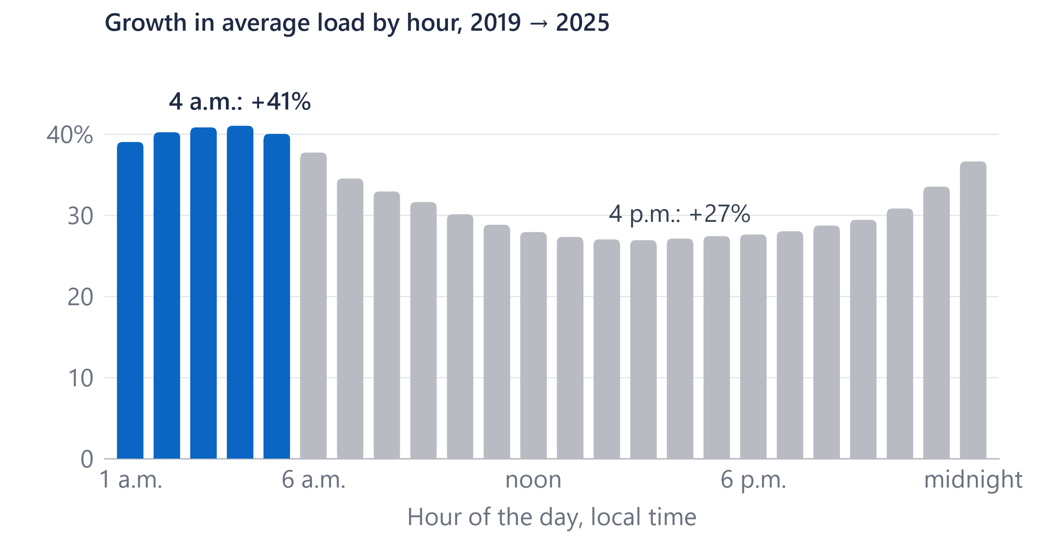
Overnight demand grew faster than afternoon demand; winter rivals summer for the peak
+41%
average load at 4 a.m., 2019 → 2025 (4 p.m.: +27%)
Winter
set the yearly peak in 2019, 2022 and 2025
Highest hour of the year +26%, lowest hour +52%.
I'd add winter and overnight views to load and outage reports.
Source: EIA-930 hourly demand, PJM Dominion (DOM) zone, which is wider than Dominion's retail territory; 2019 and 2025 full years. Winter = Dec–Feb, summer = Jun–Aug.
A3
Notes:
EIA's hourly demand for the PJM Dominion zone, which is wider than Dominion's retail territory. From 2019 to 2025 average load at 4 a.m. grew 41 percent, against 27 percent at 4 p.m. Winter set the yearly peak in 2019, 2022 and 2025. The highest hour of the year rose 26 percent and the lowest 52. This data can't identify customers, so I don't attribute the growth to data centers.

Slide 12
Every number traces to a public source; the tables behind them are tested after each load
Source | Publisher | Years | Grain | Rows
EIA-861 Reliability, 2025 final | EIA | 2025 | utility × state × year | 977
PUDL EIA-861 reliability | Catalyst Cooperative | 2013–2024 | utility × state × year | 24,358
EIA-861 Service Territory | EIA | 2025 | utility × county | 11,803
NOAA Storm Events | NOAA NCEI | 2013–2025 | storm event | 831,288
EIA-930 hourly demand | EIA | Jul 2018–Oct 2026 | region × hour | 6,077,232
Dominion Energy 2025 Annual Report | Dominion Energy | 2025 | document (130, 133) | reference
Tests after each load (T1–T12, all pass): no duplicate keys; SAIDI = SAIFI × CAIDI within 2%; Dominion 2025 equals EIA's published 306.7, 144.4 and 2,675,735 customers; every county mapped; full years; no duplicate hours.
Source: Project documentation: sources register (publisher, vintage, license) and data-quality tests; all public data.
A4
Notes:
Every source is public and every load is tested. The rows are as loaded; the license and vintage of each file are in the project's sources register.

Slide 13
What public data cannot show, and what would answer it
Public data limit | What would answer it (Dominion data, by type)
One number per utility per year (EIA-861) | Outage records by event, circuit and cause
Storms counted by county, not by line | Outage records with cause codes and circuit location
Methods differ between utilities | Dominion's daily SAIDI and its filing method
The DOM zone is wider than the retail territory | Meter interval data by circuit
No customer identities: growth can't be attributed | Customer class and large-load records
Source: Project scope limits (decision D14) and the sources above.
A5
Notes:
These are the limits I'd name before anyone else does. Each one is answered by a kind of internal data, named by type only.

Slide 14
The 12-utility comparison (Dominion and 11 peers), with each utility's reporting method
Utility | Major-event method | SAIFI 2021–25 | CAIDI 2021–25 | SAIDI 2023–25
Duke Carolinas (NC) | IEEE 1366 | 1.25 | 139 | 179
Georgia Power | Mixed | 1.24 | 114 | 141
Duke Progress (NC) | IEEE 1366 | 1.23 | 114 | 144
Dominion Energy Virginia | Own method | 1.21 | 110 | 133
Dominion Energy SC | IEEE 1366 | 1.14 | 72 | 84
Duke Energy Florida | Mixed | 0.99 | 87 | 83
Alabama Power | Own method | 0.93 | 125 | 110
PECO | IEEE 1366 | 0.74 | 99 | 66
BGE | IEEE 1366 | 0.71 | 99 | 64
PPL Electric | IEEE 1366 | 0.69 | 137 | 99
Pepco (MD) | IEEE 1366 | 0.57 | 90 | 48
FPL | IEEE 1366 | 0.49 | 96 | 47
Source: EIA-861 / PUDL, excluding major event days; means of annual values; sorted by SAIFI. Peers chosen by EIA ID before results (D10). Methods as labeled in the project's Power BI data; Mixed: “Other” in 2013 only, IEEE 1366 for 2014–25.
A6
Notes:
The full table, sorted by frequency: Dominion is fourth of the twelve. Methods differ, so treat the ranks as indicative.

