Slide 1
PROJECT
Life
Expectancy
Prediction
REPORT
P R E S E N T A T I O N
2938
Rows
193
Countries
22
Features
2000–15
Years

Slide 2
Introduction
Project title: "Life Expectancy Predictor"
Life expectancy is a critical indicator of a nation's overall health and development. The WHO Life Expectancy dataset covers 193 countries across 16 years (2000–2015), with 22 socioeconomic and health-related features per record.
This project builds machine learning models to predict life expectancy (regression) and classify countries high or low life expectancy (classification). We compare Linear Regression, Ridge, Lasso for regression, and Logistic Regression, KNN, Decision Tree, and SVM for classification.
Our goal: identify which health and socioeconomic factors most strongly drive life expectancy and build models that can guide public health policy decisions.
193
2938
2000–2015

Slide 3
Abstract
0.8534
4
This project applies machine learning to predict life expectancy using the WHO dataset (193 countries, 2000–2015).
REGRESSION: Linear Regression, Ridge, and Lasso models predict life expectancy as a continuous value. Best model: Ridge (α=10) with R²=0.8534.
CLASSIFICATION: Logistic Regression, KNN, Decision Tree, and SVM models classify countries as High or Low life expectancy (binary split at median). All models tuned with GridSearchCV (5-fold CV).
Key finding: Schooling, Income Composition, and Adult Mortality are the strongest predictors of life expectancy globally.
Best R²
(Ridge α=10)
Models trained
(Classification)
5 - fold
~85.3%
Cross-validation
used
Variance
explained

Slide 4
Problem Statement
~15% Missing Data
Multiple features had significant missing values — imputed with column median
Life expectancy varies dramatically across nations — from under 50 years in some developing countries to over 85 in developed ones. Understanding what drives these differences is critical for targeted public health policy.
Traditional analysis often focuses on single variables. Machine learning allows us to model complex, nonlinear interactions between health, economic, and social factors.
Multicollinearity
High feature correlation required regularization (Ridge, Lasso) to prevent overfitting
How accurately can we predict a country's life expectancy,
and classify it as high or low, using health & economic indicators?
100+ Countries
Country column dropped — too many categories with no meaningful numeric pattern

Slide 5
Objectives
01 Predict Life Expectancy
02 Binary Classification
03 Model Comparison
Build regression models (Linear, Ridge, Lasso) to predict continuous life expectancy values.
Classify countries as High/Low life expectancy using median split threshold.
Train and compare 7 models total; select best using R², accuracy, F1-score
04 Feature Importance
05 Hyperparameter Tuning
06 Visualize Results
Identify which health & economic factors most strongly drive life expectancy
Optimize all models using GridSearchCV with 5-fold cross-validation
Actual vs Predicted, feature importance, confusion matrix, comparisons

Slide 6
Technology Tools
Python
Pandas & NumPy
Primary language — data processing, ML, and visualization
Data loading, cleaning, imputation, and numerical computation
Scikit-learn
Matplotlib & Seaborn
LinearRegression, Ridge, Lasso, Logistic, KNN, DT, SVM, GridSearchCV, StandardScaler
Boxplots, correlation heatmap, Actual vs Predicted, residuals, confusion matrix
Jupyter Notebook
Csv \ Excel
Interactive step-by-step analysis and documentation environment
The dataset was stored in CSV format and includes various socio-economic and health-related features affecting life expectancy.

Slide 7
Research Methodology
1
Data Collection:
WHO Life Expectancy CSV — 2938 rows, 193 countries, 22 features, 2000–2015
2
EDA:
Boxplots (all features), correlation heatmap, outlier detection
3
Preprocessing:
Median imputation (15% missing), Status encoding, Country dropped, IQR capping, StandardScaler
4
Feature Selection:
Removed infant deaths, thinness 5-9 yrs, percentage expenditure (low-value / multicollinear)
5
Regression Models:
Linear Regression, Ridge, Lasso → Hyperparameter tuning → Best: Ridge (α=10), R²=0.8534
6
Classification Models:
Logistic, KNN, Decision Tree, SVM → GridSearchCV per model → Best: KNN (Accuracy : 94.04%)

Slide 8
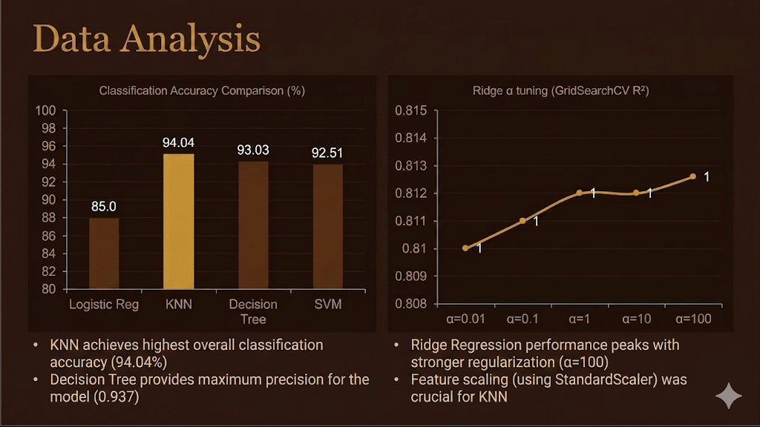
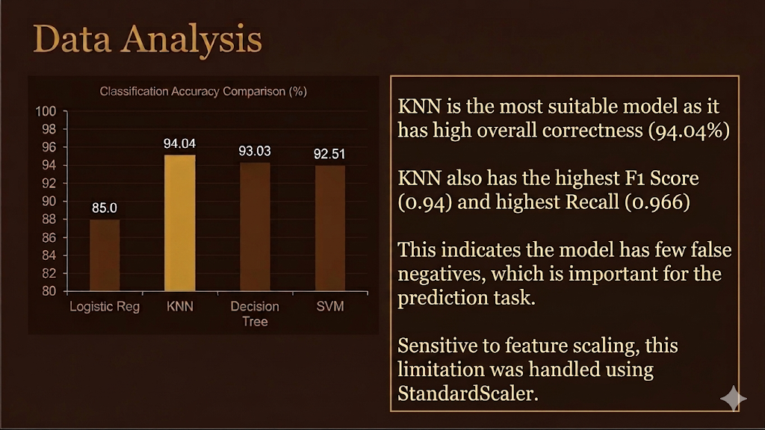
Data Analysis
SVM achieves highest classification accuracy (~94%) after hyperparameter tuning
Ridge α=100 (strong regularization) is the best regression model: R²=0.8126
All classifiers improve after GridSearchCV — raw defaults are suboptimal
Both models validated with 5-fold CV — results are generalisable, not overfit

Slide 9
Conclusion
Key Achievements
This project successfully demonstrates that life expectancy can be predicted and classified using WHO socioeconomic and health data.
REGRESSION: Ridge (α=10) achieved R²=0.8534, explaining 85.3% of variance across 193 countries.
CLASSIFICATION: KNN achieved the best accuracy classifying countries as high or low life expectancy.
KEY DRIVERS: Schooling, Income Composition, and Adult Mortality are most influential.
0.8534
~94%
Best R²
Ridge α=10
Best accuracy
KNN classifier
7
5 - fold
Total models
trained & tuned
Cross-validation
on all models
Future: XGBoost, Neural Networks

Slide 10
References
1. WHO Life Expectancy Dataset. Kaggle. https://www.kaggle.com/datasets/kumarajarshi/life-expectancy-who
2. Pedregosa, F. et al. (2011). Scikit-learn: Machine Learning in Python. JMLR, 12, 2825–2830.
3. Raschka, S., & Mirjalili, V. (2019). Python Machine Learning. Packt Publishing.
4. McKinney, W. (2010). Data Structures for Statistical Computing in Python. SciPy Conf., 51–56.
5. Hoerl, A.E., & Kennard, R.W. (1970). Ridge Regression. Technometrics, 12(1), 55–67.
6. Tibshirani, R. (1996). Regression Shrinkage & Selection via the Lasso. JRSS-B, 58(1), 267–288.
Life Expectancy Prediction · WHO Dataset · Regression & Classification Project

Slide 11
THANK YOU

