Slide 1

On-Board RFI detection
Paolo Renzi 1887793

Slide 2
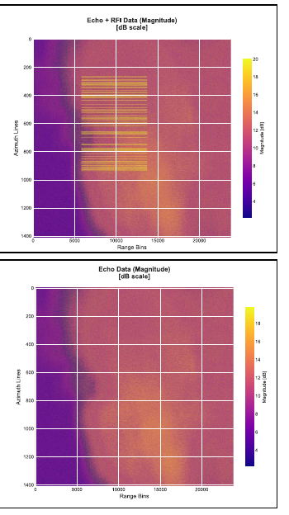
Background
Radio Frequency Interference (RFI)
Synthetic Aperture Radar data
RFI is signals in the same frequency used by the satellite
Overpowers the satellite sensors

Slide 3
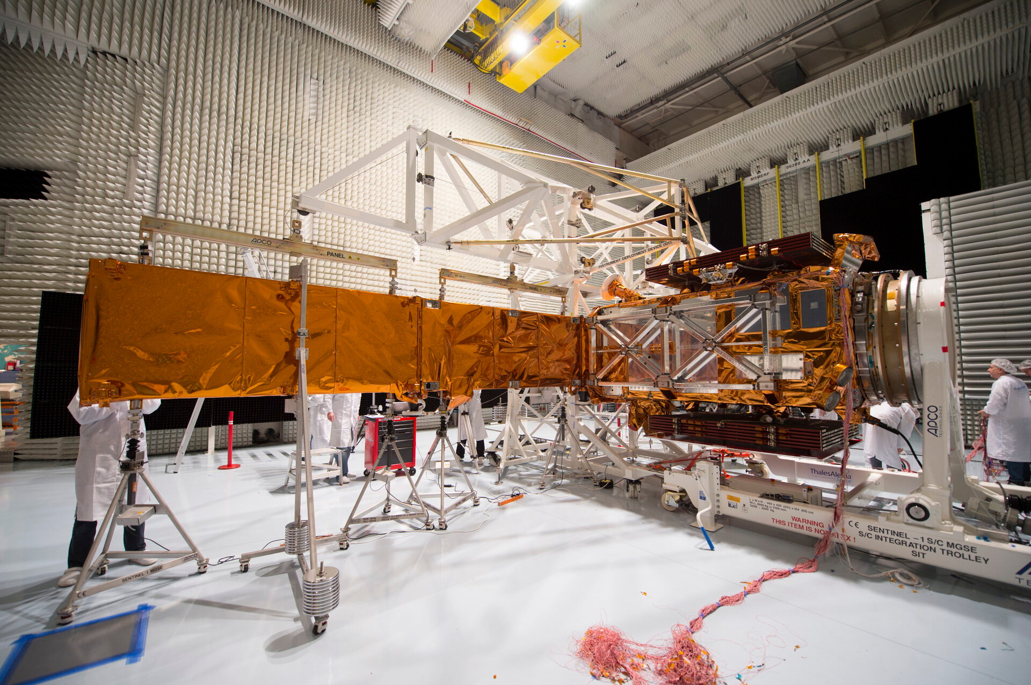
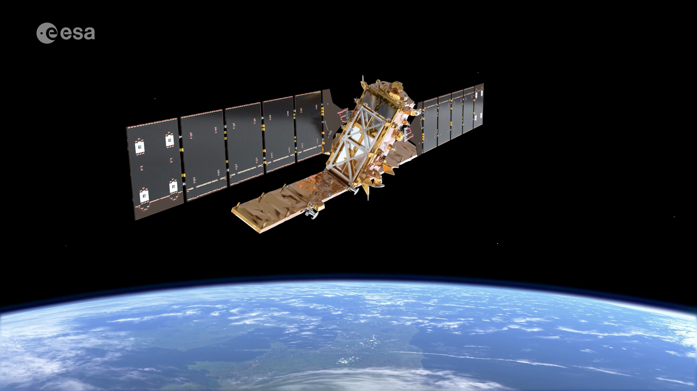
Motivations and limitations
Data is hard to find and no labeled data exists in those cases
Limited computational capabilities on-board
Less data sent to ground station if interferences are caught early
Notes:
perche risolviamo il problema e perchè così
(riduci i dati da mandare a terra)
energy based neural network

Slide 4
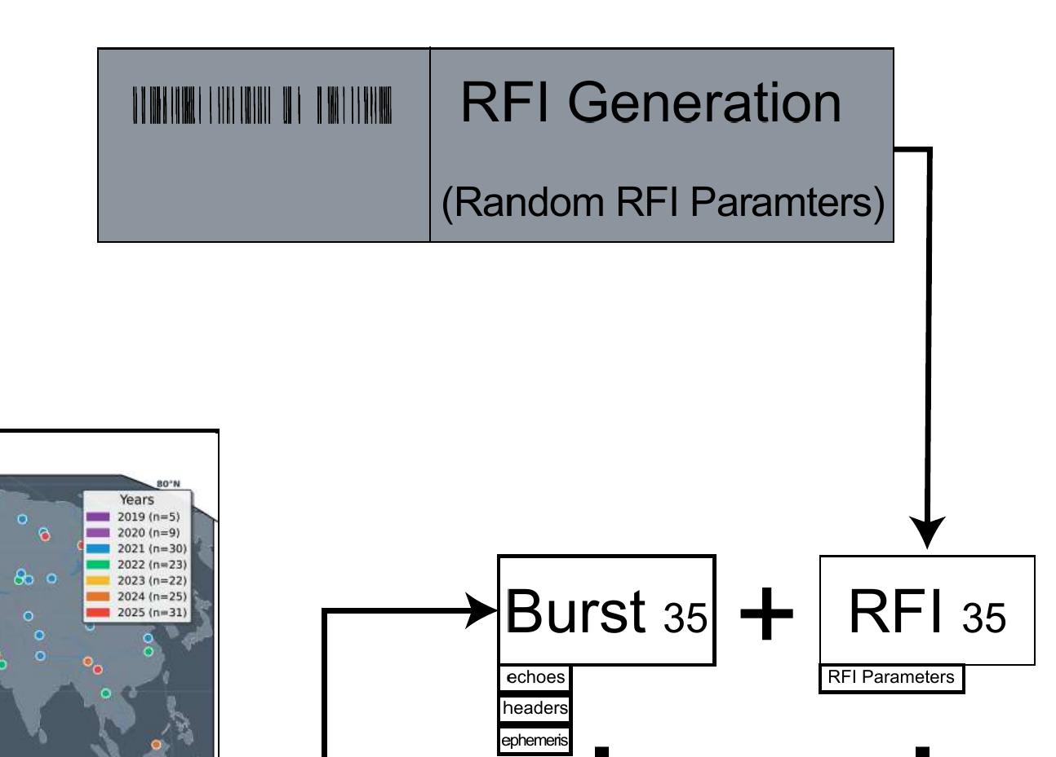
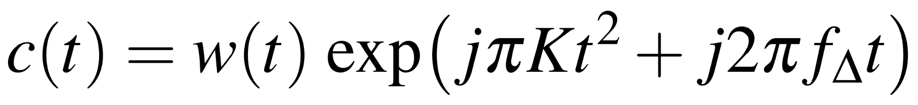
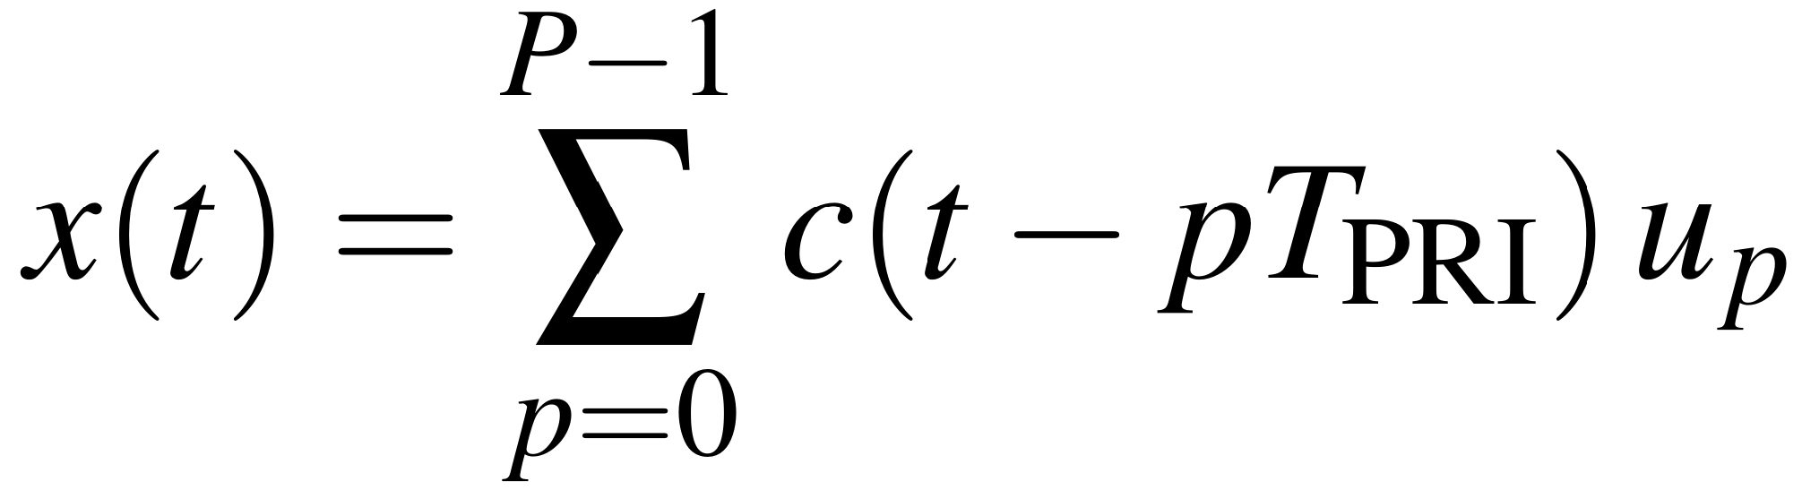
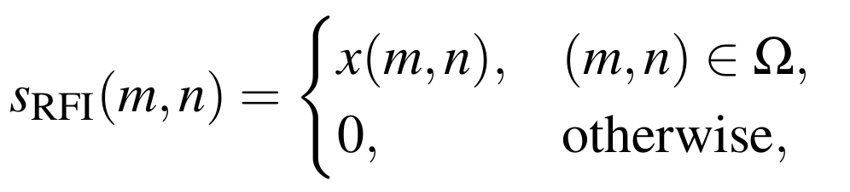
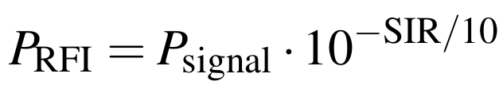
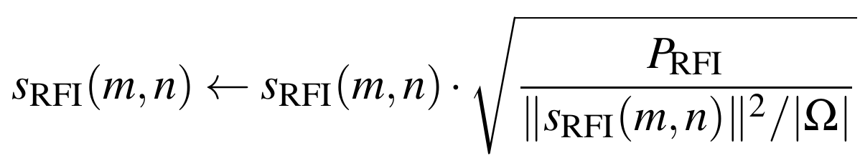
Dataset
RFInject[1]
L0 level data
Limited computational capabilities on-board
Less data sent to ground station
[1]Del Prete, R. (n.d.). RFInject: Injection of simulated radio frequency interference in Sentinel-1 Level-0 data. Φ-lab, European Space Agency (ESA); RMIT.

Slide 5
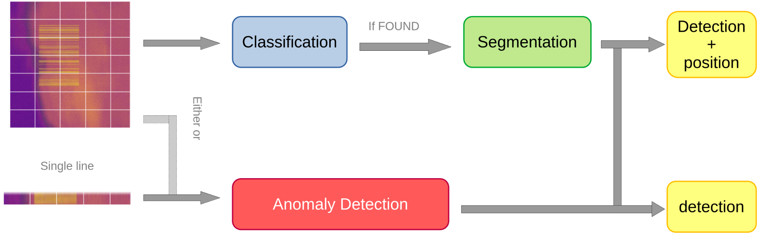
Possible approaches
CS branch
Anomaly branch
CS brach: first a classification step to see if the RFI is there then segmentation to find it
Anomaly branch: check for anomaly on the single line scale
Notes:
dividere le pipeline meglio
motivare le spike (ridurre il consumo) anche in background
spiegare meglio le motivazioni
confronto tra la poteza

Slide 6
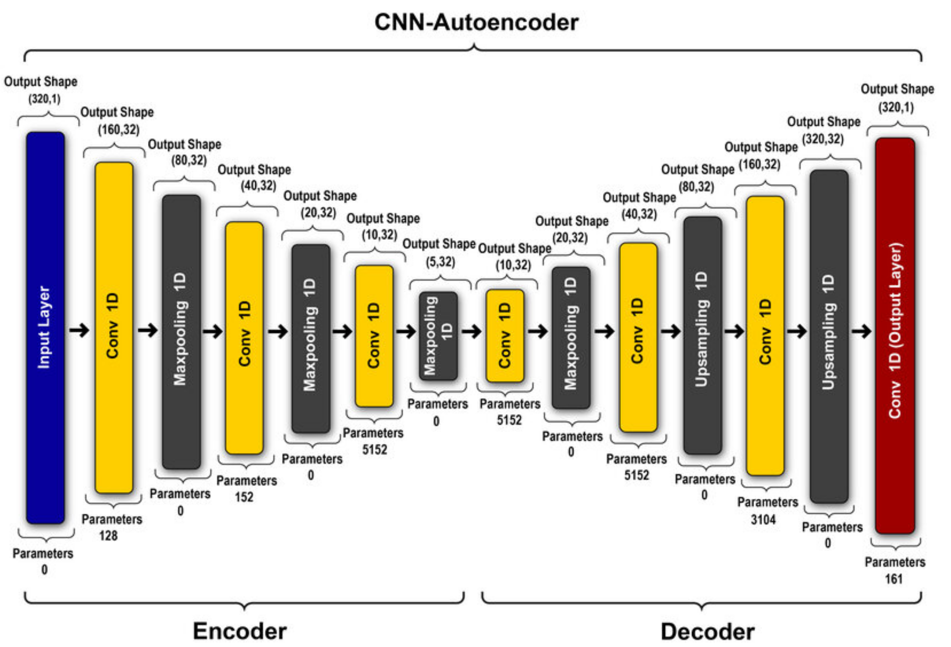
Anomaly brach
Proposed approach
Spiking CNN autoencoder
Still spiking network so low power usage
Convolutions to retain high performance

Slide 7
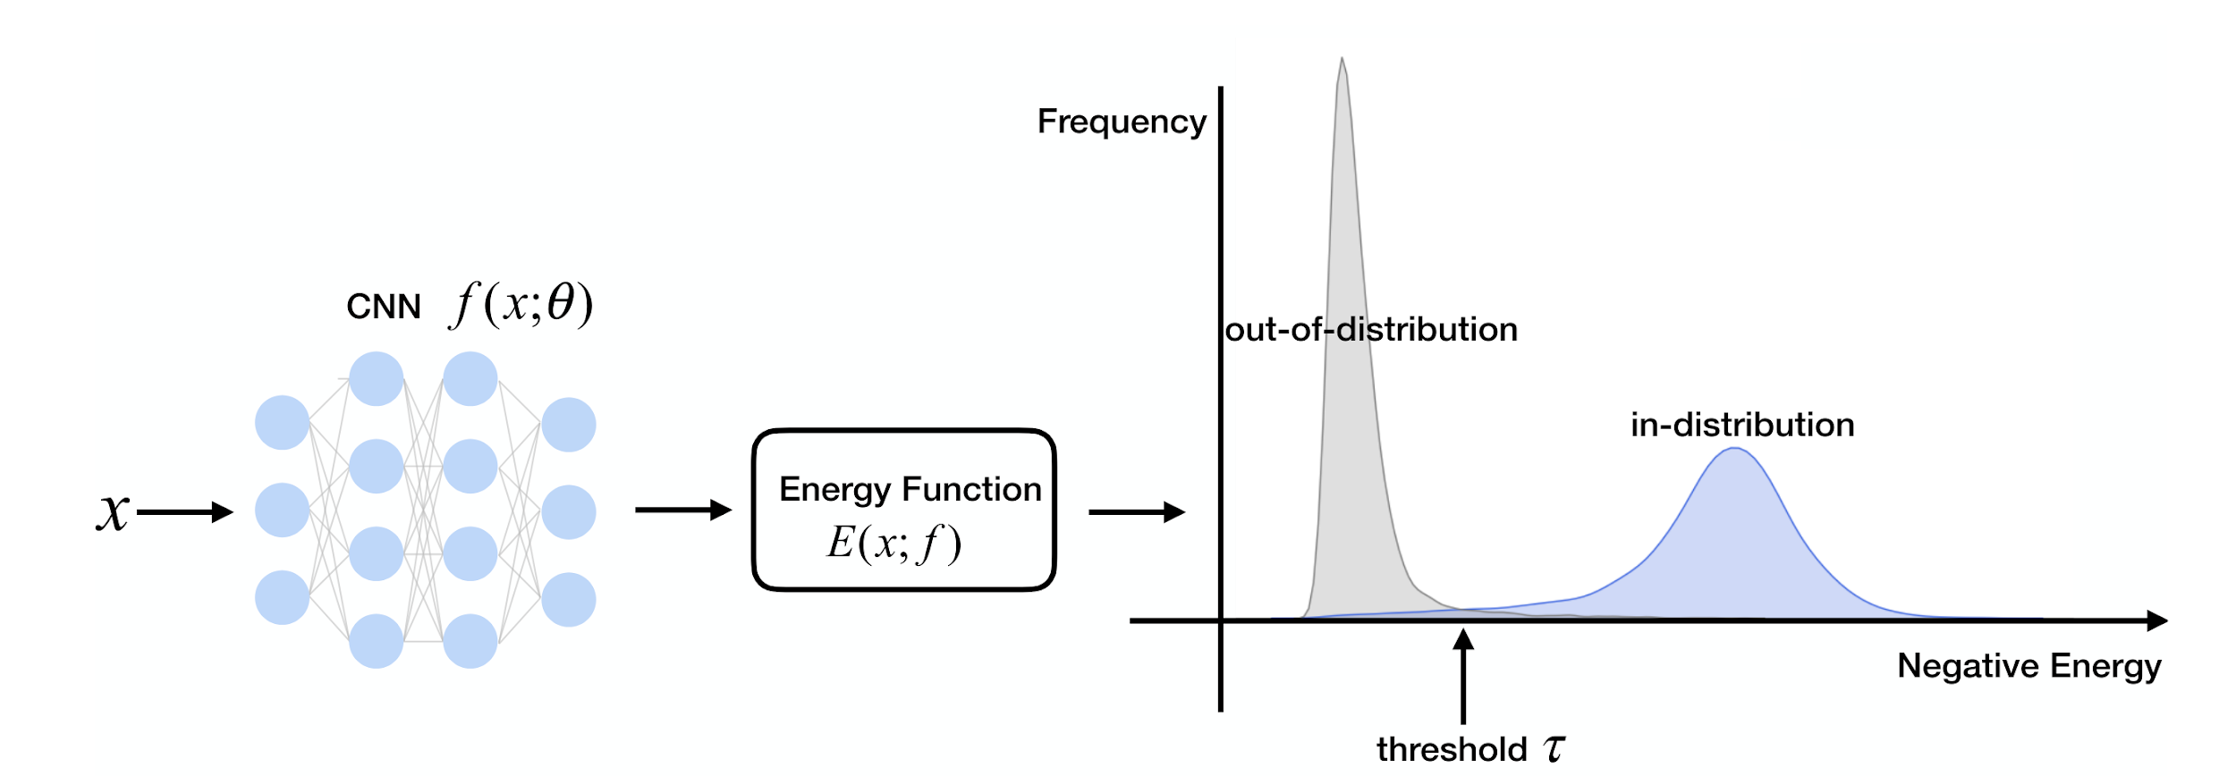
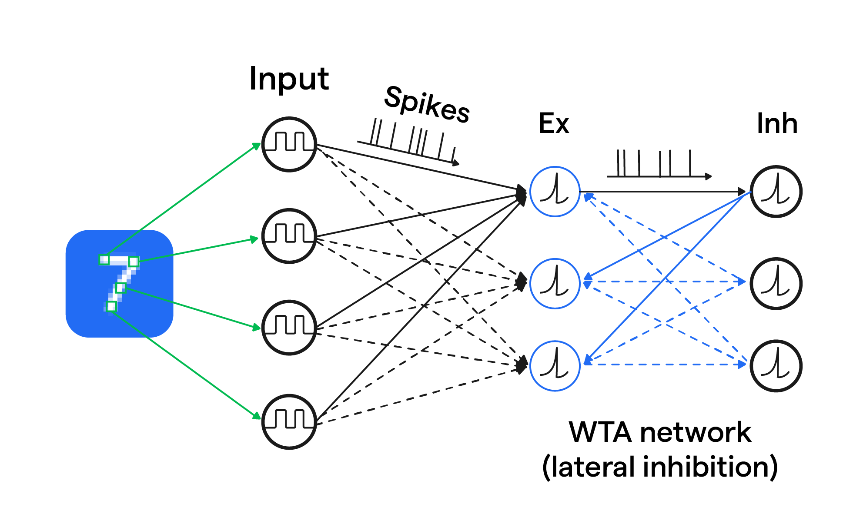
Anomaly detection
Energy approach on Energy Network
on standard networks:
Shift focus on OOD detection [4]
Can use previously trained models
Checks the difference in logits between in and out of distributions samples
on spiking network:
Energy baked into the network and hardware
Can use directly the summation of the spikes
[4]Liu, W., Wang, X., Owens, J. D., & Li, Y. (2021, April 26). Energy-based out-of-distribution detection. ArXiv https://arxiv.org/pdf/2010.03759

Slide 8
CS brach - Classification
Results linear models mnist and CIFAR10
Cases | NN energy −T⋅log(i=∑​exp(logit_i​​/T)) | SNN Firing rate (HZ)
1 | -5.40 | 4.20
1.1 | -3.70 | 5.01
1.2 | -3.75 | 4.95
2 | -3.88 | 4.99
case 1 ID, so on the same mnist dataset
case 1.1 OOD, with gaussian blur
case 1.2 OOD, with a RFI-like noise
case 2 OOD, with CIFAR10 images in grayscale and 28*28

Slide 9
Energy bridge hypothesis
Is NN energy [1] proportional to SNN firing rate?
Hypothesis tested on different networks
  FeedForward NN: 1 linear layer
  Convolutional NN: 1 convolutional layer + 1 linear layer
  Spike NN: 1 linear layer
  Convolutional Spike NN: 1 convolutional layer + 1 linear layer
In-distribution (ID) case: networks trained on MNIST dataset
Out-Of-Distribution (OOD) cases:
  MNIST test samples with gaussian blur
  MNIST test samples with RFI-like noise
  Grayscale CIFAR10 test samples
[1] Liu, W., Wang, X., Owens, J. D., & Li, Y. (2021, April 26). Energy-based out-of-distribution detection. ArXiv https://arxiv.org/pdf/2010.03759

Slide 10
Energy bridge hypothesis
Linear model results
Case | NN energy [1] | SNN Firing rate (HZ)
1 | -5.40 | 4.20
1.1 | -3.70 | 5.01
1.2 | -3.75 | 4.95
2 | -3.88 | 4.99
Case 1 - ID: MNIST test sample
Case 1.1 - OOD: MNIST test samples with gaussian blur
Case 1.2 - OOD: MNIST test samples with RFI-like noise
Case 2 - OOD: Grayscale CIFAR10 test samples
            Experimental results show an almost clear positive correlation between the NN energy and the firing rate of SNN

Slide 11
Energy bridge hypothesis
Convolutional models results
Cases | NN energy [1] | SNN Firing rate (HZ)
1 | -0.54 | 3.23
1.1 | 1.76 | 6.58
1.2 | 0.86 | 6.22
2 | 1.35 | 6.81
Case 1 - ID: MNIST test sample
Case 1.1 - OOD: MNIST test samples with gaussian blur
Case 1.2 - OOD: MNIST test samples with RFI-like noise
Case 2 - OOD: Grayscale CIFAR10 test samples
Convolutional architectures seem to have a more clear correlation compared to fully-connected (linear) architectures in distinguishing ID data from OOD data

Slide 12
Energy bridge hypothesis
Results linear models EuroSAT
Cases | NN energy −T⋅log(i=∑​exp(logit_i​​/T)) | SNN Firing rate (HZ)
1 | -3.36 | 1.69
1.1 | -3.76 | 1.55
1.2 | -3.37 | 1.58
Case 1 - ID: EuroSAT test sample
Case 1.1 - OOD: EuroSAT test samples with gaussian blur
Case 1.2 - OOD: EuroSAT test samples with RFI-like noise
linear models don’t have enough performance on the base task to distinguish between ID and OOD on EuroSAT

Slide 13
Energy bridge hypothesis
Results convolutional models EuroSAT
Cases | NN energy −T⋅log(i=∑​exp(logit_i​​/T)) | SNN Firing rate (HZ)
1 | -2.40 | 2.25
1.1 | -2.37 | 3.29
1.2 | -2.41 | 3.34
Case 1 - ID: EuroSAT test sample
Case 1.1 - OOD: EuroSAT test samples with gaussian blur
Case 1.2 - OOD: EuroSAT test samples with RFI-like noise
this simple convolutional models manage to show a small difference even on EuroSAT, especially the SNN case, so the firing rate look like a better indicator in this case

Slide 14
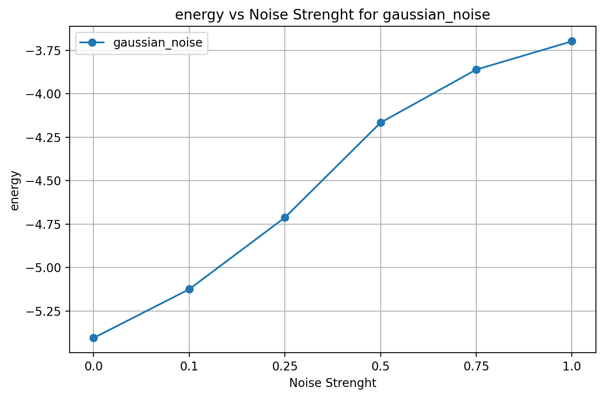
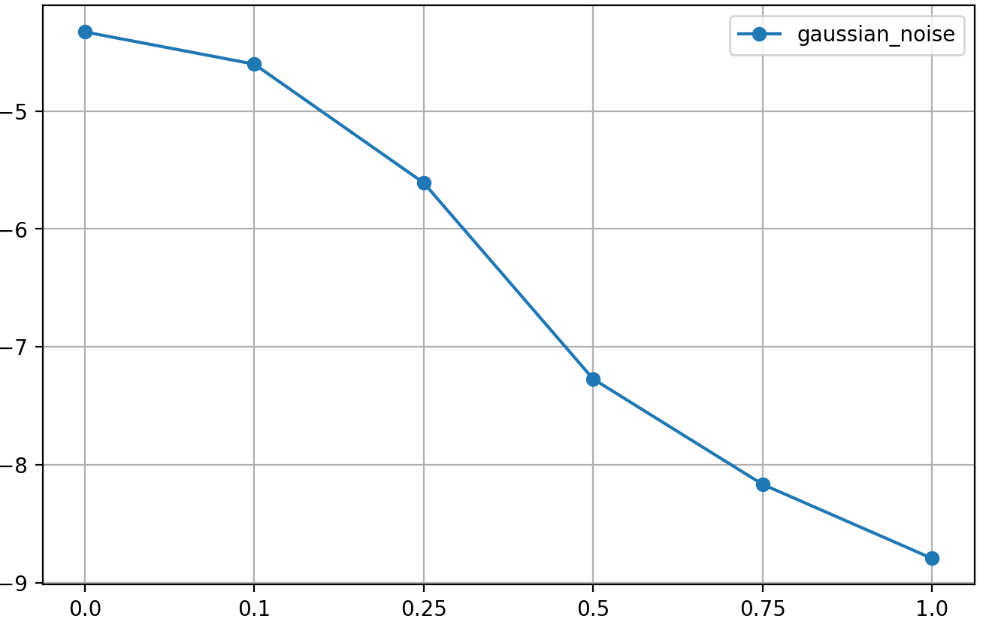
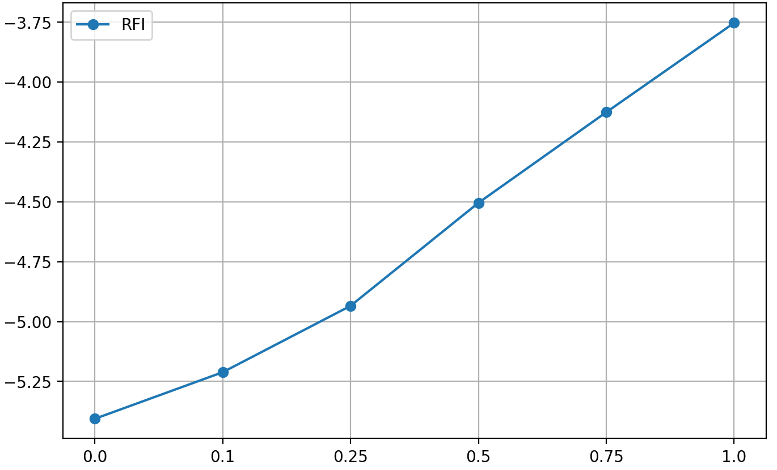
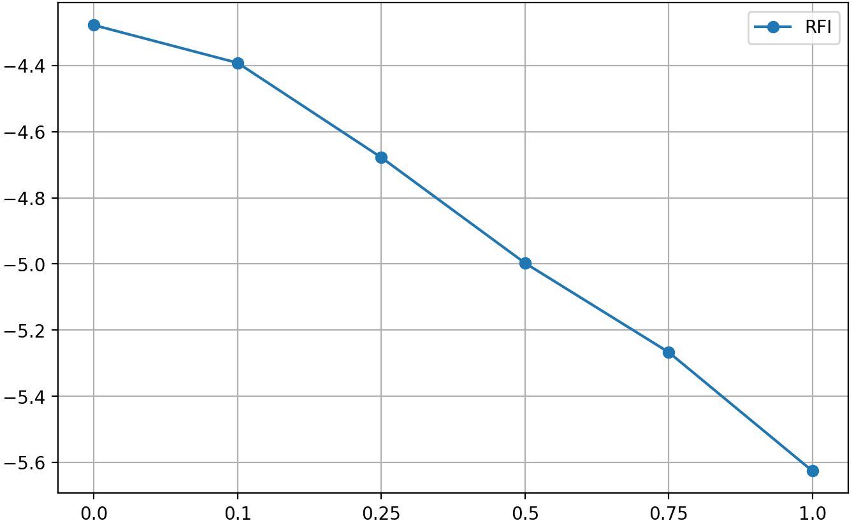
Energy bridge hypothesis
Results linear models
mnist
EuroSAT
Noise intensity(Gaussian)
Noise intensity(Gaussian)
Noise intensity(RFI)
Noise intensity(RFI)
Notes:
staccare titolettto matplot lib magari con “tabella”

Slide 15
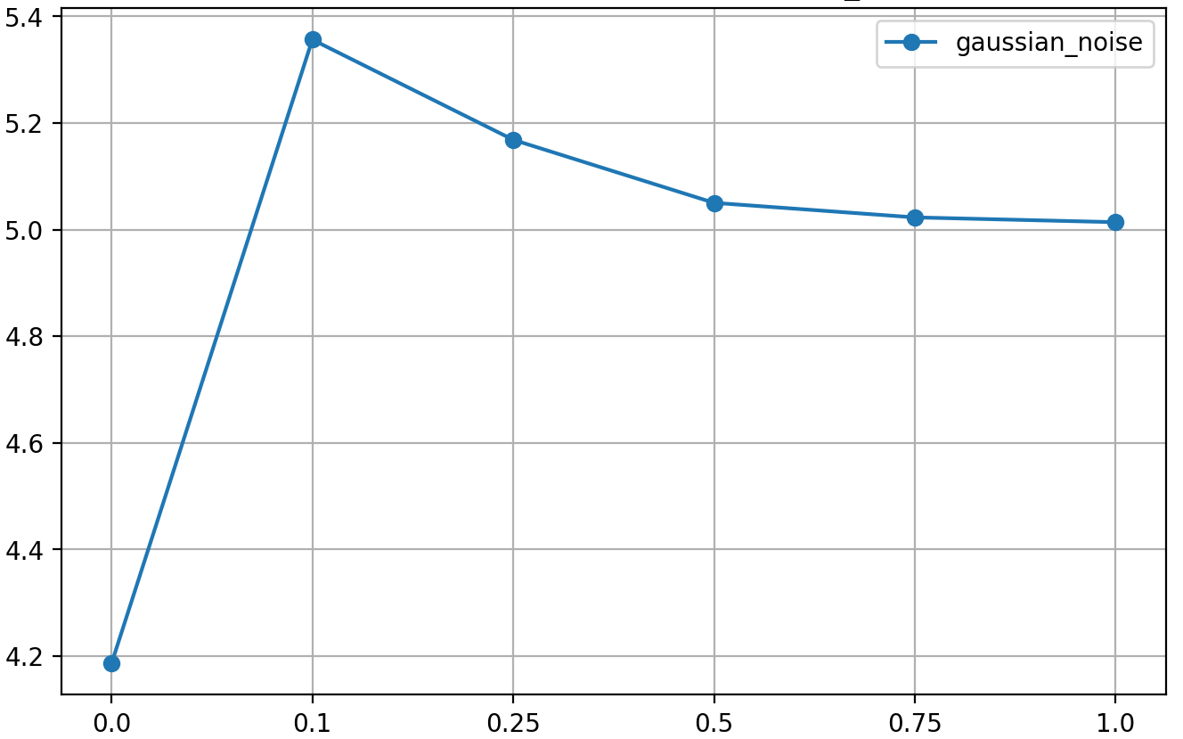
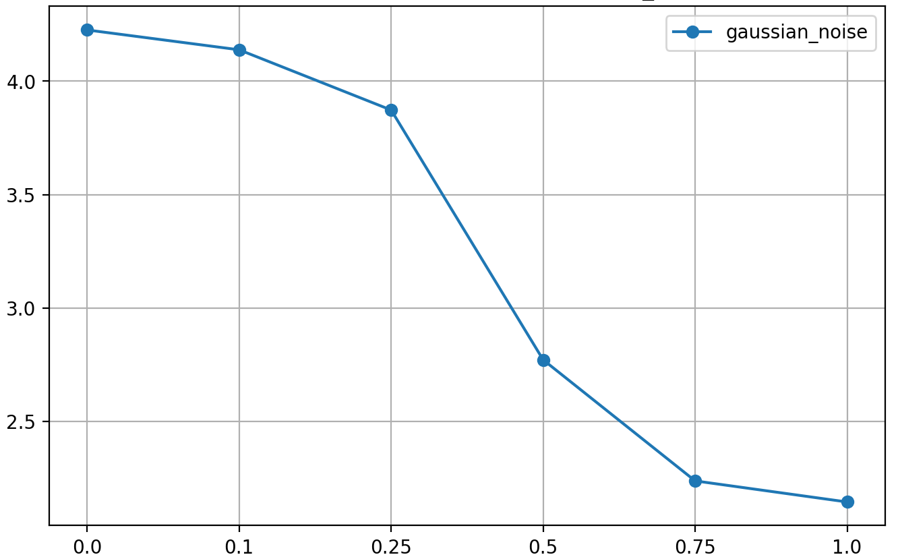
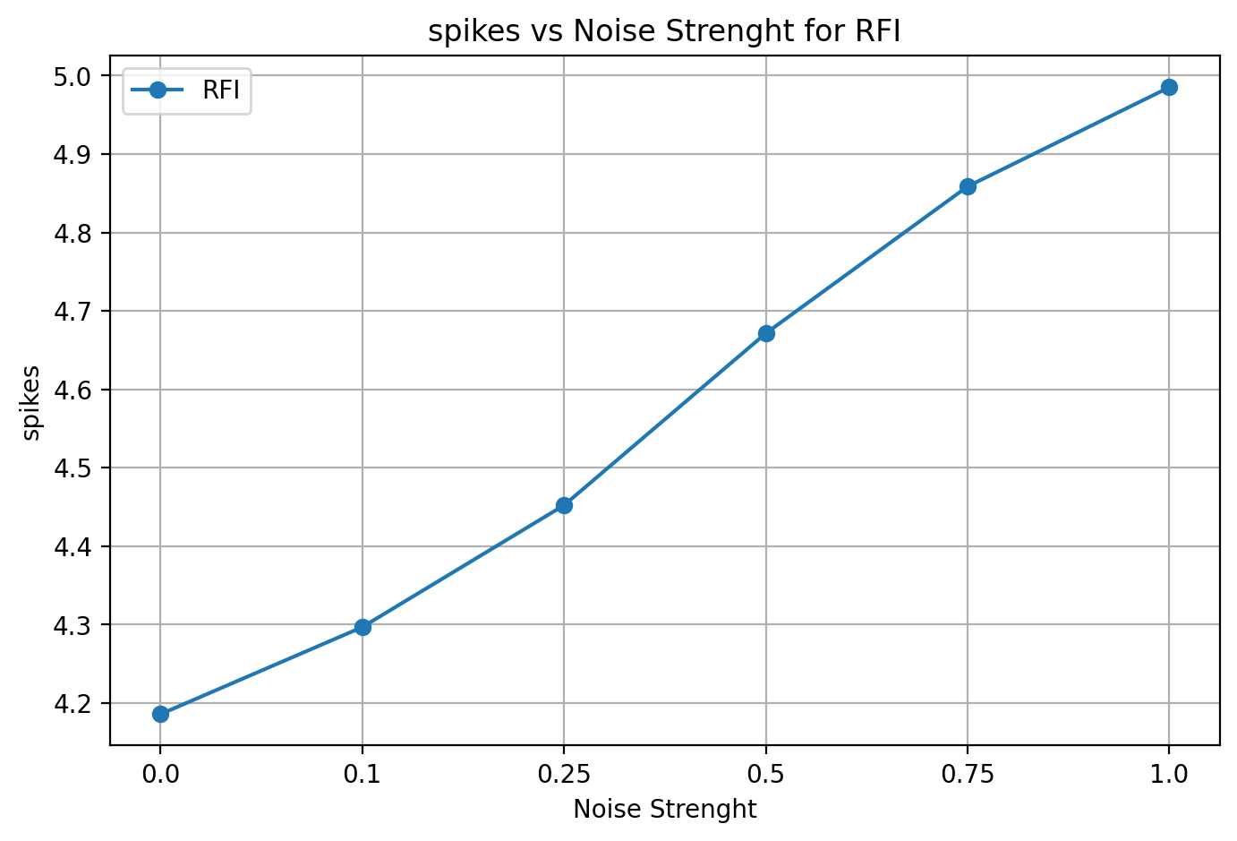
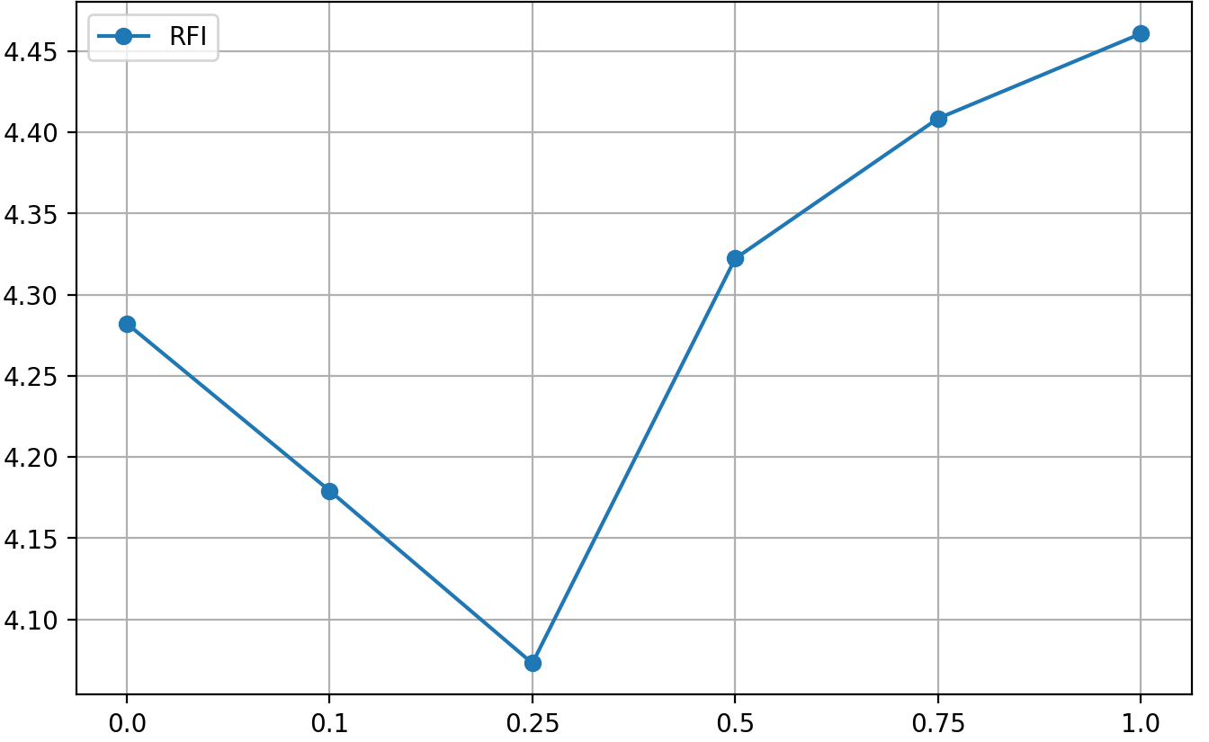
Energy bridge hypothesis
Results spike linear models
mnist
EuroSAT
Noise intensity(Gaussian)
Noise intensity(Gaussian)
Noise intensity(RFI)
Noise intensity(RFI)

Slide 16
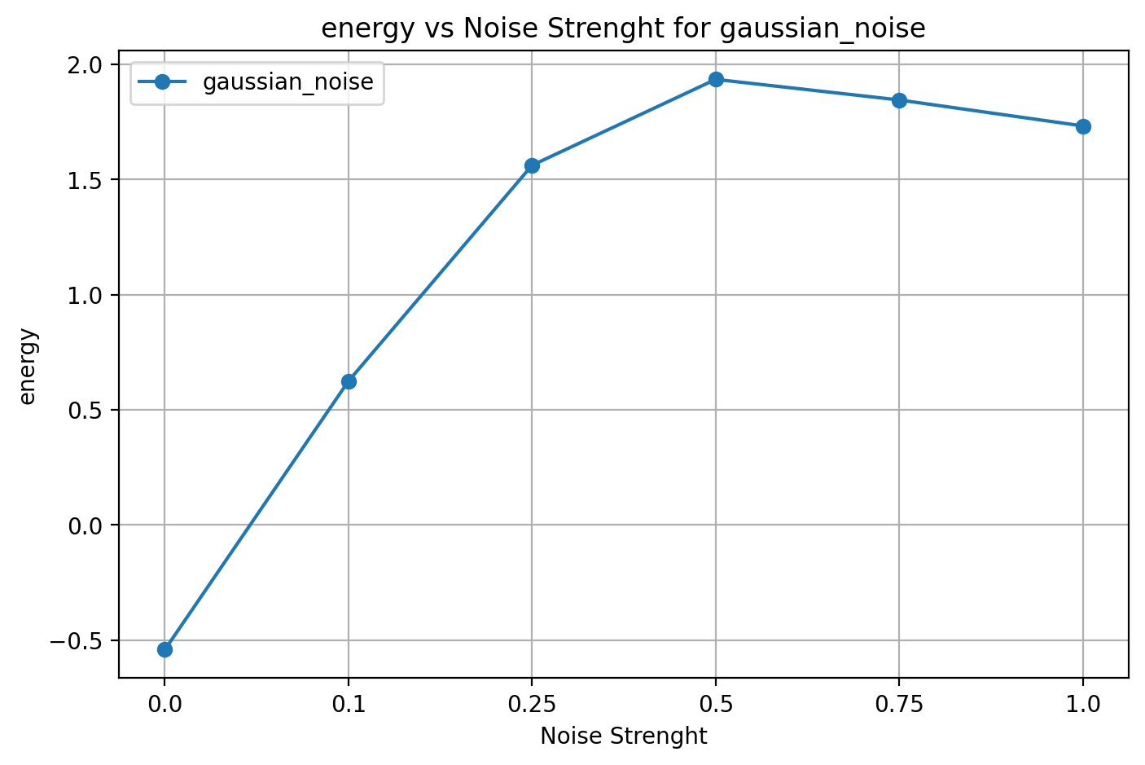
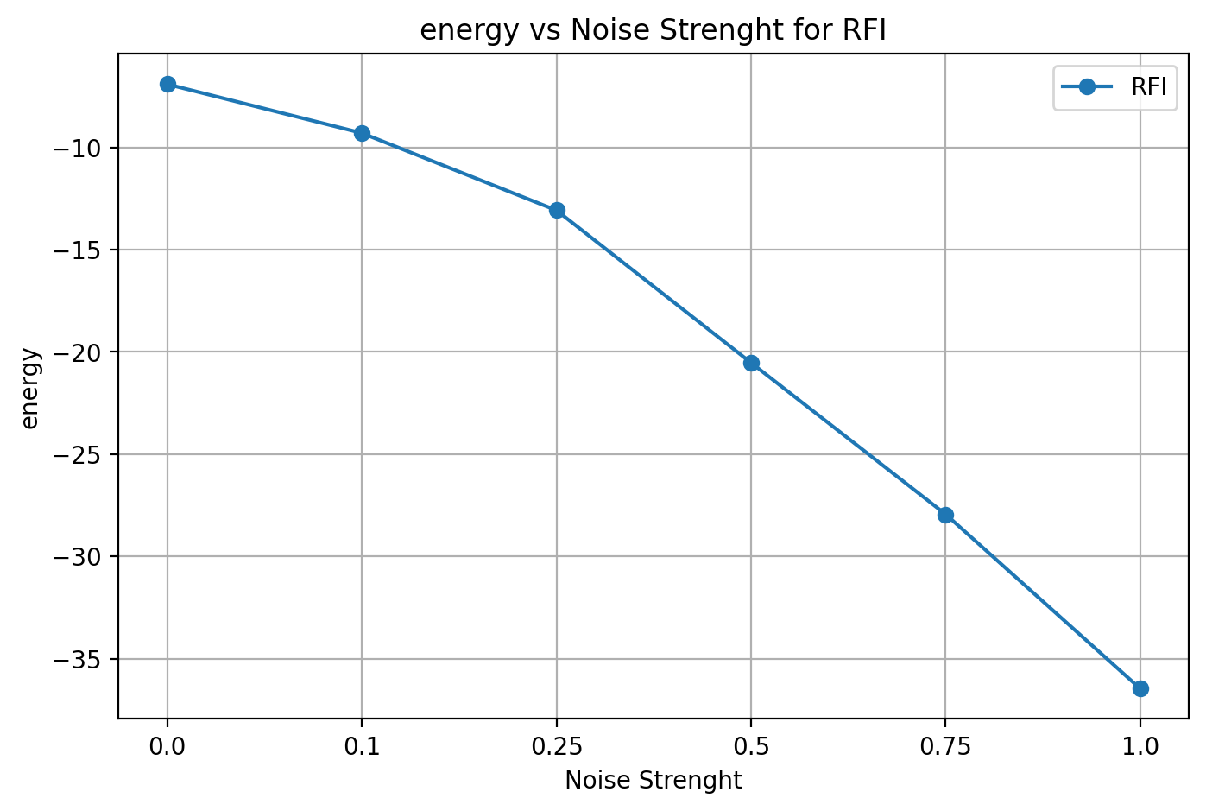
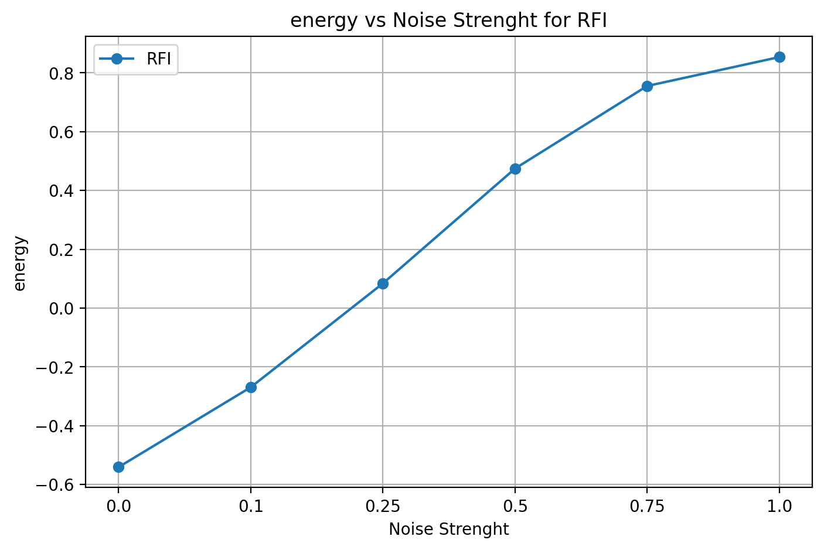
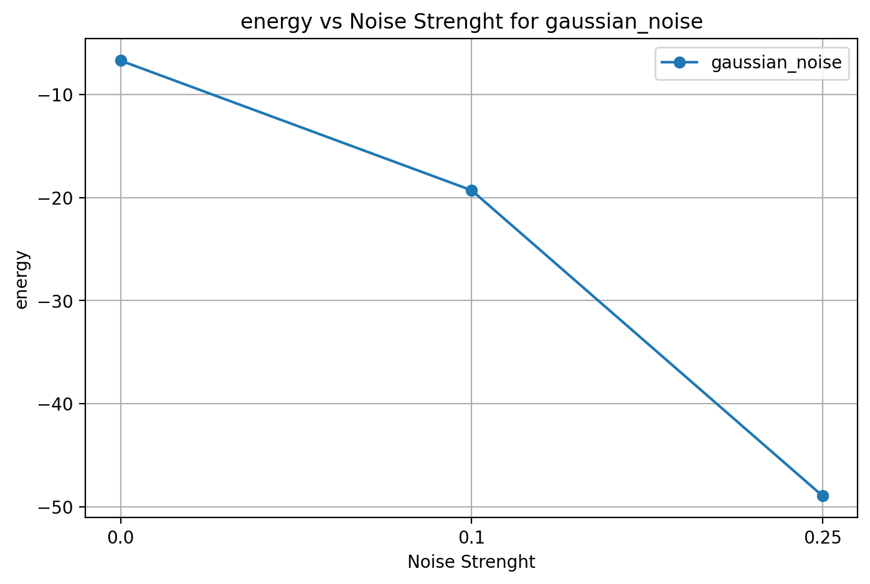
Energy bridge hypothesis
Results standard convolutional models
mnist
EuroSAT
Noise intensity(Gaussian)
Noise intensity(Gaussian)
Noise intensity(RFI)
Noise intensity(RFI)

Slide 17
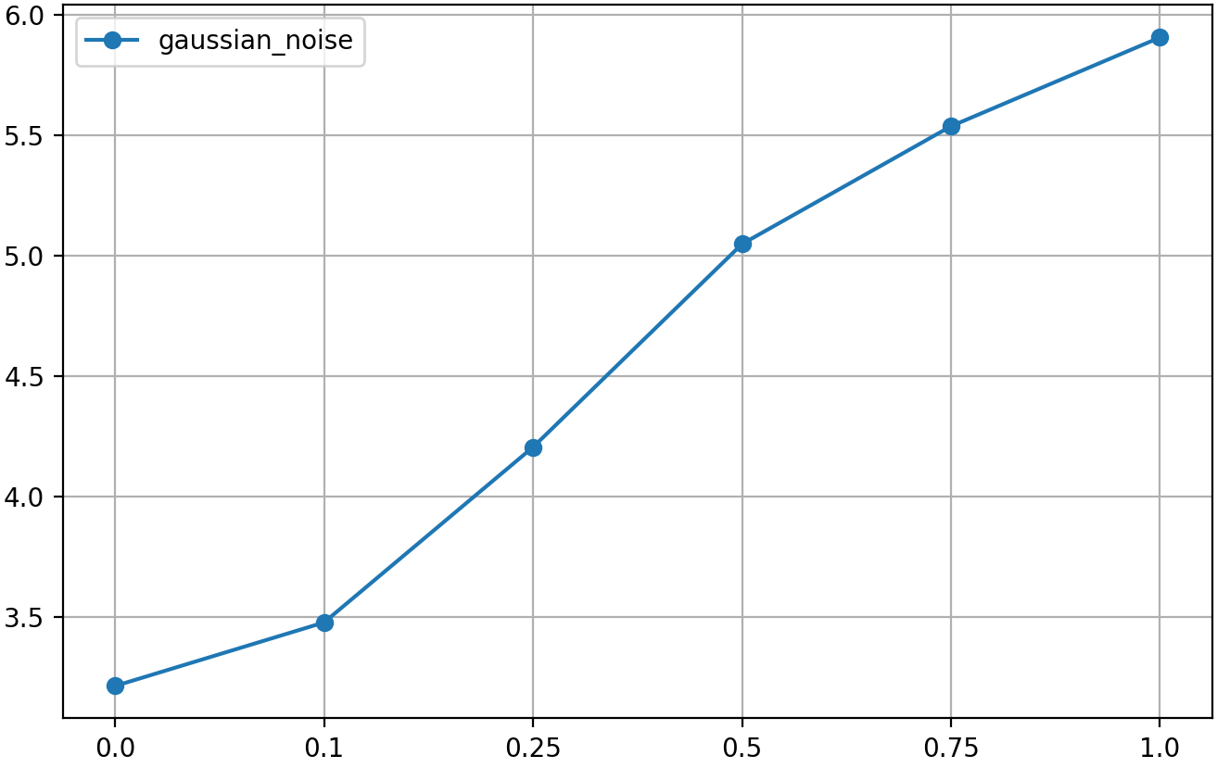
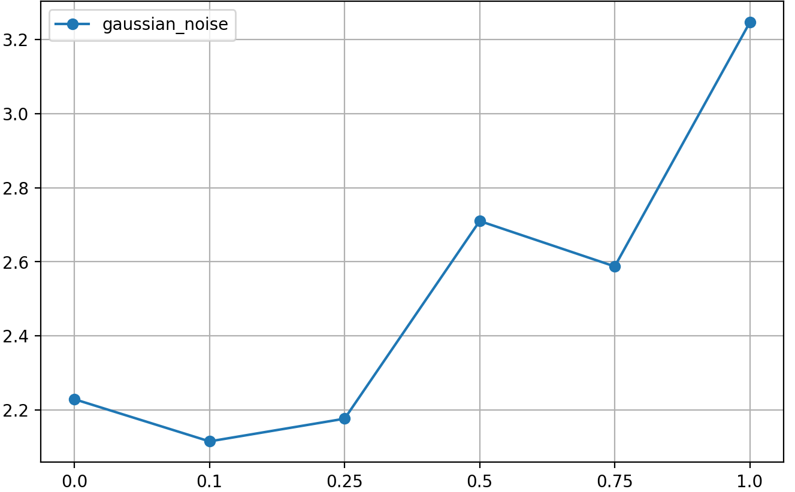
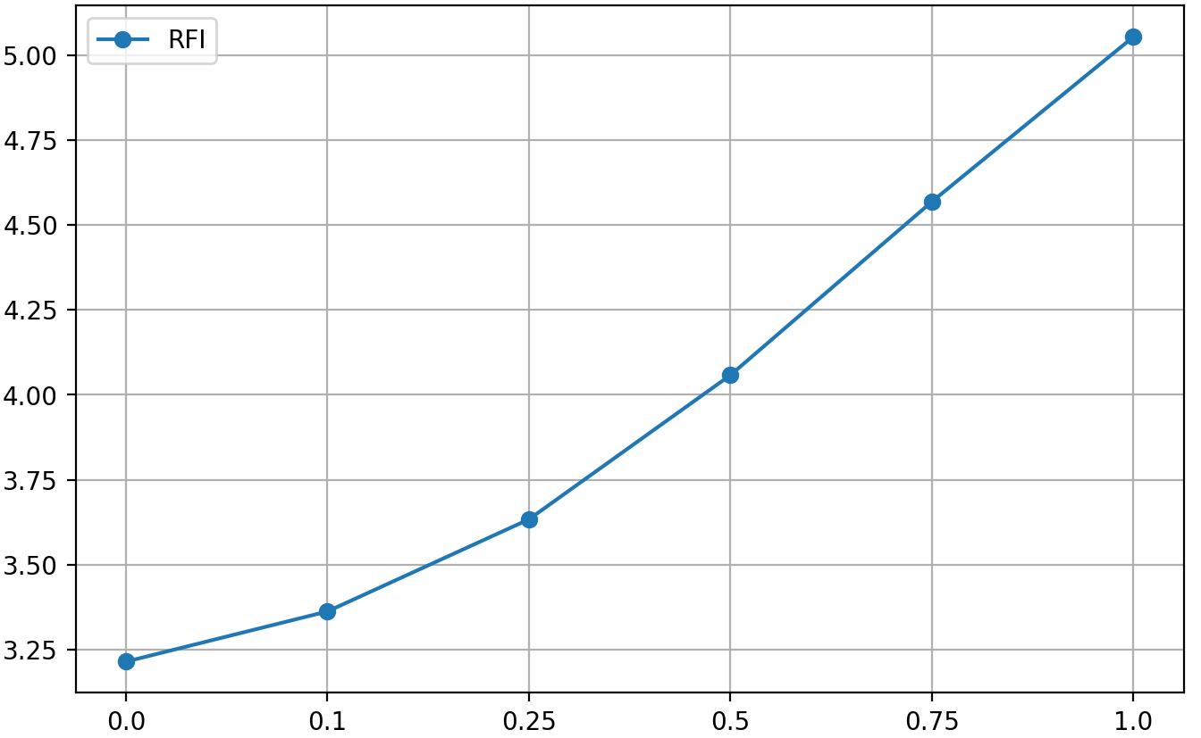
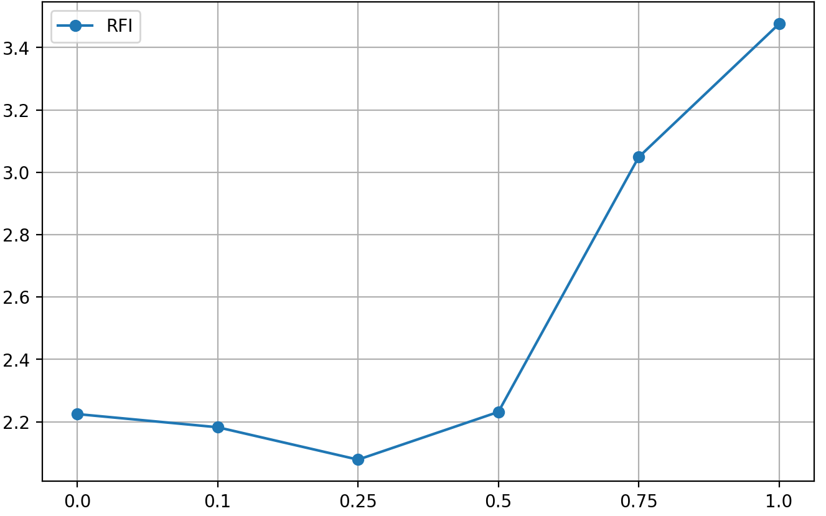
Energy bridge hypothesis
Results spike convolutional models
mnist
EuroSAT
Noise intensity(Gaussian)
Noise intensity(Gaussian)
Noise intensity(RFI)
Noise intensity(RFI)

Slide 18
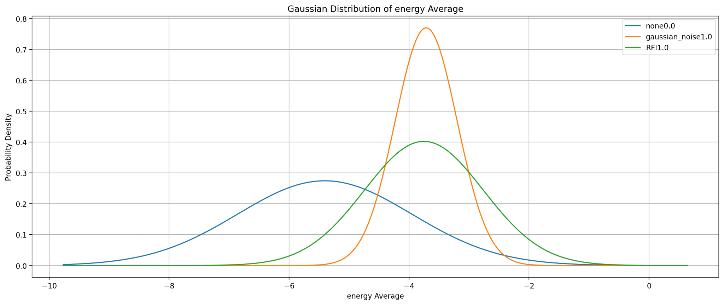
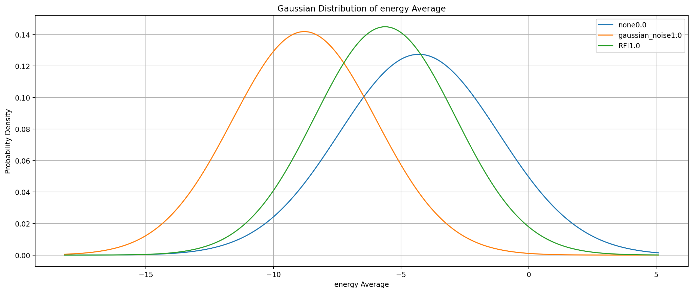
Energy bridge hypothesis
Results linear models
mnist
EuroSAT
Notes:
staccare titolettto matplot lib magari con “tabella”

Slide 19
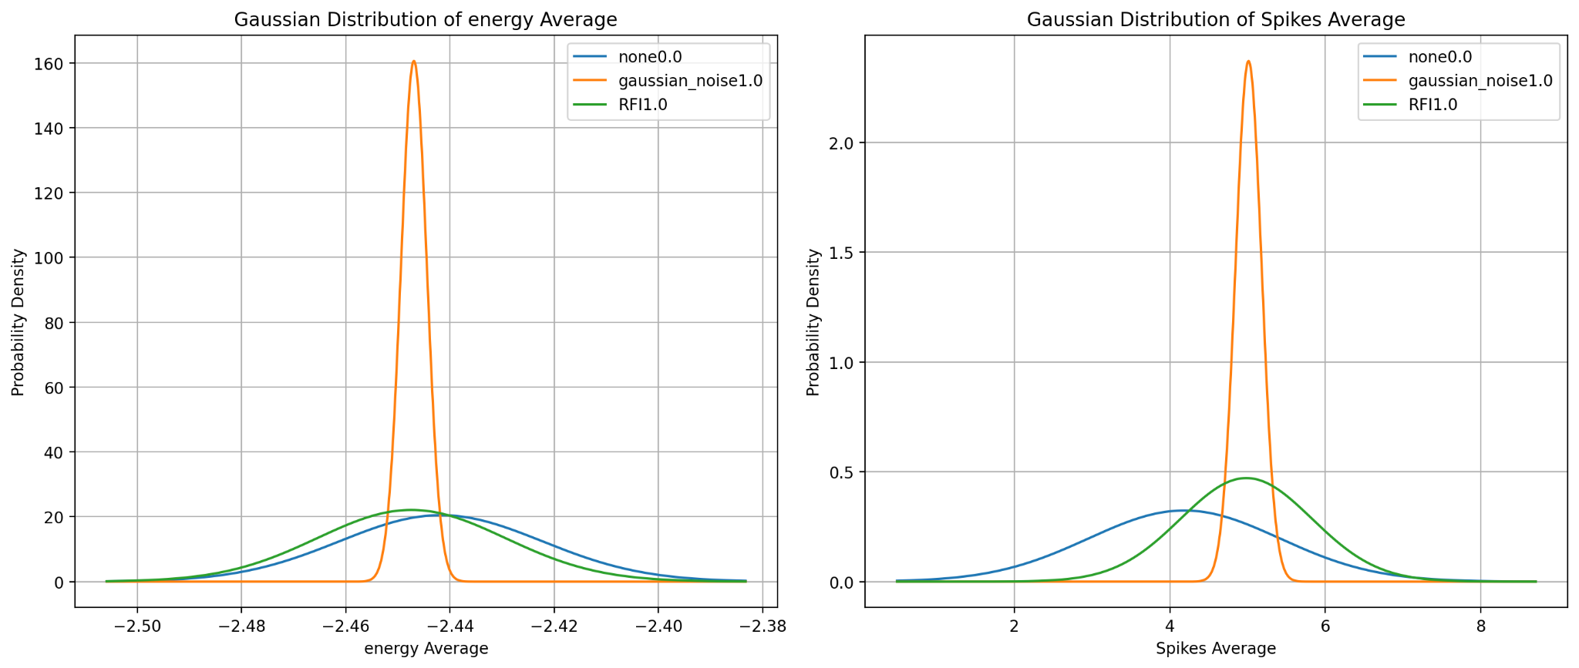
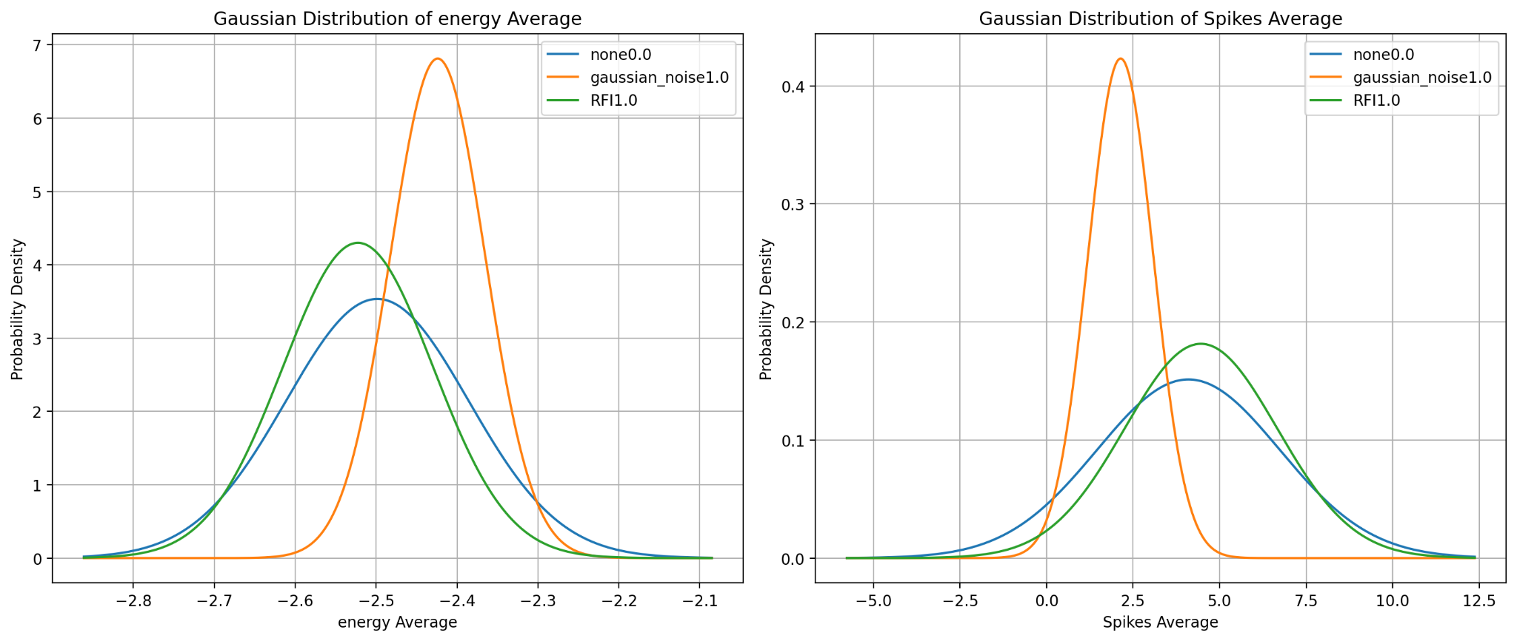
Energy bridge hypothesis
Results spike linear models
mnist
EuroSAT

Slide 20
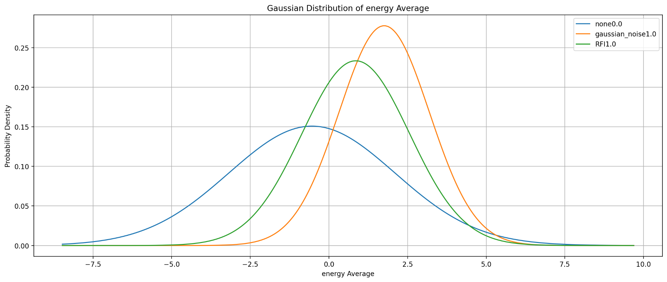
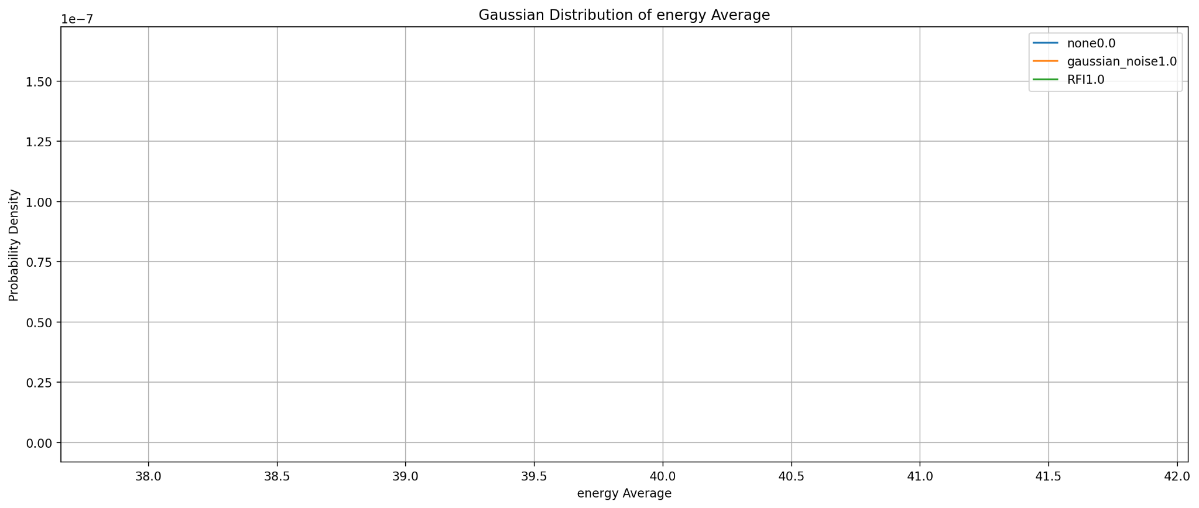
Energy bridge hypothesis
Results standard convolutional models
mnist
EuroSAT

Slide 21
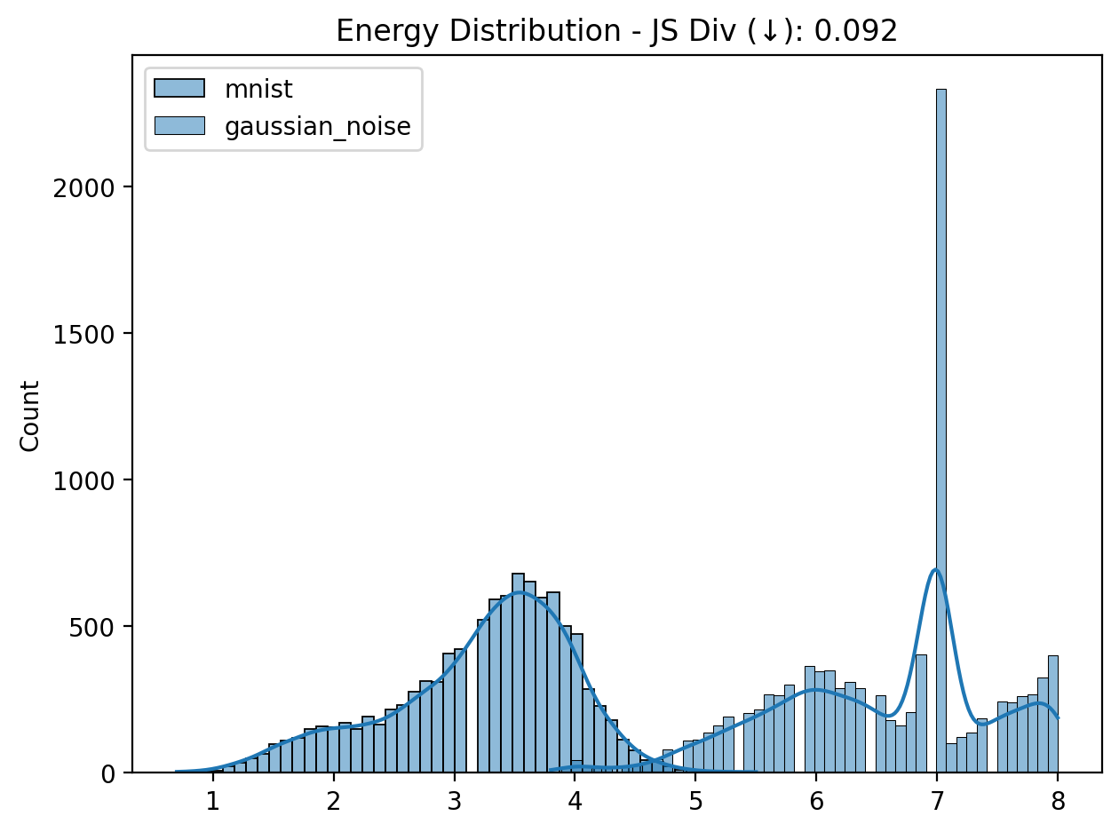
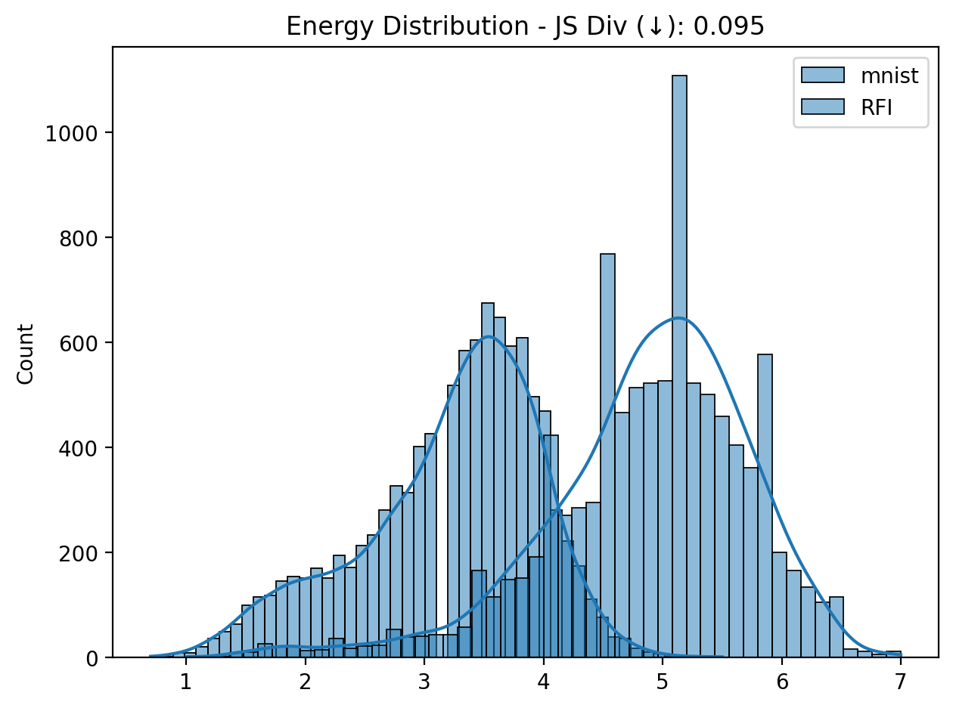
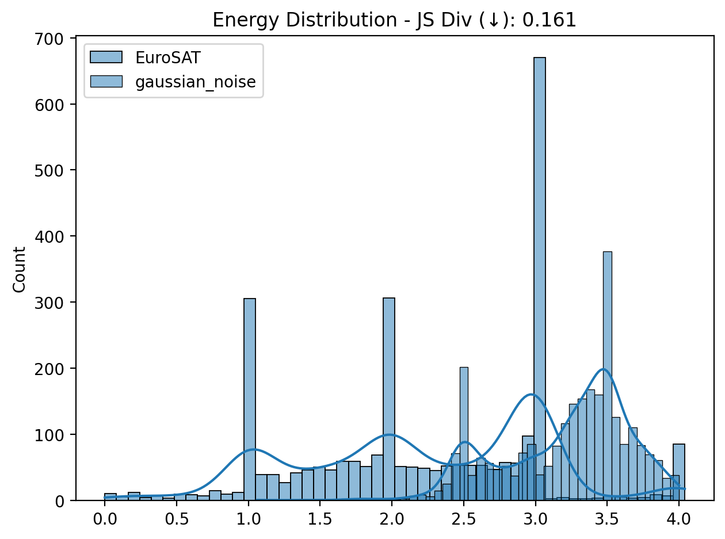
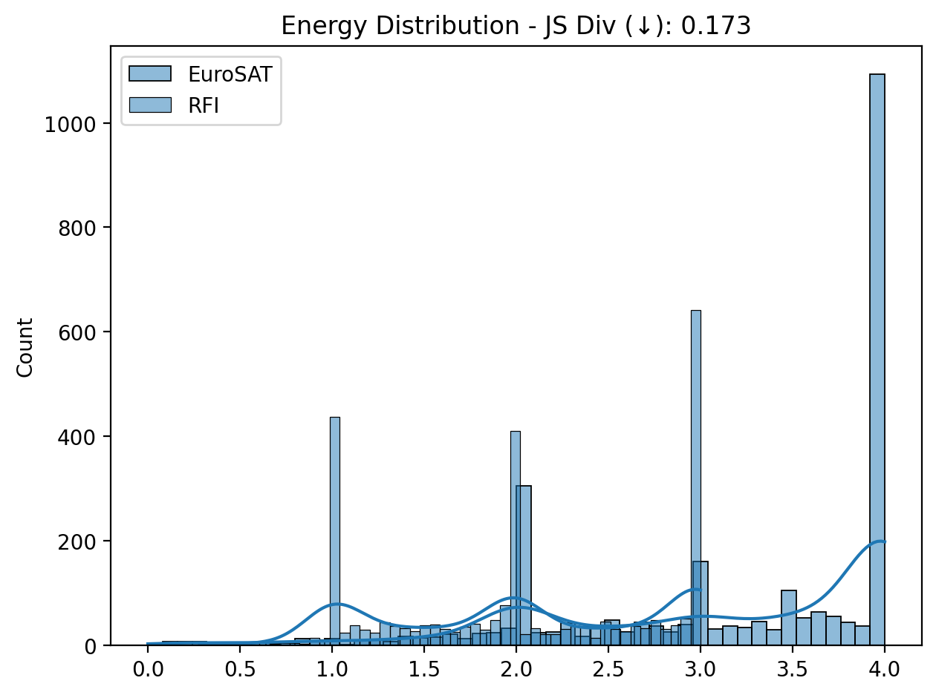
Energy bridge hypothesis
Results spike convolutional models
mnist
EuroSAT

Slide 22
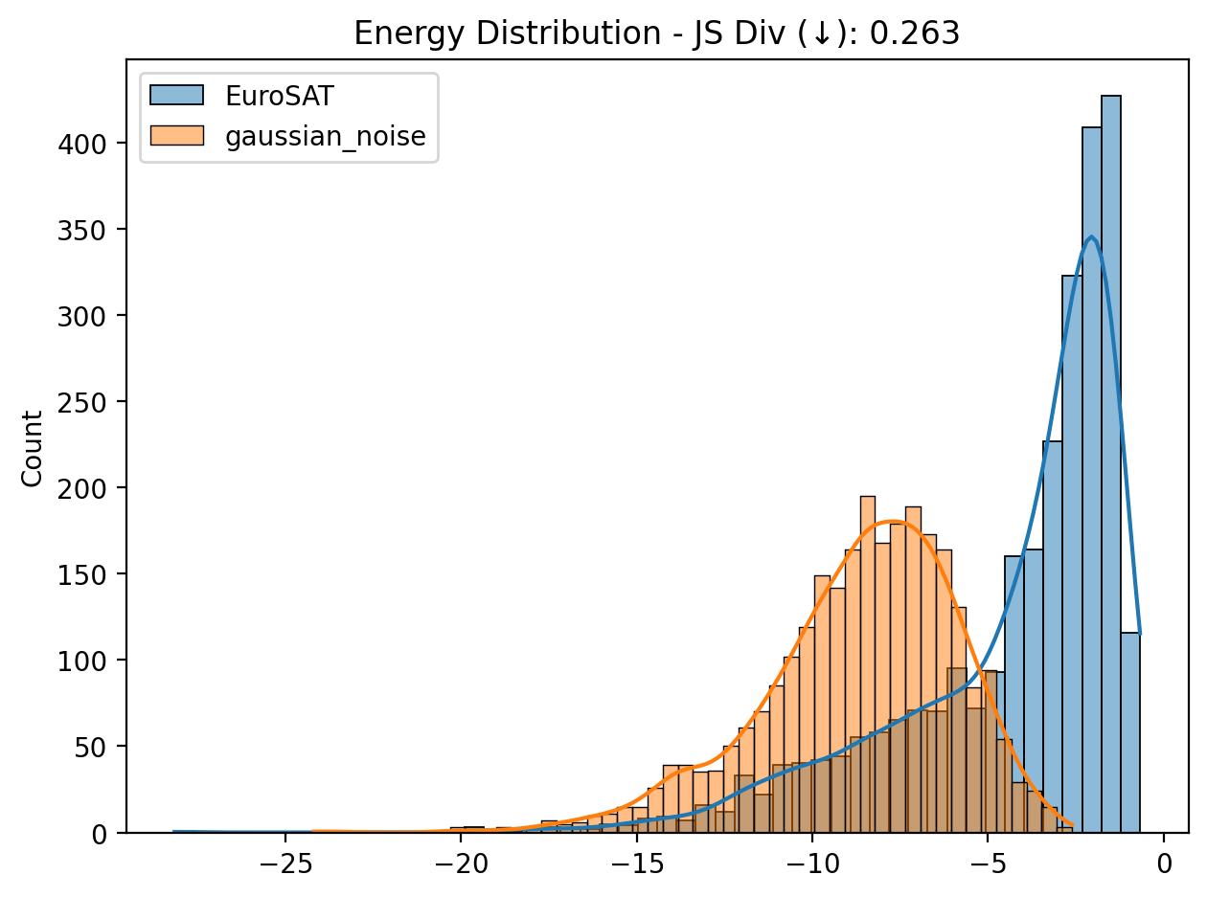
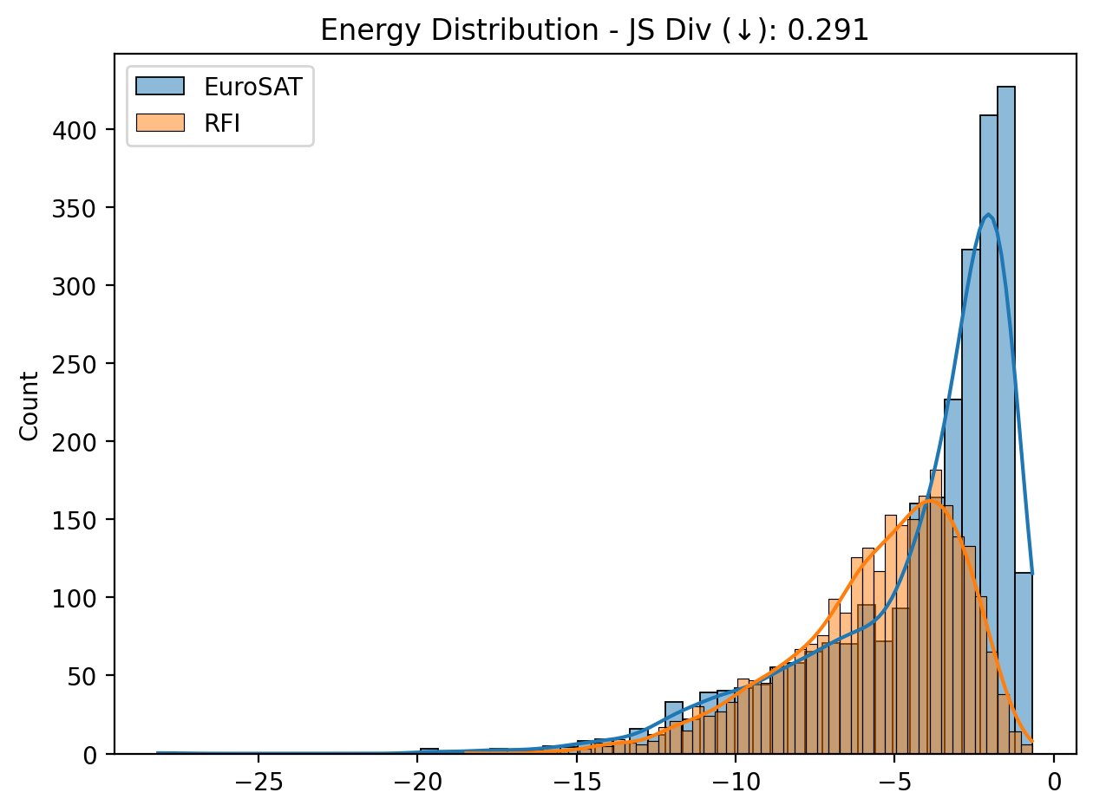
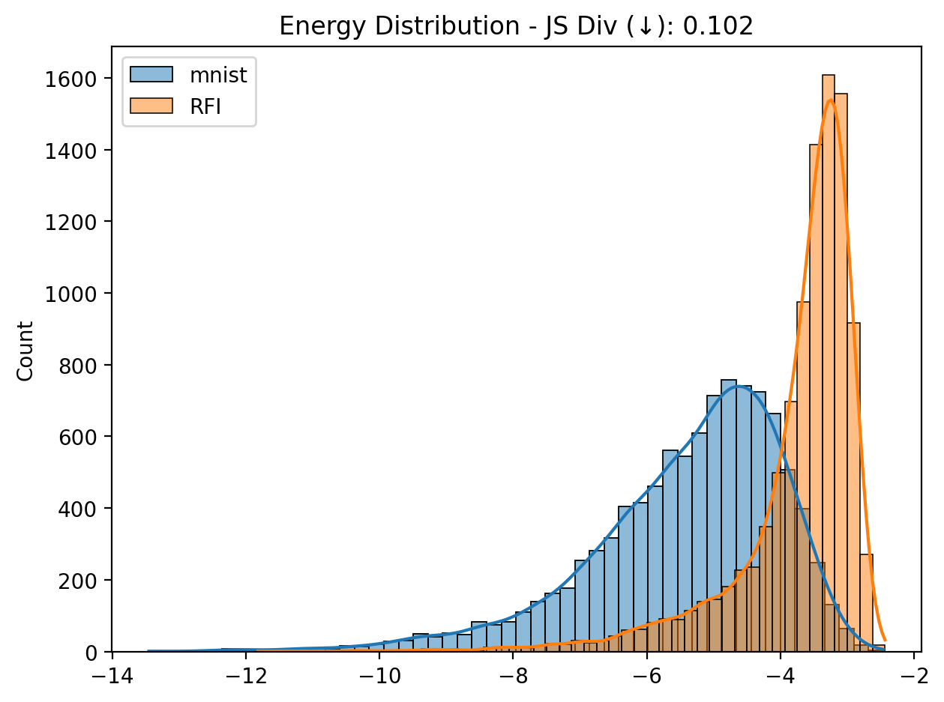
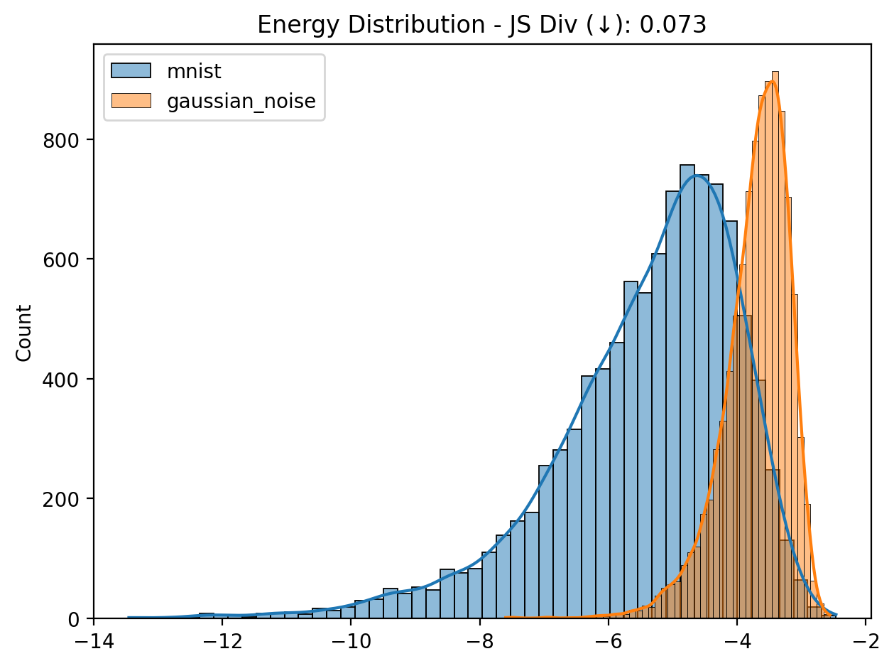
Energy bridge hypothesis
Results linear models
mnist
EuroSAT
Notes:
staccare titolettto matplot lib magari con “tabella”

Slide 23
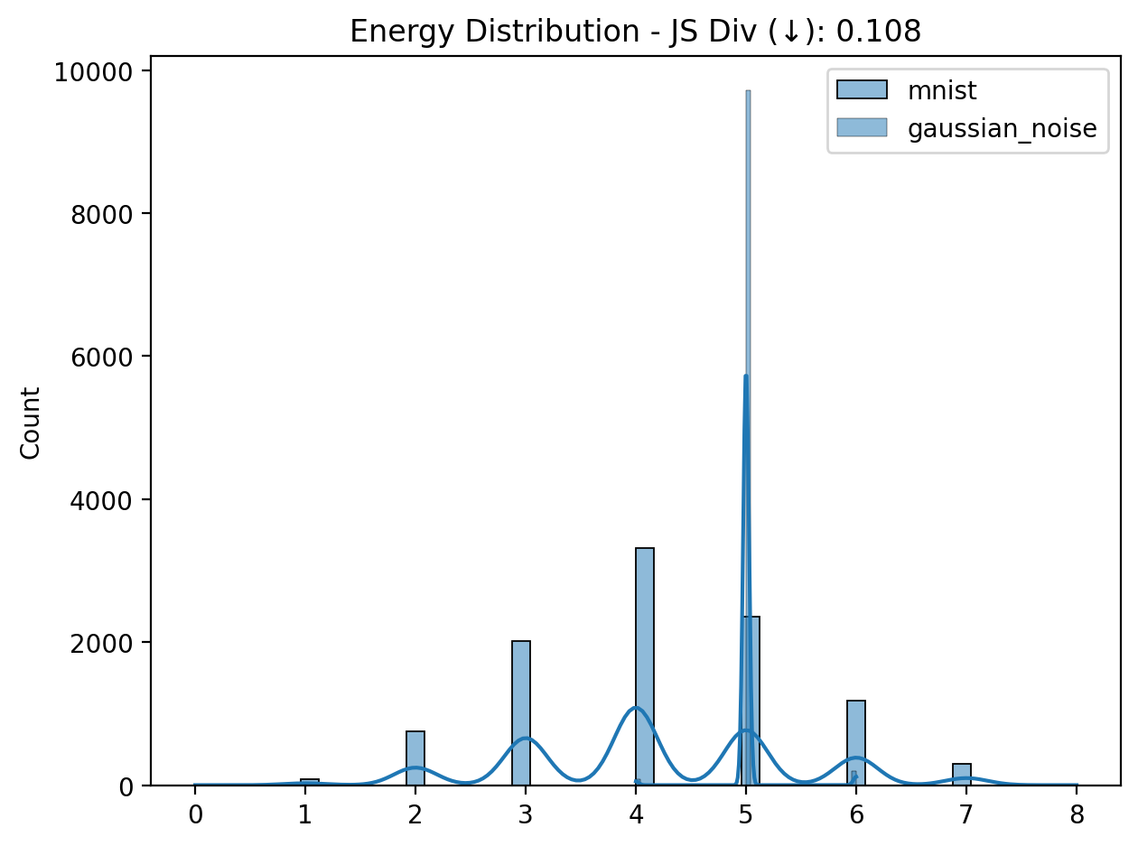
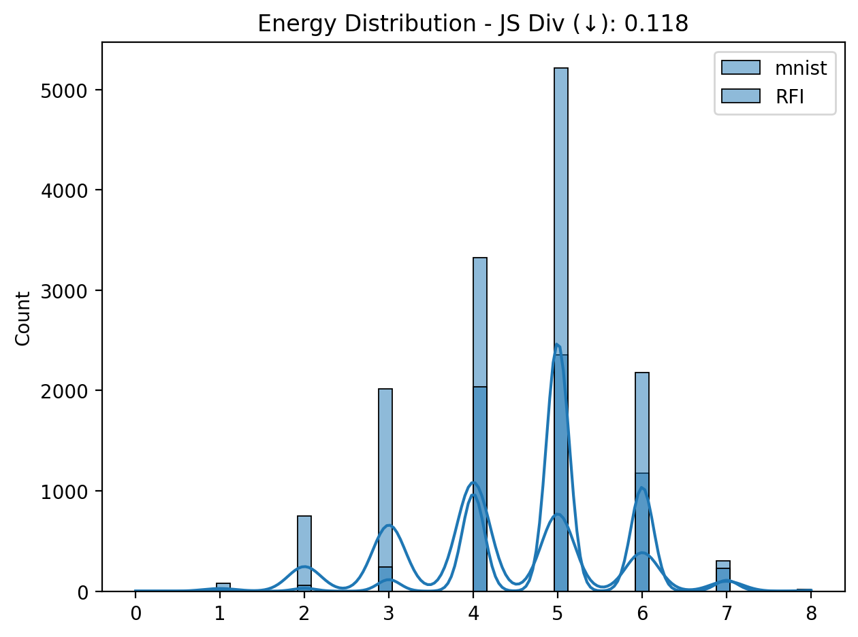
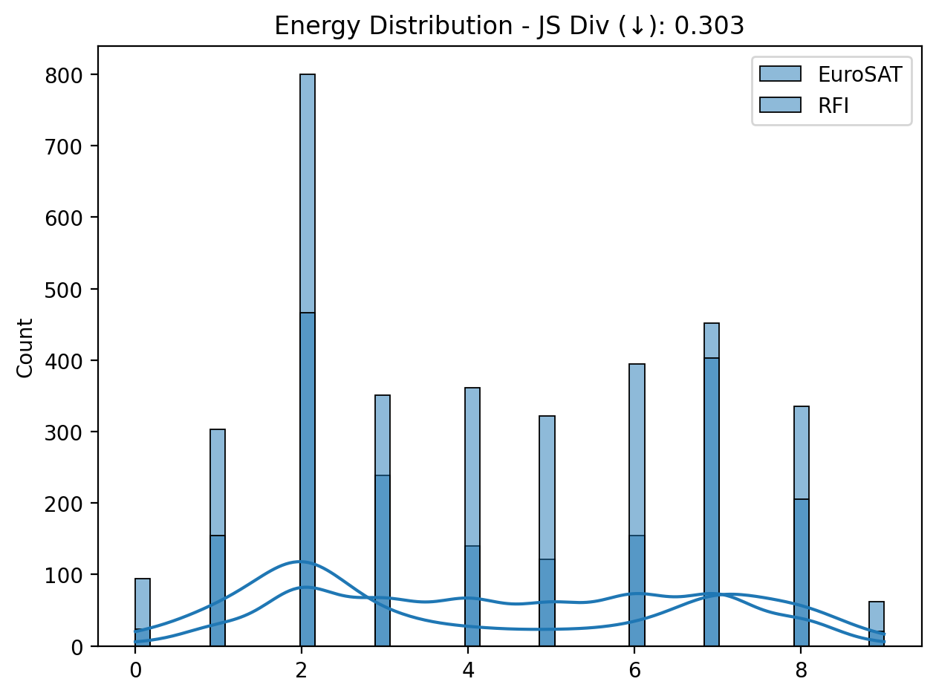
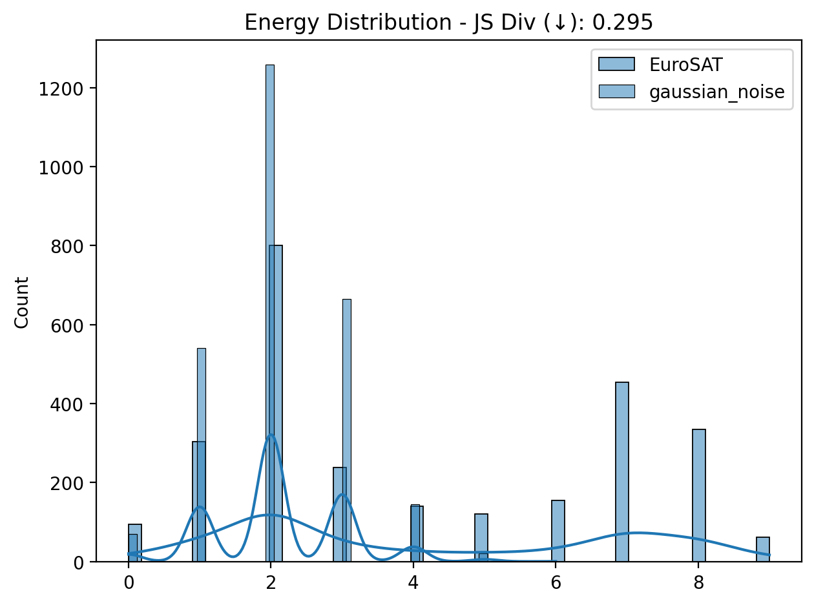
Energy bridge hypothesis
Results spike linear models
mnist
EuroSAT

Slide 24
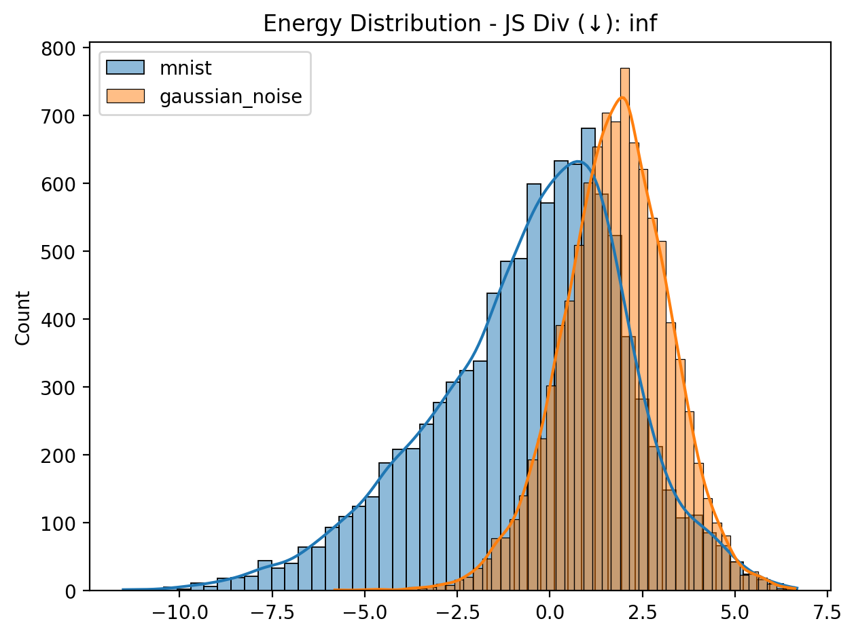
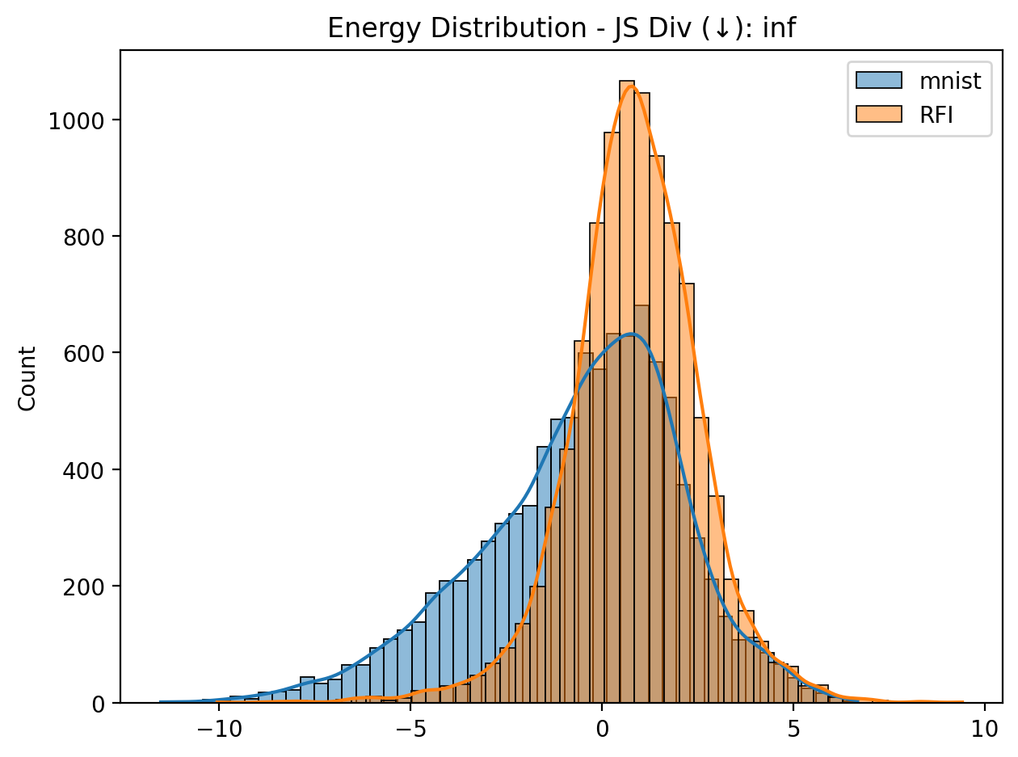
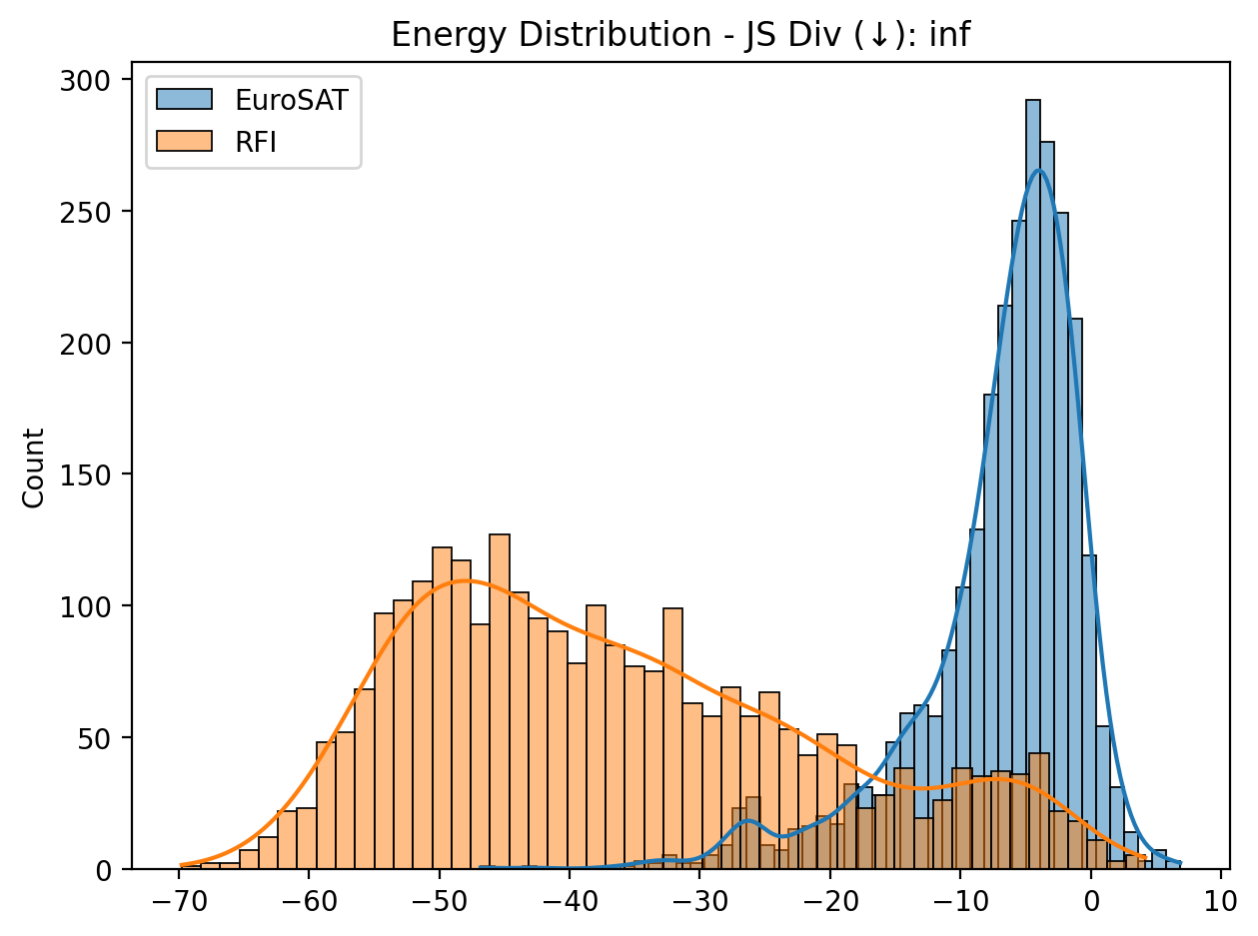

Energy bridge hypothesis
Results standard convolutional models
mnist
EuroSAT

Slide 25


Energy bridge hypothesis
Results spike convolutional models
mnist
EuroSAT

Slide 26

Energy bridge hypothesis
Results image vae models

Slide 27

Energy bridge hypothesis
Results line models

Slide 28

Energy bridge hypothesis
Results image only magnitude models

Slide 29

Energy bridge hypothesis
Results image 10 epochs models

Slide 30
Energy bridge hypothesis
Results image 10 epochs models

Slide 31

Energy bridge hypothesis
Results image 100 Time steps integration models

Slide 32
Energy bridge hypothesis
Test models results
In the following slides we will present the results we got by implementing the anomaly detection by using a threshold on either the energy or the spike depending on the type of model

Slide 33
Energy bridge hypothesis
Linear model results mnist
Noise type | Noise intensity | Accuracy (%) | Recall | F1 score
None | 0.0 | 70.42 | 35.21 | 0.41
Gaussian | 0.1 | 37.2 | 18.6 | 0.27
 | 0.25 | 50.03 | 25.02 | 0.33
 | 0.5 | 72.91 | 36.46 | 0.42
 | 0.75 | 86.91 | 43.46 | 0.46
 | 1.0 | 92.69 | 46.35 | 0.48
RFI | 0.1 | 36.25 | 18.13 | 0.41
 | 0.25 | 45.47 | 22.74 | 0.31
 | 0.5 | 60.44 | 30.22 | 0.37
 | 0.75 | 73.06 | 36.53 | 0.42
 | 1.0 | 85.55 | 42.78 | 0.46
tau -4.5

Slide 34
Energy bridge hypothesis
Linear models results EuroSAT
Noise type | Noise intensity | Accuracy (%) | Recall | F1 score
None | 0.0 | 74.96 | 37.48 | 0.43
Gaussian | 0.1 | 27.00 | 13.5 | 0.21
 | 0.25 | 38.11 | 19.05 | 0.28
 | 0.5 | 65.19 | 32.59 | 0.39
 | 0.75 | 79.48 | 39.74 | 0.44
 | 1.0 | 86.74 | 43.37 | 0.46
RFI | 0.1 | 25.22 | 12.61 | 0.20
 | 0.25 | 28.11 | 14.06 | 0.22
 | 0.5 | 31.48 | 15.74 | 0.24
 | 0.75 | 35.33 | 17.67 | 0.26
 | 1.0 | 39.07 | 19.53 | 0.28
tau -5.8

Slide 35
Energy bridge hypothesis
Convolutional models results mnist
Noise type | Noise intensity | Accuracy (%) | Recall | F1 score
None | 0.0 | 78.81 | 39.41 | 0.44
Gaussian | 0.1 | 44.66 | 22.33 | 0.31
 | 0.25 | 54.51 | 27.26 | 0.35
 | 0.5 | 62.00 | 31.00 | 0.38
 | 0.75 | 59.57 | 39.41 | 0.44
 | 1.0 | 57.35 | 28.68 | 0.36
RFI | 0.1 | 24.61 | 12.31 | 0.20
 | 0.25 | 28.75 | 14.38 | 0.22
 | 0.5 | 32.60 | 16.30 | 0.25
 | 0.75 | 34.42 | 17.21 | 0.26
 | 1.0 | 33.39 | 16.72 | 0.25
tau 1.5

Slide 36
Energy bridge hypothesis
Convolutional models results EuroSAT
Noise type | Noise intensity | Accuracy (%) | Recall | F1 score
None | 0.0 | 92.15 | 46.07 | 0.47
Gaussian | 0.1 | 61.78 | 30.89 | 0.38
 | 0.25 | 99.93 | 49.96 | 0.50
 | 0.5 | 100.00 | 100.00 | 1.00
 | 0.75 | 100.00 | 100.00 | 1.00
 | 1.0 | 100.00 | 100.00 | 1.00
RFI | 0.1 | 17.00 | 8.50 | 0.14
 | 0.25 | 30.11 | 15.06 | 0.23
 | 0.5 | 51.11 | 25.56 | 0.39
 | 0.75 | 68.19 | 34.10 | 0.41
 | 1.0 | 86.37 | 43.19 | 0.46
tau -17.0

Slide 37
Energy bridge hypothesis
Linear spike model results mnist
Noise type | Noise intensity | Accuracy (%) | Recall | F1 score
None | 0.0 | 96.98 | 48.49 | 0.49
Gaussian | 0.1 | 7.14 | 3.57 | 0.06
 | 0.25 | 40.01 | 20.01 | 0.29
 | 0.5 | 92.34 | 19.83 | 0.28
 | 0.75 | 98.48 | 49.24 | 0.50
 | 1.0 | 98.89 | 49.45 | 0.50
RFI | 0.1 | 6.42 | 3.21 | 0.06
 | 0.25 | 17.21 | 8.61 | 0.15
 | 0.5 | 39.66 | 19.83 | 0.28
 | 0.75 | 64.99 | 32.50 | 0.39
 | 1.0 | 83.33 | 41.67 | 0.45
tau 4.3

Slide 38
Energy bridge hypothesis
Linear spike models results EuroSAT
Noise type | Noise intensity | Accuracy (%) | Recall | F1 score
None | 0.0 | 58.07 | 29.04 | 0.37
Gaussian | 0.1 | 43.56 | 21.78 | 0.30
 | 0.25 | 38.48 | 19.24 | 0.28
 | 0.5 | 15.74 | 7.87 | 0.14
 | 0.75 | 2.70 | 1.35 | 0.03
 | 1.0 | 00.92 | 00.46 | 0.01
RFI | 0.1 | 43.22 | 21.61 | 0.30
 | 0.25 | 40.93 | 20.46 | 0.29
 | 0.5 | 47.07 | 23.53 | 0.32
 | 1.0 | 47.89 | 23.94 | 0.32
 | 1.0 | 48.85 | 24.42 | 0.33
tau 4.1

Slide 39
Energy bridge hypothesis
Convolutional spike models results mnist
Noise type | Noise intensity | Accuracy (%) | Recall | F1 score
None | 0.0 | 96.98 | 48.49 | 0.49
Gaussian | 0.1 | 7.14 | 3.57 | 0.07
 | 0.25 | 40.01 | 20.01 | 0.29
 | 0.5 | 92.34 | 46.17 | 0.48
 | 0.75 | 98.48 | 49.24 | 0.50
 | 1.0 | 98.89 | 48.45 | 0.50
RFI | 0.1 | 6.42 | 3.57 | 0.06
 | 0.25 | 17.21 | 8.61 | 0.15
 | 0.5 | 39.66 | 19.83 | 0.28
 | 0.75 | 64.99 | 32.50 | 0.39
 | 1.0 | 83.33 | 41.67 | 0.45
tau 4.3

Slide 40
Energy bridge hypothesis
Convolutional spike models results EuroSAT
Noise type | Noise intensity | Accuracy (%) | Recall | F1 score
None | 0.0 | 68.11 | 34.06 | 0.41
Gaussian | 0.1 | 26.22 | 13.11 | 0.21
 | 0.25 | 23.48 | 11.74 | 0.19
 | 0.5 | 11.56 | 5.78 | 0.10
 | 0.75 | 3.19 | 1.59 | 0.03
 | 1.0 | 79.37 | 39.68 | 0.44
RFI | 0.1 | 30.04 | 15.02 | 0.23
 | 0.25 | 25.41 | 12.70 | 0.42
 | 0.5 | 33.89 | 19.94 | 0.25
 | 0.75 | 68.74 | 34.37 | 0.41
 | 1.0 | 88.11 | 44.06 | 0.47
tau 2.99999

Slide 41
Energy bridge hypothesis
Convolutional spike models results EuroSAT
Noise type | Noise intensity | Accuracy (%) | Recall | F1 score
None | 0.0 | 98.88 | 49.44 | 0.50
Gaussian | 0.1 | 0.00 | 0.00 | 0.00
 | 0.1 | 0.00 | 0.00 | 0.00
 | 0.5 | 0.00 | 0.00 | 0.00
 | 0.75 | 0.00 | 0.00 | 0.00
 | 1.0 | 76.48 | 38.24 | 0.43
RFI | 0.1 | 0.00 | 0.00 | 0.00
 | 0.25 | 0.00 | 0.00 | 0.00
 | 0.5 | 0.00 | 0.00 | 0.00
 | 0.75 | 28.37 | 14.19 | 0.22
 | 1.0 | 72.30 | 36.15 | 0.42
tau 3.0

Slide 42


Energy bridge hypothesis
kld echo 0.8
kld RFI 0.79
tau 30 100% accuracy
Results VAE line magnitude only
histplot
kdeplot
Notes:
T100_b26_adam_lr0.0001_modelline_vaeTrue_only_magTrue_only_angFalse_daytime20260223-171912

Slide 43


Energy bridge hypothesis
kld echo 53.14
kld RFI 52.92
ssim echo 3.26e-5
ssim RFI 3.24e-5
tau 100 99.61% accuracy
Results VAE line magnitude only
histplot
kdeplot
Notes:
T100_b26_adam_lr0.0001_modelline_vaeTrue_only_magTrue_only_angFalse_daytime20260223-171912

Slide 44

Anomaly brach
Proposed new approach for segmentation
Spiking CNN autoencoder
Test if even just encoder spikes increase and so are a good indicator of anomaly
reuse encoder features in a segmentation head

Slide 45


CS brach - Classification
Spiking Models
ANN to SNN
Native SNN
Reuse previous architectures and training
Advanced approach
Lightweight and SOTA scores

Slide 46


CS brach - Segmentation
Models
MSViT [7]
QK attention [8]
High performance thanks to the multi-step approach
Reduced number of steps to be as efficient as possible
[7] Hua, W., Zhou, C., Wu, J., Chua, Y., & Shu, Y. (2025). MSVIT: Improving spiking vision transformer using multi-scale attention fusion. arXiv
[8] Zhou, C., Zhang, H., Zhou, Z., Yu, L., Huang, L., Fan, X., Yuan, L., Ma, Z., Zhou, H., & Tian, Y. (2024). QKFormer: Hierarchical spiking transformer using Q-K attention. arXiv.

Slide 47
CS brach - Segmentation
Proposed approach
MSViT [7]
QK attention [8]
Put together the power of MSViT with the efficiency of QKformer
[7] Hua, W., Zhou, C., Wu, J., Chua, Y., & Shu, Y. (2025). MSVIT: Improving spiking vision transformer using multi-scale attention fusion. arXiv
[8] Zhou, C., Zhang, H., Zhou, Z., Yu, L., Huang, L., Fan, X., Yuan, L., Ma, Z., Zhou, H., & Tian, Y. (2024). QKFormer: Hierarchical spiking transformer using Q-K attention. arXiv.

