Slide 1

From Data to Differential Equations
Jim Ramsay
McGill University

Slide 2
The themes
Differential equations are powerful tools for modeling data.
There are new methods for estimating differential equations directly from data.
Some examples are offered, drawn from chemical engineering and medicine.

Slide 3
Differential Equations as Models
DIFE’S make explicit the relation between one or more derivatives and the function itself.
An example is the harmonic motion equation:

Slide 4
Why Differential Equations?
The behavior of a derivative is often of more interest than the function itself, especially over short and medium time periods.
What often counts is how rapidly a system responds rather than its level of response.
Velocity and acceleration can reflect energy exchange within a system.
Recall equations like f = ma and e = mc².

Slide 5
Natural scientists often provide theory to biologists and engineers in the form of DIFE’s.
Many fields such as pharmacokinetics and industrial process control routinely use DIFE’s as models, especially for input/output systems.
DIFE’s are especially useful when feedback systems must be developed to control the behavior of systems.

Slide 6
The solution to an mth order linear DIFE is an m-dimensional function space, and thus the equation can model variation over replications as well as average behavior.
Systems of DIFE’s are important models for processes mutually influencing each other, such as treatments and symptoms, predator and prey, and etc.

Slide 7
DIFE’s require that derivatives are smooth, since they link the behavior of derivatives to that of the function itself.
Even simple nonlinear differential equations can imply function characteristics that would be impossible to model in any other way.

Slide 8
The Rössler Equations
This nearly linear system exhibits chaotic behavior that would be virtually impossible to model without using a DIFE:

Slide 9
Stochastic DIFE’s
We can introduce stochastic elements into DIFE’s in many ways:
Random coefficient functions.
Random forcing functions.
Random initial, boundary, and other constraints.
Stochastic time.

Slide 10
Differential equations and time scales
DIFE’s are important where there are events at different time scales.
The order of the equation plus one corresponds to the number of time scales.
A first-order equation can model events on two time scales: long-term, modeled by x(t), and short-term, modeled by Dx(t).

Slide 11
Handwriting has four time scales
Average spatial position needs only x(t), time scale is many seconds.
Overall left-to-right trend requires Dx(t) , with a time scale a second or less.
Cusps, loops, strokes require D²x(t) , with a time scale of 100 msec or so.
Transient effects such from pen contacting paper require D³x(t) with a scale of 10 msec.

Slide 12
If we can model data on functions or functional input/output systems, we will have a modeling tool that greatly extends the power and scope of existing nonparametric curve-fitting techniques.
These models will be dynamic in the sense of also modeling the rate of change in the system.
We may also get better estimates of functional parameters and their derivatives.

Slide 13
A simple input/output system
We begin by looking at a first order DIFE for a single output function x(t) and a single input function u(t). (SISO)
But our goal is the linking of multiple inputs to multiple outputs (MIMO) by linear or nonlinear systems of arbitrary order m.

Slide 14
u(t) is often called the forcing function.
α(t) and β(t) are the coefficient functions
that define the DIFE.
The system is linear in these coefficient
functions, and in the input u(t) and output
x(t).

Slide 15
In this simple case, an analytic solution is
possible:
where
However, in most situations involving
DIFE’s it is necessary to use numerical
methods to find the solution.

Slide 16
A constant coefficient example
We can see more clearly what happens when
Coefficients α and β are constants,
u(t) is a function stepping from 0 to 1 at time t₁:

Slide 17
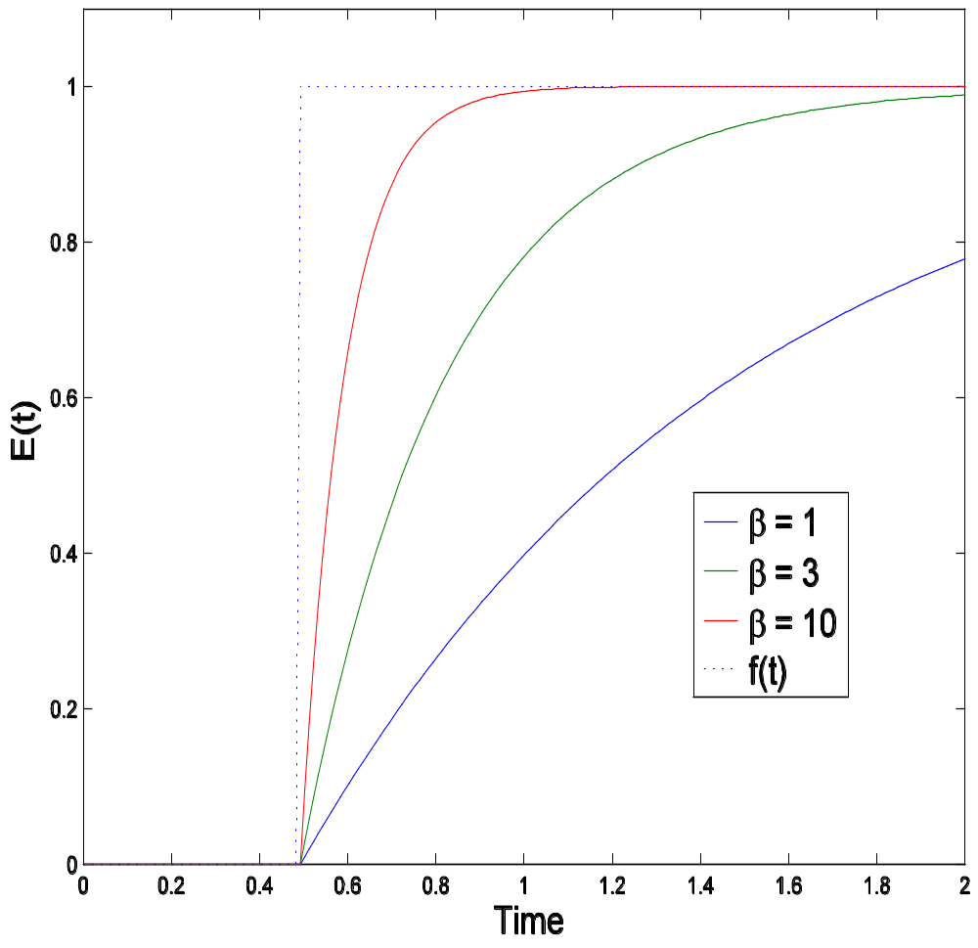
α/β is the gain in the system.
Constant β controls the responsivity of the system to a change in input.

Slide 18
How can we estimate a DIFE from noisy data?

Slide 19
The DIFE as a linear differential operator
We can express the first order DIFE as a linear differential operator:
More generally, dropping “(t)”,

Slide 20
Smoothing data with the operator L
If we know the differential equation, then the operator L_{αβ} can define a data smoother. The penalized least squares fitting criterion is:
The larger λ is, the more the fitting function x(t)
is forced to be a solution of the differential equation
Lαβx(t) = 0.

Slide 21
The smooth values
If x(t) is expanded in terms of a set K basis functions φ_{k}(t), and if N by K matrix Z contains the values of these functions at time points t_{i}, then the vector fitting the data is

Slide 22
How to estimate L
L_{αβ} is a function of weight coefficients α(t) and β(t).
If α(t) and β(t) are functions of parameter vectors a and b, respectively, then we can optimize the profiled error sum of squares
with respect to parameter vectors a and b.

Slide 23
Adding constraints
It is a simple matter to:
Constrain some coefficient functions to be zero or a constant.
Force others to be smooth, employing specific linear differential operators to smooth them towards specific target spaces.

Slide 24
And more …
This approach is easily generalizable to:
DIFE’s and differential operators of any order.
Multiple inputs u_{j}(t) and outputs x_{i}(t).
Replicated functional data.
Nonlinear DIFE’s and operators.

Slide 25
What about choosing λ?
Choosing the smoothing parameter λ is always a delicate matter.
The right value of λ will be rather large if the data can be well-modeled by a low-order DIFE, but not so large as to fail to smooth observational noise and small additional functional variation.
Generalized cross-validation seems to work.

Slide 26
Some Simulations
Let’s see how well this method works where we know what we’re estimating.

Slide 27
A simple harmonic example
For i=1,…,N and j=1,…,n, let
where the c_{ik}’s and the ε_{ij}’s are N(0,1); and t = 0(0.01)1.
The functional variation satisfies the differential equation
so that β₀(t) = β₁(t) = β₃(t)=0 and β₂(t) = (6π)² = 355.3.

Slide 28
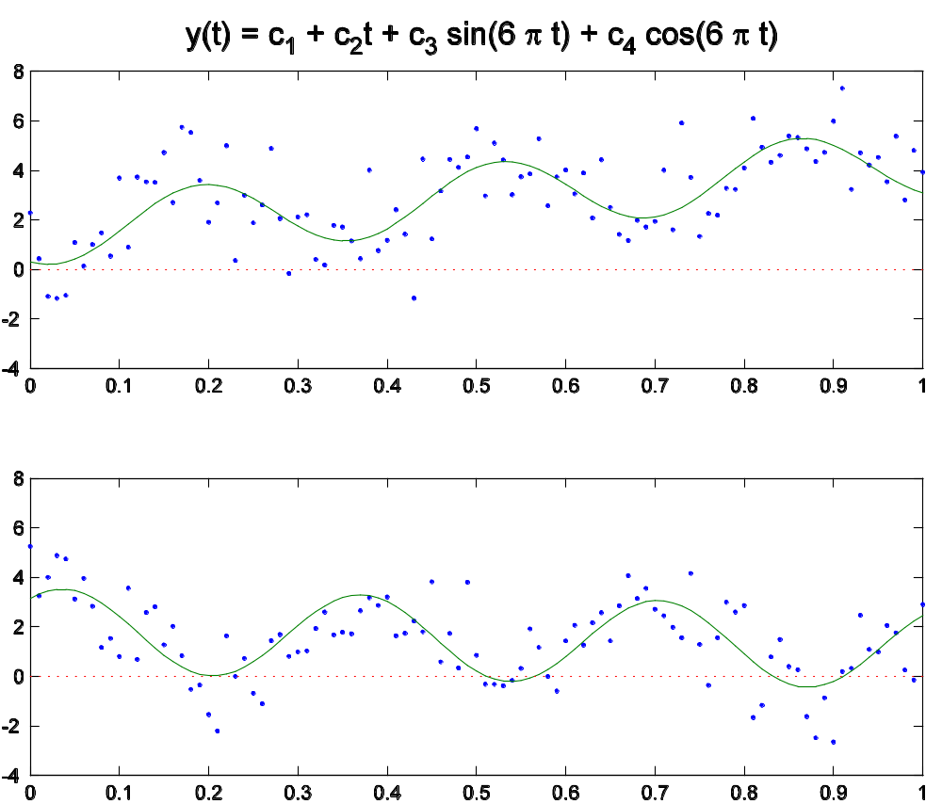

Slide 29
For simulated data with N = 20 and constant bases for β₀(t) ,…, β₃(t), we get
for L = D^{4,} best results are for λ=10⁻¹⁰ and the RIMSE’s for derivatives 0, 1 and 2 are 0.32, 9.3 and 315.6, resp.
for L estimated, best results are for λ=10⁻⁵ and the RIMSE’s are 0.18, 2.8, and 49.3, resp.
giving precision ratios of 1.8, 3.3 and 6.4, resp.
β₂ was estimated as 353.6 whereas the true value was 355.3.
β₃ was 0.1, with true value 0.0.

Slide 30
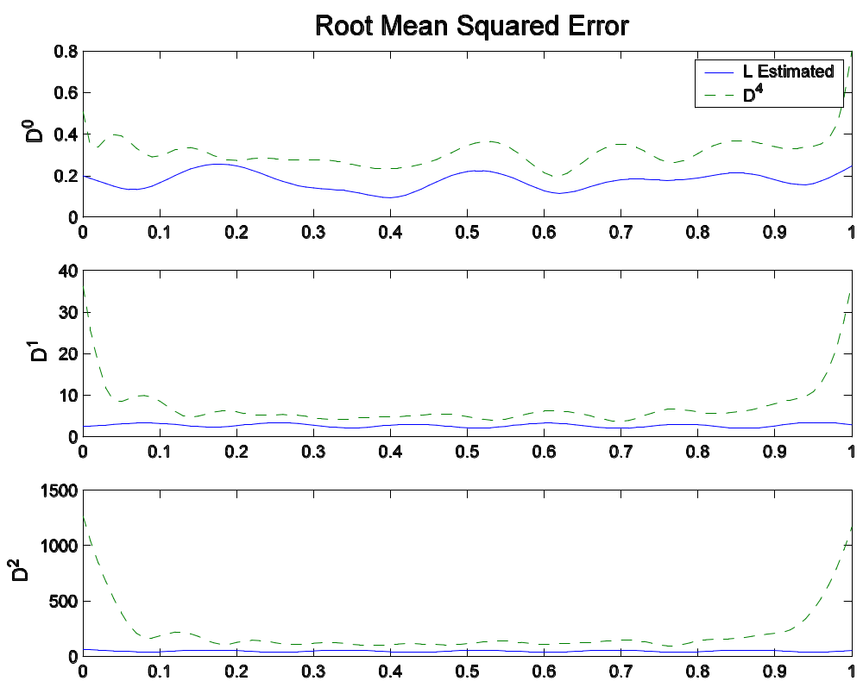

Slide 31
In addition to better curve estimates and much better derivative estimates, note that the derivative RMSE’s do not go wild at the end points.
This is because the DIFE ties the derivatives to the function values, and the function values are tamed by the data.

Slide 32
A decaying harmonic example
A second order equation defining harmonic behavior with decay, forced by a step function:
β₀ = 4.04, β₁ = 0.4, α = -2.0.
u(t) = 0, t < 2π, u(t) = 1, t ≥ 2π.
Noise with std. dev. 0.2 added to 100 randomly generated solution functions.

Slide 33
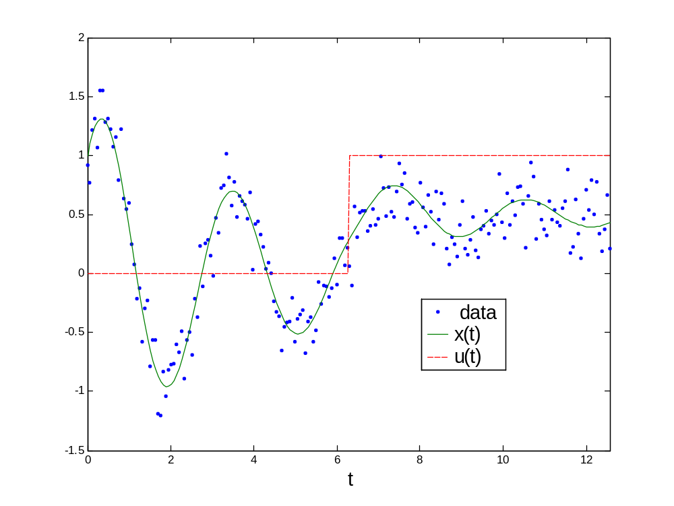

Slide 34
Results from 100 samples using minimum generalized cross-validation to choose λ:
Parameter | True Value | Mean Estimate | Std. Error
β₀ | 4.040 | 4.041 | 0.073
β₁ | 0.400 | 0.397 | 0.048
α | -2.000 | -1.998 | 0.088

Slide 35
Monotone smoothing
Some constrained functions can be expressed as DIFE’s.
A smooth strictly monotone function can be expressed as the second order DIFE

Slide 36
We can monotonically smooth data by estimating the second order DIFE directly.
We constrain β₀(t) = 0, and give β₁(t) enough flexibility to smooth the data.
In the following artificial example, the smoothing parameter was chosen by generalized cross-validation. β₁(t) was expanded in terms of 13 B-splines.

Slide 37
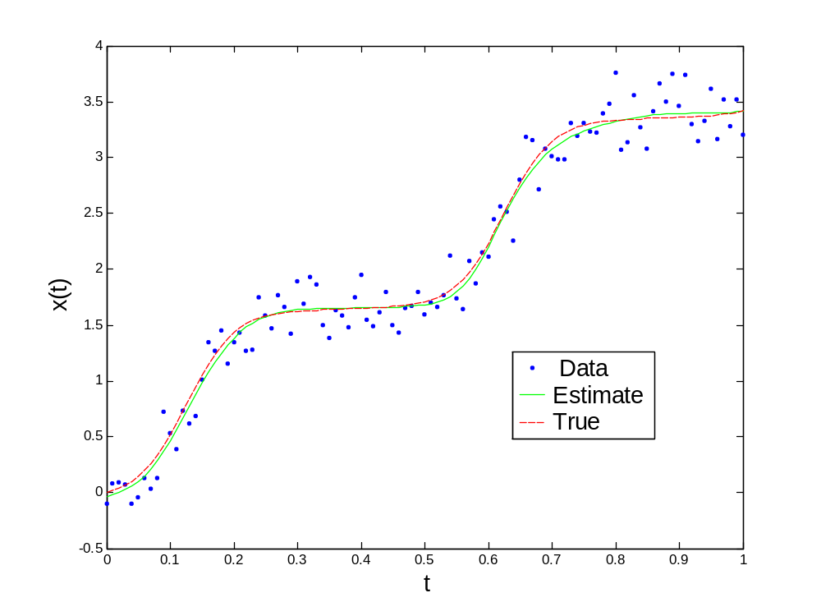

Slide 38
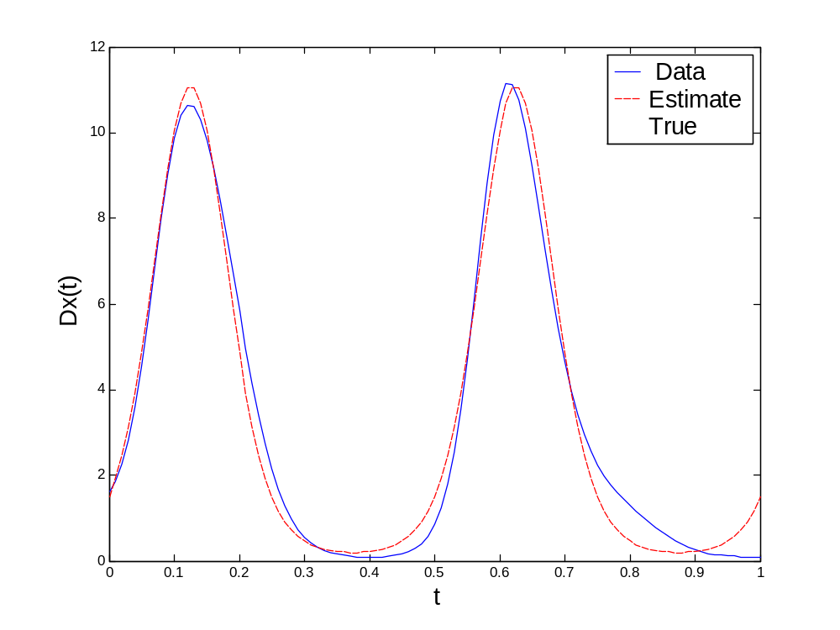

Slide 39
A Simulated Chemical Reactor
Here is a textbook model for the input and output concentrations in a non-isothermal continuously-stirred tank reactor.
Input measurements are (1) input concentration C_{in} , (2) flow rate F, (3) temperature T
Output is concentration C_{out} .

Slide 40
The Differential Equation
where
The two parameters to be estimated are:
K₀ and τ

Slide 41
Process control experiments
Engineers studying systems like these like to carry out experiments in which inputs are stepped up or down at random times.
They infer the dynamics of the process from the impacts of these steps on the output(s).

Slide 42
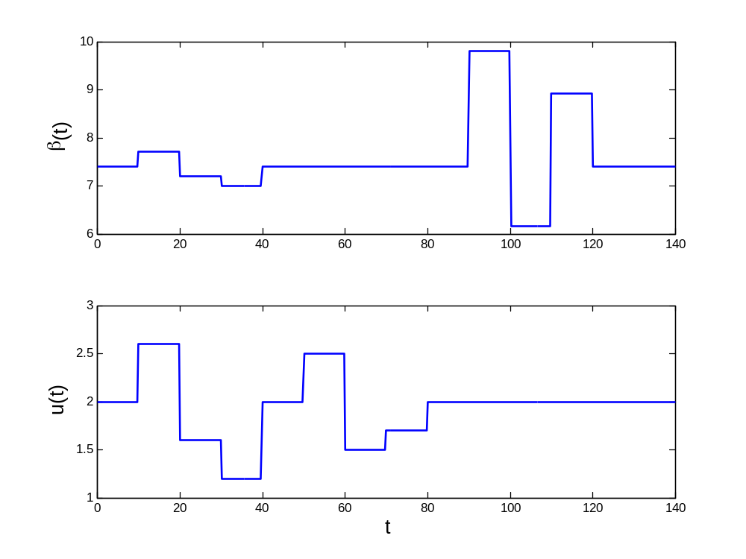

Slide 43
We solved this differential equation for known values of the two unknown parameters,
and then added zero mean Gaussian error with a standard deviation of 0.01.

Slide 44
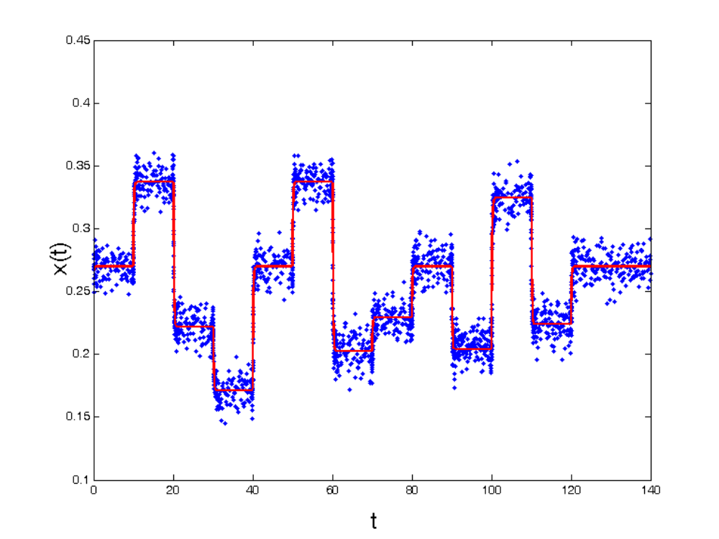

Slide 45
Our estimate of k₀ was 8.11 as opposed to the data-generating value of 8.33.
Our estimate of τ was 22.44 as opposed to the data-generating value of 23.00.

Slide 46
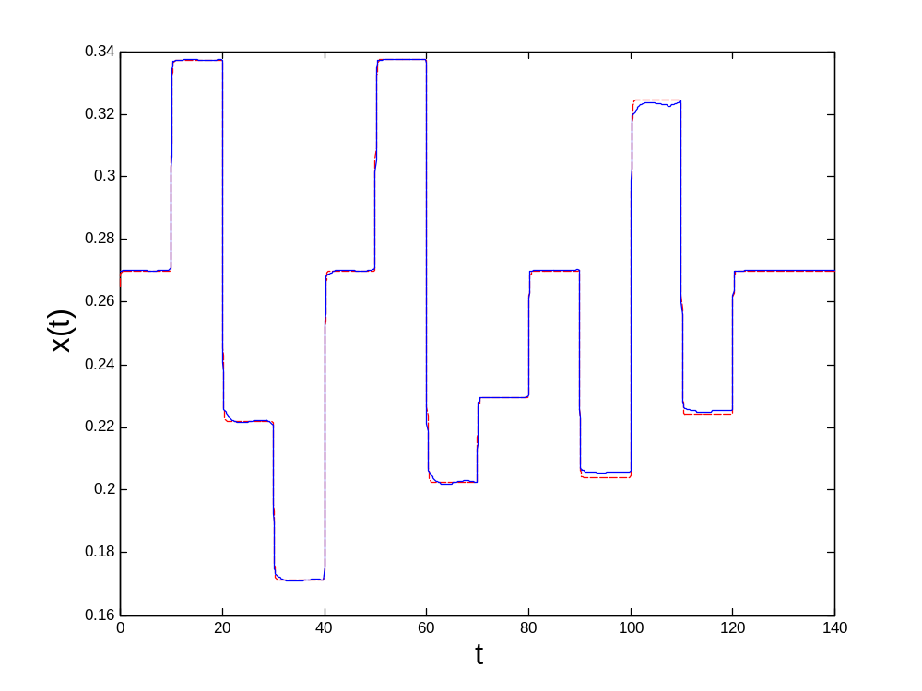

Slide 47
A Real-Data Example

Slide 48
Flow in an oil refinery distillation column
The single input is “reflux flow” and the output is “tray 47” level.
There were 194 sampling points.
30 B-spline basis functions were used to fit the output, and a step function was used to model the input.

Slide 49
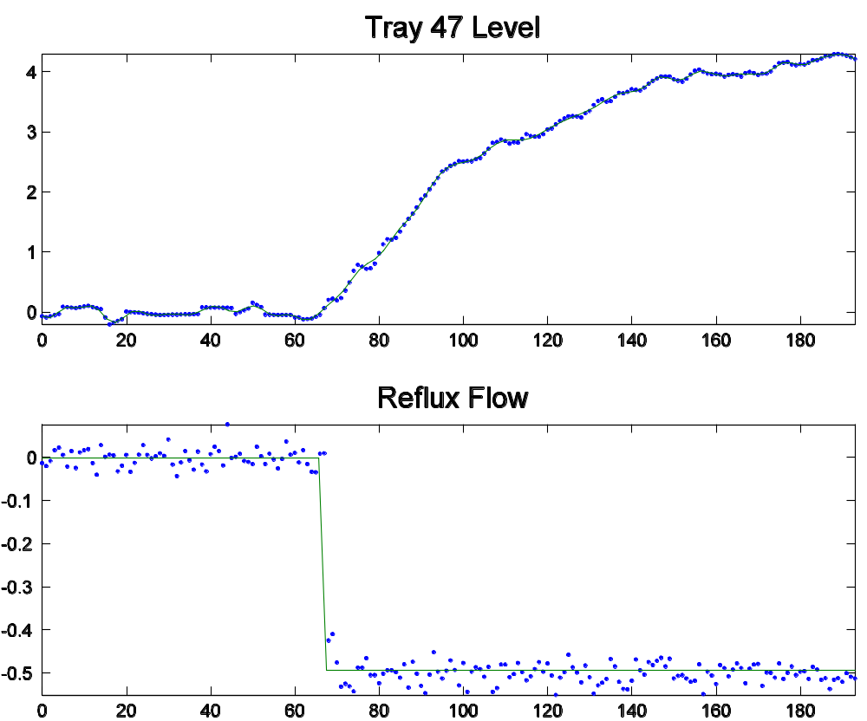

Slide 50
Results for the refinery data
After some experimentation with first and second order models, and with constant and varying coefficient models, the clear conclusion seems to be the constant coefficient model:

Slide 51
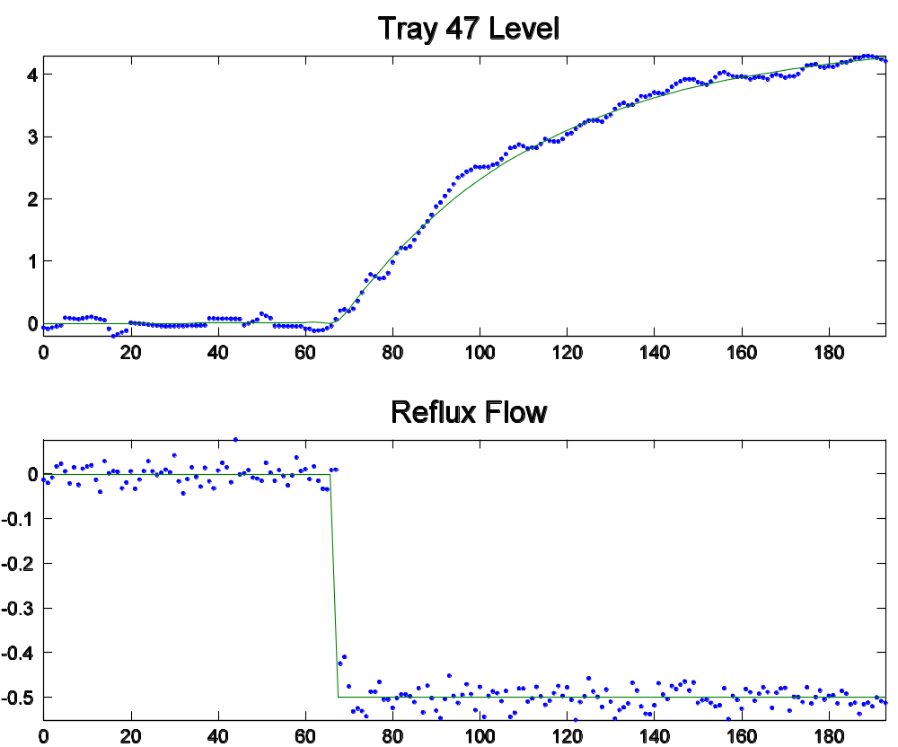

Slide 52
Summary
We can estimate differential equations directly from noisy data with little bias and good precision.
This gives us a lot more modeling power, especially for fitting input/output functional data.
Estimates of derivatives can be much better, relative to smoothing methods.
Special functions, such as monotone, can be fit by estimating the DIFE that defines them.

