Slide 1

RECAP DOCKER 101 Docker 102
Notes:
Goedeavond
Mijn naam is Johannes Sim.

Slide 2
Docker 102
Goal:
Practical 102 Docker
Tell / Show / DIY
Key take away:
What Docker is and can do for you
1 DockerHost with multiple conatainers
Multiple DockerHosts
Audience: DEV collegues

Slide 3
DISCLAIMER
Our view and way of working
Docker is changing constantly
Version CE 17.06.2.-ce

Slide 4
CoNTENT Docker 102
Summary Docker 101
Multi-stage build
Docker compose
Multi container app cats & dogs
Some Topics

Slide 5
OUR DOCKER Definition FOUND on INTERNET
is the world's leading software container platform
available for developers, ops and businesses
to build, ship and run
any app
on any infrastructure.
Notes:
Waarom deze deze definitie:
World leading op dit moment
Container = Docker
Actors: dev / ops /business
ANY app (microservice / monolit / enz)
Infra (laptop / server on premise / cloud

Slide 6
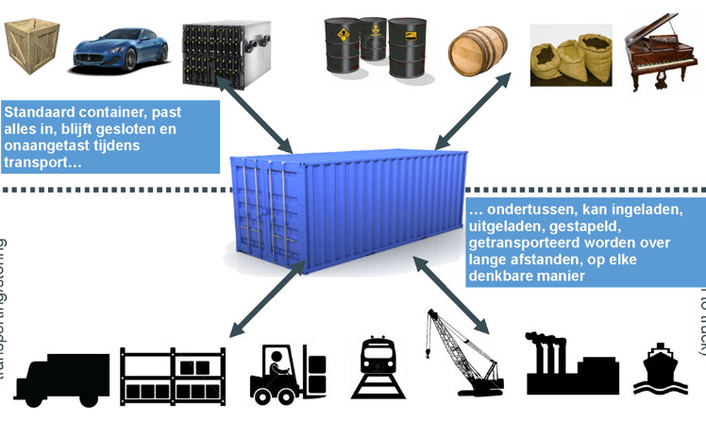
WORKS in MY MACHINE APP in A Container

Slide 7
Build – SHIP - RUN
Build
Ship
Run
DEV
OPS
Dockerfile
Image
Container
Docker Registry
Docker hub/store

Slide 8
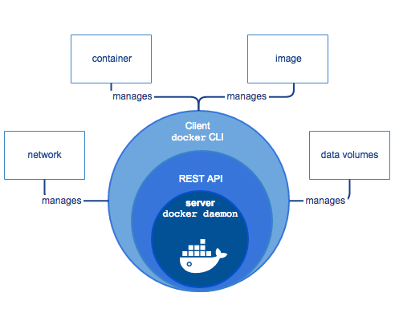
TOPIC: DOCKER ARCHITECTURE HigH LEVEL
https://docs.docker.com/engine/docker-overview/
Notes:
High Level overview
Docker CLI
Docker API
Docker Deamon
https://docs.docker.com/engine/docker-overview/

Slide 9
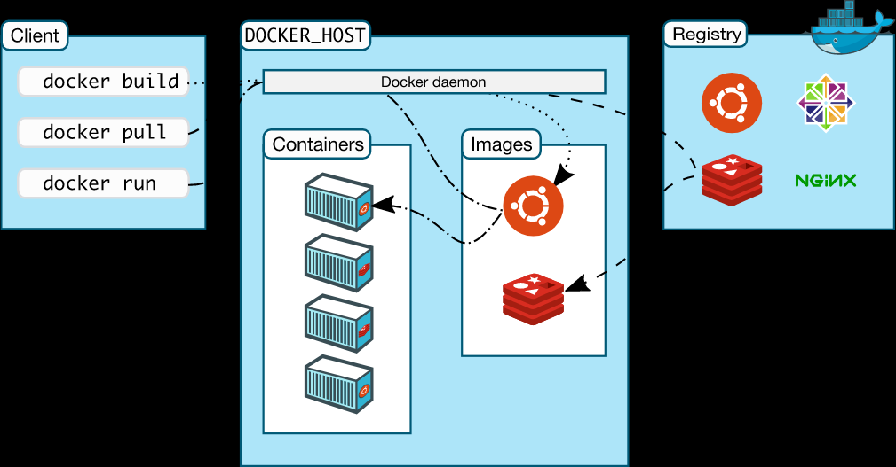
TOPIC: DOCKER ARCHITECTURE HigH LEVEL
https://docs.docker.com/engine/docker-overview/
Notes:
High Level overview
Docker CLI
Docker API
Docker Deamon
https://docs.docker.com/engine/docker-overview/

Slide 10
Docker Command
Build
Ship
Run
Docker image ls
Docker container run
Docker pull
Docker container ls
Docker image rm
Docker push
Docker container rm
Docker build
Docker container exec
Docker container start
Docker container stop
Docker system info
Docker system prune
Docker version
Notes:
docker system info
docker info
docker info
Command Line Interface

Slide 11
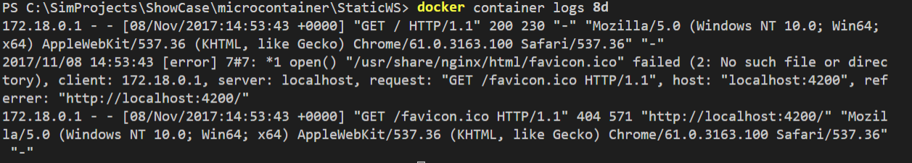
Logging
Docker container logs <containername>

Slide 12
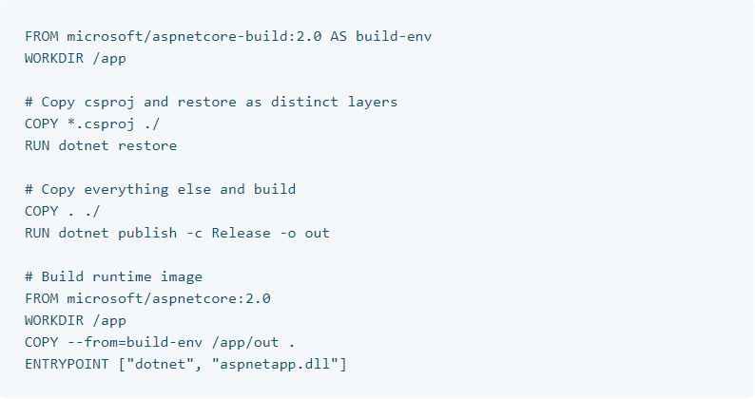
MULTISTAGE BUILD
Goal: small compact container
https://docs.docker.com/engine/examples/dotnetcore/

Slide 13
DOCKER COMPOSE
Ease of use for application – command line
One command for application with multiple containers
YAML file – version control
Same file for dev and ops

Slide 14
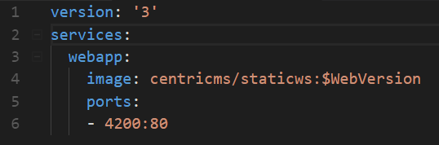

DOCKER COMPOSE EXAMPLE
.env

Slide 15
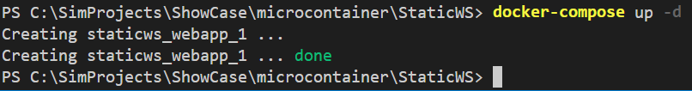
DOCKER-COMPOSE UP

Slide 16
NEW Docker BRIDGE network
Works only on 1 host
DNS name
Default bridge has no DNS due backwards compatible
Docker network create -–driver bridge <network-name>
Run with: --net <name>
Check with:
Docker network inspect
Docker container exec –it <container-name> ping <container-name>
Notes:
Docker network create –drive bridge firstnetwork
docker container run –rm -itd -p 5000:5000 -e FLASK_APP=app.py -e FLASK_DEBUG=1 --name web2 -v ${PWD}:/app --net firstnetwork web2
docker container run –rm -itd -p 6379:6379 --name redis --net firstnetwork redis:3.2-alpine
docker network inspect firstnetwork
docker container exec web2 ping redis
docker container exec –it redis redis-cli
127.0.0.1:6379> KEYS *
1) "web2_counter"
127.0.0.1:6379> INCRBY web2_counter 100000
(integer) 100022
127.0.0.1:6379>

Slide 17
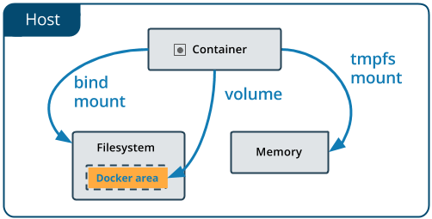
DOCKER VOLUME

Slide 18
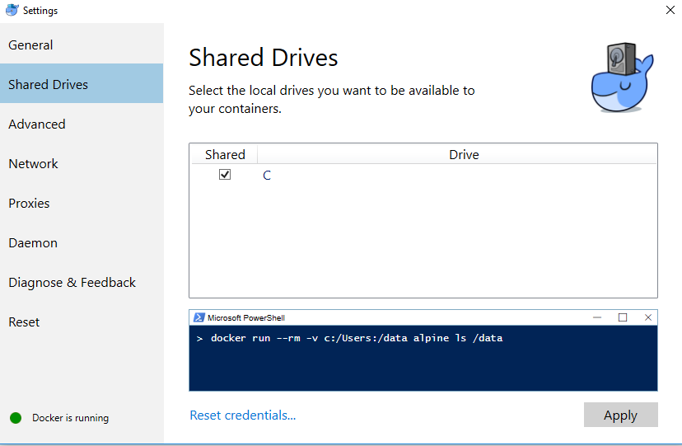
DOCKER VOLUME
Delen van de schijf Docker for Windows
docker create volume <name>
docker volume inspect
Use with –v <name>:<directory of data>
docker container run --name staticws -d -p 4200:80 -v <wndows path>:/usr/share/nginx/html/ centricms/staticws:latest
Notes:
Voor redis
Docker volume create redisstore
Docker volume inspect
--v redisstore:/data
VB:
docker container run –rm -itd -p 6379:6379 --name redis --net firstnetwork -v redisstore:/data redis:3.2-alpine
Stop en restart

Slide 19
EASE oF DOCKER VOTING Application
Why
Example from Docker
Start with 1 Docker-compose command
Also with build command
What:
Voting app
5 Micoservices
Python
NodeJS
.Net
Redis
PostgreSQL
https://github.com/dockersamples/example-voting-app

Slide 20
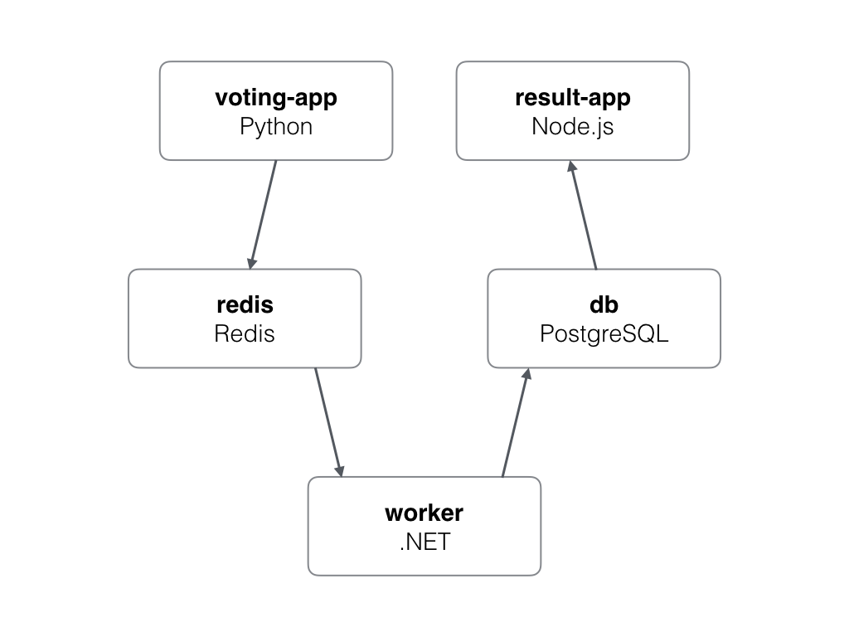
VOTING Application ARCHITECTURE – InfrastruCTURE
Webserver Linux
Applicatie server
Special server
Database server
Webserver Wintel

Slide 21
VOTING Application ARCHITECTURE – InfrastruCTURE
DockerHost

Slide 22
VOTING APP
Start with 1 command:
docker-compose up --build

Slide 23
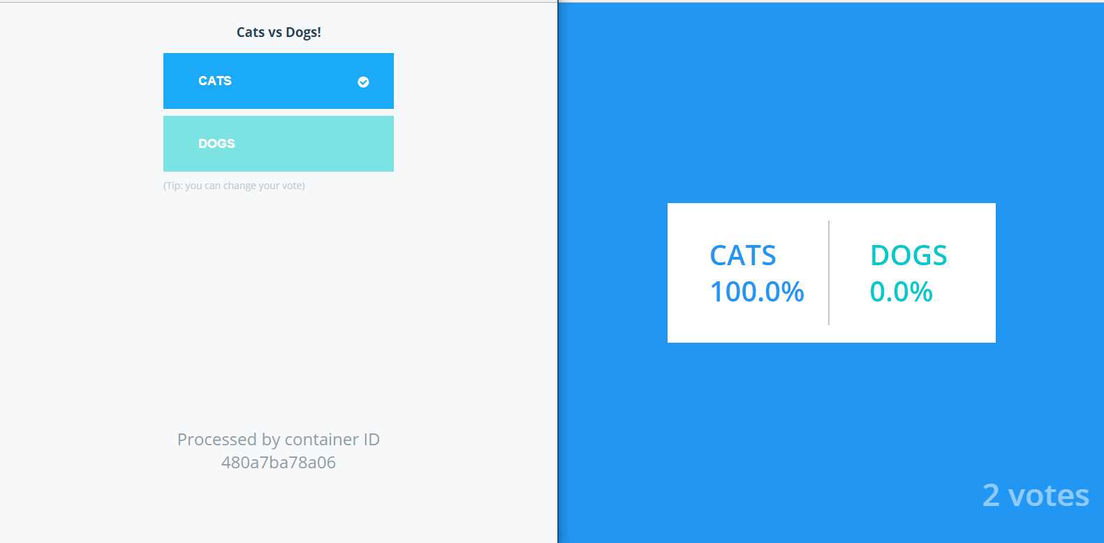
VOTING app

Slide 24
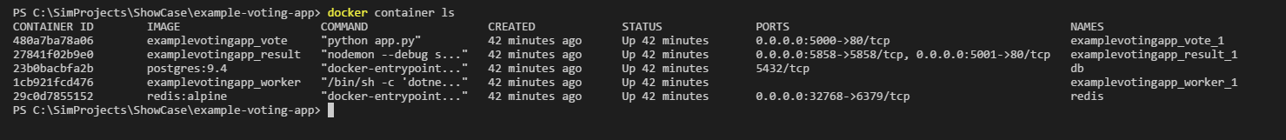
VOTING app Which container are running

Slide 25
TIPS
https://www.docker.com/
https://dockercon.docker.com/ - video’s
Workshop:
https://github.com/sixeyed/docker-windows-workshop (Windows containers)

