Slide 1

Docker 101
Notes:
Goedeavond
Mijn naam is Johannes Sim.

Slide 2
Docker 101
Goal:
Practical 101 Docker
Tell / Show / workshop
Key take away:
What Docker is and can do for you
Doing Docker 101 with confidence
Audience: DEV colleagues

Slide 3
DISCLAIMER
Our view and way of working
Docker is changing constantly
Version 17.06.2.-ce

Slide 4
CoNTENT Docker 101
What & Why Docker?
Examples
static website in 1 container on 1 DockerHost
Linux host / Docker UI
(our) Docker workflow
Docker commands explained
Some Topics

Slide 5
WHY Docker?
No more: works on my laptop
Time to Market
CI/CD (Continuous Integration / Continuous Delivery)
Time from commit to in production (cycle time)
DevOps
Try something new
Testing
…….
Notes:
DevOps
Time to Market
Time from commit to in production
Continuous Delivery
Build – Ship – Run
Works on my laptop
UseCase
Linux tool
Package manager

Slide 6
OUR DOCKER Definition FOUND on INTERNET
Is the world's leading software container platform
available for developers, ops and businesses
to build, ship and run
any app
on any infrastructure.
Notes:
Waarom deze deze definitie:
World leading op dit moment
Container = Docker
Actors: dev / ops /business
ANY app (microservice / monolit / enz)
Infra (laptop / server on premise / cloud

Slide 7
EXAMPLE: DOCKER User storIES
As Product Owner I want features and an easy process to change and maintenance processes
As DEV I want to build application only once and be sure that it is the same software
As OPS I want the same software in each environment
As Bus I want a short time to market for application feature

Slide 8
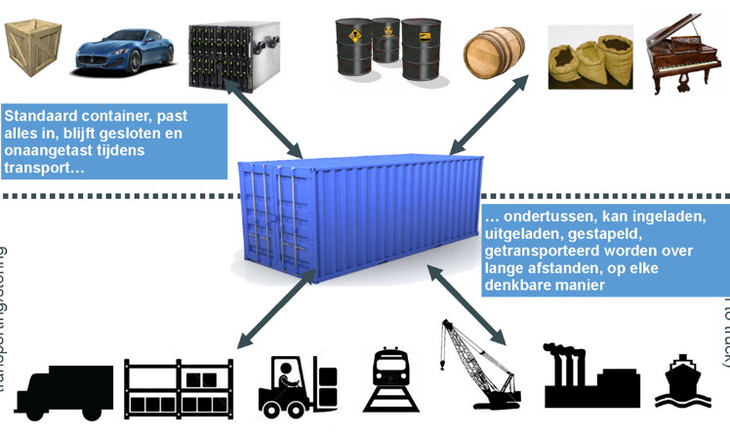
WORKS ON MY MACHINE APP in A Container

Slide 9
WORKS ON MY MACHINE RUN – CONTAINER
Applicatie
Applicatie
JAVA 7
JAVA 7
BINS/LIBS
BINS/LIBS
Docker
Docker
Operating System (Kernel)
Operating System (Kernel)
Infrastructure
Infrastructure
Laptop
Production in the cloud (Azure)

Slide 10
WORKS ON MacHINE RUN - ISOLATION
Applicatie
Applicatie
JAVA 7
JAVA 7
BINS/LIBS
BINS/LIBS
Docker
Operating System (Kernel)
Infra

Slide 11
WORKS on MY MACHINE BUILD IMAGE
Code
JAVA 7
BINS/LIBS

Slide 12
WORKS on MY MACHINE IMAGE → Container
Code
Code
JAVA 7
JAVA 7
BINS/LIBS
BINS/LIBS

Slide 13
WORKS ON MY MACHINE SHARE – REGISTRY DOCKER HUB/STORE

Slide 14
Build – SHIP - RUN
Build
Ship
Run
DEV
OPS
Dockerfile
Image
Container
Docker Registry
Docker hub/store

Slide 15

TIME TO MARKET
idee
Make image
Docker
registry
Deploy
container

Slide 16
CI/CD
Dockerfile
Make image
Docker
registry
Deploy
container

Slide 17
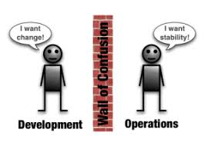
DEVOPS IMAGE = interface DEV-OPS
Laptop
Maintenance
PROD
Acceptance
Config
Config
Laptop
Test
Docker
registry
images
Docker
registry
Laptop
Dev
Dev decide what is in a image
Notes:
One team – one repro
Different suppliers
DEV “bepaalt” de stack
image = interface (tussen DEV en OPS)

Slide 18
Docker “Concepts”
Container “standard”
Build once – run anywhere
Container
in “production”
Everything what is needed and nothing more
1 process – 1 task
Immutable

Slide 19
Summary Docker
DockerFile
blueprint
recipe
Image
class
layers
Registry (private) – Docker Hub – Docker store
“app store”
Container
instance
runnning image
Notes:
Container == running image
Image = class
Container = instance
One image, many containers
Containers are immutable

Slide 20
Build – SHIP – RUN Summary
Build
Ship
Run
DEV
OPS
Dockerfile
Image
Container
Docker Registry
Docker hub/store

Slide 21
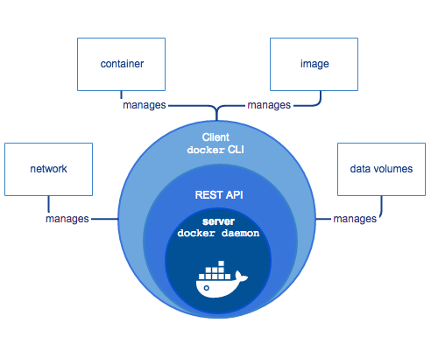
TOPIC: DOCKER ARCHITECTURE HigH LEVEL
https://docs.docker.com/engine/docker-overview/
Notes:
High Level overview
Docker CLI
Docker API
Docker Deamon
https://docs.docker.com/engine/docker-overview/

Slide 22
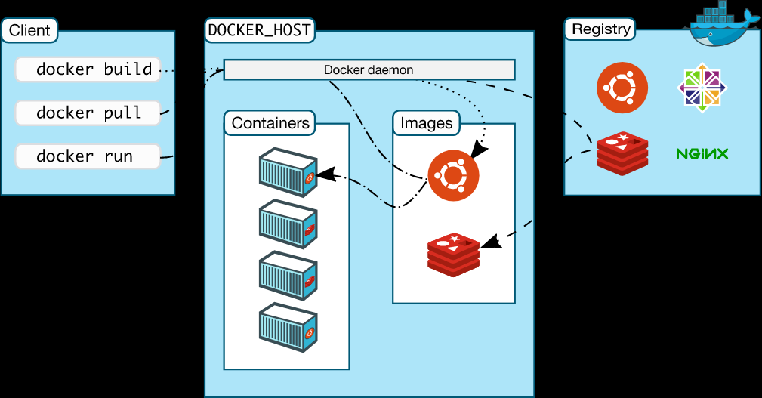
TOPIC: DOCKER ARCHITECTURE HigH LEVEL
https://docs.docker.com/engine/docker-overview/
Notes:
High Level overview
Docker CLI
Docker API
Docker Deamon
https://docs.docker.com/engine/docker-overview/

Slide 23
TOPIC: VIRTUAL MACHINE versus Container
Docker containers are not VM’s
Analogy
Apartment building = VM
Appartment = Docker Container
Share of kernel
Real world
DockerHost are VM’s
Docker can also run directly on server with OS
Notes:
Zie
DeepdiveDocker
Apartementgebouw
Container are not VM
Use Case
Docker on VM (DC, Azure)

Slide 24
Topic: DOCKER versionS
Containers are not new (Unix: 199x)
Docker to open source: march 2013
Docker 1.13 = Docker 17.03
Year.month
CE (Community Edition)
2 release channels
Edge each month
Stable each 3 month
EE (Enterprise Edition)
Current version: 17:06
Notes:
Docker 1.13 = Docker 17.03
CE
2 release channels
Edge each month
Stable each 3 month
EE
Diagram
predictable

Slide 25
Example: OUR Container WORKFLOW
Case: Static website
HTML pagina on webserver nginx
Code: HTML
Dockerfile
Build an image
Run container
Show result
Push to registry
Pull from registry
Run Azure DockerHost
Notes:
Starten van

Slide 26
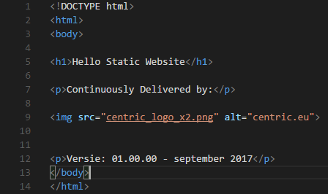
Example: HTML

Slide 27

Example DockerFILE

Slide 28
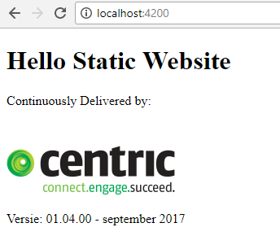
Example DOCKER RUN
docker container run --name staticws -d -p 4200:80 centricms/staticws:latest
df16bf953be84b16fe3f8b67cd90d50a056b17b5a8a3fc4075a92634c3720b65

Slide 29
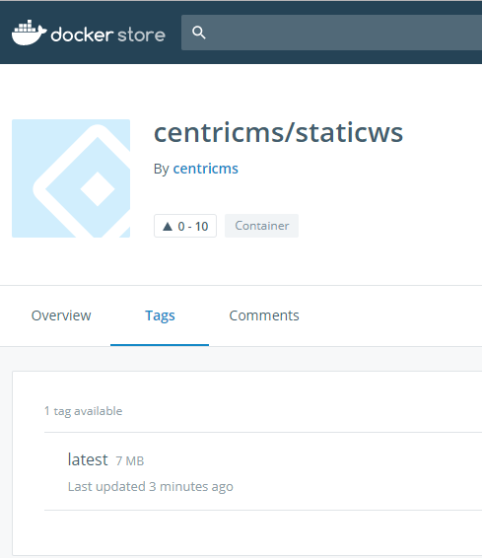
EXAMPLE PUSH
docker push centricms/staticws
The push refers to a repository [docker.io/centricms/staticws]
645034a2dbe2: Pushed
1690bc77acd5: Mounted from library/nginx
cbeb94c1f91a: Mounted from library/nginx
4bbeb364e643: Pushed
040fd7841192: Pushed
latest: digest: sha256:3b473ed6b592d06ea0f191972cf49ad13c62912733d8e0a7bb5c2a5319dbe5dd size: 1362

Slide 30
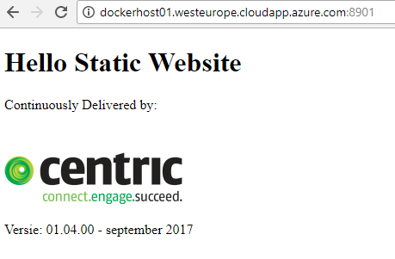
Example PULL FROM AZURE HOST
docker pull centricms/staticws:latest
latest: Pulling from centricms/staticws
ab14e39f58e6: Pull complete
206c8e58fb89: Pull complete
aeb57280dce6: Pull complete
9a661d863527: Pull complete
0459f9b530b7: Pull complete
Digest: sha256:3b473ed6b592d06ea0f191972cf49ad13c62912733d8e0a7bb5c2a5319dbe5dd
Status: Downloaded newer image for centricms/staticws:latest
docker container run --name staticws -d -p 8901:80 centricms/staticws:latest
Notes:
dockerhost01.westeurope.cloudapp.azure.com
Centric/Centric2017!
docker pull centricms/staticws:latest
docker container run --name staticws -d -p 8901:80 centricms/staticws:latest
http://dockerhost01.westeurope.cloudapp.azure.com:8901/

Slide 31
OUR WAY of WORKING
On laptop
GIT
VS CODE
DockerForWindows
Internet
GitHub
Docker Hub / Docker Store
Cloud
DockerHost on Azure

Slide 32
LAPTOP, internet, CLOUD

Slide 33
InstaLL
GIT
https://git-scm.com/download/win
VS CODE
https://code.visualstudio.com/docs/?dv=win32
Download GitHub repro
New directory
Clone repro
https://github.com/RenzoVeldkamp/MicroContainer
in directory
Git clone https://github.com/RenzoVeldkamp/MicroContainer.git

Slide 34
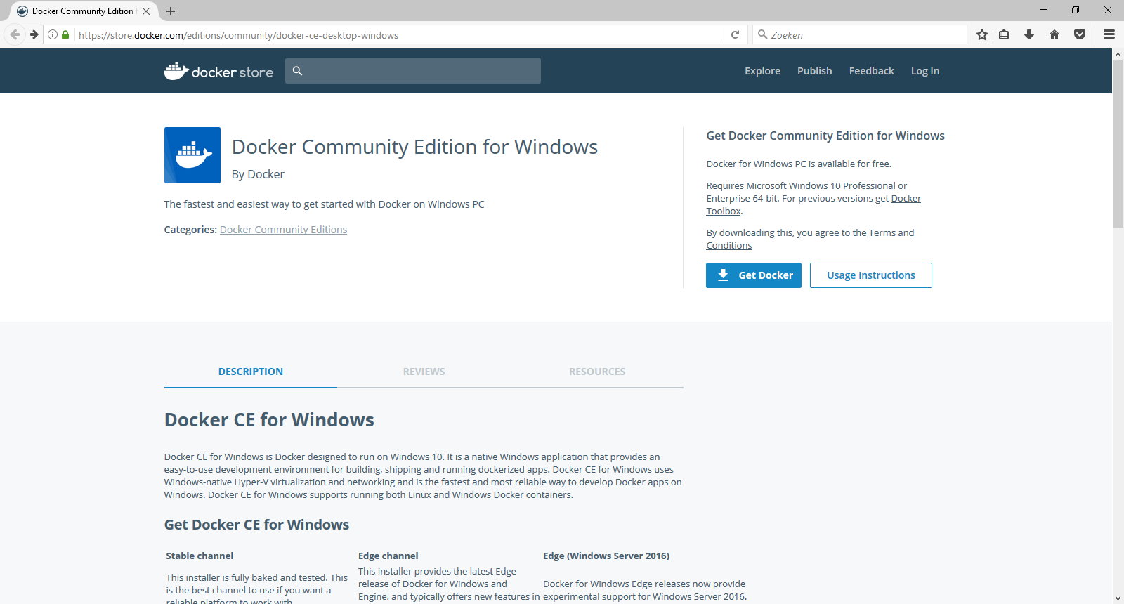
Docker downloaden
https://store.docker.com/editions/community/docker-ce-desktop-windows

Slide 35
WORKFLOW
Docker
registry
Push
image
Pull
Container
Code
Build
image
Run
container

Slide 36
Command LINE INTERFACE
How:
Powershell window in VS Code
Powershell
CMD
Docker <command>
Docker management commands
docker container <command>
docker image <command>
Docker –-help
https://docs.docker.com/engine/reference
Google search

Slide 37
Docker Command LINE INTERFACE
Build
Ship
Run
Docker image ls
Docker container run
Docker pull
Docker container ls
Docker image rm
Docker push
Docker container rm
Docker build
Docker container exec
Docker container start
Docker container stop
Docker system info
Docker system prune
Docker version
Notes:
docker system info
docker info
docker info
Command Line Interface

Slide 38
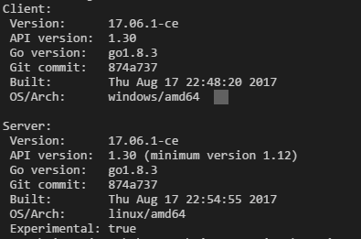
WHICH DOCKER VERSION
Docker version
Docker-compose version
Docker-machine version
Docker info
Lot of info

Slide 39
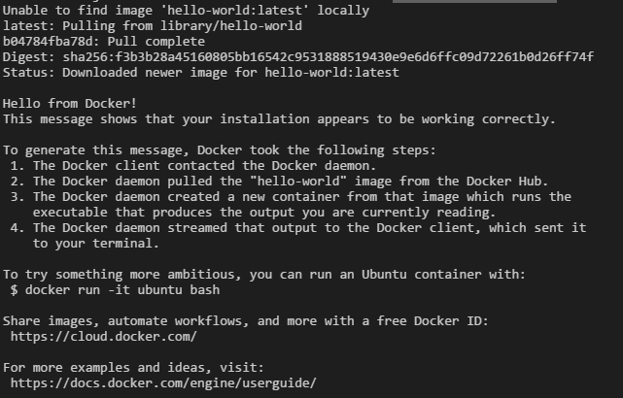
DOCKER RUNNING CORRECTLY?
docker container run hello-world

Slide 40
docker container RUN
docker container run hello-world
Run container with the content of image called hello-world
hello-world cannot be found on the DockerHost (Laptop)
hello-world will be pulled from the Docker Hub / Store
Hello-world will executed and end
docker docker run hello-world (once again)
Image on the Docker Host

Slide 41
WhiCH cONTAINERS ARE Runnning?
docker container ls
Will only show the running containers
Old command: docker ps
backwards compatible
docker container ls –a

Slide 42
EASE of Docker Ready to RUN - containers
Docker registry
Docker Hub
https://hub.docker.com/
Docker Store
Notes:
Hub - community
Store – private and paid official
Private on premise
Private
Official en unofficial
User-id / repro
Tags
Inloggen

Slide 43
EXAMPLE – EASE of Docker Ready to RUN - container
Run a Linux machine on my laptop - Alpine
Run a Docker UI - Portainer
We show:
Docker store (docker hub)
Pull image
Run container
Show result
Ship
Run
Image
Container
Notes:
https://store.docker.com/images/alpine

Slide 44
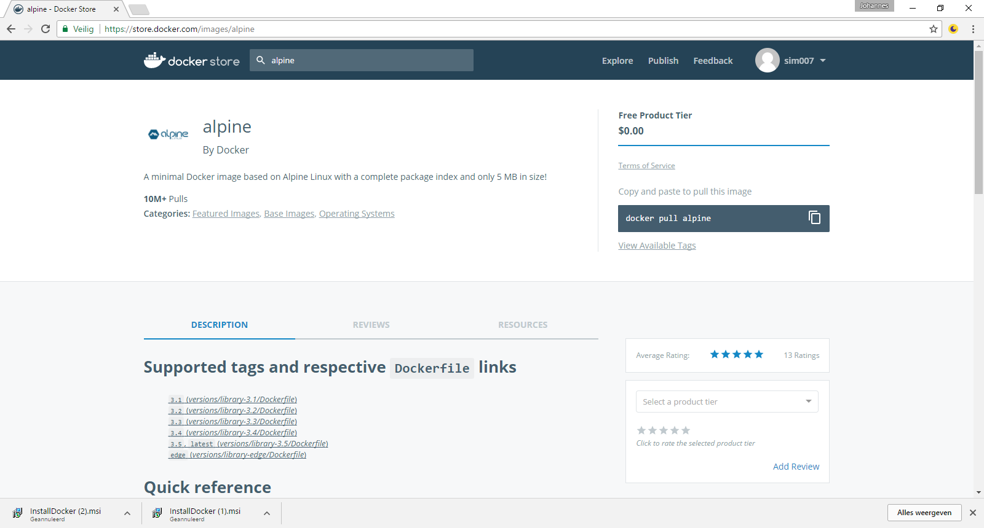
Alpine REPRO

Slide 45
LINUX ALPINE
Nr | Step | Commando
1 | Go to Docker store | https://store.docker.com/images/alpine
2 | Copy docker command | copy
3 | Go to Docker | docker pull alpine
4 | Run the container | docker container run –it alpine /bin/sh

Slide 46
GIVE some COMMANDS Alpine
 | Command
Linux version | cat /etc/*-release
 | Pwd
Show directory | ls
User | Whoami
Close Alpine container | Ctrl-D
Check if container is still running:
Docker container ls
Docker container ls -a
Notes:
docker pull alpine
docker run -it alpine /bin/sh
Alpine
cat /etc/*-release
Pwd
Ls
Whoami
exit
docker ps

Slide 47
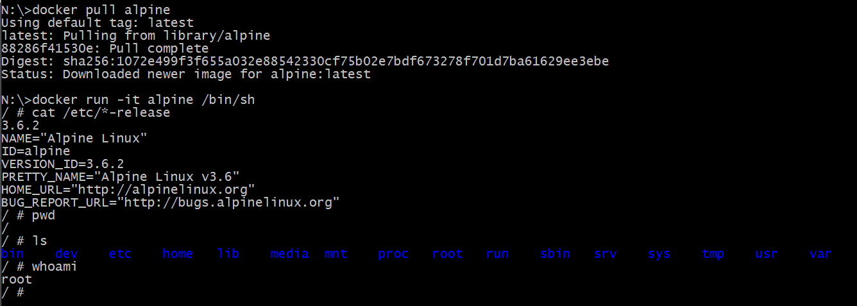
ALPINE result
Notes:
docker pull alpine
docker run -it alpine /bin/sh
Alpine
cat /etc/*-release
Pwd
Ls
Whoami
exit
docker ps

Slide 48
EXAmPLE – ease of DOCKER PORTAINER
Command:
docker container run -d -p 9000:9000 -v /var/run/docker.sock:/var/run/docker.sock portainer/portainer
Docker Store:
https://store.docker.com/community/images/portainer/portainer
Website:
https://portainer.io/
Documentation

Slide 49
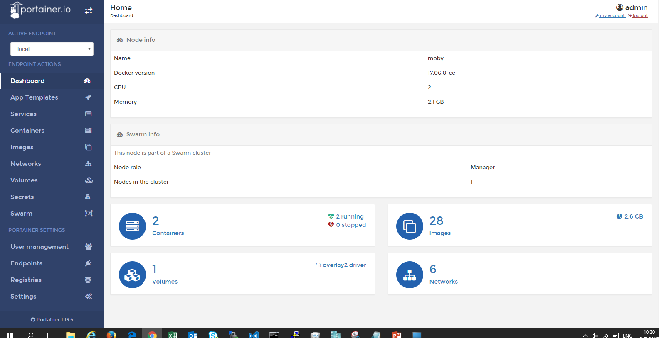
PoRTainer: a DOCKER UI DOCKER UI OR CLI?
docker container run -d -p 9000:9000 -v /var/run/docker.sock:/var/run/docker.sock portainer/portainer

Slide 50
EXPLAIN Configuration on runtime
docker container run -d -p 9000:9000 -v /var/run/docker.sock:/var/run/docker.sock portainer/portainer
 | Explain
docker container run | depricated command: docker run
-d | detached – run on background in the cli
-p <hostport> <container port> | publish
-v | use volume
Read more | https://docs.docker.com/engine/reference/commandline/container_run/

Slide 51
DOCKER Commands
Build
Ship
Run
Docker image ls
Docker container run
Docker pull
Docker container ls
Docker image rm
Docker push
Docker container rm
Docker build
Docker container exec
Docker container start
Docker container stop
Docker system info
Docker system prune
Docker version
Notes:
docker system info
docker info
docker info
Command Line Interface

Slide 52
EXAMPLE: OUR STATIC WEB SiTE
docker container run --name staticws -d -p 4200:80 centricms/staticws:latest
df16bf953be84b16fe3f8b67cd90d50a056b17b5a8a3fc4075a92634c3720b65

Slide 53
EXPLAIN DOCKER CONTAINER RUN
docker container run --name staticws -d -p 4200:80 centricms/staticws:latest
 | Explain
docker container run | Old command: docker run
--name | Container name Name must be unique!
-d | detached – run on background in the cli
-p <hostport> <container port> | publish 4200:80
<name image> | <user>/<name>:<tag>
Read more | https://docs.docker.com/engine/reference/commandline/container_run/

Slide 54
Multiple containers from 1 image
Try:
docker container run --name staticws –d –p 8000:80 centricms/staticws:latest
docker container run --name staticws –d –p 8000:80 centricms/staticws:latest
→ error same name
docker container run -d -p 8000:80 centricms/staticws:latest
docker container run -d -p 8000:80 centricms/staticws:latest
→ error same hostport
docker container run -d -p 8001:80 centricms/staticws:latest
docker container run -d -p 8002:80 centricms/staticws:latest
→ 3 static website

Slide 55
PuBLISH PORTS in a PICTURE
Container
Container
Container

Slide 56
Explain DOCKER LS
 | Explain
Container ID | Unique nuber
Image | 3 Containers from the same image
Start command | detached – run on background in the cli
Created
Status
Ports | Host port → container port / portocol
Names | No –name, Docker provide unique name
Read more

Slide 57
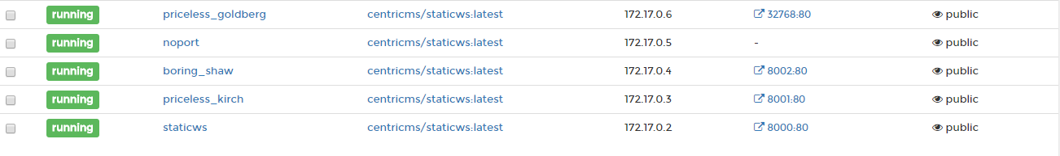
EXPLAIN - P, Docker will assign port

Slide 58
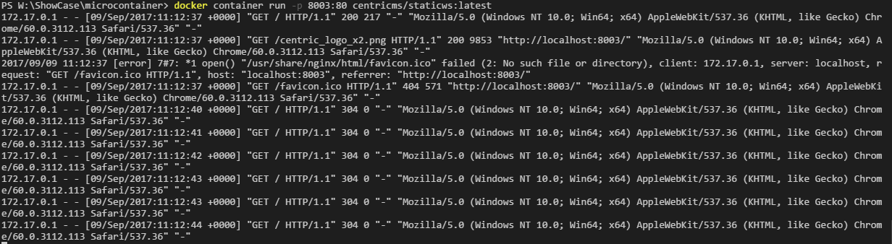
EXPLAIN -d -detached

Slide 59
DOCKER CONTAiNER COMMAND
Docker container run
new container from image
docker container run –rm – run, after stop remove
Docker container stop
Docker container start – container must exist
id or container- name

Slide 60
DOCKER EXEC
docker container exec -it <containername> /bin/sh
Look in the container
Depends on base image

Slide 61
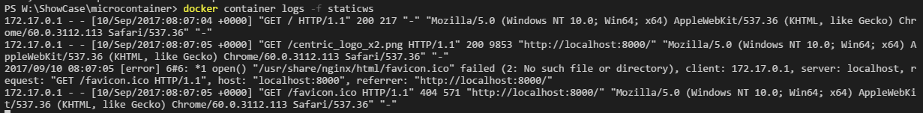
DOCKER LOGS
docker container logs –f

Slide 62
Remove DOCKER CONTAINER
Running & Stopped containers
Remove container
Docker container rm <container>
Remove running container
Docker container rm –f <container>
Remove all stopped contaners
Docker container prune

Slide 63
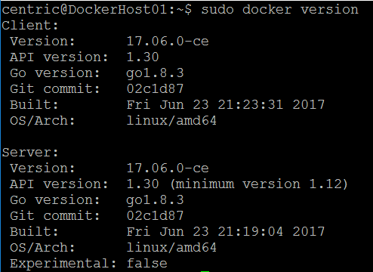
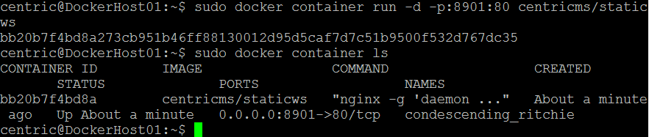
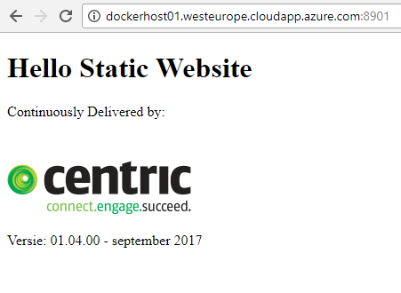
DEMO: RuN on AZURE
Notes:
Azure
Dockerhost01
Centric / Centric2017!
http://dockerhost01.westeurope.cloudapp.azure.com
Poort 8900 t/m 9000 open voor tcp
Azure:
Stel vast dockerhost01 draait
PUTTY
dockerhost01.westeurope.cloudapp.azure.com:22
Log in
Commando's met sudo
Doe het volgende
sudo docker version
sudo docker container ls
http://dockerhost01.westeurope.cloudapp.azure.com:8901
sudo Docker container run staticws

Slide 64
Docker Command
Build
Ship
Run
Docker image ls
Docker container run
Docker pull
Docker container ls
Docker image rm
Docker push
Docker container rm
Docker build
Docker container exec
Docker container start
Docker container stop
Docker system info
Docker system prune
Docker version
Notes:
docker system info
docker info
docker info
Command Line Interface

Slide 65
Docker REGISTRY
Ready to use:
DOCKER HUB / DOCKER STORE
Private registry
For companies & enterprises

Slide 66
DOCKER PUSH
You need a user-id on Docker Hub
Free of charge for public repro (images)
Docker login
Every repro (image) name must start with your user
Version – tag
Example
docker push centricms/staticws:latest

Slide 67
DOCKER IMAGE PULL
For Docker Hub / Store
No user-id needed
Official & open source
Official by Docker or supplier
Tips:
Use safe images: official, number of pull, rating, now the owner
Intelligent download (only chages)
Image is first search on local DockerHost

Slide 68
Docker Command
Build
Ship
Run
Docker image ls
Docker container run
Docker pull
Docker container ls
Docker image rm
Docker push
Docker container rm
Docker image build
Docker container exec
Docker container start
Docker container stop
Docker system info
Docker system prune
Docker version
Notes:
docker system info
docker info
docker info
Command Line Interface

Slide 69
DOCKERFILE
Recipe or blue print
Each line will be layer
Each layer will be cached

Slide 70
WHAT is IMAGE? - REVISTED
Image = stack of layers
Made by:
Dockerfile = receipe or blue print
Docker commit – seldom use – not in this Docker 101
Container made from mage must run on any environment

Slide 71
DOCKER BUILD - DOCKERIZE
DOCKERIZE = PACKAGE application in a Docker image
Image / container
consist every dependency
Small
Secure
….
Best practice:
Use the same image for very environement

Slide 72
TOPIC: DOCKER BUILD DockerFILE
Dockerfile: Recipe or blue print
Base image
FROM SCRATCH
KNOWN TRUSTED IMAGE (OFFICIAL)

Slide 73
TopIC: Version
TAG
Latest
Just a tag!
use with care
No tag: build - snapshot
Base OS
Alpine – Docker default - small
Debian
Windows

Slide 74
DoCKERFILE FOR StaticWS
Goal & requirement:
Static website that can run on laptop and Azure
Easy webserver – use nginx
Fit in the our way of working (CD flow)
Build a Docker image
Image = stack of layers
Dockerfile = receipe or blue print

Slide 75
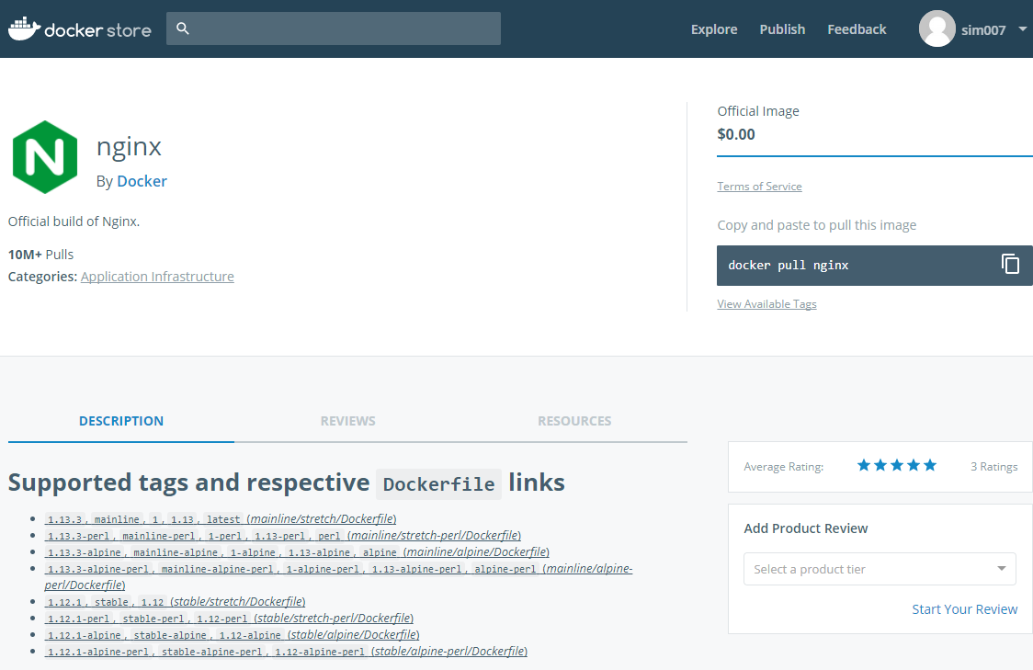
Search for NgINX

Slide 76
DOCKER BUILD
Make Dockerfile
Base on base image
From docker Store
From scratch
Copy static files to the correct directory
Build the image with:
Docker image build –t <name> .
Tips
Default filename is Dockerfile
CLI must be in the same directory as Dockerfile
Do not use netdrive or on W10

Slide 77
ExPLain DOCKER BUILD
Docker image build –t <name> .
 | Explain
docker image build | depricated command: docker build
-t <name> | Tag a unique name
. | directory
Read more | https://docs.docker.com/engine/reference/commandline/image_build/

Slide 78
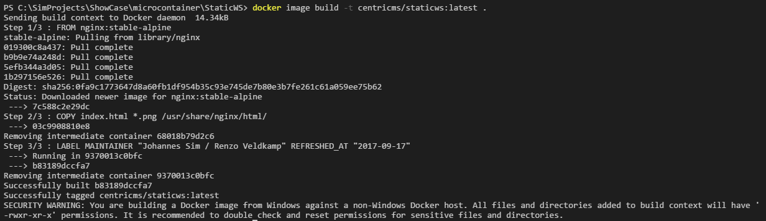
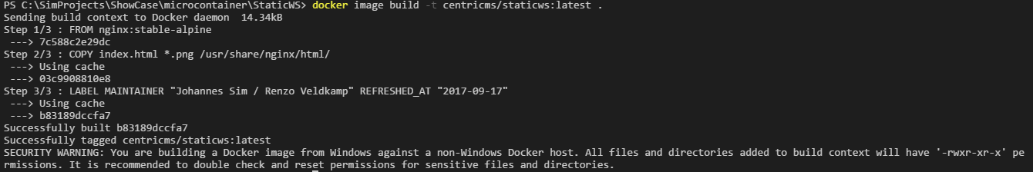
Example OUTPUT (first TIME and repeat)

Slide 79
Command DOCKER IMAGE
Docker image --help | List options for docker image
Docker image ls | List docker images | Listed deprecated: Docker images Image has id and repo name
Docker history <image> | Give Dockerfile commands
Docker inspect <image> | Lot information

Slide 80
Docker Command LINE INTERFACE
Build
Ship
Run
Docker image ls
Docker container run
Docker pull
Docker container ls
Docker image rm
Docker push
Docker container rm
Docker build
Docker container exec
Docker container start
Docker container stop
Docker system info
Docker system prune
Docker system version
Notes:
docker system info
docker info
docker info
Command Line Interface

Slide 81
Command DOCKER IMAGE
Docker system prune | Delete all not running containers and used images
Docker system prune -a | Delete all containers and images | Clean docker environment
df | Show docker disk usage
events | Get real time events from the server
info | Display system-wide information

Slide 82
SummaRY: our WorkFLOW
What is on the laptop?
Static website
Build
Build the image
Ship –Flow
Push to Docker Hub / Docker Store
Pull from Docker Hub / Docker Store
Run
Run on Laptop
Run on Azure host

Slide 83
LAB: MICROservices

Slide 84
LAB IMMUTable container
Start an alpine container
Add a file Centric in home directory
echo “deze file heet centric” >> centric
Stop the container with exit
Case 1: start new container
docker container –it alpine sh
Result: no file Centric
Case 2: start old container
docker container ls –a (find the container-id)
docker container start <id>
docker exec -it <id>
Result: Centric file

Slide 85
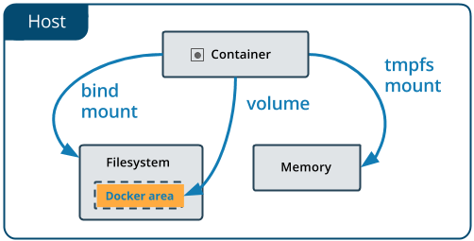
LAB DOCKER VOLUME
DEV flow – dev mode
Changes in code change without building

Slide 86
LAB EXPORT & IMPORT
Ship without docker registry
Docker export
Docker import

Slide 87
Old

Slide 88
Course overview
Day 1
Day 2
Microservices
Docker
Microservices
Docker
1
Introduction
Recap day1 & queries
2
MS 101
MS 102
3
Docker 101
Docker 102
4
Workshop
Workshop
5
Wrap-up & queries
Wrap-up

Slide 89
Docker EXAMPLES
.net site
Jenkins
Benchmark security test

Slide 90
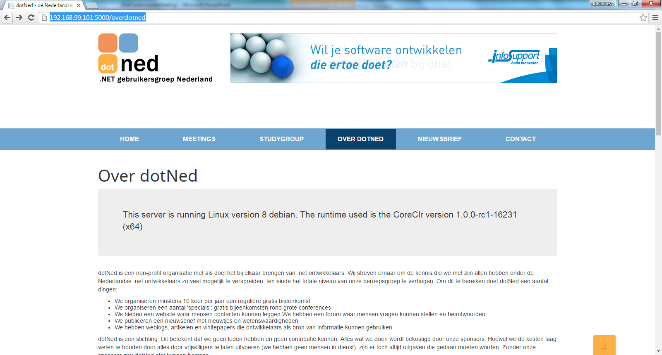
Voorbeeld: .net site in Docker container

Slide 91
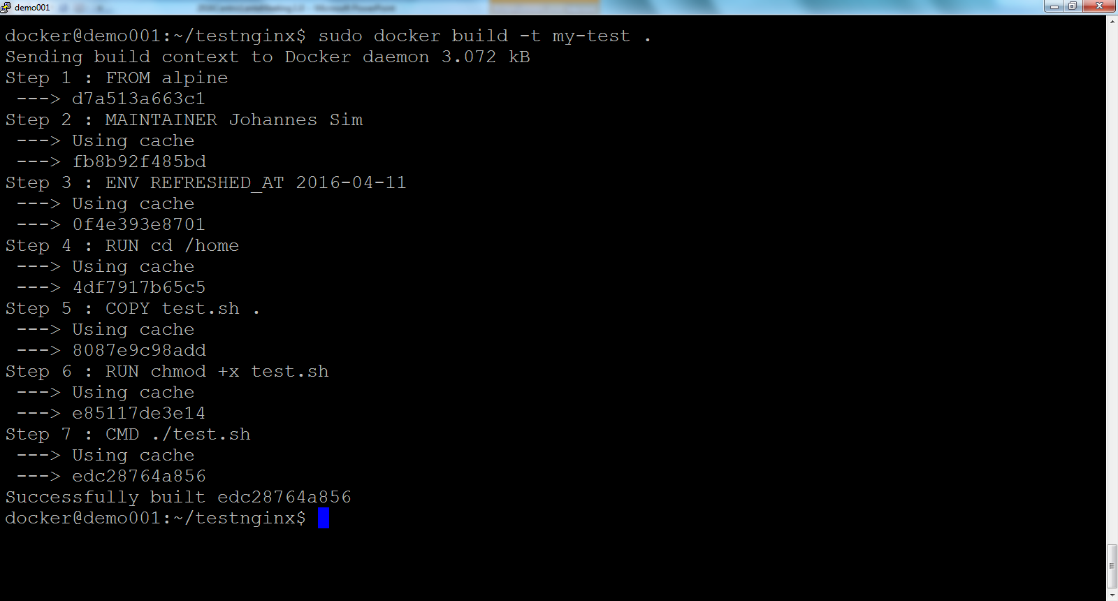
VOORBEELD: build test container

Slide 92
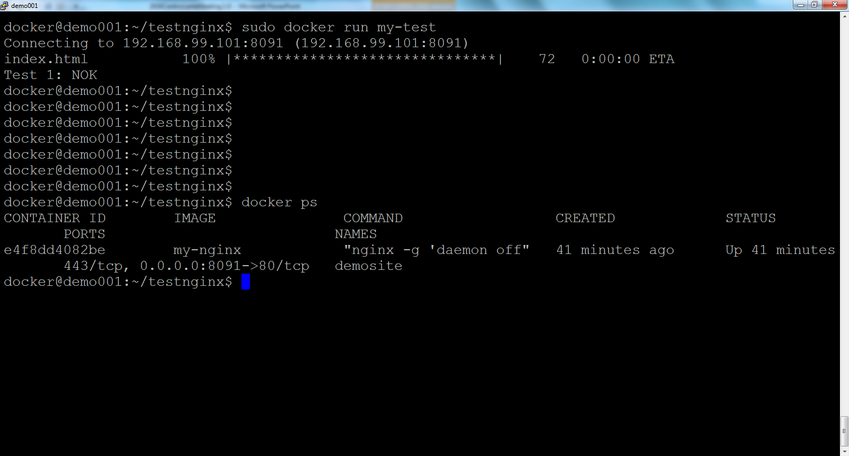
VOORBEELD: RUN TeSTCONTAINER

Slide 93
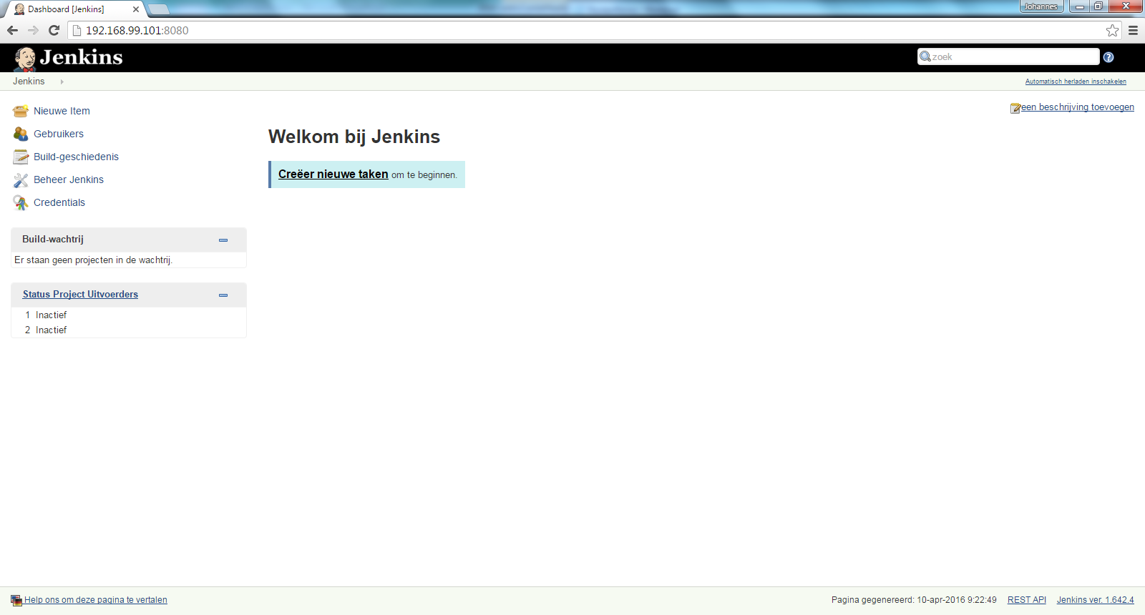
Voorbeeld: Jenkins in Docker container

Slide 94
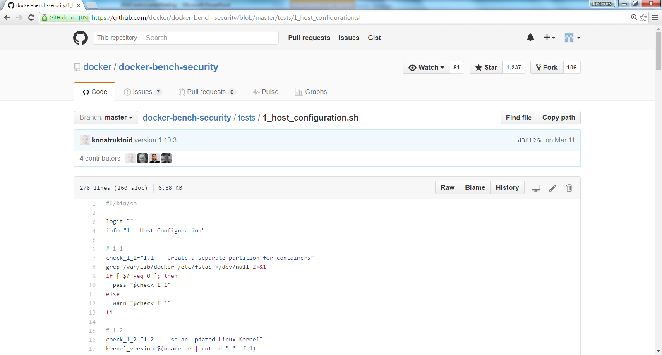
VOORBEELD: Testscript in GIT

Slide 95
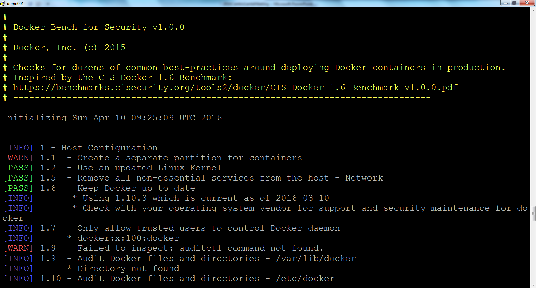
Voorbeeld: Test in Docker container

