Slide 1

Docker 101
Notes:
Goedeavond
Mijn naam is Johannes Sim.

Slide 2
Docker 101
Goal:
Practical 101 Docker
Tell / Show / DIY
Key take away:
What Docker is and can do for you
Doing with Docker with confidence
Audience: DEV collegues

Slide 3
DISCLAIMER
Our view and way of working of Docker
Docker is changing constantly
Version CE 17.06.2.-ce

Slide 4
CoNTENT Docker 101
Why Docker?
What is Docker?
Example demo
static website in 1 container on 1 DockerHost
Linux host / Docker UI / .Net
(our) Docker workflow
Docker commands explained
Static website
Some Topics

Slide 5
OUR DOCKER FOUND on INTERNET
is the world's leading software container platform
available for developers, ops and businesses
to build, ship and run
any app
on any infrastructure.
Notes:
Waarom deze deze definitie:
World leading op dit moment
Container = Docker
Actors: dev / ops /business
ANY app (microservice / monolit / enz)
Infra (laptop / server on premise / cloud

Slide 6
WHY Docker?
Time to Market
DevOps
Continuous Integration / Continuous Delivery
Time from commit to in production
No more: works on my laptop
Notes:
DevOps
Time to Market
Time from commit to in production
Continuous Delivery
Build – Ship – Run
Works on my laptop
UseCase
Linux tool
Package manager

Slide 7
Some User storIES
As PO I want a static website which I can deploy the static website as container and an easy process to change it
As DEV I want to build the website only once and be sure that it is the same software
As OPS I want the same software (in a container) in each environment
As Bus I want a short time to market

Slide 8
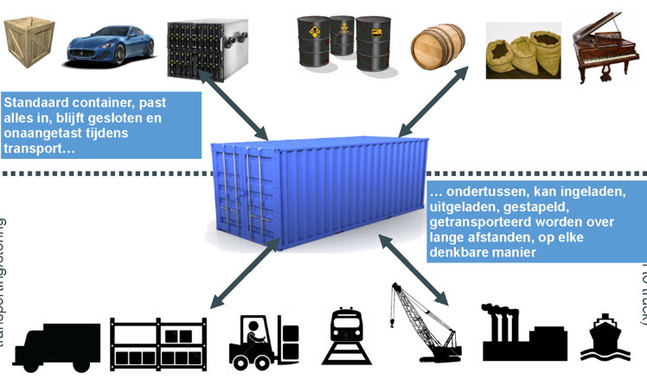
APP in A Container

Slide 9
Docker “Concepts”
Build once – run anywhere
Container in “production”
Everything what is needed and nothing more
1 process – 1 task
Immutable
Build – Ship - Run
Works on my machine
DEVOPS
Continuous Integration / Continuous Delivery

Slide 10
WHat is?
Container
Image
Registry – Docker Hub – Docker store
Notes:
Container == running image
Image = class
Container = instance
One image, many containers
Containers are immutable

Slide 11
Build – SHIP - RUN
Build
Ship
Run
DEV
Docker Registry
OPS
Dockerfile
Docker Hub
Container
Docker Store
Docker-compose
Image
App store
Swarm mode

Slide 12
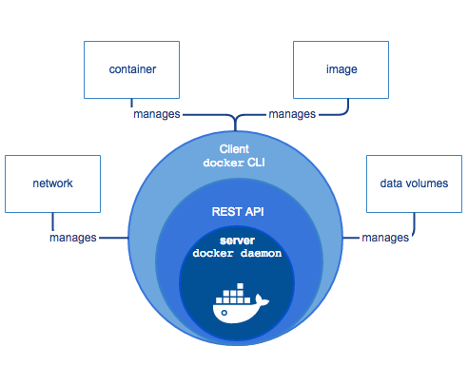
DOCKER ARCHITECTURE HigH LEVEL
https://docs.docker.com/engine/docker-overview/
Notes:
High Level overview
Docker CLI
Docker API
Docker Deamon
https://docs.docker.com/engine/docker-overview/

Slide 13
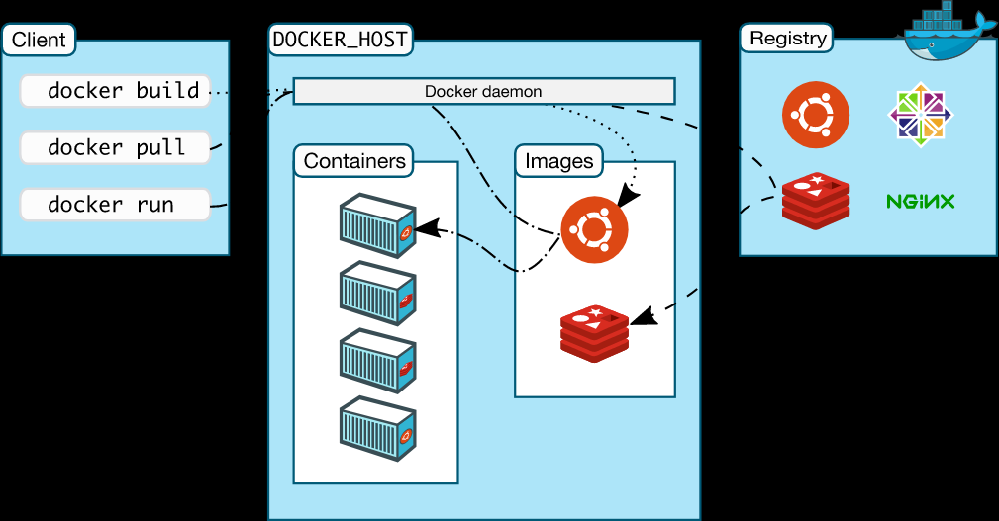
DOCKER ARCHITECTURE HigH LEVEL
https://docs.docker.com/engine/docker-overview/
Notes:
High Level overview
Docker CLI
Docker API
Docker Deamon
https://docs.docker.com/engine/docker-overview/

Slide 14
TOPIC: VM versus Container
Notes:
Zie
DeepdiveDocker
Apartementgebouw
Use Case
Docker on VM (DC, Azure)

Slide 15
Topic: DOCKER versionS
Notes:
Docker 1.13 = Docker 17.03
CE is production ready
2 release channels
Edge each month
Stable each 3 month
Diagram
predictable

Slide 16
Example: OUR Container WORKFLOW
Static website
HTML pagina on Webserver nginx
Code: HTML
Dockerfile
Build an image
Run container
Show result
Push to registry
Pull from registry
Run Azure DockerHost
Notes:
Starten van

Slide 17
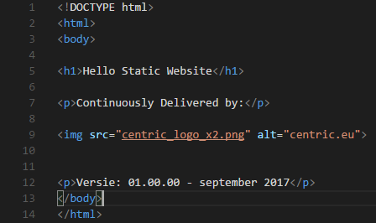
Example: HTML

Slide 18

Example DockerFILE

Slide 19
Example: BUILD

Slide 20
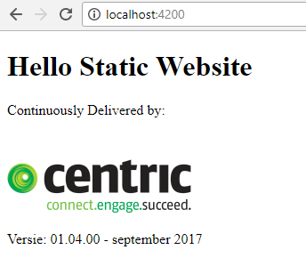
Example DOCKER RUN
docker container run --name staticws -d -p 4200:80 centricms/staticws:latest
df16bf953be84b16fe3f8b67cd90d50a056b17b5a8a3fc4075a92634c3720b65

Slide 21
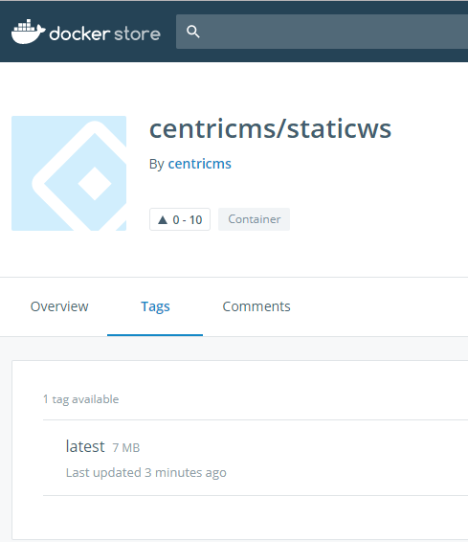
EXAMPLE PUSH
docker push centricms/staticws
The push refers to a repository [docker.io/centricms/staticws]
645034a2dbe2: Pushed
1690bc77acd5: Mounted from library/nginx
cbeb94c1f91a: Mounted from library/nginx
4bbeb364e643: Pushed
040fd7841192: Pushed
latest: digest: sha256:3b473ed6b592d06ea0f191972cf49ad13c62912733d8e0a7bb5c2a5319dbe5dd size: 1362

Slide 22
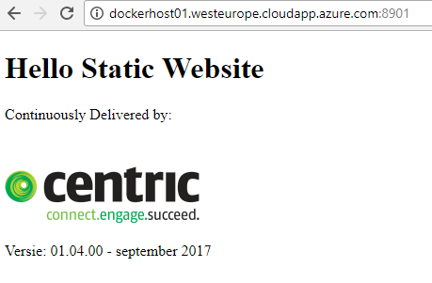
Example PULL FROM AZURE HOST
docker pull centricms/staticws:latest
latest: Pulling from centricms/staticws
ab14e39f58e6: Pull complete
206c8e58fb89: Pull complete
aeb57280dce6: Pull complete
9a661d863527: Pull complete
0459f9b530b7: Pull complete
Digest: sha256:3b473ed6b592d06ea0f191972cf49ad13c62912733d8e0a7bb5c2a5319dbe5dd
Status: Downloaded newer image for centricms/staticws:latest
docker container run --name staticws -d -p 8901:80 centricms/staticws:latest
Notes:
dockerhost01.westeurope.cloudapp.azure.com
Centric/Centric2017!
docker pull centricms/staticws:latest
docker container run --name staticws -d -p 8901:80 centricms/staticws:latest
http://dockerhost01.westeurope.cloudapp.azure.com:8901/

Slide 23
OUR WAY of WORKING
On laptop
GIT
VS CODE
DockerForWindows
Internet
GitHub
Docker Hub / Docker Store
Cloud
DockerHost on Azure

Slide 24
LAPTOP, internet, CLOUD

Slide 25
Needed on Laptop
GIT
VS CODE
DockerForWindows
Browser (Chrome)

Slide 26
InstaLL
GIT
https://git-scm.com/download/win
VS CODE
https://code.visualstudio.com/docs/?dv=win32
Download GitHub repro
New directory
Clone repro
https://github.com/RenzoVeldkamp/MicroContainer
in directory
Git clone https://github.com/RenzoVeldkamp/MicroContainer.git

Slide 27
INSTALL DockerFORWINDOWS
https://docs.docker.com/docker-for-windows/install/#download-docker-for-windows

Slide 28
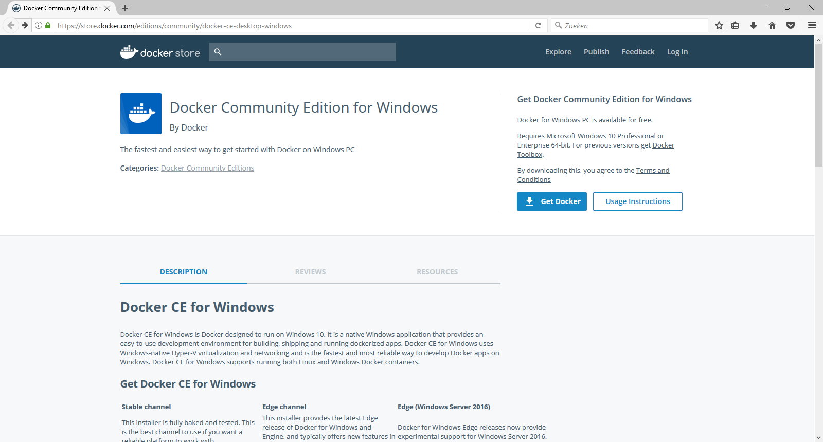
Docker downloaden
https://store.docker.com/editions/community/docker-ce-desktop-windows

Slide 29
Docker Command LINE INTERFACE
Build
Ship
Run
Docker image ls
Docker container run
Docker pull
Docker container ls
Docker image rm
Docker push
Docker container rm
Docker build
Docker container exec
Docker container start
Docker container stop
Docker system info
Docker system prune
Docker version
Notes:
docker system info
docker info
docker info
Command Line Interface

Slide 30
Command LINE INTERFACE
How:
Powershell window in VS Code
Powershell
CMD
Docker <command>
Docker management commands
docker container <command>
docker image <command>
Docker –-help
https://docs.docker.com/engine/reference
Google search

Slide 31
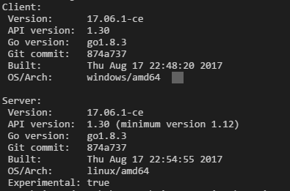
WHICH VERSION
Docker version
Docker-compose version
Docker-machine version
Docker info
Lot of info

Slide 32
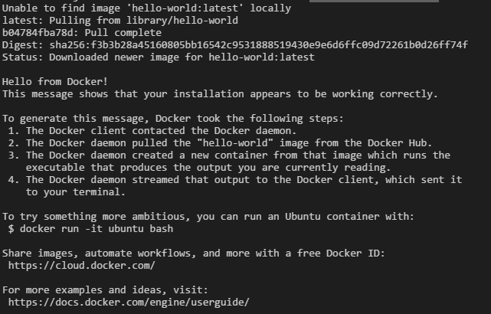
Check Docker: PULL AND RUN
docker container run hello-world

Slide 33
EXPLAIN docker container RUN
docker container run hello-world
Run container with the content of image called hello-world
hello-world cannot be found on the Docker Host
hello-world will be pulled from the Docker Hub / Store
Hello-world will executed and end
docker docker run hello-world
Image on the Docker Host

Slide 34
WhiCH cONTAINERS ARE Runnning?
docker container ls
Will only show the running containers
Old command: docker ps
backwards compatible
docker container ls –a

Slide 35
EXAMPLE – EASE of Docker Ready to RUN - container
Docker registry
Docker Hub
https://hub.docker.com/
Docker Store
Notes:
Hub - community
Store – private and paid official
Private on premise
Private
Official en unofficial
User-id / repro
Tags
Inloggen

Slide 36
EXAMPLE – EASE of Docker Ready to RUN - container
Run a Linux machine on my laptop - Alpine
Run a Docker UI - Portainer
We show:
Docker store (docker hub)
Pull image
Run container
Show result
Notes:
https://store.docker.com/images/alpine

Slide 37
LINUX ALPINE
Nr | Step | Commando
1 | Go to Docker store | https://store.docker.com/images/alpine
2 | Copy docker command | copy
3 | Go to Docker | docker pull alpine
4 | Run the container | docker container run –it alpine /bin/sh

Slide 38
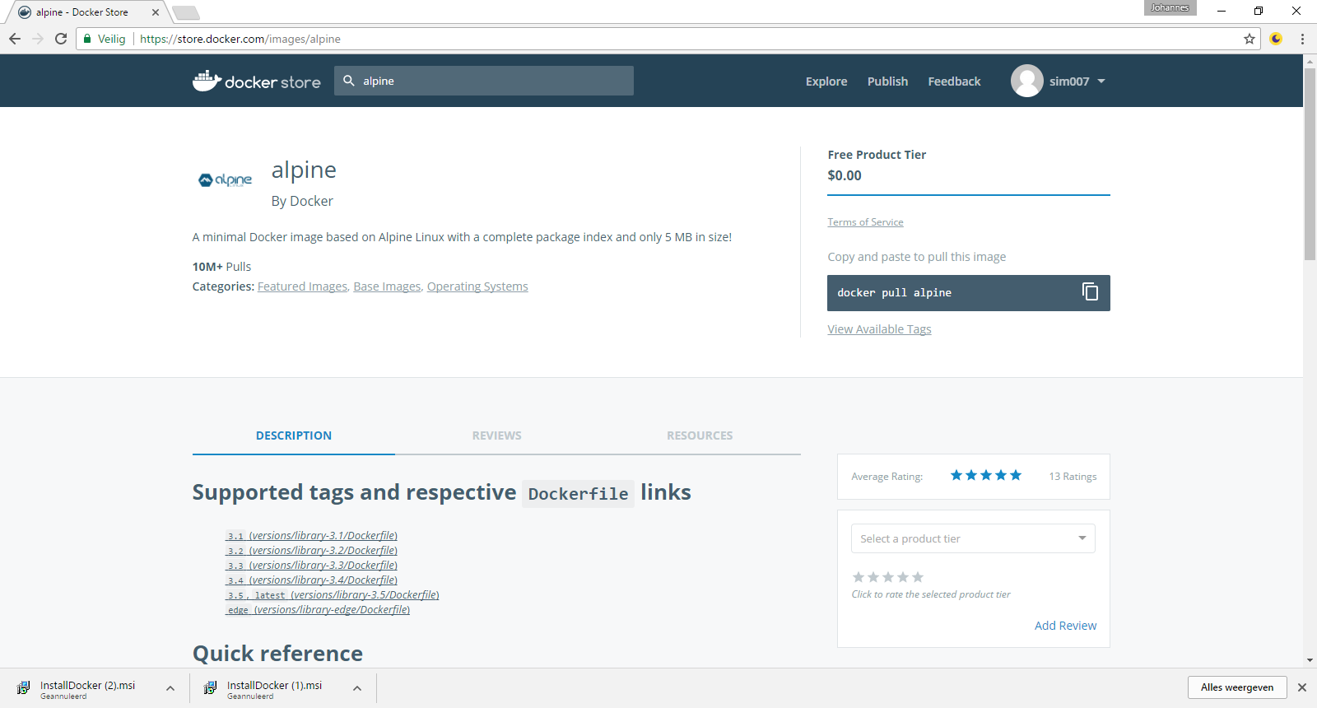
Alpine REPRO

Slide 39
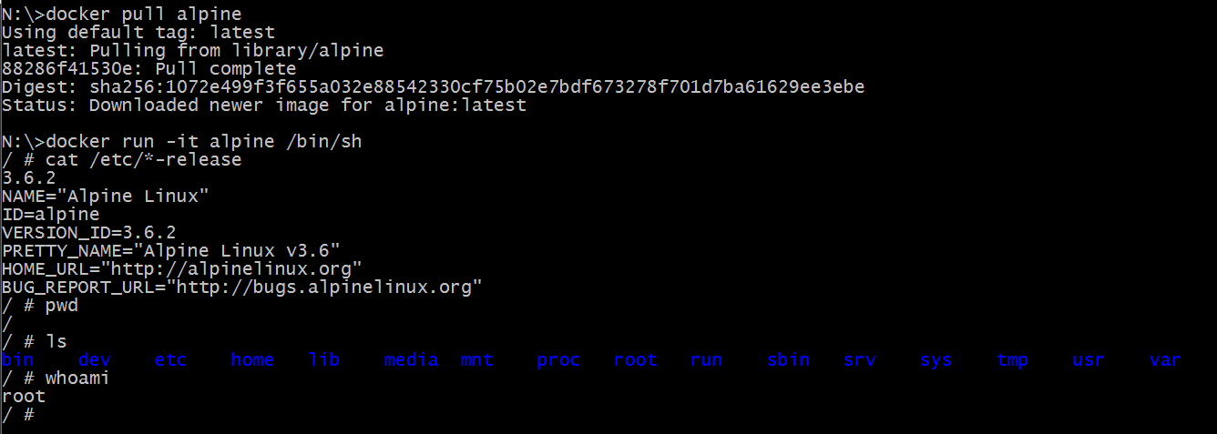
Alpine - DEMO
Notes:
docker pull alpine
docker run -it alpine /bin/sh
Alpine
cat /etc/*-release
Pwd
Ls
Whoami
exit
docker ps

Slide 40
EXAmPLE – ease of DOCKER PORTAINER
Command:
docker container run -d -p 9000:9000 -v /var/run/docker.sock:/var/run/docker.sock portainer/portainer
Docker Store:
https://store.docker.com/community/images/portainer/portainer
Website:
https://portainer.io/
Documentation

Slide 41
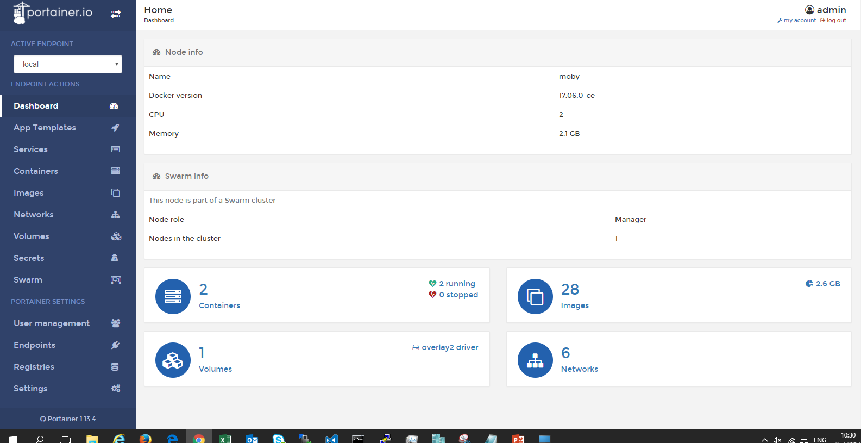
EXAMPLE – EASE of Docker PoRTainer
docker run -d -p 9000:9000 -v /var/run/docker.sock:/var/run/docker.sock portainer/portainer

Slide 42
ExPLain
docker container run -d -p 9000:9000 -v /var/run/docker.sock:/var/run/docker.sock portainer/portainer
 | Explain
docker container run | Old command: docker run
-d | detached – run on background in the cli
-p <hostport> <container port> | publish
-v | use volume
Read more | https://docs.docker.com/engine/reference/commandline/container_run/

Slide 43
Build
Ship
Run
Docker image ls
Docker container run
Docker pull
Docker container ls
Docker image rm
Docker push
Docker container rm
Docker build
Docker container exec
Docker container start
Docker container stop
Docker system info
Docker system prune
Docker version
Notes:
docker system info
docker info
docker info
Command Line Interface

Slide 44
STATICWS
docker container run --name staticws -d -p 4200:80 centricms/staticws:latest
df16bf953be84b16fe3f8b67cd90d50a056b17b5a8a3fc4075a92634c3720b65

Slide 45
EXPLAIN DOCKER CONTAINER RUN
docker container run --name staticws -d -p 4200:80 centricms/staticws:latest
 | Explain
docker container run | Old command: docker run
--name | Container name Name must be unique!
-d | detached – run on background in the cli
-p <hostport> <container port> | publish 4200:80
<name image> | <user>/<name>:<tag>
Read more | https://docs.docker.com/engine/reference/commandline/container_run/

Slide 46
Multiple containers from 1 image
Try:
docker container run --name staticws –d –p 8000:80 centricms/staticws:latest
docker container run --name staticws –d –p 8000:80 centricms/staticws:latest
→ error same name
docker container run -d -p 8000:80 centricms/staticws:latest
docker container run -d -p 8000:80 centricms/staticws:latest
→ error same hostport
docker container run -d -p 8001:80 centricms/staticws:latest
docker container run -d -p 8002:80 centricms/staticws:latest
→ 3 static website

Slide 47
EXPlain PuBLISH
Container
Container
Container

Slide 48
Explain DOCKER LS
 | Explain
Container ID | Unique nuber
Image | 3 Containers from the same image
Start command | detached – run on background in the cli
Created
Status
Ports | Host port → container port / portocol
Names | No –name, Docker provide unique name
Read more

Slide 49
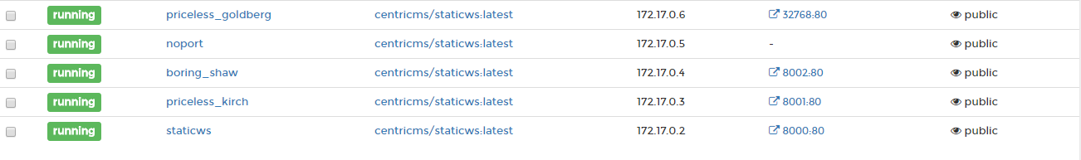
EXPLAIN - P, Docker will assign port

Slide 50
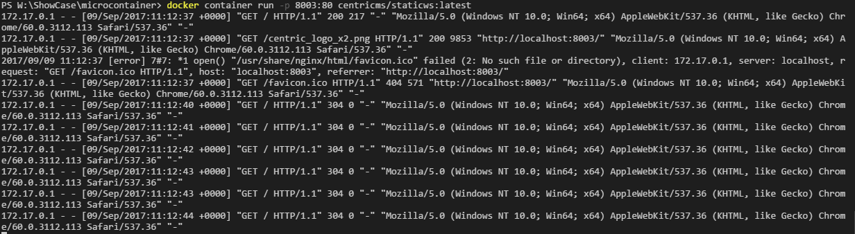
EXPLAIN -d -detached

Slide 51
DOCKER CONTAiNERS COMMAND
Docker container run
new container from image
docker container run –rm – run, after stop remove
Docker container stop
Docker container start – container must exist
id or container- name

Slide 52
DOCKER EXEC
docker container exec -it <containername> /bin/sh
Look in the container
Depends on base image

Slide 53
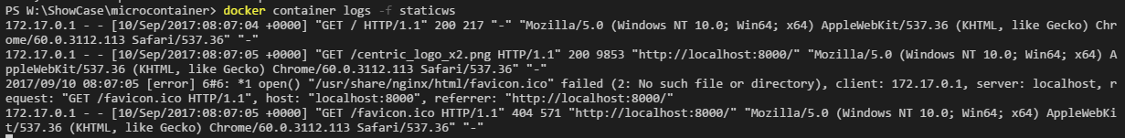
DOCKER LOGS
docker container logs –f

Slide 54
Remove DOCKER CONTAINER
Running & Stop containers
Remove container
Docker container rm <container>
Remove running container
Docker container rm –f <container>
Remove all stopped contaners
Docker container prune

Slide 55
DEMO: RuN on AZURE

Slide 56
Docker Command LINE INTERFACE
Build
Ship
Run
Docker image ls
Docker container run
Docker pull
Docker container ls
Docker image rm
Docker push
Docker container rm
Docker build
Docker container exec
Docker container start
Docker container stop
Docker system info
Docker system prune
Docker version
Notes:
docker system info
docker info
docker info
Command Line Interface

Slide 57
Docker REGISTRY
Ready to use:
DOCKER HUB / DOCKER STORE
Private registry
For companies & enterprises

Slide 58
DOCKER PUSH
You need a user-id on Docker Hub
Free of charge for public repro (images)
Docker login
Every repro (image) name must start with your user
Version – tag
Example
docker push centricms/staticws:latest

Slide 59
DOCKER IMAGE PULL
For Docker Hub / Store
No user-id needed
Official & open source
Official by Docker or supplier
Tips:
Use safe images: official, number of pull, rating, now the owner
Intelligent download (only chages)
Image is first search on local DockerHost

Slide 60
Docker Command LINE INTERFACE
Build
Ship
Run
Docker image ls
Docker container run
Docker pull
Docker container ls
Docker image rm
Docker push
Docker container rm
Docker build
Docker container exec
Docker container start
Docker container stop
Docker system info
Docker system prune
Docker version
Notes:
docker system info
docker info
docker info
Command Line Interface

Slide 61
WHAT is IMAGE?
Image = stack of layers
Made by:
Dockerfile = receipe or blue print
Docker commit – seldom use – not in this Docker 101
Container made from mage must run on any environment

Slide 62
EXAMPLE DOCKER BUILD - DOCKERIZE
DOCKERIZE = PACKAGE application in Docker image
Image must be:
Every dependency
Small
Secure
….
Use the same image in CD flow

Slide 63
TOPIC: DOCKER BUILD

Slide 64
TopIC: Version
TAG
Latest

Slide 65
DoCKER FILE FOR StaticWS
Goal & rquirement:
Static website that can run on laptop and Azure
Easy webserver – use nginx
Fit in the CD-flow (way of working)
Build a Docker image
Image = stack of layers
Dockerfile = receipe or blue print

Slide 66
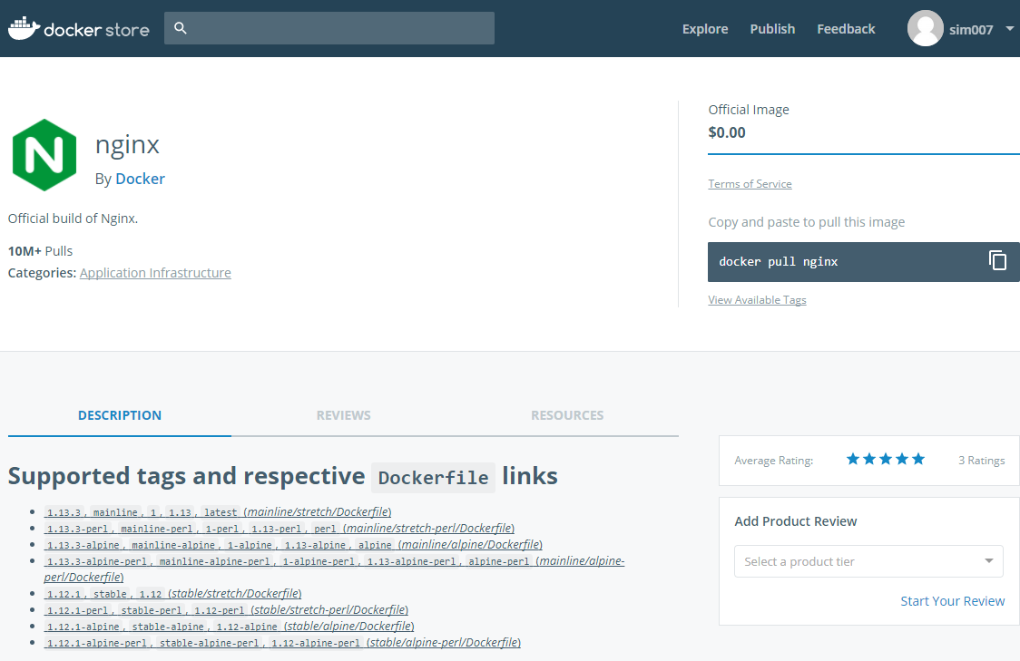
Search for NgINX

Slide 67
DOCKER BUILD
Make Dockerfile
Base on base image
From docker Store
From scratch
Copy static files to correct directory
Build the image with:
Docker build –t <name> .
Tips
Dockerfile
CLI must be in the same directory as Dockerfile
Do not use netdrive or on W10

Slide 68
Summary our Work FLOW
What is on the laptop?
Static website
Build
Build the image
Ship –Flow
Push to Docker Hub / Docker Store
Pull from Docker Hub / Docker Store
Run
Run on Laptop
Run on Azure host

Slide 69
Docker Command LINE INTERFACE
Build
Ship
Run
Docker image ls
Docker container run
Docker pull
Docker container ls
Docker image rm
Docker push
Docker container rm
Docker build
Docker container exec
Docker container start
Docker container stop
Docker system info
Docker system prune
Docker version
Notes:
docker system info
docker info
docker info
Command Line Interface

Slide 70
IMMUTable container EXAMPLE
Start an alpine container
Add a file Centric in home directory
echo “deze file heet centric” >> centric
Stop the container with exit
Case 1: start new container
docker container –it alpine sh
Result: no file Centric
Case 2: start old container
docker container ls –a (find the container-id)
docker container start <id>
docker exec -it <id>
Result: Centric file

Slide 71
Old

Slide 72
Course overview
Day 1
Day 2
Microservices
Docker
Microservices
Docker
1
Introduction
Recap day1 & queries
2
MS 101
MS 102
3
Docker 101
Docker 102
4
Workshop NodeJS example
Workshop .Net example
5
Wrap-up & queries
Wrap-up

Slide 73
On YOUR Laptop

Slide 74
Docker DeMO
Docker installeren
Docker CLI interface
“hello world”
.net site
Webserver + test
Jenkins
Benchmark security test
Docker UI / Kitematic

Slide 75

Samenvattend: DOCKER MODEL
DEV “bepaalt” de stack
Dezelfde Container (running image) op iedere omgeving
1 Registry voor images
image = interface (tussen DEV en OPS)
API (Application Program Interface)

Slide 76
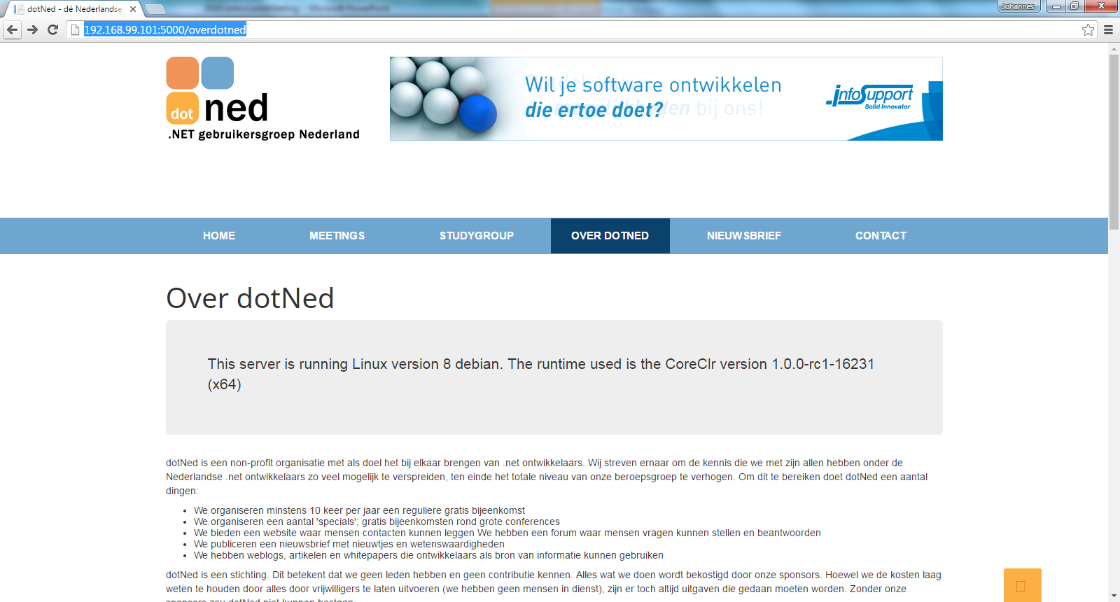
Voorbeeld: .net site in Docker container

Slide 77
CD PIPeLINE
Notes:
It depens uiteraard op de context.
Wat missen jullie?
OTAP
Quality gates

Slide 78
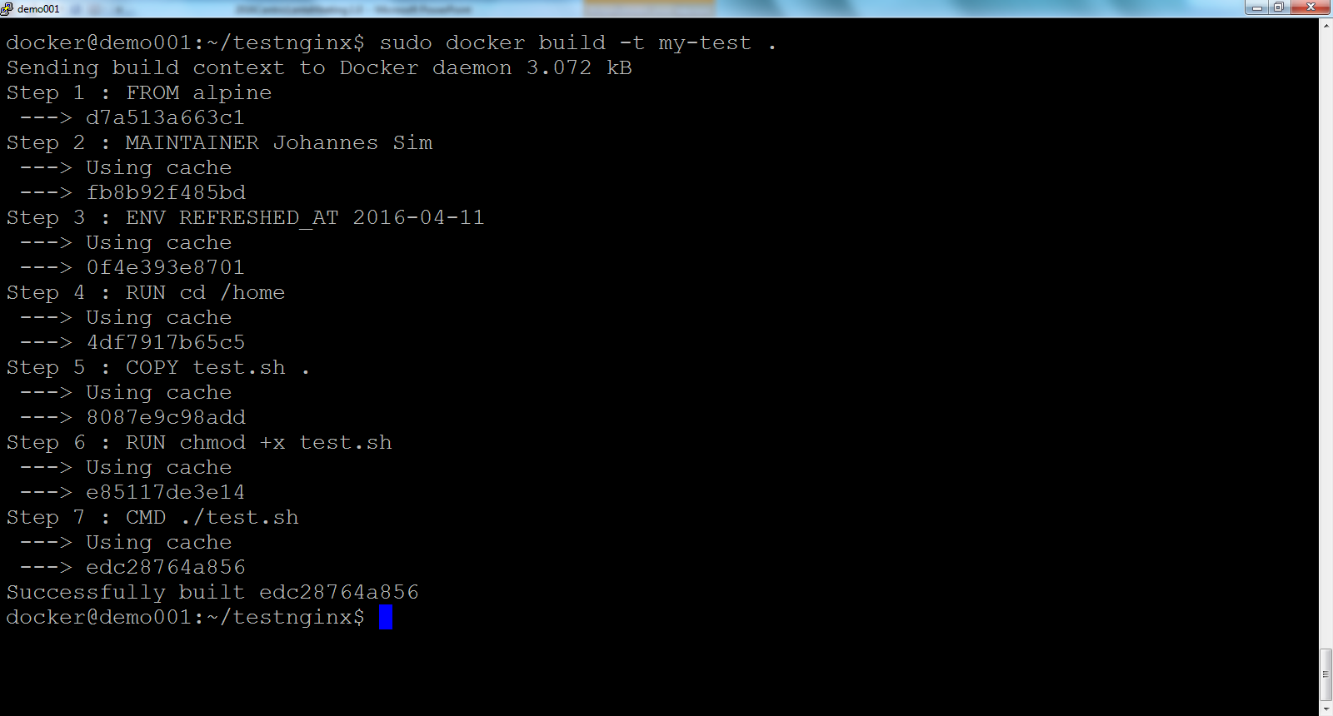
VOORBEELD: build test container

Slide 79
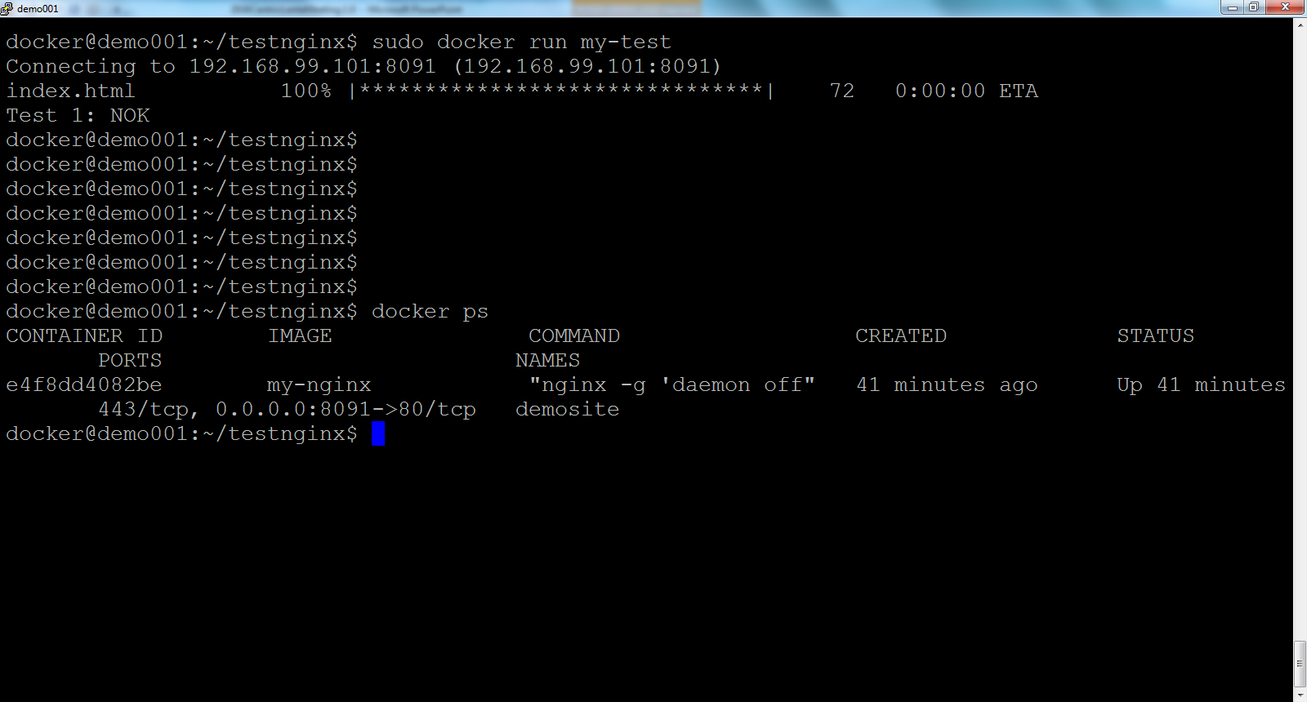
VOORBEELD: RUN TeSTCONTAINER

Slide 80
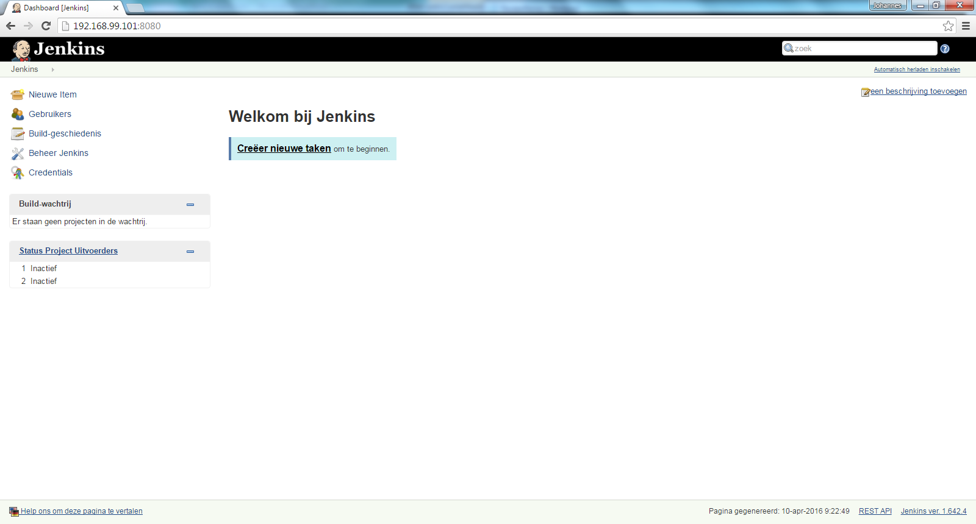
Voorbeeld: Jenkins in Docker container

Slide 81
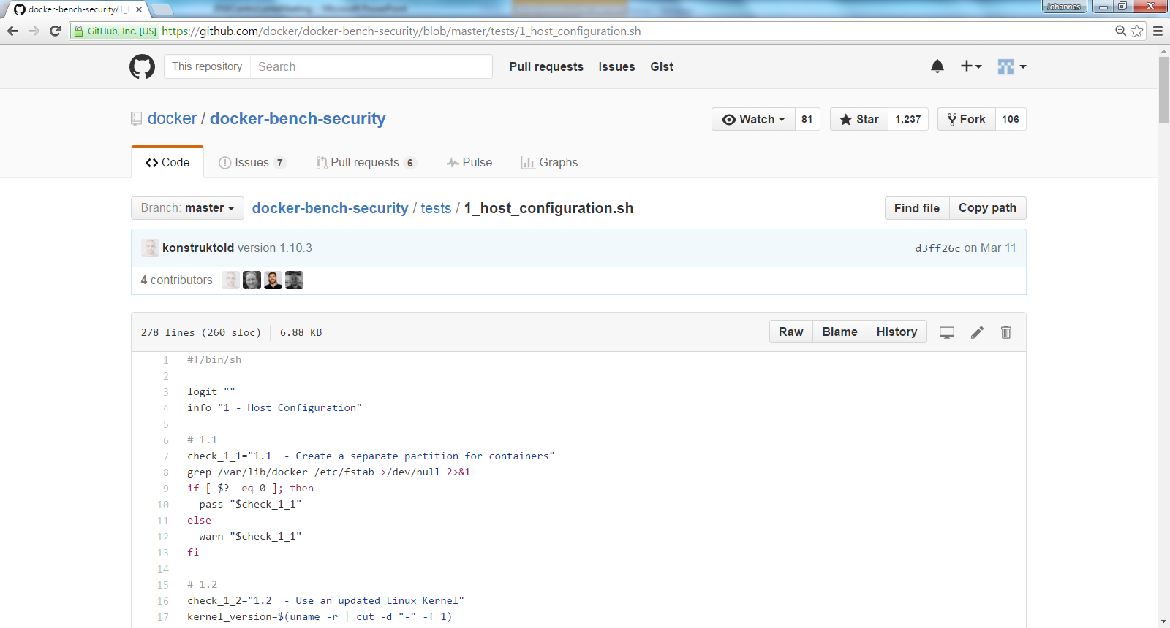
VOORBEELD: Testscript in GIT

Slide 82
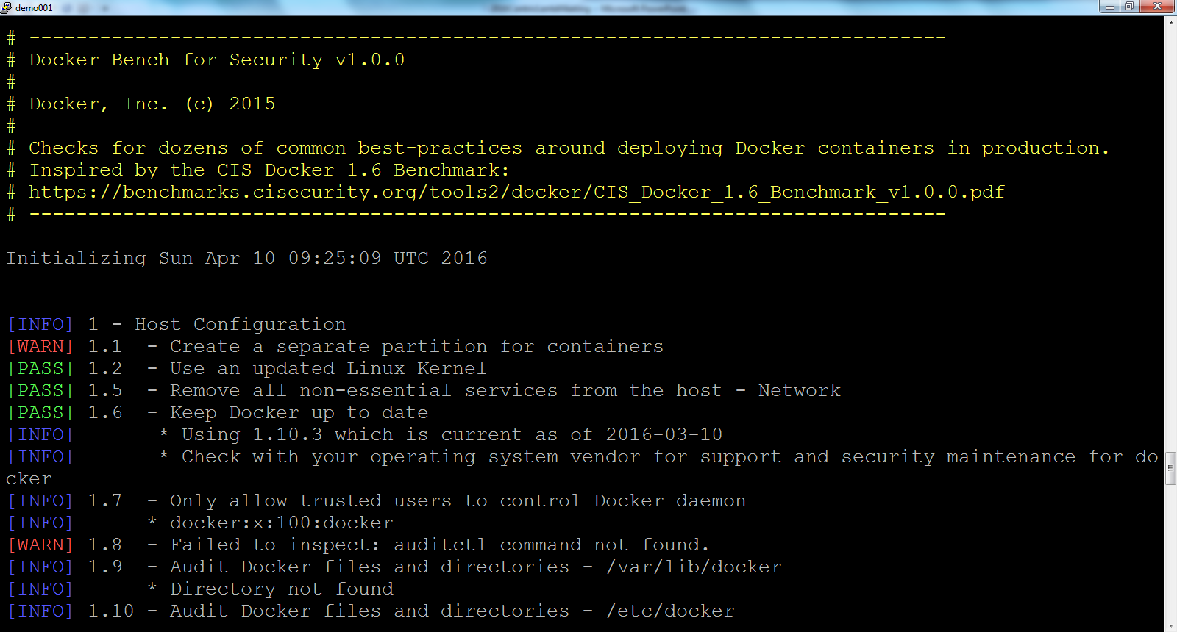
Voorbeeld: Test in Docker container

