Slide 1

Docker 102
Notes:
Goedeavond
Mijn naam is Johannes Sim.

Slide 2
Docker 102
Goal:
Practical 102 Docker
Tell / Show / DIY
Key take away:
What Docker is and can do for you
1 DockerHost with multiple conatainers
Multiple DockerHosts
Audience: DEV collegues

Slide 3
DISCLAIMER
Our view and way of working
Docker is changing constantly
Version CE 17.06.2.-ce

Slide 4
CoNTENT Docker 102
Summary Docker 101
Multi-stage build
Docker compose
Examples:
OSS
Docker voting app
Some Topics

Slide 5
OUR DOCKER Definition FOUND on INTERNET
is the world's leading software container platform
available for developers, ops and businesses
to build, ship and run
any app
on any infrastructure.
Notes:
Waarom deze deze definitie:
World leading op dit moment
Container = Docker
Actors: dev / ops /business
ANY app (microservice / monolit / enz)
Infra (laptop / server on premise / cloud

Slide 6
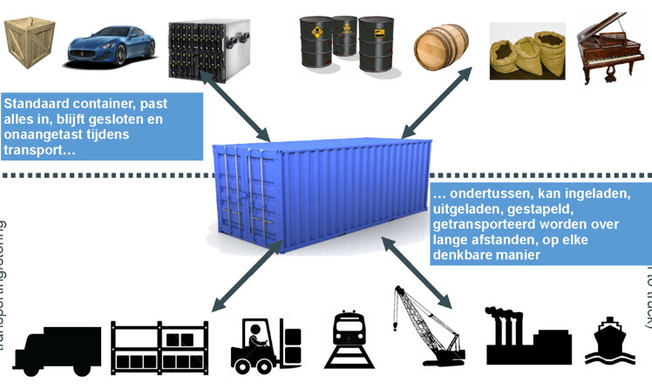
WORKS in MY MACHINE APP in A Container

Slide 7
Build – SHIP - RUN
Build
Ship
Run
DEV
OPS
Dockerfile
Image
Container
Docker Registry
Docker hub/store

Slide 8
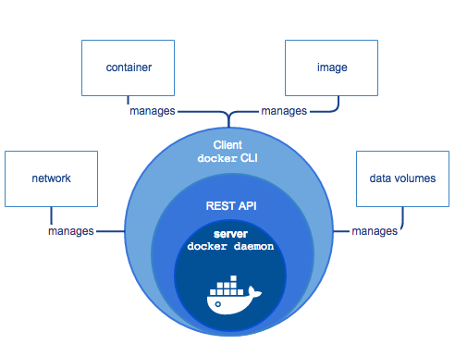
TOPIC: DOCKER ARCHITECTURE HigH LEVEL
https://docs.docker.com/engine/docker-overview/
Notes:
High Level overview
Docker CLI
Docker API
Docker Deamon
https://docs.docker.com/engine/docker-overview/

Slide 9
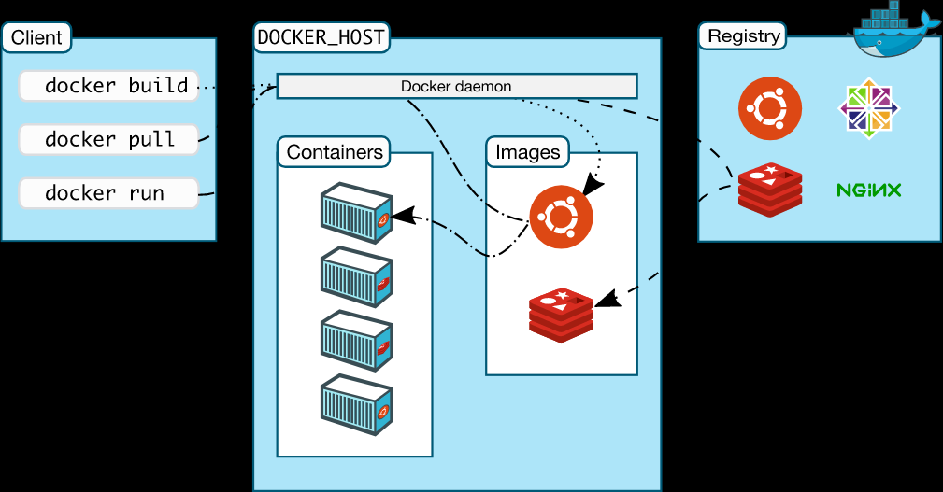
TOPIC: DOCKER ARCHITECTURE HigH LEVEL
https://docs.docker.com/engine/docker-overview/
Notes:
High Level overview
Docker CLI
Docker API
Docker Deamon
https://docs.docker.com/engine/docker-overview/

Slide 10
Docker Command
Build
Ship
Run
Docker image ls
Docker container run
Docker pull
Docker container ls
Docker image rm
Docker push
Docker container rm
Docker build
Docker container exec
Docker container start
Docker container stop
Docker system info
Docker system prune
Docker version
Notes:
docker system info
docker info
docker info
Command Line Interface

Slide 11
MULTISTAGE BUILD
Goal: small compact container

Slide 12
DOCKER COMPOSE
Ease of use for application – command line
One command for application with multiple containers
YAML file – version control
Same file for dev and ops

Slide 13
OSS EXAMPLE

Slide 14
LAB: OSS APP

Slide 15
LAB DOCKER VOTING APP

