Slide 1
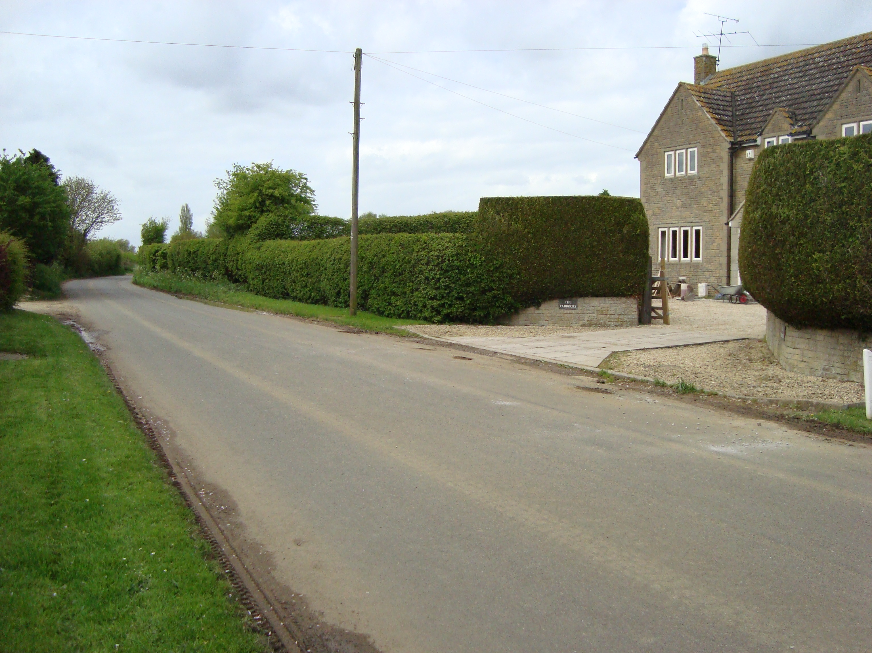
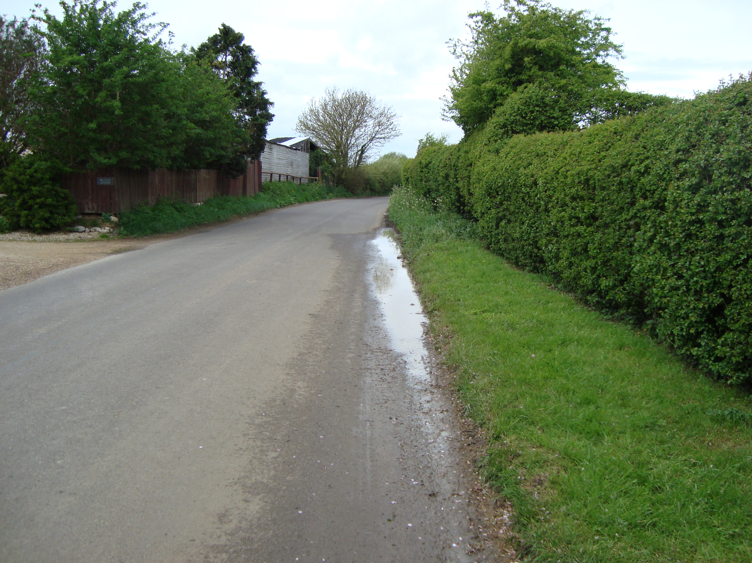
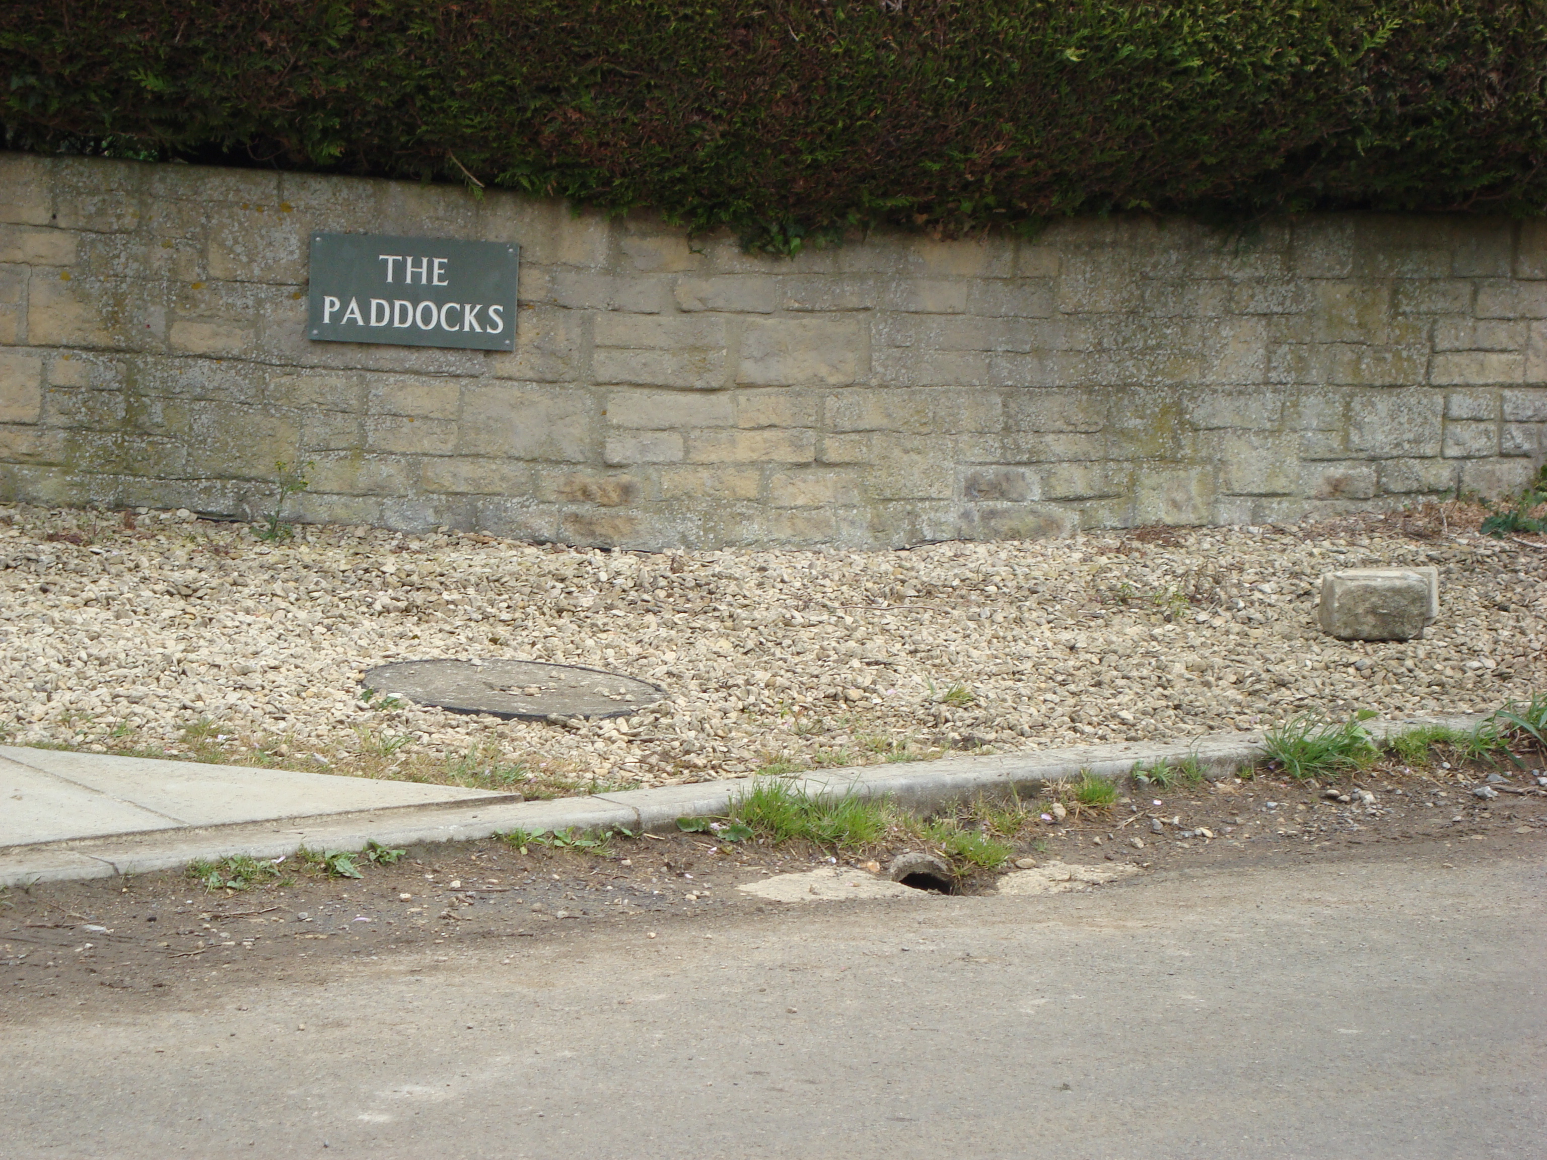
Drainage outside West End Stables and The Paddocks at West End, Foxham
Standing water
Drain

