Slide 1
IMDB Movie Analysis

Slide 2
PROJECT DESCRIPTION
The project aims to analyze the factor influencing the success of movies on IMBD , with success defined by high IMDB ratings.
The analysis will explore correlations between movie ratings & variables like genre, director, budget, and many factors.
Data cleaning and preprocessing will be the main important step to handle missing values, remove duplicates.
The goal is to find the key insights that can help predict a movie's success on IMDB ratings.

Slide 3
TECH STACK USED
SOFTWARE:
EXCEL:
Excel is a powerful spreadsheet software used for data analysis, calculations, and visualization.
It allows users to create the table, charts, and graphs to organize and present data.
Excel has formulas, functions
It is widely used in finance, business, research, and education for managing large datasets for predicting the useful insights.

Slide 4
APPROACH
DATA PREPROCESSING:
The team has given the dataset(excel) with name IMDB_MOVIES.
The given data was not cleaned and preprocessed,that means it is not ready to analyze and make insights.
So we need to start the project by Cleaning the Dataset.
Firstly I made the table by using the data columns provided.

Slide 5
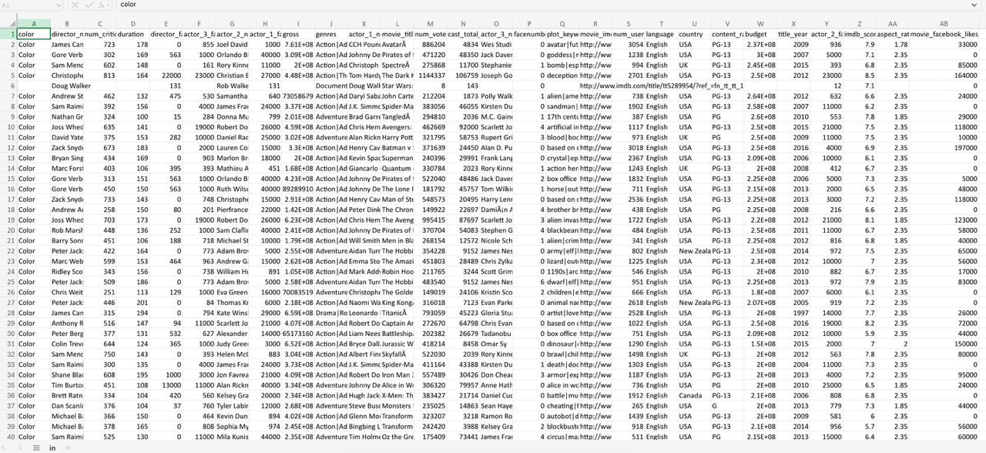

Slide 6
DATACLEANING
Then deleted the unnecessary columns which are not useful for analysing such as
color
Num_critic_for_review
Director_facebook_likes
actor_2_name
actor_3_facebook_likes
actor_1_facebook_likes
actor_1_name
num_voted_users
cast_total_facebook_likes
actor_3_name
facenumber_in_poster
plot_keywords
movie_imdb_link
num_user_for_reviews
content_rating
title_year
actor_2_facebook_likes
aspect_ratio
movie_facebook_likes

Slide 7
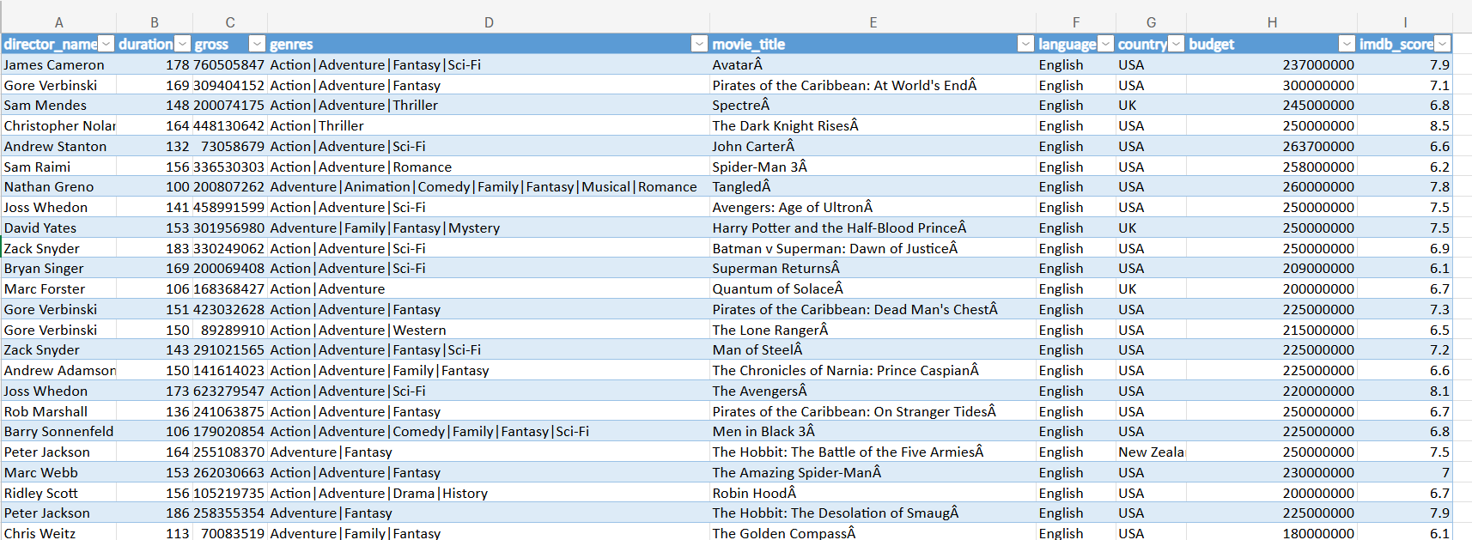
Created the table:

Slide 8
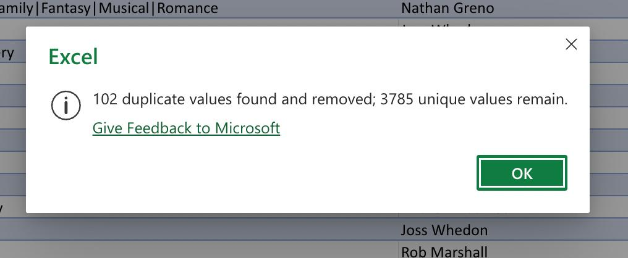
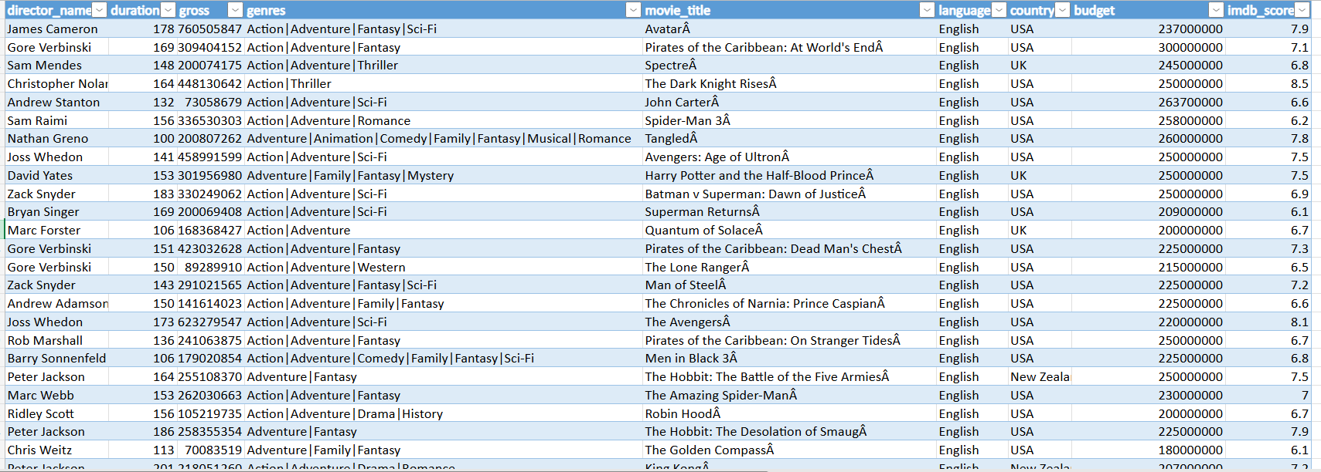
I Checked all columns by setting filters as blanks ,deleted the rows which has blanks.
Deleted the duplicates from the column name Movie_titles.
My data looks in this way after cleaning process

Slide 9
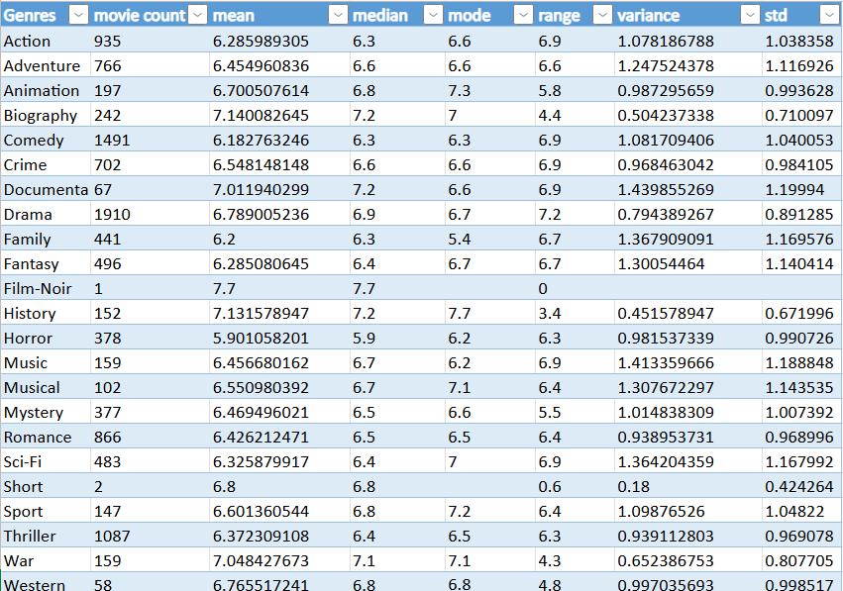
Data Analytics Tasks
A. Movie Genre Analysis: Analyze the distribution of movie genres and their impact on the IMDB .
Task: Determine the most common genres of movies in the dataset. Then, for each genre, calculate descriptive statistics (mean, median, mode, range, variance, standard deviation) of the IMDB scores.

Slide 10
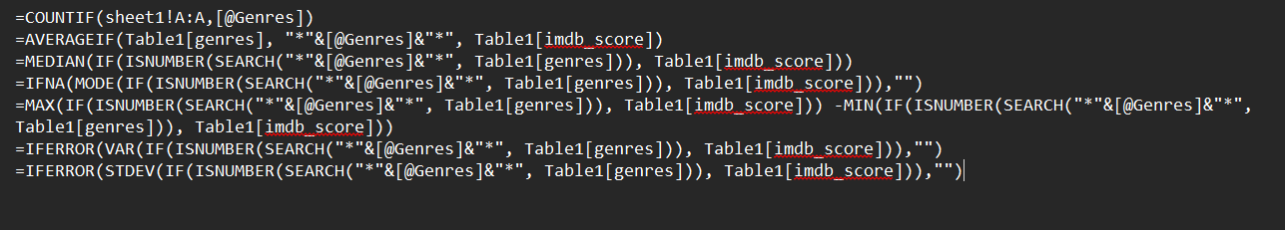
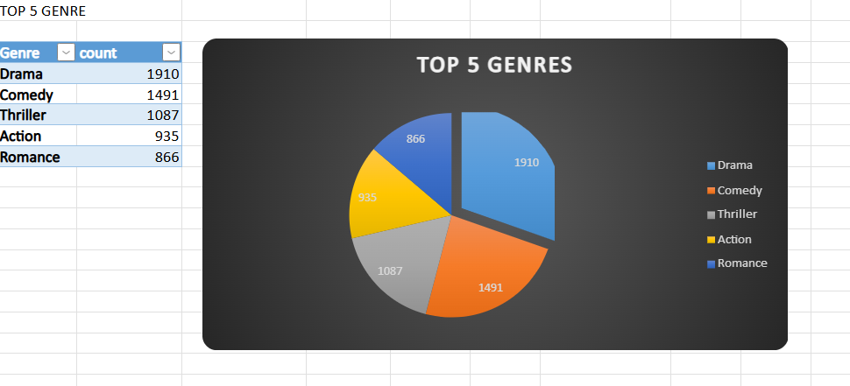
FORMULAS USED

Slide 11
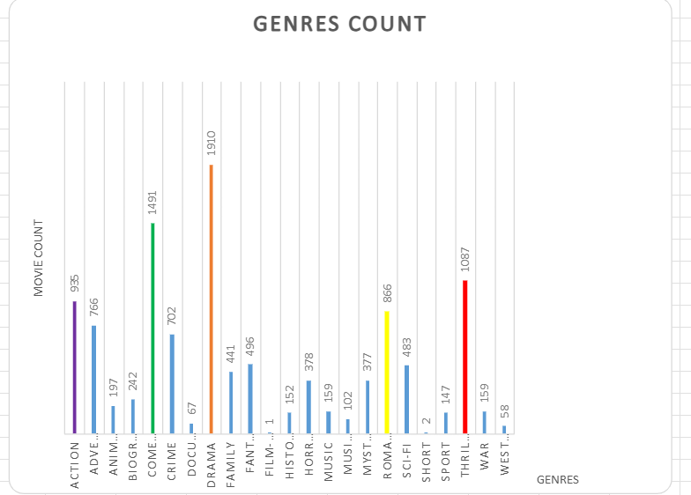

Slide 12
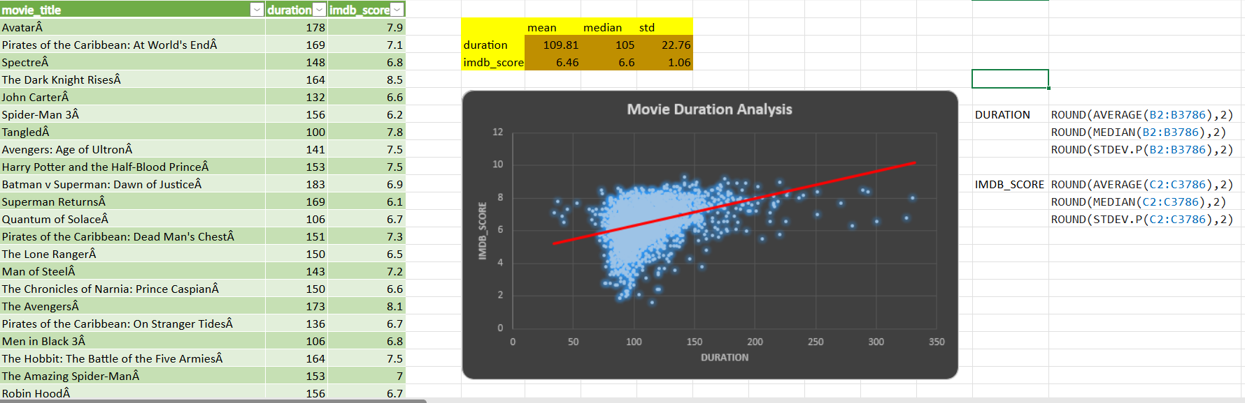
Data Analytics Tasks
B. Movie Duration Analysis: Analyze the distribution of movie durations and its impact on the IMDB. Task: Analyze the distribution of movie durations and identify the relationship between movie duration and IMDB score.

Slide 13
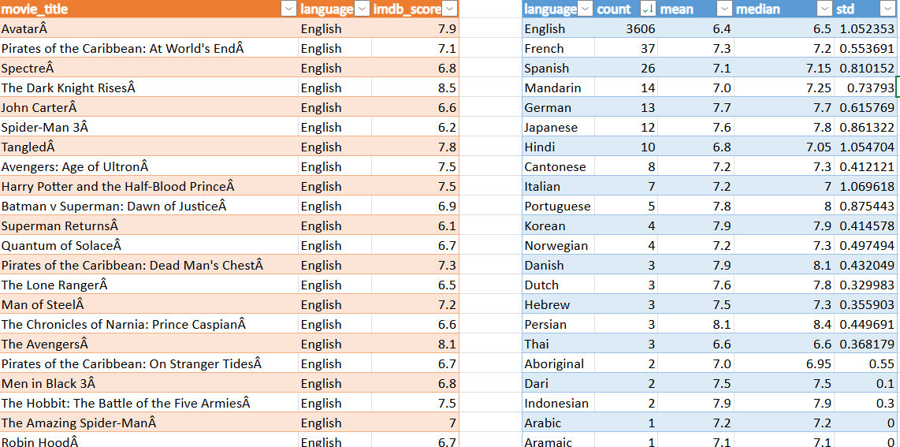
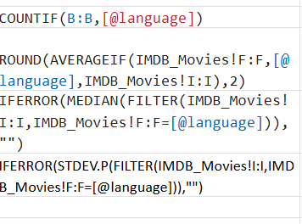
Data Analytics Tasks
C. Language Analysis: Situation: Examine the distribution of movies based on their language.
Task: Determine the most common languages used in movies and analyze their impact on the IMDB score using descriptive statistics.

Slide 14
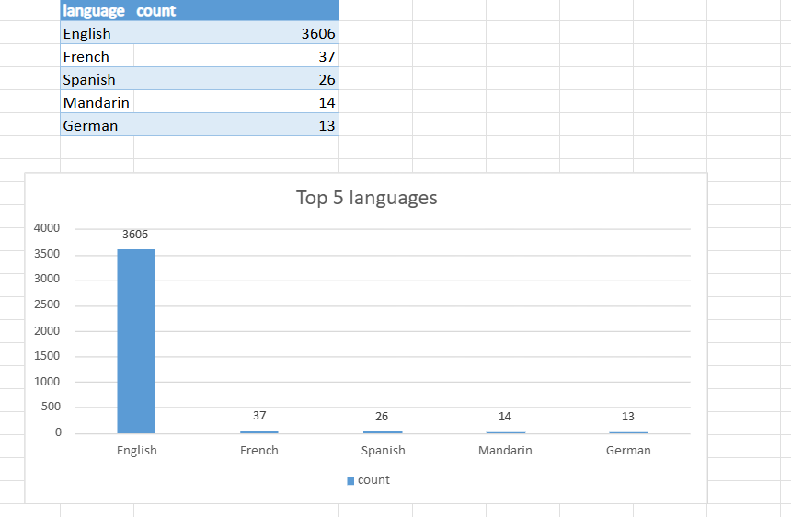

Slide 15
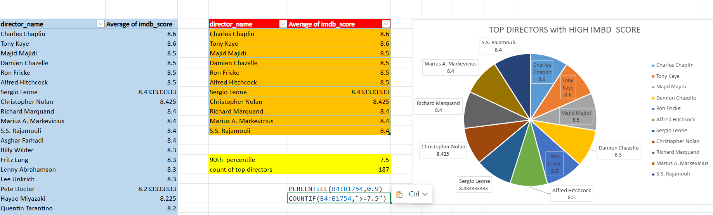
Data Analytics Tasks
D. Director Analysis: Influence of directors on movie ratings.
Task: Identify the top directors based on their average IMDB score and analyze their contribution to the success of movies using percentile calculations.

Slide 16
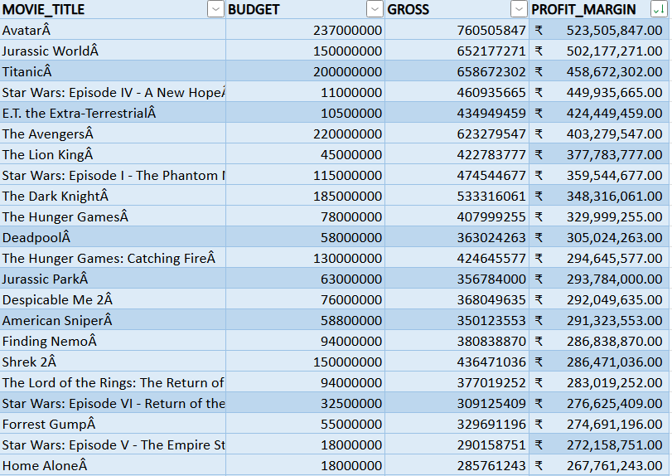
Data Analytics Tasks
E. Budget Analysis: Explore the relationship between movie budgets and their financial success.
Task: Analyze the correlation between movie budgets and gross earnings, and identify the movies with the highest profit margin.

Slide 17
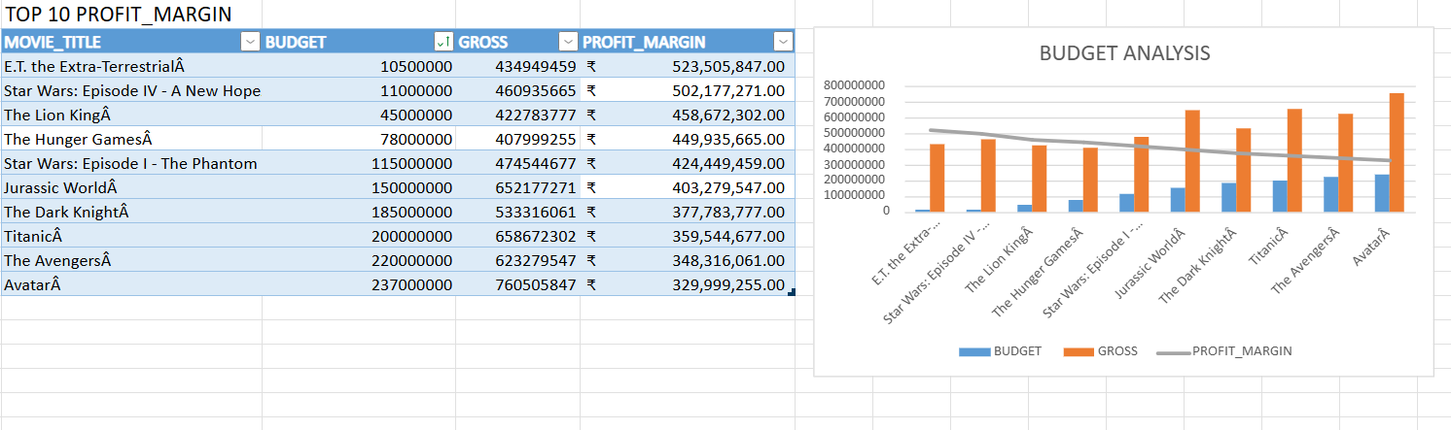
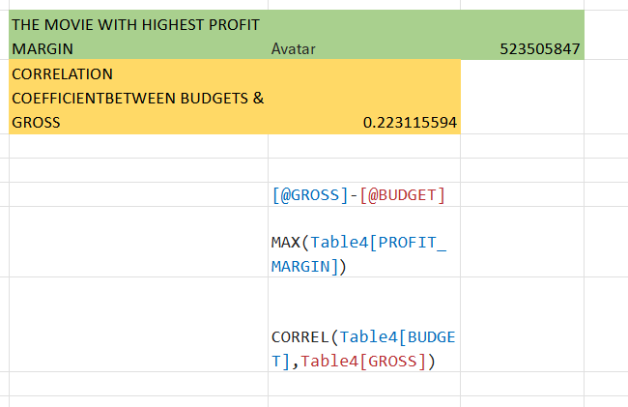

Slide 18
INSIGHTS
IMDB Genre Analysis: Various genres demonstrate various IMDB ratings, where some genres record more stable scores compared to other genres.
Movie Length Analysis: The duration of a movie might influence its IMDB rating, with shorter or longer films perhaps receiving varying scores.
Language Analysis: The language of a film can influence its IMDB rating, with certain languages associated with higher or lower ratings.
Director Analysis: Directors who have a greater average IMDB score create more successful films and influence ratings considerably.
Budget Analysis: Films with larger budgets tend to generate more revenue; examining profit margins is a way of identifying the most profitable movies.

Slide 19
A. Analysis of Film Genre Finding: Certain genres routinely score better on IMDB than others. The Five Whys Method: What causes some genres to rank higher on IMDB?
Their production quality and storytelling tend to be more captivating. What is the effect of captivating narrative on ratings?
Better reviews result from viewers' emotional connections. What is the significance of emotional connection in ratings?
Positive ratings are more likely to come from happy viewers. What causes favorable ratings to be concentrated in particular genres?
Strong storylines of some genres, such as drama and comedy. Why do certain genres have stronger narratives?
Studios provide them more critical attention and funding. Insight: Because of their emphasis on narrative and critical reception, the drama and comedy genres have higher IMDB scores.

Slide 20
B. Analysis of Film Length Finding: IMDB scores for longer films are generally marginally higher. The Five Whys Method: Why are lengthier films rated higher?
They allow for deeper character development and intricate stories. What is the significance of character development?
Stronger emotional bonds are formed by viewers. Why are ratings increased by emotional connections?
Positive reviews are more likely to be left by viewers who are actively involved. Why do good IMDB scores depend on users who are actively watching?
They affect re-watchability and word-of-mouth advertising. For what reason does word-of-mouth affect ratings?
A self-reinforcing loop of high ratings is produced by positive publicity. Insight: Longer films typically offer more engaging viewing experiences, which improves reviews.

Slide 21
C. Analysis of Language Finding: Although they may not always have the highest ratings, English-language films predominate in the sample. The Five Whys Method: Why is the dataset dominated by English-language films?
Their global audience is larger. Why are ratings impacted by a worldwide audience?
Average scores become more balanced as the number of reviews increases. For what reason do more reviews promote balance?
They lessen the influence of extreme viewpoints. What is the influence of diversity reviews on ratings?
Scores are more realistic when viewed from a wider angle. Why do niche languages occasionally receive higher ratings?
They serve particular, more engaged audiences. Insights: Although English-language films are more common, niche-language films frequently have higher ratings because of their devoted followings.

Slide 22
D. Analysis of the Director Finding: Some directors routinely score highly on IMDB. The Five Whys Method: What causes certain directors to receive high scores on a regular basis?
They deliver compelling stories and have a unique flair. Why is having a unique style important?
It builds a devoted following.
Why do loyal fans contribute to higher ratings? Loyal followers evaluate generously because they value the artistic concept, which is why they contribute to greater ratings. Why do grades depend on creative vision and creativity?
They set films apart from mediocre offerings. Why does success come from differentiation?
In a crowded market, distinctive films stand out. Insights: Filmmakers with distinctive styles and compelling narratives produce memorable movies with big box office receipts.

Slide 23
E. Analysis of Budgets Finding: Films with larger budgets typically do better at the box office and earn greater reviews. The Five Whys Method: Why do films with larger budgets do better?
Their marketing and production quality are superior. What is the significance of production quality?
Excellent effects and images improve the watching experience. Why do higher ratings result from an improved experience?
Audiences value well-crafted narratives and cinematography. Why do polished aspects influence how an audience perceives a film?
People tend to associate a better film with a higher-quality production. Why does success result from this perception?
Box office income is driven by positive evaluations and word-of-mouth. Insights: Better production, marketing, and storytelling are made possible by larger resources, which raise IMDB ratings and contribute to financial success.

Slide 24
CONCLUSION
Excel is a powerful tool for data analysis, making it easy to preprocess & clean , organize, and visualize the large datasets.
Its built-in functions, pivot tables, and charts help draw meaningful insights quickly& effectively . With automation through formulas and macros, Excel streamlines complex tasks efficiently and quickly.
The project had a good impact about ,what kind of movies are having high imbd_score and the factors effecting it.
Reference link:
IMDB_EXCEL

Slide 25
Thank you

