Slide 1
BANK LOAN CASE STUDY

Slide 2
PROJECT DESCRIPTION
The project aims to analyze the factors influencing loan approvals and defaults, with success defined by timely loan repayments.
The analysis will explore correlations between loan repayment status and variables like customer attributes, loan amount, credit history, and other financial factors.
Data cleaning and preprocessing will be a crucial step to handle missing values, remove duplicates, and identify outliers.
The goal is to find key insights that can help predict loan defaults and improve lending decisions.

Slide 3
TECH STACK USED
SOFTWARE:
EXCEL:
Excel is a powerful spreadsheet software used for data analysis, calculations, and visualization.
It allows users to create the table, charts, and graphs to organize and present data.
Excel has formulas, functions
It is widely used in finance, business, research, and education for managing large datasets for predicting the useful insights.

Slide 4
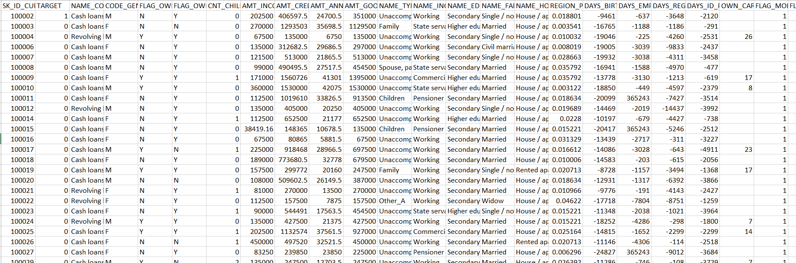
RAW DATA

Slide 5
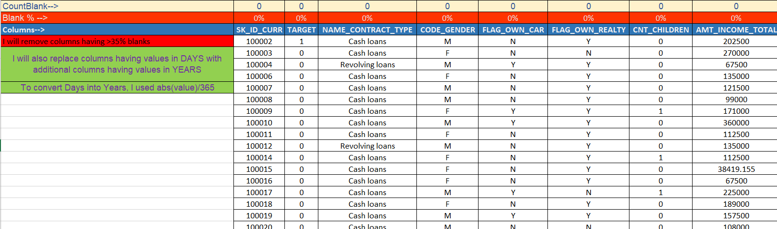
Data Analytics Tasks
A.Identify Missing Data and Deal with it Appropriately:
Task: Identify the missing data in the dataset and decide on an appropriate method to deal with it using Excel built-in functions and features.
The team has given us 50,000 rows and DR columns.

Slide 6
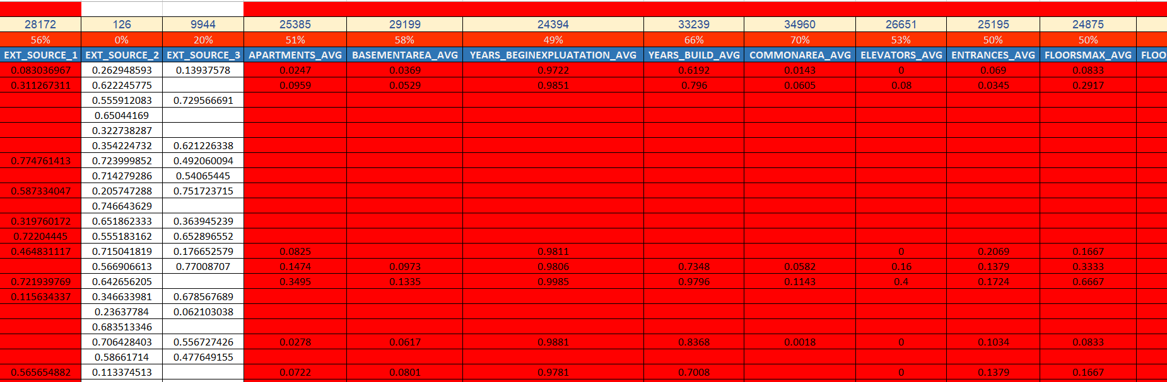

Slide 7
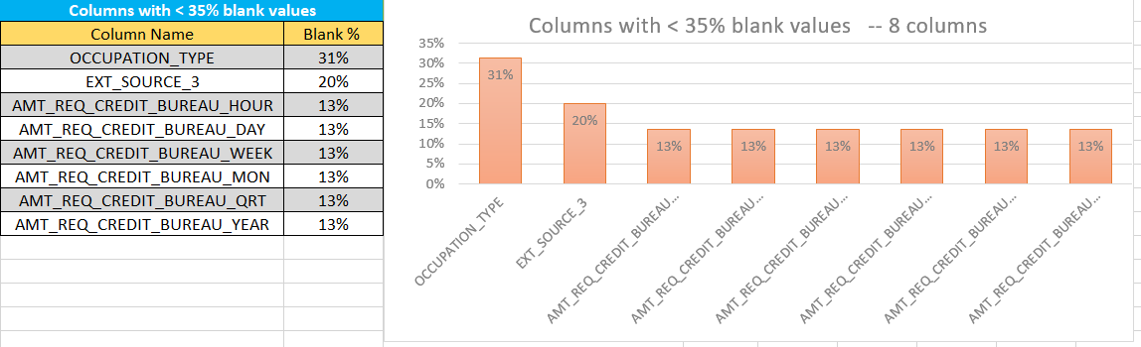
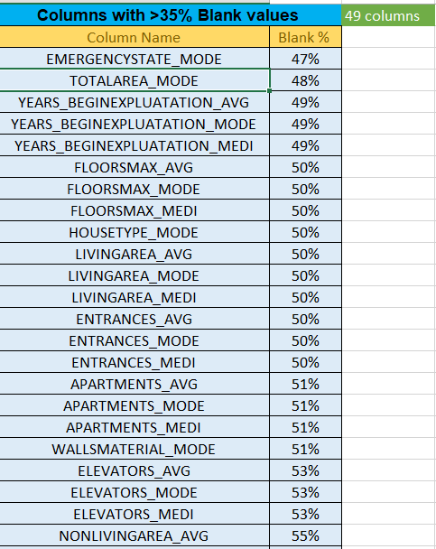
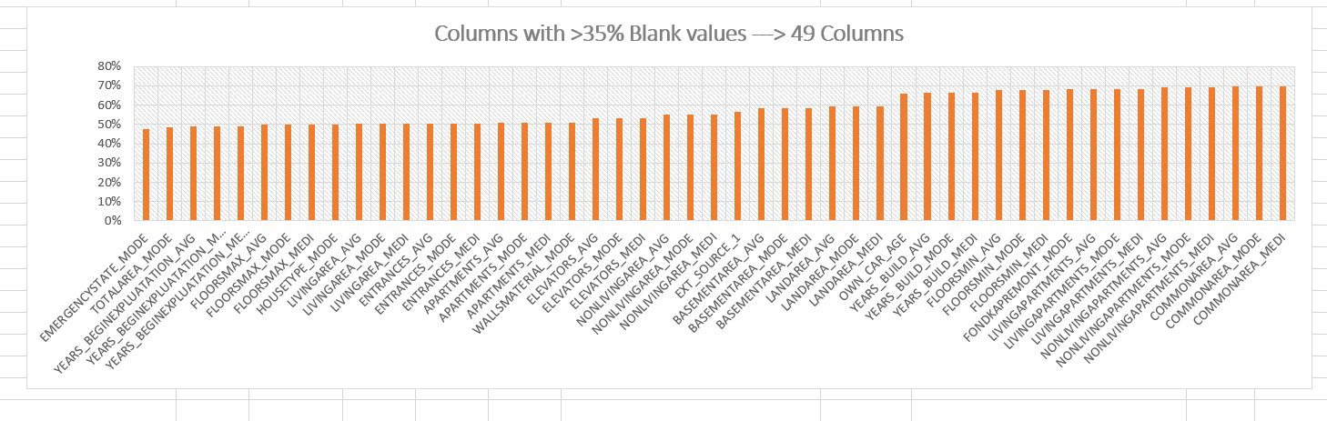

Slide 8
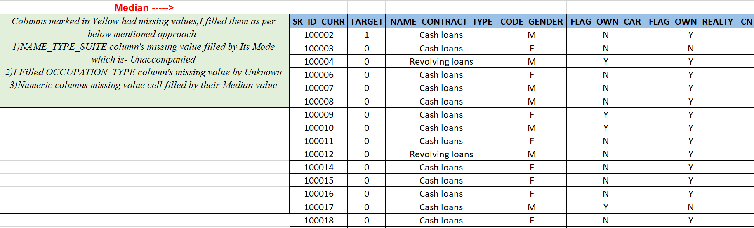

Slide 9
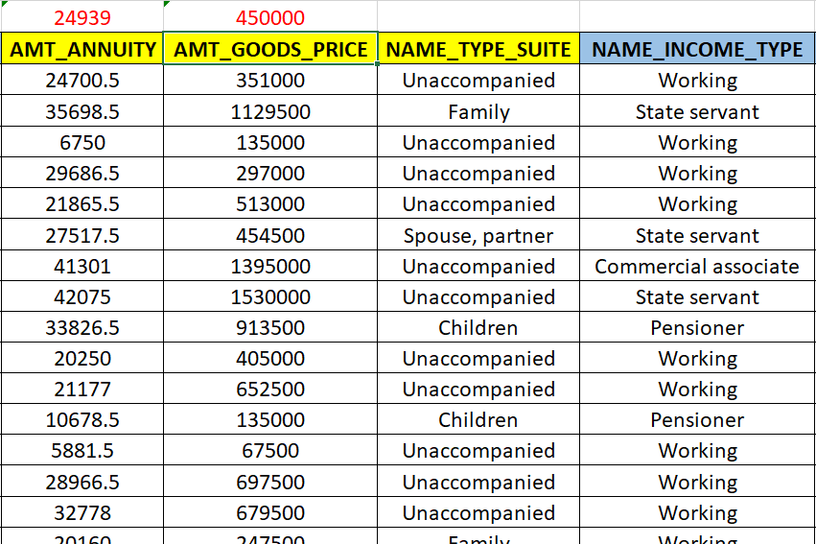
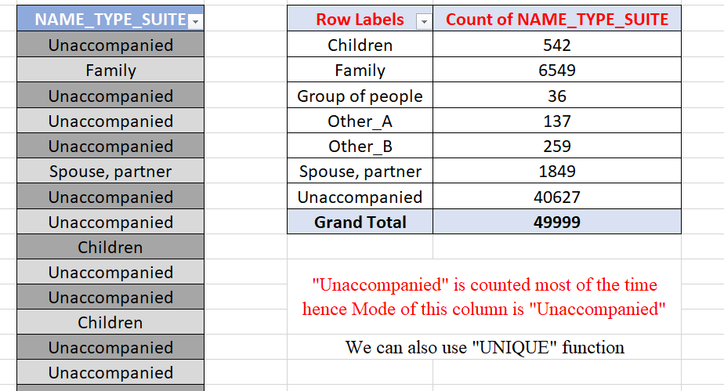

Slide 10
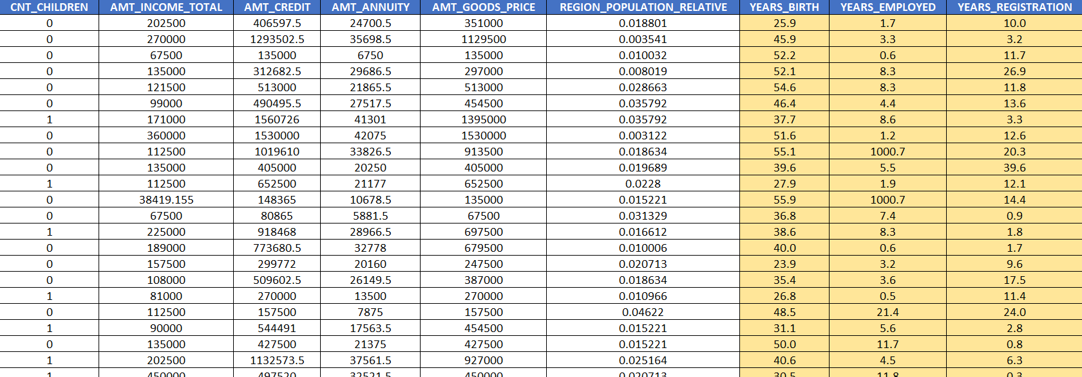
Data Analytics Tasks
B. Identify Outliers in the Datasets:
Task: Outliers can significantly impact the analysis and distort the results. You need to identify outliers in the loan application dataset.

Slide 11
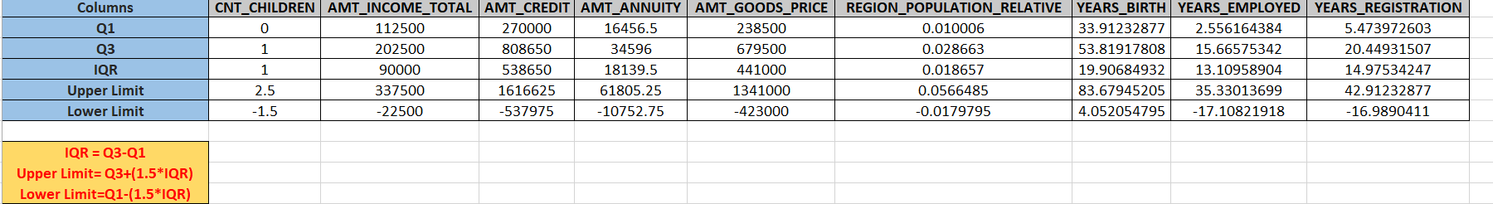
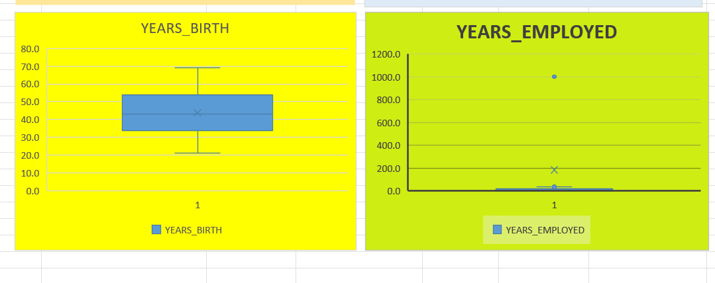
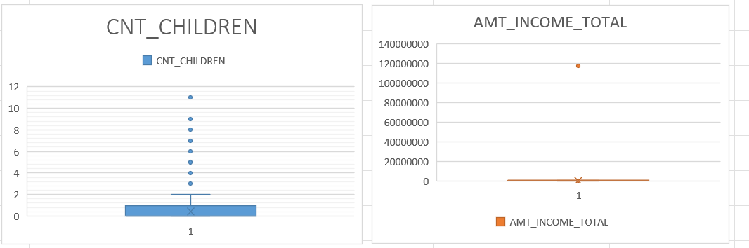
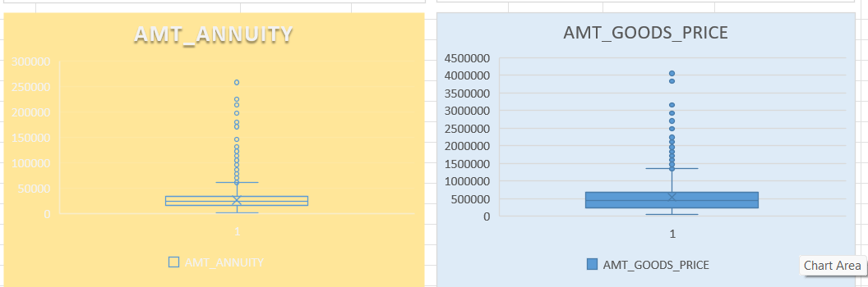

Slide 12
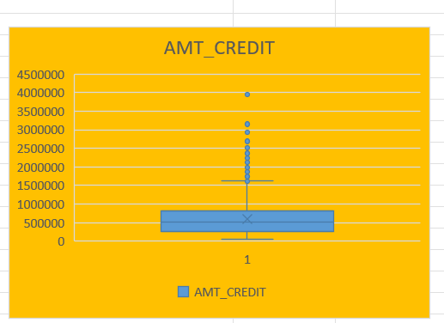
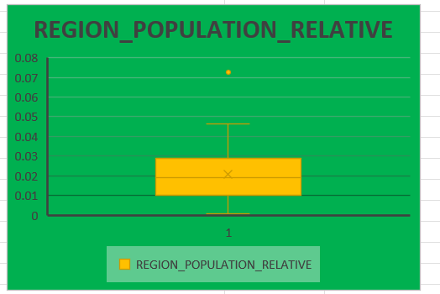
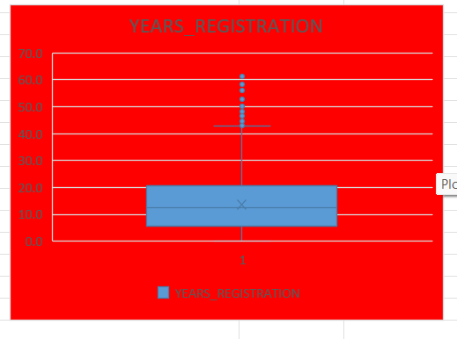

Slide 13
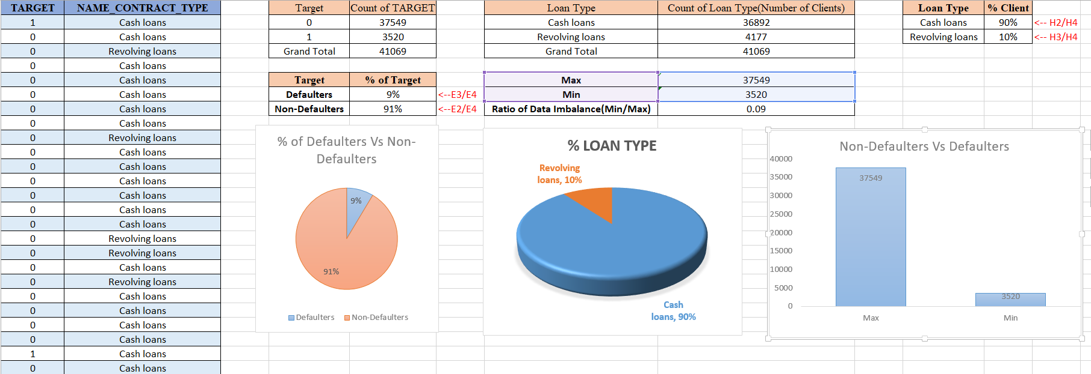
Data Analytics Tasks
C.Analyze Data Imbalance:
Task: Determine if there is data imbalance in the loan application dataset and calculate the ratio of data imbalance using Excel functions.

Slide 14
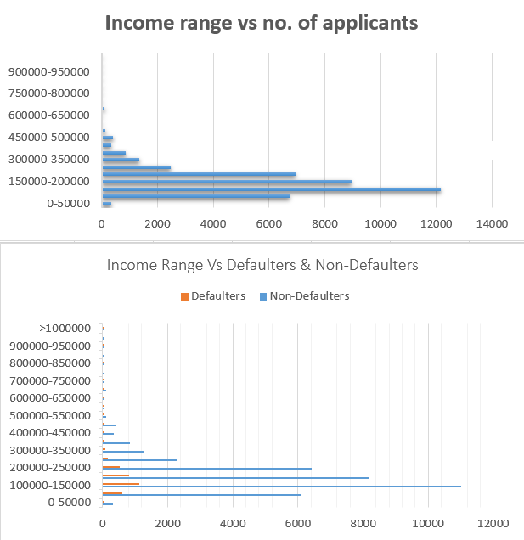
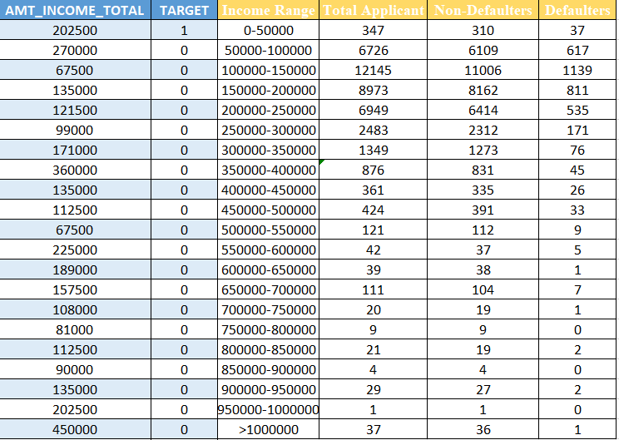
Data Analytics Tasks
D. Perform Univariate, Segmented Univariate, and Bivariate Analysis:
Task: Perform univariate analysis to understand the distribution of individual variables, segmented univariate analysis to compare variable distributions for different scenarios, and bivariate analysis to explore relationships between variables and the target variable using Excel functions and features.
Segmented Univariate Analysis:

Slide 15
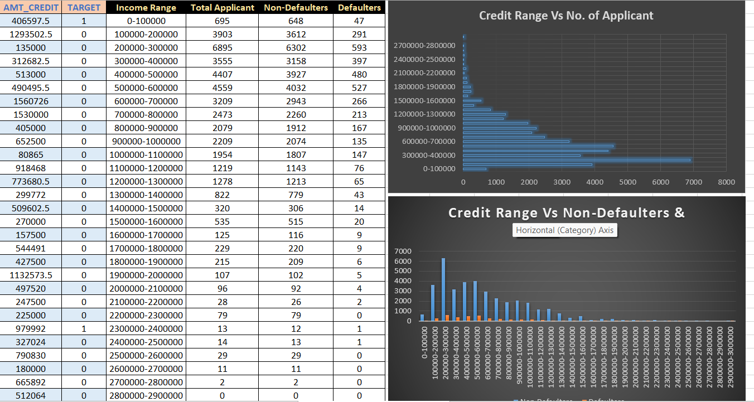
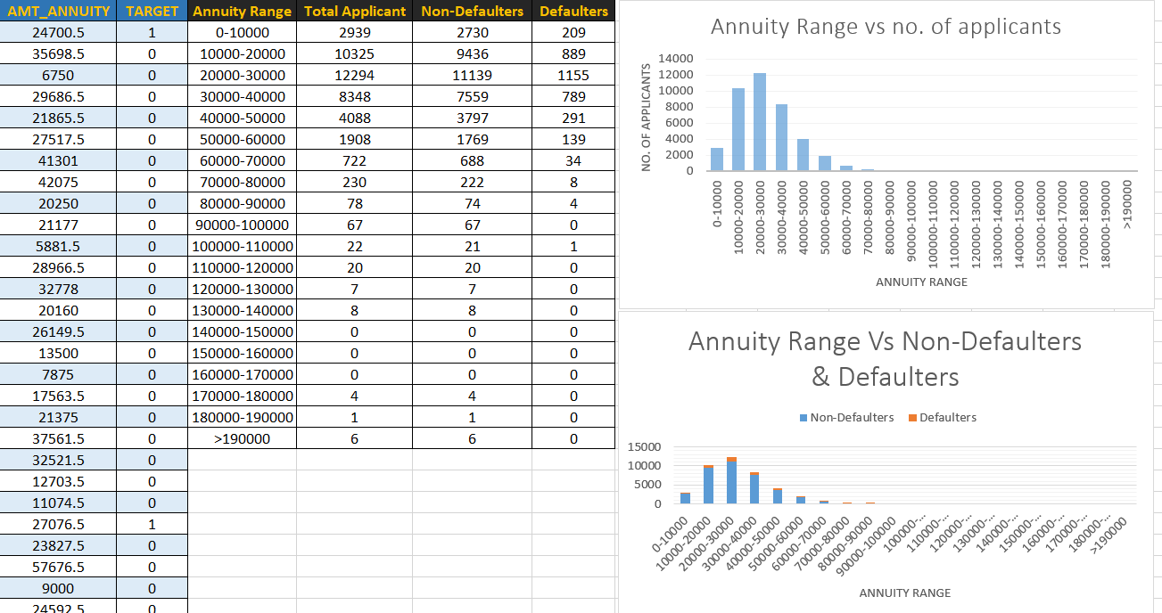

Slide 16
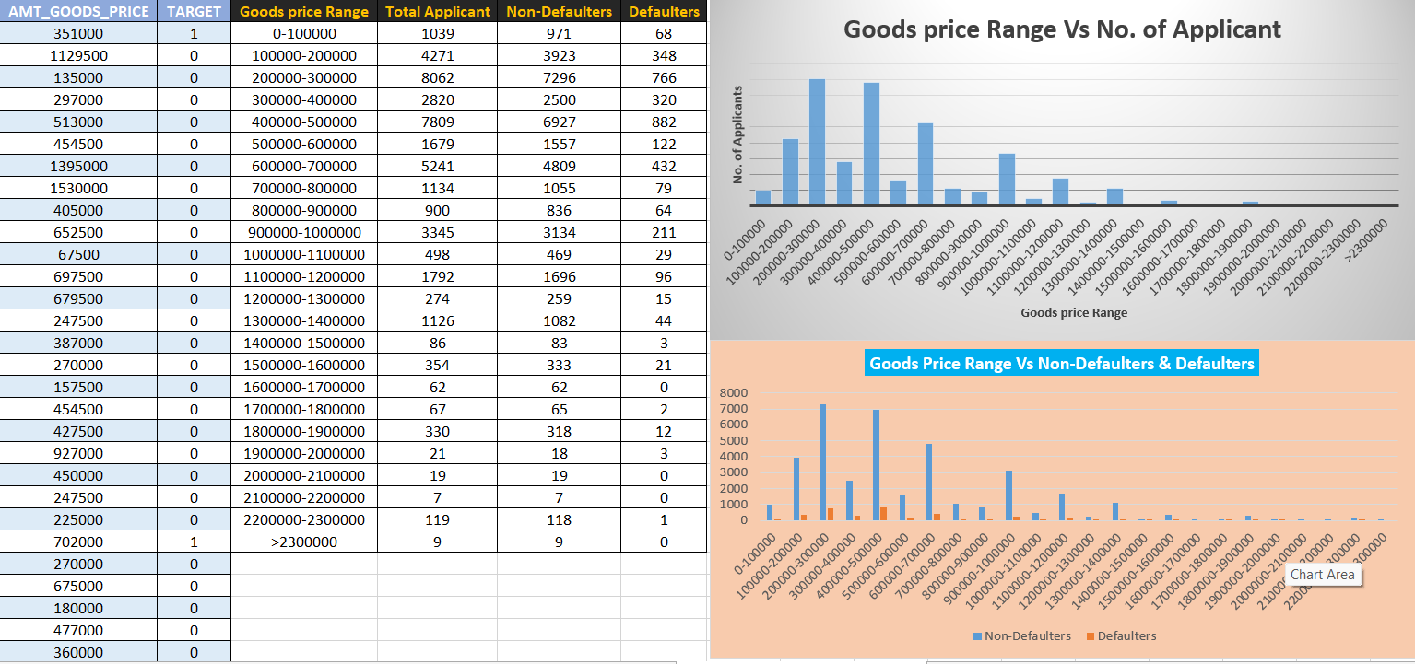

Slide 17
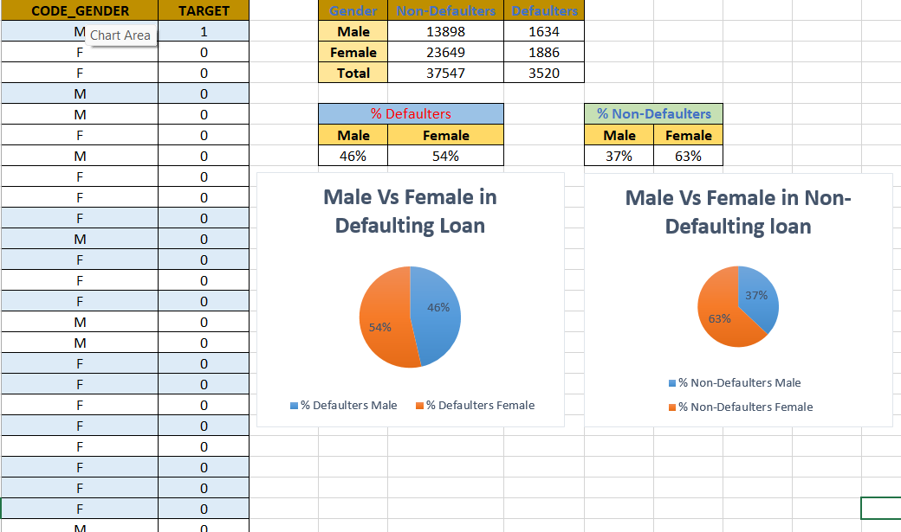
Univariate

Slide 18
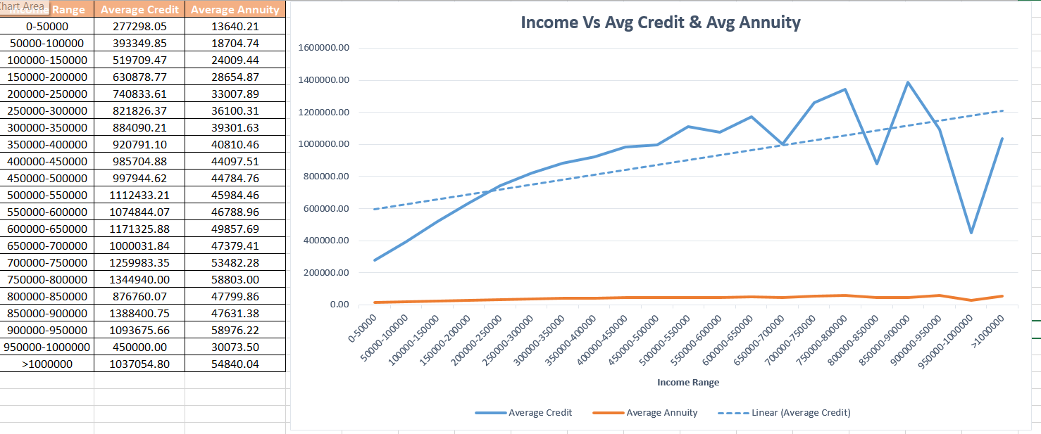
Bivariate Analysis

Slide 19
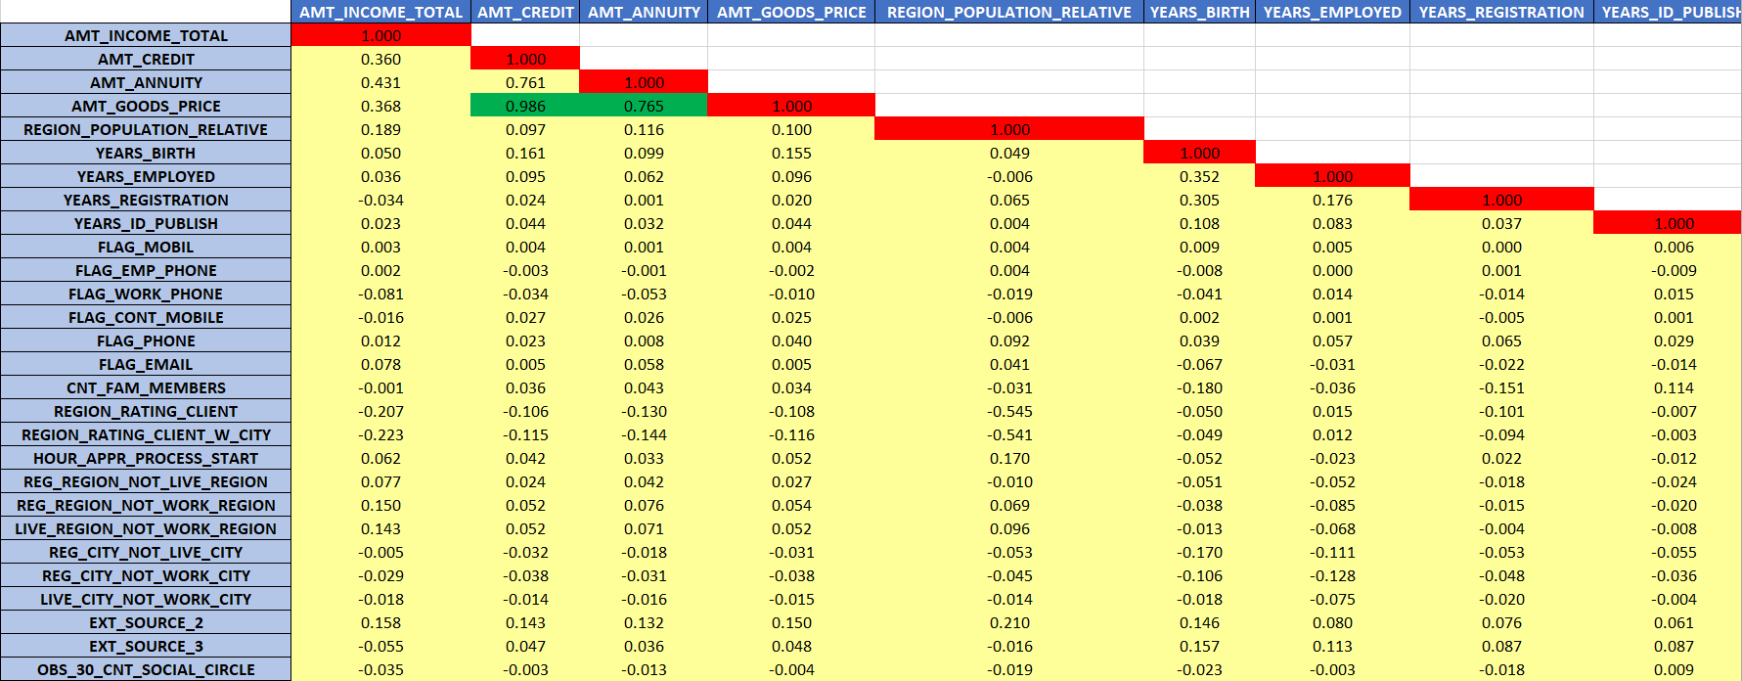
Data Analytics Tasks
E. Identify Top Correlations for Different Scenarios:
Task: Segment the dataset based on different scenarios (e.g., clients with payment difficulties and all other cases) and identify the top correlations for each segmented data using Excel functions.
Correlation_Non-Defaulters:

Slide 20
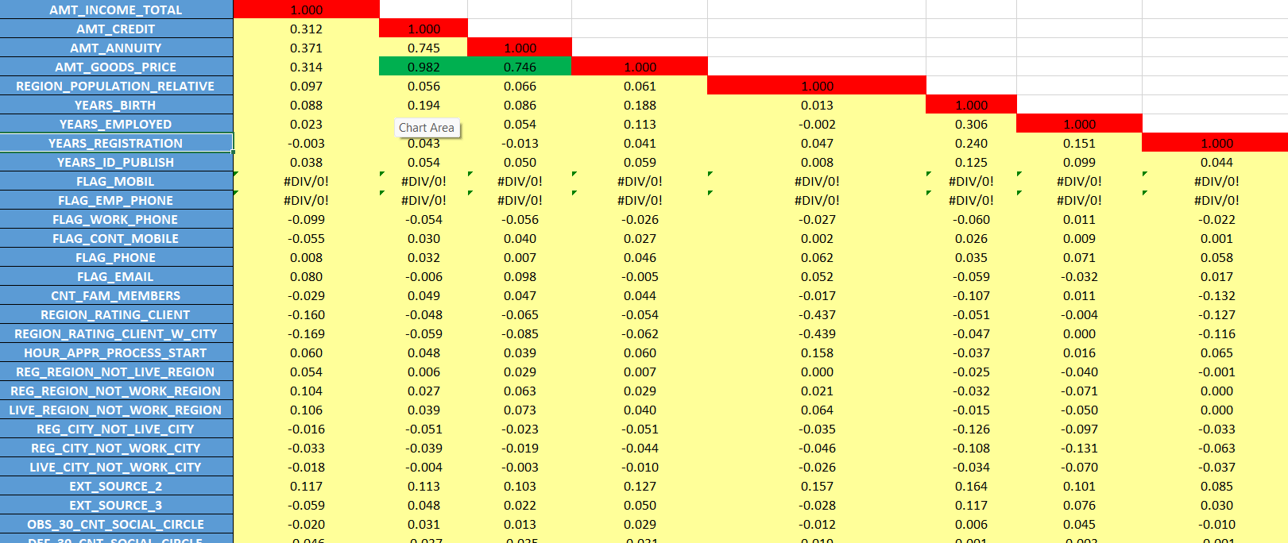
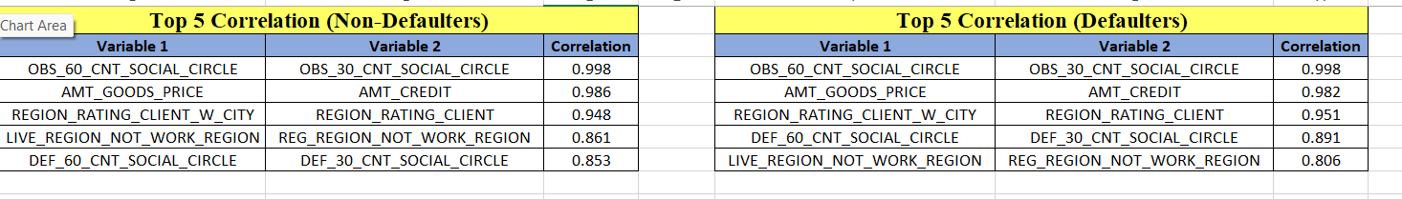
Correlation_Defaulters
Top Correlation

Slide 21
INSIGHTS
Loan Approval Analysis: Different applicant profiles demonstrate varying loan approval rates, where some customer segments have more stable approval outcomes compared to others.
Loan Amount Analysis: The amount of the loan might influence its repayment success, with higher or lower loan amounts potentially affecting default rates.
Credit History Analysis: A customer’s credit history can impact loan approval and repayment, with strong credit scores associated with lower default risks.
Customer Profile Analysis:Customers with stable financial backgrounds and responsible borrowing habits are more likely to repay loans successfully.
Risk Assessment Analysis: Loans issued to high-risk applicants tend to have higher default rates; analyzing financial indicators helps in identifying potential defaulters.

Slide 22
CONCLUSION
Excel is a powerful tool for data analysis, making it easy to preprocess, clean, organize, and visualize large datasets.
Its built-in functions, pivot tables, and charts help draw meaningful insights quickly and effectively. With automation through formulas and macros, Excel streamlines complex tasks efficiently and accurately.
The project provided valuable insights into loan approvals and defaults, helping identify key factors that influence repayment success and financial risk.
Reference link:
Bank_loan_excel

Slide 23
Thank you

