Slide 1
VUE JS
By: Nyarko Isaac Kwadwo

Slide 2
What is Vue JS
Is a JavaScript framework for building user interfaces.
It was build on top of standard HTML, CSS, and JavaScript and provides a declarative and component-based programming model that helps you efficiently develop user interfaces.
Is also use for desktop development with Electron framework and for building apps for Android and iOS with NativeScript.

Slide 3
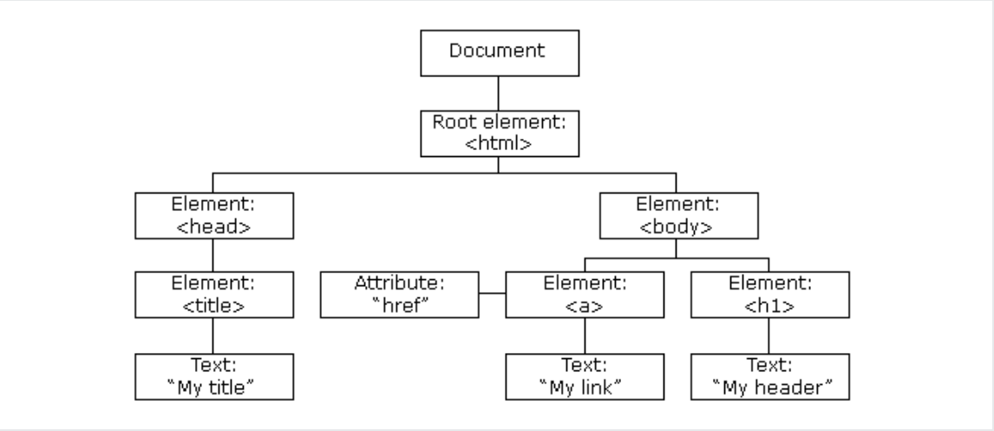
Advantages of Vue Js Framework
Virtual DOM rendering and performance:
A Document Object Model (DOM) is something you’ll probably encounter when rendering web pages. A DOM represents an HTML page with its styles, elements, and content as a tree structure of objects (nodes). The DOM tree objects stored as a tree is generated by a browser when loading a page.

Slide 4
…continue
Reactivity system and data binding options:
Data binding is a connection between the data model (data source) and the view DOM or HTML template). One-way data binding allows information to flow in one direction, from model to view or vice versa.
Two-way data binding enables data exchange between model and view in both directions. In other words, the model also listens to the events on the DOM and any updates on one side instantly reflect on the other.

Slide 5
…continue
Single-file components and readability:
A Vue application/web page is built of components that represent encapsulated elements of your interface. Components can be written in HTML, CSS, and JavaScript without dividing them into separate files.
Splitting the application code, called Component Based Architecture (CBA) is also utilized in Angular and React. Such an approach has lots of benefits

Slide 6
…continue
Integration capabilities and flexibility:
An important aspect of any emerging technology is the ability to integrate with existing applications.
With Vue.js it’s as easy as pie because it relies only on JavaScript and doesn’t require any other tools to work.

Slide 7
Disadvantages
Language barrier
Lack of support for large-scale projects
Risk of over flexibility
Limited resources
Lack of experienced developers

Slide 8
CREATE WEB PAGE
Lead trainees to create a simple web page using HTML and CSS

Slide 9
Adding Vue to HTML Project
// Add this to the header
<script src="https://unpkg.com/vue@3/dist/vue.global.js"></script>
// Create a div in the page body that wrap the content and pass id
<div id="app">{{ message }}</div>
// Add this Vue syntax below the body
<script>
const { createApp } = Vue
createApp({
data() {
return {
message: 'Hello Vue!'
}
}
}).mount('#app')
</script>

Slide 10
Creating Vue Project from Scratch
Create any empty folder for the project
Open the folder using VS Code
Type npm init in the terminal, this provide all necessary information to generate package.json file
Create a folder by name src that will be use to store the project files.
Create a file in the src folder and name it index.js that will serve as an entry point of the project.
Create index.html file that will hold the html code.
Create App.vue that will be our first page.

Slide 11
…continue
Run npm install vue@next to install Vue 3
Add the following to Package.json in the object devDependencies {}
"@babel/core": "^7.16.7",
"@babel/preset-env": "^7.16.7",
"@vue/compiler-sfc": "^3.2.26",
"babel-loader": "^8.2.3",
"css-loader": "^6.5.1",
"html-loader": "^3.0.1",
"html-webpack-plugin": "^5.5.0",
"mini-css-extract-plugin": "^2.4.5",
"sass": "^1.45.2",
"sass-loader": "^12.4.0",
"vue-loader": "^17.0.0",
"vue-style-loader": "^4.1.3",
"webpack": "^5.65.0",
"webpack-cli": "^4.9.1",
"webpack-dev-server": "^4.7.2"

Slide 12
…continue
const path = require("path");
const HtmlWebpackPlugin = require("html-webpack-plugin");
const MiniCssExtractPlugin = require("mini-css-extract-plugin");
const { VueLoaderPlugin } = require("vue-loader");
module.exports = {
mode: "development",
entry: "./src/index.js",
output: {
path: path.resolve(__dirname, "dist"),
},
devServer: {
static: { directory: path.join(__dirname, "dist") },
port: 9000,
open: true,
},
module: {
rules: [
{
test: /\.scss$/,
use: [
{ loader: "vue-style-loader" },
{
loader: MiniCssExtractPlugin.loader,
options: {
esModule: false,
},
},
{ loader: "css-loader" },
{ loader: "sass-loader" },
],
},
{
test: /\.vue$/i,
exclude: /(node_modules)/,
use: {
loader: "vue-loader",
},
},
{
test: /\.(js|jsx)$/,
exclude: /(node_modules)/,
use: {
loader: "babel-loader",
options: {
presets: ["@babel/preset-env"],
},
},
},
{
test: /\.html$/i,
loader: "html-loader",
},
],
},
plugins: [
new MiniCssExtractPlugin(),
new VueLoaderPlugin(),
new HtmlWebpackPlugin({
template: "./src/index.html",
}),
],
optimization: {
splitChunks: {
cacheGroups: {
styles: {
name: "styles",
type: "css/mini-extract",
chunks: "all",
enforce: true,
},
},
},
},
};

Slide 13
…continue
Create a file in your root directory and name it webpack.config.js and paste the content on slide 12
When done run npm install to install all dependencies needed
Add content to the following files to complete the process, index.js, index.html, App.vue
Now run npm run start to launch the page.

Slide 14
Creating Vue Project Using CLI
Install vue CLI globally using npm install -g @vue/cli
npm init vue@latest to the process of creating vue project
Follow the step to complete the installation
If you are unsure about an option, simply choose No by hitting enter for now
cd <your-project-name >
npm install to install dependencies
npm run dev to start the dev server

Slide 15
Directory Structure
Explain the directories create by the CLI

Slide 16
Vue Router

