Slide 1
Counterfactual Regret Minimization (CFR) in (Simplified) Poker and Rock-Paper-Scissors
Radostin Barzakov

Slide 2
Introduction to CFR
What is CFR(Zinkevich,2007)?
Algorithm for solving extensive-form games
Minimizes regret to approach Nash Equlibrium
Applications:
Poker variants (Kuhn, Leduc)
Simplified models like Rock-Paper-Scissors

Slide 3
Project Objectives
Evaluate convergence to Nash equilibria in Kuhn and Leduc Poker
Analyze impact of iterations and deck size on CFR performance
Visualize and interpret strategy evolution over iterations
Benchmark CFR agents against theoretical Nash Equilibrium and simple agents

Slide 4
Rock-Paper-Scissors (RPS) CFR
Proof of Concept
Implemented CFR for RPS game, training agents individually and simultaneously​
Results:
Strategies converge to expected equilibrium distribution (approx. 1/3 each action)
Quick convergence due to simplicity of game dynamics

Slide 5
Kuhn Poker
Methodology:
Ran external CFR algorithm for various iteration counts (100 - 50,000)
Recorded execution time, number of information sets, strategy entropy​
Findings:
Convergence improves significantly with iterations
Strategy entropy decreases, indicating less randomness as strategies stabilize
Optimal strategies closely approximate theoretical Nash equilibrium after enough iterations

Slide 6
Visualization of Kuhn Poker Strategies
Graphs:
Execution Time vs. Iterations
Strategy Entropy vs. Iterations
Observations:
Execution time scales logarithmically with iterations​
Strategy entropy stabilizes, indicating effective convergence

Slide 7
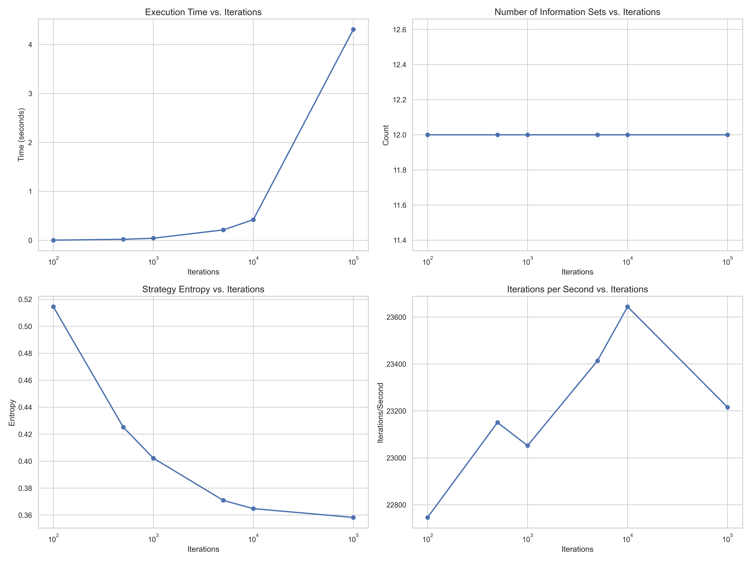

Slide 8
Leduc Poker Evaluation
Methodology:
Implemented CFR algorithm across multiple iterations (1,000 to 100,000)
Measured exploitability, runtime, and average utility​
Findings:
Exploitability sharply decreases as iterations increase, indicating strategy convergence towards Nash Equilibrium
Runtime increases with iterations, highlighting computational trade-offs

Slide 9
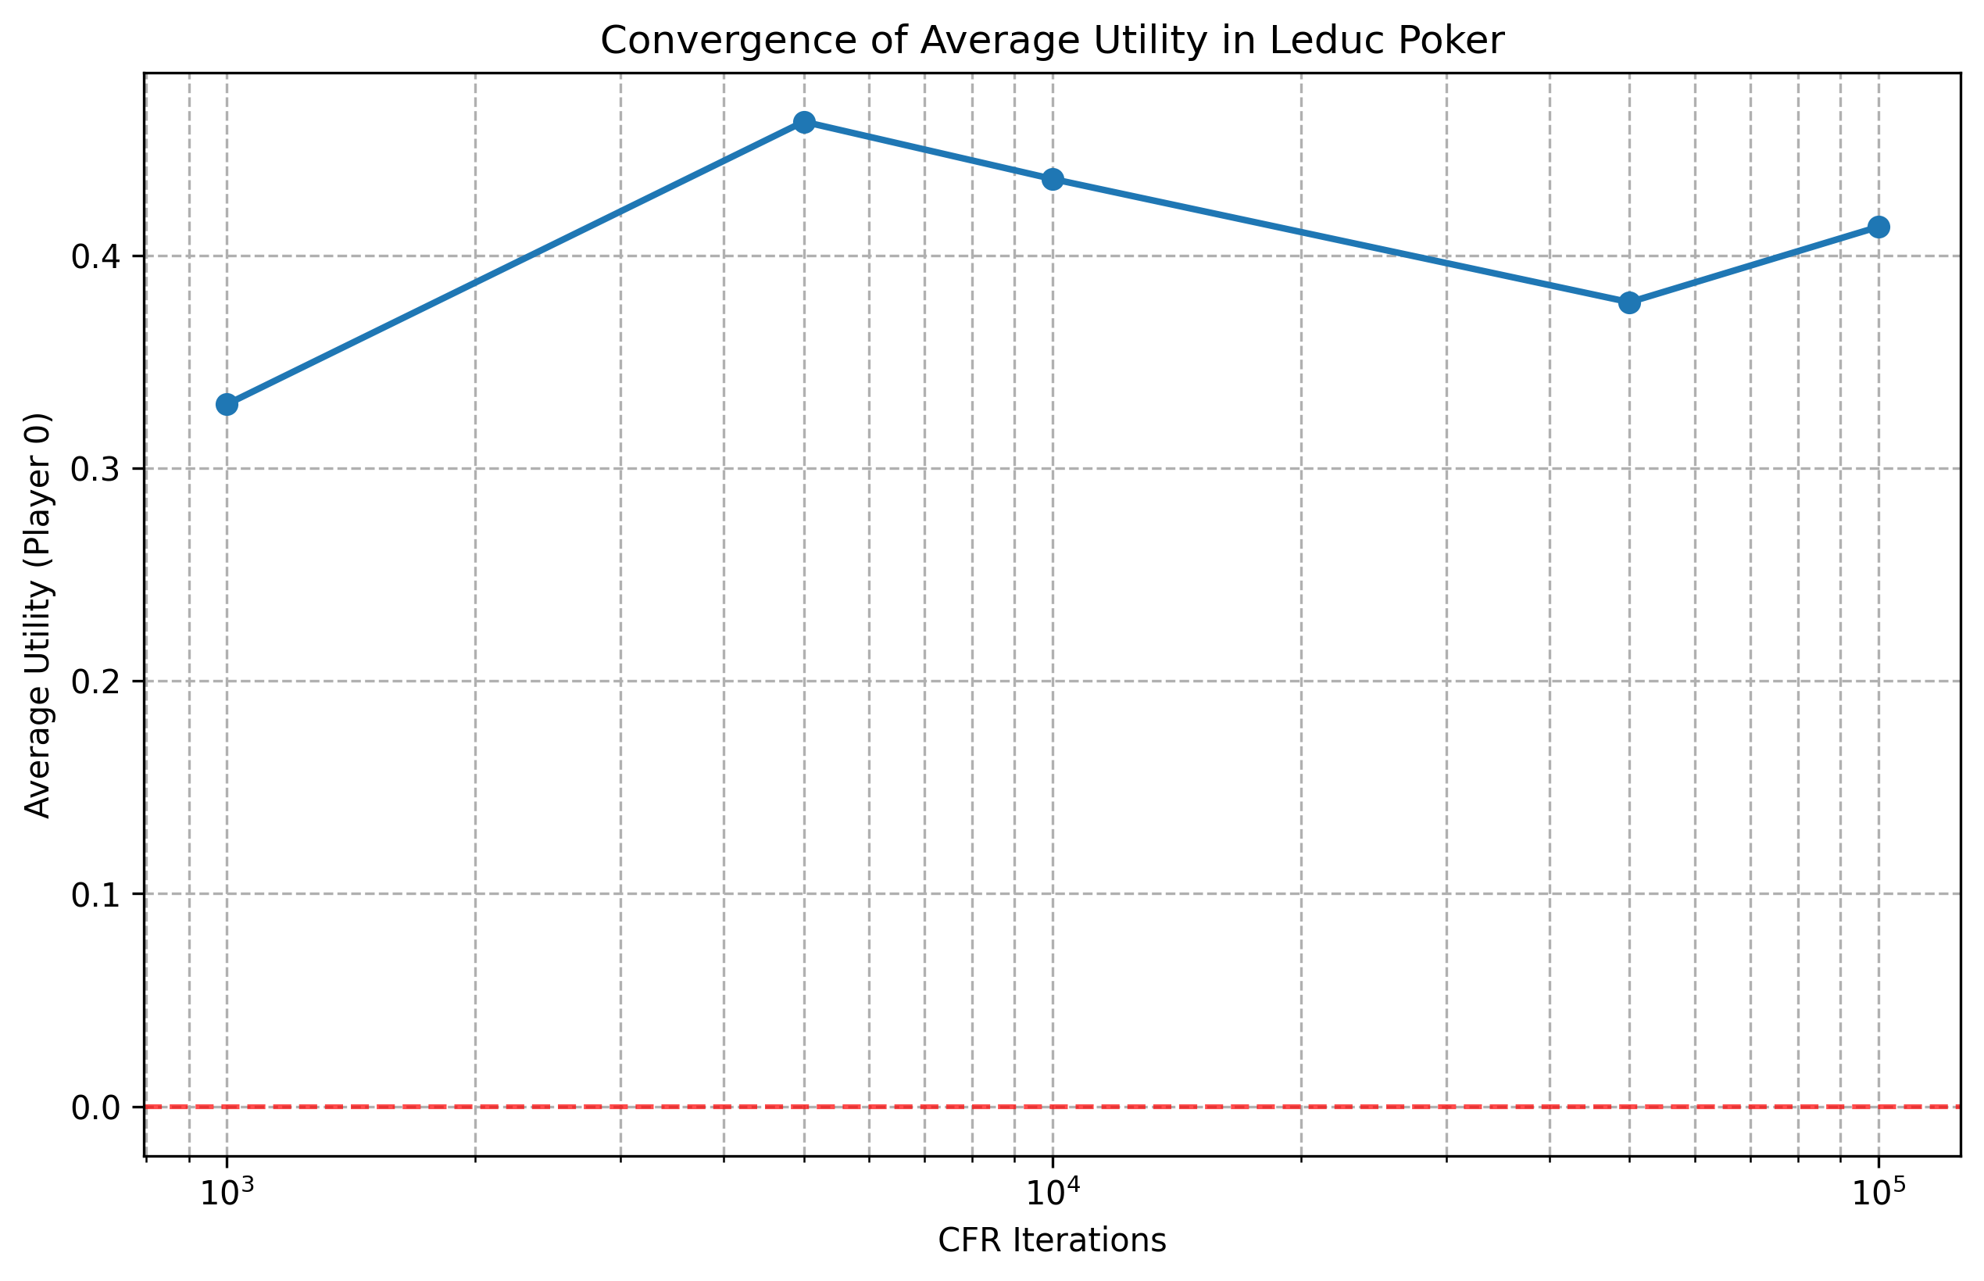

Slide 10
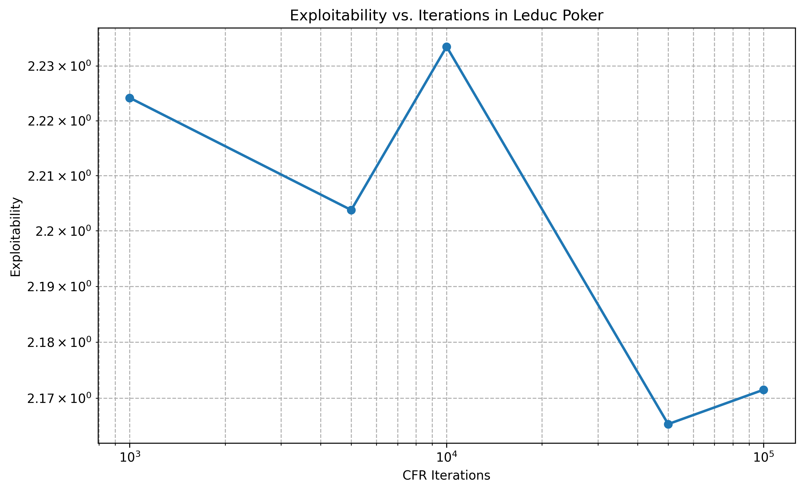
Exploitability = the average per-hand gain a perfect (best-response) opponent would achieve against our strategy zero at Nash equilibrium.

Slide 11
Strategy Evolution in Leduc Poker
Tracked strategy changes in information sets over iterations:
Player strategy heatmaps at different stages (Round 1 and Round 2)
Visualizations show gradual strategy stabilization with increased iterations

Slide 12
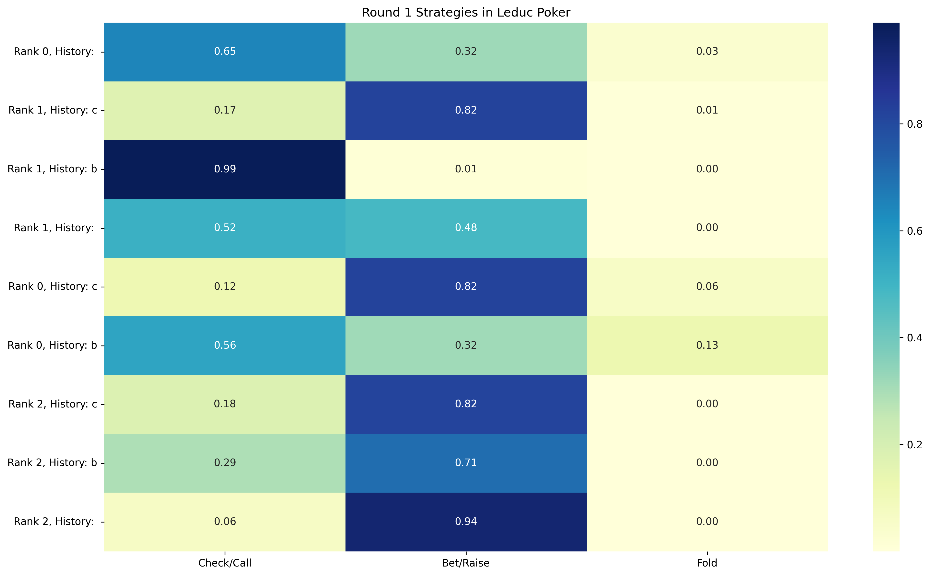

Slide 13
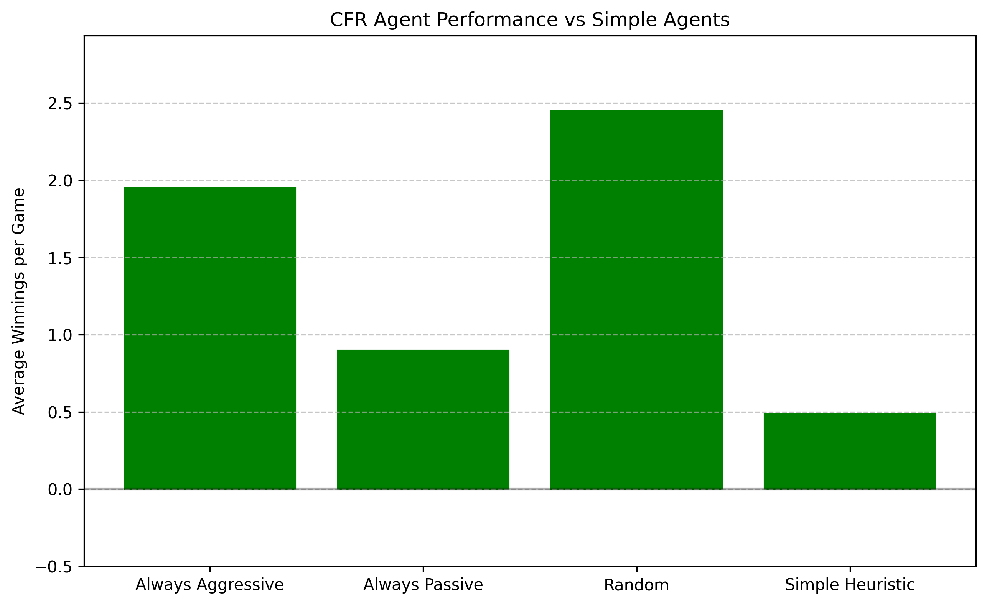

Slide 14
Conclusions
CFR effectively approximates Nash Equilibrium across game complexities
Convergence heavily influenced by iterations and complexity of game dynamics

Slide 15
Future Work
Future improvements:
Enhanced sampling techniques to reduce computational costs(MCCFR)
Reduce complexity for larger state games (binning)

Slide 16
Q&A Session
Thank you for your attention. Any questions?

