Slide 1



Making CIGARs
Compact Idiosyncratic
Gapped Alignment Report
Replicon Genetics 2018, 2019, 2020

Slide 2

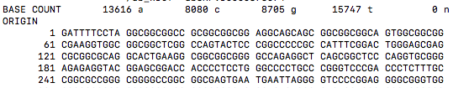
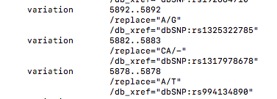
Replicon prototype
Variation table:
dbSNP, COSMIC etc
Reference Sequence
Generate
variants
Heterotype1
Heterotype2
Somatic1
Somatic2
deletion
insert
Fragmentation
Random start, set length, average read-depth (or: “all possible oligmers”)
Option to annotate: Variant origin, start point, CIGAR, for each fragment

Slide 3
CIGAR annotation refers to position of features compared to the reference sequence
deletion
insert
Variant
Reference
Variant
CIGAR
50M 1X 200M 150D 300M I100 200M 1X 50M
“I”s are 100 nucleotides in the Variant, that are not present in the Reference sequence
“D”s are 150 nucleotides in the Reference, that are not present in the Variant sequence
A sequence fragment from the variant sequence can be annotated as a CIGAR, to state its
relationship to the Reference
First 250 nt would read
50M1X199M Offset 0, starts base 1
250 nt fragment, from next base along reads Offset 1, starts base 2
49M1X200M
Next 250nt fragment 48M1X200M150D1M Offset 2, starts base3
Trick is: calculate the CIGAR starting from a randomly-defined start position

Slide 4
FASTA output KRAS G12C
50 nt fragments for KRAS c.34G>T (G12C)
>frag14 het1 5650 50M
ATCCAACAATAGAGGTAAATCTTGTTTTAATATGCATATTACTGGTGCAG
>frag15 het1 5548 38M1X11M
TGAAAATGACTGAATATAAACTTGTGGTAGTTGGAGCTtGTGGCGTAGGC
>frag16 het2 5644 50M
AATATGATCCAACAATAGAGGTAAATCTTGTTTTAATATGCATATTACTG
>frag17 het1 5585 1M1X48M
TtGTGGCGTAGGCAAGAGTGCCTTGACGATACAGCTAATTCAGAATCATT
>frag18 het1 5516 50M
CACATTTTCATTATTTTTATTATAAGGCCTGCTGAAAATGACTGAATATA
>frag70 het2 5547 50M
CTGAAAATGACTGAATATAAACTTGTGGTAGTTGGAGCTGGTGGCGTAGG
>fragn = “fragment” number, FASTA id
het1 = heterotype1, het2=heterotype2
5650 etc: relative start position on reverse-complemented reference sequence (Ensembl KRAS link)
CIGAR strings: 50M = 50 nucleotides Matched with reference ,
1M1X48M = 1Match, 1 mismatch (X), 48 Match
Substituted T in het1
Original G in het2

Slide 5
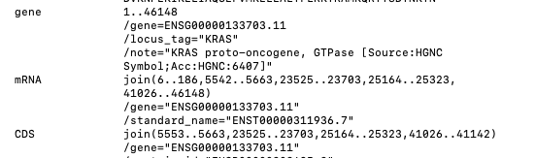
Spliced sequences
cDNA
Reference
Instead of D use N (“Skipped” in CIGAR annotation)
400M 310N 100M 200N 120M 180N 120M
Exon 2

Slide 6
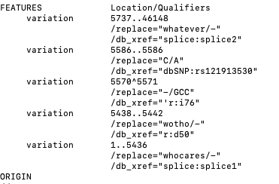


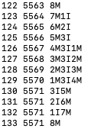
Definition
Splice from 5737 to end
KRAS G12C mutation
Insert between 5570 & 5571
Hijack the feature table
Splice out up to 5436
Trigger name “splice”
Mutation start
Reference start

