Slide 1
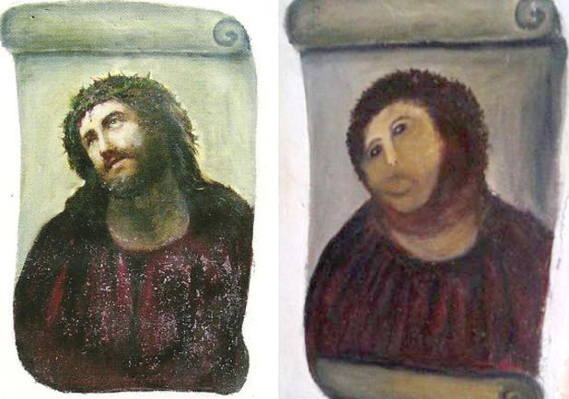

NGS synthetic sequence creation
Simulation or parody?
Image copyright original owner - apologies for lost reference
Copyright © 2018-2025; Cary O'Donnell ; apart from referenced items
syrgenreads@gmail.com

Slide 2
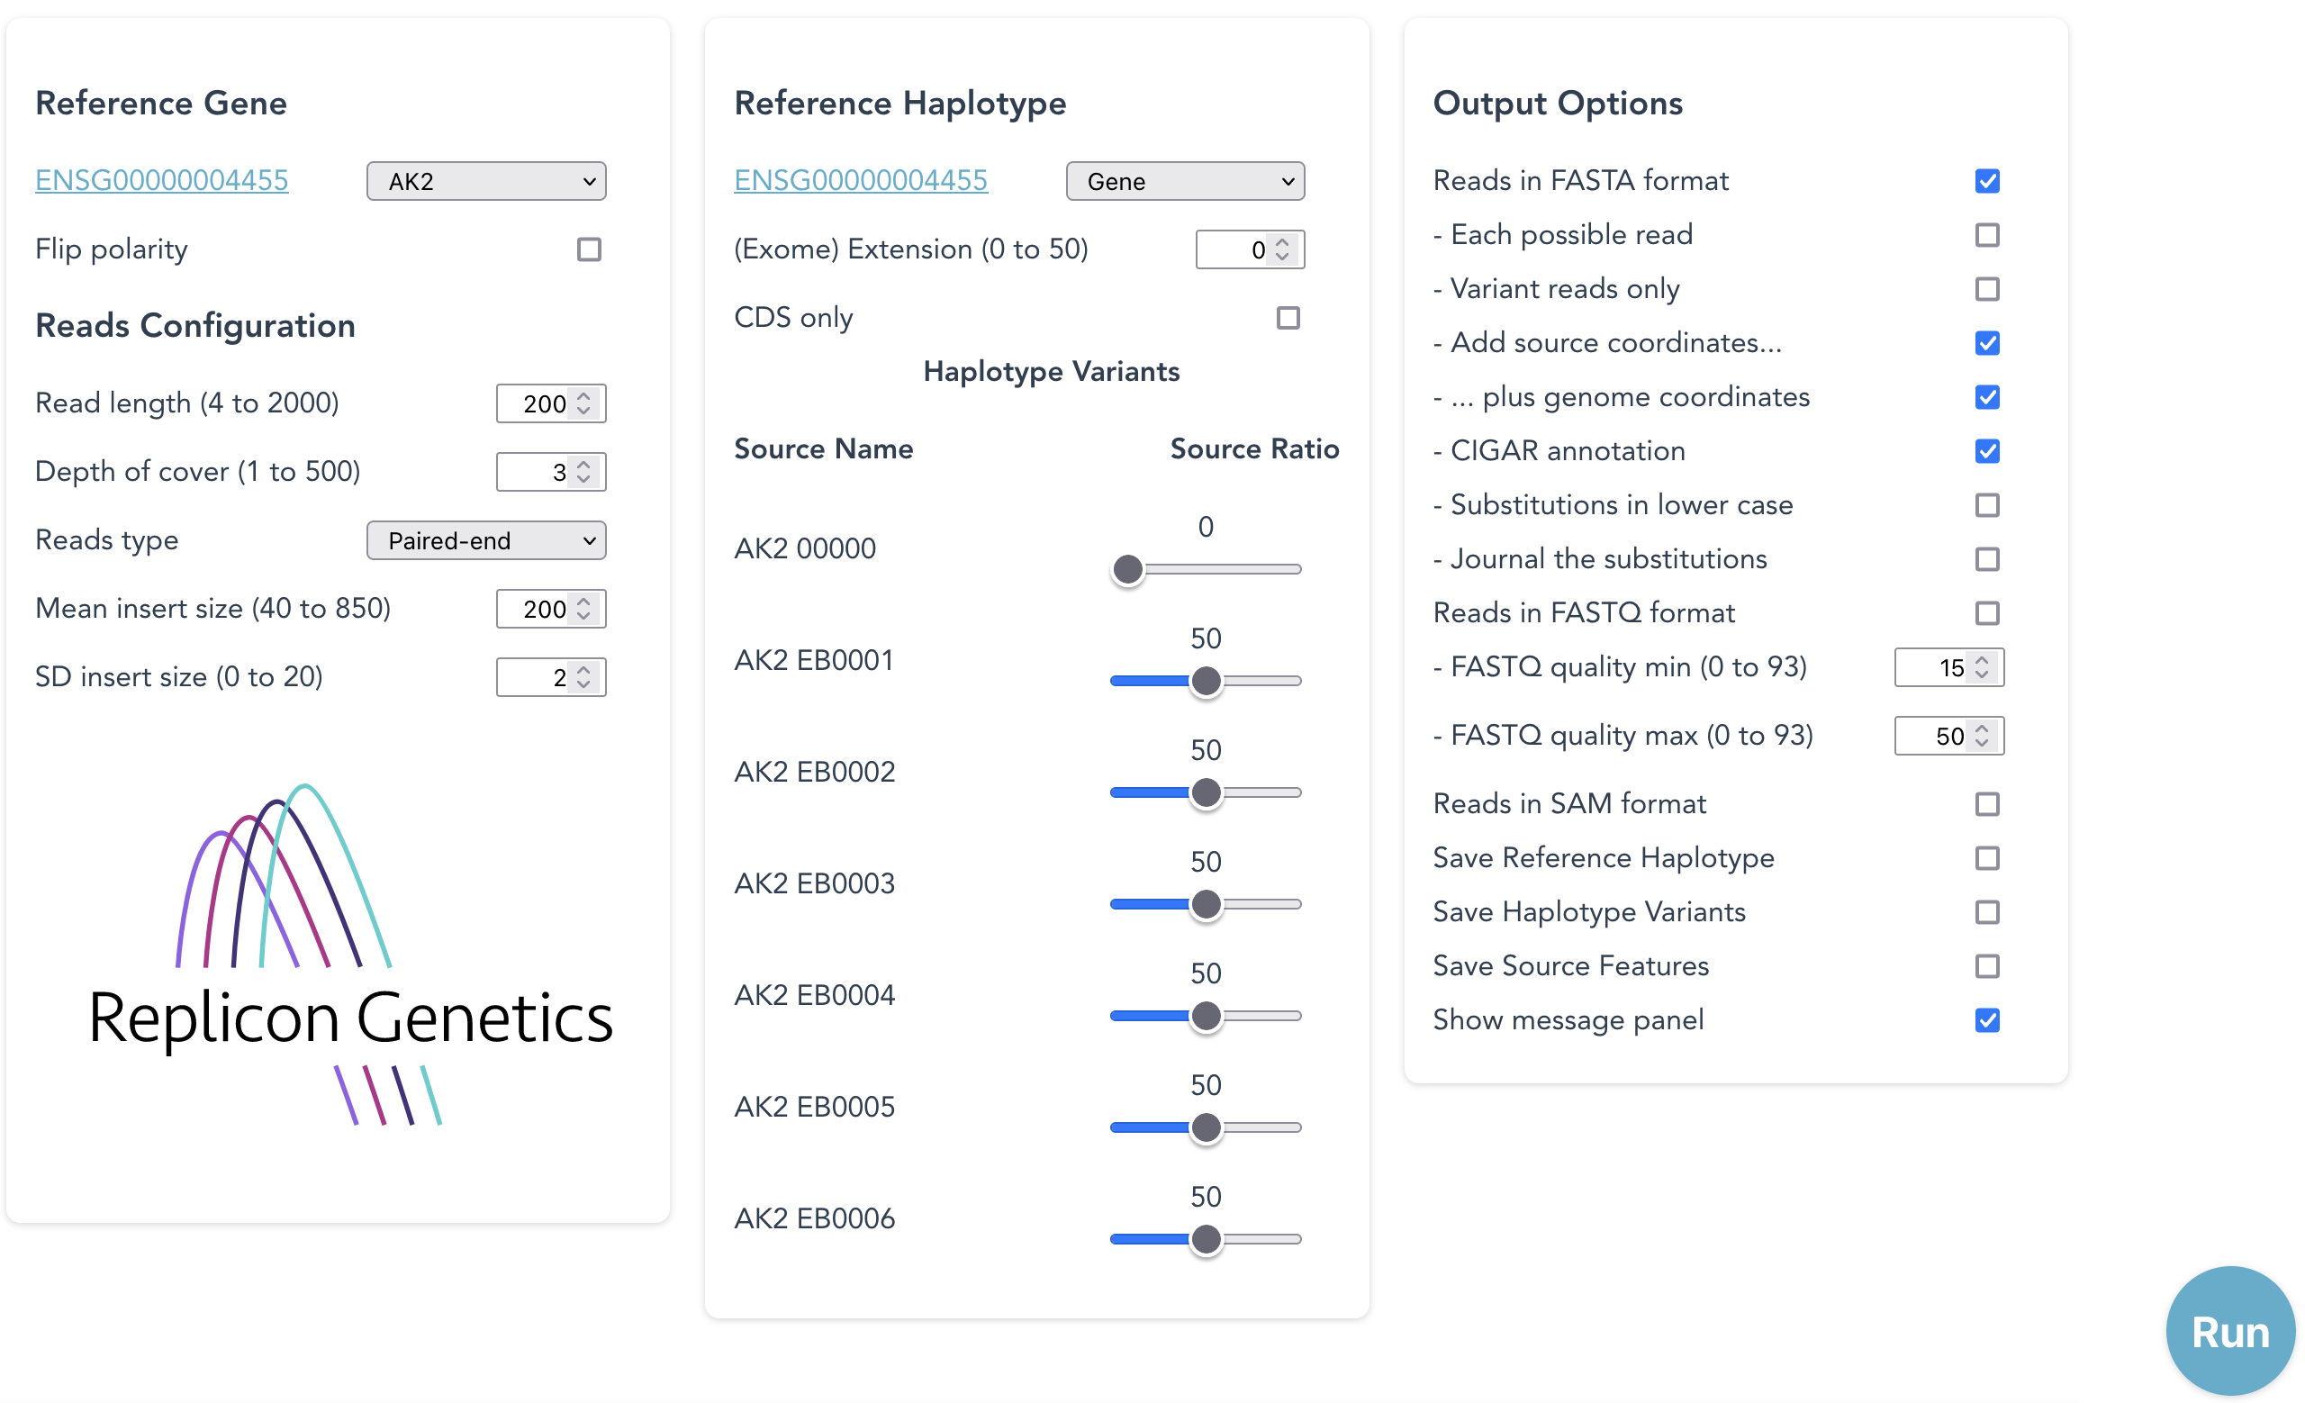
SyRGen – an application to Generate sequence-standards

Slide 3




Synthetic Sequence Standards: Why do this?
Less reliance
on samples
Faster test
development times
Added validation
Lab to lab consistency
Test validation is usually performed using tissue samples with known changes in the DNA. This may be impossible where the samples required are unavailable or from a very rare disease. Clinical samples may never reliably provide both positive and negative controls.
Synthetic reads can present any number of clinically-relevant mutations to the data analysis component of a diagnostic test.
Running a large number of samples through a full diagnostic test is costly and time-consuming.
Synthetic reads would eliminate the time taken to acquire samples, speeding the test development process for clinical deployment.
Synthetic reads will allow parallel development of data analysis systems, and is adaptable to any reference genome.
.
Synthetic reads can present any number of clinically-relevant mutations to the data analysis component of a diagnostic test. This should improve the quality of diagnostic testing, reassuring laboratory scientists that the bioinformatics analysis is functioning as expected and not mis-diagnosing patients, especially for rare variants or genes with 1000s of variants.
Medical healthcare regulatory agencies recognise that reference standards are important, and a key gap exists for data standards, including NGS standards, for evaluating the competency of genetic tests.
Synthetic reads can provide ‘control’ data to be shared among laboratories to ensure consistency of data analysis and interpretation.
In 2018; CO believed there was a "5-year window ... before AI would do the job"

Slide 4
Generating Synthetic Reads:
Fragment a template sequence
Template (reference or variant haplotype)
Random-start fragments
Each possible read
Paired-end reads
Exact start position of each read on reference is known

Slide 5

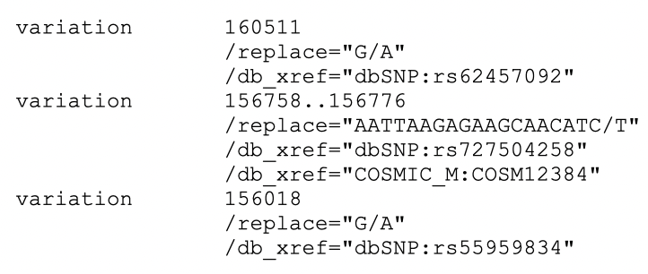
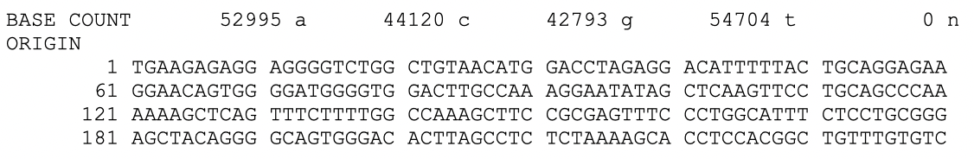
Variant template generation
One Variation table per haplotype: dbSNP, COSMIC etc
Reference Sequence
Reference
Generate
variants
Haplotype1
Haplotype2
Somatic1
Somatic2
deletion
insert
Fragment
Random start, set length, average read-depth (or: “each possible read”)
Option to annotate: Variant origin, start point, CIGAR, for each fragment

Slide 6
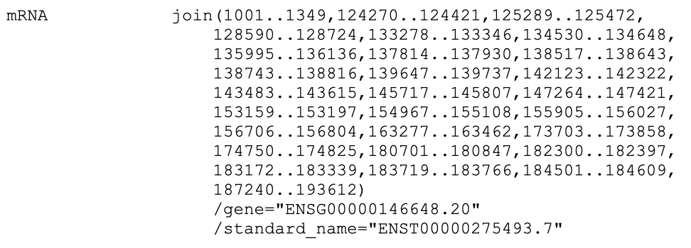
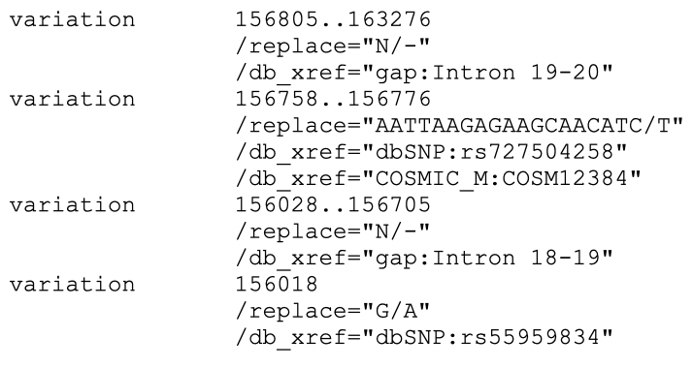
Exome template generation
Add exons as deletions to Variation table
mRNA join table
Reference
Add exons as
deletions
Haplotype1
Splice
Fragment
Random start, set length, average read-depth (or: “each possible read”)
Option to annotate: Variant origin, start point, CIGAR, for each fragment

Slide 7
Exome template generation
Add exons as deletions to Variation table
mRNA join table
Reference
Add exons as
deletions
Haplotype1
Splice with
extension
Fragment
Random start, set length, average read-depth (or: “each possible read”)
Option to annotate: Variant origin, start point, CIGAR, for each fragment

Slide 8
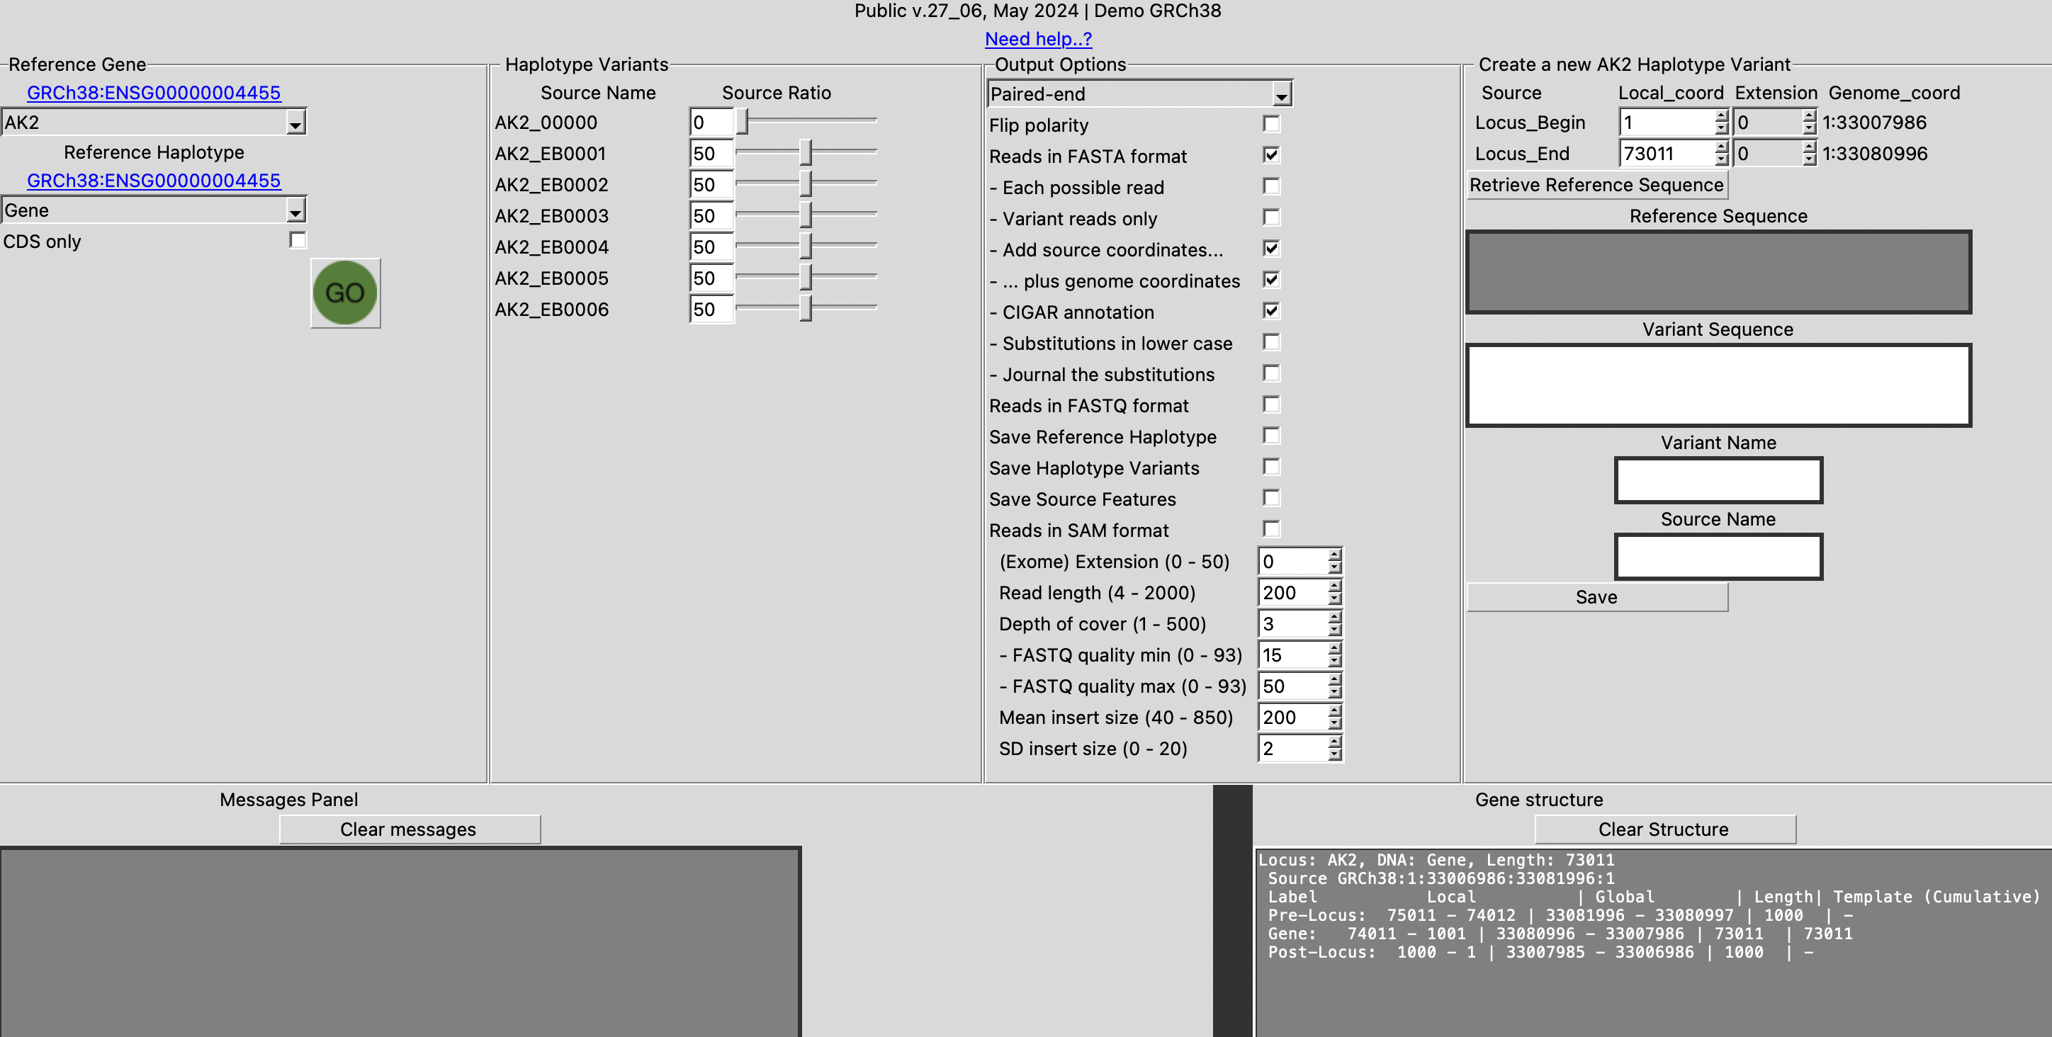
Python Tkinter GUI
Run from any platform using Python

Slide 9
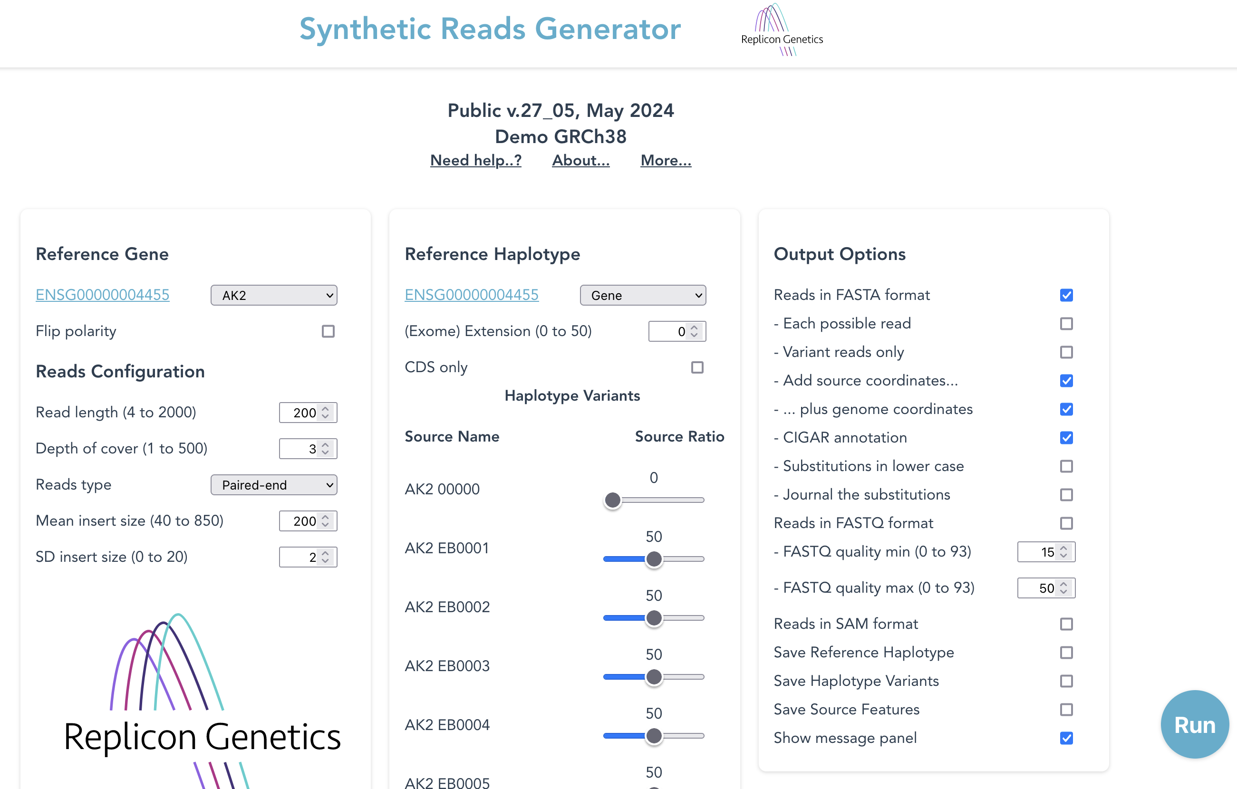
JavaScript GUI
Currently served from AWS to Firefox browser

Slide 10
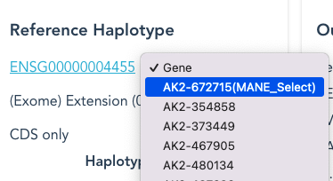
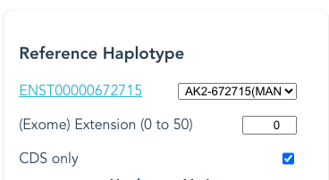
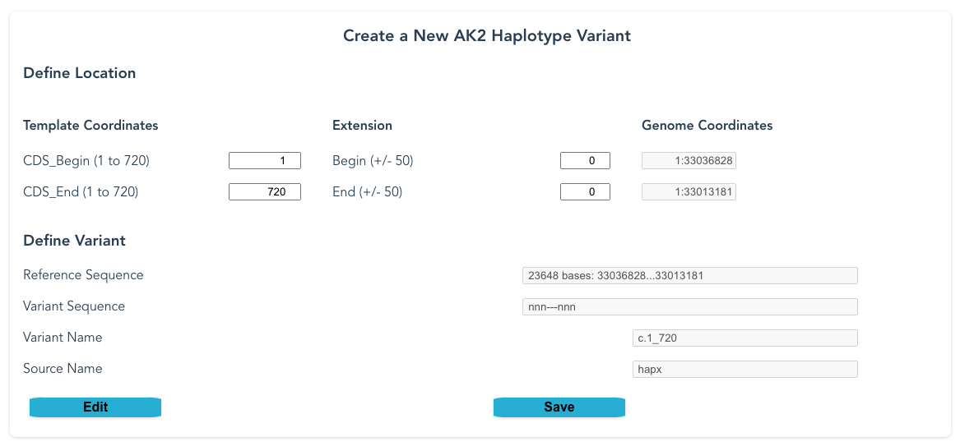
GUI-defined variant-definition
Define at CDS-level using HGVS expression syntax

Slide 11
AK2 variants
NB: AK2 is coded on reverse strand, but we can use CDS ordinates
Source Name | HGVS expression (CDS-sequence definition) | Comment
AK2 EB0001 | NM_001625.4(AK2):c.453del(p.Tyr152fs) implemented as NM_001625.4(AK2):c.452_453CC>C(p.Tyr152fs) | Single-base deletion clinvar:18254 dbSNP:rs1553151177
AK2 EB0002 | NM_001625.4(AK2):c.336_338del(p.Asp113del) | Three-base deletion clinvar:840748
AK2 EB0003 | NM_001625.4(AK2):c.331-1G>A | Splicing-site deletion clinvar:18253 dbSNP:rs1192619329
AK2 EB0004 | NM_001625.4(AK2):c.698_699del(p.Lys233fs) | Deprecated clinvar:1034623
AK2 EB0005 | NM_001625.4(AK2):c.350_402del(p.Lys117Thrfs*32) | Theoretical; 53-base-long deletion
AK2 EB0006 | NM_001625.4(AK2):c.406_425+3dup dup=ATCCGAAGAATCACAGGAAGGTA | Theoretical; 23-base duplication crossing a splice-boundary.

Slide 12
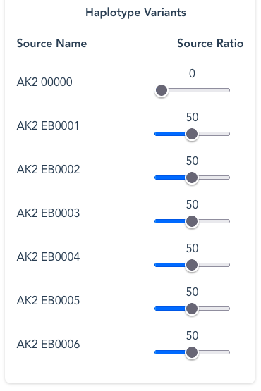
GUI variant-definition for AK2
Define at CDS-level using HGVS expression syntax

Slide 13
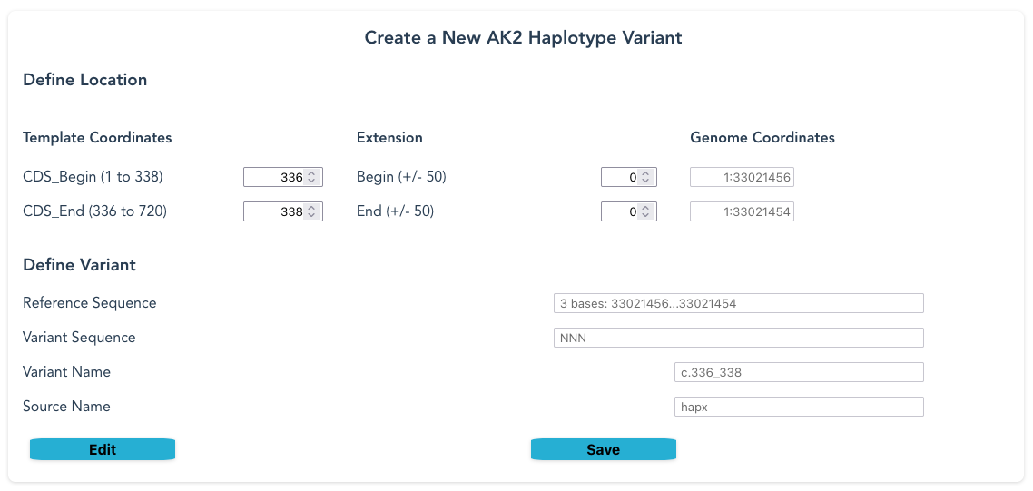
GUI variant-definition for AK2
Define c.336_338del(p.Asp113del)

Slide 14
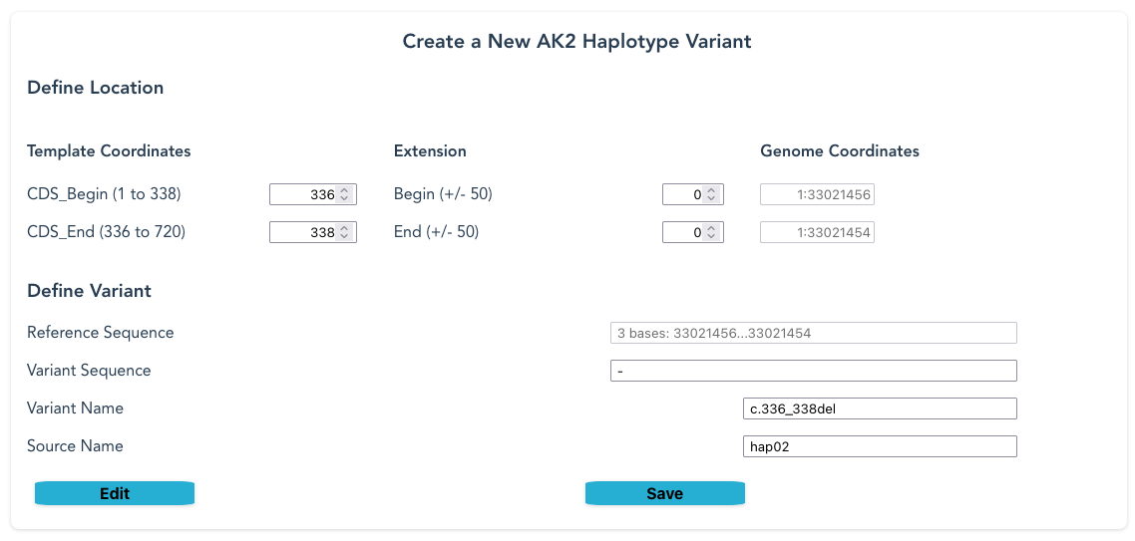
GUI variant-definition for AK2
Define c.336_338del(p.Asp113del)

Slide 15
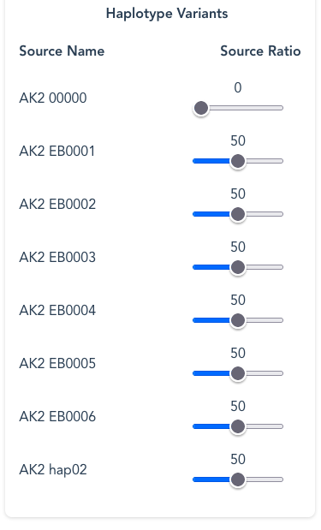
GUI variant-definition for AK2
Define c.336_338del(p.Asp113del)

Slide 16
GUI variant-definition for AK2
Define c.336_338del(p.Asp113del)

Slide 17
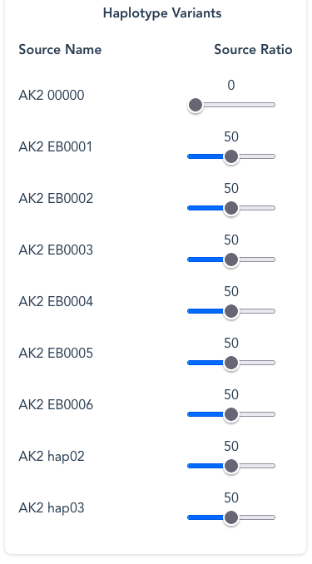
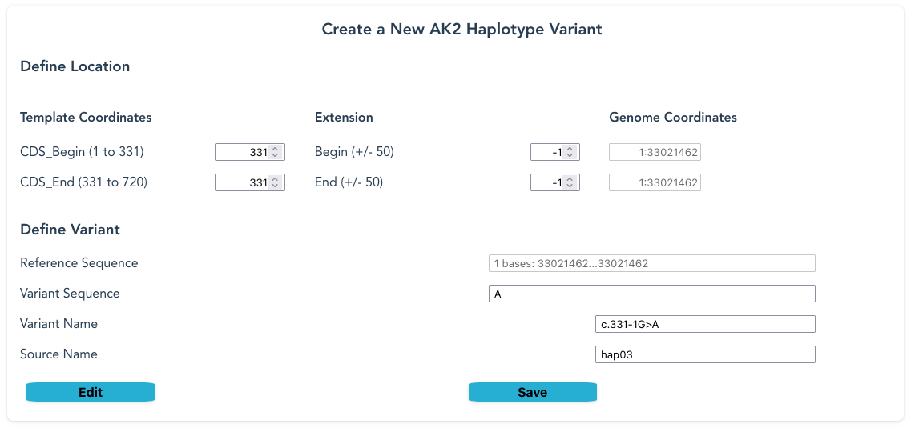
GUI variant-definition for AK2
Define c.331-1G>A

Slide 18
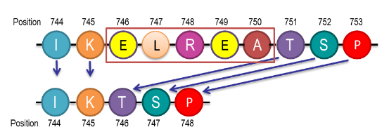
Case study – EGFR data curation
Taking novel variants from a publication, then putting them into SyRGen
About 1 in 3 non-small cell lung cancers (NSCLCs) have a change in the EGFR gene that changes the EGFR protein.
EGFR mutations are found in all types of NSCLC and are most common in nonsmokers.
These are detected by testing tissue samples.
EGFR DNA-deletions result in proteins with missing amino acids.
Most exon19 deletions occur between amino acids 746 and 753.
The image is an example of an EGFR exon 19 deletion from item 1 in the table featured later
Image copyright original owner - apologies for lost reference

Slide 19
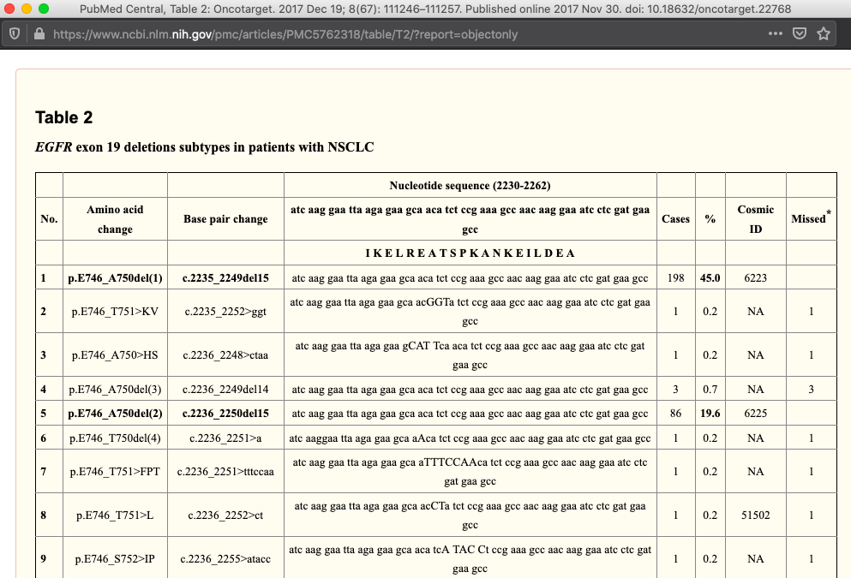
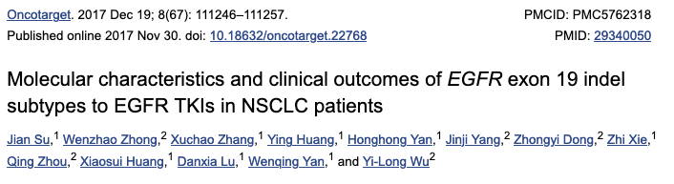

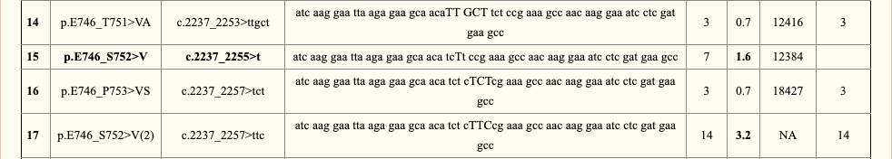
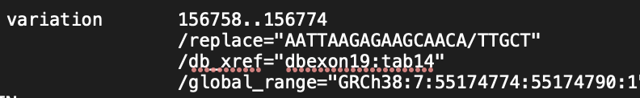
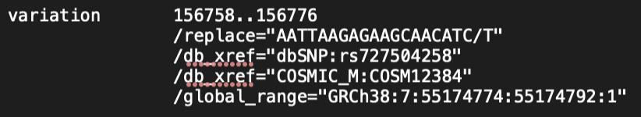

EGFR exon-19 mutations classification and detection
Subtypes missed by commercial kits
Create feature definitions for those variants absent from databases*, as well as present
There are compilation errors in this table, published in 2017:
* COSMIC 12416 & 133195 do not exist (Dec 2019) – entries 14 & 17
Link:Full analysis document
https://www.ncbi.nlm.nih.gov/pmc/articles/PMC5762318/

Slide 20
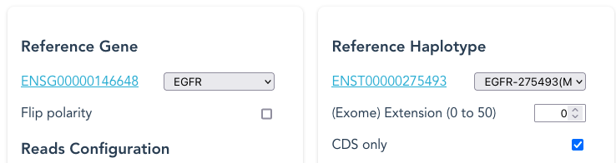
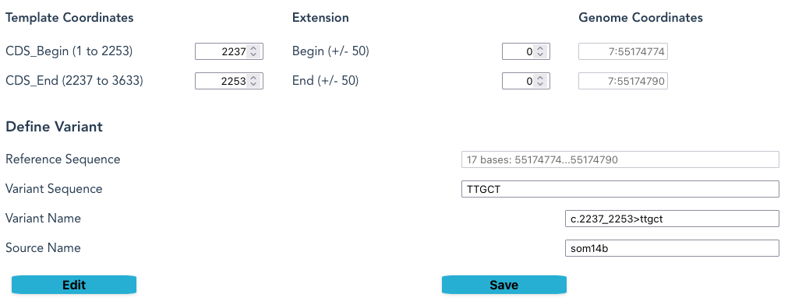
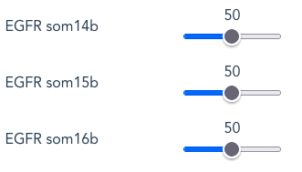
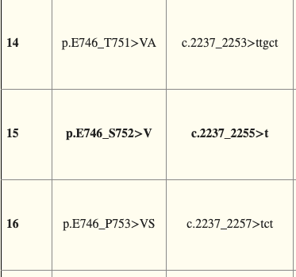
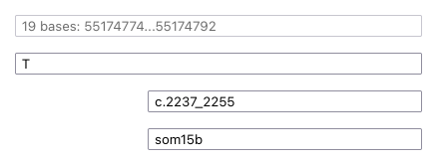
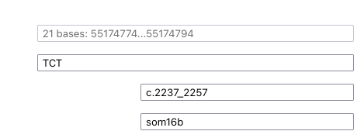
Adding EGFR exon-19 variants to SyRGen

Slide 21
FASTA output examples for EGFR
50 nt-length random single-reads
>frg1_hap1 h:149542 r:149542 g:55168558 50M /1
CCACTAAAACTGCATTTCCTTTCTACAATTTCAATTTCTCCCTTTGCTTC
>frg2_hap2 h:169333 r:169333 g:55188349 50M /1
ACCCAGCCCTTCAAGGTCAAACACAGCCCCCGCCCCTCACTCTGGGGTAC
>frg398_som14 h:155756 r:155756 g:55174772 2M17D5I43M /1
GGttgctTCTCCGAAAGCCAACAAGGAAATCCTCGATGTGAGTTTCTGCT
>frg400_som14 h:155758 r:155775 g:55174791 17D5I45M /1
ttgctTCTCCGAAAGCCAACAAGGAAATCCTCGATGTGAGTTTCTGCTTT
>frg448_som14 h:158780 r:158792 g:55177808 6M1X43M /1
TCCACGgAGATTGTTGTGGAATACCAAGCATGCTTGCTGTAGGTCACGGT
Hap1 = haplotype1 Hap2 = haplotype2 Som14 = somatic14
CIGAR 50M = “50 base match to ref”
/1 ="forward" /2 ="reverse"
17D = “17-base deletion”
5I = “5 base insertion”
h:n = “n-position on haplotype
r:n* = “n-position on reference”
g:n="n-position on genome"
*cannot numerically-map the 17D; record position of 1st M of 45M
1X = “1-base mismatch to ref”

Slide 22
FASTQ output examples
FASTQ – 50 nt fragments with random quality scores
@frg1_hap1 h:149542 r:149542 g:55168558 50M /1
CCACTAAAACTGCATTTCCTTTCTACAATTTCAATTTCTCCCTTTGCTTC
+
@=>Q0EQRHHK8J>SRK1POJ>I8D<>@GDS@41OEKF?CSLF@MOBB7;
@frg2_hap2 h:169333 r:169333 g:55188349 50M /1
ACCCAGCCCTTCAAGGTCAAACACAGCCCCCGCCCCTCACTCTGGGGTAC
+
A:OAG191OEL7N5FRJJ9SSJB1D9AFIA1DBS30LQLI42140>EKEK
>frg398_som14 h:155756 r:155756 g:55174772 2M17D5I43M /1
GGttgctTCTCCGAAAGCCAACAAGGAAATCCTCGATGTGAGTTTCTGCT
+
30LI6:3;L6NCQ3QPRG?5BERGE7<RPBQ0C:FI4QNG0>8IE:454I
@frg400_som14 h:155758 r:155775 g:55174791 17D5I45M /1
ttgctTCTCCGAAAGCCAACAAGGAAATCCTCGATGTGAGTTTCTGCTTT
+
CF9?KM74L0PQE=KP5S<L?NDQL:D@LHQ:<>1;N6S?C12=GKD@=J

Slide 23
Paired-end reads output
FASTA format: reads
>frg149429_som14 h:156785 r:156785 g:55174801 23M17D5I22M /2
ATTTCCTTGTTGGCTTTCGGAGAagcaaCCTTGATAGCGACGGGAATTT
>frg149429_som14 h:156587 r:156587 g:55174603 50M /1
AGCCCCAGTGTCCCTCACCTTCGGGGTGCATCGCTGGTAACATCCACCCA
SAM format: reference-alignment data for 'perfect' solution
@HD VN:1.6 SO:coordinate
@SQ SN:ref LN:194612 AS:hg38 UR:EGFR_locseq.fasta
@CO ACCESSION: chromosome:GRCh38:7:55018017:55212628:1
...
frg149429_som14 147 chr7 156736 22 22M17D5I23M = 156587 -200 AAAATTCCCGTCGCTATCAAGGttgctTCTCCGAAAGCCAACAAGGAAAT *
frg149429_som14 99 chr7 156587 17 50M = 156736 200 AGCCCCAGTGTCCCTCACCTTCGGGGTGCATCGCTGGTAACATCCACCCA *
h:n = “n-position on haplotype
r:n* = “n-position on reference”
g:n="n-position on genome"

Slide 24
Paired-end reads output
FASTA format: reads
>frg149429_som14 h:156785 r:156785 g:55174801 23M17D5I22M /2
ATTTCCTTGTTGGCTTTCGGAGAagcaaCCTTGATAGCGACGGGAATTT
>frg149429_som14 h:156587 r:156587 g:55174603 50M /1
AGCCCCAGTGTCCCTCACCTTCGGGGTGCATCGCTGGTAACATCCACCCA
SAM format: reference-alignment data for 'perfect' solution
@HD VN:1.6 SO:coordinate
@SQ SN:ref LN:194612 AS:hg38 UR:EGFR_locseq.fasta
@CO ACCESSION: chromosome:GRCh38:7:55018017:55212628:1
...
frg149429_som14 147 chr7 156736 22 22M17D5I23M = 156587 -200 AAAATTCCCGTCGCTATCAAGGttgctTCTCCGAAAGCCAACAAGGAAAT *
frg149429_som14 99 chr7 156587 17 50M = 156736 200 AGCCCCAGTGTCCCTCACCTTCGGGGTGCATCGCTGGTAACATCCACCCA *
/1 ="forward-read"
/2 ="reverse-read"
Lower r value is Read1
h:n = “n-position on haplotype
r:n* = “n-position on reference”
g:n="n-position on genome"

Slide 25
Paired-end reads output
FASTA format: reads
>frg149429_som14 h:156785 r:156785 g:55174801 23M17D5I22M /2
ATTTCCTTGTTGGCTTTCGGAGAagcaaCCTTGATAGCGACGGGAATTT
>frg149429_som14 h:156587 r:156587 g:55174603 50M /1
AGCCCCAGTGTCCCTCACCTTCGGGGTGCATCGCTGGTAACATCCACCCA
SAM format: reference-alignment data for 'perfect' solution
@HD VN:1.6 SO:coordinate
@SQ SN:ref LN:194612 AS:hg38 UR:EGFR_locseq.fasta
@CO ACCESSION: chromosome:GRCh38:7:55018017:55212628:1
...
frg149429_som14 147 chr7 156736 22 22M17D5I23M = 156587 -200 AAAATTCCCGTCGCTATCAAGGttgctTCTCCGAAAGCCAACAAGGAAAT *
frg149429_som14 99 chr7 156587 17 50M = 156736 200 AGCCCCAGTGTCCCTCACCTTCGGGGTGCATCGCTGGTAACATCCACCCA *
/1 ="forward-read"
/2 ="reverse-read"
Lower r value is Read1
Reverse-complemented,
so start base differs
h:n = “n-position on haplotype
r:n* = “n-position on reference”
g:n="n-position on genome"

Slide 26
Paired-end reads output
In this implementation, forward-reads are in a separate file from reverse_reads
FASTA format: reads
>frg149429_som14 h:156785 r:156785 g:55174801 23M17D5I22M /2
ATTTCCTTGTTGGCTTTCGGAGAagcaaCCTTGATAGCGACGGGAATTT
>frg149429_som14 h:156587 r:156587 g:55174603 50M /1
AGCCCCAGTGTCCCTCACCTTCGGGGTGCATCGCTGGTAACATCCACCCA
SAM format: reference-alignment data for 'perfect' solution
@HD VN:1.6 SO:coordinate
@SQ SN:ref LN:194612 AS:hg38 UR:EGFR_locseq.fasta
@CO ACCESSION: chromosome:GRCh38:7:55018017:55212628:1
...
frg149429_som14 147 chr7 156736 22 22M17D5I23M = 156587 -200 AAAATTCCCGTCGCTATCAAGGttgctTCTCCGAAAGCCAACAAGGAAAT *
frg149429_som14 99 chr7 156587 17 50M = 156736 200 AGCCCCAGTGTCCCTCACCTTCGGGGTGCATCGCTGGTAACATCCACCCA *
/1 ="forward-read"
/2 ="reverse-read"
Lower r value is Read1
Reverse-complemented,
so start base differs
Bitwise flags
147=(is read2)+128; this reverse complemented +16; read mapped in proper pair +2; +1
99=(is read1)+ 64;mate reverse complemented +32; read mapped in proper pair +2; +1

Slide 27
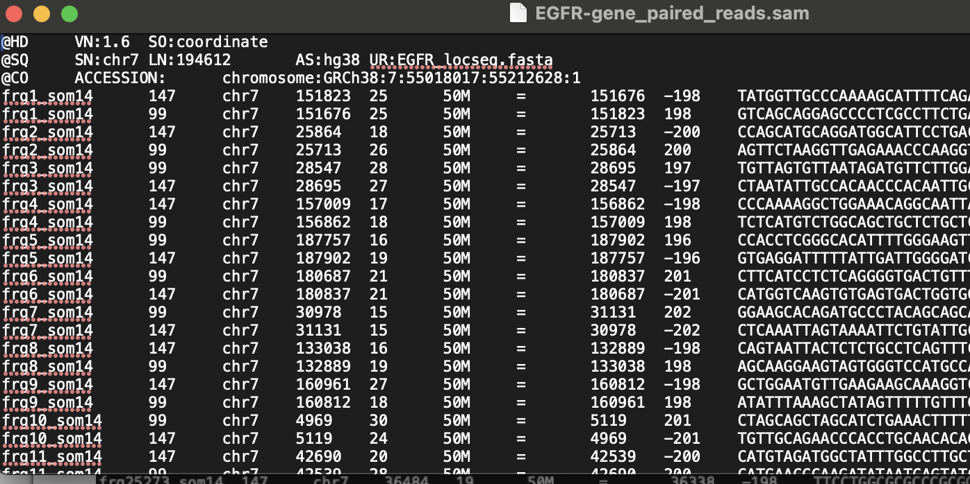
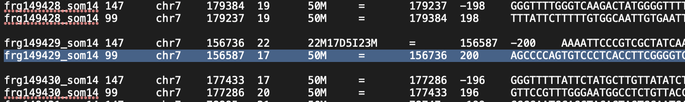
SAM output
Variation in insert length around mean of 200 and SD of 2 (Gaussian distribution)
Unmatched read frg641_som14
Previous example with frg149429_som14

Slide 28
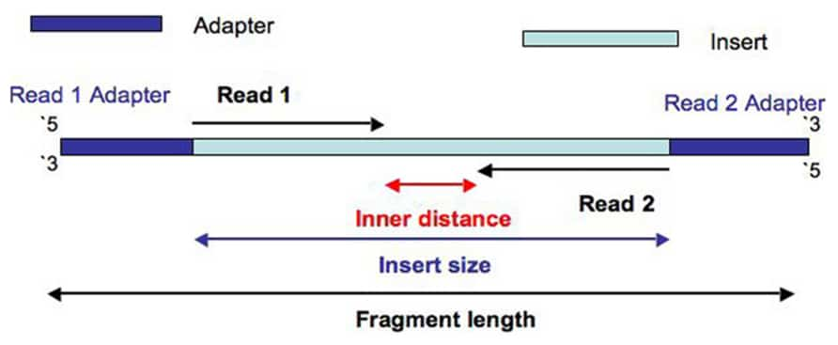
Paired-end
In the algorithm:
a) Generate insert size using Gaussian distribution
b) Select a random start position on Reference
c) Randomly select whether it's the start of Read1, or end of Read2
d) Calculate the position of the other read using insert-size and read-length
NB: Exclude where read_length > insert-size
Allows for overlapping Reads with relevant combinations
Allows for single reads when paired read falls outside Reference
Diagram from The Sequencing Centre 15-Apr-2024 https://thesequencingcenter.com/knowledge-base/what-are-paired-end-reads/#tab-id-5

Slide 29
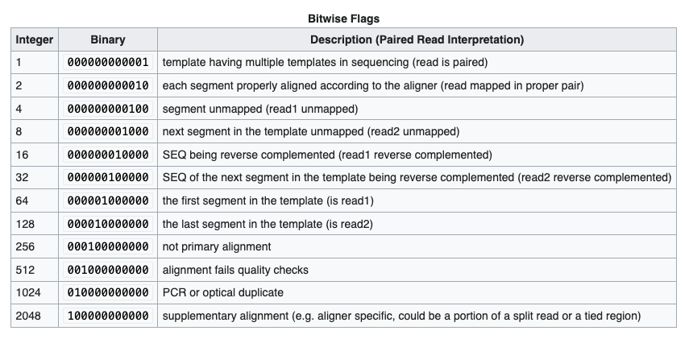
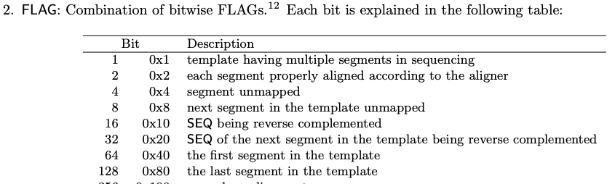
SAM bitwise flags
Top table from : https://en.wikipedia.org/wiki/SAM_(file_format)
Bottom from: SAM format specification at https://samtools.github.io/hts-specs/SAMv1.pdf

Slide 30
Identifying overlaps between features
Or: “How to identify features that lie within introns in order to exclude them from exome definitions”

Slide 31
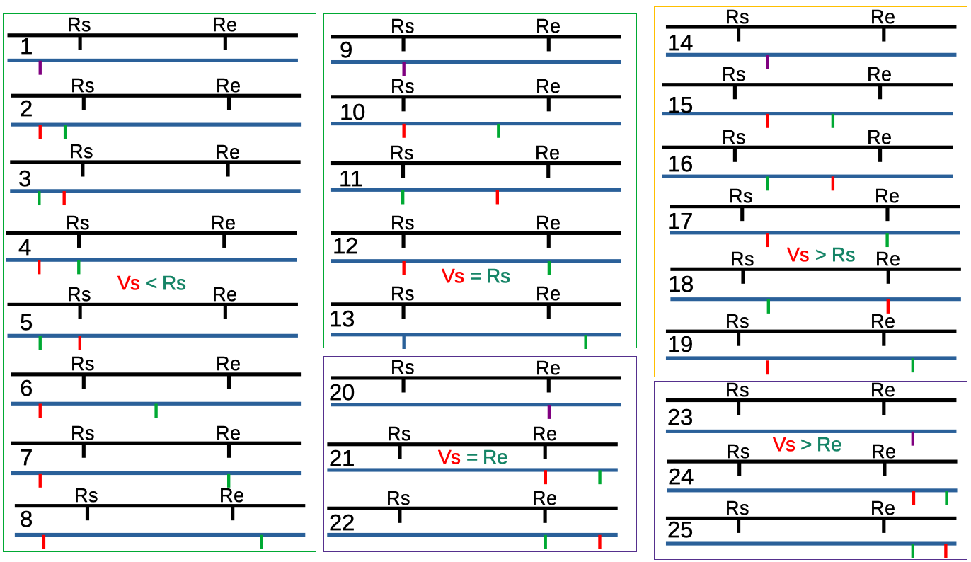
Overlap types between Reference and Variant features, as implemented
Rs is the starting location/position of a Reference feature; Re the end; eg: intron ranges
Vs is the starting location of a Variant feature: ; Ve is the ending location
When Vs==Ve ie: a SNP; point marked in purple: ; Vs < Ve is a > 1 base substitution
When Vs > Ve it defines an insertion and Vs = Ve +1(always)
A number 1 to 25 is assigned to each different “Overlap Type”

Slide 32
Overlap types between Reference and Variant features, as implemented
Rs is the starting location/position of a Reference feature; Re the end; eg: intron ranges
Vs is the starting location of a Variant feature: ; Ve is the ending location
When Vs==Ve ie: a SNP; point marked in purple: ; Vs < Ve is a > 1 base substitution
When Vs > Ve it defines an insertion and Vs = Ve +1(always)
Hide
Hide
Hide
Hide
No Overlap
Hide
Hide
Hide
Truncate deletion at end
Hide
Hide
No Overlap- insert
Truncate deletion at start
Truncate deletion at start
Hide
Truncate deletion at end
Truncate deletion at start
No Overlap – outside
Deletion longer than ref
Incorrect Hide?
A number 1 to 25 is assigned to each different “Overlap Type”

Slide 33
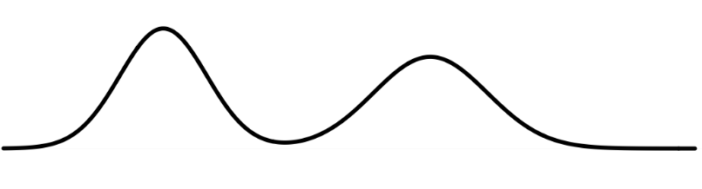
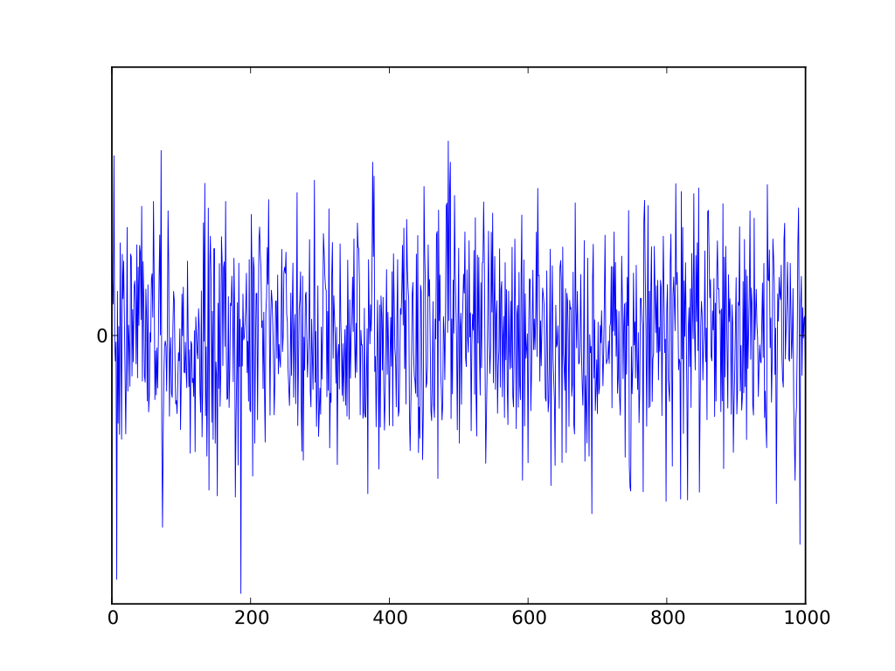
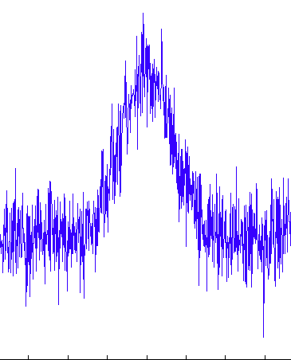
More rules to add? parody → simulation
Hard- or easy-to-sequence regions
So: under/over represented (set %)
May be direction-dependent?
Repetitive elements?
Affects quality score?
Distribution of quality-score across reference sequence?
Distribution of quality-scores across fragment?
White noise:
Random quality score
at each position
Normal distribution of
quality score
with restricted noise

Slide 34
Conditions of re-use
This document is available under the same conditions as the software: you may redistribute it and/or modify
it under the terms of the GNU Affero General Public License as published
by the Free Software Foundation, either version 3 of the License, or
any later version.
This program is distributed in the hope that it will be useful,
but WITHOUT ANY WARRANTY; without even the implied warranty of
MERCHANTABILITY or FITNESS FOR A PARTICULAR PURPOSE. See the
GNU Affero General Public License for more details.
You should have received a copy of the GNU Affero General Public License
along with this. If not, see the original repository at
https://github.com/snowlizardz/rg_exploder_shared, or the licences at <https://www.gnu.org/licenses/>.
Contact: syrgenreads@gmail.com

