Slide 1
Intro to Xamarin
Benjamin Romano
Xamarin Student Ambassador
bromano@crimson.ua.edu
Notes:
Xamarin Introduction!

Slide 2
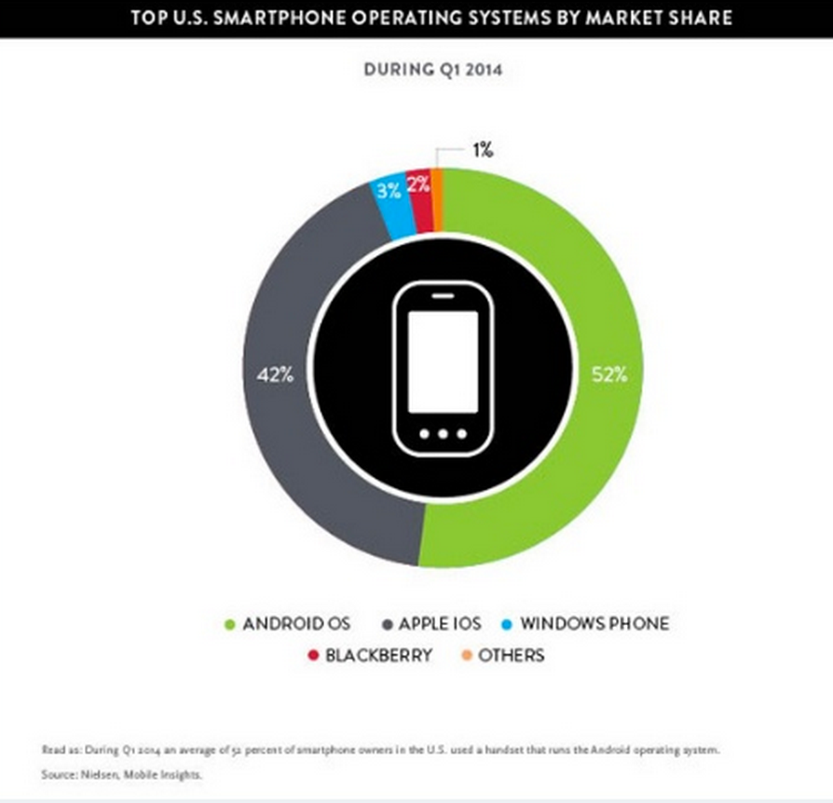
What are the best platforms to reach people?
Android: 52%
iOS: 42%
WinPhone: 3% (6mil users)
Blackberry: 2%
Other: 1%

Slide 3
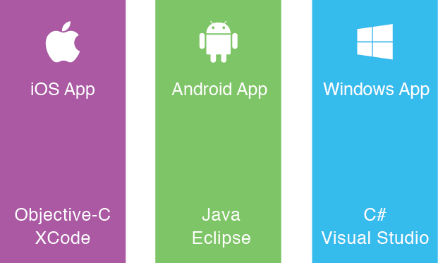

Current Way to Develop Apps
OR
Notes:
Expensive to produce multiple apps
Highest quality apps
Lots of fragmentation; hard to create consistent experience

Slide 4

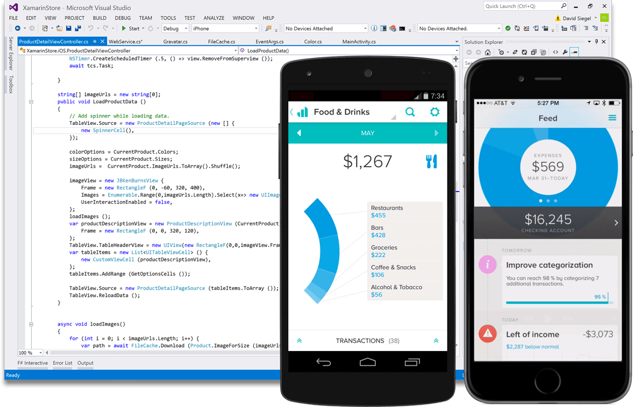
Create native iOS, Android, Mac and
Windows apps in Visual Studio and C#

Slide 5
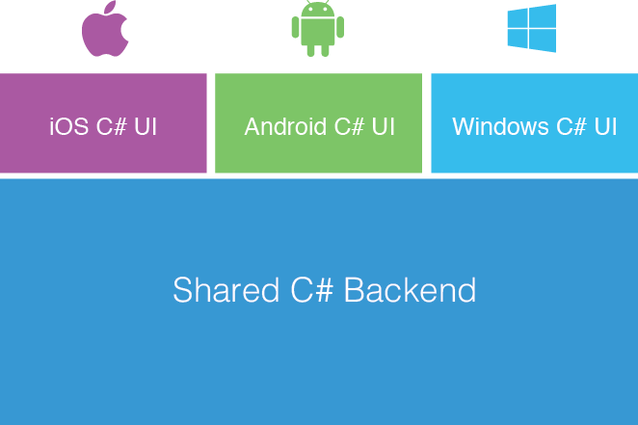
Xamarin Platform
Separate Code for UIs
Shared UI Code
Shared UI Code
Notes:
Xamarin recently introduced Xamarin.Forms a new library for cross platform user interface. We will touch up on this later, but this enables you to be highly productive, share code, but build out UI on each platform and access platform APIs.
With Xamarin.Forms you now have a nice Shared UI Code layer, but still access to platform APIs
You can start from native, pick a few screens, or start with forms, and replace with native later

Slide 6
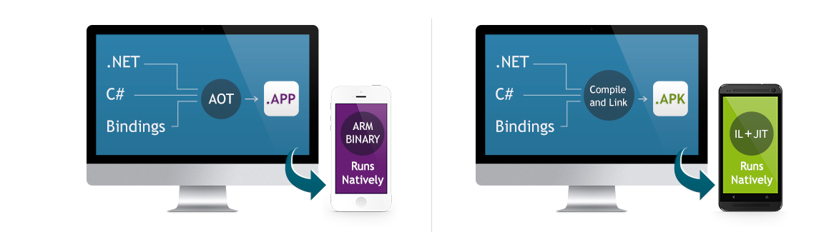
Xamarin Performance
Xamarin.iOS does full Ahead Of Time (AOT) compilation to produce an ARM binary for Apple’s App Store.
Xamarin.Android takes advantage of Just In Time (JIT) compilation on the Android device.
Notes:
There is no compromise on performance.
Xamarin apps look and feel native because they are native.

Slide 7
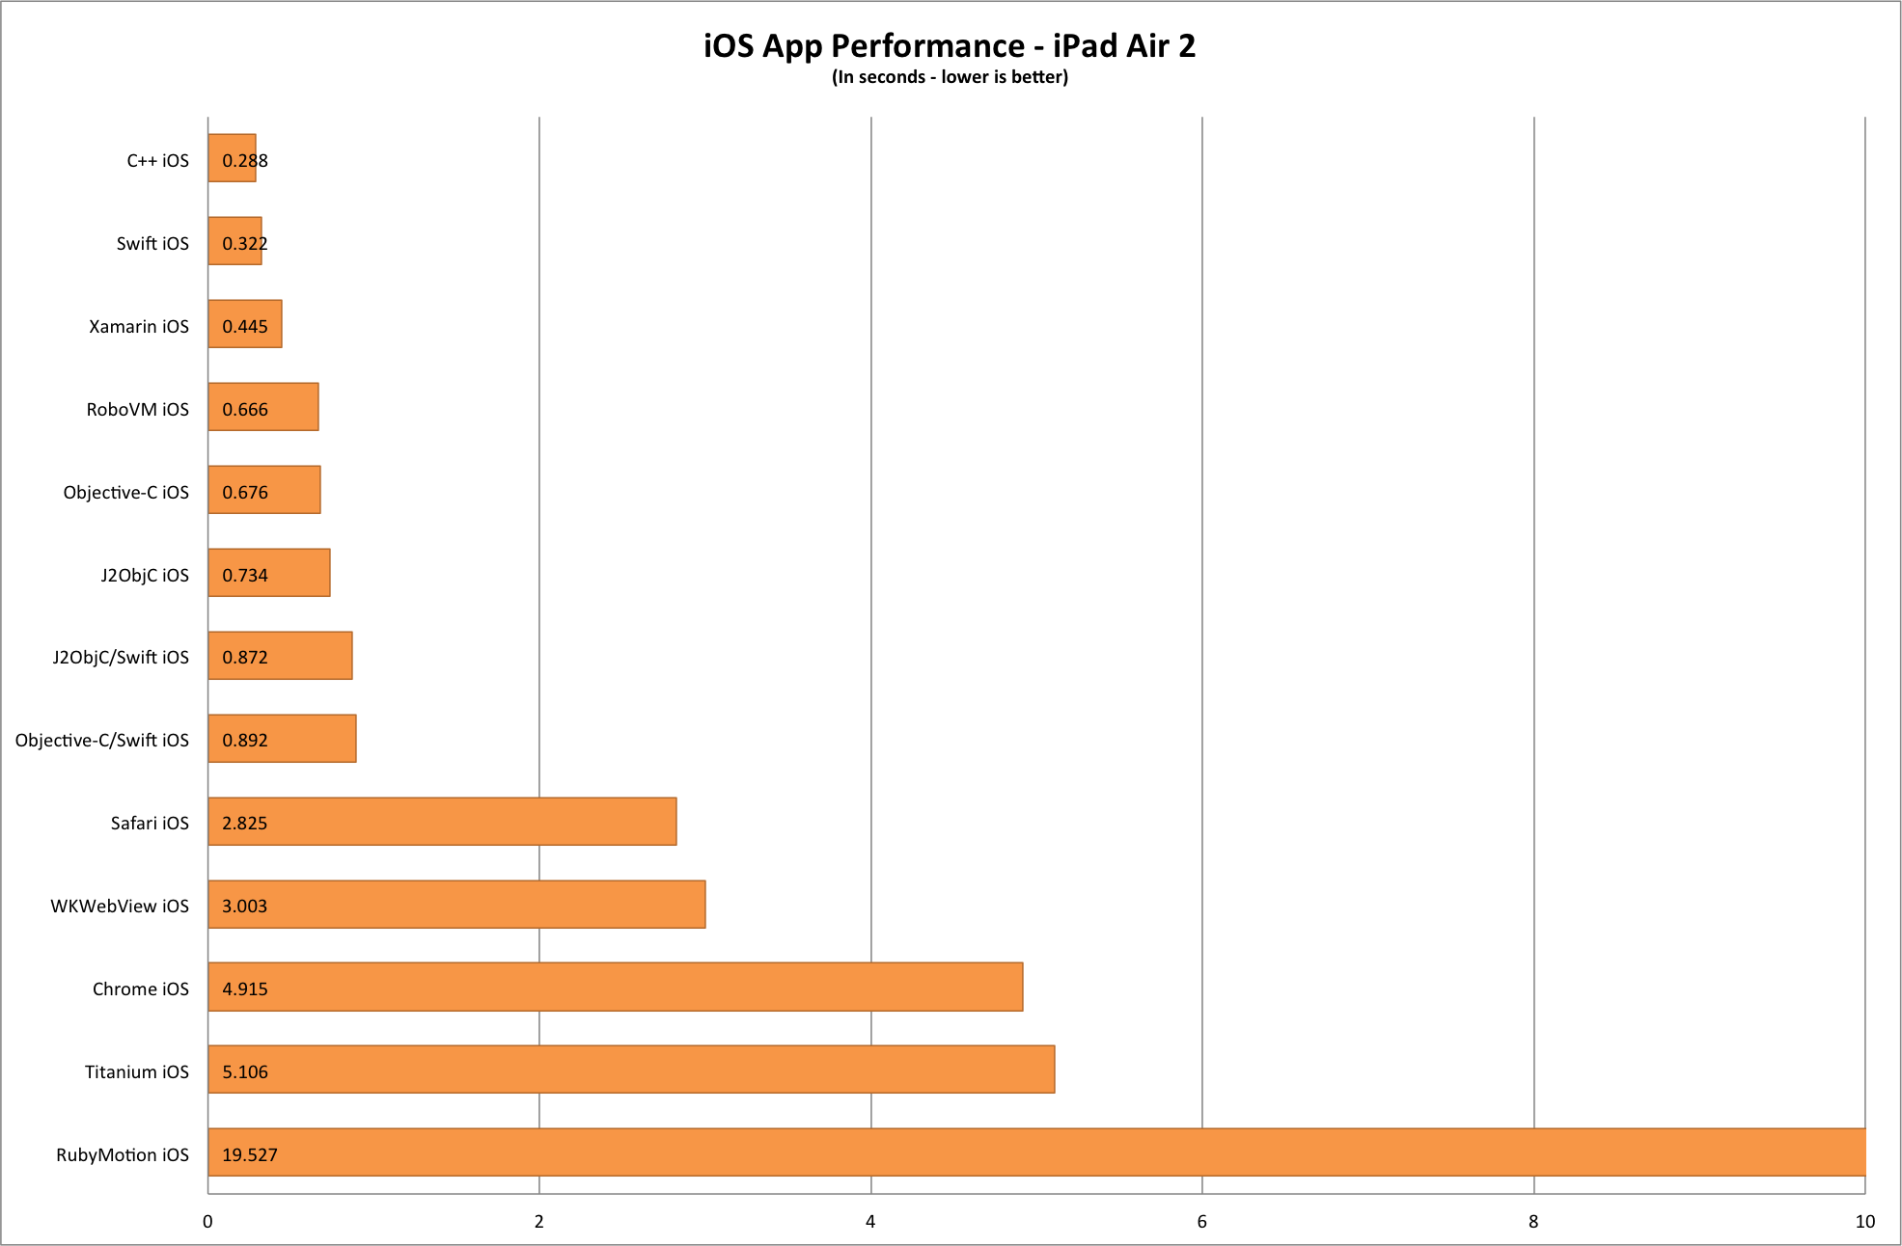

Slide 8
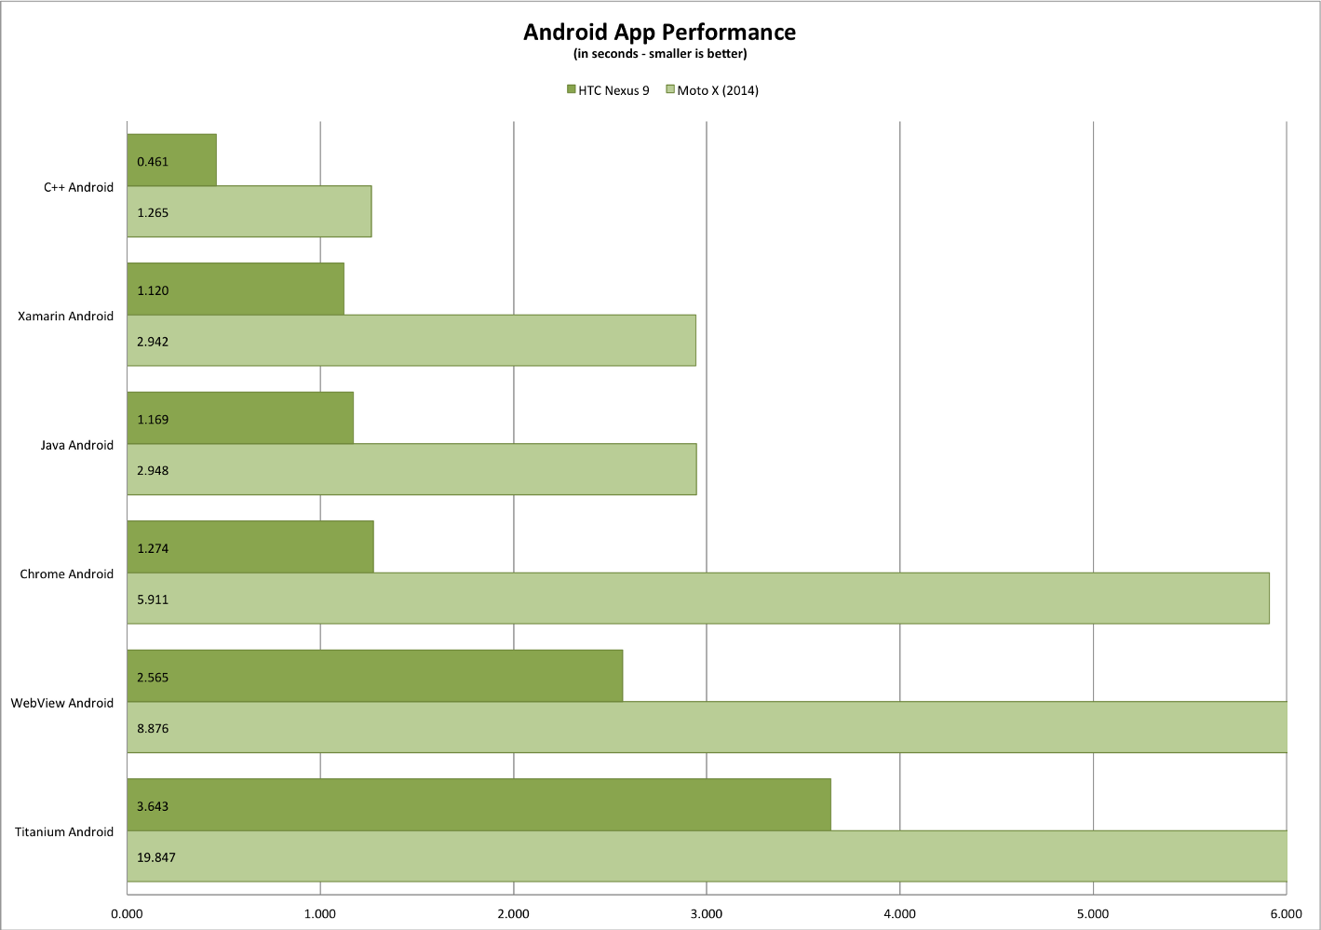

Slide 9
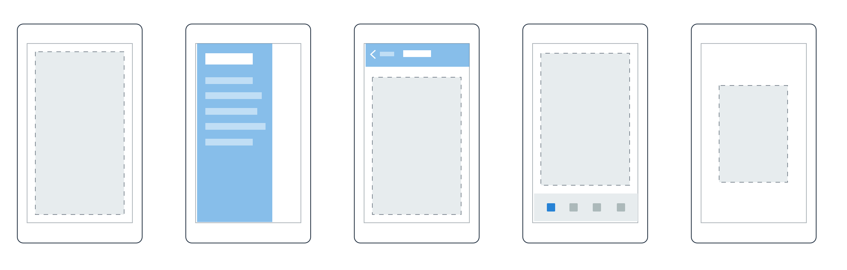
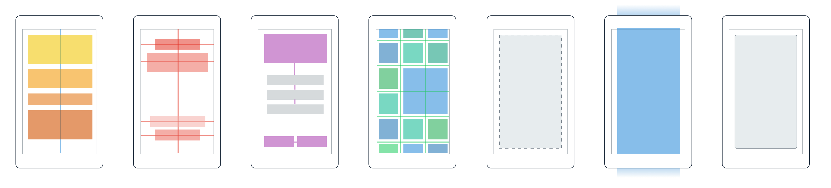
Layouts
Pages
Content
MasterDetail
Navigation
Tabbed
Carousel
Stack
Absolute
Relative
Grid
ContentView
ScrollView
Frame
Notes:
Inside of a page are layouts
A lot of options from something simple like a stack panel to complex and powerful grids

Slide 10
Controls
ActivityIndicator
BoxView
Button
DatePicker
Editor
Entry
Image
Label
ListView
Map
OpenGLView
Picker
ProgressBar
SearchBar
Slider
Stepper
TableView
TimePicker
WebView
EntryCell
ImageCell
SwitchCell
TextCell
ViewCell
Notes:
You have more than 40 controls, layouts, and pages to mix and match from.
These are all of the controls you have out of the box, you can of course create your own.
What is unique is you get the native control and have access to it.
Consider an Entry Field
On iOS it is mapped to UITextField
Android it is EditText
Windows Phoneit is a TextBox

Slide 11
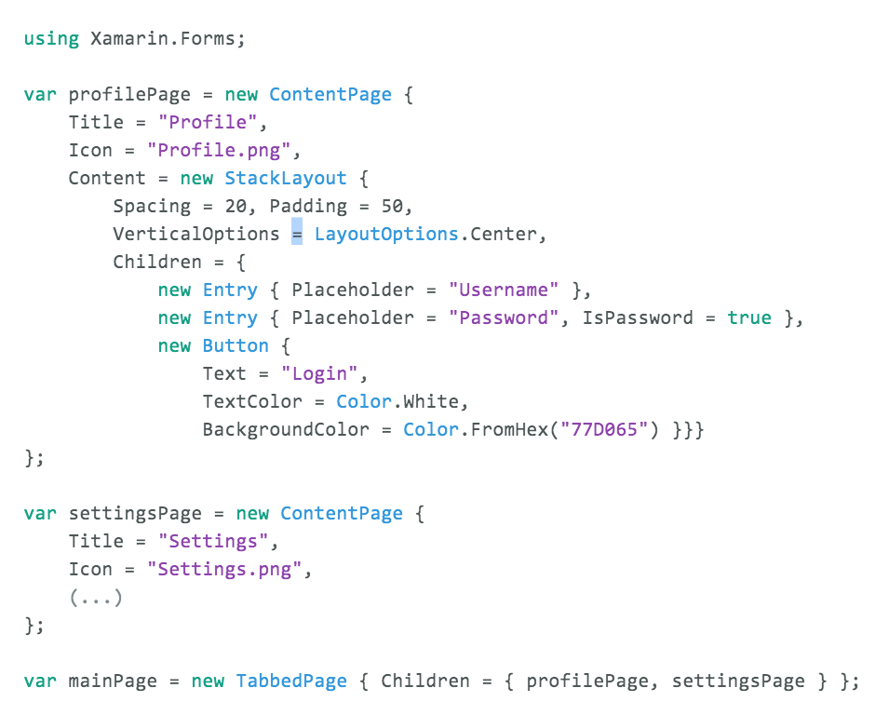
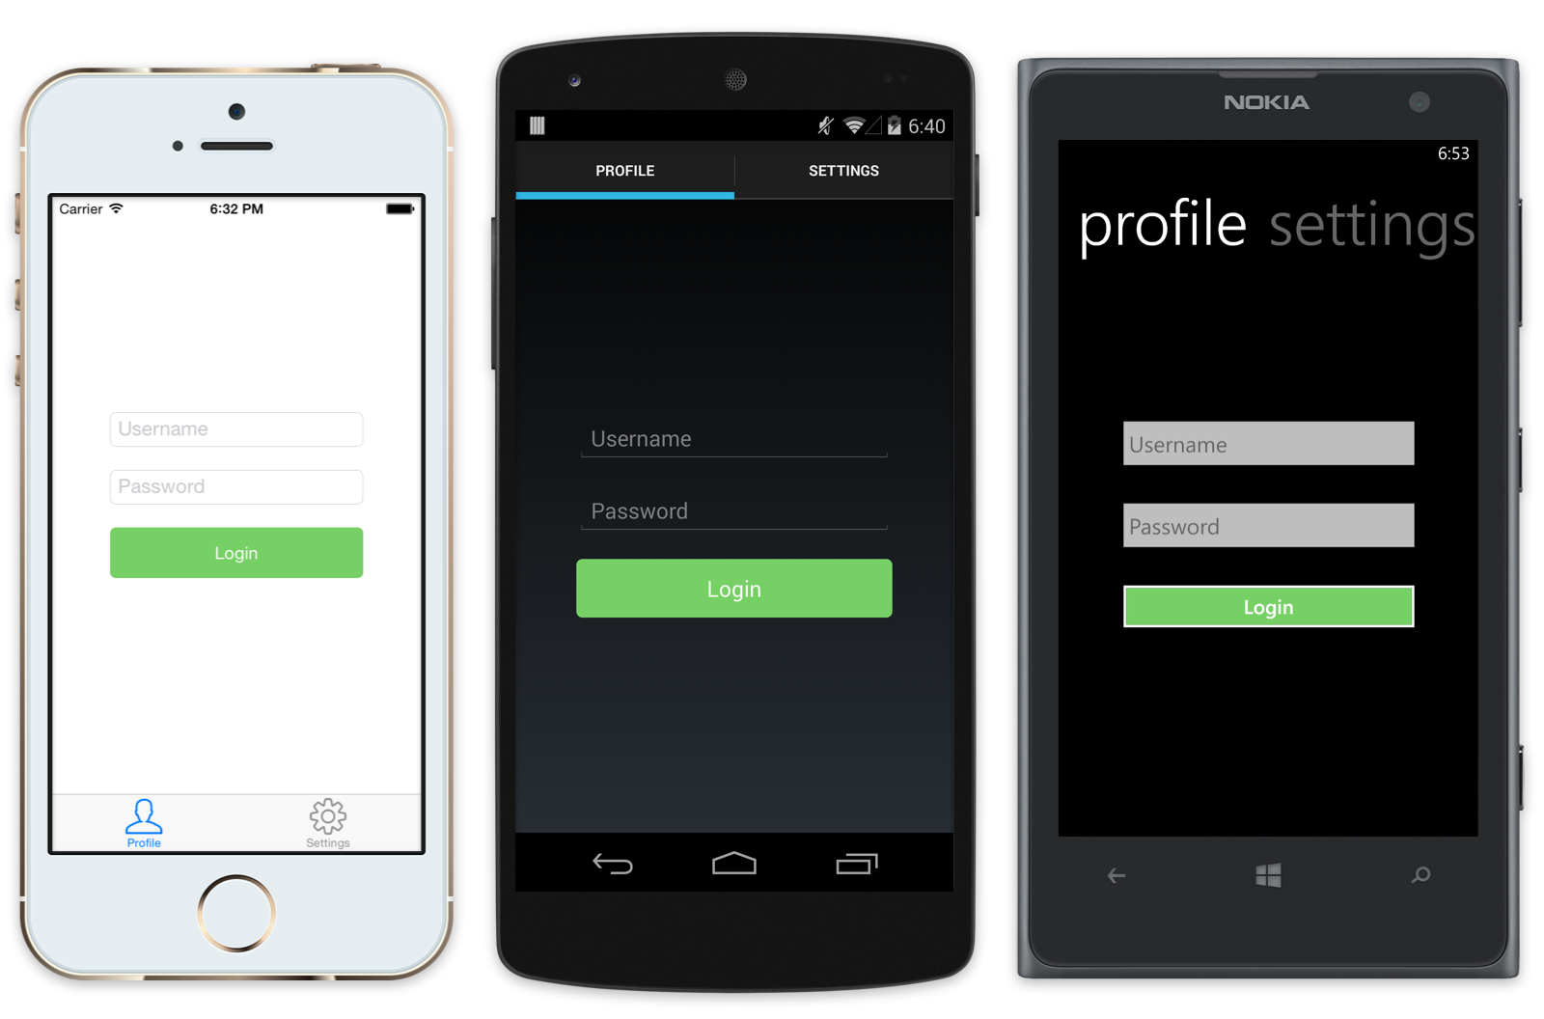
Xamarin.Forms Example

Slide 12
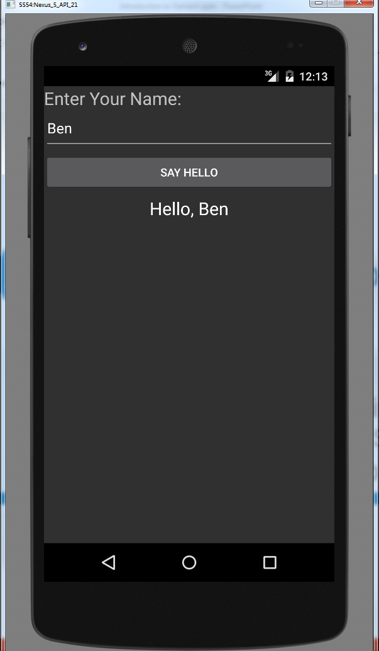
Demo

