Slide 1
VISI KOMPUTER
Universitas Katolik Darma Cendika

Slide 2
Nama Kelompok
MARIA CHATRIN BUNAEN - 19340017
FEDERICO MATTHEW PRATAMA - 233405001
FERNANDO PERRY - 233406005

Slide 3
VGG

Slide 4
Setup & Dataset
Dataset: 50k CelebA 64x64
Label file: list_attr_celeba.txt (Male label) -> 1 = Male 0 = Female
Jumlah data yang digunakan: 10.000 images

Slide 5
Data Split
Training / Validation split: 80% / 20%
Training images: 8.000, shape: (8000, 64, 64, 3) -> 8000 Data, 64x64, RGB
Validation images: 2.000, shape: (2000, 64, 64, 3) -> 2000 Data, 64x64, RGB
Labels sesuai: (8000,) / (2000,) -> 8000 Untuk Training, 2000 Untuk Validasi

Slide 6
Model Architecture - V1
VGG-like architecture untuk binary classification (Male/Female)
Total parameters: 4,629,921 (17.66 MB) → Perkiraan memori RAM yang digunakan
Layer highlight:
Conv2D + MaxPooling → Ekstraksi fitur gambar & reduksi resolusi
Flatten + Dense + Dropout → Ubah fitur 2D ke 1D, proses klasifikasi, cegah overfitting
Output: Dense(1, sigmoid) → Prediksi probabilitas Male/Female

Slide 7
Training - V1
Konfigurasi:
Epochs: 10, Batch size: 32, Learning Rate: 0.001, Optimizer: Adam
Training Results:
Training Accuracy terakhir: 96.59%
Validation Accuracy terakhir: 93.75%
Validation Loss terakhir: 0.2422
Training Time: 0.79 menit (~47 detik)

Slide 8
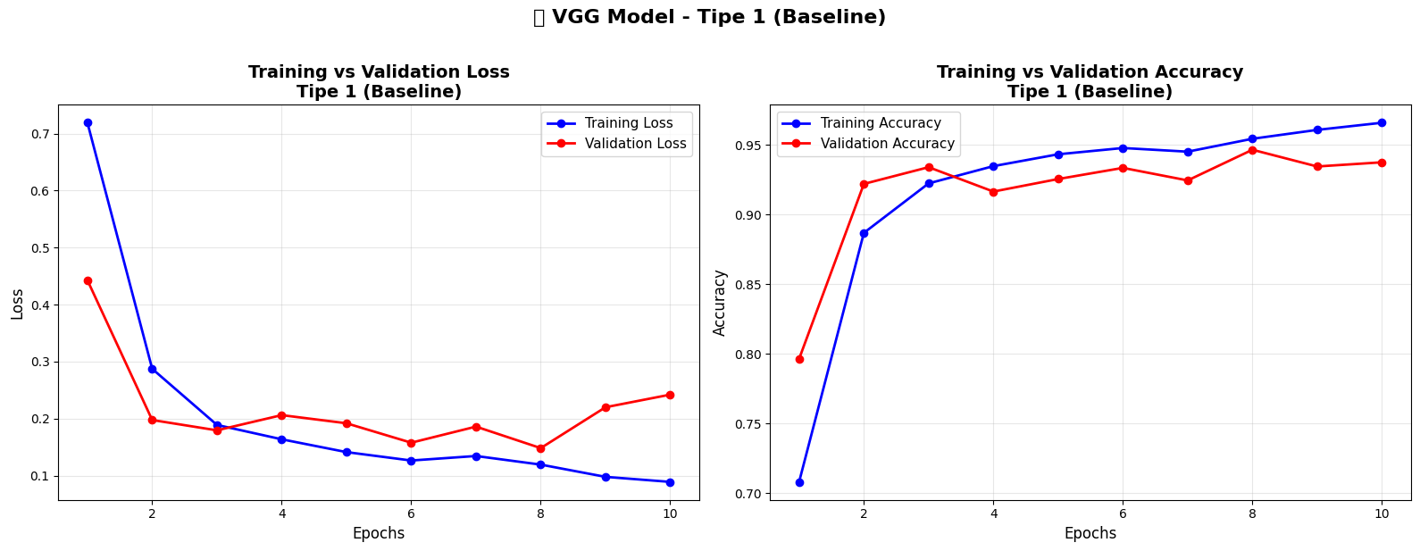
Plot - V1

Slide 9
Evaluation & Insight - V1
Validation Metrics: Loss: 0.2422, Accuracy: 0.9375 (93.75%)
Insight:
Model VGG Tipe 1 cukup baik untuk klasifikasi Male/Female
Training cepat konvergen (10 epochs, akurasi stabil >90%)
Efisien - Training time sangat singkat (<1 menit)
Gap training-validation: 2.84% (96.59% - 93.75%) → Model balance, tidak overfitting

Slide 10
Model Architecture - V2
VGG-like architecture untuk binary classification (Male/Female)
Total parameters: 4,629,921 (17.66 MB) → Perkiraan memori RAM yang digunakan
Layer highlight:
Conv2D + MaxPooling → Ekstraksi fitur gambar & reduksi resolusi
Flatten + Dense + Dropout → Ubah fitur 2D ke 1D, proses klasifikasi, cegah overfitting
Output: Dense(1, sigmoid) → Prediksi probabilitas Male/Female

Slide 11
Training - V2
Konfigurasi:
Epochs: 20, Batch size: 64, Learning Rate: 0.0001, Optimizer: Adam
Training Results:
Training Accuracy terakhir: 98.65%
Validation Accuracy terakhir: 92.55%
Validation Loss terakhir: 0.2554
Training Time: 1.38 menit (~83 detik)

Slide 12
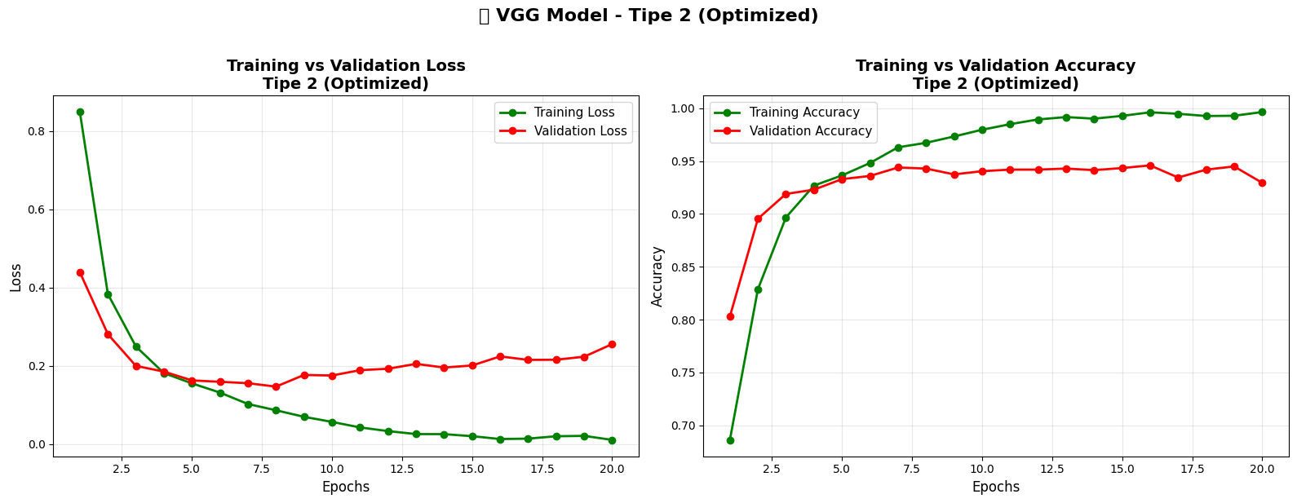
Plot - V2

Slide 13
Evaluation & Insight - V2
Validation Metrics: Loss: 0.2554, Accuracy: 0.9295 (92.95%)
Insight:
Model VGG Tipe 2 sangat baik untuk klasifikasi Male/Female
Training konvergen halus (20 epochs, learning curve smooth)
Overfitting terdeteksi - Gap training-validation: 6.70% (99.65% - 92.95%)
Validation accuracy lebih rendah dari Tipe 1 (92.95% vs 93.75%)
Model terlalu fit pada training data, perlu regularisasi lebih atau data augmentation

Slide 14
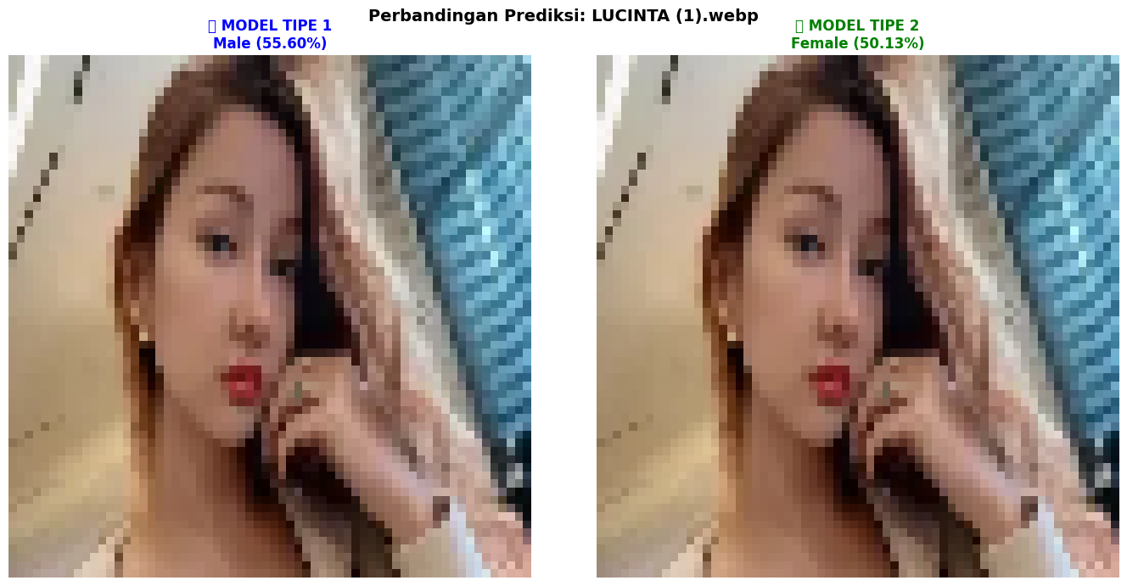
Testing V1 + V2

Slide 15
GoogleNet

Slide 16
Setup & Dataset
Dataset: 50k CelebA 64x64
Label file: list_attr_celeba.txt (Male label) -> 1 = Male 0 = Female
Jumlah data yang digunakan: 10.000 images

Slide 17
Data Split
Training / Validation split: 80% / 20%
Training images: 8.000, shape: (8000, 64, 64, 3) -> 8000 Data, 64x64, RGB
Validation images: 2.000, shape: (2000, 64, 64, 3) -> 2000 Data, 64x64, RGB
Labels sesuai: (8000,) / (2000,) -> 8000 Untuk Training, 2000 Untuk Validasi

Slide 18
Model Architecture - V1
GoogleNet architecture dengan Inception modules untuk binary classification (Male/Female)
Total parameters: 5,974,577 (22.79 MB)
Layer highlight:
Inception Module → Multi-scale feature extraction dengan kernel 1x1, 3x3, 5x5 paralel
GlobalAveragePooling + Dropout → Reduksi dimensi efisien & cegah overfitting
Output: Dense(1, sigmoid) → Prediksi probabilitas Male/Female

Slide 19
Training - V1
Konfigurasi:
Epochs: 10, Batch size: 32, Learning Rate: 0.001, Optimizer: Adam
Training Results:
Training Accuracy terakhir: 58.76%
Validation Accuracy terakhir: 58.75%
Validation Loss terakhir: 0.6780
Training Time: 1.93 menit (~116 detik)

Slide 20
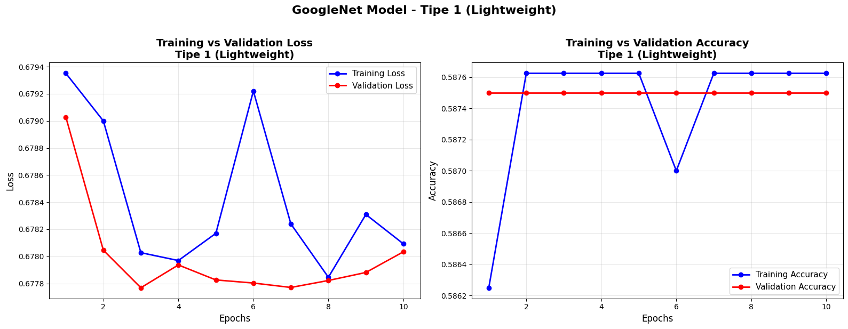
Plot - V1

Slide 21
Evaluation & Insight - V1
Validation Metrics: Loss: 0.6780, Accuracy: 0.5875 (58.75%)
Insight:
Model GoogleNet Tipe 1 mengalami underfitting severe
Akurasi hanya 58.75% (hampir sama dengan random guess ~50%)
Model tidak belajar pattern sama sekali (stuck di plateau)
Gap training-validation: 0.01% (58.76% - 58.75%)

Slide 22
Model Architecture - V2
GoogleNet architecture dengan Inception modules untuk binary classification (Male/Female)
Total parameters: 5,974,577 (22.79 MB)
Layer highlight:
Inception Module → Multi-scale feature extraction dengan kernel 1x1, 3x3, 5x5 paralel
GlobalAveragePooling + Dropout → Reduksi dimensi efisien & cegah overfitting
Output: Dense(1, sigmoid) → Prediksi probabilitas Male/Female

Slide 23
Training - V2
Konfigurasi:
Epochs: 20, Batch size: 64, Learning Rate: 0.0001, Optimizer: Adam
Training Results:
Training Accuracy terakhir: 99.39%
Validation Accuracy terakhir: 93.30%
Validation Loss terakhir: 0.3380
Training Time: 3.5menit (~210 detik)

Slide 24
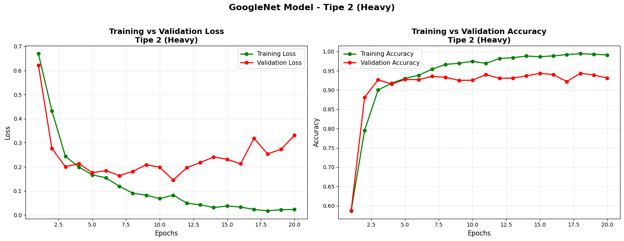
Plot - V2

Slide 25
Evaluation & Insight - V2
Validation Metrics: Loss: 0.3380, Accuracy: 0.9330 (93.30%)
Insight:
Model GoogleNet Tipe 2 SANGAT BAIK untuk klasifikasi Male/Female
Akurasi 93.30% - Jauh lebih tinggi dari Tipe 1 (58.75%)
Overfitting terdeteksi - Gap training-validation: 6.09% (99.39% - 93.30%)
Training konvergen smooth dengan learning rate kecil (0.0001)

Slide 26

Testing V1 + V2

Slide 27
ResNet

Slide 28
Setup & Dataset
Dataset: Dataset: 50k CelebA 64x64
Label file: list_attr_celeba.txt (Male label) -> 1 = Male 0 = Female
Jumlah data yang digunakan: 2.000 images

Slide 29
Data Split
Training / Validation split: 80% / 20%
Training images: 1.600, shape: (1600, 128, 128, 3) -> 8000 Data -> ResNet expect min 224x224
Validation images: 400, shape: (400, 128, 128, 3) -> 2000 Data, 64x64, RGB
Labels sesuai: (1600,) / (400,) -> 1600 Untuk Training, 400 Untuk Validasi

Slide 30
Model Architecture - V1
ResNet50 dengan Transfer Learning untuk binary classification (Male/Female)
Total parameters: 23,589,761 (89.99 MB)
Layer highlight:
ResNet50 Base (Frozen - 175 layers) → Pretrained dari ImageNet, tidak dilatih
GlobalAveragePooling2D → Rata-rata feature map dari ResNet, reduksi dimensi efisien
Dropout (0.2) → Regularisasi ringan
Dense(1, sigmoid) → Output binary classification (Male/Female)

Slide 31
Training - V1
Konfigurasi:
Epochs: 10, Batch size: 8, Learning Rate: 0.001, Optimizer: Adam, Dropout: 0.2
Training Results:
Training Accuracy terakhir: 58.31%
Validation Accuracy terakhir: 58.25%
Validation Loss terakhir: 0.6830
Training Time: 0.55 menit (~33 detik) Early stopped di epoch 3 (patience=2

Slide 32
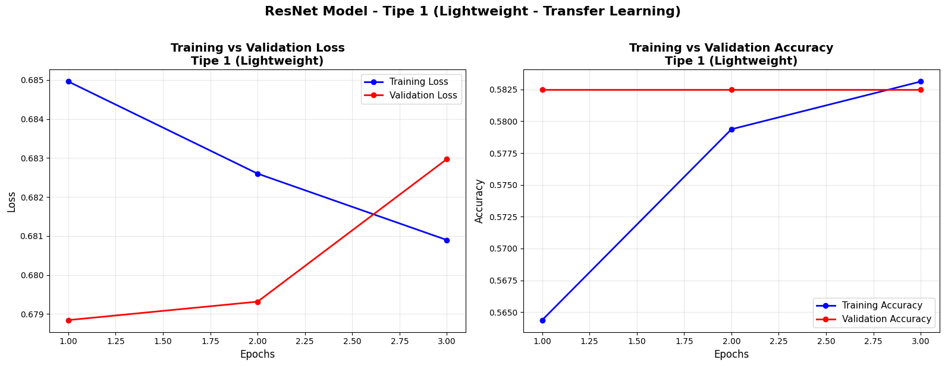
Plot - V1

Slide 33
Evaluation & Insight - V1
Validation Metrics: Loss: 0.6789, Accuracy: 0.5825 (58.25%)
Insight:
Model hanya memprediksi Female untuk SEMUA input (233 Female benar, 0 Male benar)
Precision Male = 0.00 → Tidak ada satupun prediksi Male yang benar
Recall Male = 0.00 → Model gagal total mendeteksi Male
Model bias total ke kelas Female

Slide 34
Model Architecture - V2
ResNet50 dengan Fine-tuning untuk binary classification (Male/Female)
Total parameters: 23,589,761 (89.99 MB)
Layer highlight:
ResNet50 Base (Frozen - 175 layers)
GlobalAveragePooling2D → Rata-rata feature map
Dropout (0.5) → Regularisasi tinggi
Dense(1, sigmoid) → Output binary classification (Male/Female)

Slide 35
Training - V2
Konfigurasi:
Epochs: 20, Batch size: 16, Learning Rate: 0.0001, Optimizer: Adam, Dropout: 0.5
Training Results:
Training Accuracy terakhir: 86.44%
Validation Accuracy terakhir: 81.25%
Validation Loss terakhir: 0.4456
Training Time: 1.16menit (~69 detik) Early stopped di epoch 8 (patience=3)

Slide 36
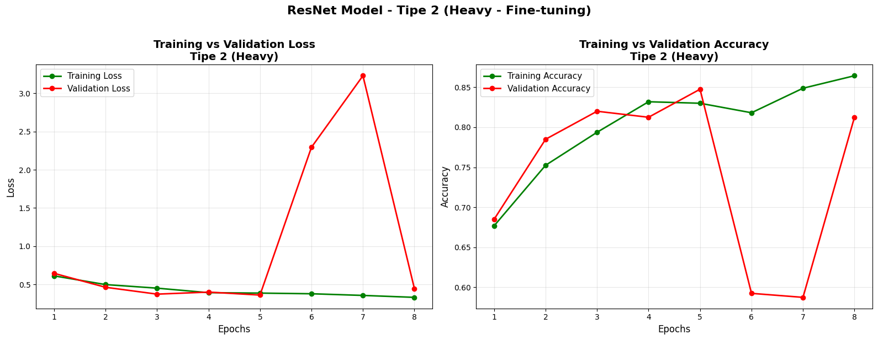
Plot - V2

Slide 37
Evaluation & Insight - V2
Validation Metrics: Loss: 0.3619, Accuracy: 0.8475 (84.75%)
Insight:
Model ResNet Tipe 2 Lebih Baik dari Tipe 1 (84.75% vs 58.25%)
Fine-tuning berhasil meningkatkan akurasi +26.5%
Overfitting ringan terdeteksi - Gap: 5.19% (86.44% - 81.25%)
Training konvergen cepat (hanya 8 epochs vs target 20)

Slide 38

Testing V1 + V2

Slide 39
AlexNet

Slide 40
Setup & Dataset
Dataset: Dataset: 50k CelebA 64x64
Label file: list_attr_celeba.txt (Male label) -> 1 = Male 0 = Female
Jumlah data yang digunakan: 2.000 images

Slide 41
Data Split
Training / Validation split: 80% / 20%
Training images: 1.600, shape: (1600, 128, 128, 3) -> 8000 Data -> ResNet expect min 224x224
Validation images: 400, shape: (400, 128, 128, 3) -> 2000 Data, 64x64, RGB
Labels sesuai: (1600,) / (400,) -> 1600 Untuk Training, 400 Untuk Validasi

Slide 42
Model Architecture - V1
AlexNet-like architecture untuk binary classification (Male/Female)
Total parameters: 6,109,441 (23.31 MB)
Layer highlight:
Conv Block 1-2: Large kernels (11x11, 5x5) + BatchNorm + MaxPool
Conv Block 3-5: Small kernels (3x3) stacked + MaxPool
FC Layers: Dense(512) + Dropout(0.3) × 2
Output: Dense(1, sigmoid)

Slide 43
Training - V1
Konfigurasi:
Epochs: 10, Batch size: 32, Learning Rate: 0.001, Optimizer: Adam, Dropout: 0.3
Training Results:
Training Accuracy terakhir: 73.25%
Validation Accuracy terakhir: 67.75%
Validation Loss terakhir: 0.5990
Training Time: 0.53 menit

Slide 44
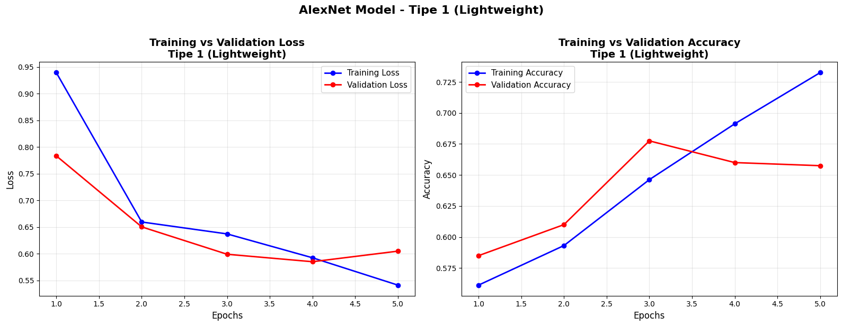
Plot - V1

Slide 45
Evaluation & Insight - V1
Validation Metrics: Loss: 0.5990, Accuracy: 0.6775 (67.75%)
Insight:
Model AlexNet Tipe 1 memiliki performa Cukup tapi perlu perbaikan
Akurasi 67.75% lebih baik dari ResNet Tipe 1 (58.25%), tapi masih rendah
Overfitting ringan terdeteksi - Gap: 7.5% (73.25% - 65.75%)
Bias ke kelas Female - Recall Male hanya 36% vs Female 91%

Slide 46
Model Architecture - V2
AlexNet-like architecture untuk binary classification (Male/Female)
Total parameters: 6,109,441 (23.31 MB)
Layer highlight:
Conv Block 1-2: Large kernels (11x11, 5x5) + BatchNorm + MaxPool
Conv Block 3-5: Small kernels (3x3) stacked + MaxPool
FC Layers: Dense(512) + Dropout(0.5) × 2
Output: Dense(1, sigmoid)

Slide 47
Training - V2
Konfigurasi:
Epochs: 20, Batch size: 64, Learning Rate: 0.0001, Optimizer: Adam, Dropout: 0.5
Training Results:
Training Accuracy terakhir: 77.94%
Validation Accuracy terakhir: 60.25%
Validation Loss terakhir: 0.6859
Training Time: 0.45 Menit

Slide 48
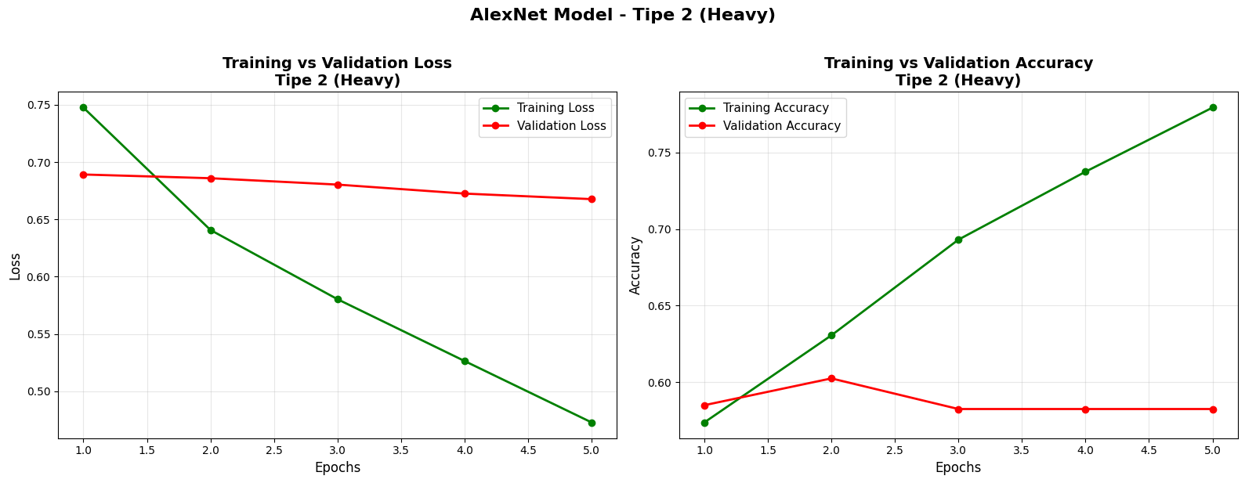
Plot - V2

Slide 49
Evaluation & Insight - V2
Validation Metrics: Loss: 0.6859, Accuracy: 0.6025 (60.25%)
Insight:
Model AlexNet Tipe 2 LEBIH BURUK dari Tipe 1
Akurasi 60.25% vs Tipe 1 67.75% → Turun 7.5%
Overfitting PARAH - Gap: 19.69% (77.94% - 58.25%)
Bias ke kelas Female ekstrem - Recall Male hanya 6% vs Female 99%

Slide 50

Testing V1 + V2

Slide 51
Best Algorithm?

Slide 52
Ranking Algorithm (Menurut Kelompok Kami)
VGG Tipe 1 (93.75%) – Validasi paling tinggi, cepat konvergen, stabil
GoogleNet Tipe 2 (93.10%) – Akurasi tinggi, setara VGG, tapi butuh tuning careful
VGG Tipe 2 (92.95%) – Akurasi tinggi, tapi overfitting lebih besar dari Tipe 1
ResNet Tipe 2 (84.75%) – Terbaik untuk dataset kecil (1.6K), fine-tuning sukses

Slide 53
Ranking Algorithm (Menurut Kelompok Kami)
AlexNet Tipe 1 (67.75%) – Moderate, berat untuk dataset kecil, perlu improvement
AlexNet Tipe 2 (60.25%) – Gagal, overfitting parah, hyperparameter salah
GoogleNet Tipe 1 (58.75%) – Gagal total, underfitting, LR salah
ResNet Tipe 1 (58.25%) – Gagal total, transfer learning tanpa fine-tuning tidak cukup

