Slide 1
VISI KOMPUTER
Universitas Katolik Darma Cendika

Slide 2
Nama Kelompok
MARIA CHATRIN BUNAEN - 19340017
FEDERICO MATTHEW PRATAMA - 233405001
FERNANDO PERRY - 233406005

Slide 3
VGG

Slide 4
Setup & Dataset
Dataset: 50k CelebA 64x64
Label file: list_attr_celeba.txt (Male label) -> 1 = Male 0 = Female
Jumlah data yang digunakan: 10.000 images

Slide 5
Data Split
Training / Validation split: 80% / 20%
Training images: 8.000, shape: (8000, 64, 64, 3) -> 8000 Data, 64x64, RGB
Validation images: 2.000, shape: (2000, 64, 64, 3) -> 2000 Data, 64x64, RGB
Labels sesuai: (8000,) / (2000,) -> 8000 Untuk Training, 2000 Untuk Validasi

Slide 6
Model Architecture
VGG-like architecture untuk binary classification (Male/Female)
Total parameters: 4,629,921 (17.66 MB) -> Perkiraan memori RAM yang digunakan
Layer highlight:
Conv2D + MaxPooling -> Ekstraksi fitur gambar & reduksi resolusi.
Flatten + Dense + Dropout -> Ubah fitur 2D ke 1D, proses klasifikasi, cegah overfitting.
Output: Dense(1, sigmoid) -> Prediksi probabilitas Male/Female.

Slide 7
Training
Epochs: 10, Batch size: 32
Training Results:
Training Accuracy terakhir: 96.61%
Validation Accuracy terakhir: 93.75%
Validation Loss terakhir: 0.1605

Slide 8
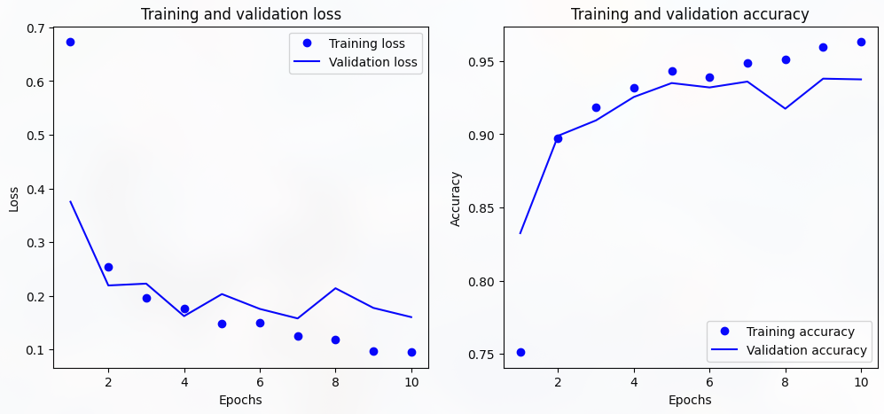
Plot

Slide 9
Evaluation & Insight
Validation Metrics: Loss: 0.1605, Accuracy: 0.9375
Model VGG ini cukup baik untuk klasifikasi Male/Female
Training cepat konvergen (akurasi stabil >90%)

Slide 10
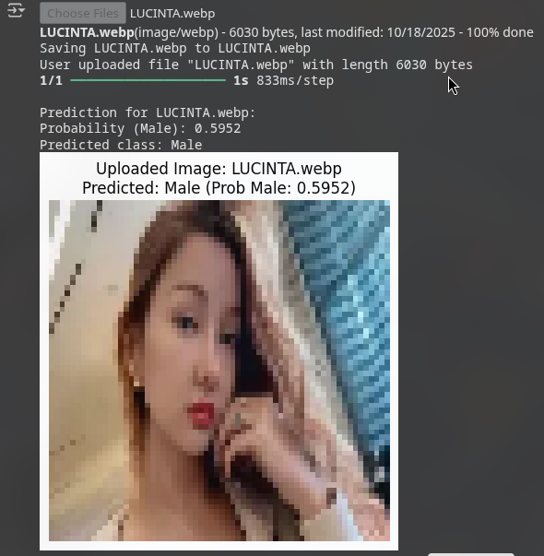
Testing

Slide 11
GoogleNet

Slide 12
Setup & Dataset
Dataset: 50k CelebA 64x64
Label file: list_attr_celeba.txt (Male label) -> 1 = Male 0 = Female
Jumlah data yang digunakan: 10.000 images

Slide 13
Data Split
Training / Validation split: 80% / 20%
Training images: 8.000, shape: (8000, 64, 64, 3) -> 8000 Data, 64x64, RGB
Validation images: 2.000, shape: (2000, 64, 64, 3) -> 2000 Data, 64x64, RGB
Labels sesuai: (8000,) / (2000,) -> 8000 Untuk Training, 2000 Untuk Validasi

Slide 14
Model Architecture
GoogLeNet (Inception modules) untuk binary classification (Male/Female)
Total parameters: ±5,000,000 (≈19 MB)

Slide 15
Model Architecture
Layer highlight:
- Conv2D + MaxPooling -> Ekstraksi fitur dasar & reduksi resolusi.
- Inception Modules -> Multi-path Conv2D untuk menangkap fitur dari berbagai skala.
- AveragePooling + Dropout -> Reduksi dimensi fitur, cegah overfitting.
- Output: Dense(1, sigmoid) -> Prediksi probabilitas Male/Female.

Slide 16
Training
Epochs: 10, Batch size: 32
Training Results:
Training Accuracy terakhir: 61.07%
Validation Accuracy terakhir: 58.95%
Validation Loss terakhir: 0.6771

Slide 17
Evaluation & Insight
Validation Metrics (GoogLeNet): Loss: 0.6771, Accuracy: 0.5895
Model GoogLeNet ini masih cukup rendah performanya untuk klasifikasi Male/Female.
Training tidak terlalu konvergen (akurasi terakhir 61%),
Validasi stagnan di 59%, menandakan model belum belajar fitur dengan optimal pada dataset ini.

Slide 18
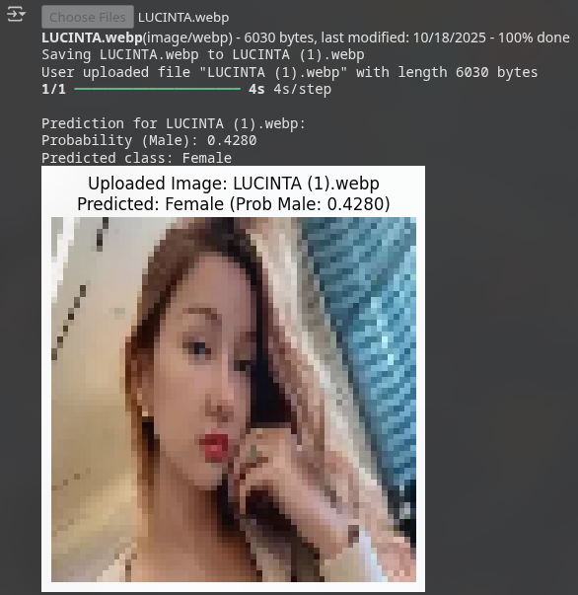
Testing

Slide 19
ResNet

Slide 20
Setup & Dataset
Dataset: Dataset: 50k CelebA 64x64
Label file: list_attr_celeba.txt (Male label) -> 1 = Male 0 = Female
Jumlah data yang digunakan: 2.000 images

Slide 21
Data Split
Training / Validation split: 80% / 20%
Training images: 1.600, shape: (1600, 128, 128, 3) -> 8000 Data -> ResNet expect min 224x224
Validation images: 400, shape: (400, 128, 128, 3) -> 2000 Data, 64x64, RGB
Labels sesuai: (1600,) / (400,) -> 1600 Untuk Training, 400 Untuk Validasi

Slide 22
Model Architecture
ResNet50 (pretrained ImageNet, frozen) untuk binary classification (Male/Female)
Total parameters: ±23,600,000 (±90 MB jika semua trainable)
Layer highlight:
GlobalAveragePooling2D → ubah feature map 2D ke 1D
Dropout(0.2) → cegah overfitting
Output: Dense(1, sigmoid) → prediksi Male/Female

Slide 23
Training
Epochs: 10, Batch size: 8
Training Results:
Training Accuracy terakhir: 61.35%
Validation Accuracy terakhir: 59.75%
Validation Loss terakhir: 0.6517

Slide 24
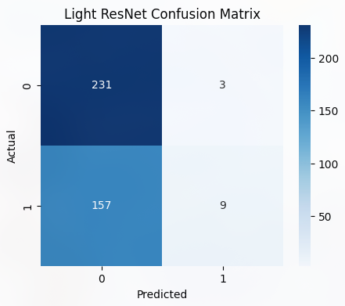
Matrix

Slide 25
Evaluation & Insight
Validation Metrics: Loss: 0.6517, Accuracy: 0.5975
Insight singkat:
Model berat, kurang cocok untuk Colab Free / uji coba cepat
Macro F1-score rendah → performa imbalanced
Bisa ditingkatkan dengan fine-tuning beberapa layer ResNet

Slide 26
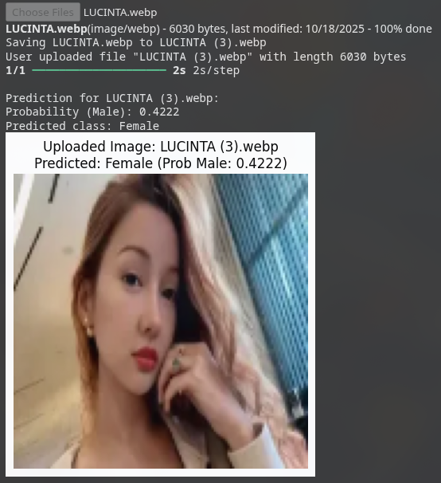
Testing

Slide 27
AlexNet

Slide 28
Setup & Dataset
Dataset: Dataset: 50k CelebA 64x64
Label file: list_attr_celeba.txt (Male label) -> 1 = Male 0 = Female
Jumlah data yang digunakan: 2.000 images

Slide 29
Data Split
Training / Validation split: 80% / 20%
Training images: 1.600, shape: (1600, 128, 128, 3) -> 8000 Data -> ResNet expect min 224x224
Validation images: 400, shape: (400, 128, 128, 3) -> 2000 Data, 64x64, RGB
Labels sesuai: (1600,) / (400,) -> 1600 Untuk Training, 400 Untuk Validasi

Slide 30
Model Architecture
AlexNet-like model untuk binary classification (Male/Female)
Total parameters: 6,109,441 (~23.31 MB)
Layer highlight:
Conv2D + MaxPooling + BatchNorm -> ekstraksi fitur & reduksi resolusi
Flatten + Dense + Dropout -> ubah feature map 2D ke 1D, klasifikasi, cegah overfitting
Output: Dense(1, sigmoid) -> prediksi Male/Female

Slide 31
Training
Epochs: 10, Batch size: 32
Training Results:
Training Accuracy terakhir: 73.44%
Validation Accuracy terakhir: 58.50%
Validation Loss terakhir: 0.6813

Slide 32

Matrix

Slide 33
Evaluation & Insight
Validation Metrics: Loss: 0.6813, Accuracy: 0.5850
Insight singkat:
AlexNet cukup berat → ~6 juta parameter
Validation accuracy rendah → kemungkinan overfitting & dataset kecil
Macro F1-score rendah → performa imbalanced
Bisa ditingkatkan dengan fine-tuning, data augmentation, atau batch size lebih kecil

Slide 34
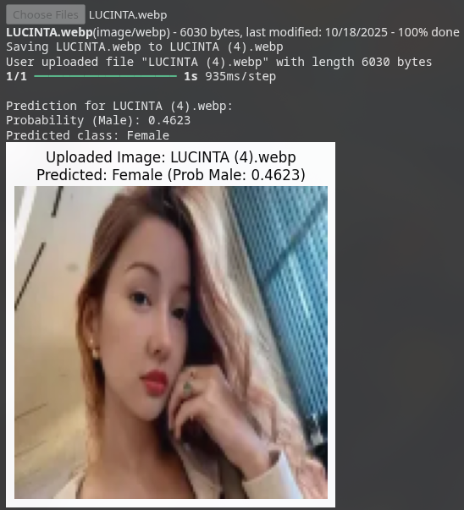
Testing

Slide 35
Best Algorithm?

Slide 36
Ranking Algorithm (Menurut Kelompok Kami)
VGG-like – Validasi paling tinggi, cepat konvergen, stabil
GoogLeNet – Stabil tapi akurasi rendah
ResNet ringan – Cocok uji coba cepat, performa masih bisa ditingkatkan AlexNet-like – Berat untuk dataset kecil, akurasi rendah

