Slide 1


DATABASE MANAGEMENT WITH PL/SQL
INVETORY MANAGEMENT SYSTEM
Prepared by Mushimiyumukiza Blaise 26229

Slide 2




PROBLEM STATEMENT
Current issues because of using manual Inventory and order processing:
Stockouts and overstocking
Customer dissatisfaction
Delayed shipments
Poor management
SOLUTION: CENTRALISED ORACLE PL/SQL-BASED SYSTEM

Slide 3
SYSTEM CONTEXT & TARGET USERS
Used in: Retail businesses (online/offline)
Key users
1
Warehouse Managers
3
Suppliers
2
Sales Teams
4
Business Analysts
5
Customers

Slide 4





PROJECT GOALS
Key Goals
Automate inventory and order workflows
Provide real-time inventory updates
Enhance accuracy and data security
Support scalable retail operations

Slide 5



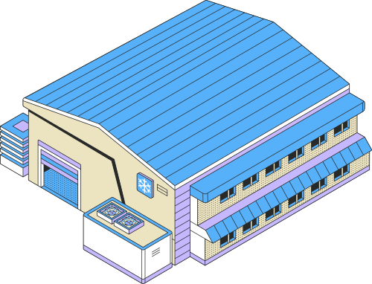



ENTINTIES
Customers
Products
Suppliers
Invetory
Buyers or clients
Sellable goods
Stocked items
Warehouses
Orders
order items
Shipments
Storage locations
Purchase requests
Ordered products
Delivery batches

Slide 6
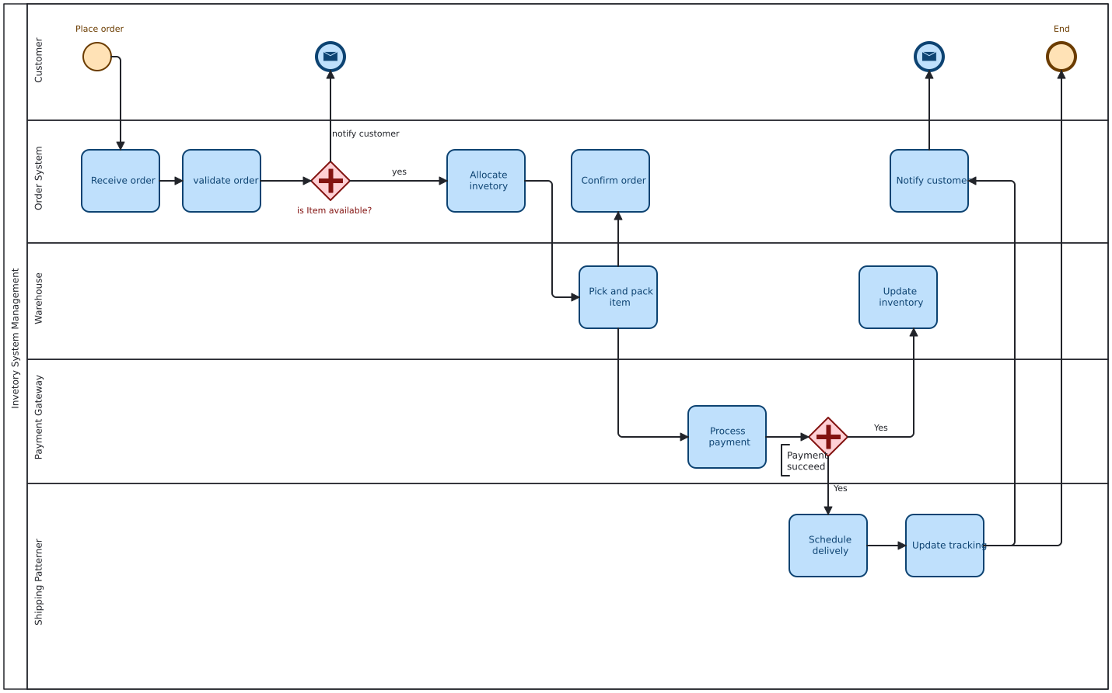
MIS PROCESS MODELING (BPMN)

Slide 7
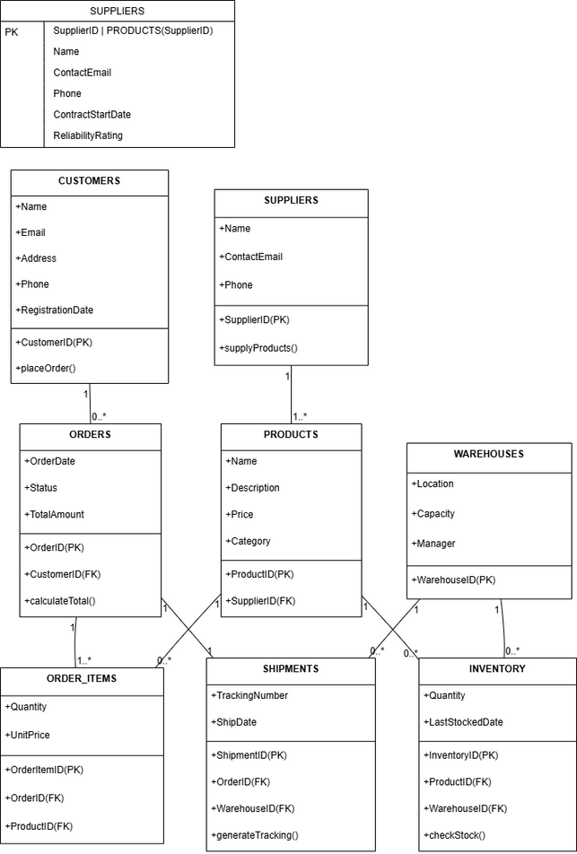
LOGICAL DATA MODEL HIGHLIGHTS

Slide 8
IMPLEMENTATION & TESTING
Actions Required:
1
Created all tables using SQL
Inserted realistic test data
2
Verified data integrity with sample queries
3

Slide 9

ADVANCED PL/SQL FEATURES
1
Procedures for placing orders
Triggers for inventory updates
2
Packages for modular operations
3
Window functions for analytics
4

Slide 10
AUDITING & SECURITY
Audits Include:
01
02
03
04
Restrict DML during weekdays and holidays
Track operations in AUDIT_LOGS
Holiday table and audit package
Aligns with compliance standards

Slide 11



THANK YOU!
+250789785870
mushimiyumukizab@gmail.com
KK 44 St, Kicukiro,Nyanza

