Slide 1


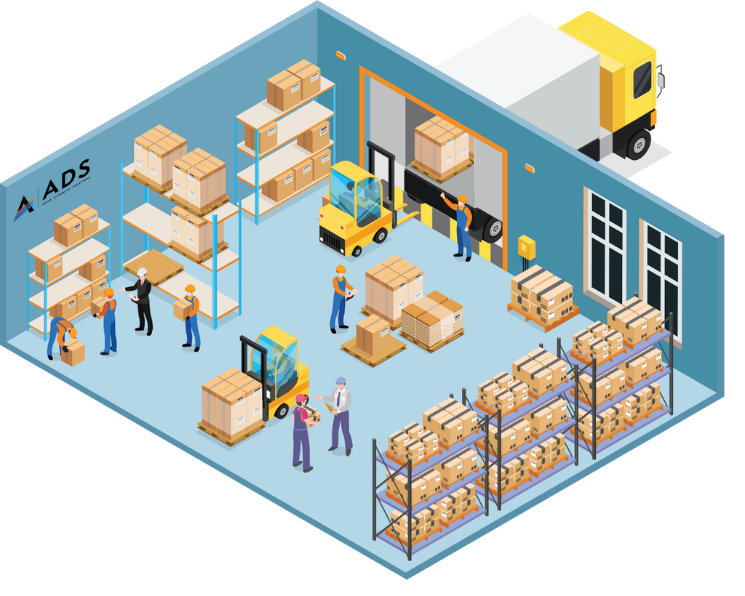
Database development with PL/SQL
Adventist University Of Central Africa
Inventory and Order Management System Solution
Names:Mushimiyumukiza Blaise
ID:26229
01

Slide 2

Database development with PL/SQL
Adventist University Of Central Africa
Problem Statement and Objectives
Problem Definition:
Inefficient inventory management and order processing in retail supply chains.
Leads to stockouts, overstocking, delayed order fulfillment, and poor customer satisfaction.
Target Users:
Context:
Target Users:
Project Goals:
Automate workflows (inventory tracking, order processing).
Improve accuracy in stock level reporting.
Enhance data security.
Provide real-time insights.
Reduce operational costs.
System will be used in retail businesses with multiple warehouses, suppliers, and outlets.
Manages inventory, automates order processing, and provides real-time insights.
Retail Managers
Warehouse Staff
Suppliers
Customers
02

Slide 3

Database development with PL/SQL
Adventist University Of Central Africa
01
Main Entities in the Database:
Products: Product details (ID, name, price, category).
Inventory: Stock levels across warehouses.
Warehouses: Warehouse details (ID, location, capacity).
Suppliers: Supplier information (ID, name, contact).
Purchase Orders: Orders placed with suppliers.
Customers: Customer information (ID, name, address).
Sales Orders: Customer orders (ID, product, quantity, status).
Transactions: Inventory movements (ID, product, warehouse, quantity, type).
02
03
Anticipated Benefits:
Automation: Reduces manual effort.
Accuracy: Real-time stock and order tracking.
Efficiency: Streamlines workflows.
Cost Savings: Optimizes inventory costs.
Customer Satisfaction: Improves order accuracy and delivery.
Data Security: Role-based access control.
03

