Slide 1
Hands-On Reproducible Neuroimaging
Are you ready?
Do you have your VirtualBox?
Do you have the course .ova?
If not, please see one of the course staff!
Please remember to complete the pre-course survey:
https://bit.ly/2MuJcP8

Slide 2
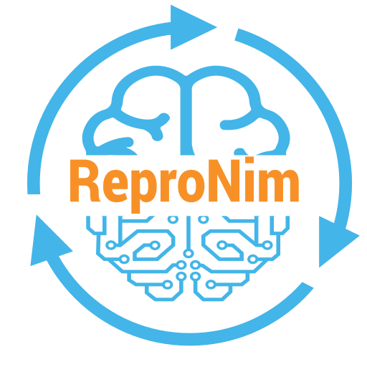
OHBM All Day Educational Course
Hands on Reproducible Brain Imaging
Introduction to Reproducible Neuroimaging: Motivations

Slide 3
Show of hands: Who thinks engaging in Reproducible Research is important?
Show of hands: If I pulled the neuroimaging papers just from this year (PubMed currently says that there are 3,381 of them), how many do you think would be reproducible?
90 - 100% ?
Between 50 - 90% ?
25 - 50% ?
Less than 25% ?
None?

Slide 4
It’s not a completely fair question, as we’ve not yet really established what we mean by ‘reproducible’. Can any of the audience tell me what they mean by ‘reproducible’?
So, there are lots of different potential ways to talk about reproducibility. I’m going to set some definitions that we will use for today. There are definitely other ways to think about this, and define terms, but I think the following framework

Slide 5
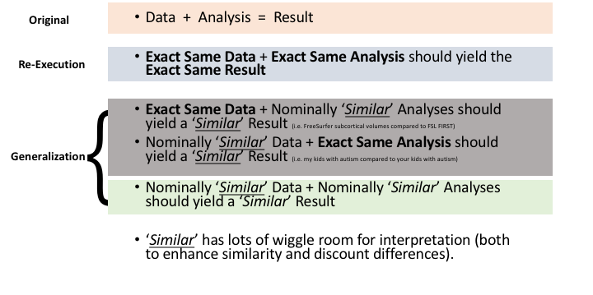
Spectrum of Reproducibility

Slide 6
The premise is that a ‘true’ finding should generalize (i.e. always be true).
If a paper reaches a conclusion such as
“The volume of the corpus callosum is reduced in children with autism”,
That statement, if generalizable, should hold for any valid way of measuring corpus callosum volume, and in all children with Autism.
Individual papers usually do not explore multiple valid ways of making a measurement (i.e. run FreeSurfer and ANTS); and, particularly for complex spectrum-style disorders, the representativeness of any finite sample and a disorder is to be questioned (it is possible that the subset of patients with autism that consent to undergo a MRI scan is not a truly representative sample of the Autism diagnosis, for example…)

Slide 7
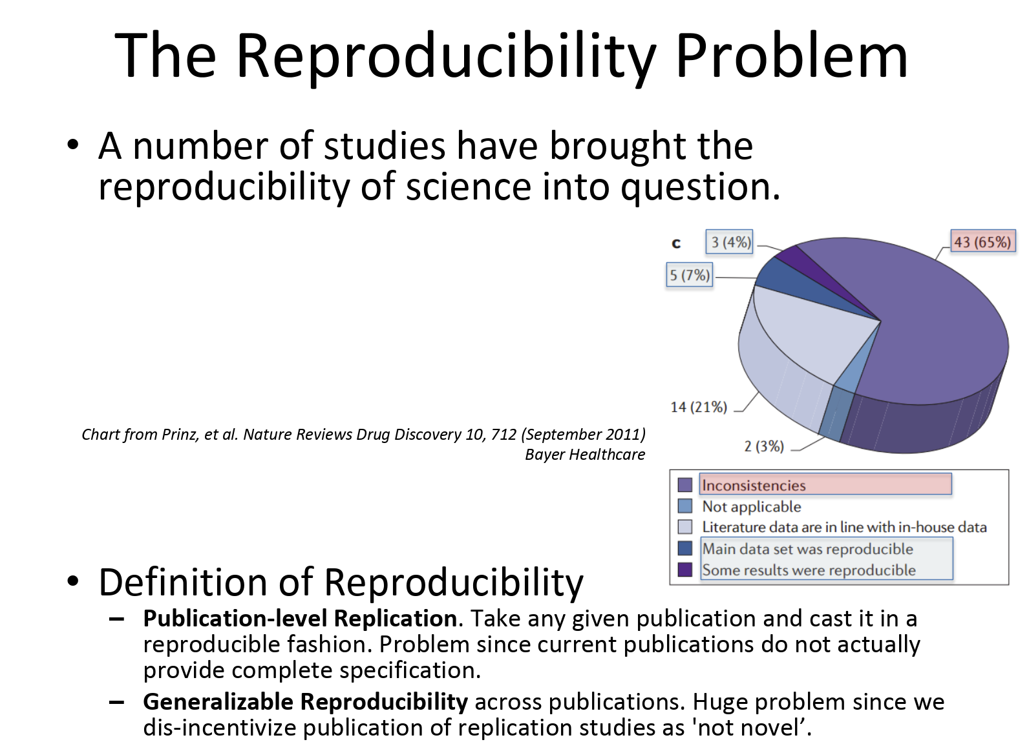

Slide 8
Progress in improving mental health outcomes has been slow
Patients with mental disorders show many biological abnormalities which distinguish them from normal volunteers; however, few of these have led to tests with clinical utility. Several reasons contribute to this delay: lack of a biological ‘gold standard’ definition of psychiatric illnesses; a profusion of statistically significant, but minimally differentiating, biological findings; ‘approximate replications’ of these findings in a way that neither confirms nor refutes them; and a focus on comparing prototypical patients to healthy controls which generates differentiations with limited clinical applicability.
Causes include: Low power/Small N, Incorrect ‘Target’ (diagnosis as opposed to domain), Incomplete Methods & Results Description, Publication Bias
S Kapur, A G Phillips and T R Insel, Molecular Psychiatry (2012) 17, 1174–1179

Slide 9
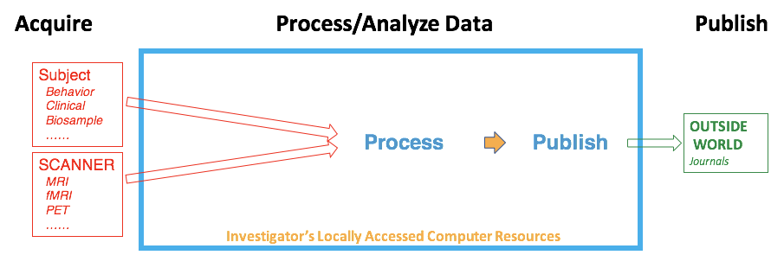
Acquisition Lab-Centered View (Pre ReproNim)
?
?
?
Variance Points

Slide 10
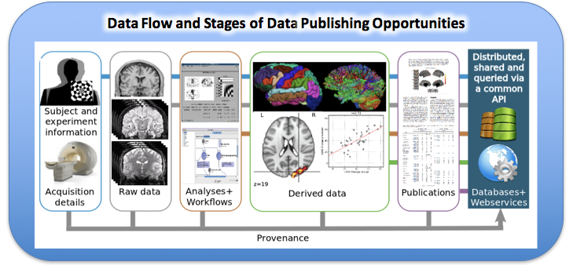
General Neuroimaging Workflow

Slide 11
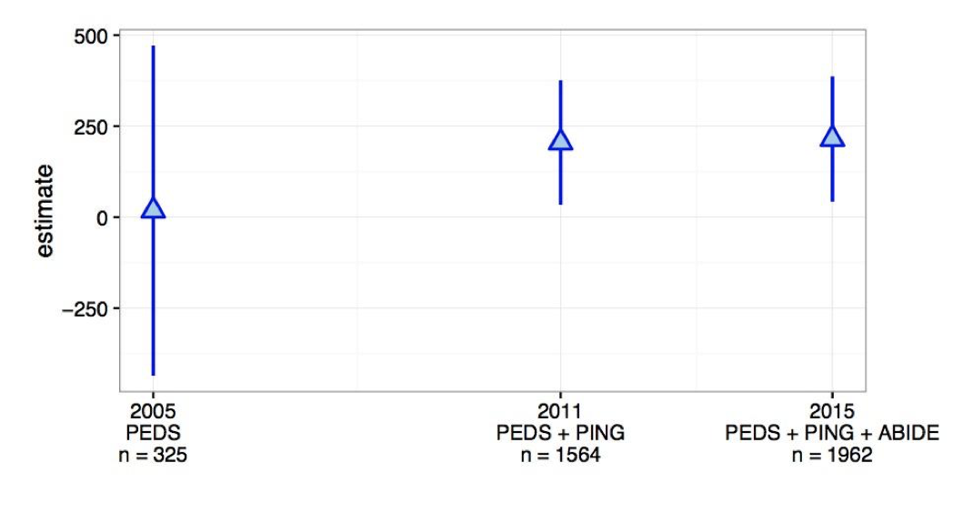
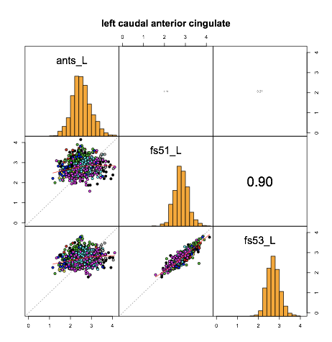
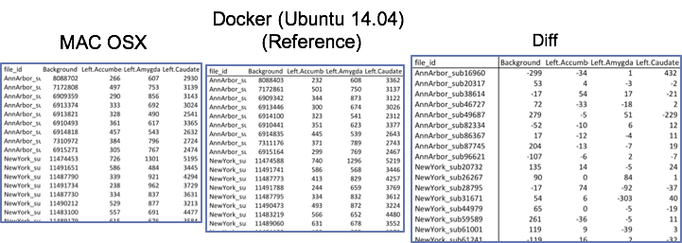
Everything matters!
Operating System Matters (i.e. Linux vs. OSX)
Tool Selection Matters (i.e. Freesurfer vs. Ants)
Data Matters (100 subjects versus 1000 subjects)

Slide 12
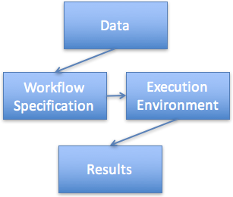
A Vision for a Next-Generation Publication
The Reproducible Publication of the future includes:
Words, as usual, PLUS the following supplemental information:
Data
Workflow Specification
Execution Environment Specification
Complete Results
In other words, given the data, workflow specification and execution environment specification, a third party can generate (and validate) the exact results independently.
Ghosh SS, Poline JB, Keator DB et al. A very simple, re-executable neuroimaging publication. F1000Research 2017, 6:124 (doi: 10.12688/f1000research.10783.2)
Notes:
Explore the ‘generalization’ space

Slide 13
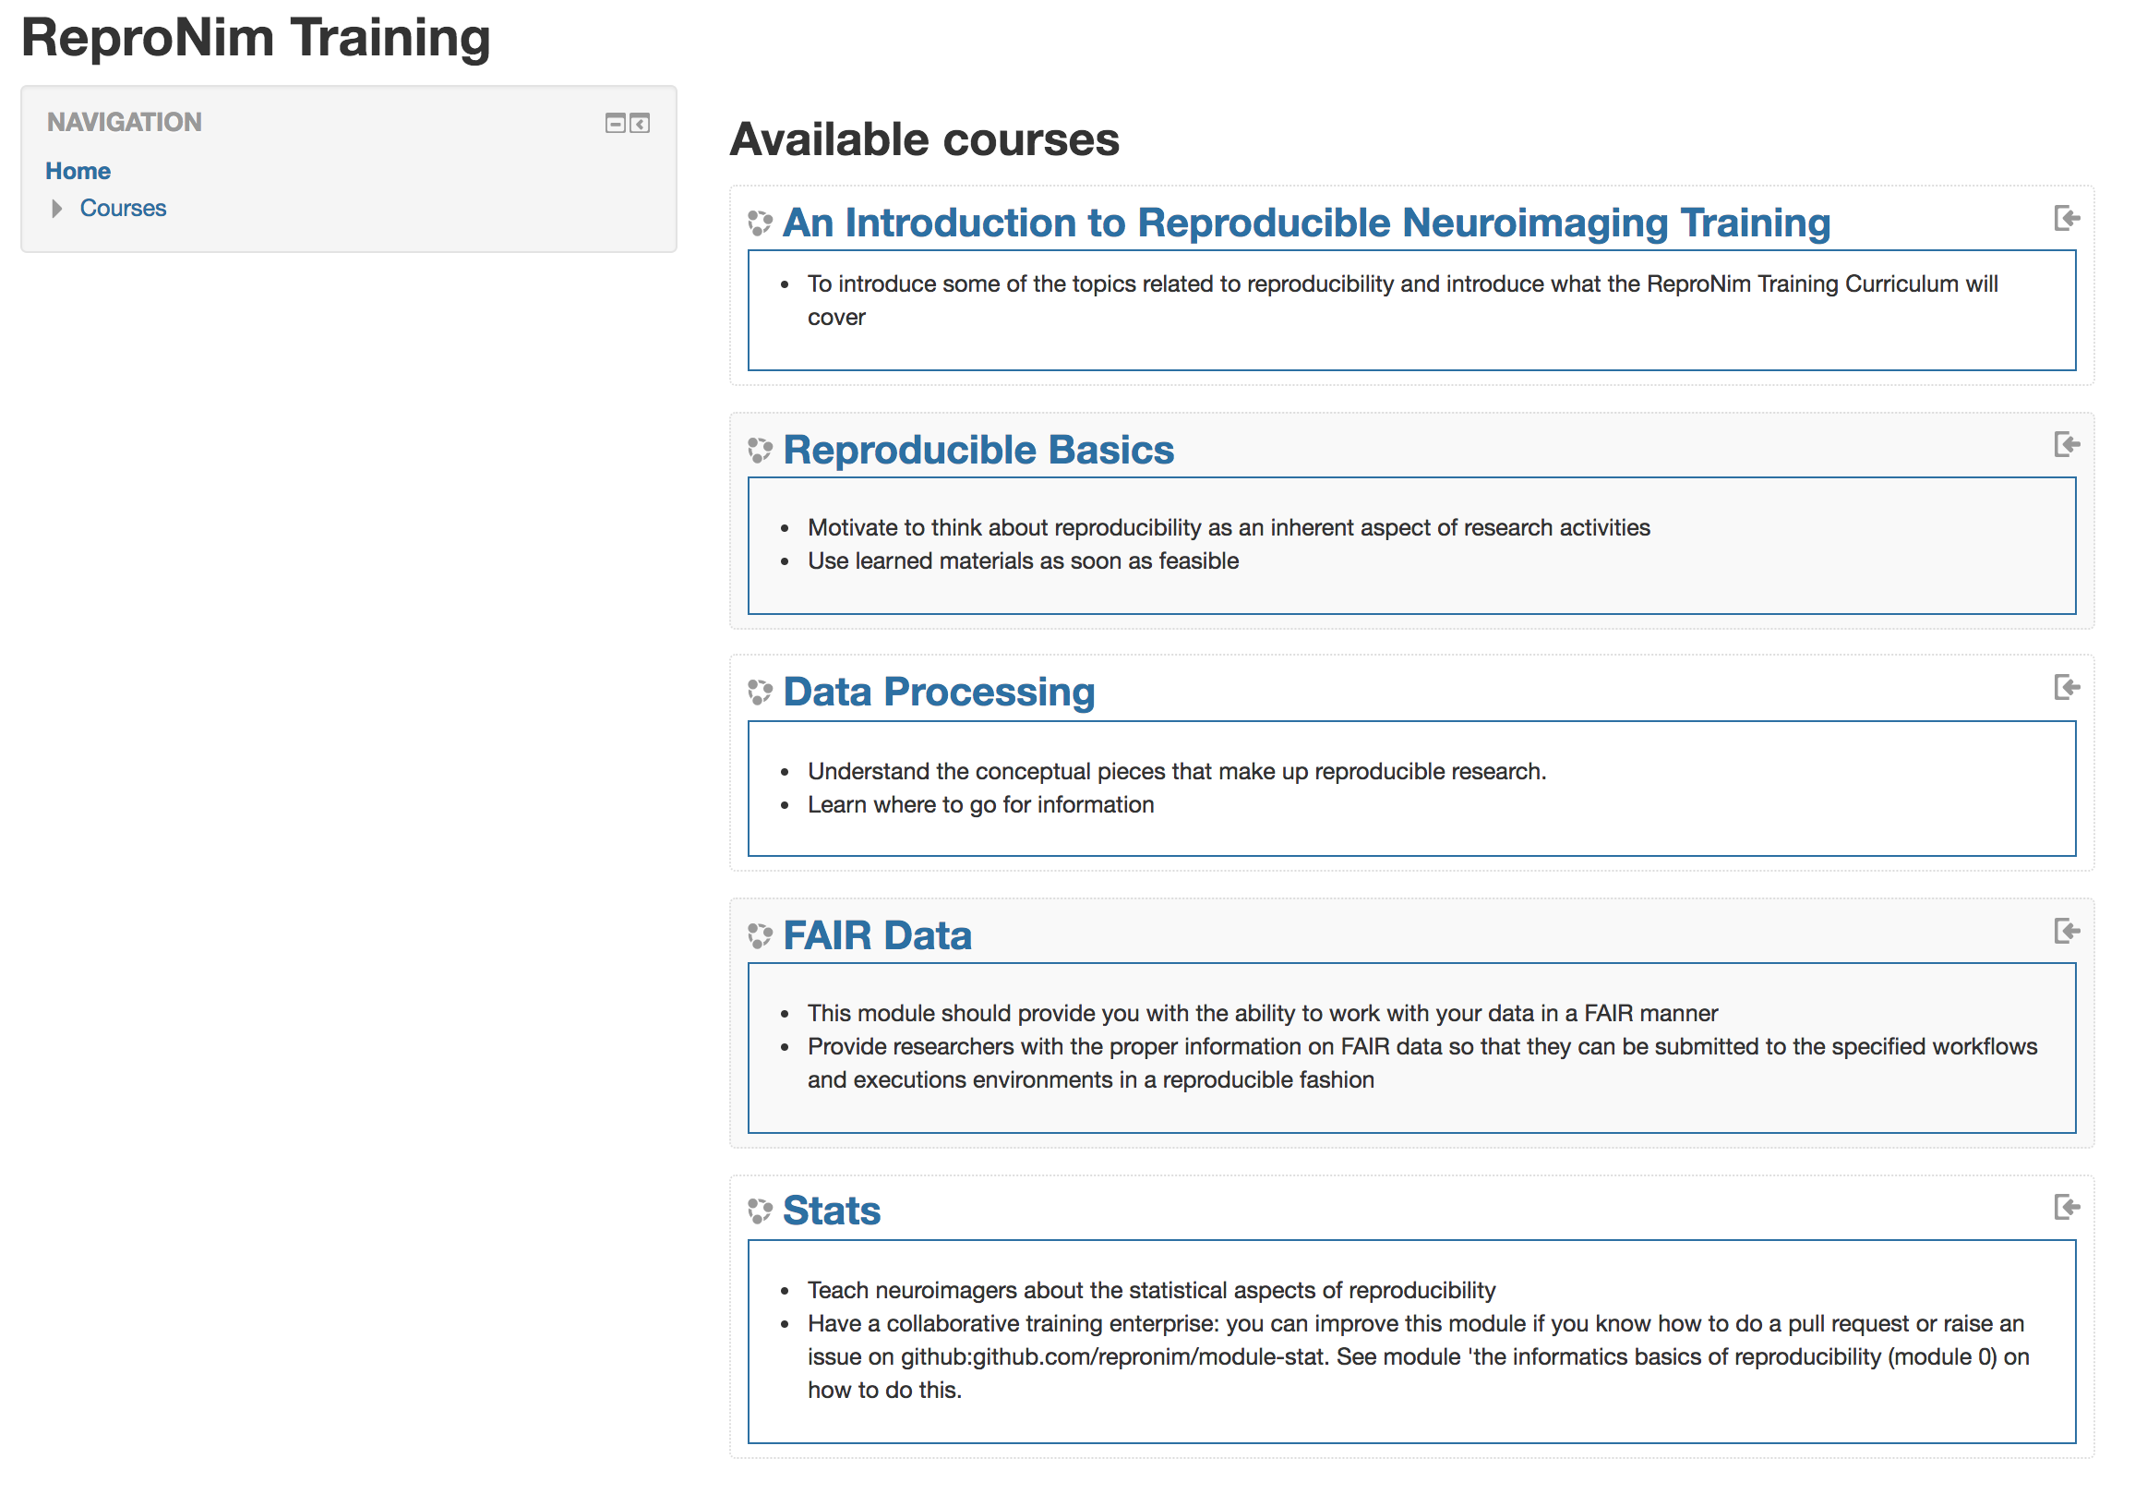
The materials we are using today are part of a larger curriculum
training.repronim.org
It borrows from the concepts of Software and Data Carpentry, and ultimately has a “Train the Trainer” design.
As this full curriculum is designed to potentially spans many months, spending 1 day on this will potentially feel “Appropriately Overwhelming”. That’s ok (and even the intent). We all will still have a lot of learning and practice to do after today's session.
Notes:
Appropriately overwhelming…
Train the trainer...

Slide 14
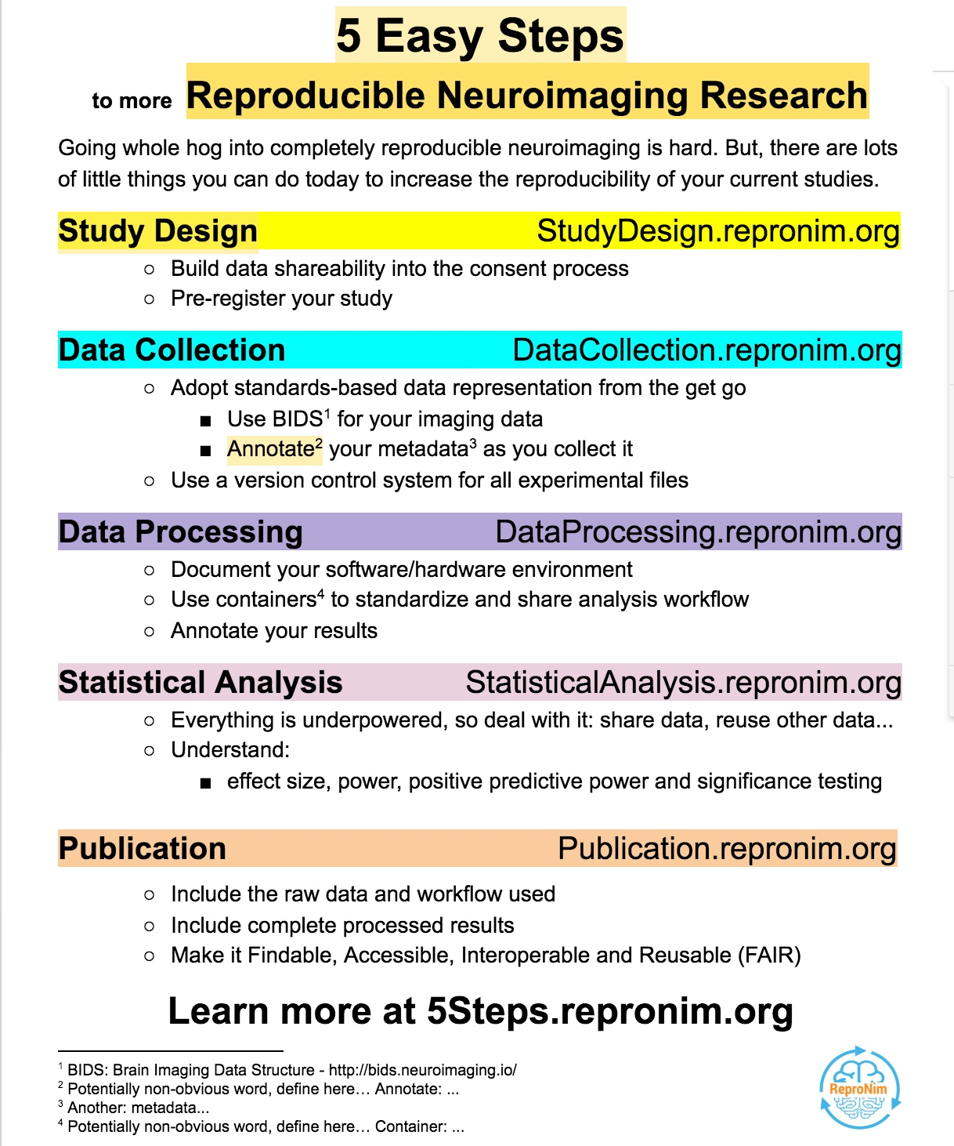
Identify simple things researchers WANT to do.
Give them instructions for things that they will understand that they CAN do.
Support/embrace incremental improvements!
Think Locally; Act Globally
Think reproducibly; Act re-executably

Slide 15
Schedule
8:30-10:00
FAIR Data - BIDS datasets - Jeffrey Grethe, UCSD
10:15-11:45
Computational basis - Yaroslav Halchenko, Dartmouth College and Michael Hanke, Magdeburg
13:00-14:30
Neuroimaging Workflows - Dorota Jarecka and Satrajit Ghosh, MIT
14:45-16:00
Statistics for reproducibility - Celia Greenwood and Jean-Baptiste Poline, McGill

