Slide 1
Slide 1 (this one) – just for reference or index
Slide 2 = previous ‘front page’ Trifold used at OHBM and SfN, 2018-2019
Slide 3 = Analysists edit New/revised front page for potential 2022 SfN Trifold
Slide 4 = blank
Slide 5 = previous back page Trifold from 2018-2019
Slide 6 = New/revised back side for potential 2022 SfN Trifold
Slide 7 = blank
Slide 8 = Analysists edit New/revised front page for potential 2022 SfN Trifold
Slide 9 = New/revised back side for potential 2022 SfN Trifold

Slide 2




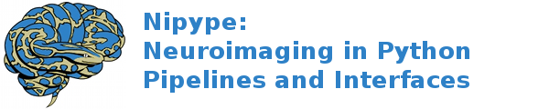

Training and Education
Overview
The ReproNim vision is to to help neuroimaging researchers to:
Find and Share data in a FAIR fashion (discover resources with NeuroBLAST)
Comprehensively describe their data and analysis workflows in precisely replicable fashion (describe research processes with ReproIN and BrainVerse)
Manage their computational resource options (do analysis with NICEMAN).
Our Educational Objectives include:
Topical training in the overall issues that affect the reproducibility of neuroimaging research (data acquisition and characterization, experimental methods, analyses, record keeping and reporting, reusability, and sharing of data and methods)
Development of a next-generation cadre of software developers that are versed in the techniques that promote reproducibility and education of the neuroimaging researcher in the tools that promote complete experimental description.
Our initial (Phase 1) curriculum focuses on the developer in order to initiate a set of tools that are reproducibility-enabled. Future curricula will extend the reach of these materials to encompass a broader community of researchers.
Center for Reproducible
Neuroimaging Computation
ReproNim envisions a neuroimaging research landscape in which knowledge is generated, recorded and reported in a reproducible fashion and coupled with the ability to reuse and extend these studies by others in the community.
URL: ReproNim.org
Twitter: @ReproNim
Email: info@repronim.org
Using these tools, neuroimagers can take a data ‘Acquisition-Centered’ view on these processes in which experimental data is both generated and processed locally, and then submitted to the outside world. Alternatively, they have the option of a ‘Discovery-Centered’ view in which an experimental question is addressed with applicable data generated by and discovered from external resources, processed via locally accessible computer resources, and then published for the outside world.
training.repronim.org
ReproNim is made possible by:
NIDM Working Group
Support: NIH-NIBIB P41 EB019936

Slide 3
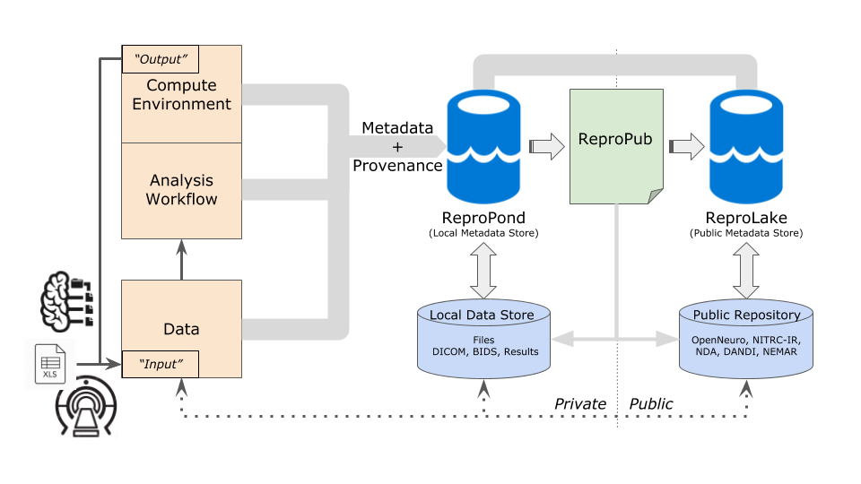
Training and Education
Overview
Our Educational Objectives include:
Topical training in the overall issues that affect the reproducibility of neuroimaging research (data acquisition and characterization, experimental methods, analyses, record keeping and reporting, reusability, and sharing of data and methods)
Development of a next-generation cadre of software developers and data analysists that are versed in the techniques that promote reproducibility and education of the neuroimaging researcher in the tools that promote complete experimental description.
In order to extend the reach of these concepts, materials and tools to the broader community, we also offer a one-year Train-the-Trainer ReproNim/INCF Training Fellowship. This highly competitive program, now in its third year, enables Fellows from a wide array of disciplines to develop and deliver training activities customized to their respective target audiences.
ReproNim’s goal is to improve the reproducibility of neuroimaging research, while making the process easier and more efficient for investigators.
Center for Reproducible
Neuroimaging Computation
ReproNim envisions a neuroimaging research landscape in which knowledge is generated, recorded and reported in a reproducible fashion and coupled with the ability to reuse and extend these studies by others in the community.
ReproNim delivers a reproducible analysis framework comprised of components that include:
Data and Software Discovery
Implementation of Standardized Description of data, results and workflows
Development of Execution Options that facilitates operation in all computational environments
Training and Education to the community
URL: ReproNim.org
Twitter: @ReproNim
Email: info@repronim.org
All components of the framework are intended to foster continued use and development of the reproducible and generalizable framework in neuroimaging research.
ReproNim is made possible by:
training.repronim.org
repronim.org/fellowship.html
NIDM Working Group
Support: NIH-NIBIB P41 EB019936

Slide 5
DO
DESCRIBE
DISCOVER
neuroblast.repronim.org
brainverse.repronim.org
niceman.repronim.org
This project is integrating existing technologies for automation of specification, creation and use of computing environments with free and open source availability of neuroimaging software and data. We envision:
Tools to facilitate operation in multiple computational environments and reduce barriers to scale and reliability.
Tools to enable automated sharing of computational environments for collaborative and publication purposes.
The result will be a NeuroImaging Computation Environments MANager (NICEMAN) application. NICEMAN will provide: A specification to describe environments consistently across available data and software distributions; and a software platform to allow convenient discovery, description, and management of the computation environment(s) so that they could be easily traced, validated, compared, executed and reproduced.
This project is developing tools for reproducible description based on recording, reporting and reusing experimenter procedures from start to finish. Type of machine-captured experimental metadata range from scanner (data acquisition) to methods, analyses and results. We envision:
Tools to help researchers record (describe) experimental procedures
Tools to help researchers define and semantically describe analysis workflow
We are developing BrainVerse to help researchers manage, track and share information in a comprehensive format. BrainVerse is a cross-platform framework for collaborative, desktop applications. Initial applications include: NIMH Data Archive (NDA) editor (allows importing and curating NDA forms to support data acquisition in a project); a project planner and executor (allows creating a plan for data acquisition in a project and collecting data using common forms); and a NIDM term editor (allows the community to search for and build a common vocabulary around neuroimaging).
This project is developing tools for on-demand access (Discovery) for widely distributed web-based data, publication and software resources, with highly refined search tools. There are two broad classes of product we envision:
Tools to help researchers Publish their data, making it discoverable,
Tools to help researchers Discover published data.
These tools are designed to facilitate data sharing, use and discovery. We are developing an integrated application, NeuroBLAST, that will powerfully enable user-specified search and publish functions to data repositories, published studies, versioned software packages, study-related questions, and content. While NeuroBlast is the key deliverable application, numerous infrastructure elements need to be completed in order to bring this tool to production, including: core terminology and ontology support; data, resource, and terminology web services; as well as a neuroimaging resource registry and discovery portal.

Slide 6
DO
DESCRIBE
DISCOVER
This project is developing and refining tools for reproducible description based on recording, reporting and re-using experimenter procedures from start to finish. Types of machine-captured experimental metadata range from scanner (data acquisition) to methods, analyses and results. We envision:
Tools to help researchers record (describe) experimental procedures
Tools to help researchers define and semantically describe analysis workflow
Our objective is to help researchers manage, track and share information in a comprehensive format, using a cross-platform framework for collaborative, desktop applications. Initial applications include: NIMH Data Archive (NDA) editor (allows importing and curating NDA forms to support data acquisition in a project); a project planner and executor (allows creating a plan for data acquisition in a project and collecting data using common forms); and a NIDM term editor (allows the community to search for and build a common vocabulary around neuroimaging).
This project is developing and refining tools for on-demand access (Discovery) for widely distributed web-based data, publication and software resources, with highly refined search tools:
Tools to help researchers Publish their data, making it discoverable,
Tools to help researchers Discover published data.
This work is designed to facilitate data sharing, use and discovery, with the overarching objective to powerfully enable user-specified search and publish functions to data repositories, published studies, versioned software packages, study-related questions, and content.
In order to realize these objectives, numerous underlying infrastructure elements are needed to be completed. Infrastructure development is therefore an important aspect of this project, including: core terminology and ontology support; data, resource, and terminology web services; as well as a neuroimaging resource registry and discovery portal.
This project is integrating existing technologies for automation of specification, creation and use of computing environments with free and open source availability of neuroimaging software and data. We envision:
Tools to facilitate operation in multiple computational environments and reduce barriers to scale and reliability.
Tools to enable automated sharing of computational environments for collaborative and publication purposes.
We aim to provide the mechanisms to manage NeuroImaging Computation Environments, including: A specification to describe environments consistently across available data and software distributions; and a software platform to allow convenient discovery, description, and management of the computation environment(s) so that they could be easily traced, validated, compared, executed and reproduced.

Slide 8
Training and Education
Overview
Our Educational Objectives include:
Topical training in the overall issues that affect the reproducibility of neuroimaging research (data acquisition and characterization, experimental methods, analyses, record keeping and reporting, reusability, and sharing of data and methods)
Development of a next-generation cadre of software developers and data analysists that are versed in the techniques that promote reproducibility and education of the neuroimaging researcher in the tools that promote complete experimental description.
In order to extend the reach of these concepts, materials and tools to the broader community, we also offer a one-year Train-the-Trainer ReproNim/INCF Training Fellowship. This highly competitive program, now in its third year, enables Fellows from a wide array of disciplines to develop and deliver training activities customized to their respective target audiences.
ReproNim’s goal is to improve the reproducibility of neuroimaging research, while making the process easier and more efficient for investigators.
Center for Reproducible
Neuroimaging Computation
ReproNim envisions a neuroimaging research landscape in which knowledge is generated, recorded and reported in a reproducible fashion and coupled with the ability to reuse and extend these studies by others in the community.
ReproNim delivers a reproducible analysis framework comprised of components that include:
Data and Software Discovery
Implementation of Standardized Description of data, results and workflows
Development of Execution Options that facilitates operation in all computational environments
Training and Education to the community
URL: ReproNim.org
Twitter: @ReproNim
Email: info@repronim.org
All components of the framework are intended to foster continued use and development of the reproducible and generalizable framework in neuroimaging research.
ReproNim is made possible by:
training.repronim.org
repronim.org/fellowship.html
NIDM Working Group
Support: NIH-NIBIB P41 EB019936

Slide 9
DO
DESCRIBE
DISCOVER
This project is developing and refining tools for reproducible description based on recording, reporting and re-using experimenter procedures from start to finish. Types of machine-captured experimental metadata range from scanner (data acquisition) to methods, analyses and results. We envision:
Tools to help researchers record (describe) experimental procedures
Tools to help researchers define and semantically describe analysis workflow
Our objective is to help researchers manage, track and share information in a comprehensive format, using a cross-platform framework for collaborative, desktop applications. Initial applications include: NIMH Data Archive (NDA) editor (allows importing and curating NDA forms to support data acquisition in a project); a project planner and executor (allows creating a plan for data acquisition in a project and collecting data using common forms); and a NIDM term editor (allows the community to search for and build a common vocabulary around neuroimaging).
This project is developing and refining tools for on-demand access (Discovery) for widely distributed web-based data, publication and software resources, with highly refined search tools:
Tools to help researchers Publish their data, making it discoverable,
Tools to help researchers Discover published data.
This work is designed to facilitate data sharing, use and discovery, with the overarching objective to powerfully enable user-specified search and publish functions to data repositories, published studies, versioned software packages, study-related questions, and content.
In order to realize these objectives, numerous underlying infrastructure elements are needed to be completed. Infrastructure development is therefore an important aspect of this project, including: core terminology and ontology support; data, resource, and terminology web services; as well as a neuroimaging resource registry and discovery portal.
This project is integrating existing technologies for automation of specification, creation and use of computing environments with free and open source availability of neuroimaging software and data. We envision:
Tools to facilitate operation in multiple computational environments and reduce barriers to scale and reliability.
Tools to enable automated sharing of computational environments for collaborative and publication purposes.
We aim to provide the mechanisms to manage NeuroImaging Computation Environments, including: A specification to describe environments consistently across available data and software distributions; and a software platform to allow convenient discovery, description, and management of the computation environment(s) so that they could be easily traced, validated, compared, executed and reproduced.

