Slide 1
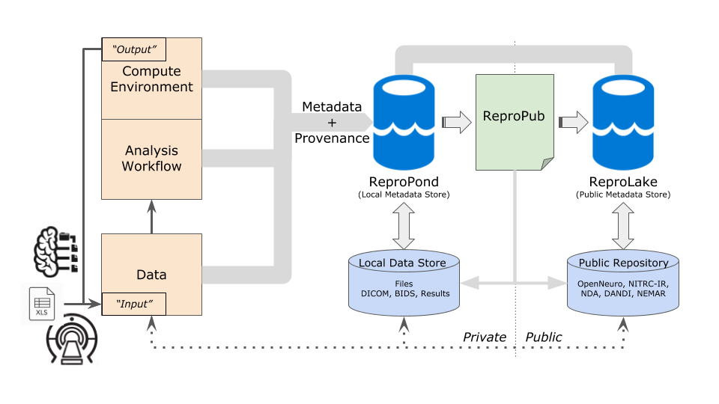




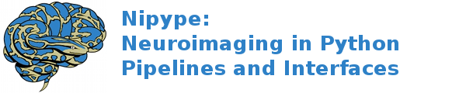

Training and Education
Overview
Our Educational Objectives include:
Topical training in the overall issues that affect the reproducibility of neuroimaging research (data acquisition and characterization, experimental methods, analyses, record keeping and reporting, reusability, and sharing of data and methods)
Development of a next-generation cadre of software developers and data analysists that are versed in the techniques that promote reproducibility and education of the neuroimaging researcher in the tools that promote complete experimental description.
In order to extend the reach of these concepts, materials and tools to the broader community, we also offer a one-year Train-the-Trainer ReproNim/INCF Training Fellowship. This highly competitive program, now in its third year, enables Fellows from a wide array of disciplines to develop and deliver training activities customized to their respective target audiences.
ReproNim’s goal is to improve the reproducibility of neuroimaging research, while making the process easier and more efficient for investigators.
Center for Reproducible
Neuroimaging Computation
ReproNim envisions a neuroimaging research landscape in which knowledge is generated, recorded and reported in a reproducible fashion and coupled with the ability to reuse and extend these studies by others in the community.
ReproNim delivers a reproducible analysis framework comprised of components that include:
Data and Software Discovery
Implementation of Standardized Description of data, results and workflows
Development of Execution Options that facilitates operation in all computational environments
Training and Education to the community
URL: ReproNim.org
Twitter: @ReproNim
Email: info@repronim.org
ReproNim is made possible by:
All components of the framework are intended to foster continued use and development of the reproducible and generalizable framework in neuroimaging research.
training.repronim.org
repronim.org/fellowship.html
NIDM Working Group
Support: NIH-NIBIB P41 EB019936

Slide 2
DO
DESCRIBE
DISCOVER
This project is developing and refining tools for reproducible description based on recording, reporting and re-using experimenter procedures from start to finish. Types of machine-captured experimental metadata range from scanner (data acquisition) to methods, analyses and results. We envision:
Tools to help researchers record (describe) experimental procedures
Tools to help researchers define and semantically describe analysis workflow
Our objective is to help researchers manage, track and share information in a comprehensive format, using a cross-platform framework for collaborative, desktop applications. Initial applications include: NIMH Data Archive (NDA) editor (allows importing and curating NDA forms to support data acquisition in a project); a project planner and executor (allows creating a plan for data acquisition in a project and collecting data using common forms); and a NIDM term editor (allows the community to search for and build a common vocabulary around neuroimaging).
This project is developing and refining tools for on-demand access (Discovery) for widely distributed web-based data, publication and software resources, with highly refined search tools:
Tools to help researchers Publish their data, making it discoverable,
Tools to help researchers Discover published data.
This work is designed to facilitate data sharing, use and discovery, with the overarching objective to powerfully enable user-specified search and publish functions to data repositories, published studies, versioned software packages, study-related questions, and content.
In order to realize these objectives, numerous underlying infrastructure elements are needed to be completed. Infrastructure development is therefore an important aspect of this project, including: core terminology and ontology support; data, resource, and terminology web services; as well as a neuroimaging resource registry and discovery portal.
This project is integrating existing technologies for automation of specification, creation and use of computing environments with free and open source availability of neuroimaging software and data. We envision:
Tools to facilitate operation in multiple computational environments and reduce barriers to scale and reliability.
Tools to enable automated sharing of computational environments for collaborative and publication purposes.
We aim to provide the mechanisms to manage NeuroImaging Computation Environments, including: A specification to describe environments consistently across available data and software distributions; and a software platform to allow convenient discovery, description, and management of the computation environment(s) so that they could be easily traced, validated, compared, executed and reproduced.

