Slide 1
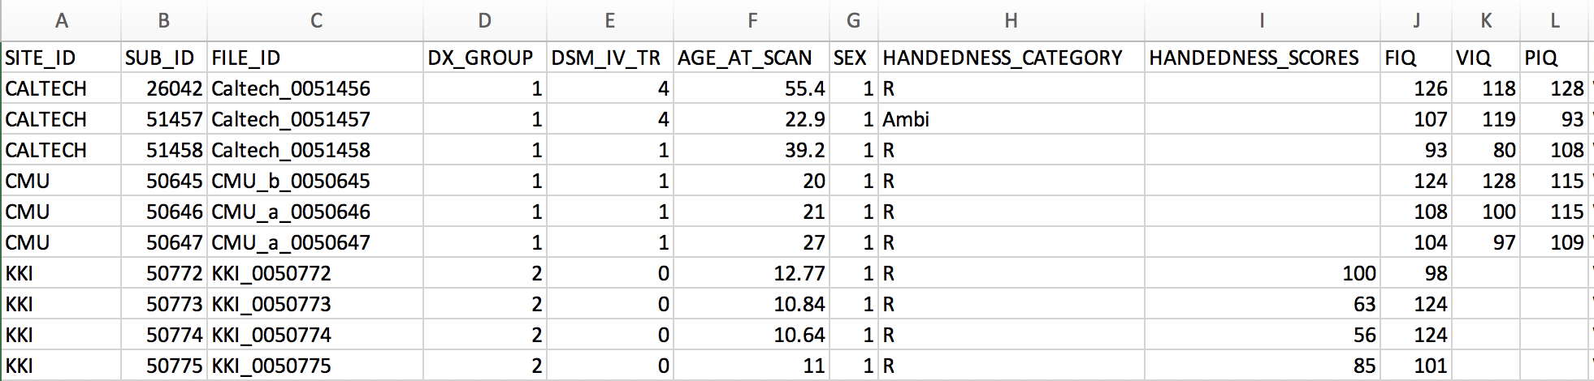
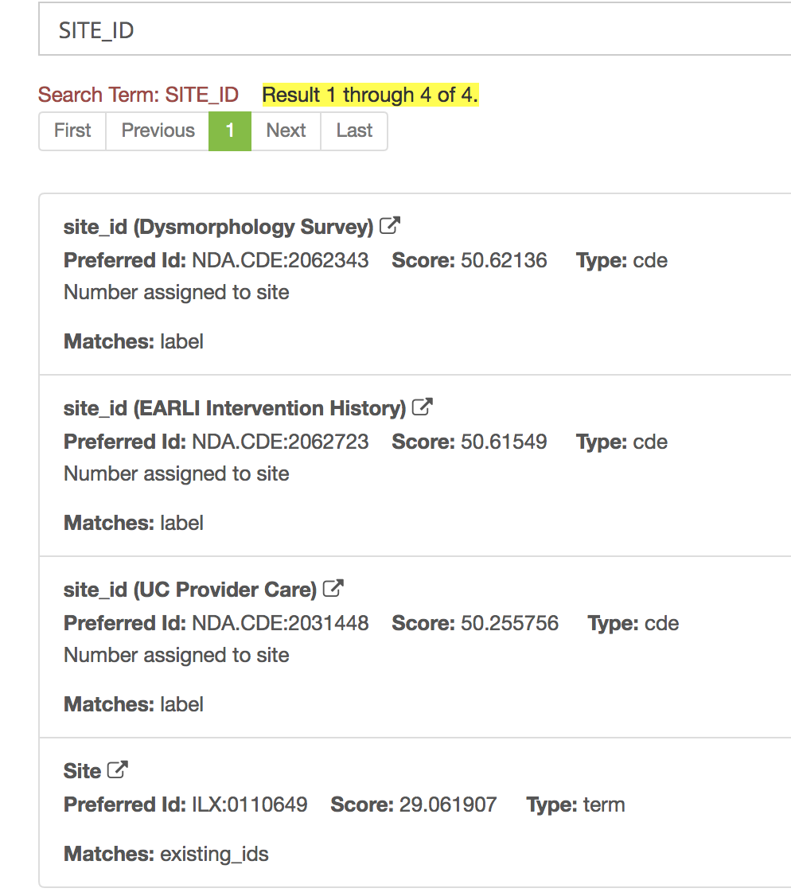
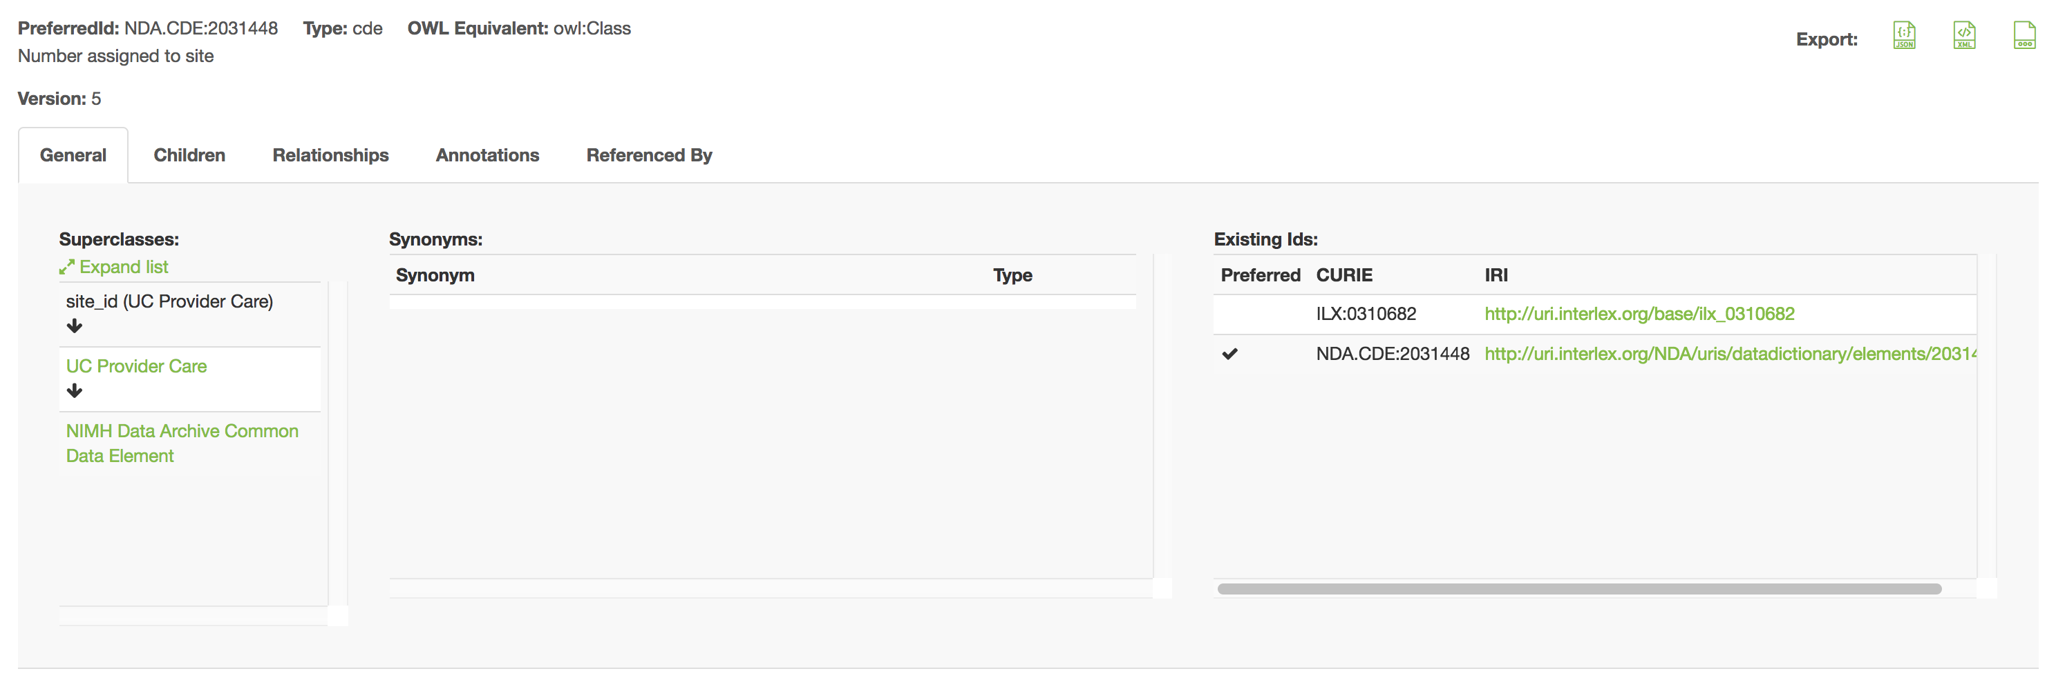
Annotating Tabular Data - GUI
https://scicrunch.org/scicrunch/interlex/dashboard

Slide 2
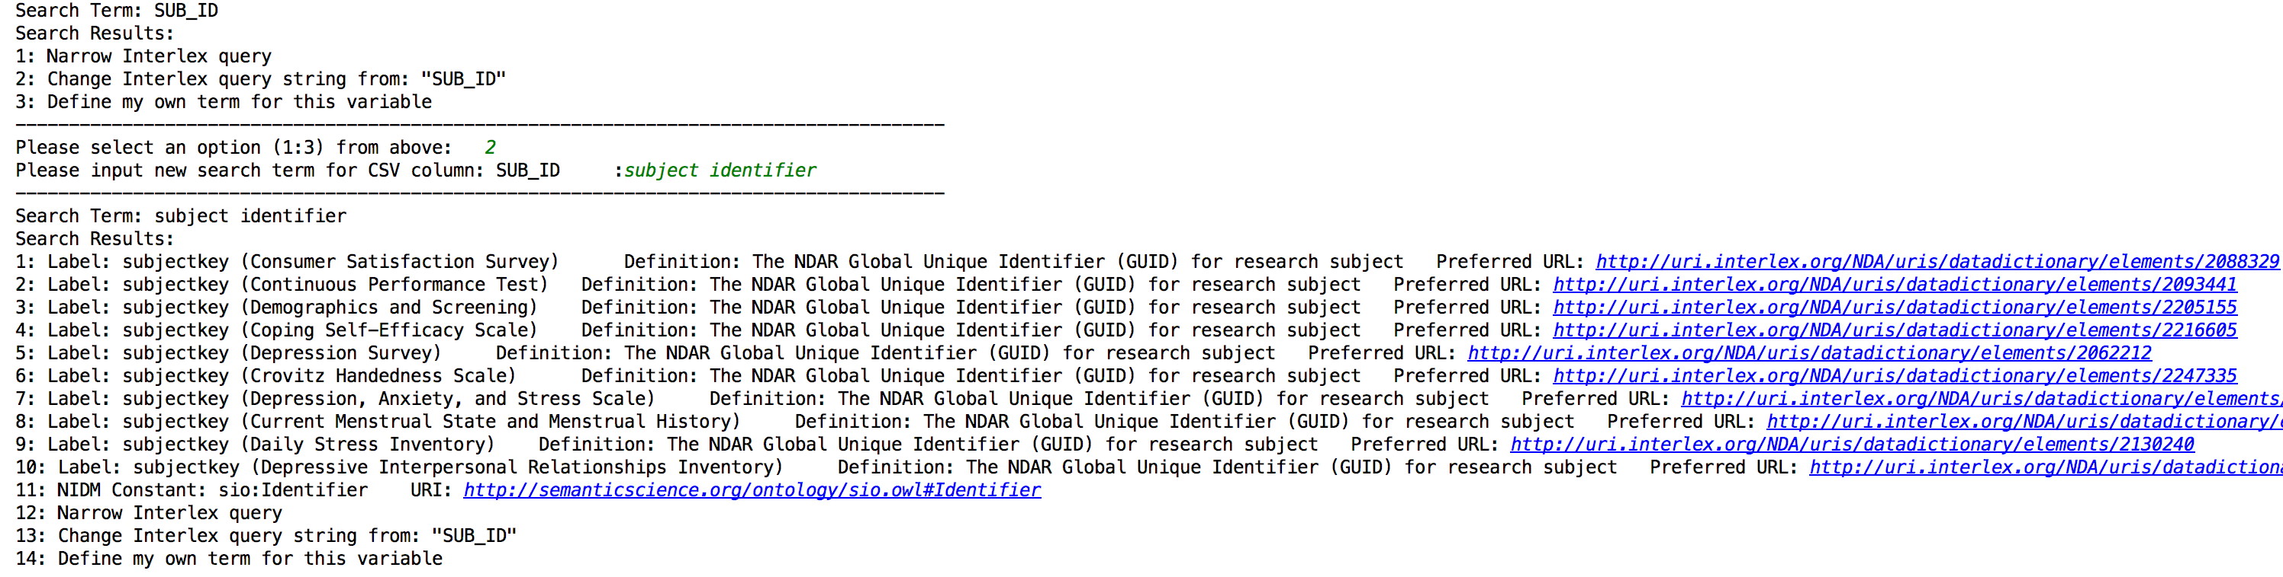
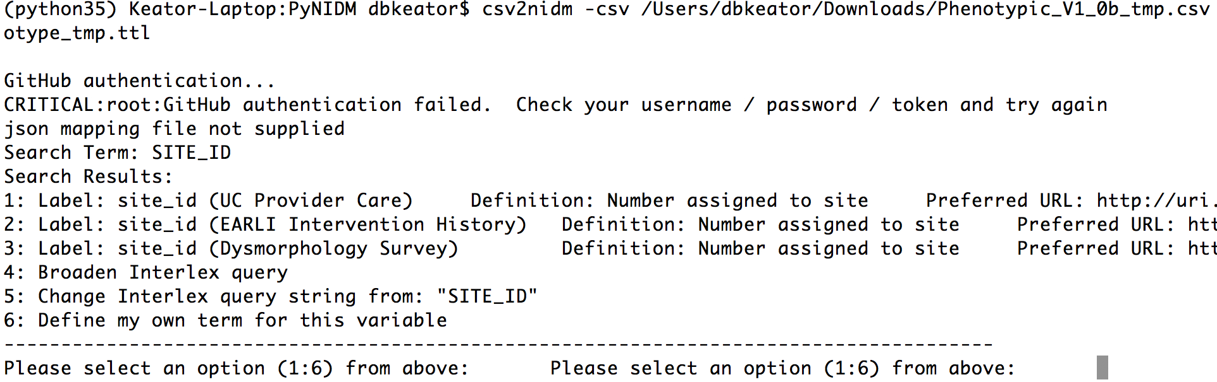
Annotating Tabular Data - CLI
https://github.com/incf-nidash/PyNIDM

Slide 3
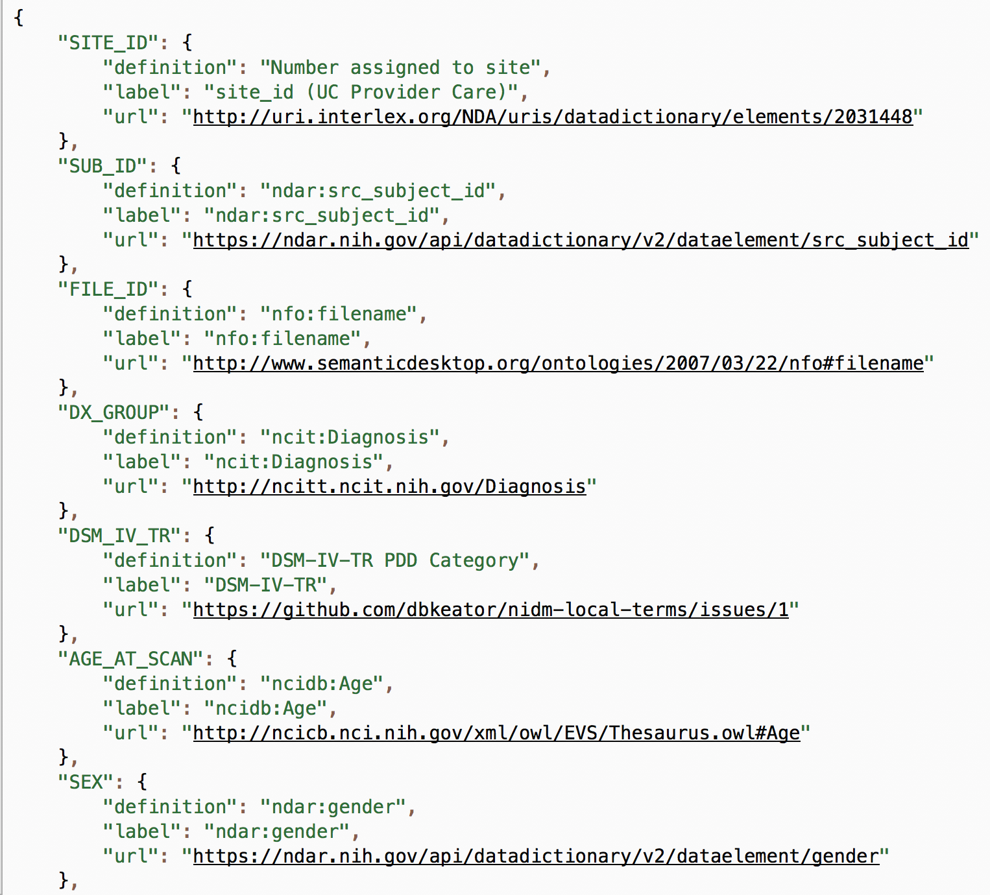
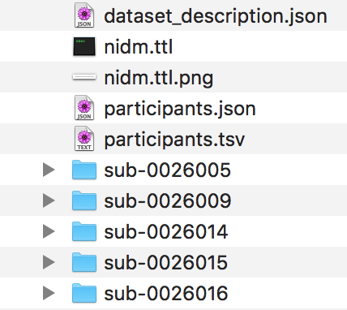
BIDS Annotations

Slide 4
NIDM Resources
Main Website: http://nidm.nidash.org/
Mailing List: incf-nidash-nidm@googlegroups.com
Google Drive: http://bit.ly/NIDMDrive
GitHub
NIDM Specs Repository: https://github.com/INCF-NIDASH/nidm-specs
NIDM-Results API: https://github.com/incf-nidash/nidmresults
SPM Software API: https://github.com/incf-nidash/nidmresults-spm
FSL Software API: https://github.com/incf-nidash/nidmresults-fsl
PyNIDM API Repository: https://github.com/incf-nidash/PyNIDM
NIDM Training Materials (a bit older): https://github.com/incf-nidash/nidm-training
Other interesting repos: https://github.com/incf-nidash
Simple Annotation Example: https://docs.google.com/document/d/1N_olJLBHW2WarKpu73PwGdmCS83d57iMZDI662fXZuc/edit#
Sample ABIDE and ADHD200 NIDM Files: https://github.com/dbkeator/simple2_NIDM_examples

