Slide 1

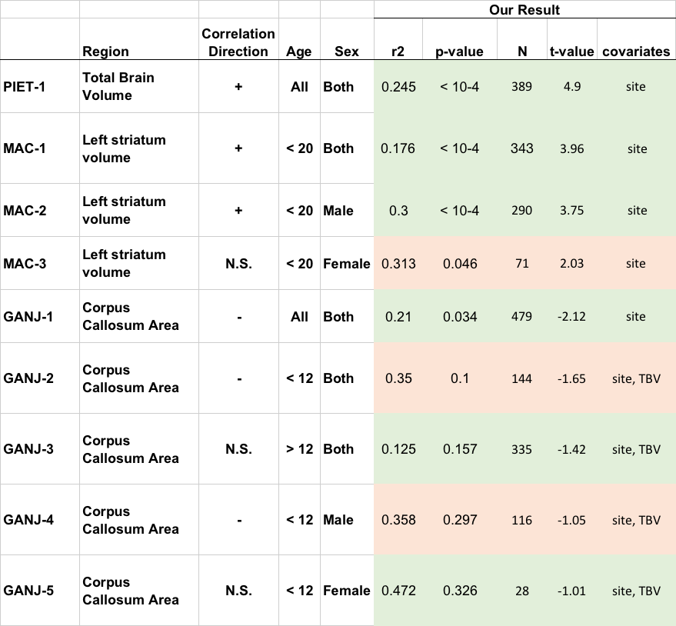
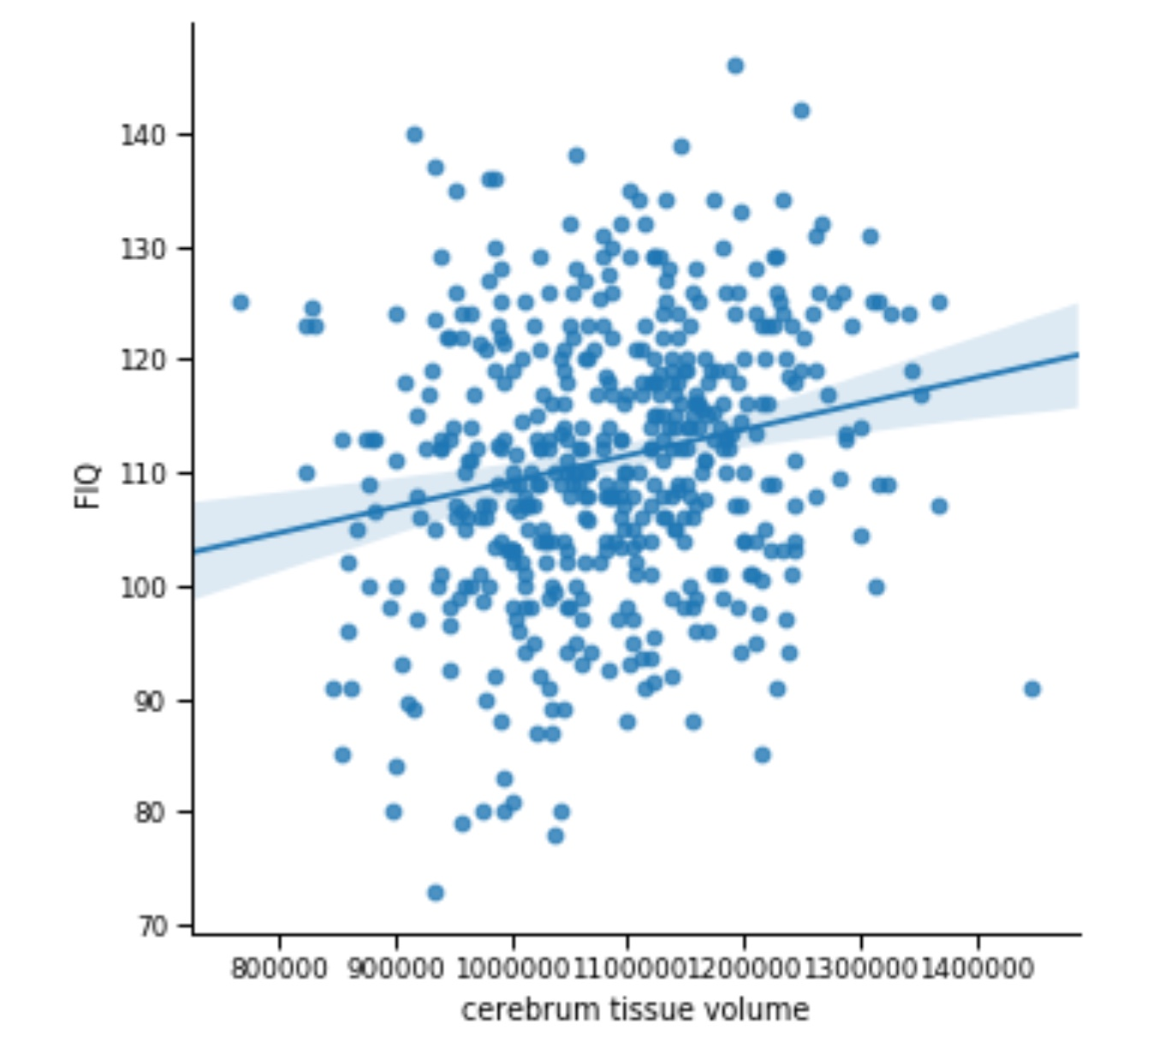
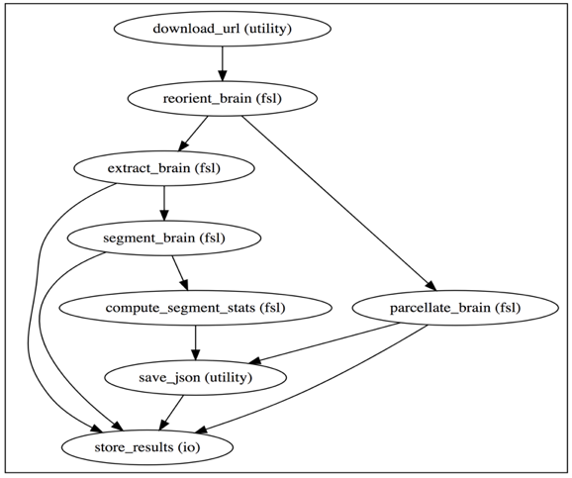
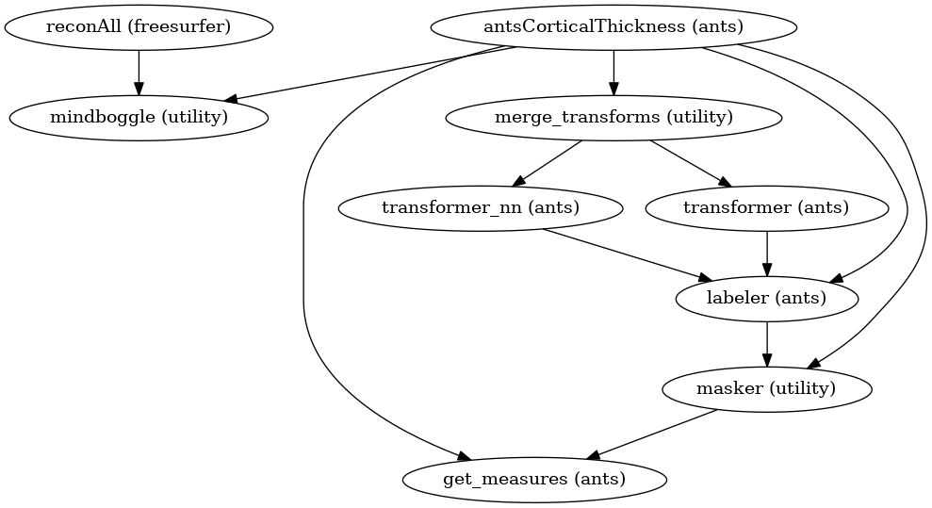
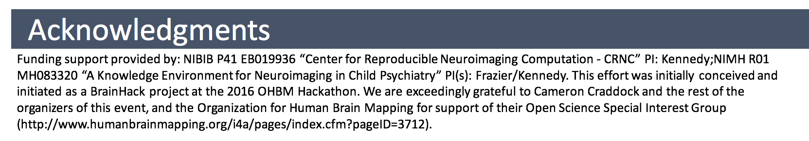
A 'Simple' Re-Executable Publication: IQ in Typically Developing Children
Hypotheses:
PIET-1: Total Brain Volume will positively correlate with IQ (in both sexes across the complete age range).
MAC-1: Left striatum volume (caudate + putamen) will positively correlate with IQ in the total (male + female) child (age < 20) group.
MAC-2: Left striatum volume (caudate + putamen) will positively correlate with IQ in the male children group.
MAC-3: Left striatum volume (caudate + putamen) will not correlate with IQ in the female children group.
MAC-3: Left striatum volume (caudate + putamen) will not correlate with IQ in the female children group.
GANJ-1: Total Corpus Callosum midsagittal area, after correcting for total brain volume, will negatively correlate with IQ.
GANJ-2: Total Corpus Callosum midsagittal area, after correcting for total brain volume, will negatively correlate with IQ in the young (age < 12) group.
GANJ-3: Total Corpus Callosum midsagittal area, after correcting for total brain volume, will not significantly correlate with IQ in the adolescent (age > 12) group.
GANJ-4: Total Corpus Callosum midsagittal area, after correcting for total brain volume, will negatively correlate with IQ in the male (age < 12) group.
GANJ-5: Total Corpus Callosum midsagittal area, after correcting for total brain volume, will not significantly correlate with IQ in the female (age < 12) group.
Satrajit Ghosh¹, Goncalves Mathias², David Keator³, Tom Gillespie⁴, Jeffrey Grethe⁵, Steven Hodge⁶, Yaroslav Halchenko⁷, Jean-Baptiste Poline⁸, David Kennedy⁹
¹MIT/HMS, Cambridge, MA, ²MIT, Cambridge, MA, ³University of California Irvine, Irvine, CA, ⁴UCSD, San Diego, CA, ⁵University of California San Diego, San Diego, CA, ⁶University of Massachusetts Medical School, Worcester, United States, ⁷Dartmouth College, Dartmouth, NH, ⁸McGill University, Montreal, Quebec, ⁹University of Massachusett Medical School, Worcester, MA
Introduction:
The relationship between IQ and brain structural volume in typically developing brain is a known confound in virtually all structural neuroimaging studies. A better understanding of this effect is important for ongoing studies. We selected three publications related to IQ and structural volumes in typically developing children from the literature and attempt to prospectively replicate the main observations in current publicly available data in a re-executable and extensible fashion.
(1) Pietschnig et al. "Our results showed significant positive associations of brain volume and IQ (r = .24, R2 = .06) that generalize over age (children vs. adults), IQ domain (full-scale, performance, and verbal IQ), and sex."
(2) MacDonald PA, et al. "Correlations between the WASI-IQ and the left striatum, composed of the caudate nucleus and putamen, were significant. When these data were analyzed separately for male and female children, positive correlations were significant for the left striatum in male children only."
(3) Ganjavi H, et al. "After correcting for total brain volume and age, a significant negative correlation was found between total CC midsagittal area and IQ (r = −0.147; p = 0.040). Post hoc analyses revealed a significant negative correlation in children (age less than 12) (r = −0.279; p = 0.004) but not in adolescents (age≥12) (r = −0.005; p = 0.962). Partitioning the subjects by gender revealed a negative correlation in males (r = −0.231; p = 0.034) but not in females (r = 0.083; p = 0.389)."
These main observations can be turned into new hypotheses (pre-registered at OSF: https://osf.io/yuv52) for replication:
Results:
Results are shown in the table below.
Hypotheses:
PIET-1: Total Brain Volume will positively correlate with IQ (in both sexes across the complete age range).
MAC-1: Left striatum volume (caudate + putamen) will positively correlate with IQ in the total (male + female) child (age < 20) group.
MAC-2: Left striatum volume (caudate + putamen) will positively correlate with IQ in the male children group.
MAC-3: Left striatum volume (caudate + putamen) will not correlate with IQ in the female children group.
MAC-3: Left striatum volume (caudate + putamen) will not correlate with IQ in the female children group.
GANJ-1: Total Corpus Callosum midsagittal area, after correcting for total brain volume, will negatively correlate with IQ.
GANJ-2: Total Corpus Callosum midsagittal area, after correcting for total brain volume, will negatively correlate with IQ in the young (age < 12) group.
GANJ-3: Total Corpus Callosum midsagittal area, after correcting for total brain volume, will not significantly correlate with IQ in the adolescent (age > 12) group.
GANJ-4: Total Corpus Callosum midsagittal area, after correcting for total brain volume, will negatively correlate with IQ in the male (age < 12) group.
GANJ-5: Total Corpus Callosum midsagittal area, after correcting for total brain volume, will not significantly correlate with IQ in the female (age < 12) group.
Conclusions:
Six of the nine a priori hypotheses regarding IQ and brain structure volumes in typically developing children selected from the literature were confirmed in the FreeSurfer analysis of the ABIDE dataset. Further analysis is ongoing to see if additional findings from these (and other) publications can also be confirmed. Of particular interest is findings in this literature that were not significant (which may be limited in terms of power) to see if newer, higher powered studies do indeed find a significant relationship.
Methods:
A re-executable publication (aka “ReproPub”) requires specification of 5 key elements: 1) the source data, 2) the processing workflow, 3) the computational environment, 4) the complete derived results, and 5) the complete statistical results (4).
Data: The source data for this analysis comes from the typical subjects included in the ABIDE (5) dataset.
Processing: The analysis was run using a custom Docker container [https://hub.docker.com/r/mgxd/mindboggle/tags (1.4.0-aws)] containing FSL and Mindboggle on AWS Batch. Each T1 image was processed using this container to generate four sets of outputs. The output of the Simple1 workflow (4) using FSL (6), and the outputs from FreeSurfer (7), ANTs (8), and Mindboggle (9) using the mindboggle123 script (10). The outputs were aggregated and mapped into a common namespace using Interlex and combined with the phenotypic clinical and demographic data. For the analyses in this abstract the FreeSurfer outputs are being used. Linear regression for the given structural volume and full-scale IQ (FIQ) was performed (covarying for total brain volume in GANJ-*).
References:
Pietschnig et al. Meta-analysis of associations between human brain volume and intelligence differences: How strong are they and what do they mean? Neurosci Biobehav Rev. 2015 Oct;57:411-32.
MacDonald PA, et al. Investigating the relation between striatal volume and IQ. Brain Imaging Behav. 2014 Mar;8(1):52-9.
Ganjavi H, et al. Negative associations between corpus callosum midsagittal area and IQ in a representative sample of healthy children and adolescents. PLoS One. 2011;6(5):e19698.
Ghosh, et al. A very simple, re-executable neuroimaging publication F1000Research 2017, 6:124
Di Martino, et al. The autism brain imaging data exchange: towards a large-scale evaluation of the intrinsic brain architecture in autism. Mol Psychiatry. 2014 Jun;19(6):659-67. doi: 10.1038/mp.2013.78. Epub 2013 Jun 18.
Smith, et al. Advances in functional and structural MR image analysis and implementation as FSL. NeuroImage, 23(S1):208-19, 2004.
Fischl, et al. Whole Brain Segmentation: Neurotechnique Automated Labeling of Neuroanatomical Structures in the Human Brain. Neuron, Vol. 33, 341–355, January 31, 2002,
Avants, et al. Advanced normalization tools (ANTS), OR Insight 1–35 · November 2008.
Klein, at al. Mindboggle: Automated brain labeling with multiple atlases, BMC Medical Imaging 5(1):7 · November 2005
https://github.com/nipy/mindboggle/blob/master/mindboggle/mindboggle123

