Slide 1
Cas3-Derived Target DNA Degradation Fragments Fuel Primed CRISPR Adaptation
Аuthors: Kim Kunne, Sebastian N. Kieper, Jasper W. Bannenberg,
Martin Depken, Maria Suarez-Diez,Stan J.J. Brouns
stanbrouns@gmail.com
Reviewers: Potanina Darya, Surikova Elena, Chashnikova Nastya
potanina.dasha@ya.ru
Tutor: Chervonzeva Zoya
chezoya@gmail.com

Slide 2
Prokaryotic immunity
Prokaryotic genome contains clusteres of regularly short palindromic repeats (CRISPR) with fragments of invader's DNA inside.
This spacers are transcribed and processed into small crRNA that guide Cas (CRISPR-associated) proteins to their DNA or RNA target sequences, resulting in target cleavage and neutralization of the invading threat.

Slide 3
Priming
Priming is a mechanism for improving the immune response through updating the base of spacers.

Slide 4
Objectives of the study
Although the genetic requirements for priming are known, the exact role of required proteins during priming remains unknown.
As well as what makes priming so robust.

Slide 5
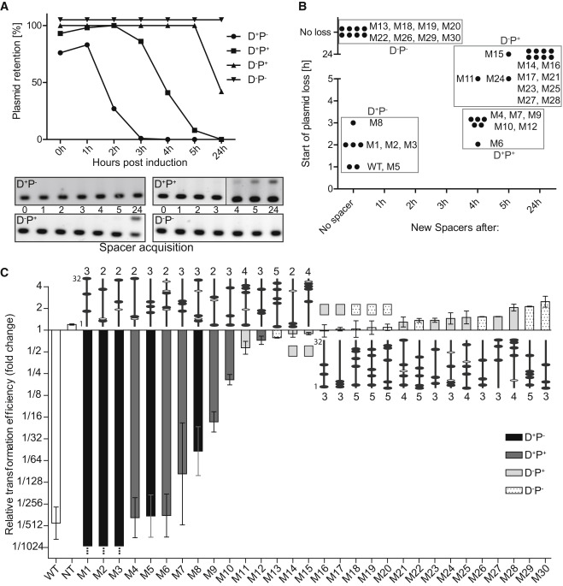
Timing of Plasmid Loss and Spacer Acquisition Reveals Distinct Underlying Processes
Moderate Direct Interference Activity Facilitates the Priming Process

Slide 6
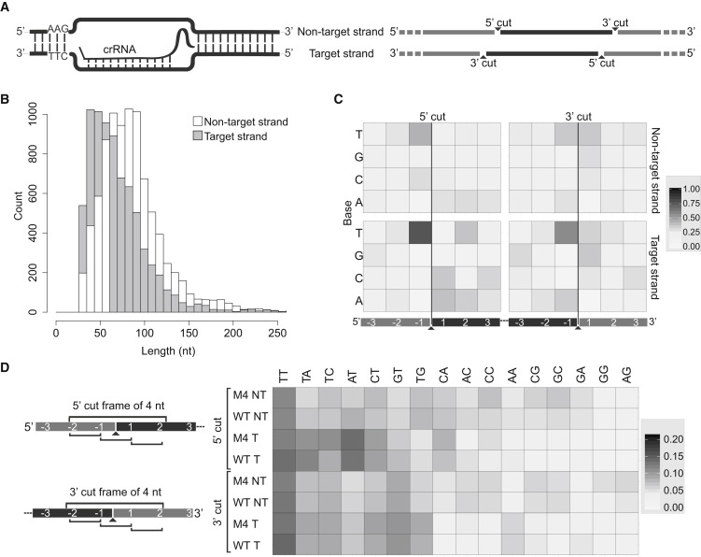
Cas3 Cleavage Is Sequence Specific for Thymine Stretches

Slide 7


Slide 8

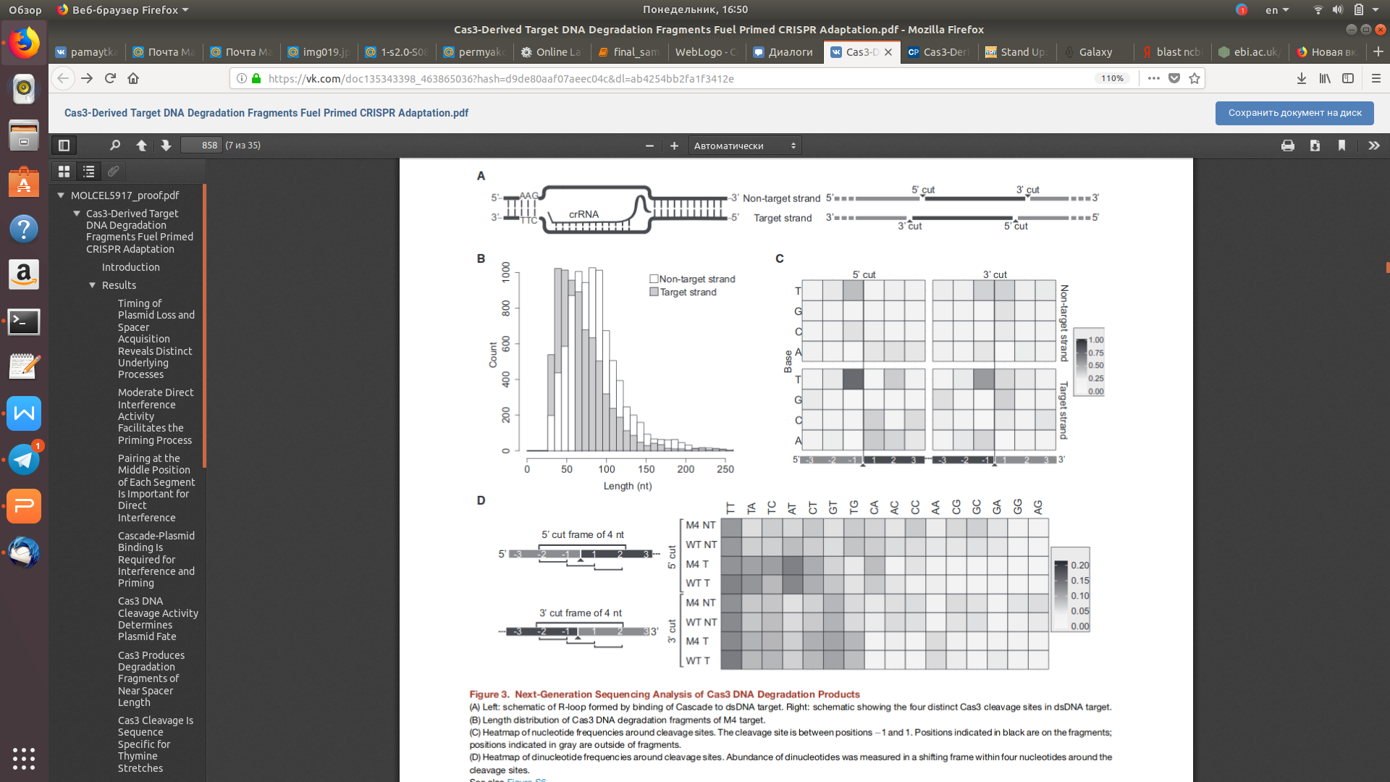
HMMMMM....
Plasmid Assembly
A lot of AAA... and TTT... bases at th end of contigs (may be adapter?)
This ------>>>>

Slide 9
Our goals:
To make plasmid assembly
To compare our plasmid with their
To determine qualitative structure of restriction sites
To compare it with their dates

Slide 10
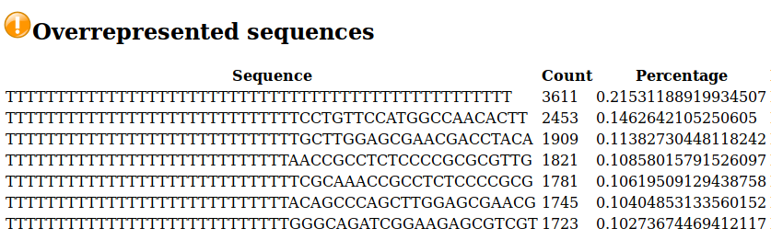
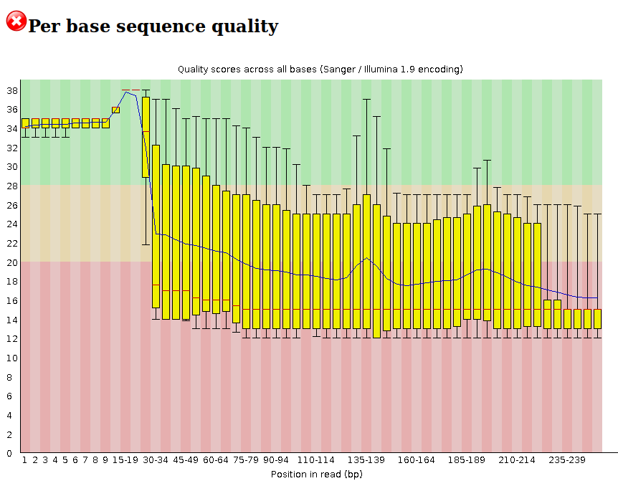
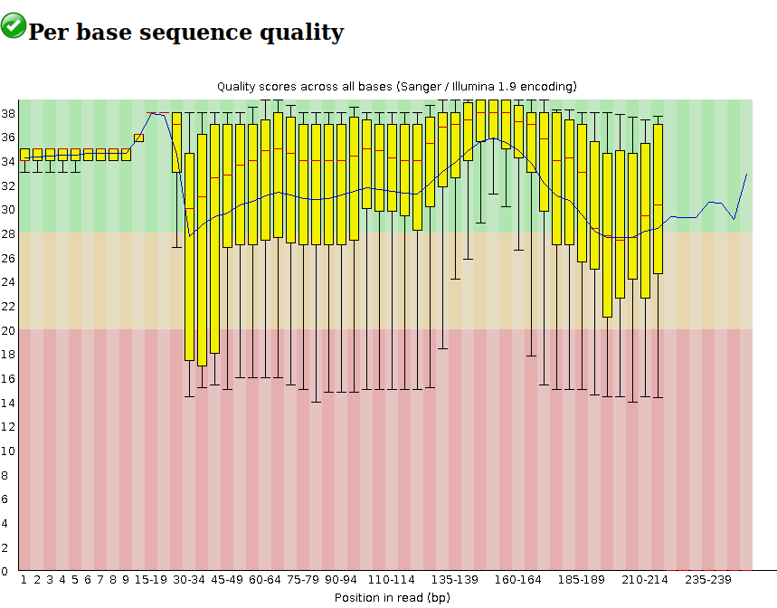
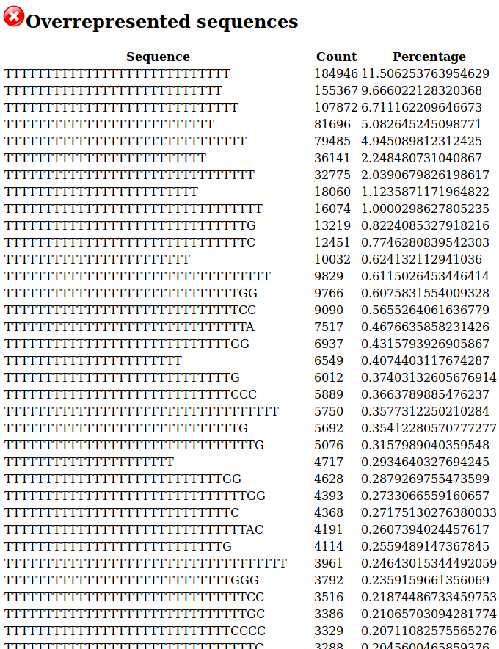
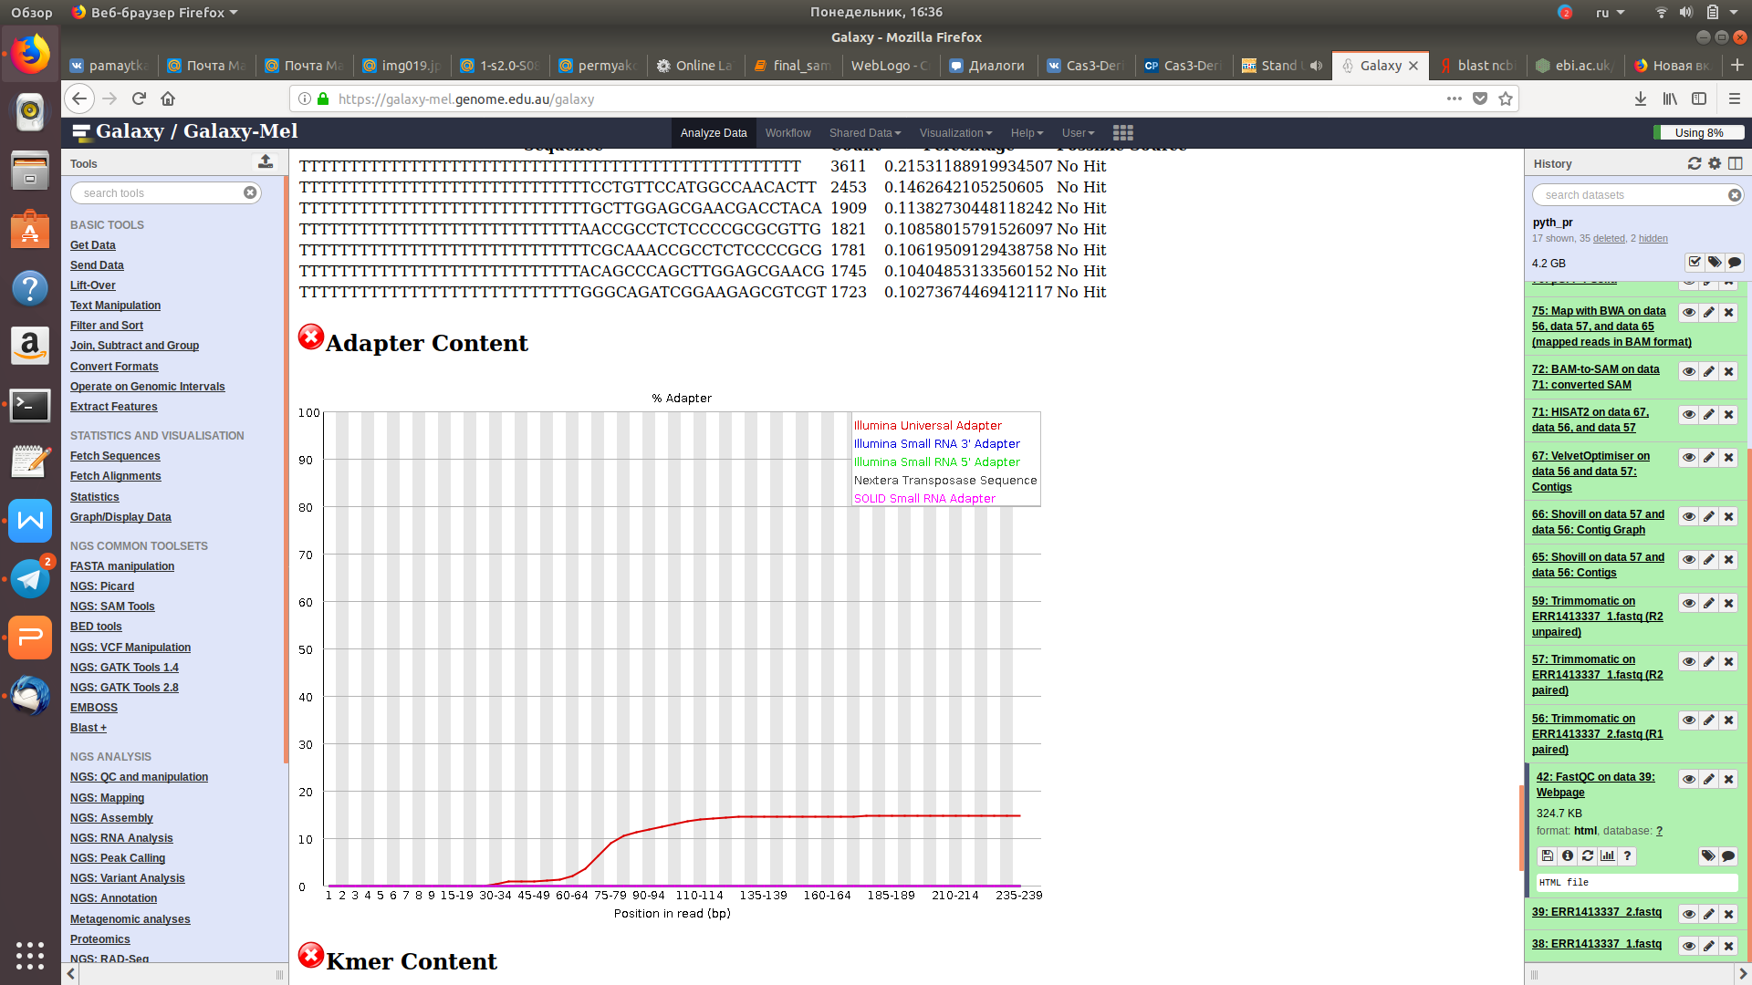
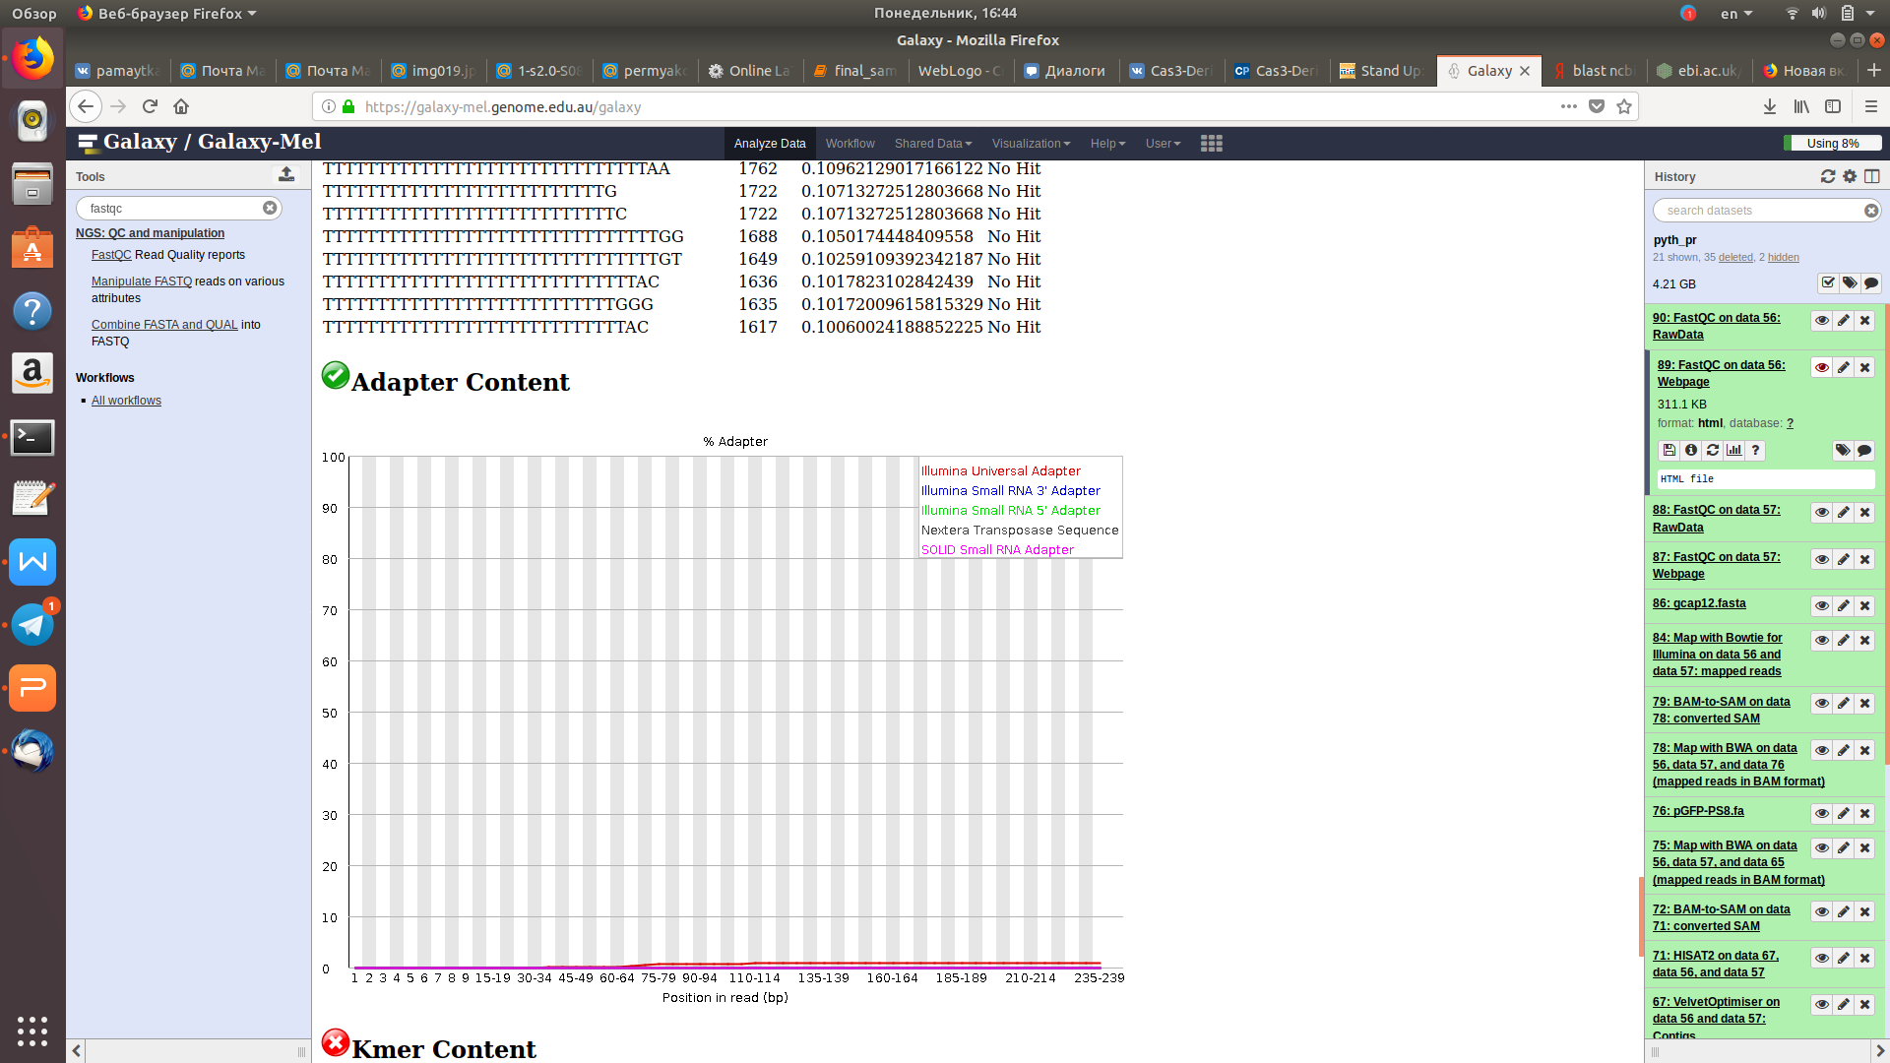
Before/After

Slide 11
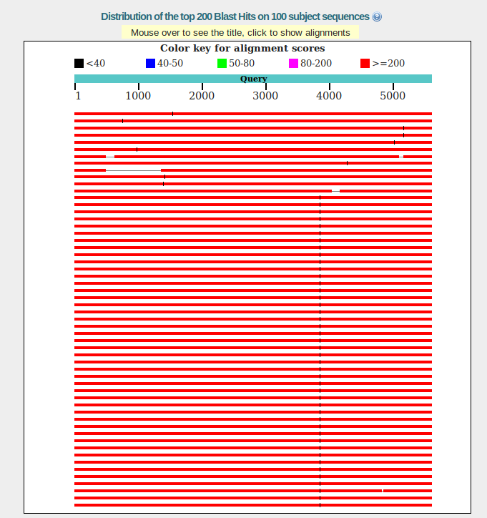
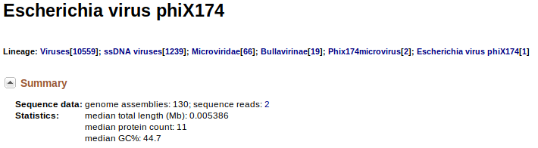
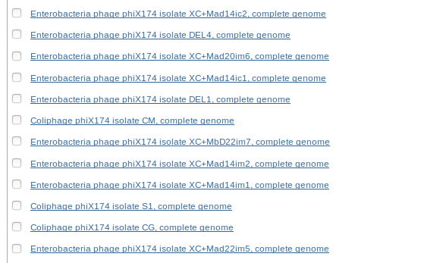
Running BLAST

Slide 12
Niceties
for target chain
# 2|-----> *
# <!-----|1 non target
for non-target chain
#2|-----!>
# * <------|1

Slide 13
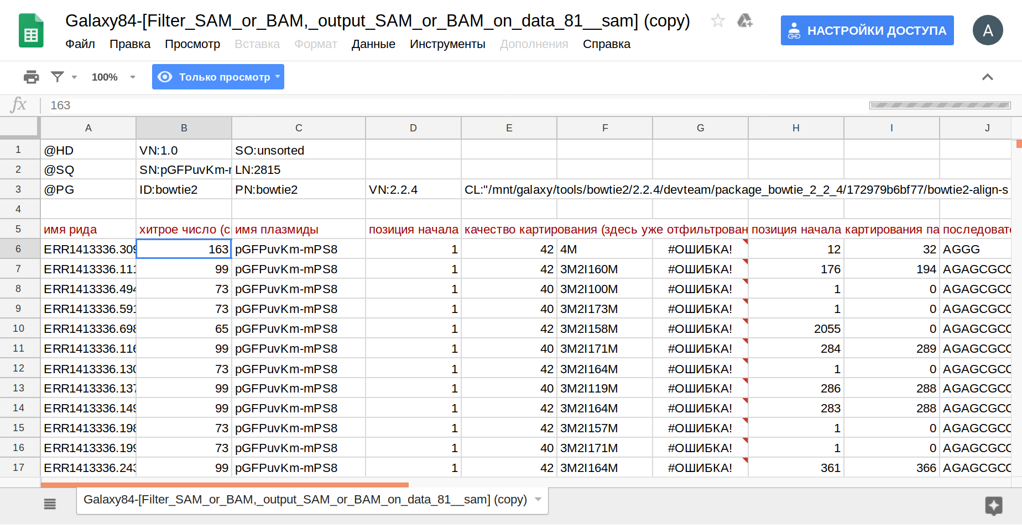
10100011 |

Slide 14
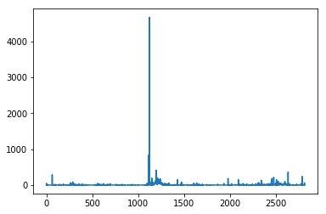
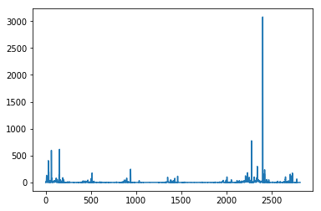
The link between position and number the reads ends fall. target(left) and non target(right)
number of reads
position
position

Slide 15
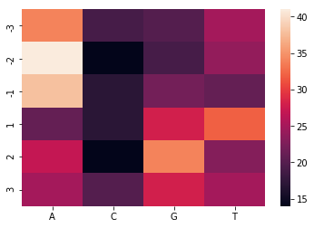
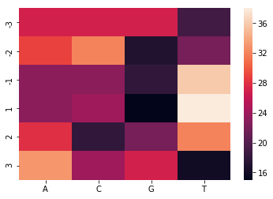
^ their | <<<<-------our
5' cut
target
non-target

Slide 16
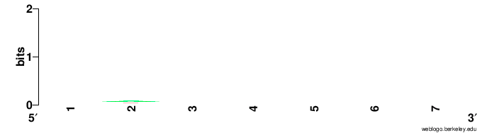

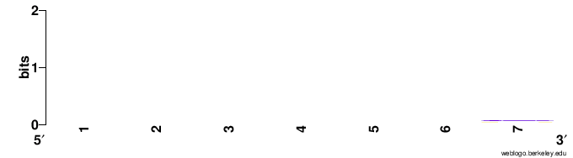
Attempt to create Logo
target
non-target

Slide 17
Conclusions
Reads were bad and dirty
It was impossible to make plasmid assembly and plasmid wasn't in article
Our heatmaps don't illustrate results obtained in the article

