Slide 1
Coming to a Computing Consensus
Braeden Van Deynze, Christie Bahlai, Chad Zirbel
LTER All Scientists’ Meeting 2018
October 2nd, 2018
Pacific Grove, CA

Slide 2

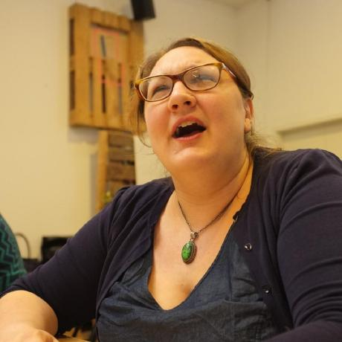
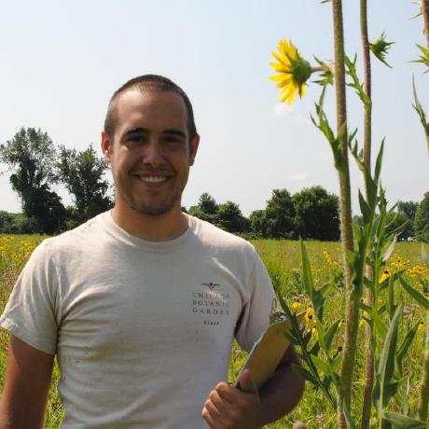
Who We Are
Braeden Van Deynze
Grad Student
Michigan State
Christie Bahlai
Asst. Professor
Kent State
Chad Zirbel
Post Doc
Minnesota

Slide 3
Today’s Outline
Challenges in Collaboration
Web-Based Collaboration Tools
Reflect on Past Experiences
Develop The N Commandments of Collaborative Computing
Goal: Explore solutions to the challenges of modern, data-intensive collaborative projects over long-distances

Slide 4
Challenges of Collaboration
What conditions are necessary for collaboration?

Slide 5
Challenges of Collaboration
What conditions are necessary for collaboration?
Willing participants
A shared goal
Communication
Commitment

Slide 6
Challenges of Collaboration
What additional challenges does cross-site LTER research introduce?

Slide 7
Challenges of Collaboration
What additional challenges does cross-site LTER research introduce?
Consistent communication and goals across…
Distance
Time
Cultural differences across…
Sites
Disciplines

Slide 8

GitHub
A Digital Collaboration Tool

Slide 9
GitHub Slide Content Placeholder

Slide 10
Small Group Discussions
Learning from Past Collaborations

Slide 11
Small Group Discussions
What you’ll need…
Some people to talk with
Some notetaking technology (e.g., pen and paper, laptop, tablet)
What we’ll do…
Reflect on past collaborative experiences
Gather anecdotal evidence to support The N Commandments of Collaborative Computing
Focus on digital aspects and tools that worked (or not)

Slide 12
Part 1: Introductions
Share…
Institution and LTER site
Role (e.g., professor, postdoc, grad student, etc.)
Research area

Slide 13
Part 2: Reflecting Back
Think…
Blah
Blah
Share…

Slide 14
Part 3: Looking Forward
Think…
Blah
Blah
Share…

Slide 15
Consensus Building
Developing The N Commandments

