Slide 1
Coming to a Computing Consensus
Braeden Van Deynze, Christie Bahlai, Chad Zirbel
LTER All Scientists’ Meeting 2018
October 2nd, 2018
Pacific Grove, CA

Slide 2

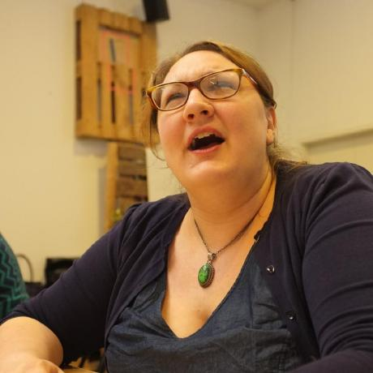
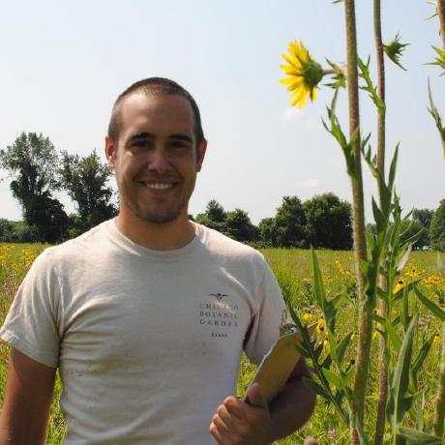
Who We Are
Braeden Van Deynze
Grad Student
Michigan State
Christie Bahlai
Asst. Professor
Kent State
Chad Zirbel
Post Doc
Minnesota

Slide 3
Today’s Outline
Challenges in Collaboration
Web-Based Collaboration Tools
Reflect on Past Experiences
Develop The N Commandments of Collaborative Computing
Goal: Explore solutions to the challenges of modern, data-intensive collaborative projects over long-distances

Slide 4
Challenges of Collaboration
What conditions are necessary for collaboration?

Slide 5
Challenges of Collaboration
What conditions are necessary for collaboration?
Willing participants
A shared goal
Communication
Commitment

Slide 6
Challenges of Collaboration
What additional challenges does cross-site LTER research introduce?

Slide 7
Challenges of Collaboration
What additional challenges does cross-site LTER research introduce?
Consistent communication and goals across…
Distance
Time
Cultural differences across…
Sites
Disciplines

