Slide 1
Coming to a Computing Consensus
Braeden Van Deynze, Christie Bahlai, Chad Zirbel
LTER All Scientists’ Meeting 2018
October 2nd, 2018
Pacific Grove, CA

Slide 2

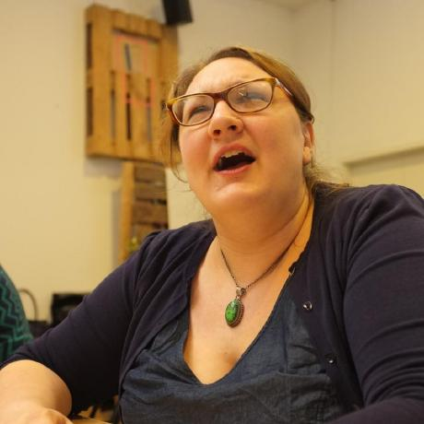
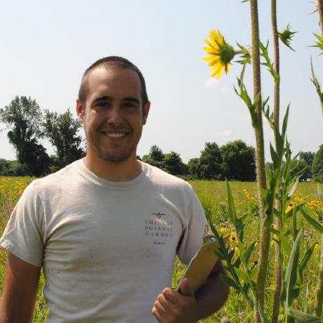
Who We Are
Braeden Van Deynze
Grad Student
Michigan State
Christie Bahlai
Asst. Professor
Kent State
Chad Zirbel
Post Doc
Minnesota

Slide 3
Today’s Outline
Challenges in Collaboration
Web-Based Collaboration Tools
Reflect on Past Experiences
Develop The N Commandments of Collaborative Computing
Goal: Explore solutions to the challenges of modern, data-intensive collaborative projects over long-distances

Slide 4
Challenges of Collaboration
What conditions are necessary for collaboration?

Slide 5
Challenges of Collaboration
What conditions are necessary for collaboration?
Willing participants
A shared goal
Communication
Commitment

Slide 6
Challenges of Collaboration
What additional challenges does cross-site LTER research introduce?

Slide 7
Challenges of Collaboration
What additional challenges does cross-site LTER research introduce?
Consistent communication and goals across…
Distance
Time
Cultural differences across…
Sites
Disciplines

Slide 8

GitHub
A Digital Collaboration Tool

Slide 9
What is Github?
The repo
What is a pull request?
What is a fork?
Using the issues page?

Slide 10
Some examples

Slide 11
What are the pros of Github?
Discuss in groups (x minutes)

Slide 12
What are the cons of Github?
Discuss in groups (x minutes)

Slide 13
Resources for learning more

Slide 14
GitHub Slide Content Placeholder

Slide 15
Small Group Discussions
Learning from Past Collaborations

Slide 16
Small Group Discussions
What you’ll need…
Some people to talk with
Some notetaking technology (e.g., pen and paper, laptop, tablet)
What we’ll do…
Reflect on past collaborative experiences
Gather anecdotal evidence to support The N Commandments of Collaborative Computing
Focus on digital aspects and tools that worked (or not)

Slide 17
Part 1: Introductions
Share…
Institution and LTER site
Role (e.g., professor, postdoc, grad student, etc.)
Research area

Slide 18
Part 2: Reflecting Back
Think…
Blah
Blah
Share…

Slide 19
Part 3: Looking Forward
Think…
Blah
Blah
Share…

Slide 20
Consensus Building
Developing the N Commandments

