Slide 1
Coming to a Computing Consensus
Braeden Van Deynze, Christie Bahlai, Chad Zirbel
LTER All Scientists’ Meeting 2018
October 2nd, 2018
Pacific Grove, CA

Slide 2

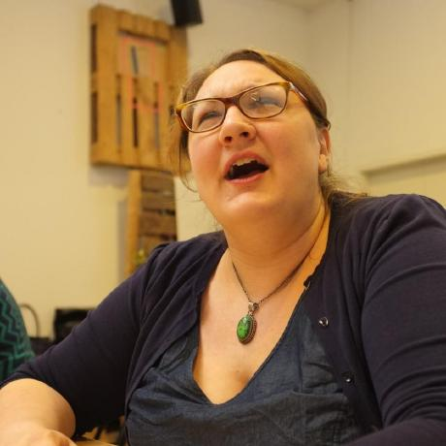
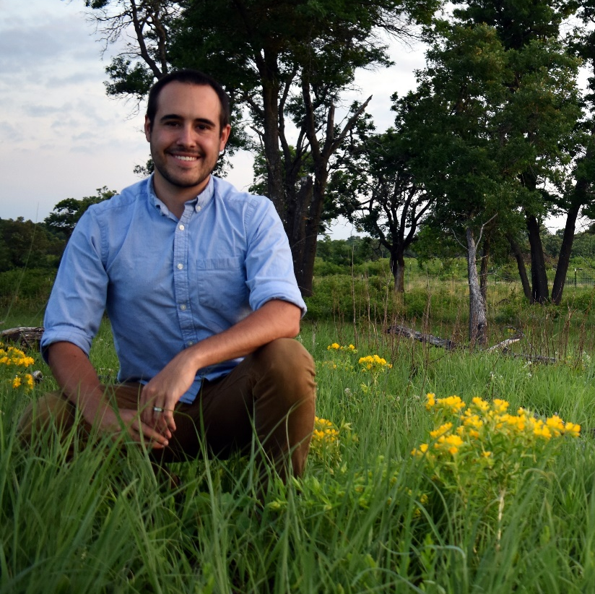
Who We Are
Braeden Van Deynze
Grad Student
Michigan State
Christie Bahlai
Asst. Professor
Kent State
Chad Zirbel
Post Doc
Minnesota

Slide 3
Today’s Outline
Challenges in Collaboration
Web-Based Collaboration Tools
Reflect on Past Experiences
Develop The N Commandments of Collaborative Computing
Goal: Explore solutions to the challenges of modern, data-intensive collaborative projects over long-distances

Slide 4
Challenges of Collaboration
What conditions are necessary for collaboration?

Slide 5
Challenges of Collaboration
What conditions are necessary for collaboration?
Willing participants
A shared goal
Communication
Commitment

Slide 6
Challenges of Collaboration
What additional challenges does cross-site LTER research introduce?

Slide 7
Challenges of Collaboration
What additional challenges does cross-site LTER research introduce?
Consistent communication and goals across…
Distance
Time
Cultural differences across…
Sites
Disciplines

Slide 8

GitHub
A Digital Collaboration Tool

Slide 9
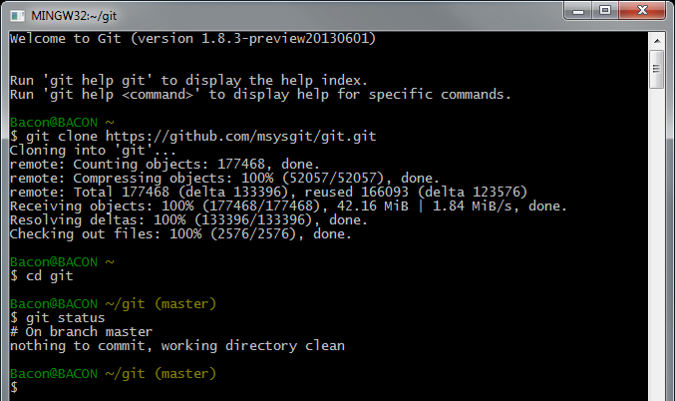
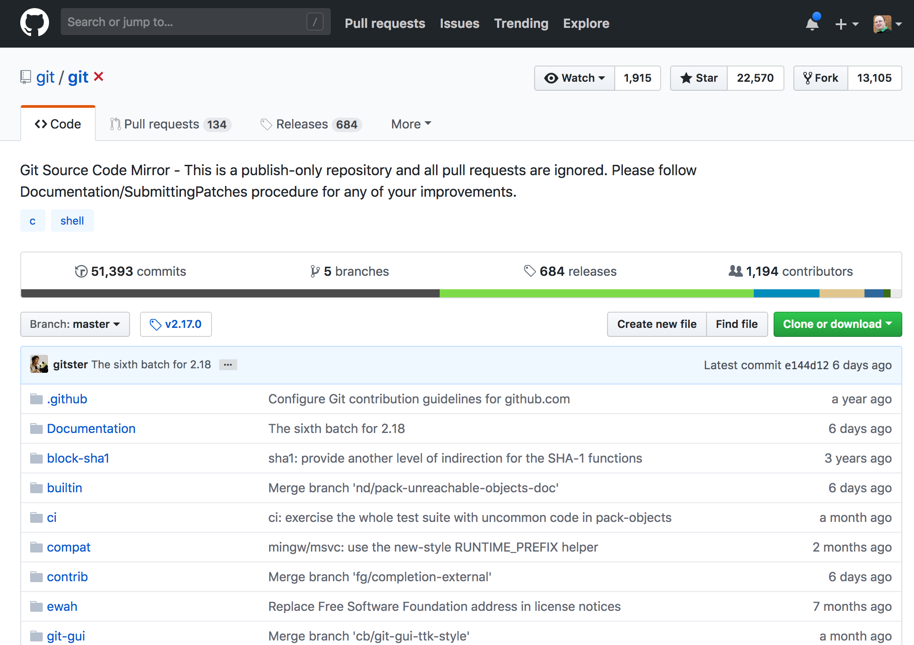

What is Git/ Github?
Git is a command line language for version control
Git is running in the background when you use Github
Github is a web/desktop interface for version control
Free hosting service that allows you to work collaboratively online

Slide 10
What is Git/ Github?
Git is a command line language for version control
Git is running in the background when you use Github
Github is a web/desktop interface for version control
Free hosting service that allows you to work collaboratively online
You can use Github without knowing Git or how to use the command line
Today we will focus on Github and Github desktop

Slide 11
The repo (repository)
The home for your project
All of the files are stored here (including old versions)
Files in the repo are stored both locally and on Github

Slide 12
Version control
Track changes to a file
go back to previous versions of a file
Merge/resolve conflicting versions of a file

Slide 13
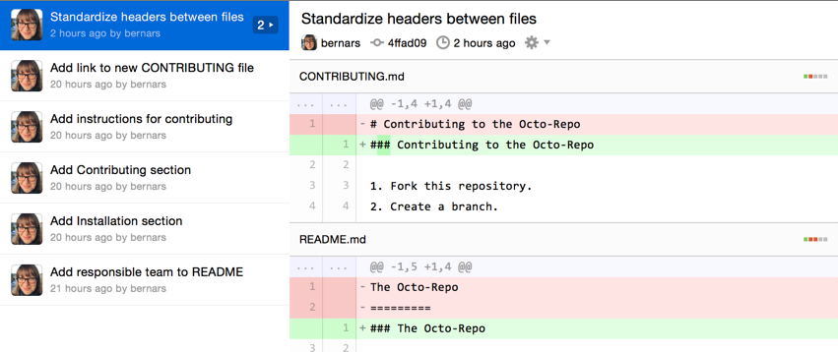
Commit
save of a version of a file.

Slide 14
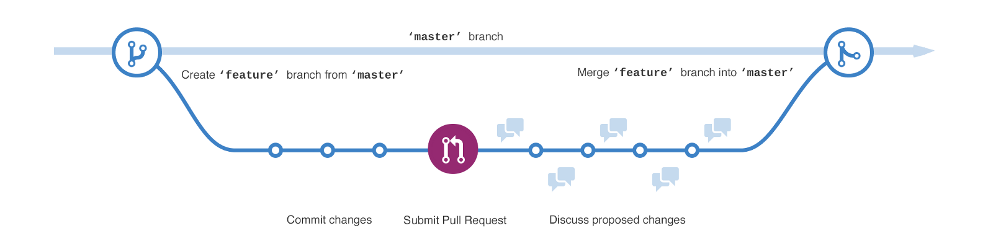
Branch/Merge
Try new things without messing up a project
Make code better without breaking existing code

Slide 15
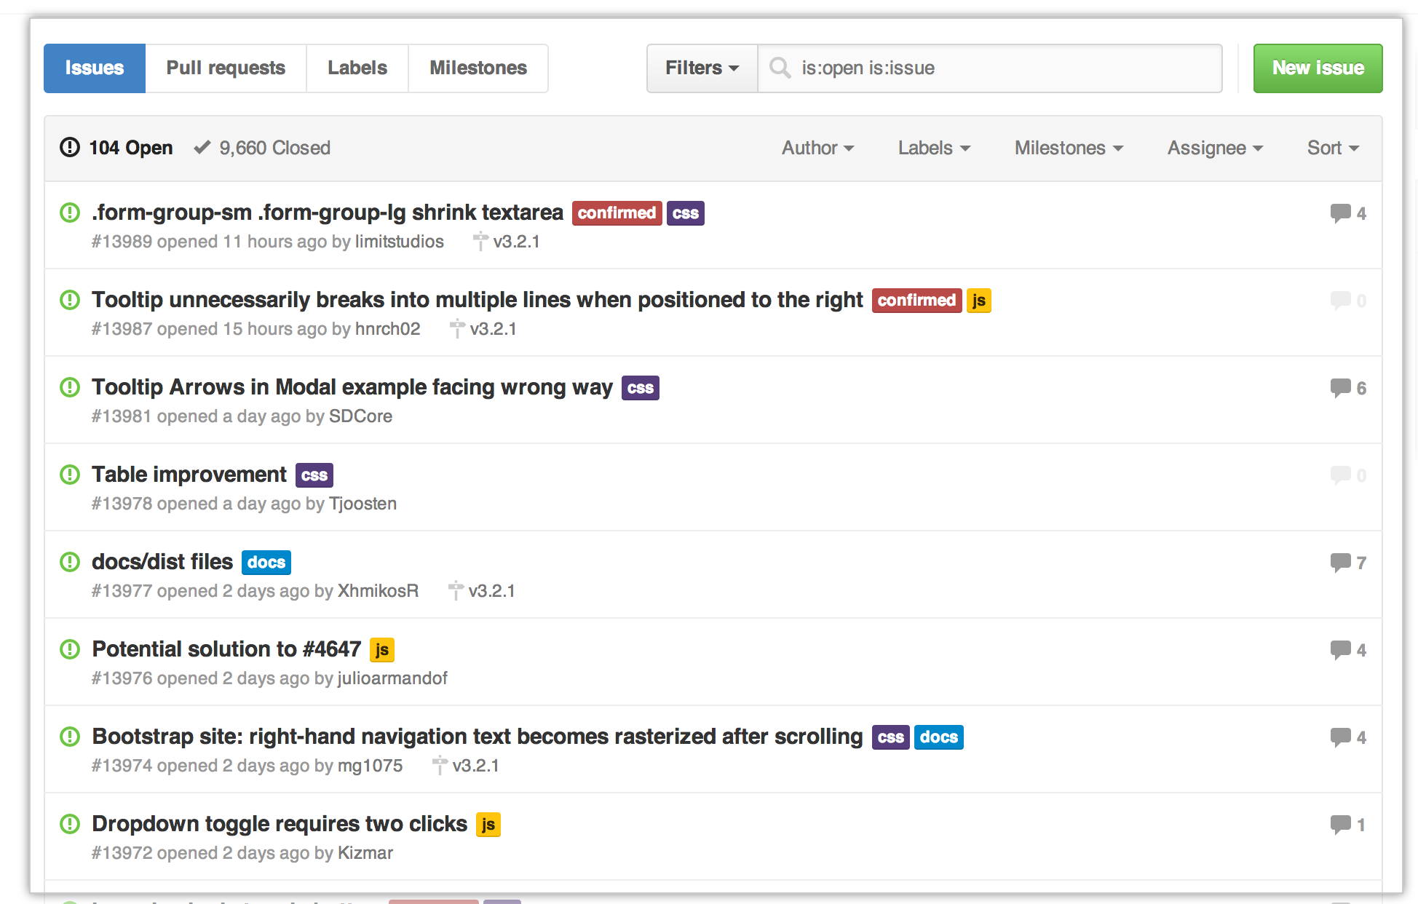
Issues
To-do list for the project
Bugs that need fixing
Tasks needed to be done
Future plans
Can assign issues to collaborators (or yourself)
Can label issues for certain parts of the project

Slide 16
Forking/Pull requests
Make a copy of a repository
Make changes
re-deploy as a different project
Create a different/better version of the current repo
Currently hidden slide. Maybe more than we want to get into

Slide 17

Using Github for collaboration
A few scenarios that sound familar

Slide 18
Multiple people working on the same files
The multiple conflicting versions monster

Slide 19
Version control and merge conflict resolution

Slide 20




20 tasks to do, 3 people working on the project, and no common to-do list
Who is doing what?

Slide 21
Using issues

Slide 22
Try something new without messing up your project.

Slide 23
Using branches and merge

Slide 24
What are the pros of Github?
Discuss in groups (x minutes)

Slide 25
What are the cons of Github?
Discuss in groups (x minutes)

Slide 26
Resources for learning more

Slide 27
Small Group Discussions
Learning from Past Collaborations

Slide 28
Small Group Discussions
What you’ll need…
Some people to talk with
Some notetaking technology (e.g., pen and paper, laptop, tablet)
What we’ll do…
Reflect on past collaborative experiences
Gather anecdotal evidence to support The N Commandments of Collaborative Computing
Focus on digital aspects and tools that worked (or not)

Slide 29
Part 1: Introductions
Share…
Institution and LTER site
Role (e.g., professor, postdoc, grad student, etc.)
Research area

Slide 30
Part 2: Reflecting Back
Think…
What was the goal of the project (e.g., a paper, a novel dataset, a grant proposal, an outreach program, etc.)?
How many people were involved? What kind of people (e.g., interdisciplinary, different career stages, different technical expertise, etc.)?
Was the group based in one location? How long did the collaboration last?
Share…

Slide 31
Part 3: Looking Forward
Think…
What tools, resources, or workflows do you consider necessary for a successful collaboration?
What can be done to more easily facilitate the use of these tools throughout a project’s lifecycle?
Share…

Slide 32
Consensus Building
Developing the N Commandments

Slide 33
What Consensus Is
Everyone’s opinions are heard and encouraged
Differences viewed as helpful, chances to learn more
Everyone can understand the result and how it was reached

Slide 34
What Consensus Is Not
Unanimous agreement on end product
Conflict is avoided, ignored
Result is everyone's first choice

Slide 35
Consensus Process
Stage 1: Share ideas
Stage 2: Review ideas

