Slide 1

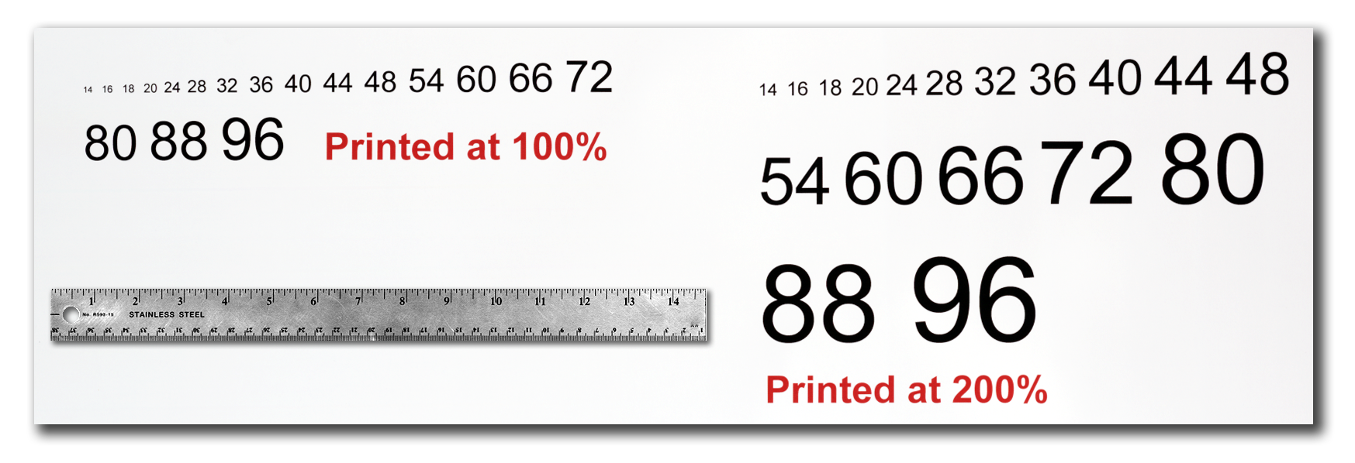



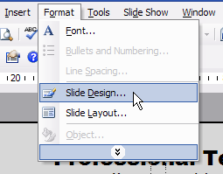
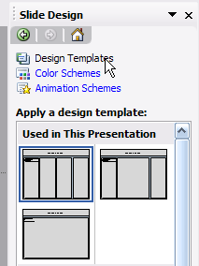
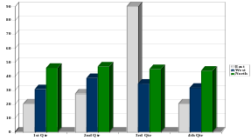
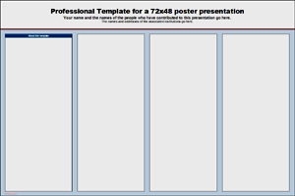
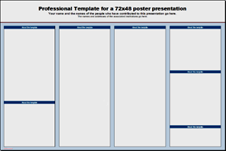

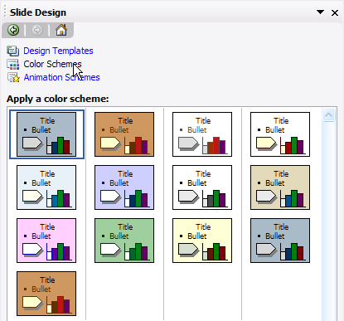


OPTIONAL
LOGO HERE
Professional Template for a 72x36 poster presentation
Your name and the names of the people who have contributed to this presentation go here.
The names and addresses of the associated institutions go here.
OPTIONAL
LOGO HERE
About this template
Text Sizes
Importing Photographs
Research Poster Design Services
This template was designed to produce a 72x36 poster.
You can modify it as needed for your presentation before you send it back to PosterPresentations.com for premium quality, same day (rush-free) affordable printing.
By using this template poster will look professional, easy to read and save you valuable time from figuring out proper placement of titles, subtitles and text body.
For poster design beginners we have included many helpful tips you can find on the poster template itself.
For better understanding of the poster-making process, we have also added a series of helpful online tutorials that will guide you through the poster design process and answer most of your poster production questions.
You can access the online tutorials from our HelpDesk page at:
http://www.posterpresentations.com/html/helpdesk.html
(copy and paste this link to your browser or press the F5 key on you keyboard and click on the link)
For further assistance and to order your printed poster call PosterPresentations.com at 1.866.649.3004.
For this template we use the Arial font family at several recommended text sizes. You can use any typeface you like and at any size but try to stay close to the suggested limits.
Figure 4 gives a visual reference of what different font sizes look like when printed at 100% and at 200%.
Due to a page size limitation in PowerPoint and unless your poster is going to be less than 56” in length, all the work done on this template is at half the size of the final poster. For example, if you choose a 21 point font for this poster, the actual printed size will appear as 42 points.
It is highly recommended to use the largest images you have access to for your poster. Avoid images downloaded from the web and avoid copying and pasting images instead of using the “Insert” command. To insert an image to your poster go to INSERT>PICTURE>FROM FILE (Figure 9).
Are you too busy or somewhat “PowerPoint-challenged” and would you like to have your poster presentation professionally designed, printed and delivered on time for your meeting?
We’ll be happy to provide you with our expertise.
All you would need is to email us the following:
  A Word document with all your text or your multi-page PowerPoint document.
  Your logos, photos, charts, graphs and tables.
  Your deadline!
That’s it!
Your presentation will be ready within 24 to 48 hours and a proof will be emailed to you for revisions and final approval. Once we have your approval, your poster will be printed and shipped by next day or second day FedEx to your work, home or hotel.
Call us for a free estimate. We will be happy to assist.
You can reach us toll-free at: 1-866-649-3004
Monday through Friday 9AM to 6PM PST.
(Figure 9)
When the only source of a needed photo or graphic is the Web, scaling has to be applied with caution. Scaling an image more than three times its original size may introduce pixelization artifacts. Refer to figure 10 as an example. A simple way to preview the printing quality of an image is to zoom in at 100% or 200%, depending on the final size of the poster. What you’ll see is likely what you’ll get at printing time.
Figure 4
Changing the poster’s column layout
Depending on how you layout your poster, you may want to change the column layout configuration.
For your convenience, we have included alternate master layouts. To select a different layout go to FORMAT>SLIDE DESIGN (Figure 5). The slide design pane will open. From there you can select an alternate layout (Figure 6).
Figure 10: Original image at 100%, enlarged 200% and 400%.
Poster Basics – Poster Layout
Importing Tables & Graphs
To start using this template you first need to delete most of the contents of this page. Keep the poster title and one of the blue section headers.
The cleared template should now look like in Figure 1.
After you decide how many sections you need for your poster (Introduction, Methods, Results, References, etc.), use the “copy” and “paste” commands to create as many copies of the blue section headers as needed.
Move the header copies approximately to where you think they need to be on the poster, so you can get a better sense of the overall poster layout. It will help you organize your content. See Figure 2.
You can now start adding your text.
To add text use the text tool to draw a text box starting from the left edge of a column to the right edge and start typing in your text. You can also paste the text you may have already copied from another source. See Figure 3.
Repeat the process throughout the poster as needed.
Importing tables, charts and graphs is easier than importing photos.
To import charts and graphs from Excel, Word or other applications, go to EDIT>COPY, copy your chart and come back to PowerPoint.
Go to EDIT>PASTE and paste the chart on the poster. You can scale your charts and tables proportionally by holding down the Shift key and dragging in or out one of the corners.
How to order your poster for printing
We complete and ship poster printing orders the same day they come in as long as we have your files by 12 pm Pacific Time (3 pm Eastern), Monday through Friday. Orders due the next day take priority. We do not charge rush fees for printing and our shipping rates are standard FedEx rates.
How to order your printed poster:
To order your poster go to www.posterpresentations.com
and click on “Order your poster” on the top menu. Fill in the form and send us your file by choosing one of the two options offered.
Figure 5
Figure 6
TABLE ONE
1998 | 1999 | 2000
2001 | 2002 | 2003
2004 | 2005 | 2006
Customizing the template color schemes
For those who wish to further personalize their poster presentation, we have included a number of printer-tested alternative color schemes for this poster template.
If you want to change the default colors and use your own color scheme, go to FORMAT>SLIDE DESIGN (Figure 7). The SLIDE DESIGN pane will open. Select COLOR SCHEMES (Figure 8). There, you can try different color schemes until you find the one you like.
Labeling your headers
Contact information
The blue headers are used to identify and separate the main topics of your presentation. The most commonly used headers in poster presentations are:
PosterPresentations.com a Canterbury Media Services, Inc. company
2117 Fourth Street, Studio C Berkeley, California 94710 | T: 510.649.3001 F: 510.649.0331 TF: 1.866.649.3004 E: production@cp-digital.com
A
B
Introduction, Summary or Abstract | Conclusion
Materials and Methods | Literature Cited
Result | Acknowledgements
Figure 1
Figure 2
Figure 3
Figure 7
Figure 8

