Slide 1


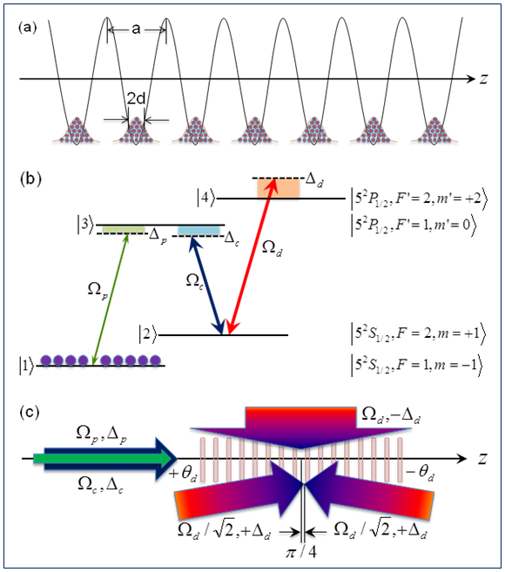

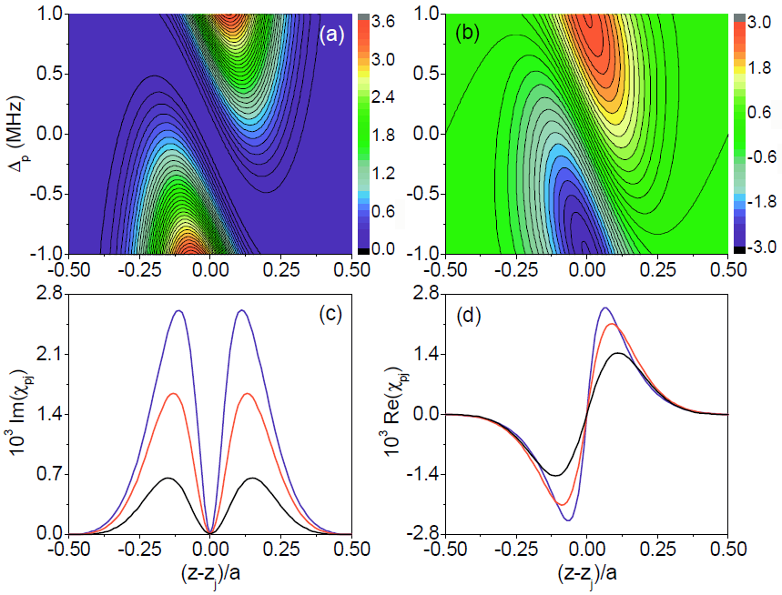
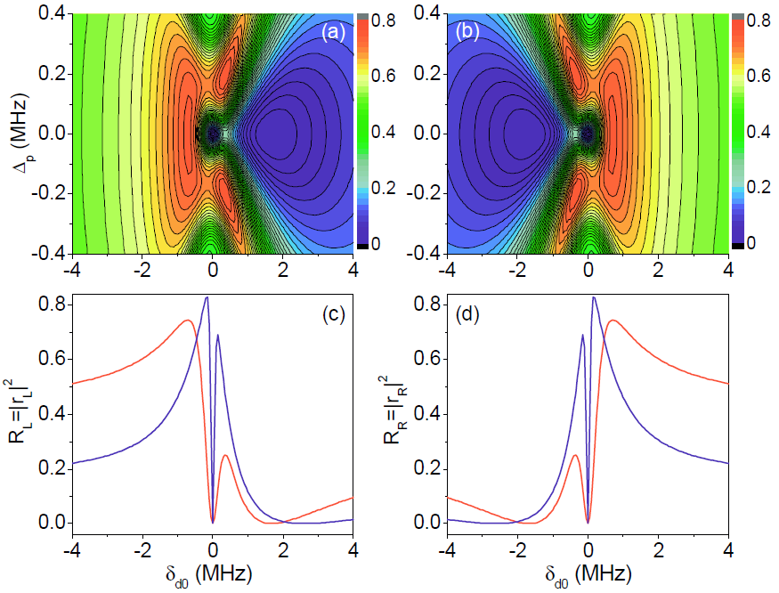
Title
XXX^{1,}*, XXX², XXX³
（¹XXX, XXX University, XXX, China）
（²XXX, XXX University, XXX, China）
（³XXX, XXX University, XXX, China）
*xxxx@xxx.edu.cn
logo of your University
INTRODUCTION
METHODS
XXX xxx, …
Xxx xxx, …
Xxx xxx, …
Fig.1. (a) Xxx xxx, … (b) Xxx xxx, …
RESULTS
Fig. 2. (a) Xxx xxx,… (b) …, …
Fig.3. (a) Xxx xxx, … (b) …, …
CONCLUSION
FUNDING
We have studied ….
This work was supported by the National Natural Science Foundation of China …
Physical Review Letters, …, …

