Slide 1

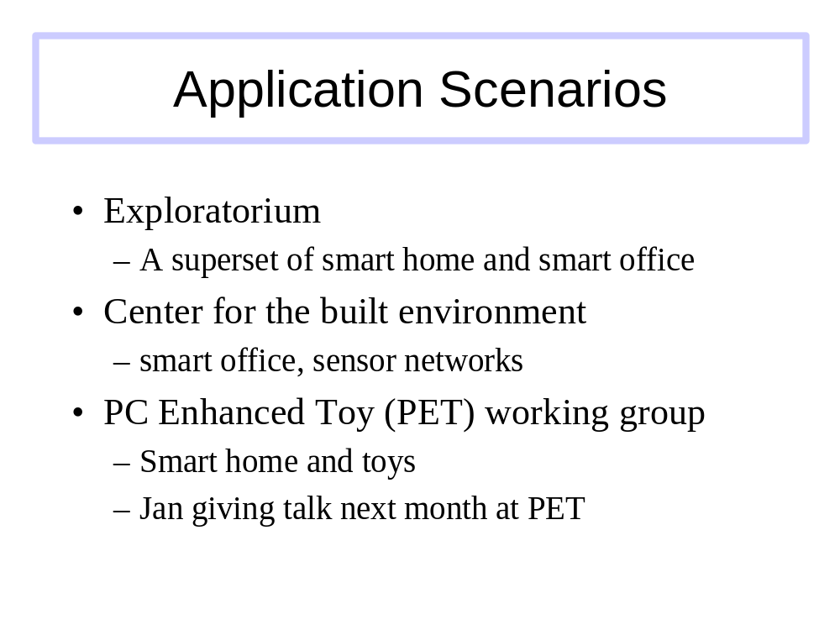
My Poster Title
Name(s), Faculty Advisor
Department, UC Campus

