Slide 1


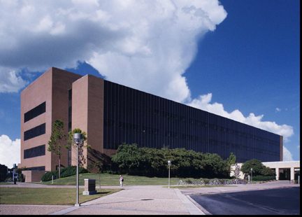
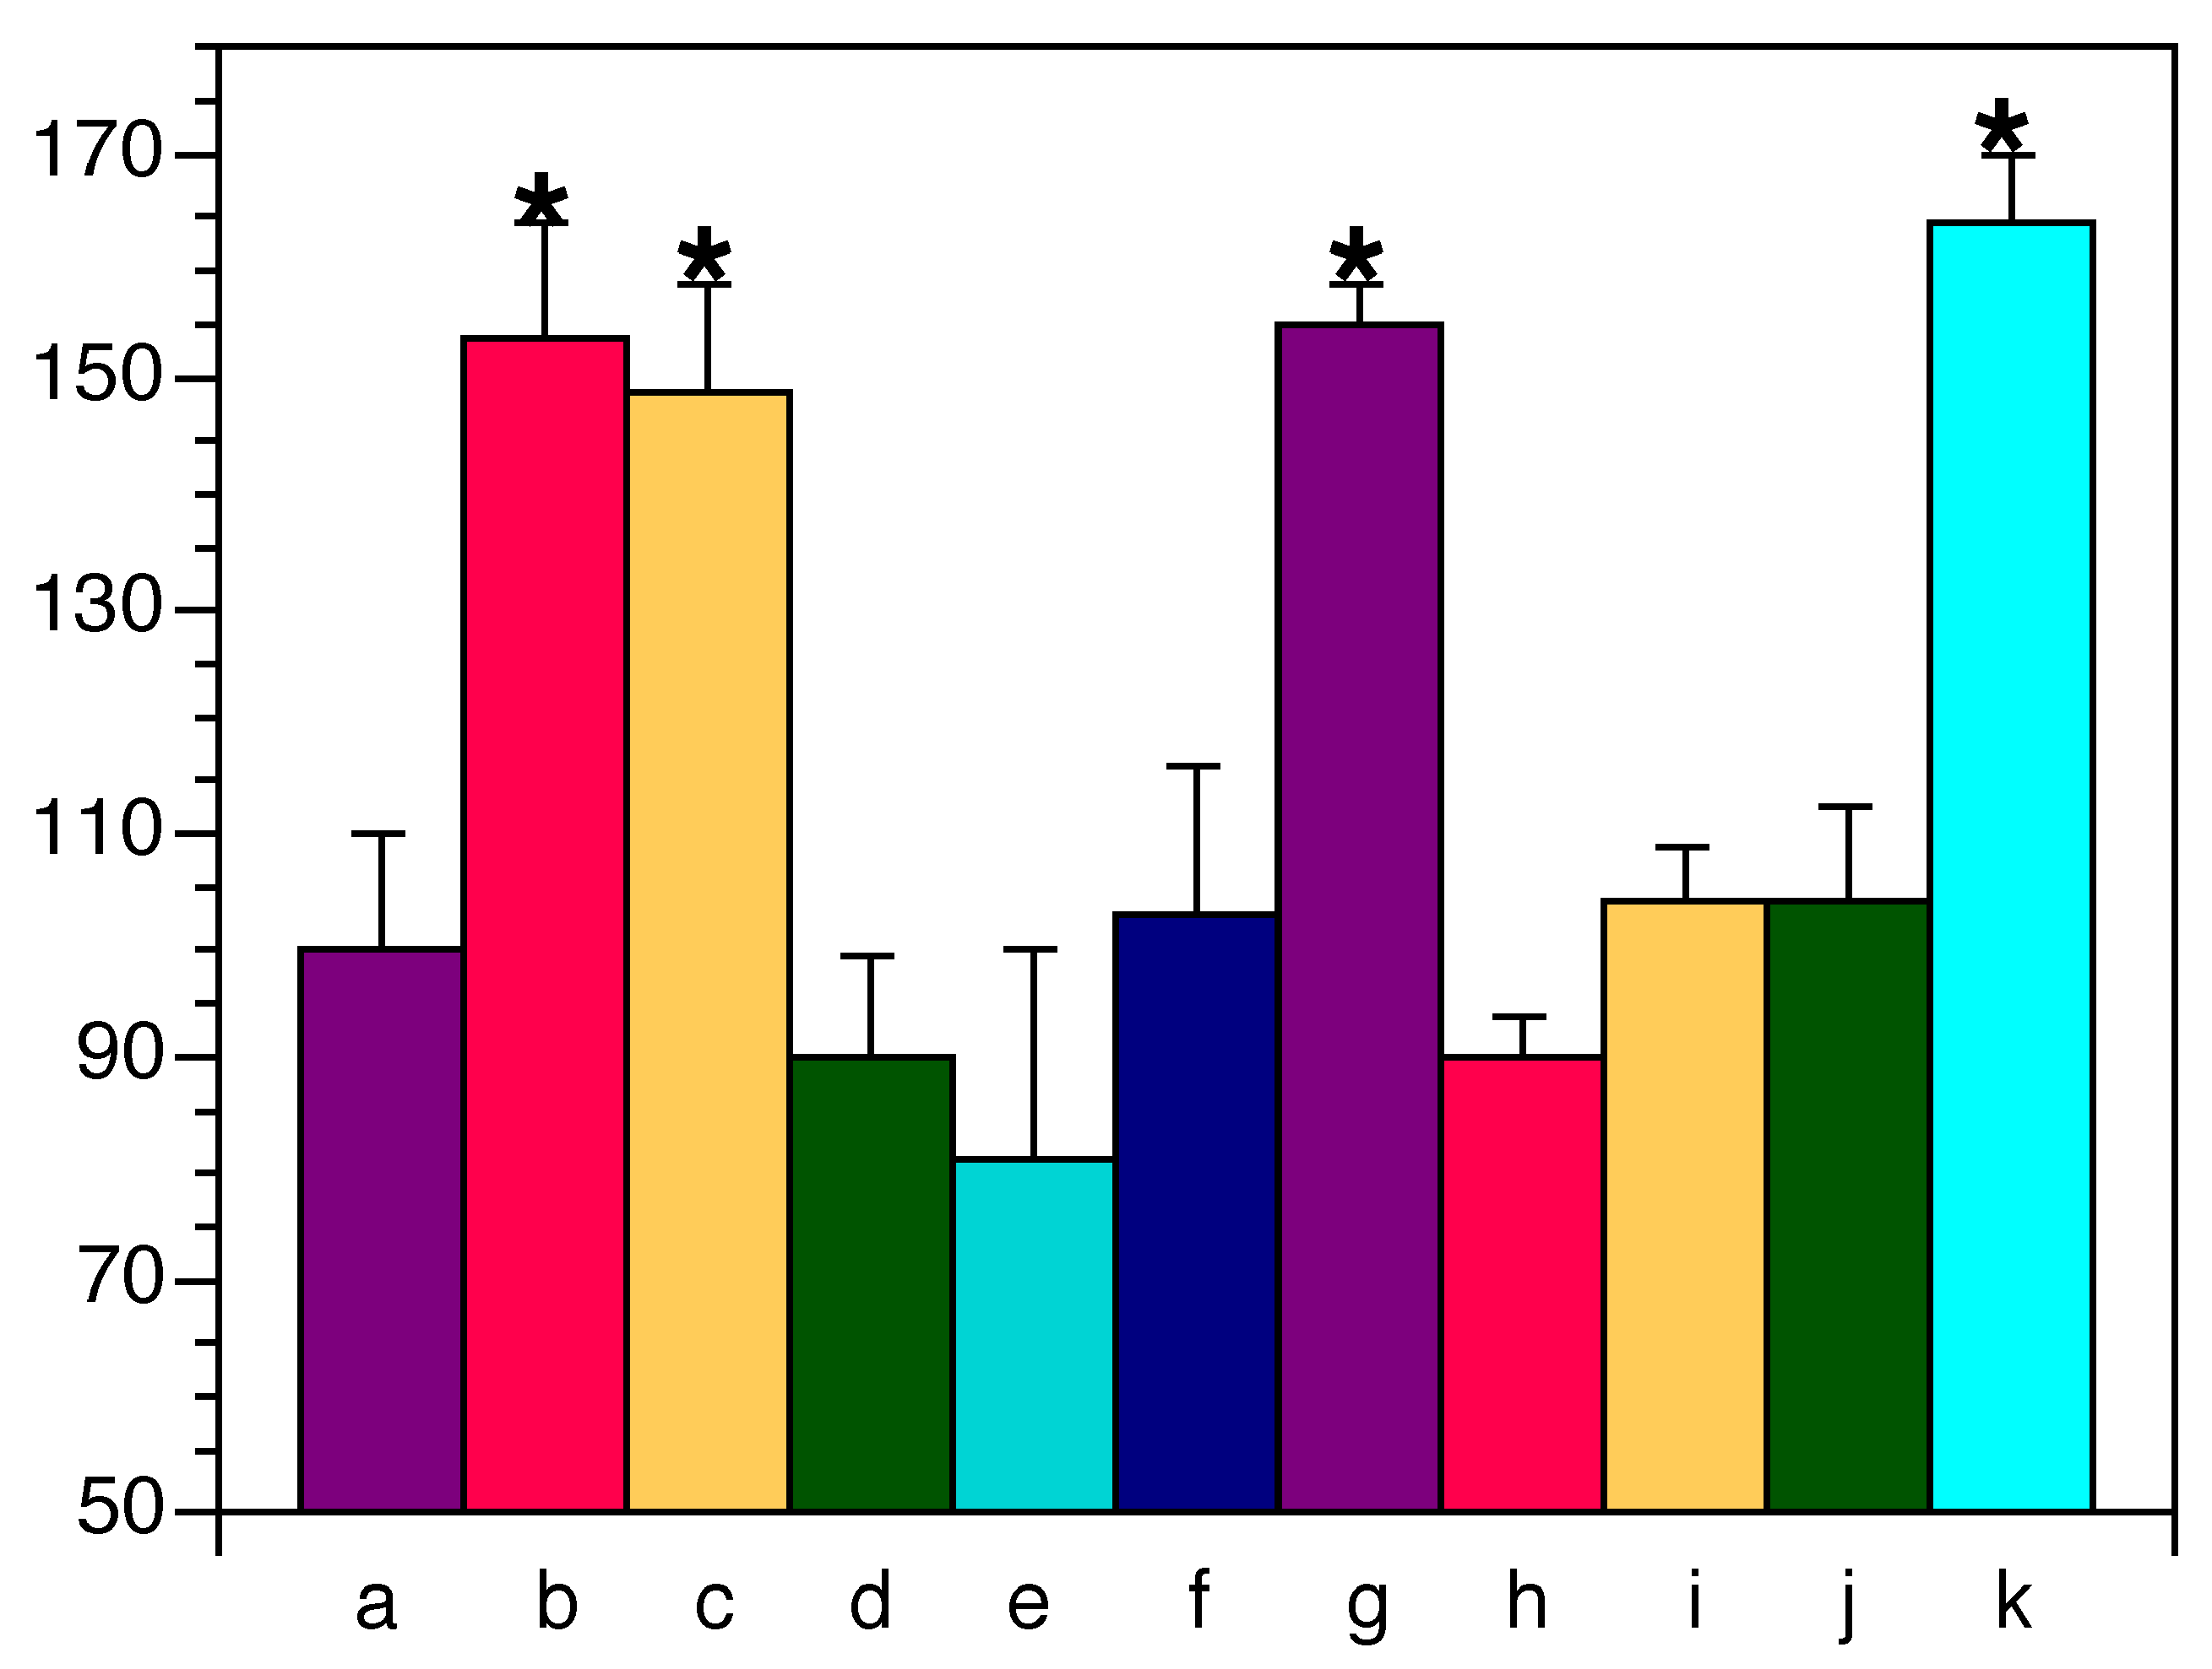
Abstract # 0000
Make the Main Title with Large Bold Type
Your Name Here
Your Department Here
Texas A&M Health Science Center
Before You Begin
Check the requirements for your meeting:
  Are there dimensional requirements for the poster?
  What is the size of the space you are going to have for presenting the poster?
  Does it need to be horizontal or vertical?
  Does the poster need to show the abstract number? If so, does it need to be part of the poster title? The abstract number for this template is in the extreme upper left hand corner above the title box.
More about Text Boxes
Right-click within the text box and select the “Format Text Box” option from the popup window. Select the tab that says “Text Box”. In this window you can set internal margins. These boxes have a half-inch (.5) margin around the bottom and sides, and a slightly smaller margin on the top.
Another option within the “Format Text Box” dialog box is text rotation. There is more about rotated text in the legend of the graph below.
Another way to get to the “Format Text” box is by choosing “Format” on the top menu bar. Under the “Format” menu are other helpful formatting features.
Other Tips
Be sure to have the formatting and drawing tool boxes turned on. These are of indispensable help in creating posters.
  Go under the “Tools” menu and select “Customize”, then select the “Toolbars” tab and make sure the drawing and formatting tools are checked.
Bullets and scientific symbols are sometimes difficult to print.
  It is advisable to use Arial or Helvetica fonts when having to use a lot of scientific symbols, and the “Symbols” font for special characters that are not included in either of the two text fonts.
  Bullets sometimes translate as different symbols between the computer and the printer. Even if they look right on screen, they sometimes “translate” wrong in the printing stage. The best way to avoid this is to make all your bullets numbers to start with, then change them to bullets later. Sounds strange, but it works.
Figure legends can be slightly smaller than the main text.
Getting Started
Choose “Page Setup” under the “File” menu and define your poster size. Typical posters are 36 x 48 or 40 x 56, but they can be any size up to 40 inches for the short measurement. This poster is 38 x 53. PowerPoint’s maximum width is 56 inches.
Under the “Format” menu choose “Background”.
Select a color from the drop-down menu, or choose “Fill Effects”, which offers many options such as gradients and textures.
Tables and Photographs
Tables, illustrations and photographs can be placed to match the text blocks. Draw a rectangle box where you want to insert the graphic element. Be sure to include figure legends. Line up text blocks and figures whenever possible, and try to maintain even spacing between blocks.
Illustrations, especially seals of institutions, can be tricky to incorporate into the poster with no background block included. It is best to use .GIF files, inserting them using the “Insert File” command. You must customize your drawing tool bar in order to use the “Set Transparent Color” tool to set the background to the color of what is behind the illustration.
When importing photographs from another program, make sure they are at least as large as you want them to appear on your poster. Enlarging the photograph using the scaling feature in PowerPoint does not work well. The image might look fine on your computer screen, but it will not always print well.
Conclusion
When you have all your elements on the poster, line them up and make sure they fit.
Make sure the spaces between your text, pictures and other elements are visually balanced. With the “Line” tool, draw guidelines in contrasting colors the length and width of your poster. Hold down the Shift key while drawing them to keep lines straight. Use these guidelines to line up the elements of your poster. When you are finished, just delete them.
Permeability (% of control)
Text Boxes
Be sure to make text large and easy to read. Headings for these text blocks are 50-point bold, and the body text is
32-point bold. The body text can be bold or normal, depending on the text you use and the amount of text in your poster. All the text in this poster is set up within white text blocks, so when you replace this text with yours, the block will expand to fit the length of your text. All the text blocks in this template can be modified, but it is best to keep a uniform width for each box.
The text boxes on this stencil are formatted with a white fill, no outline and a black shadow. A variety of other combinations can be chosen. Make sure the color of the text contrasts with the box color for easy reading.
With rotated text, such as that on the left side of this graph, use only Arial or Helvetica fonts, as not all text will print out correctly when rotated. To make sure this will not happen, it is best to insert rotated text within PowerPoint once the graph is imported into your poster file. Use the rotate text feature in the “Format Text Box” mentioned above.
References
Put your references here. They can be in slightly smaller type.
OTHER NOTES:
Only official College of Medicine and Health Science Center logos should be used. These are available via the “HSC Style Guidelines and Seal Downloads” link on the HSC website under the “News and Public Info” page.
Windows XP Version

