Slide 1
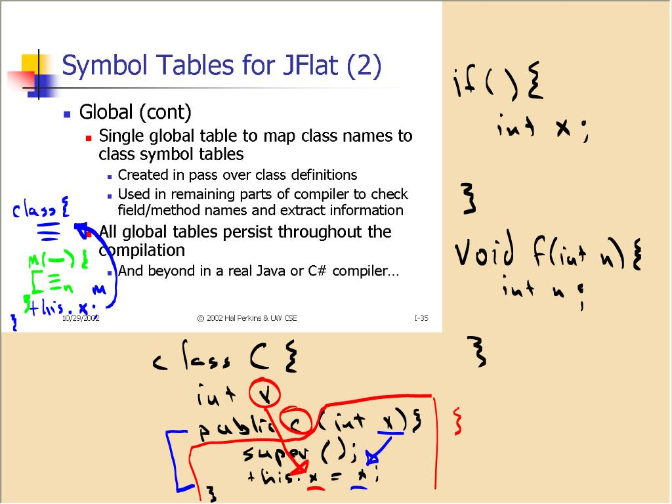
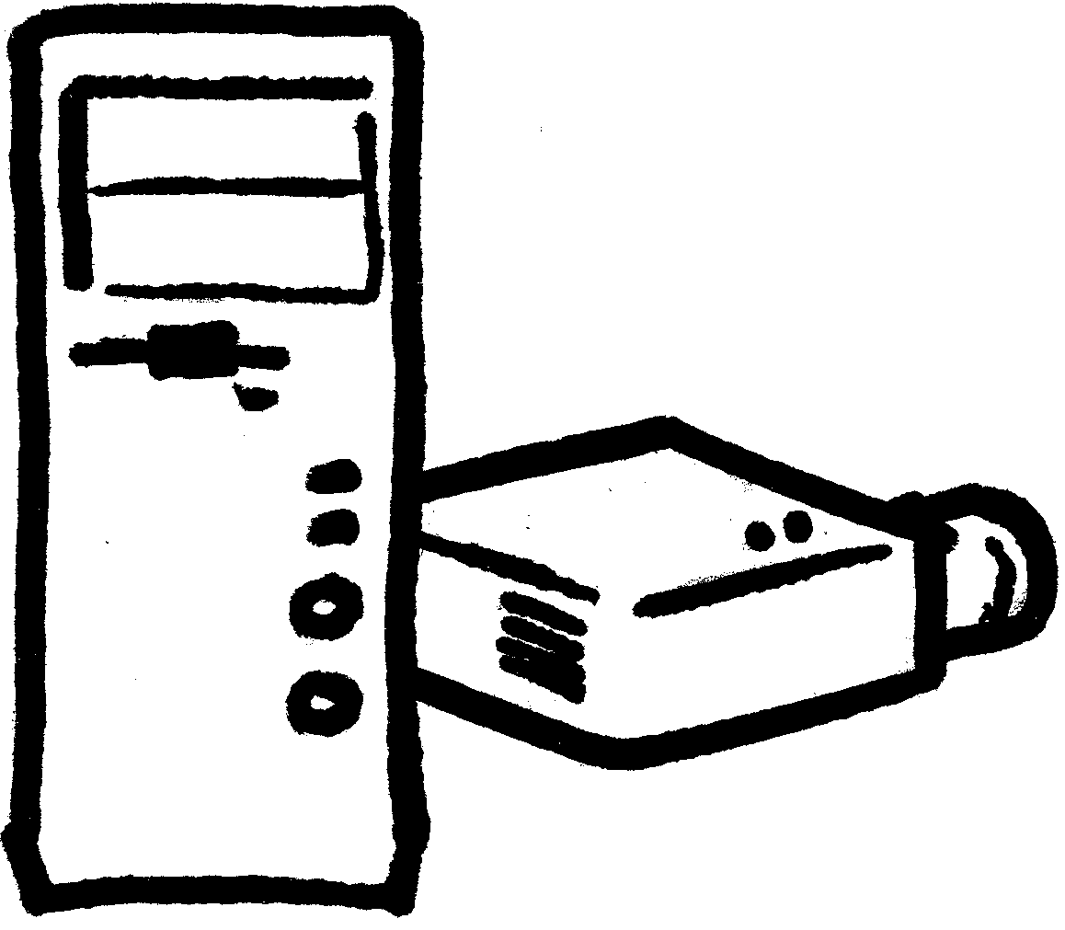


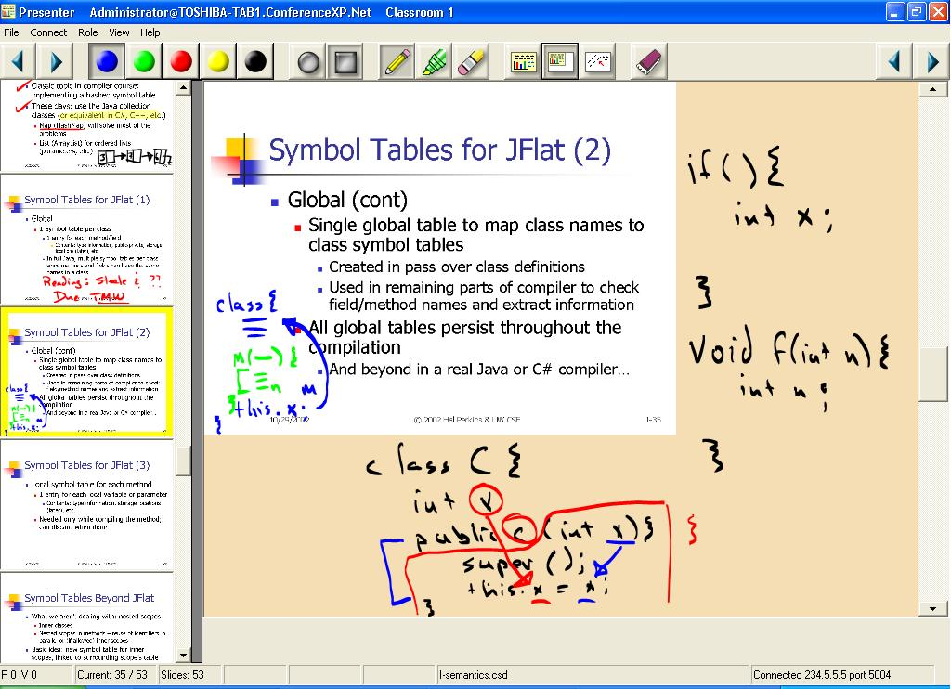

Ken Yasuhara:
important setting for printing for PDF distilling (and probably best to do for wide-body printer, too):
printer’s advanced properties ->
Graphic ->
TrueType Font: Download as Softfont
Classroom Presenter:
A Tablet PC-based Presentation System
Richard Anderson٭, Ruth Anderson, Tammy VanDeGrift٭, Steven A. Wolfman٭, and Ken Yasuhara٭
http://www.cs.washington.edu/research/edtech/
Beyond Conventional and
Computer-based Presentation
High-quality handwriting directly over slides allows instructors to extem-poraneously augment prepared slides.
Handwriting on a separate layer from the slides allows instructor to scroll off handwriting to accom-modate additional notes—“virtual mylar.”
Classroom View
Overhead projectors and whiteboards offer instructors the freedom to adapt presentations to suit the audience. Existing computer-based presentation tools such as PowerPoint are less flexible but offer advantages in preparing structured presentations with high-quality examples and illustrations.
Classroom Presenter provides novel navigation and handwriting features motivated by experience with the system in real classrooms and fully integrates the advantages of computer-based presentation systems with the flexibility of handwriting provided by conventional systems.
In-Class Studies, Iterative Design
Shrinking the current slide expands margin space for additional handwriting without losing presentation context.
Ongoing Use of Classroom Presenter
15 courses, 10 instructors, ~1400 students
Background Study
course: distance-learning cryptography
setup: PowerPoint and digitizing whiteboard
design lesson: integration of handwriting directly over slides
Background Study
course: distance-learning cryptography
setup: PowerPoint and digitizing whiteboard
System Architecture
Separation of Instructor and Classroom views allows instructor’s interface to be tailored for fast, direct access to useful features, e.g., filmstrip view and notes displayed only to the instructor.
PC driving classroom projector
Pilot Studies
courses: distance-learning databases; large, non-distance intro programming
setup: successive versions of Classroom Presenter
design lessons: separation of instructor view with handwriting and presentation controls;
value of wireless instructor device
WIRELESS
Deployment Study
course: large, non-distance intro programming
setup: Classroom Presenter
Wireless networking allows instructor to move freely about the classroom or even hand the tablet to students, e.g., to handwrite solutions to in-class exercises.
instructor with Tablet PC
Student and Instructor Response
Instructor View
Classroom Presenter has been enthusiastically received by students and instructors.
Student Responses About
Classroom Presenter
(vs. PowerPoint
& whiteboard)
In interviews, the instructor said handwriting on the Tablet PC was very natural. He said he could give more engaging presentations, because he could draw pictures and provide stimulus for the students. The instructor repeatedly mentioned to the class that he loved using Classroom Presenter, even telling them he wished he could use the system in his other courses to make them better.
Toolbar includes choices of pen color and type (marker vs. highlighter), erasing handwriting, switching to whiteboard mode.
 | less | no change | more
Attention to lecture | 4% | 39% | 57%
Understanding of lecture | 2% | 52% | 46%
Filmstrip View displays current slide in context of next and previous slides, including handwriting. Instructor can click on a slide to navigate directly to it.
Acknowledgments
Contact information
We thank the many students, teaching assistants, and instructors who provided feed-back on the system and participated in studies. We also thank innumerable colleages at our institutions and in the Microsoft Research Learning Sciences & Technology group. This work was supported in part by a grant from Microsoft Research.
Education Technology
U. of Washington, Computer Science & Engineering
Education & Educational Technology Group
http://www.cs.washington.edu/research/edtech/
٭UW CSE, Seattle, WA 98195-2350
{anderson,tammy,wolf,yasuhara}@cs.washington.edu
U. of Virginia, Computer Science, Charlottesville, VA 22904-4740
ruth@cs.virginia.edu
Classroom Presenter is available free for educational and research use:
http://www.cs.washington.edu/education/dl/presenter/

