Slide 1
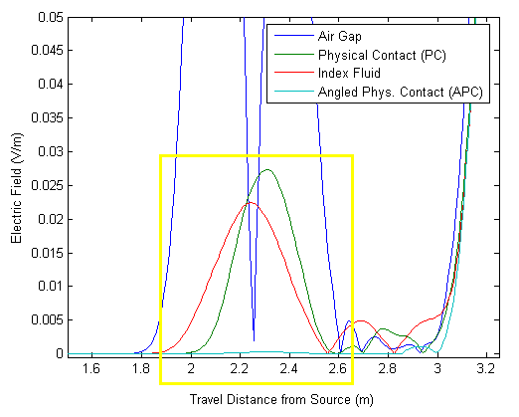
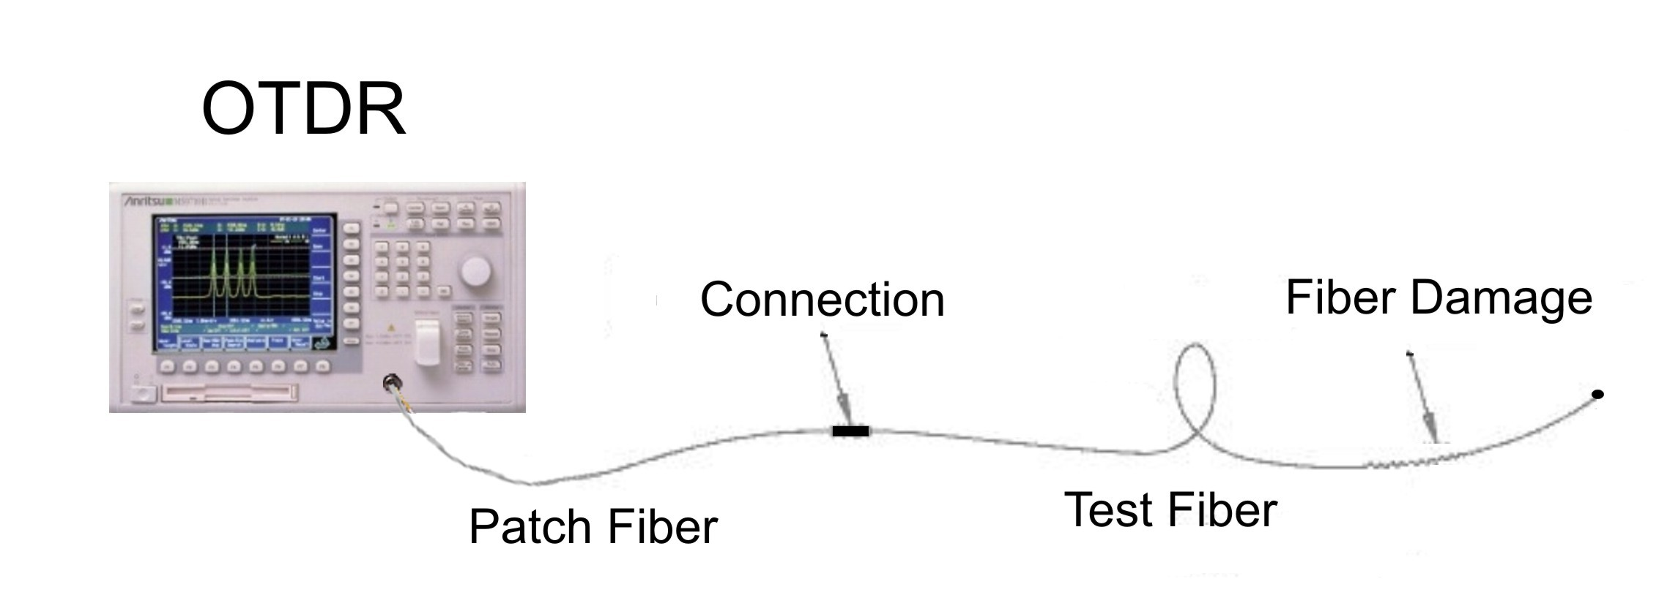
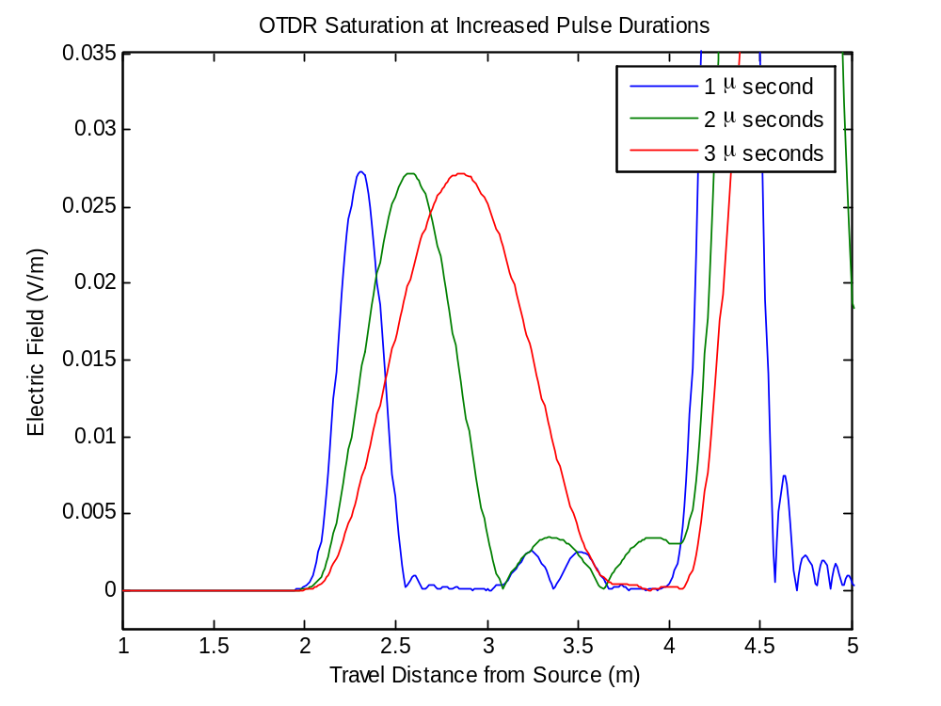
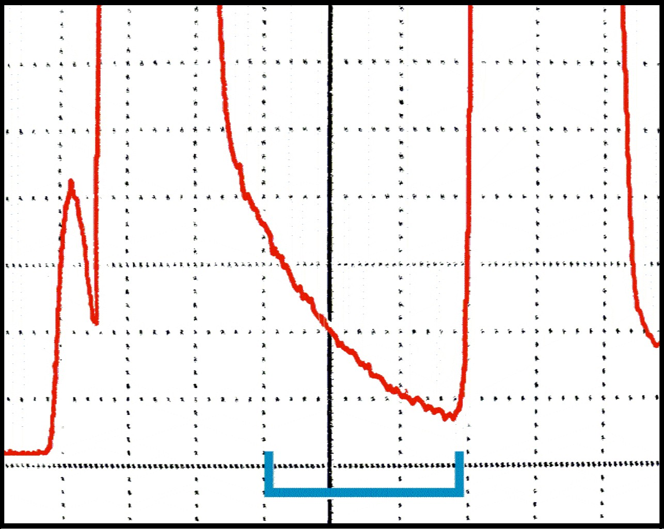
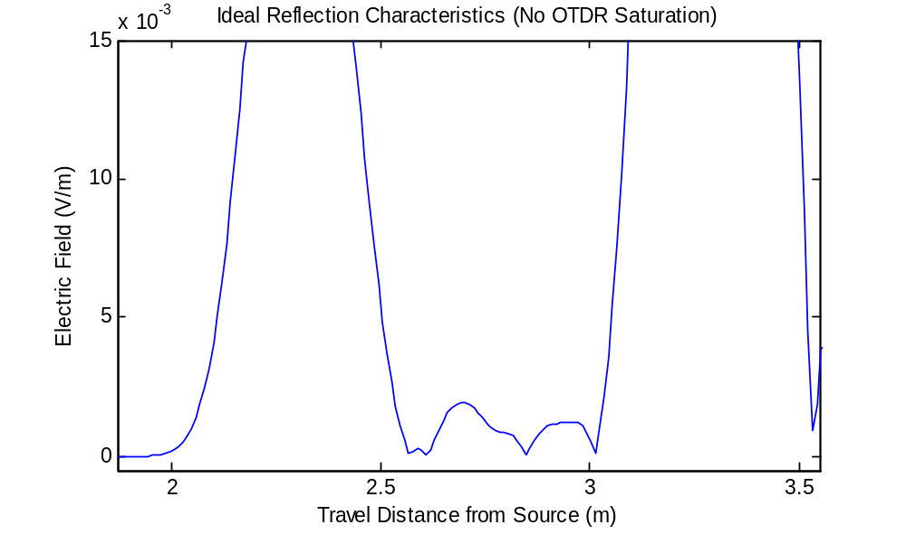
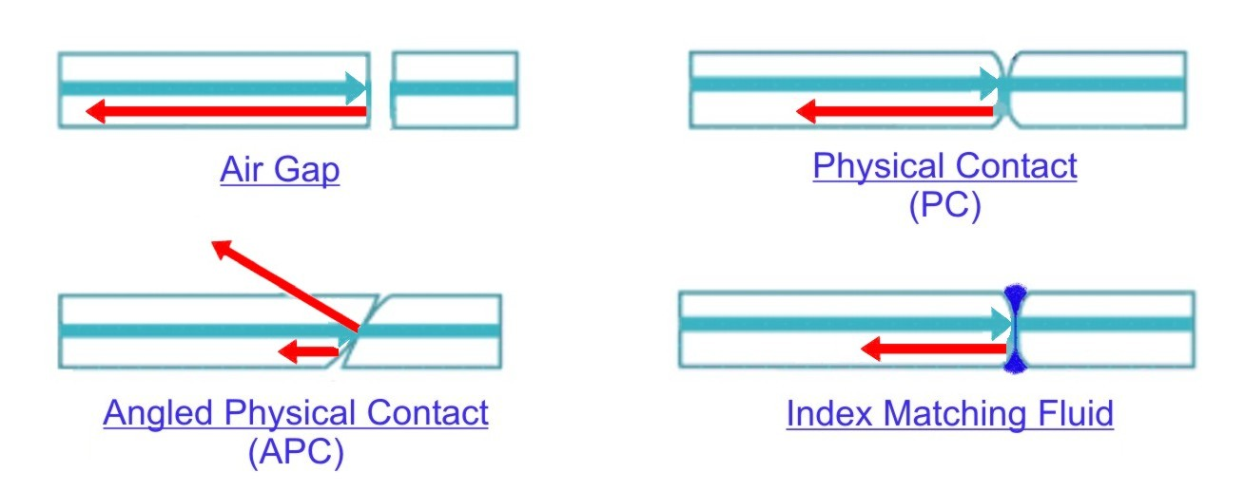

Fiber optic characterization using a simulated Optical Time-Domain Reflectometer (OTDR)
Robb P. Merrill
Department of Electrical and Computer Engineering - University of Utah
Introduction
Optical Time Domain Reflectometry (OTDR) is a common technique for detecting damage in fiber optic cables. The process involves transmitting a pulse of light down the optical fiber, analyzing the amount of light reflected back to the source, and displaying the reflection patterns on the OTDR screen.
During characterization of short fiber optic cables of approximately 1 meter, Fresnel reflections pose a serious challenge to accurate damage detection. The Fresnel tail obliterates any small reflections that are produced by damaged sections of cable, and the damage is overlooked.
Simulation Method
The Finite Difference Time Domain method [1] was implemented in MATLAB to simulate a pulse of light traveling through the patch and test fibers. The following parameters used in the simulation were obtained from an actual OTDR system: Index of refraction (n) of test fiber = 1.4525, Wavelength (λ) of light pulse = 850 nanometers [3] .
      Pulse Duration
Plotting the reflection response patterns from all four connection types shows that the Angled Physical Contact connector produced the lowest reflection (see Figure 6). Though much less expensive, Index Matching Fluid only has a lifetime of 2 years. Most optical fiber applications require 10 years life or more [3].
To determine the effect of the light pulse duration on the saturation level of the OTDR unit, one period of a raised cosine pulse was transmitted through the fiber at various frequencies. A pulse duration of 1 microsecond proved to be the most favorably responsive for the parameters of the simulation (see Figure 3). In real-world application, however, the duration must actually be smaller due to the relatively slow simulation speed vs. the physical speed of light.
Abnormalities in the fiber, such as bends, cracks, connectors, and other abrupt changes in the refractive index create reflection spikes called Fresnel (“Fre'-nel”) reflections [2]. After a spike is detected, a significant delay occurs when the reflectometer ‘settles down’ from its saturated state. This delay is called a Fresnel tail (Figure 1).
1
Figure 5: Reflection patterns using various connectors (reduced Fresnel magnitudes inside yellow box)
Summary
Short fiber optic cables present many challenges that must be overcome in order to accurately detect fiber damage using OTDR. Pulse durations shorter than 1 microsecond, and Angled Physical Contact (APC) fiber connectors are recommended to provide the greatest reduction in Fresnel reflection. By performing OTDR simulations, an optical systems engineer could understand the behavior of a fiber network and detect potential problems before actual production.
Figure 1: OTDR screenshot showing reflection spike from cable connector, and resulting Fresnel tail (area marked by bracket)
Figure 3: Simulated Fresnel Tail skews, then obliterates, the damage reflection at larger durations
Connector Type
The index of refraction of the patch vs. the test fiber was allowed differ by up to 10%, which created a mismatch at the junction of the two fibers. Four types of connectors were simulated to determine which produced the lowest reflection magnitude.
Figure 2: Simulated ideal response showing fiber damage (small reflection bumps).
Damage is visible because no Fres-nel tail is present.
Figure 4: Common types of fiber optic connectors with relative reflection magnitudes shown
References
[1] Sadiku, N.O. Matthew. Numerical Techniques in Electromagnetics
[2] Newton, Steven A. Novel Approaches to Optical Reflectometry
[3] Knapp, John. Characterization of Fiber-Optic Cables Using an Optical Time Domain Reflectometer (OTDR)

