Slide 1

LHS Knowledge ARTEFACTS
Team 4
Challenge 2 – Acute Kidney Injury

Slide 2
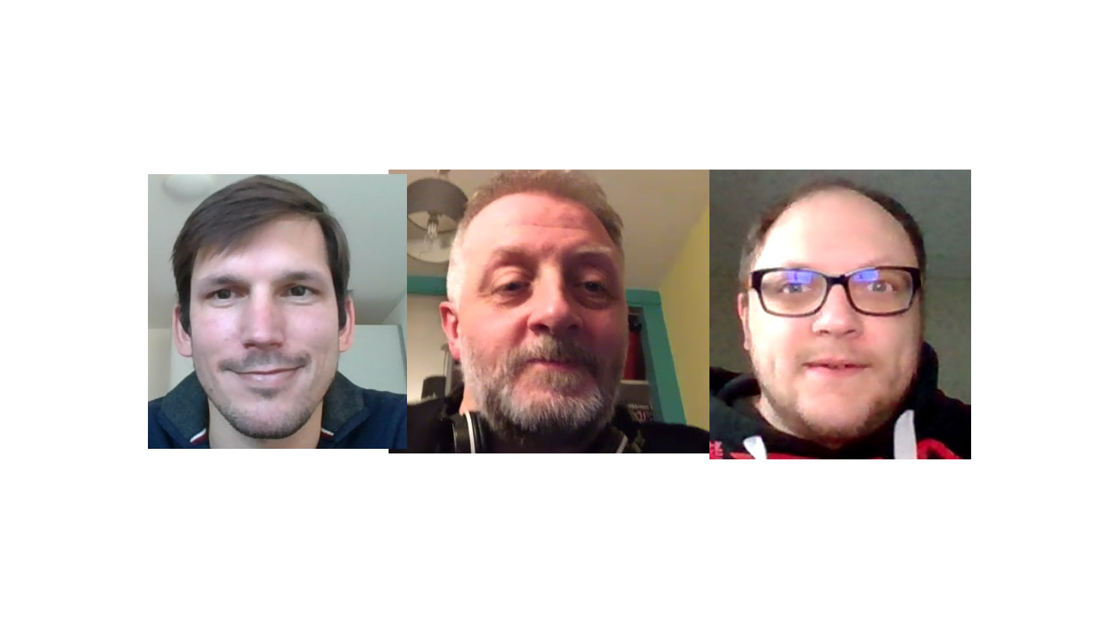

Slide 3
We are team 4
Julian: Physician, clinical background in internal medicine, currently working in medical informatics on semantics
Scott: Experienced software engineer. Recently joined university of Manchester. Learning about FHIR, informatics and academia in general.
Ben: Software engineer, Data engineer & business analyst. Good amount of experience with FHIR.

Slide 4
Challenges around the day
People issues – we lost a teammate through connectivity problems
Technical issues – we lost time on the initial ideas phase due to computer problems
A laptop died
Audio failures
Hard to distribute work between the team

Slide 5
Implementation
We used CQL to build a query!
This was super simple and exclusively looked for SNOMED codes
Could be extended to any standard terminology or even CodeSystems/ValueSets embedded within a FHIR server
Could identify elements by range or likely any other sensibly queryable signateure
We didn’t put this into a FHIR server.
This looked time consuming and given the resource available there were obvious lessons to take
It looked easily possible to POST this to a FHIR server with only a little work
We the looked at other ideas around usage within the context of an LHS

Slide 6
In Practice
Making a CQL query is good but in our example we noticed some challenges for usage:
We primarily used SNOMED codes, but where does the consensus come from within a healthcare setting
In more “hot topic” illnesses there may be consensus beyond a given setting
There may be disagreement in literature or amongst specialists on the codes to use, or the signatures to look for
Whichever codes we choose are still imperfect representations for clinical signatures.

Slide 7
Who should be involved in defining key signatures
AKI is “well understood” but what about emergent issues or evolving ones
Extensibility of code becomes more important
Shared/divided responsibilities of clinical/informatics teams
Getting sceptics to invest time and resource can be a challenge
From experience these people have extensive knowledge and their resistance may come from a viewpoint over the use of tech in their work
Perhaps the CQL file then becomes a shared language to translate between domains
If clinicians and tech are responsible for monitoring and updating, meetings and work might become more focussed

