Slide 1

Facial Expression Recognition: Leveraging PCA & LDA
Exploring emotion classification from facial images using foundational ML techniques.
Recep Enes SAMAT - 21243510075
CMPE363 - Introduction to Machine Learning

Slide 2
Project Overview
Dataset & Goal
Key Techniques
Classifiers
FER2013: Facial Expression Recognition
PCA and LDA (manual implementation)
Logistic Regression
k-NN
Classify emotions from images
Dimensionality reduction
Random Forest

Slide 3

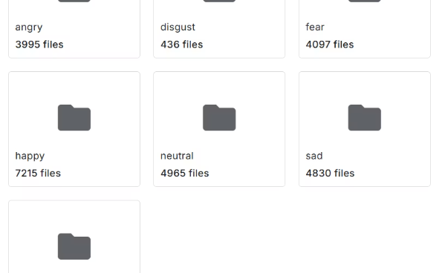
FER2013 Dataset Details
Image Format
Grayscale 48x48 pixel images
Emotion Classes
7 categories: Angry, Disgust, Fear, Happy, Sad, Surprise, Neutral

Slide 4

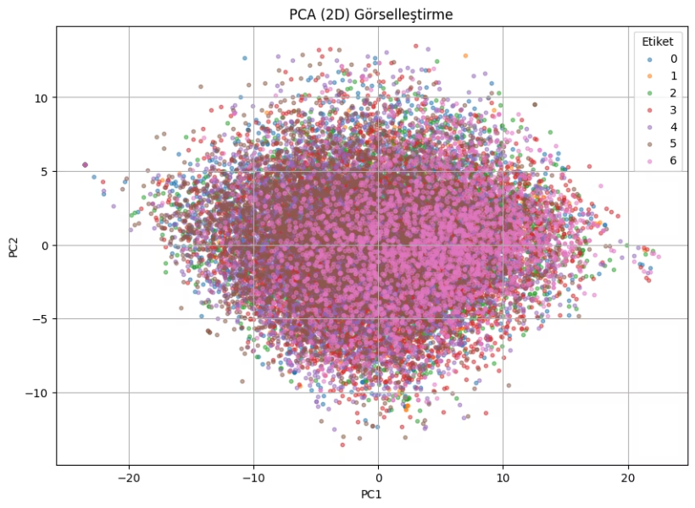


Principal Component Analysis (PCA)
Maximizes Variance
Reduces dimensions
Manual Implementation
Covariance matrix, eigen decomposition
Dimensionality Reduced
2304 to 150 components

Slide 5

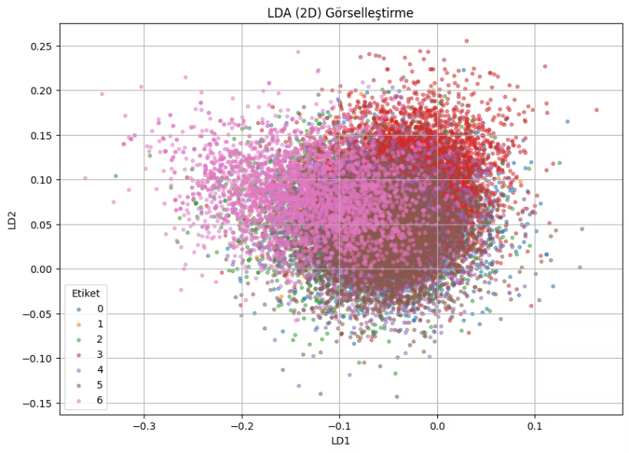


Linear Discriminant Analysis (LDA)
Maximizes Class Separation
Uses scatter matrices
Manual Implementation
Eigenvectors of Sw⁻¹Sb
Component Limit
Max 6 components (classes - 1)

Slide 6



Machine Learning Models Utilized
Logistic Regression
k-Nearest Neighbors (k-NN)
Random Forest
Probability-based classification
Ensemble of decision trees
Tested k=1, 3, 5, 7, 9

Slide 7
Accuracy Results Overview
Model Name
PCA
LDA
Logistic Regression
37.7960%
34.5778%
3-NN
34.6336%
—
Random Forest
42.4073%
37.1551%

Slide 8
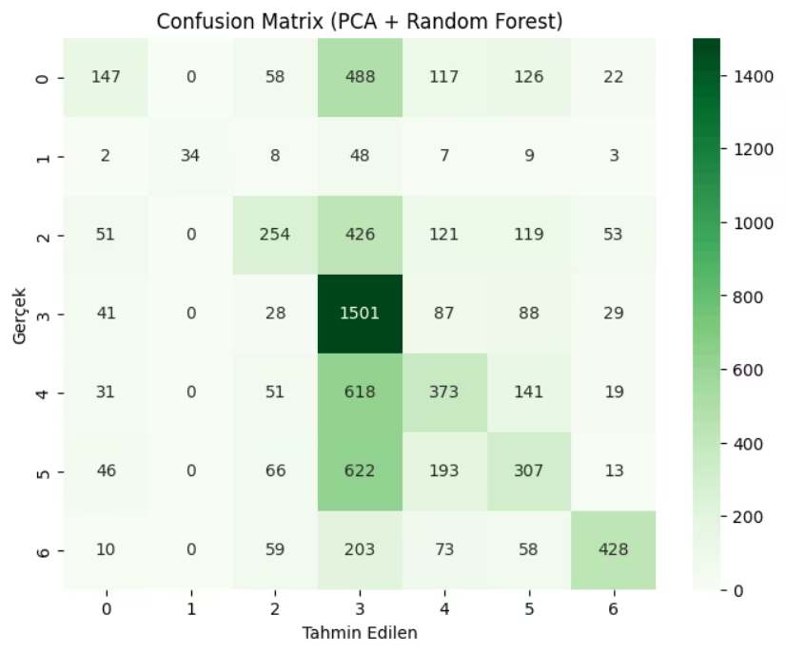
Confusion Matrix Insights
Example: PCA + Random Forest
Highest performance model
Confusion: "Fear" vs. "Disgust"
Confusion: "Fear" vs. "Neutral"

Slide 9
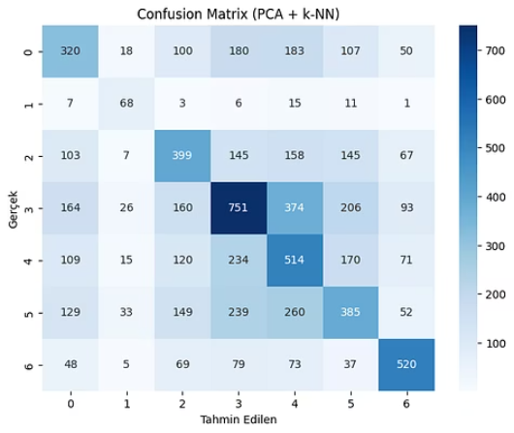
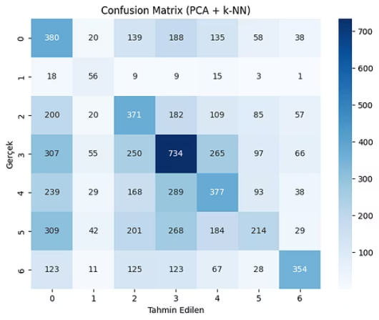
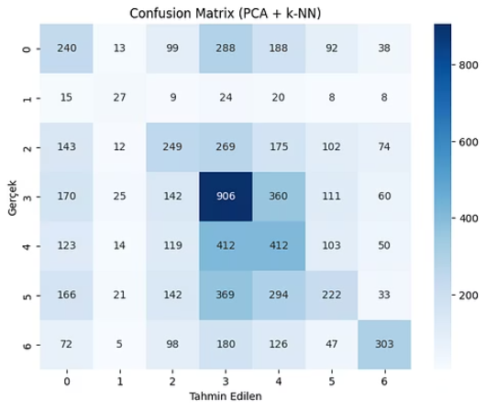
k-NN Sensitivity Analysis
Best Result
Accuracy Decreases
Over-Generalization
k=1, 41.2% accuracy
As k increases
Larger k impacts performance

Slide 10
Key Takeaways & Next Steps
42.4%
2
1
Top Accuracy
Deeper Understanding
k-NN Sensitivity
PCA + Random Forest combination
Manual PCA and LDA implementations
Observed accuracy vs. k-value trends

Slide 11
Conclusion
PCA + Random Forest gave the highest accuracy
Manuel Implementation of PCA and LDA deepened understanding
k-NN sensitivity to k-value was observed

Slide 12
Thank You for Listening!

