Slide 1

.
Stroke Prediction:
Work so far…
Dipartimento di Ingegneria Informatica, Informatica e Statistica
Amedeo Ranaldi
Andrea Potì
Giulio D’Erasmo
Onur Ergun
Master Degree in Data Science
A. A. 2021-2022

Slide 2

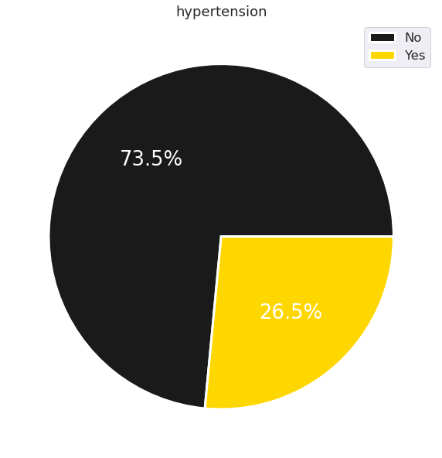
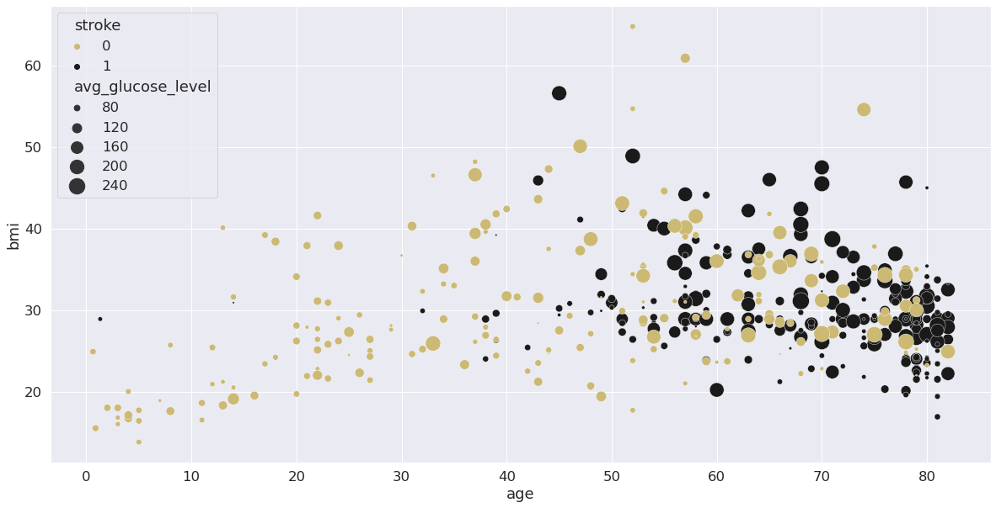
DATASET VS REAL LIFE
Official data
Frequent after the age of 55( 75% of strokes occur in people over the age of 65).
Body-mass index
Avarange glucose level.
Hemorrhagic stroke accounts for approximately 3% -5% of all strokes). Cause -> Hypertension
Our data
Effective consistency of age, bmi, and avg glucose -> stroke probability
Only 26.5% of patients who had stroke had hypertension

Slide 3
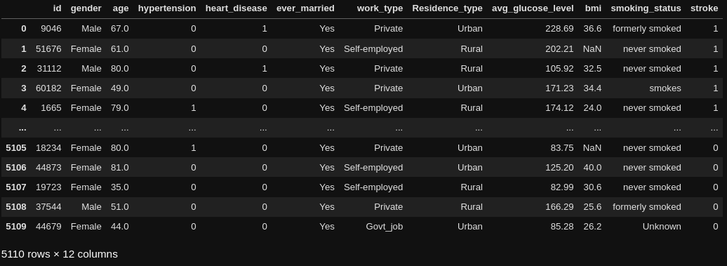

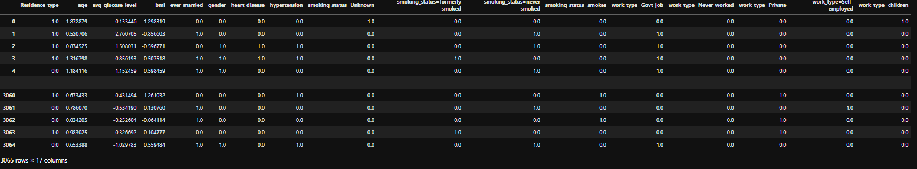
Pre-processing
Found nan-values on the ‘bmi’ column and filled them with the mean
Normalized numeric values
One-hot-encoding for the only two categorial features
Use DictVectorize to one-hot-encode the multiple categorical features

