Slide 1

.
Stroke Prediction:
Work so far…
Dipartimento di Ingegneria Informatica, Informatica e Statistica
Amedeo Ranaldi
Andrea Potì
Giulio D’Erasmo
Onur Ergun
Master Degree in Data Science
A. A. 2021-2022

Slide 2

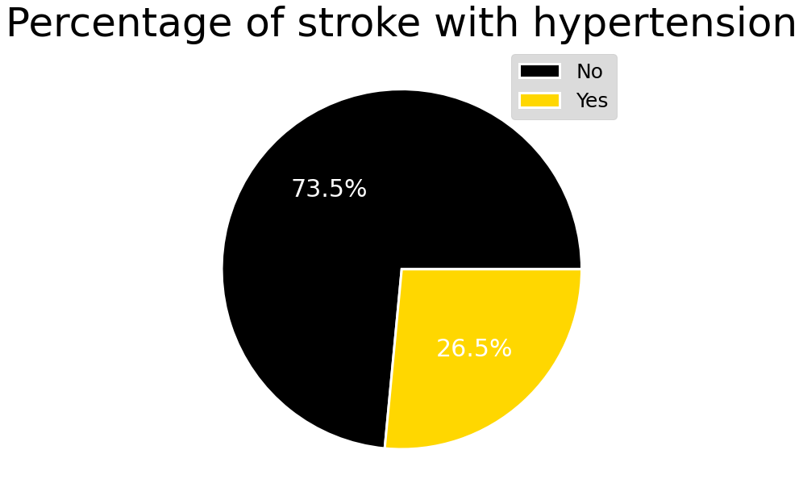
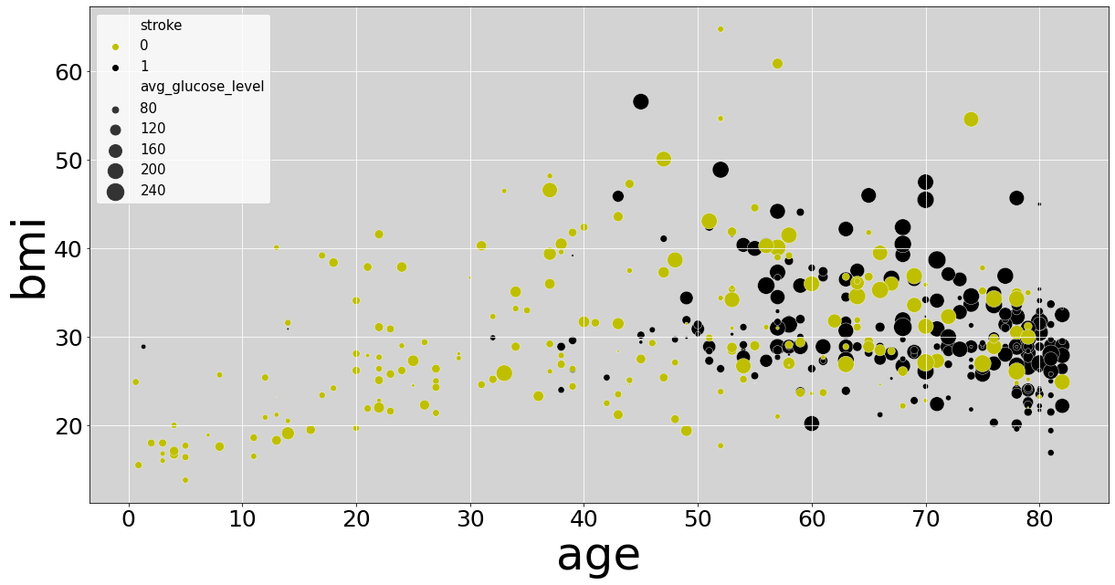
DATASET VS REAL LIFE
Official data
Frequent after the age of 55( 75% of strokes occur in people over the age of 65).
Body-mass index
Average glucose level.
Hemorrhagic stroke accounts for approximately 3% -5% of all strokes). Cause -> Hypertension
Our data
Effective consistency of age, bmi, and average glucose -> stroke probability
Only 26.5% of patients who had stroke had hypertension

Slide 3
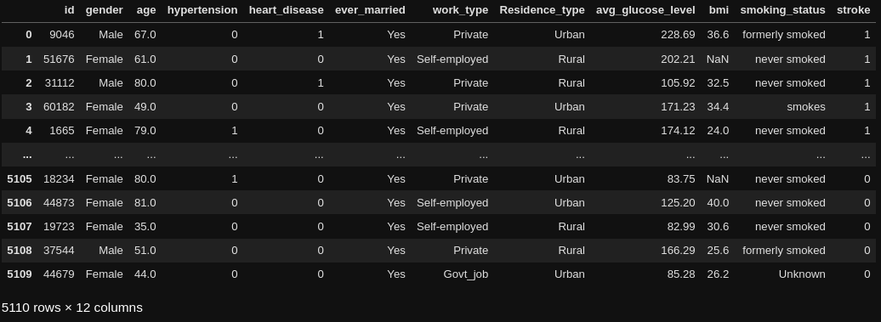

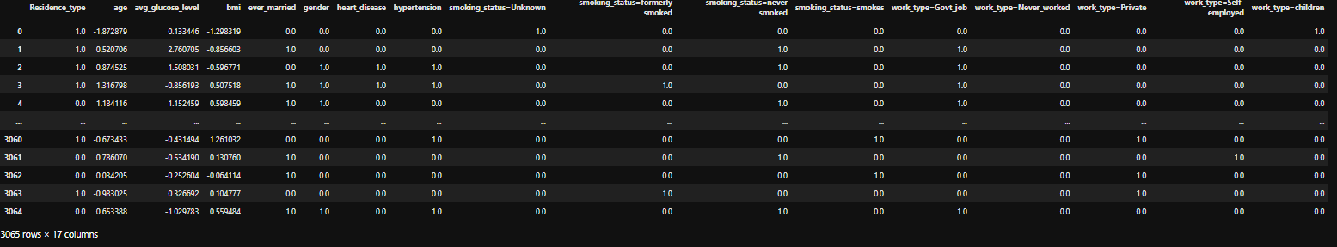
Pre-processing
Found nan-values on the ‘bmi’ column and filled them with the mean
Standardized numeric values
One-hot-encoding for the only two categorial features
Use DictVectorize to one-hot-encode the multiple categorical features

Slide 4
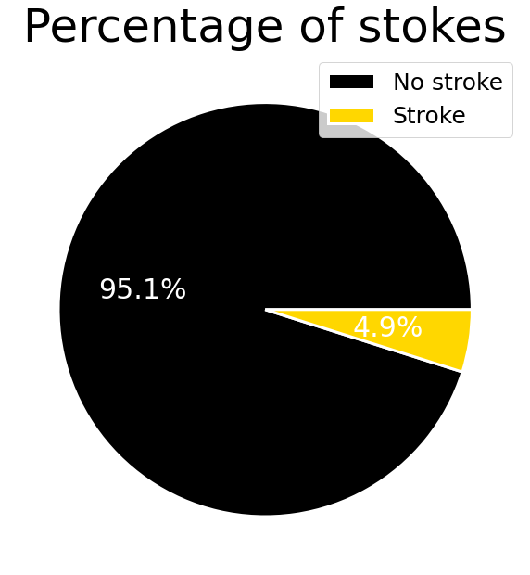
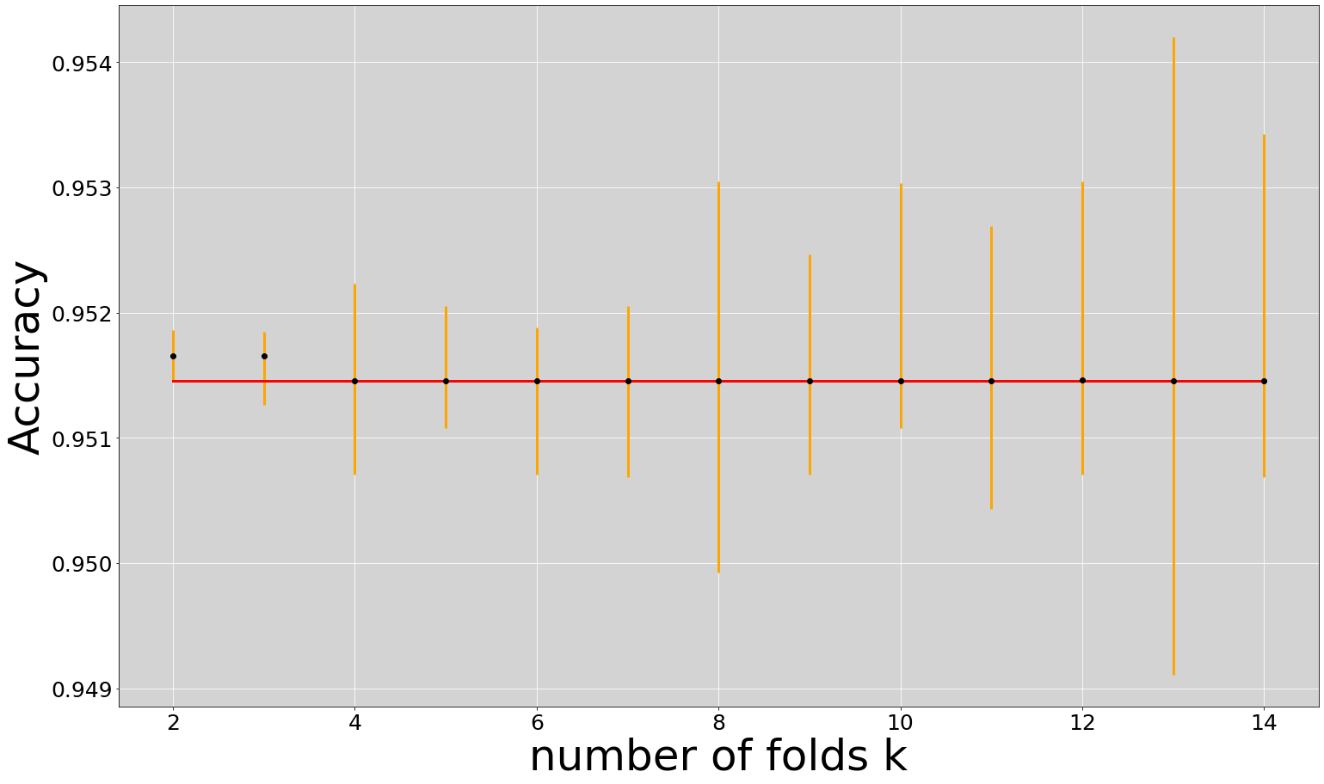
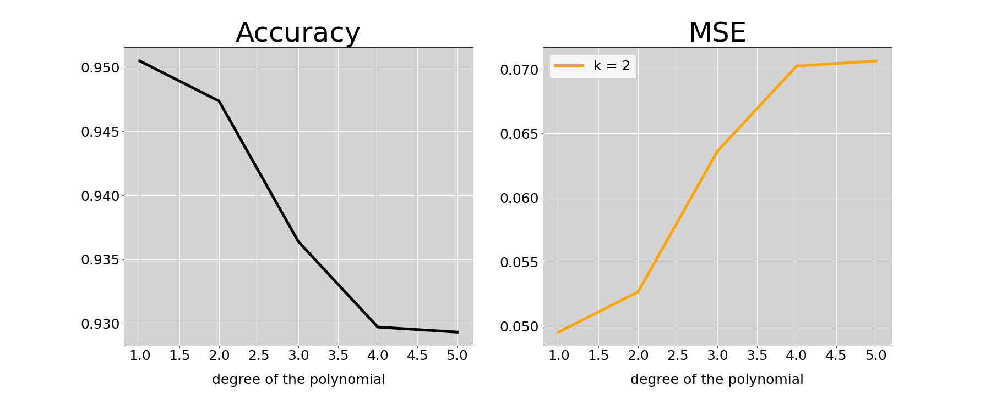
Analyzing the model: Logistic Regression
Dataset unbalanced
Hence, the cross validation with stratified K-folds suit perfect for as!
We splitted the dataset into K consecutive folds; each fold is used once as a validation while the k - 1 remaining folds form the training set. The folds are made by preserving the percentage of samples for each class.
Choosing the degree of the logistic regression’s polynomial
We plotted the MSE and accuracy of the model for different polynomial degrees

Slide 5

Next steps…
Repeating the process with other models and different metrics or evaluation (like train/dev/test and loss likelihood)
Compare the overall performance of the models for our dataset.

