Slide 1
Seminar presentation
Biological Hydrogen Production: A Sustainable Energy Solution

Slide 2
Seminar Presentation on Biological Hydrogen Production: A Sustainable Energy Solution
Submitted By Submited To :

Slide 3
Overview
The report presentation sets the stage for understanding the importance of sustainable energy sources in the context of industrial growth and the pressing need to reduce carbon emissions.
Significance: It is imperative to acknowledge the ever-growing energy demands that accompany industrial expansion and the pivotal role of sustainable energy sources in meeting these demands. At the same time, the detrimental consequences of excessive carbon emissions on the environment, climate, and human health cannot be ignored.
Purpose: The purpose of this report is to explore the potential of biological hydrogen production as a renewable and eco-friendly energy source, focusing on various production routes and feedstock options. This report aims to shed light on the advancements in the field, emphasizing its cost-effectiveness and sustainability.
Scope: The scope of this report encompasses an overview of biohydrogen production, its various routes, feedstock selection, efficient microorganisms, techno-economic analysis, and a comprehensive conclusion. Through this report, we seek to provide a holistic understanding of the current state of biohydrogen production and its potential as an environmentally friendly and cost-efficient energy source for the future.

Slide 4
Table of Content
Biohydrogen Production: An Overview
Various Routes of Biological Hydrogen Production
Direct Bio photolysis
Dark Fermentation
Photo fermentation
Microbial Electrolysis
Feedstocks for Biohydrogen Production
Uses of Hydrogen as a fuel
Conclusion
Reference

Slide 5
INTRODUCTION
Biohydrogen production is a revolutionary process that stands out as a carbon-free method. It harnesses the power of nature to generate hydrogen gas, a clean and sustainable energy carrier.
Carbon-Free Process: Biohydrogen production is characterized by its carbon-free nature, which means it doesn't release harmful greenhouse gases like traditional hydrogen production methods. It offers an environmentally responsible solution to our growing energy needs.
Advantages: One of the key advantages of biohydrogen production is its operation at ambient temperature and pressure. Unlike conventional hydrogen production methods that often require extreme conditions, biohydrogen production thrives under normal environmental parameters. This not only reduces energy input but also minimizes infrastructure complexities, making it an attractive choice for sustainable energy production.

Slide 6
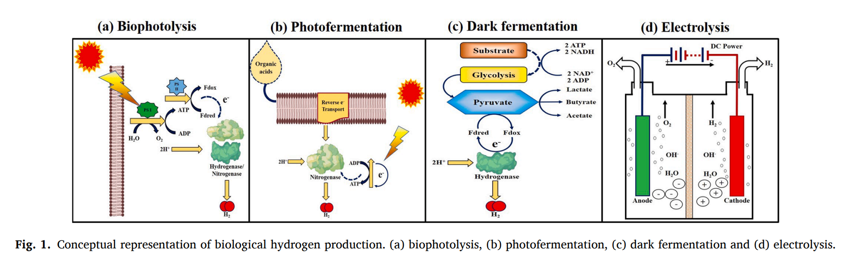
Various Routes of Biological Hydrogen Production
Source: (Sivaramakrishnan et al., 2021)

Slide 7
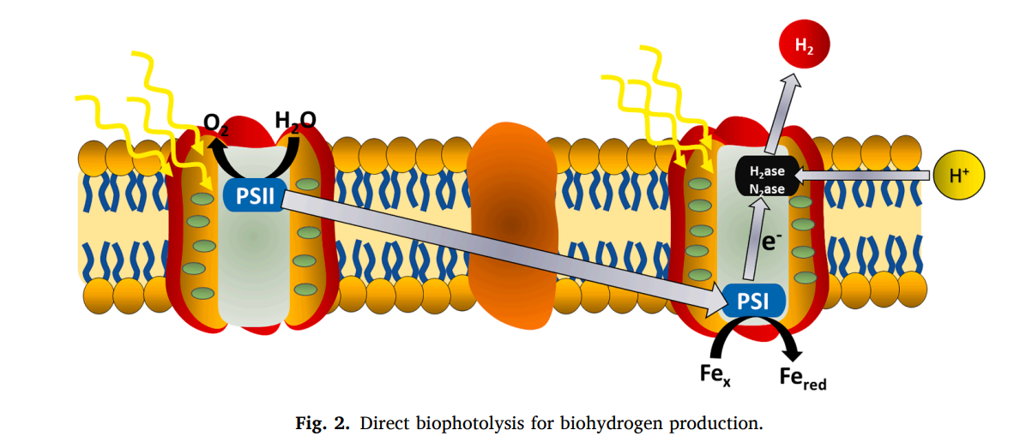
Direct Bio Photolysis
Direct bio photolysis is a biological hydrogen production method that harnesses the power of photosynthetic microorganisms like algae and cyanobacteria.
In this process, these microorganisms use sunlight to directly split water into hydrogen and oxygen through the photosynthetic machinery.
The chemical reaction involved can be summarized as:
H₂O → H₂ + 1/2 O₂.
Direct bio photolysis offers a sustainable and environmentally friendly way to produce hydrogen, utilizing renewable solar energy.
Source: (Sivaramakrishnan et al., 2021)

Slide 8
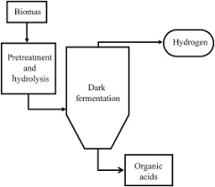
Dark Fermentation
Dark fermentation (DF) is another route for biological hydrogen production that occurs under anaerobic conditions, typically in the absence of light.
This method employs various microorganisms and substrates, such as food and beverage wastewater, glycerol, and glucose, to produce hydrogen.
The chemical reaction for dark fermentation can be expressed as:
Substrate → Hydrogen + Organic Acids.
Dark fermentation is eco-friendly and cost-effective and can use a variety of waste materials as feedstocks.
Fig 3: schematic diagram of Dark Fermentation Source: (Mishra, Krishnan, Rana, Singh, Sakinah, & Ab Wahid, 2019)

Slide 9
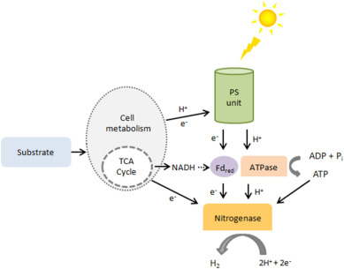
Photo fermentation
Photo fermentation is a biological hydrogen production process that combines the principles of both photosynthesis and fermentation.
Photosynthetic microorganisms, like purple non-sulfur bacteria, are used to convert organic compounds produced during photosynthesis into hydrogen.
The chemical reaction involves the conversion of organic compounds into hydrogen and carbon dioxide in the presence of light.
Photo fermentation offers an efficient means of producing hydrogen from organic substrates.
Fig 4: Photo fermentation Diagrammatic representation Source: (Bozoglan, Midilli, & Hepbasli, 2012)

Slide 10
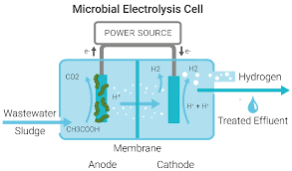
Microbial Electrolysis
Microbial electrolysis is a cutting-edge method that uses a consortium of microorganisms to produce hydrogen with the help of an electrical voltage.
It's an energy-efficient process that can be integrated with renewable energy sources like wind or solar power.
The chemical reactions involve the reduction of water at the cathode and the oxidation of organic matter at the anode to produce hydrogen.
Microbial electrolysis holds promise for efficient and sustainable hydrogen production with minimal environmental impact.
Fig 5: Microbial Electrolysis
Source: (Kim, Baek, Yun, Junsim, Park, & Kim, 2006))

Slide 11
Feedstocks for Biohydrogen Production
Biohydrogen production can utilize a range of feedstocks, including food and beverage wastewater, glycerol, glucose, agricultural residues, and more. The selection depends on factors like feedstock availability, cost, and compatibility with chosen microorganisms.
Importance of Feedstocks: The choice of feedstock is critical in biohydrogen production. It impacts the efficiency, sustainability, and economics of the process. Feedstocks provide the organic substrates that microorganisms use to produce hydrogen, and their availability and suitability affect the overall success of hydrogen production methods.
Pretreatment Steps: To optimize feedstock conversion, pretreatment steps may be necessary. These can include delignification, hydrolysis, and sterilization, depending on the nature of the feedstock. Delignification, for example, helps break down lignin, making the cellulose and hemicellulose components more accessible for microbial conversion.

Slide 12
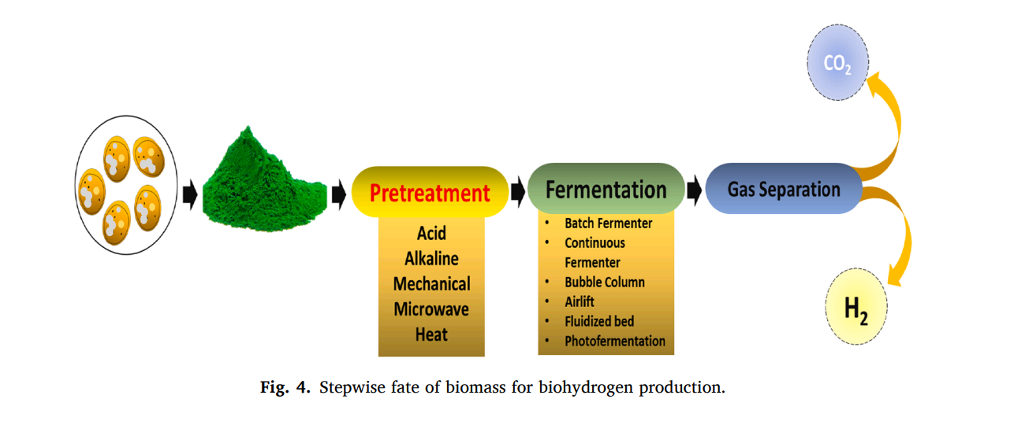
Source: (Sivaramakrishnan et al., 2021)

Slide 13
Uses of Hydrogen as a fuel
Ammonia Production: Hydrogen is a key component in the production of ammonia, a fundamental ingredient in fertilizers. This process is essential for global agriculture.
Oil Refining: Hydrogen is widely utilized in petroleum refining. It is employed in hydro-desulfurization (HDS) and hydrocracking operations, helping to remove impurities and improve the quality of refined petroleum products.
Methanol Production: Hydrogen is a catalyst in methanol production. Methanol is a versatile chemical used in various industrial processes and as a fuel.
Space Exploration and Aviation: In the aerospace industry, hydrogen is used as rocket fuel. It provides a high-energy density fuel source for launching spacecraft.
Power Generation: Hydrogen can be used as a clean and flexible energy carrier in power generation. It is employed in fuel cells to generate electricity and heat.
Global Logistics: Hydrogen plays a role in logistics, where it can be used as a fuel source for vehicles and forklifts. It offers a sustainable energy option for transportation and logistics.
Public and Personal Transportation: Hydrogen fuel cell vehicles are a developing technology that utilizes hydrogen as a clean and efficient fuel source for cars and other forms of transportation.

Slide 14
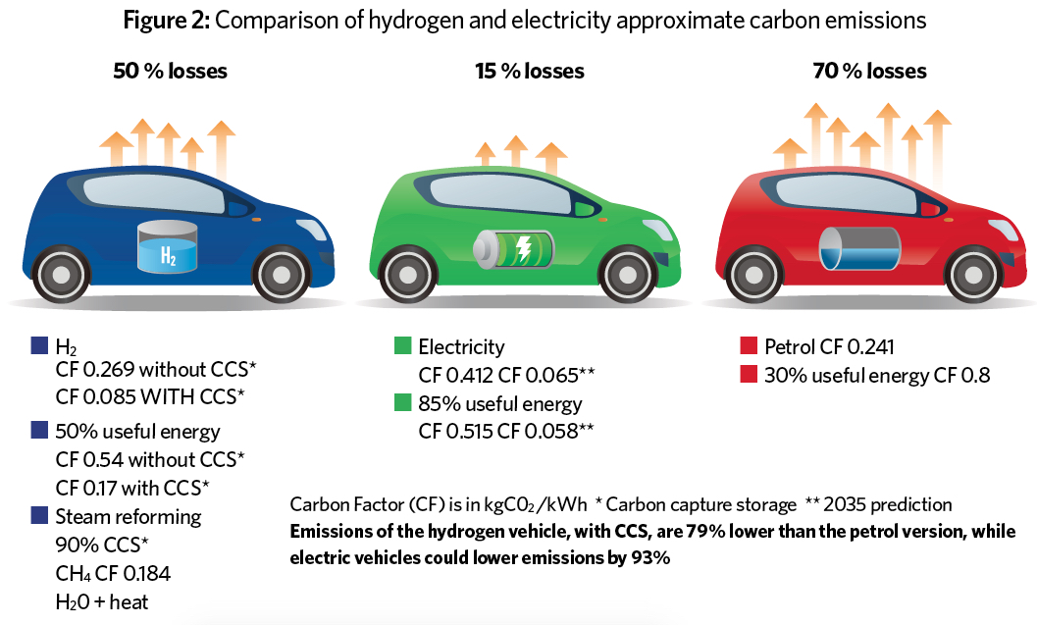
Fig 7: (CIBSE Journal, n.d.)

Slide 15
Conclusion
In conclusion, this report highlights the significance of biohydrogen production as a promising, carbon-free method to meet the growing demand for sustainable energy and promote industrial growth while reducing carbon emissions. By providing an overview of various biological hydrogen production routes, including direct bio photolysis, dark fermentation, photo fermentation, and microbial electrolysis, it underscores the versatility of these eco-friendly processes that can operate at ambient temperatures and pressures. Emphasizing the importance of feedstocks and efficient microorganisms, the report demonstrates the potential of biohydrogen production as a cost-efficient and sustainable energy source. The techno-economic analysis underscores its feasibility, setting the stage for its broader adoption. As we conclude, we emphasize the necessity for continued research and development to unlock the full potential of biohydrogen production and accelerate our transition to a cleaner, more sustainable energy future.

Slide 16
Reference
1. Akhlaghi, N. and Najafpour-Darzi, G. (2020). A comprehensive review on biological hydrogen production. International Journal of Hydrogen Energy, 45(43), pp.22492–22512. doi:https://doi.org/10.1016/j.ijhydene.2020.06.182.
2. Keskin, T., Abo-Hashesh, M. and Hallenbeck, P.C. (2011). Photofermentative hydrogen production from wastes. Bioresource Technology, 102(18), pp.8557–8568. doi:https://doi.org/10.1016/j.biortech.2011.04.004.
3. Mishra, P., Krishnan, S., Rana, S., Singh, L., Sakinah, M. and Ab Wahid, Z. (2019). Outlook of fermentative hydrogen production techniques: An overview of dark, photo and integrated dark-photo fermentative approach to biomass. Energy Strategy Reviews, 24, pp.27–37. doi:https://doi.org/10.1016/j.esr.2019.01.001.
4. Zhang, B., Zhang, S.-X., Yao, R., Wu, Y.-H. and Qiu, J.-S. (2021). Progress and prospects of hydrogen production: Opportunities and challenges. Journal of Electronic Science and Technology, p.100080. doi:https://doi.org/10.1016/j.jnlest.2021.100080.
5. Sivaramakrishnan, R., Shanmugam, S., Sekar, M., Mathimani, T., Incharoensakdi, A., Kim, S.-H., Parthiban, A., Edwin Geo, V., Brindhadevi, K. and Pugazhendhi, A. (2021). Insights on biological hydrogen production routes and potential microorganisms for high hydrogen yield. Fuel, 291, p.120136. doi:https://doi.org/10.1016/j.fuel.2021.120136.

Slide 17
6. Mıynat, M.E., Ören, İ., Özkan, E. and Argun, H. (2020). Sequential dark and photo-fermentative hydrogen gas production from agar embedded molasses. International Journal of Hydrogen Energy. doi:https://doi.org/10.1016/j.ijhydene.2019.12.174.
‌
7. Bozoglan, E., Midilli, A. and Hepbasli, A. (2012). Sustainable assessment of solar hydrogen production techniques. Energy, 46(1), pp.85–93. doi:https://doi.org/10.1016/j.energy.2012.03.029.
8. Abd-Alla, M.H., Morsy, F.M. and El-Enany, A.-W.E. (2011). Hydrogen production from rotten dates by sequential three stages fermentation. International Journal of Hydrogen Energy, [online] 36(21), pp.13518–13527. doi:https://doi.org/10.1016/j.ijhydene.2011.07.098.
‌
9. Oh, Y. (2004). Photoproduction of hydrogen from acetate by a chemoheterotrophic bacterium Rhodopseudomonas palustris P4. International Journal of Hydrogen Energy. doi:https://doi.org/10.1016/j.ijhydene.2003.11.008.
10. Kim, M., Baek, J., Yun, Y., Junsim, S., Park, S. and Kim, S. (2006). Hydrogen production from Chlamydomonas reinhardtii biomass using a two-step conversion process: Anaerobic conversion and photosynthetic fermentation. International Journal of Hydrogen Energy, 31(6), pp.812–816. doi:https://doi.org/10.1016/j.ijhydene.2005.06.009.
‌
11. CIBSE Journal. (n.d.). Power of good – future of UK heat. [online] Available at: https://www.cibsejournal.com/general/power-of-good-future-of-uk-heat/.
‌

Slide 18
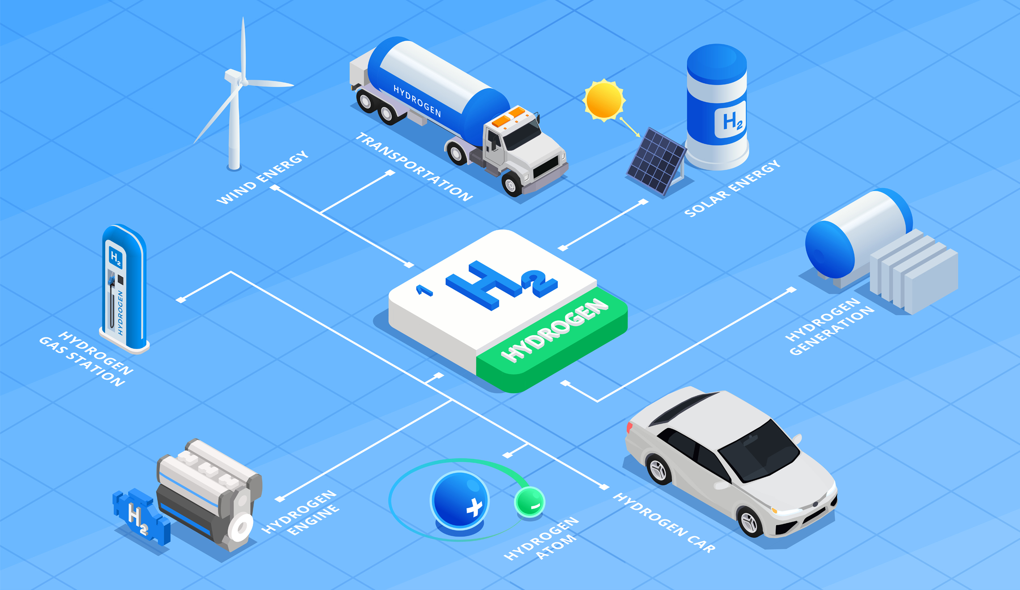
THANK YOU
THANKYOU

