Slide 1
HR Analytics: Employee Attrition Prediction & Cause Analysis
Presented by: E.Rashad

Slide 2
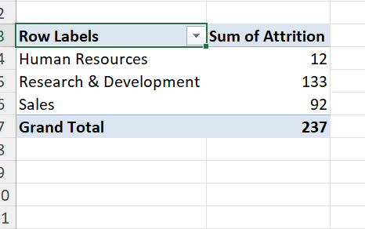
DEPARTMENT BREAKDOWN OF ATTRITION
Total Employee Attrition: A total of 237 employees have left the company
Highest Attrition by Department: In terms of headcount, the highest turnover was recorded in Research & Development (133 employees) and Sales (92 employees).

Slide 3
.
Research & Development (R&D): Accounts for the majority of turnover at 56.12%.
Sales: Represents 38.82% of total departures.
Human Resources (HR): Shows the lowest share at 5.06%.

Slide 4
.
A significant majority of employees who left the company did so due to heavy overtime workloads (53.59%).

Slide 5
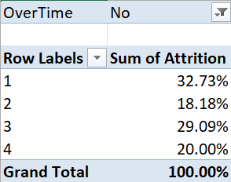
Satisfaction Levels Breakdown: Shows the precise distribution of satisfaction scores (ranging from 1 to 4) among this specific segment, highlighting key retention risks outside of work hours.
Primary Root Cause: Low Job Satisfaction (Score 1) is the single largest factor for non-overtime turnover, accounting for 32.73% of departures.

Slide 6
Thank you for your attention.
.

