Slide 1
Quarto @ Swiss TPH
Reproducible documents for your research projects
Zhihan Zhu, Research Informatics
28.10.2026
Notes:
https://research-it-swiss-tph.github.io/quarto_training/

Slide 2
Agenda
Quarto @ Swiss TPH
Introduction to Quarto
Structure of a Quarto document
Quarto formats
Swiss TPH templates
Q&A (and/or a break)
Hands-on session

Slide 3
Introduction to Quarto

Slide 4
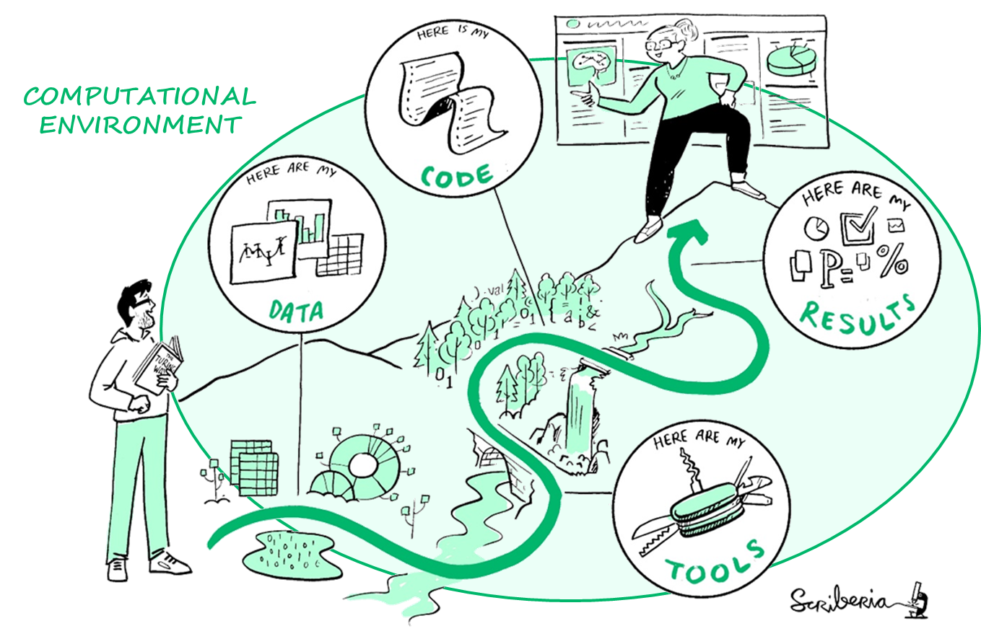
Reproducibility in research
Same data
+Same tools
+Same code
=Same results
Notes:
Achieving reproducibility requires clear access to the underlying data, the code used for analysis, and the results produced. It also depends on documenting the tools, such as software and libraries, alongside the computational environment, including hardware configurations and operating systems.

Slide 5
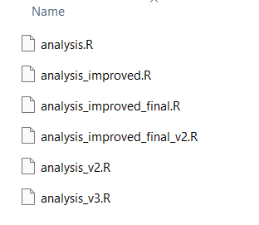
Imagine you sent your collaborator a report
…and after six months
‘Could you please exclude those who under 18 and regenerate Figure 3?’
And your project folder looks like:
You may struggle to find out which script you used…

Slide 6

One source of truth
Quarto has everything in one place
Your narrative, your code, and your results should live in one document and be generated in one step.
Directly generate

Slide 7
Structure of a
Quarto document

Slide 8
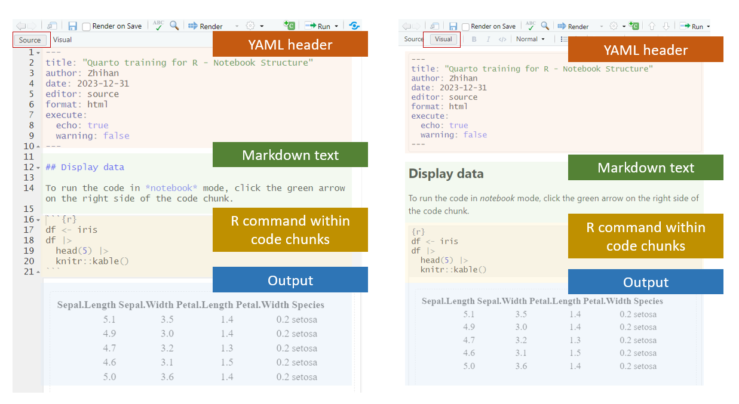
Structure of Quarto document

Slide 9
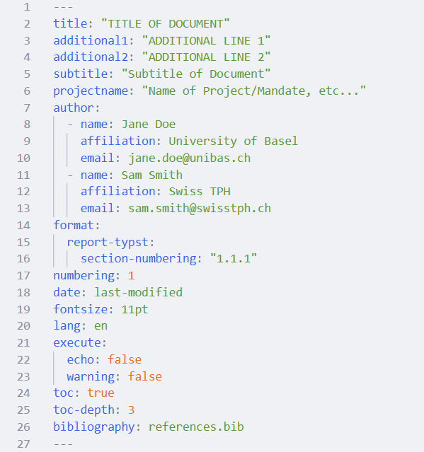
Structure of Quarto document
YAML header
Contains commands and metadata.
One header at the top of the document.
Surrounded by `---` on the top and bottom of the section.

Slide 10
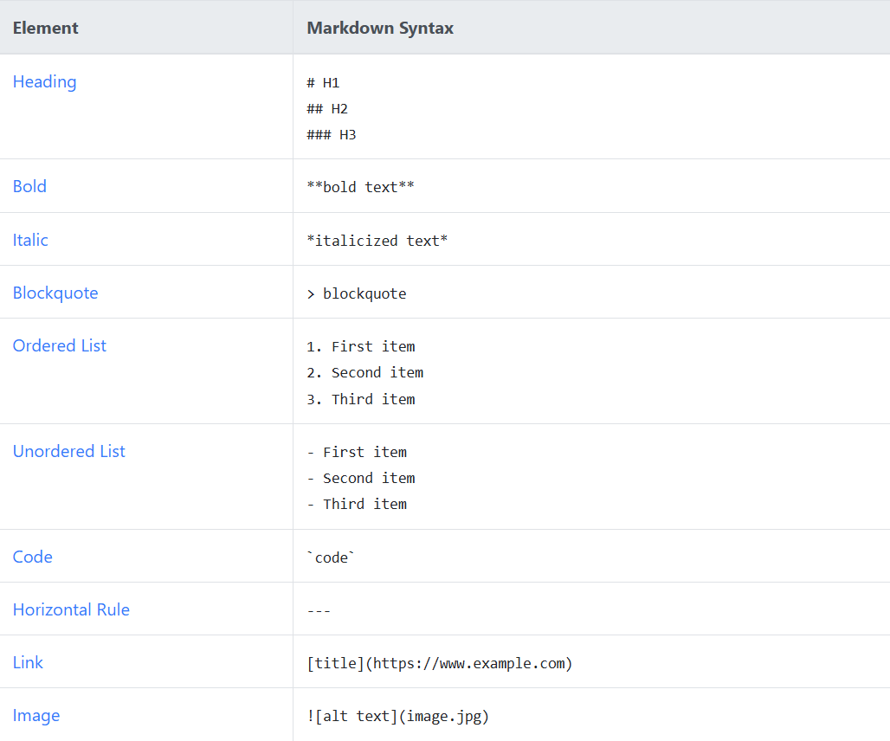
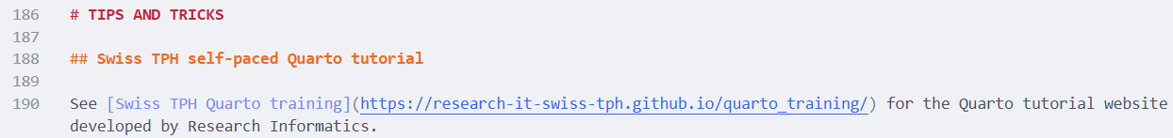
Structure of Quarto document
Markdown text
A markup language, which can have formatting.
This is where you have your free text.

Slide 11
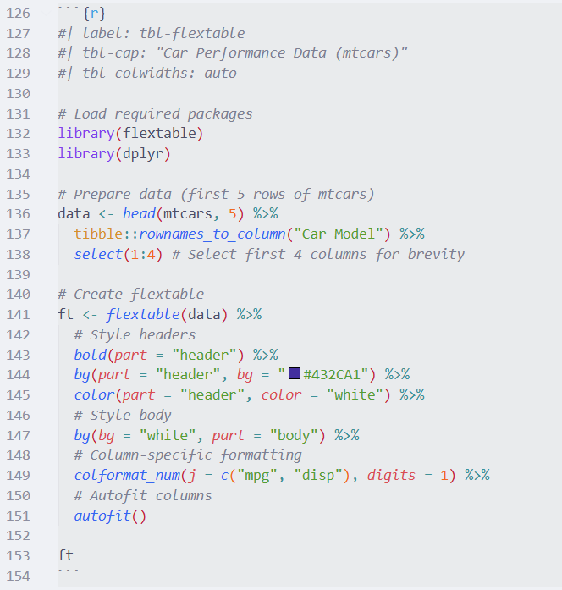
Structure of Quarto document
Code blocks
This is where you write your executable commands, e.g. R.
They are identified by language name surrounded by braces, e.g. {r}
You can have cell level options at the top of the code block.

Slide 12
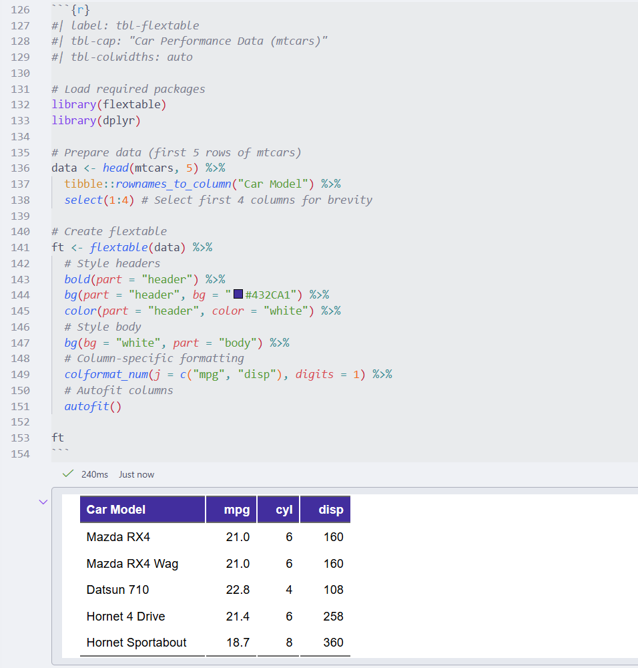
Structure of Quarto document
Output
Output of your code can be displayed inline in your IDE and/or in the rendered document.

Slide 13
Quarto formats

Slide 14
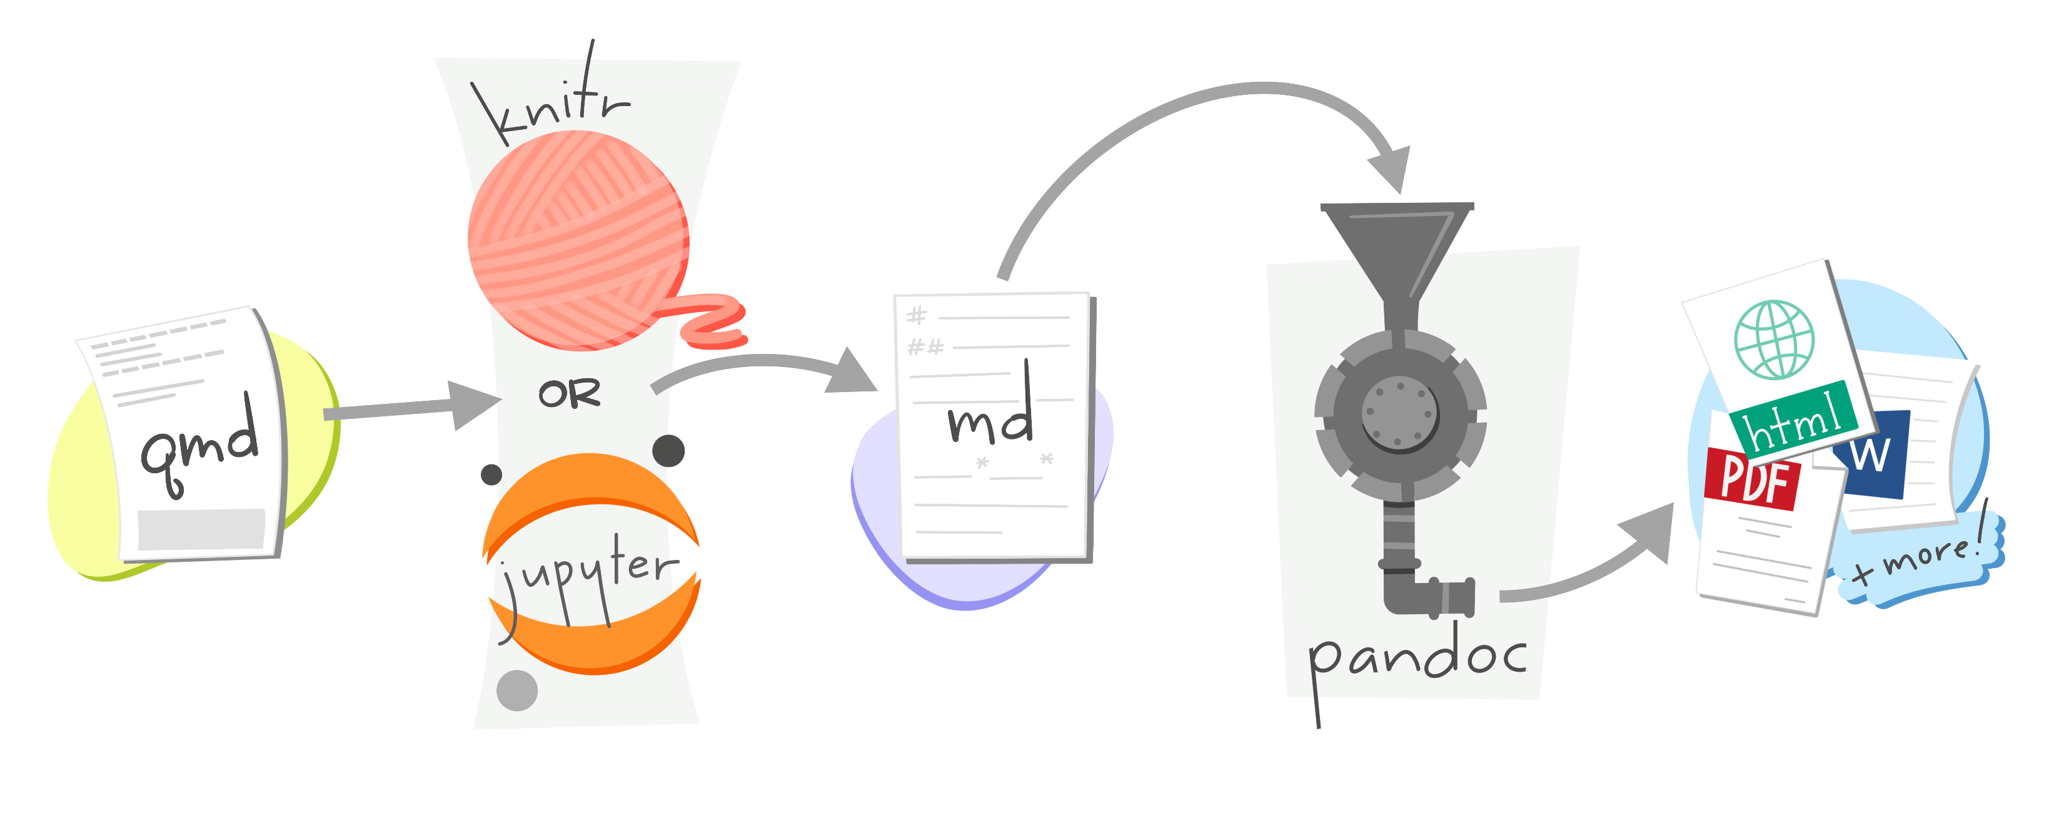
Multi-format output

Slide 15



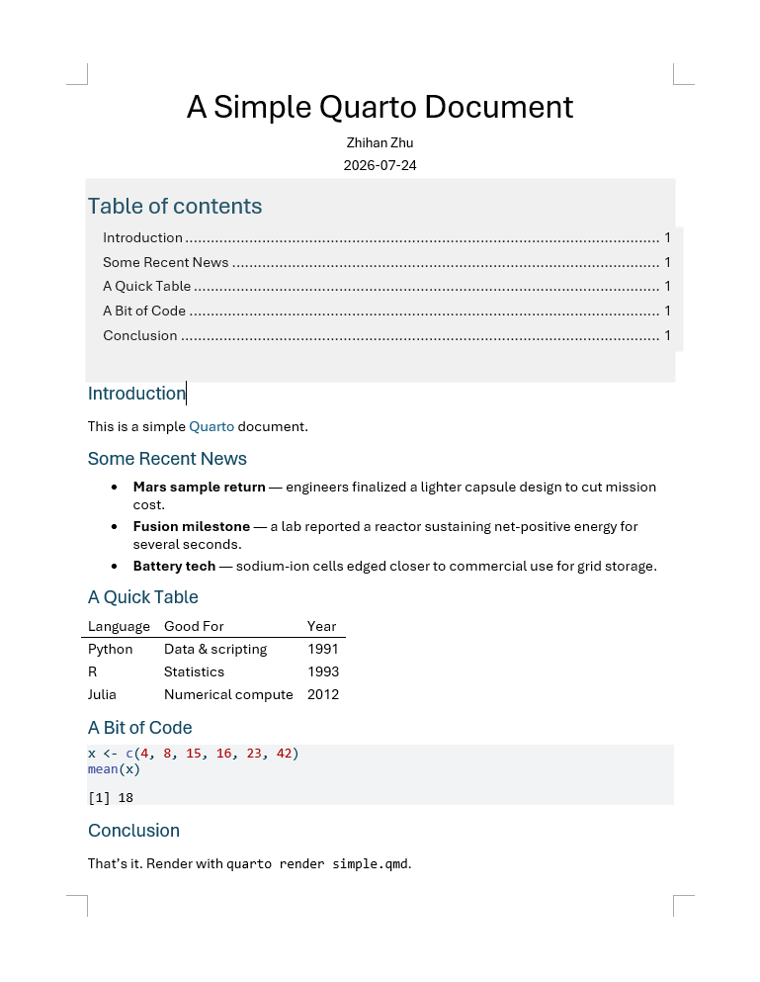
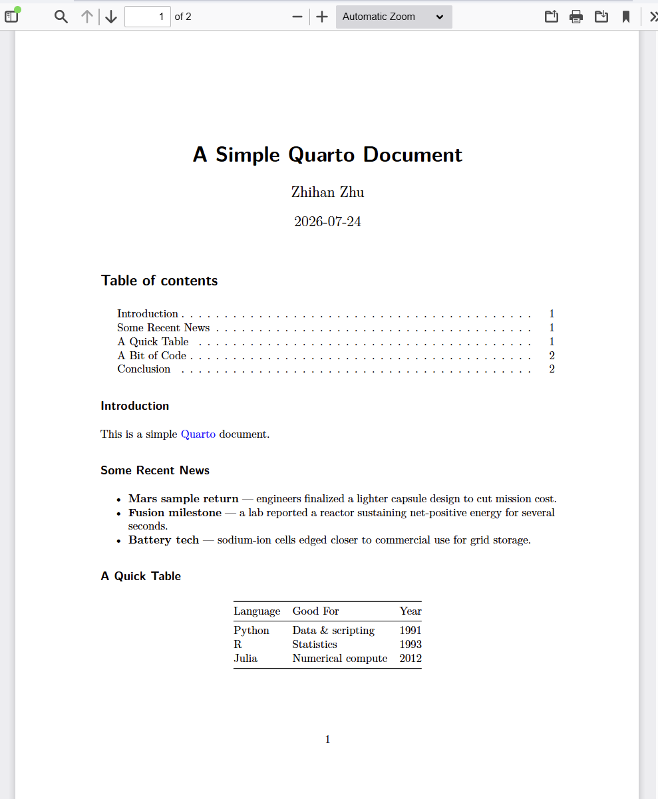
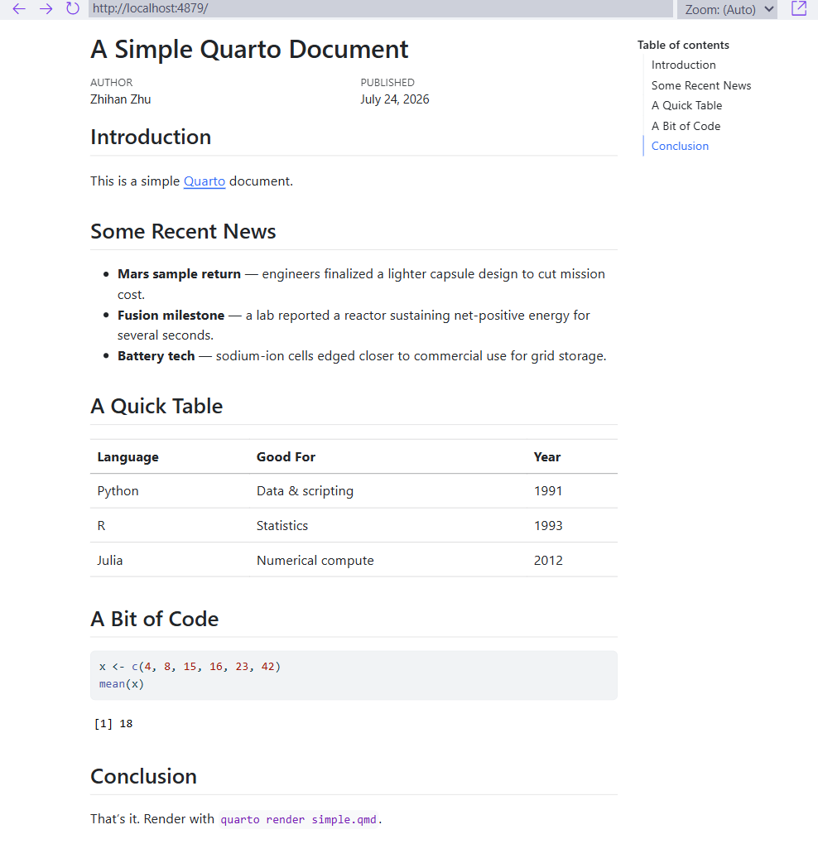
Control output format in YAML header

Slide 16
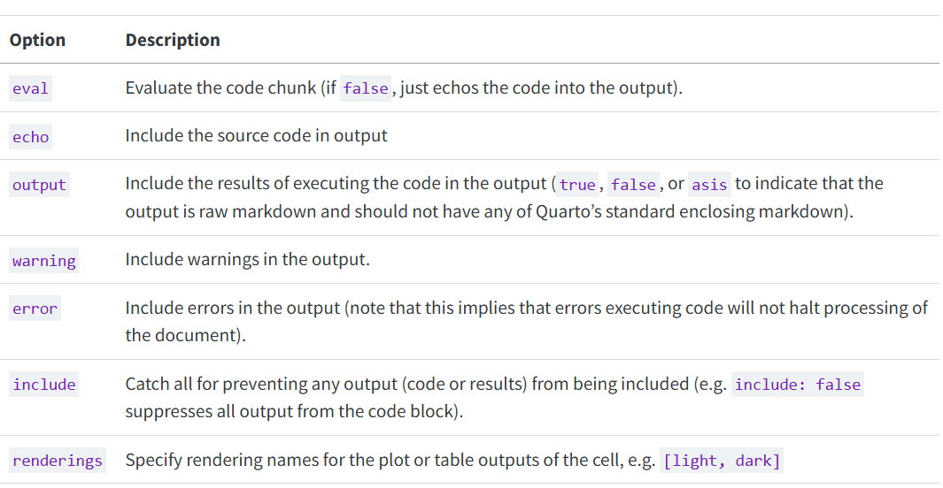
Output options
Notes:
Execution Options – Quarto

Slide 17
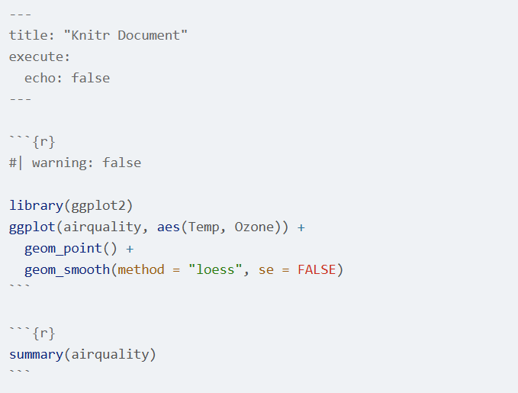
An example of output options
Can be in the YAML header to become global options
Or in a code block to become local options
Notes:
Execution Options – Quarto

Slide 18
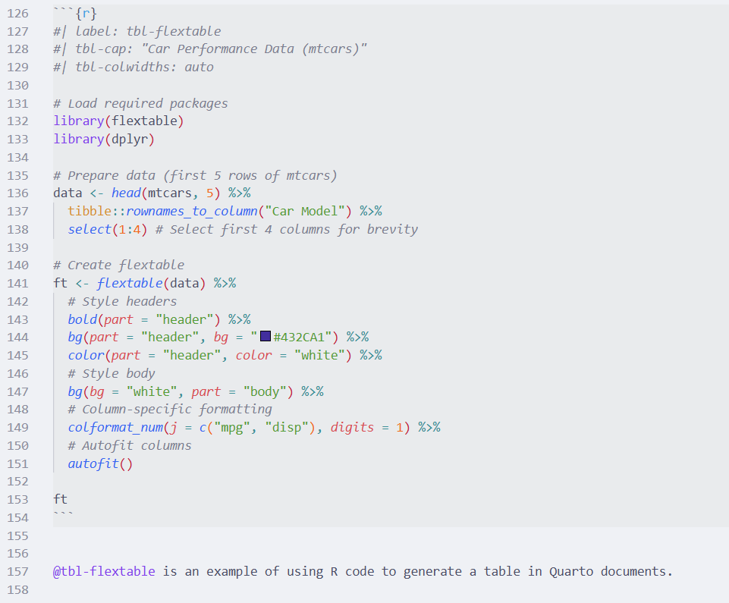
Cross-reference
Tips:
In order for a figure to be cross-referenceable, its label must start with the fig- prefix.
In order for a table to be cross-referenceable, its label must start with the tbl- prefix.
Refer to a specific table or figure

Slide 19
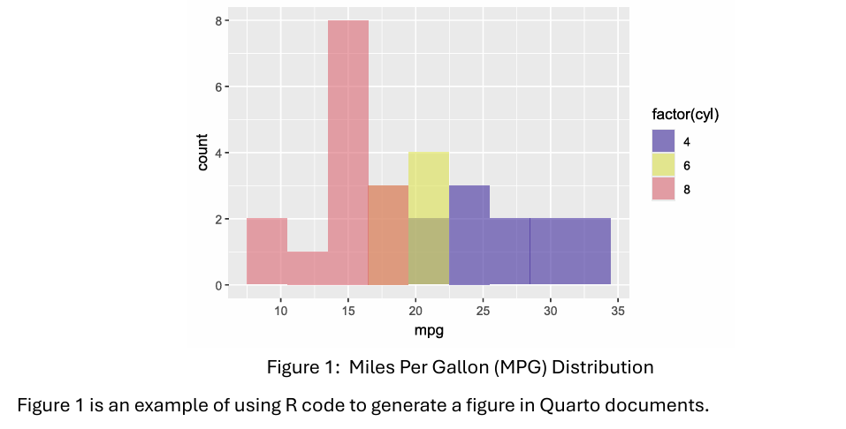
Cross-reference

Slide 20
Bonus: Parametrised reports
A demo?

Slide 21
Bonus: Extensions

Slide 22
Swiss TPH Templates

Slide 23
Swiss TPH templates
What are available?
For now, Swiss TPH Quarto templates are available in these formats:
PDF report (Latex and Typst)
PDF letterhead (Latex and Typst)
Word
Powerpoint
Revealjs
Contributors: Hélène Langet, Zhihan Zhu
Research-IT-Swiss-TPH/stphtoolbox: Swiss TPH R toolbox for reproducible research

Slide 24
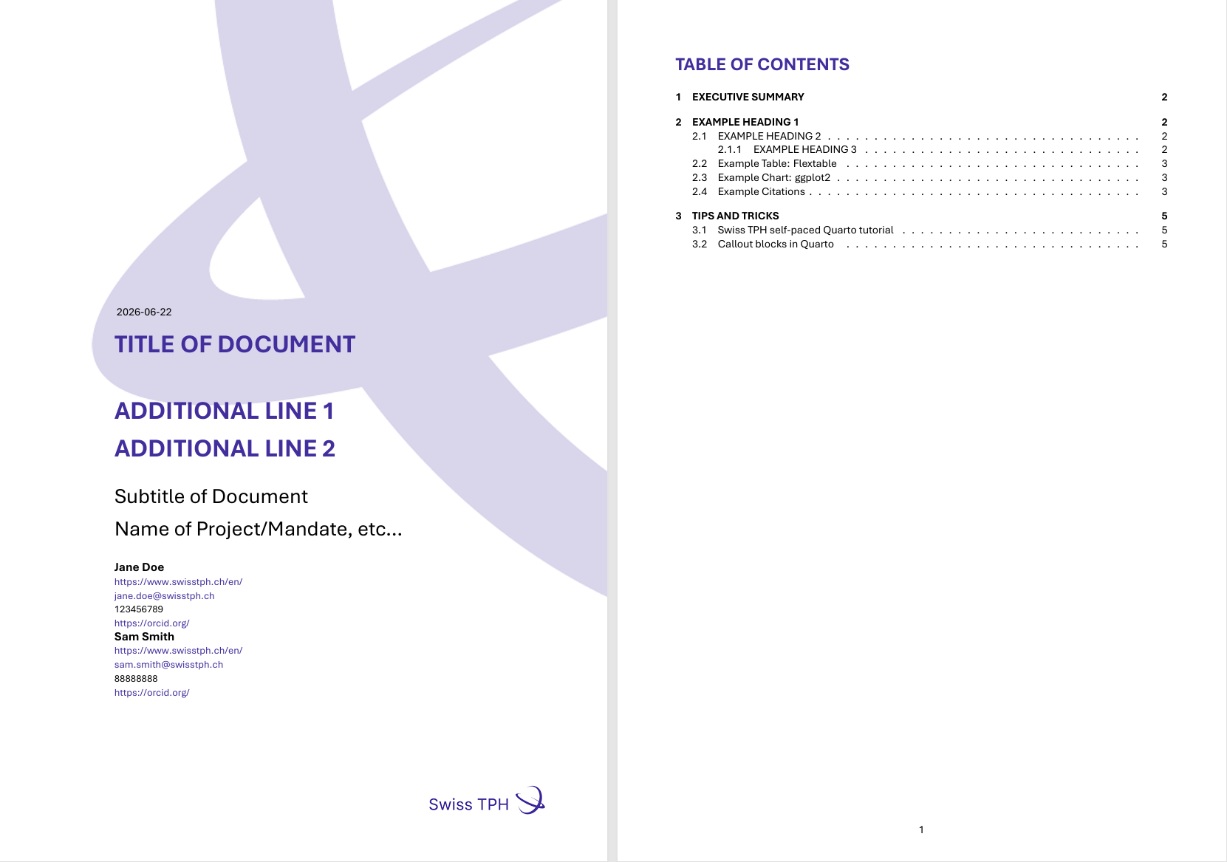
Swiss TPH Quarto template gallery
PDF(Latex) cover page and table of content

Slide 25
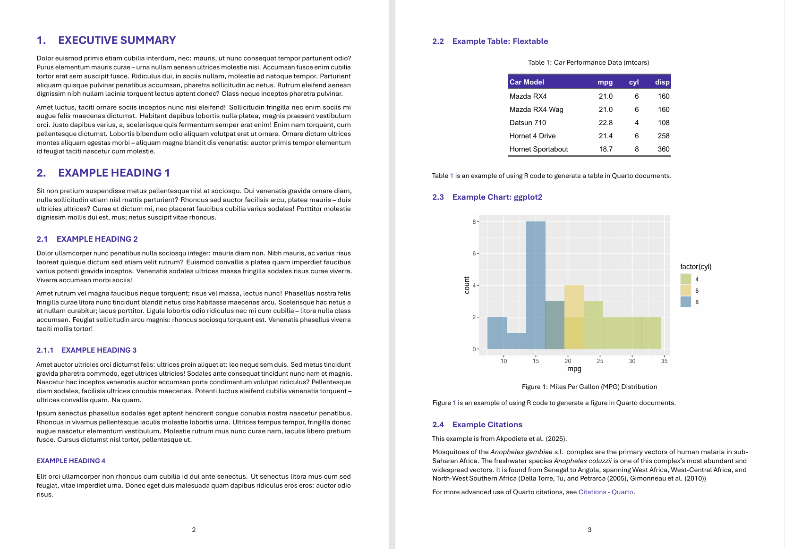
Swiss TPH Quarto template gallery
PDF(Latex) headings, text, tables and plots

Slide 26
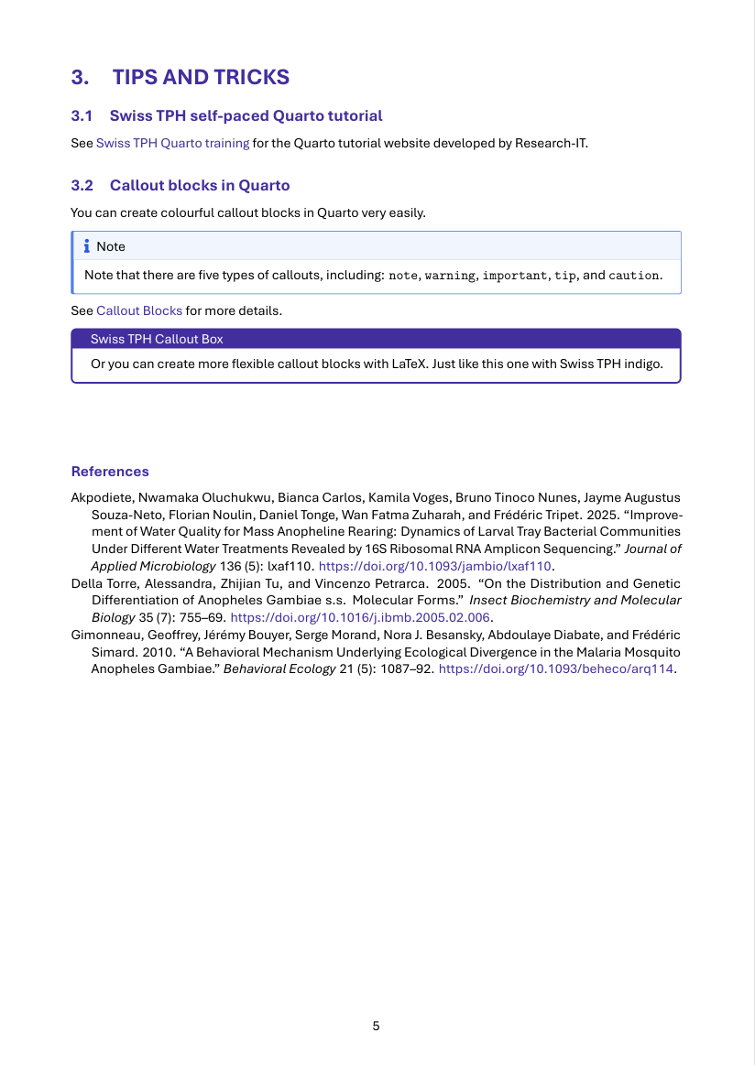
Swiss TPH Quarto template gallery
PDF(Latex) callout boxes, references, and more…

Slide 27
Thank you for your attention
Zhihan Zhu
zhihan.zhu@swisstph.ch

