Slide 1
Swiss TPH Powerpoint presentation example
My example subtitle Research IT

Slide 2
Introduction to Quarto

Slide 3
Quarto
Quarto enables you to weave together content and executable code into a finished presentation. To learn more about Quarto presentations see https://quarto.org/docs/presentations/.

Slide 4
Bullets
When you click the Render button a document will be generated that includes:
Content authored with markdown
Output from executable code

Slide 5
Graphics generated by R

Slide 6
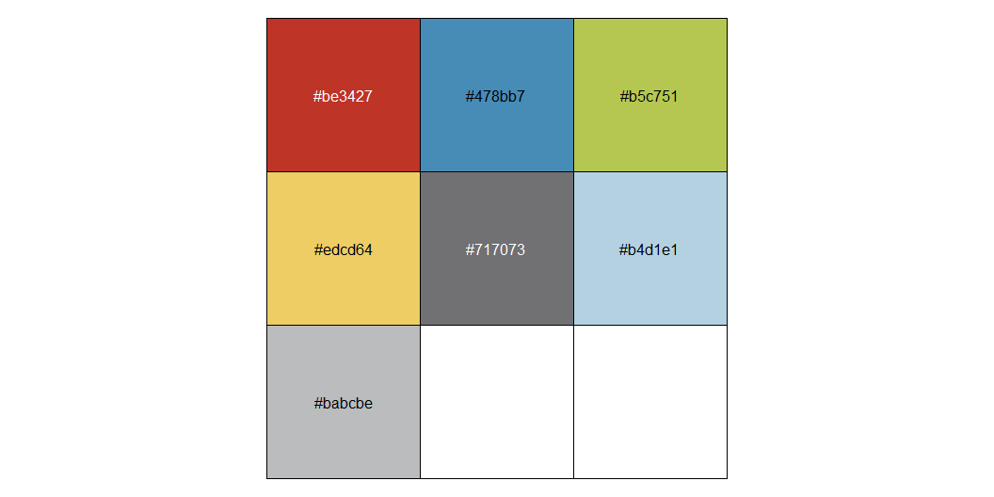
Colors

Slide 7
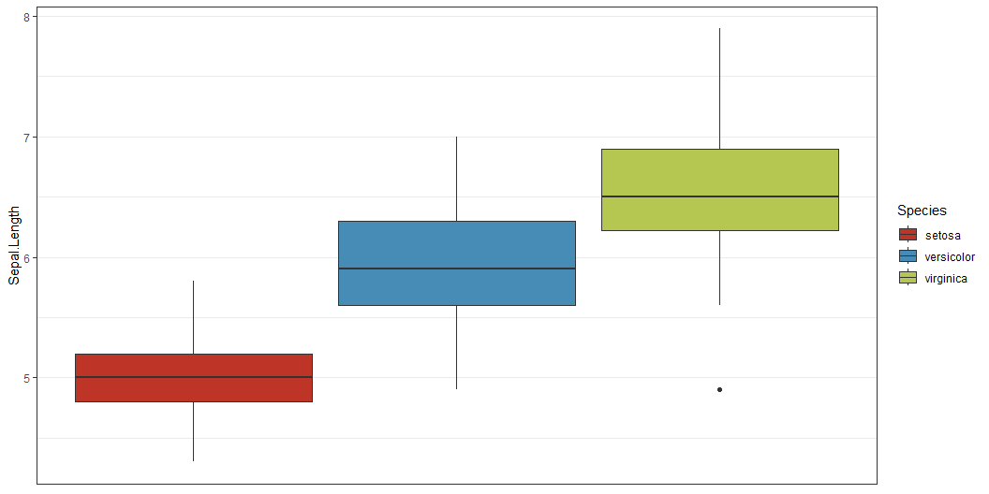
Results
The iris dataset was used for this demo.

